Slide 1

Horizon Huskies Soccer
Boys’ Season – Fall – August, September, October
Girls’ Season – Spring – March, April, May

Slide 2

requirements FOR Participation
All Requirements Must be Completed Prior to the First Game
Players must have a sports physical completed by a physician.
  7th and 8th only. 6th graders don’t need a physical uploaded.
Complete the online Athletic Registration for each participating player:
  https://students.arbitersports.com/organizations/century-high-school-2
  Upload your completed sports physical here as part of the online registration process.
The seasonal sports activity fee for soccer must be paid via MyPaymentsPlus
  https://www.mypaymentsplus.com/

Slide 3
requirements FOR Participation
Additional Information Regarding Athletics Participation
BPS Explanation of Activity Participation Fees
BPS Athletic Training and Sports Medicine
Horizon Middle School Athletics

Slide 4

Equipment
Shin Guards
Soccer Shoes
  Tennis shoes/sneakers are allowable, but a soccer specific shoe is strongly recommended.
  No shoes with toe studs, or sharp spikes that could cut or puncture another player.
Soccer Socks
  Long socks that completely cover the shin guards.
Soccer Ball
  Not required, but it’s helpful if you can bring your own ball to practices. Coaches will provide game balls for matches.
Water Bottle

Slide 5

Uniforms
7th and 8th Grade: A light green, numbered T-Shirt must be purchased ($10.00) to serve as the uniform.
  Uniforms owned from a prior season may be re-used.
6th Grade: The darker green, numbered T-shirt that is provided to each student (free of charge) for all 6th grade activities will be used.
Players provide their own shorts and socks.
  Shorts and socks should both be primarily black in color. Specific brand / style does not matter.
  All players must wear the same color shorts and socks during a match.
In cold weather, players may wear long sleeve shirts or sweatshirts underneath their uniform, and sweatpants in lieu of shorts.
  Hoods on sweatshirts must be tucked in.
  No exposed metal, such as zippers and buttons, when wearing pants instead of shorts.
  Pants must be the same color as shorts would otherwise be.
All jewelry and accessories must be removed prior to the game. (Earrings, watches, bracelets, necklaces, rings, etc.)

Slide 6


PRACTICE SCHEDULE
6th grade practices are typically held Monday and Thursday shortly after school from 4:00 to 5:00 PM.
7th and 8th grade practices are typically held Monday, Tuesday, Thursday, and Friday evenings from 5:30 to 7:00 PM.
All practices take place on the Horizon soccer fields directly behind the school.
Wednesday is always a day off.
Practice times may be modified as necessary throughout the season to due scheduling constraints or facility availability.
  Coaches will communicate any deviations from the normal schedule in advance.

Slide 7

Games
7th and 8th Grade Format:
6th Grade Format:
Games consist of two 30 minute halves.
9 v 9 format; medium sized fields.
Each team will play approximately 10 games throughout the season.
  7 game regular season, plus season finale afternoon jamboree.
Majority of games are played on Saturday afternoons.
One or two matches will be played on a Tuesday or Thursday evening (5:15 or 6:30 PM kickoffs)
Games take place at Cottonwood Park or Dacotah Centennial Soccer Complex (Mandan)
Games consist of two 30 minute halves.
11 v 11 format; full sized fields.
Each team will play approximately 10 games throughout the season.
  8 game regular season, plus post season tournament.
Additional exhibition games may be played, such as a weekend jamboree, or matches against Minot, Dickinson, Williston, and Jamestown.
Kickoff times are usually 5:15 or 6:30 PM on weekdays.
Game locations are Horizon, Wachter, Rita Murphy, Dacotah Centennial Soccer Complex (Mandan), Sanford Sports Complex (Legacy HS), St Mary’s HS, and Cottonwood.
Game schedules will be posted to the Horizon Activity Calendar when they become available.

Slide 8
Fall 2025 6th Grade Game Dates
Thursday, September 4th
Saturday September 6th
Saturday, September 13th
Saturday, September 20th
Saturday, September 27th
Saturday, October 4th
Saturday, October 11th (Jamboree or Final Game)
Saturday Kickoff sometime between 1:00 – 6:00 pm
Games at Cottonwood Park or Dacotah Centennial Park (Mandan)
Reschedule will typically occur if there are weather related cancellations.

Slide 9
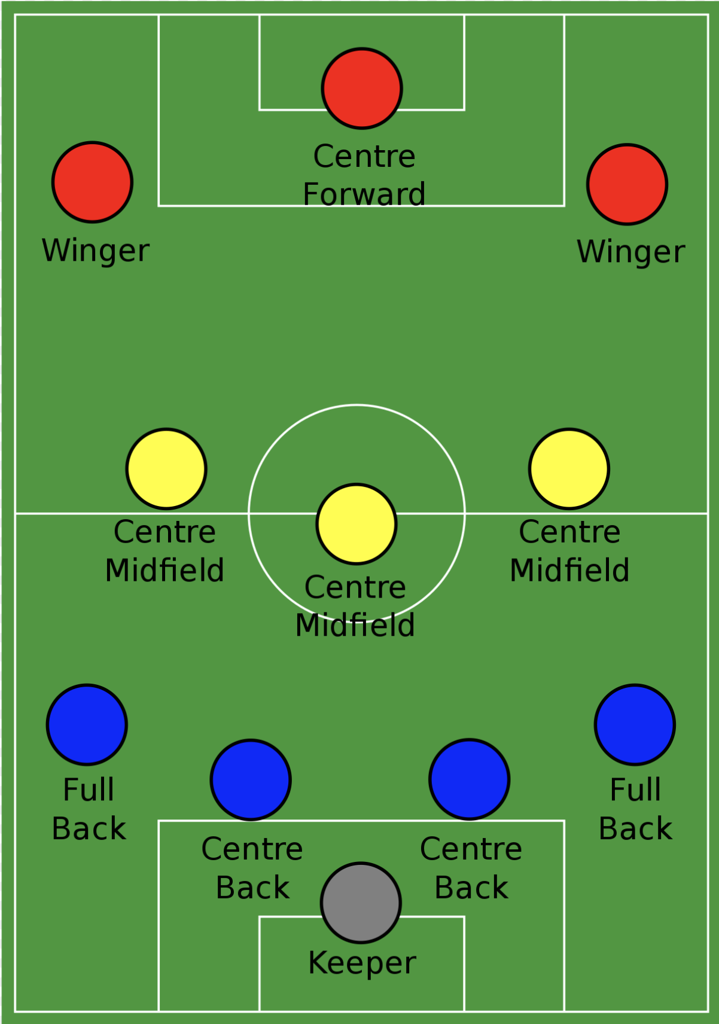
Leagues, DIVISIONS, and Rosters
6th graders only play within their grade level.
  A and B teams are formed in 6th grade.
7th and 8th graders combine to form a larger pool of players.
  Allows us to create ideal roster sizes, and maximize playing time for each player.
  A and B divisions
Regarding A and B divisions
  Program’s focus is 100% developmental; not about winning games.
  Group players with others at/near their ability level. Balance between being adequately challenged and still achieving success.
When multiple divisions are not viable, all teams are made as competitively equal as possible, and will play in one division.
Players will be assigned to a team, based on the judgment of the coaching staff.
  Team assignments are flexible until the postseason tournament.
  A player may be temporarily or permanently re-assigned to a different team during the season.
  Playing time is NOT equal; determined by each player’s attendance, work ethic, sportsmanship, etc. throughout the season.

Slide 10

Player responsibilities
Be ready to start practices on time.
Arrive at least 20 minutes early to games to dress and warmup.
Be properly equipped for all practices and games.
Wear appropriate clothing for the weather.
Communicate all absences to the coaching staff.
Demonstrate respect to teammates, opponents, coaches, and officials throughout the season.
Keep parks and facilities clean.
  Pickup your garbage, water bottles, tape, etc.

Slide 11

Conflict Resolution
First, speak directly to the coach about any concerns or problems you have during the season.
If still unresolved, contact the Horizon Soccer Coaching Coordinator.
If still no resolution can be obtained, escalate your concerns to the Horizon Athletic Director.

Slide 12


Team Communication
Horizon Soccer Website
Team Group Chat
Practice, Game, and Tournament Schedules
Team Photo Information
Coaches Contact Information
Each season, a group chat (currently using GroupMe) is setup to facilitate direct and immediate communication to players and parents.
Coaches will communicate any short notice events or reminders about key dates via phone/text.
  Scheduling changes such as time or location change.
  Game or practice cancelled due to inclement weather, etc.
  Game / tournament schedule published, etc.
Coaches can relay the link to join the group chat if you didn’t join at the pre-season meeting.

