Slide 1


Marie Riviere School
Annual Parent Presentation
August 14, 2025

Slide 2
Agenda
Looking Back at 2024-25
2025-2026 Priorities
Student Learning in 2025-2026
Supporting Student Learning at Home
Appendix

Slide 3
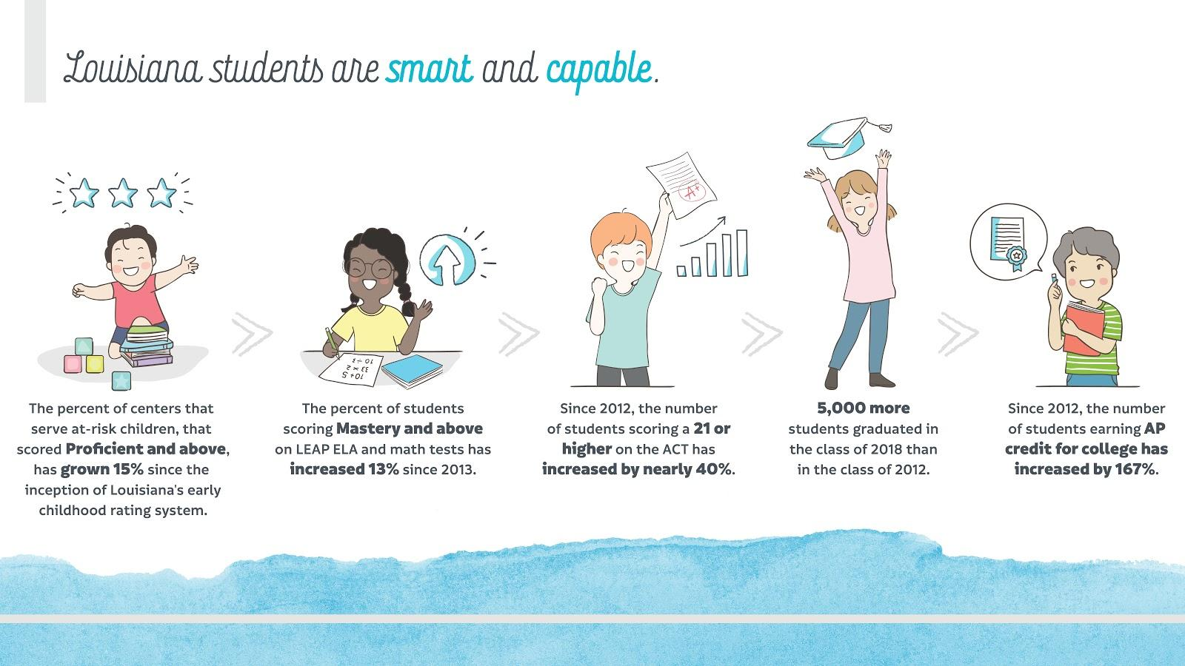
Louisiana Student Success

Slide 4
Seagull Pride in 2025-2026
Our Seagulls had a great year in 2025-2026. Here are a few of our successes:
74% of our K-3rd grade students are reading on grade level.
52.2% of our EL Learners met or exceeded their ELPT growth trajectory.
4% gain in the number of students reaching Mastery or above on LEAP 2025.

Slide 5
Release of Spring LEAP Student Reports for ELA, Mathematics, and Science
Scores are available through Student Progress Center and will be sent home in the students’ yellow folders.
Social Studies scores have not been released.

Slide 6
How to Use the LEAP Student Reports
The 2025 LEAP scores help teachers identify where students need extra support or a greater challenge in specific subject areas. They will also be used to measure how well schools and school systems are helping students achieve higher expectations.
The LEAP test is just one measure of how well your child is performing academically. Other information, such as grades, teacher feedback, and scores on other tests, will help determine your child’s academic strengths and needs.
Each set of student reports are accompanied by a Parent Guide to the LEAP Student Reports that provide information on how to read the results and use them to support student learning at home. Translated versions in Spanish, Vietnamese, and Arabic are available on the Louisiana Department of Education’s (LDOE) website in the Family Support Toolbox.

Slide 7
State Literacy Screener
DIBELS is the State Literacy Screener
The screener identifies students’ weaknesses in reading.
It is completed 3 times during the year.
  August, December, and April
Students who are well below at the end of the year in 3rd grade will be retained.

Slide 8
Louisiana Student Standards
Educational Standards:
set clear and consistent learning expectations for students and teachers;
define what students should know and be able to do in a particular subject at each grade level; and
help set high goals for all students.
Standards help students to:
Develop deep understanding, skill, and fluency in mathematics
Think critically in mathematics through speaking, writing, and solving problems
Apply mathematics to real-world problems and tasks
Build knowledge, discuss, and write about topics, themes, and ideas in complex texts
Support thoughts and opinions about complex text using evidence
www.louisianabelieves.com/academics/academic-standards
Why are standards important?
The Louisiana Student Standards assure that all students, regardless of their address, background, or ability, have a clear roadmap to success in college or a career.
Clearly defined goals help families and teachers work together to ensure that students succeed, have access to extra assistance when they need it, and are challenged appropriately.

Slide 9
Our Curriculum
Content | Curriculum | Why do we use it?
Mathematics | Illustrative Mathematics | Builds number sense Helps students learn to apply mathematics to real-world situations Builds efficiency with mathematics problems
English Language Arts | Guidebooks & CKLA | Provides engaging texts Integrates reading and writing so students write about what they read Provides ample opportunity for student conversations
Science | Open SciEd (New this year) | provides ample opportunities for students to investigate scientific questions helps students use science to explain real-world happenings integrates reading a variety of sources
Social studies | Bayou Bridges (K-2nd & 4th-5th) Gallopade (3rd) | Provides primary sources Engages students in writing about history
.

Slide 10
End of Year Tests: LEAP 2025
At the end of this school year, students in grades 3-8 will take the following state tests:
  Students in grades 3rd-5th will take the LEAP 2025 assessments for ELA, mathematics, social studies, and science online.
  Kindergarten- 5th English Language Learners will take the ELPT in February/March.
  State Literacy Screener for K-3rd Grade- DIBELS
  State Numeracy Screener for K-3rd
This slide should be updated based on your school’s/school system’s assessment mode decision for grades 3 and 4.

Slide 11
Parent Engagement
Marie Riviere Elementary School is committed to providing parents with meaningful, two-way communication opportunities with both teachers and the administrative team throughout the year. Here is where to go with questions.
Contact your child’s teachers with questions about your child’s progress, learning needs, or school events/programs through email.
Additional questions or concerns that cannot be addressed by your child’s teacher, should be directed to the front office.
Be on the lookout for our YELLOW Home Communication folders and our monthly newsletters.
Our school uses Talking Points to communicate with parents.
Use this slideo insert information about how parents should communicate with teachers and the school leader throughout the school year.

Slide 12
Tools and Resources to Support Parents: General
Below are additional resources that you can access to further support your child’s learning at home.
Louisiana’s Family Support Toolbox Library: information on standards, test results, and all parent guides www.louisianabelieves.com/resources/family-support-toolbox
Great Kids Milestones: free online collection of videos showing what success looks like in reading, writing, and mathematics in grades K–12 www.greatschools.org/gk/milestones/
LearnZillon: free online site to support students in schools that have adopted the ELA Guidebooks curriculum www.learnzillion.com/resources/81666-english-language-arts-guidebook-units
PTA Family Guides: tips for helping your child succeed in key learning areas.
https://www.pta.org/home/family-resources/family-guide
Clever

