Slide 1
The Smokey Powell Clinic
Student’s Name - appointment:

Slide 2

When will I go?
Tomorrow!
You may leave early in the morning and ride on the school bus or
You’ll get signed out early–about ____ (write time here)
Your parent/guardian will pick you up and drive you there
This Photo by Unknown Author is licensed under CC BY-NC

Slide 3
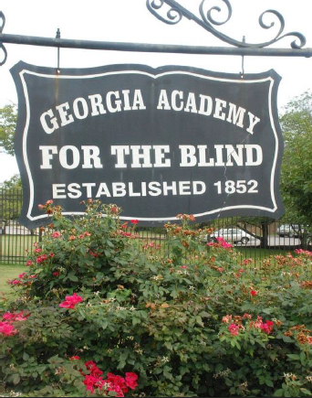
Where is it?

Slide 4
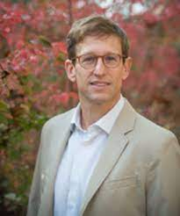
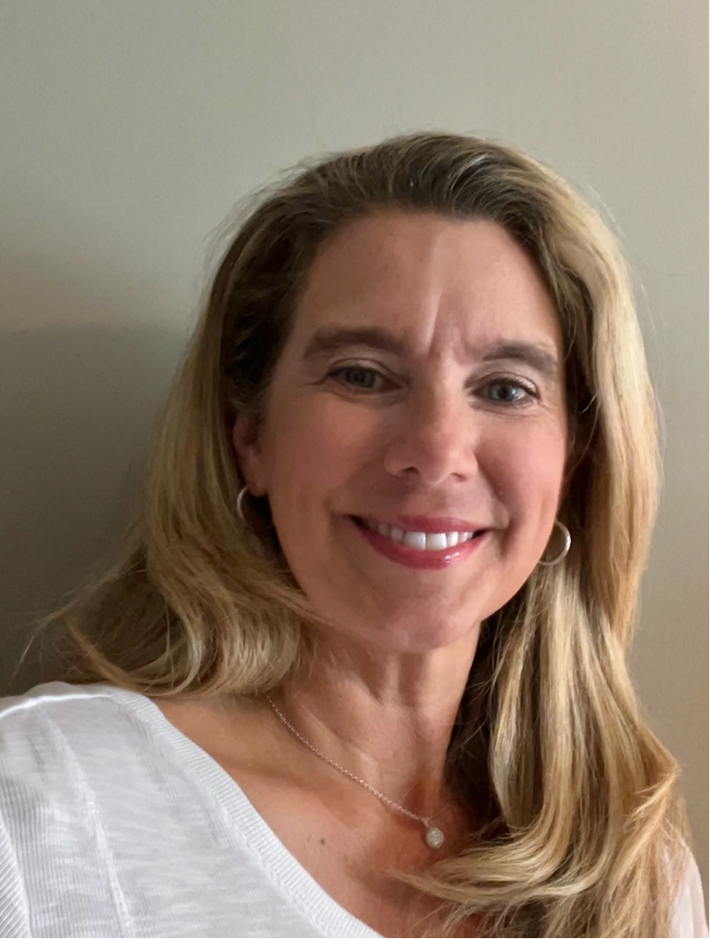
Who will be there?
You
Teacher
Mom/ Dad/ guardian
Dr. Forche or
Dr. Gallagher

Slide 5
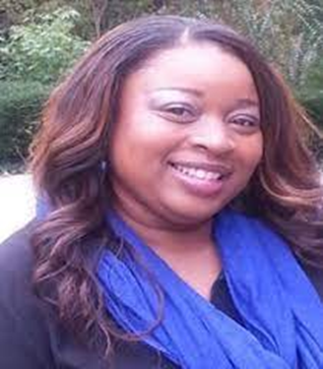
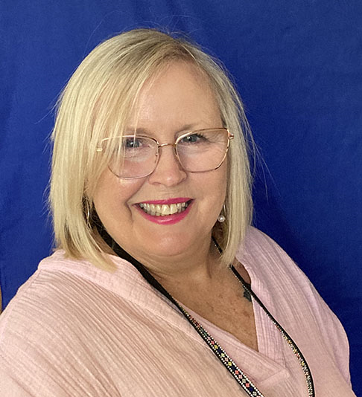
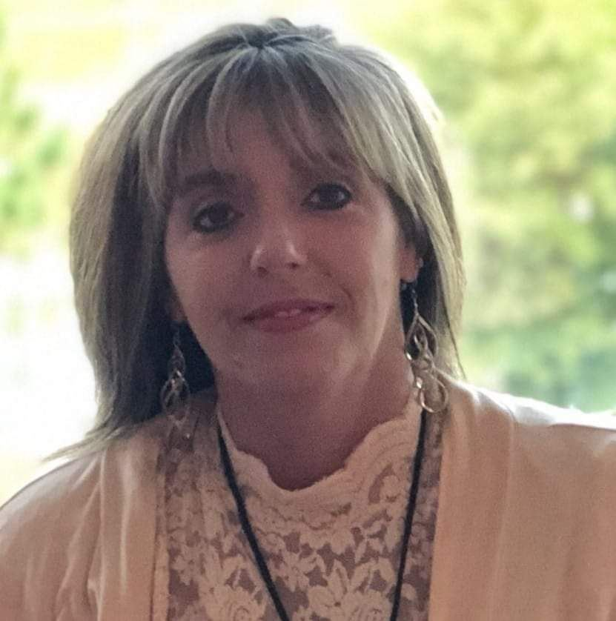
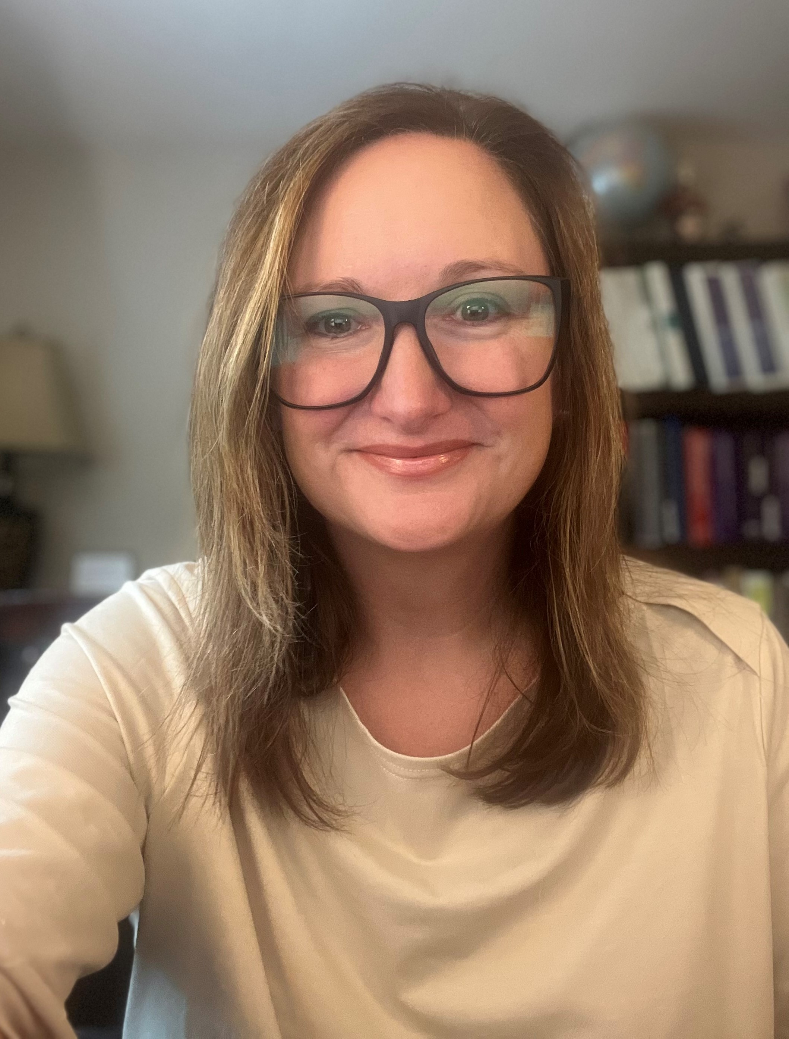
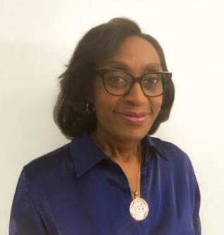
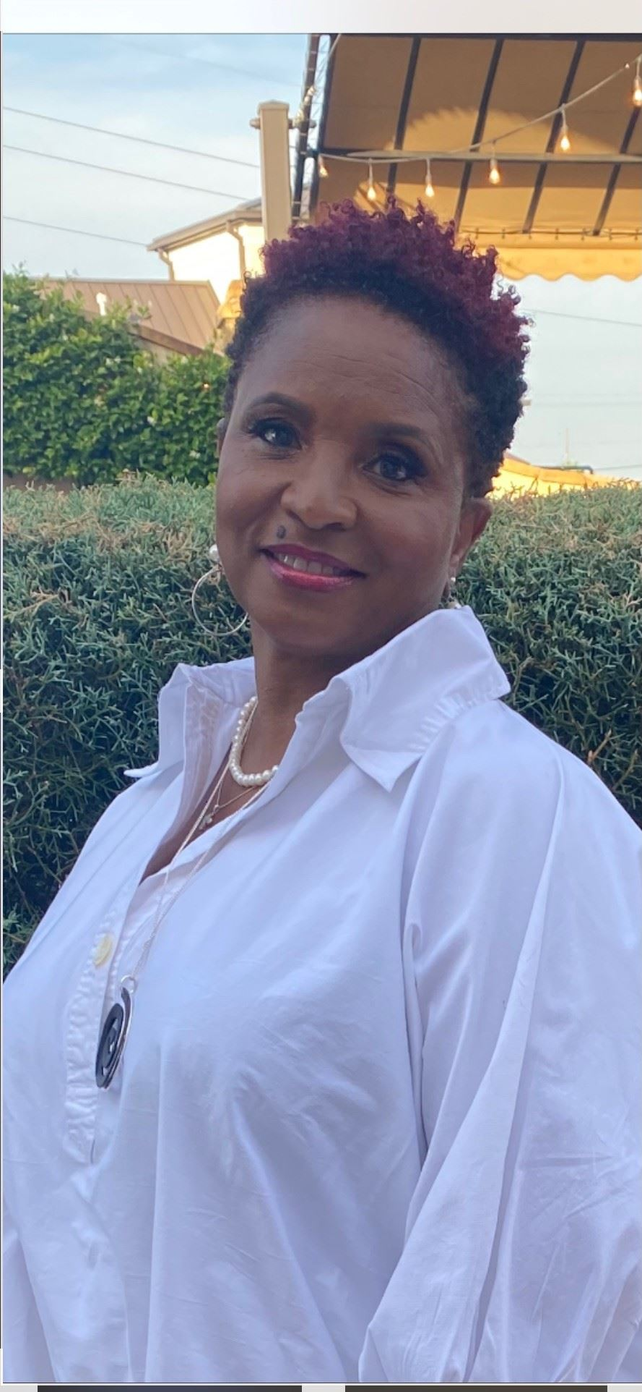
SPC Staff
Ms. Tara
Ms. Zel
Ms. Heather
Ms. Stephanie
Ms. Sharon
Ms. Gloria

Slide 6
Why am I going?? How is this different from the regular eye doctor?
You’re going to see if there are any low vision devices that can help you see better and work more efficiently in school
It’s different than the regular eye doctor because it’s more fun!
  You will NOT get your eyes dilated here
  NO shots
  You get to try out all kinds of different devices
  You might get to take devices back with you

Slide 7
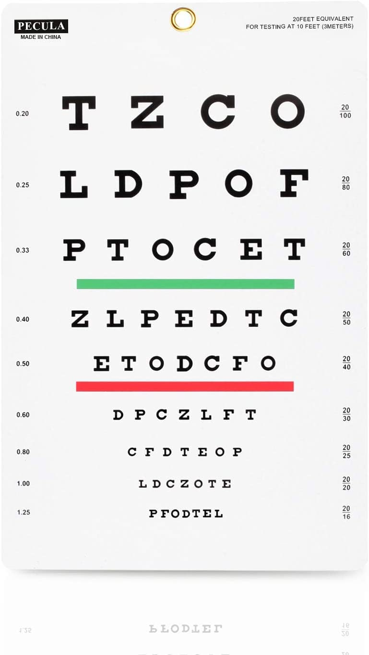
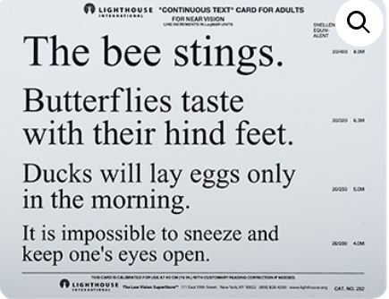
What will I have to do?
They’ll ask you to read some eye charts
They’ll ask you to read some print at near
They might ask you some questions about things that are hard to see

Slide 8
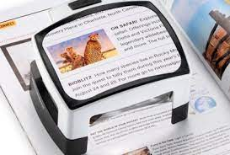
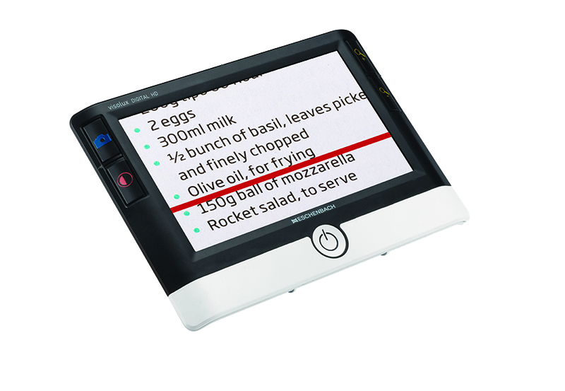
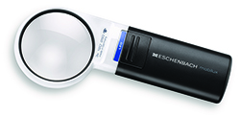
They might ask you to try some different magnifiers for near.

Slide 9
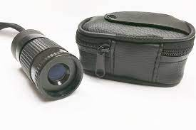
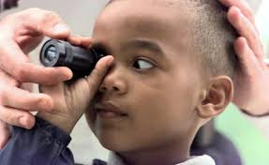
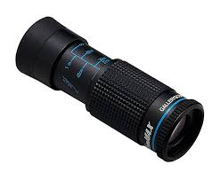
They might ask you to try a monocular for distance viewing.

Slide 10
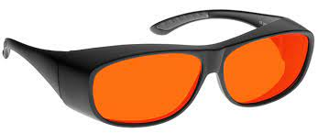
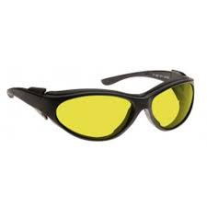
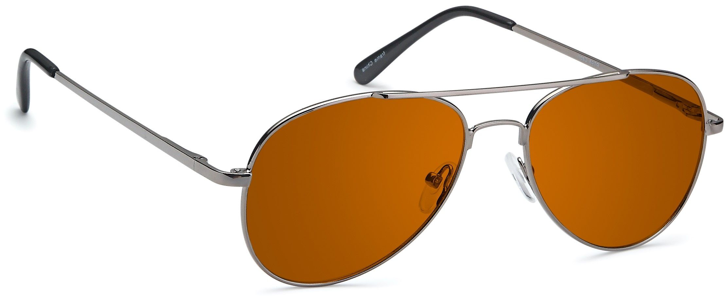
They even have all different colors of dark glasses for outside.

Slide 11

What if I don’t like the devices they show me?
They want to hear your honest opinion, so it’s fine to say you don’t like something they show you
  It’s more helpful if you can tell them WHY you don’t like it
It’s important to keep an open mind
  This is a chance to try out different things
  Remember that it usually gets easier to use a device with practice

Slide 12

How long will this take?
Less than an hour
You’ll be done before 4pm

Slide 13

What happens when I’m done?
If they find a device that seems like it might be helpful, you could get one to take away
They will send a report to your teacher and your parent or guardian

Slide 14

Any other questions?

Slide 15

Extra credit!
Google search the Smokey Powell Low Vision Clinic
How many more clinic dates are there in 2025? (click SPC Clinic Dates on the right)
What was Smokey Powell’s real name? (look under About Smokey Powell on the left)
Replace the clipart car on slide 2 with a photo of a car that looks like yours

