Slide 1


Slide 2

NJ State Standards
Grades are standards based
  ES- exceeding standard
  MS- meets standard
  AS- approaching standard (compare it to your B/C average range when you were in school!)
  NS- needs support

Slide 3

Reading
Fountas and Pinnell- the alphabet, letter sounds, sight words, writing minilessons
  What are letter names?
  What is the purpose of letters?
  How do sounds work together to make words?
  What words can you notice automatically and read?
  How can you express yourself through drawings, talking and writing?

Slide 4
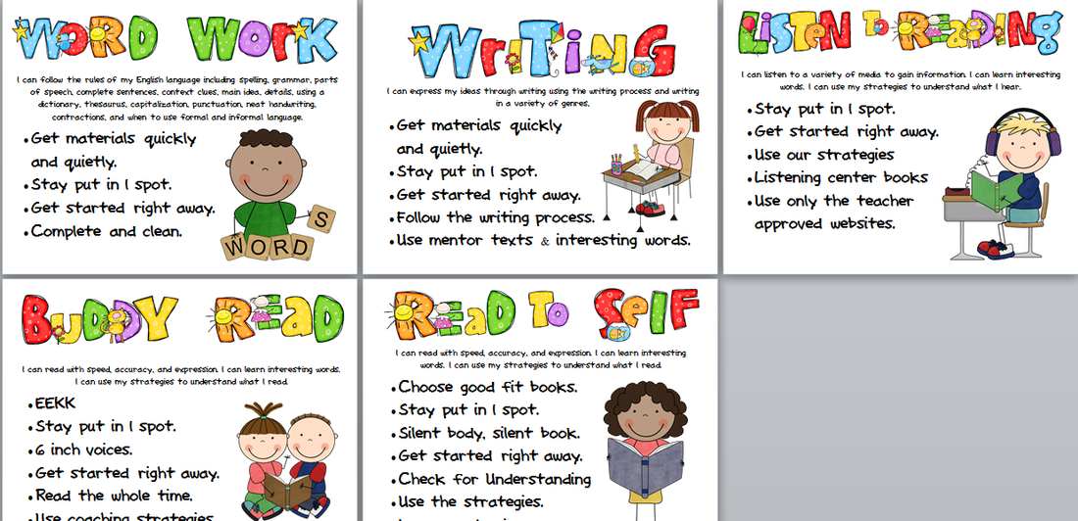
Reading
Daily 5
  Fountas and Pinnell minilessons followed by Daily 5 rotation (this is where your child’s teacher meets with them for small group instruction)

Slide 5
Reading
Benchmark Assessment System (BAS)
  Determines your child’s reading level
  Your child’s teacher uses these reading levels to create small groups and develop instruction appropriate for your child’s learning needs

Slide 6

Math
EnVision Math Series
  Aligned with NJ standards
  Modeled learning
  Access to manipulatives
  Visual learning experience
  Interactive learning experience

Slide 7

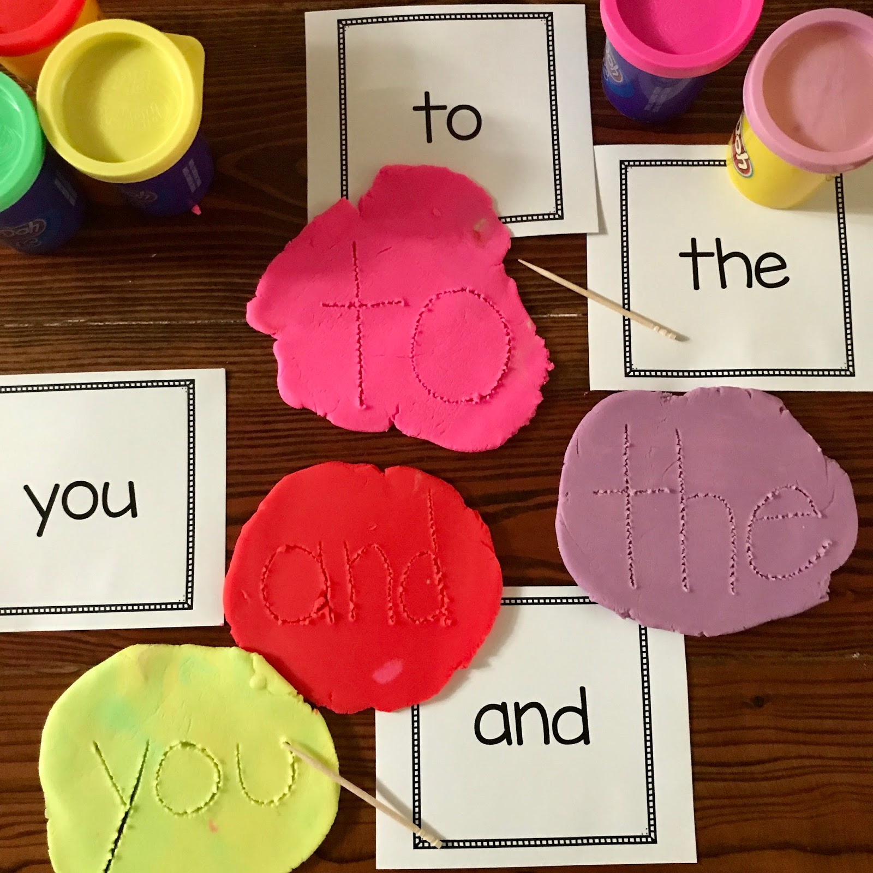
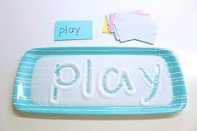
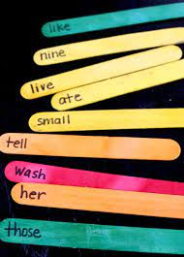
Support at Home: Sight Words
Using salt, sugar, or sand, trace words
Pull out popsicle sticks to read… see how many you read correctly to keep!
Using a toothpick, write words in play-doh

Slide 8
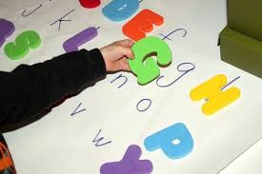
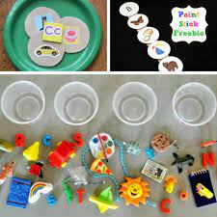
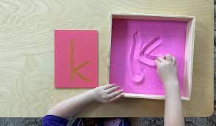
Support at Home: Phonics (letters and sounds)
Lowercase and uppercase letter match
Using salt, sugar, or sand, trace letters
Find objects in your home to sort. Find objects that start with the B sound, etc.

Slide 9
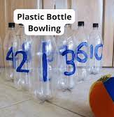
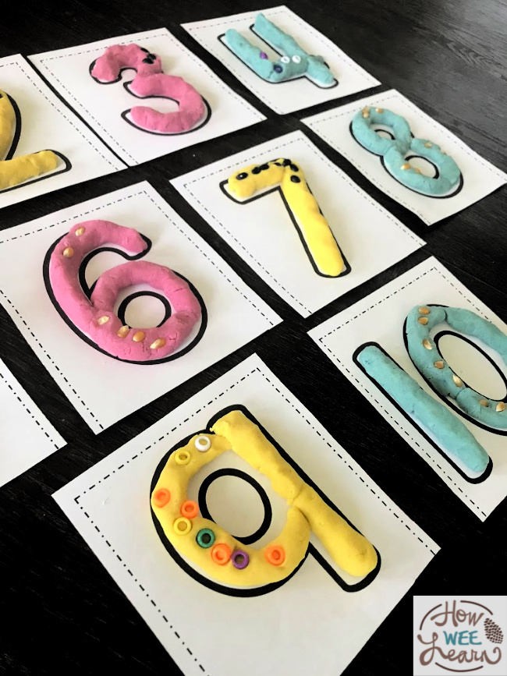
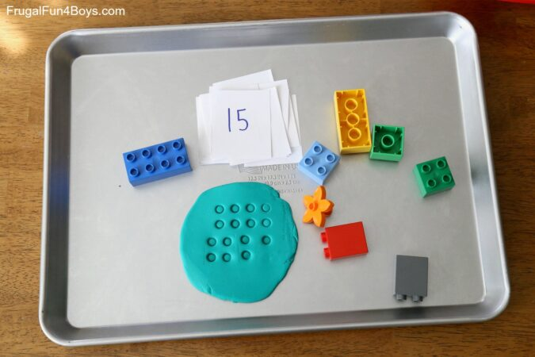
Support at Home: Math
Identify numbers when they are knocked over
Use legos to form dots in play-doh to practice counting
Play-doh numbers

Slide 10





What Else Can You Do?
First-Hand Experiences

Slide 11
What Else Can You Do?
Opportunity for PLAY!
Parallel Play | Play in Small Groups
Open-ended play (encourage the use of imagination!) Sand and water activities Play-Doh | Take turns, sharing, making negotiations Problem solving Make discoveries

Slide 12
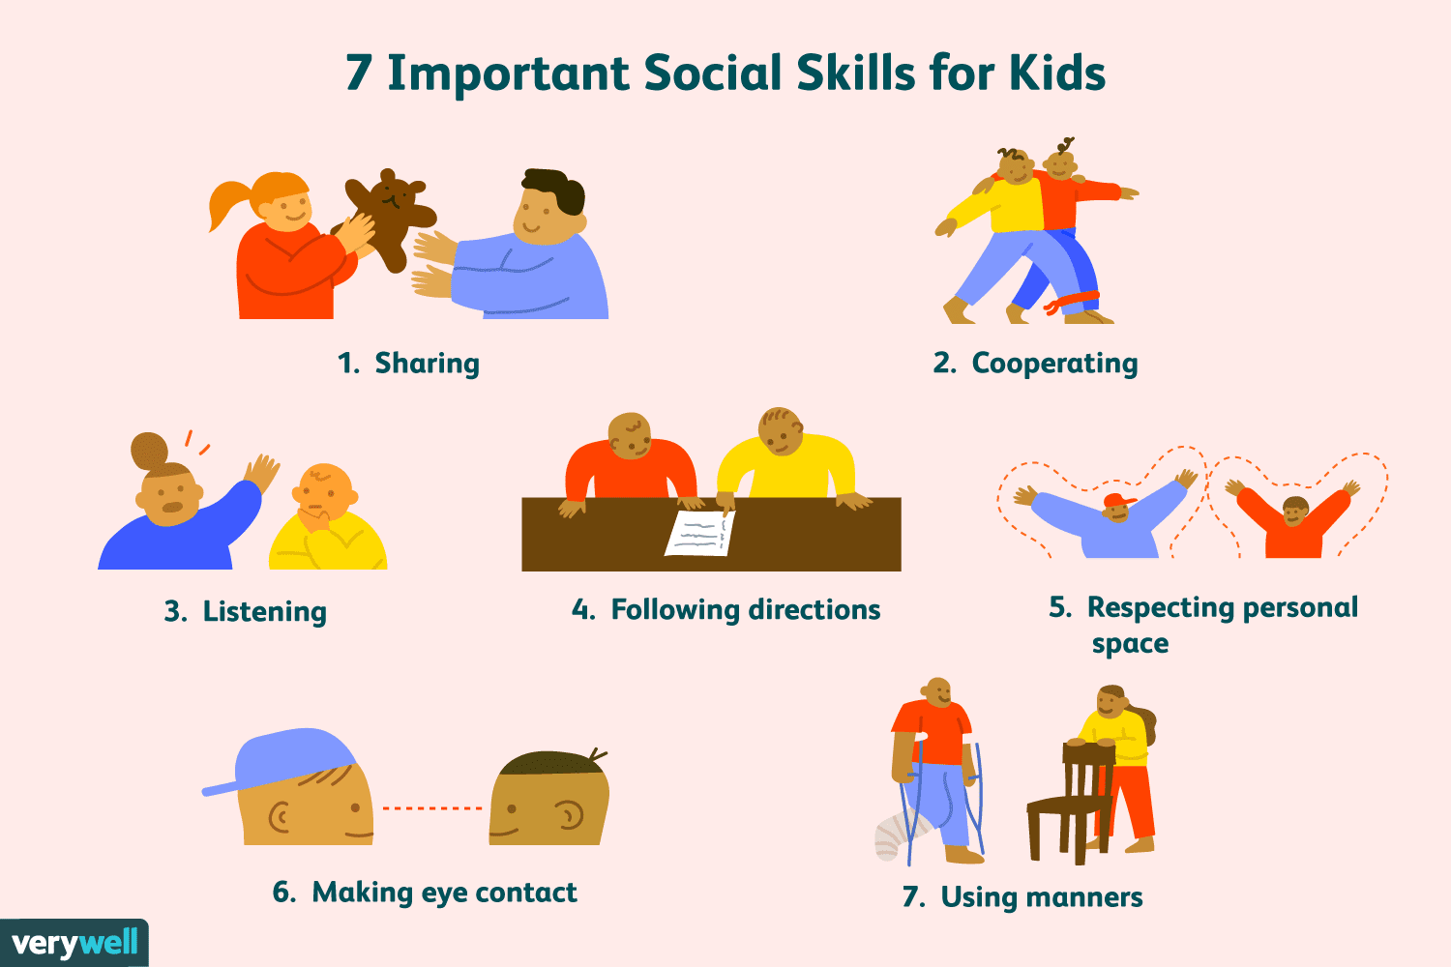
Independence/Socialization

Slide 13
Independence/Socialization
Understanding right and wrong
Respecting the rights and feelings of others
Share, take turns, use kind words
Playing without needing constant supervision
Make decisions independently

Slide 14
Independence/Socialization
Can your child:
Ties shoes?
Take off/put on coat?
Zipper/button?
Use the bathroom independently?
Open lunch?
Buckle seatbelt?
Blow nose?

Slide 15

Partnerships

Slide 16
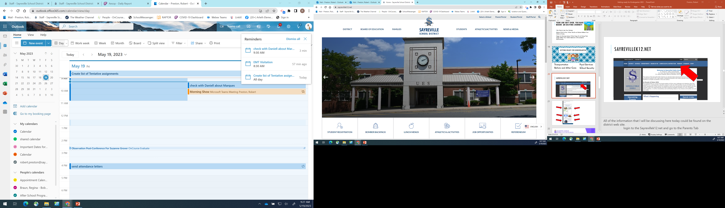
District Website
Sayrevillek12.net

Slide 17
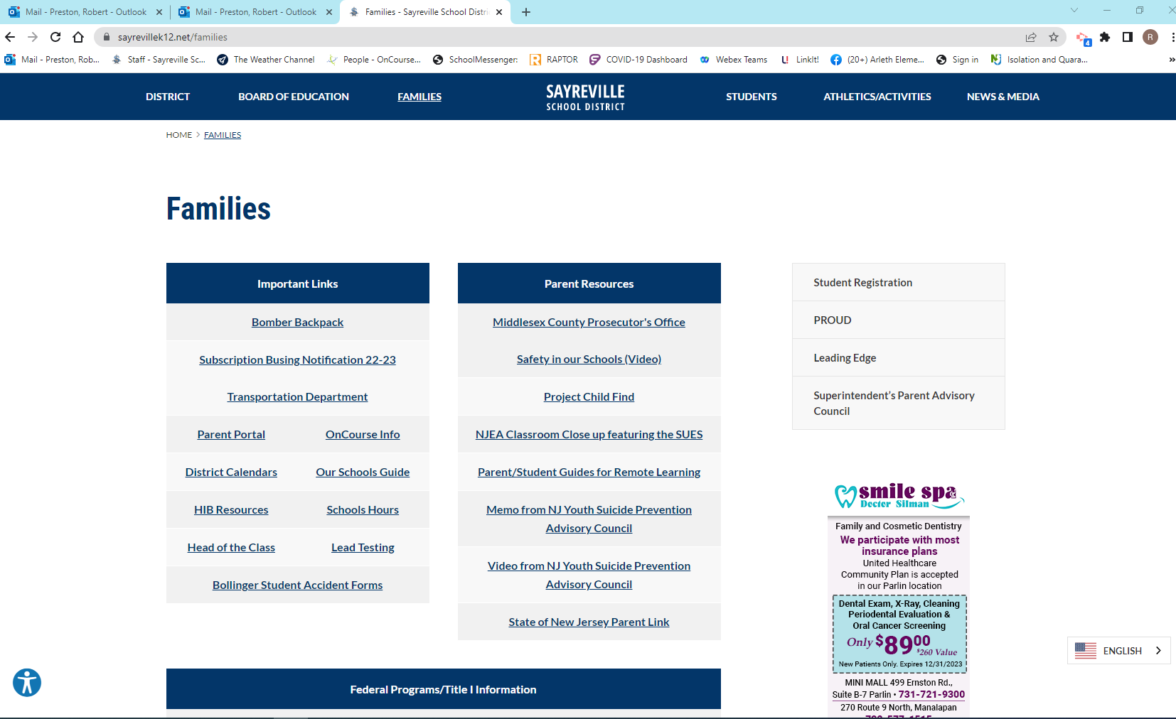

Slide 18
Food Services
What’s for lunch?
How do I pay for lunch?
What if my child forgets their lunch?
What if my child has food allergies?

Slide 19
Food Services

Slide 20
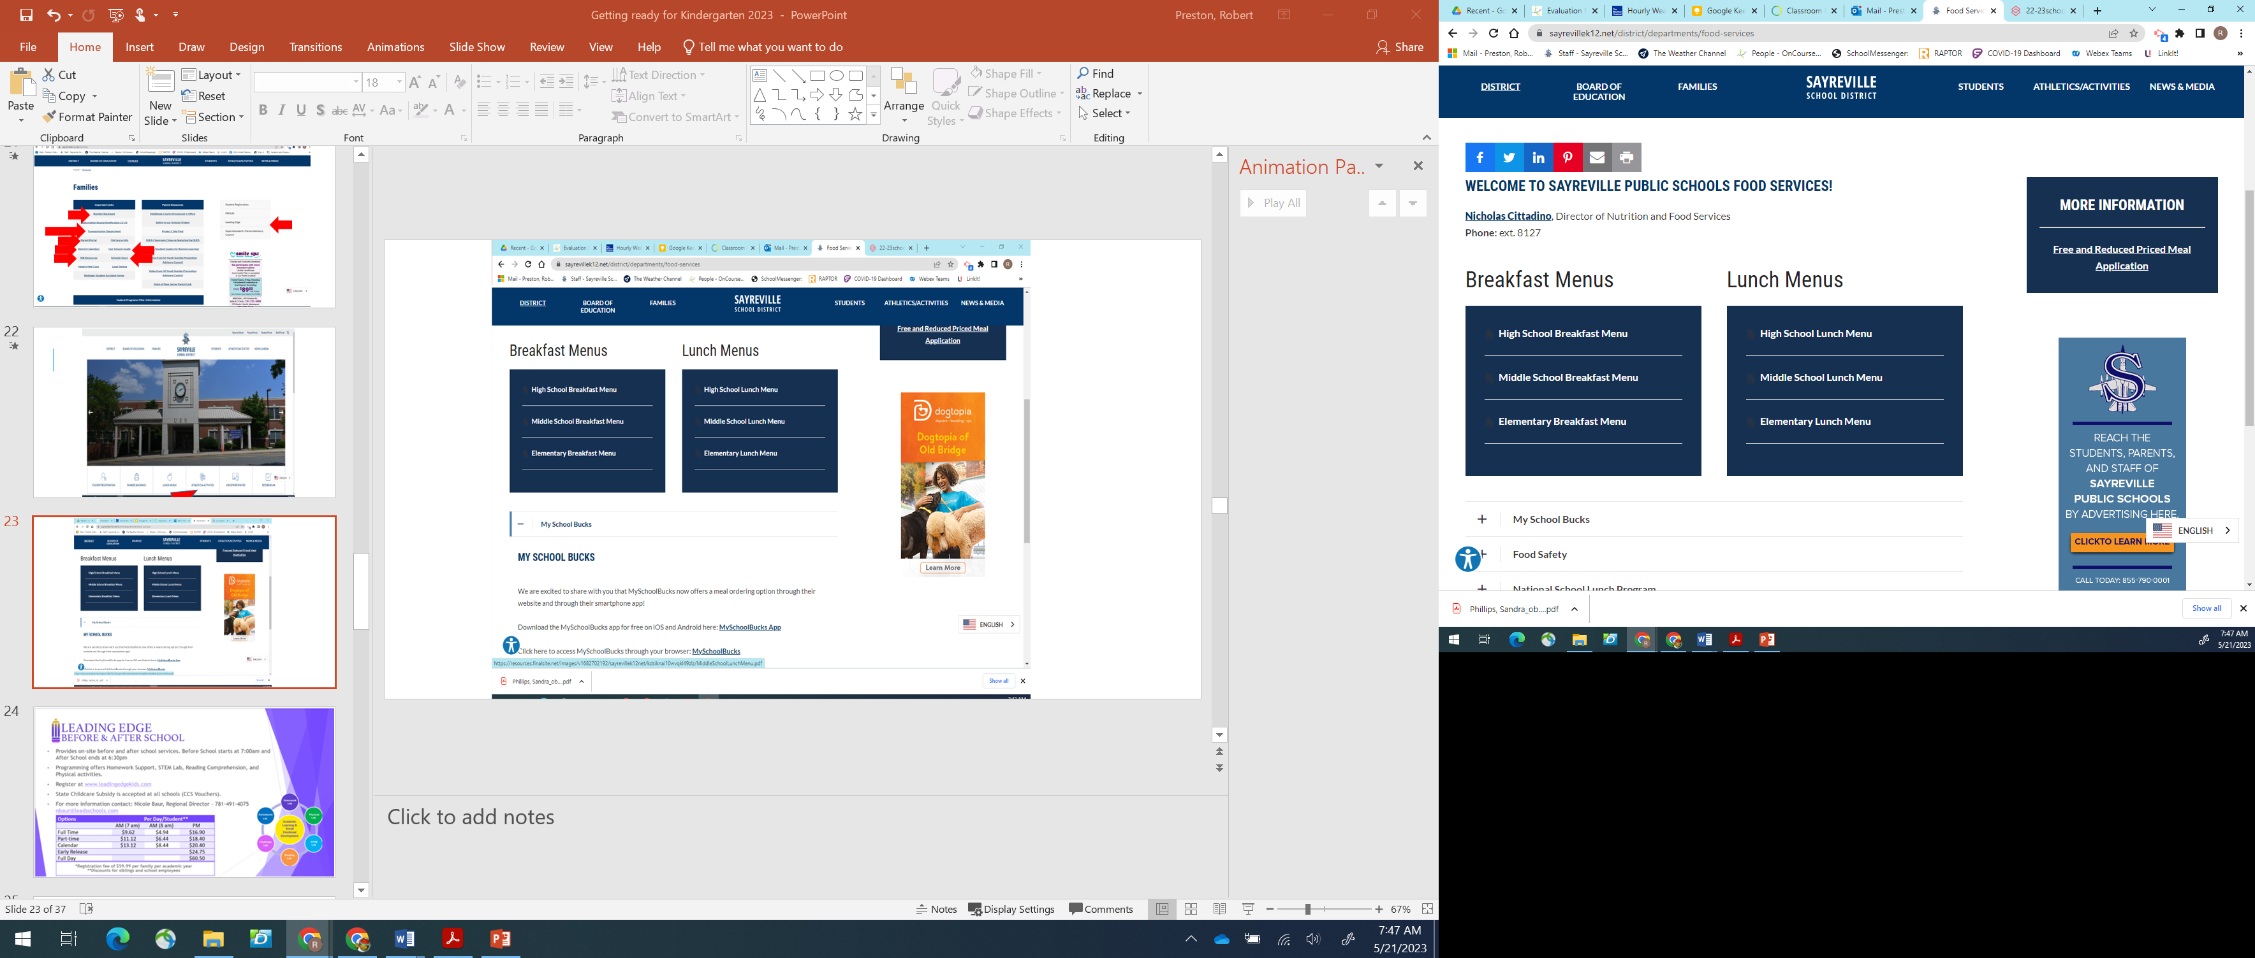
Food Services

Slide 22
Safety and Security
Campus Monitors
ID Required
Raptor
Drop Box
Student Pick-Up Forms
Security Vestibule
Bags Subject to Search

Slide 23
Safety and Security
Police in schools
  Share services agreement
  Security
  Patrol the building
  Assist with drills

Slide 24
Transportation
School Bus
Where is my bus stop?
Which bus does my child take?
My child has never been on a bus before…
If you reside within .7 miles of the school, your child is not eligible for a school bus. The .7 miles is measured using the shortest walking path.

Slide 25
School Bus Safety
Be there 10 minutes prior to bus arrival
Wait at designated bus stop in a safe place
Do not board the bus until it has stopped, and the bus driver has indicated to board
Remember never to stand in the danger zone that surrounds the bus. The danger zone is 10’ from all sides of the bus
All Kg-3rd grade students must be met at the bus stop by a parent. Please do not wait in your car or house

Slide 26
School Bus Safety
Take your seat and sit properly, facing forward at all times. The driver or principal will assign seats as necessary
Students must stay in their seats and seatbelt must be buckled at ALL times
Remove your backpack and place it under your seat or on your lap
Keep the aisle clear at all times
Always keep your head, hands and arms inside the bus
Talk quietly; the driver needs to concentrate to safely drive the bus.

Slide 27
School Bus Safety
Be absolutely quiet when approaching a railroad crossing
Please do not bring any toys on the bus and keep cell phones and other electronic devices in your backpack
Eating and drinking is not allowed on the bus at any time. This rule protects students or drivers that have food allergies, prevents choking, and maintains bus cleanliness.
Always follow the bus driver’s instructions

Slide 28
Transportation Contact Information
Questions?
Please feel free to reach out the Transportation Department
732-316-4045
TransDept@SayrevilleK12.net
patrick.cerniglia@sayrevillek12.net

Slide 29
Next Steps…
Finalize Registrations
      Annual Enrollment Update
      Vaccinations / Physical
Kindergarten Screenings
September Orientation
Reach out to your principal with any questions

Slide 30


