Slide 1
MCSD Construction Update
July 21, 2025
Ward Odom
Executive Director of Facilities and Capital Planning

Slide 2
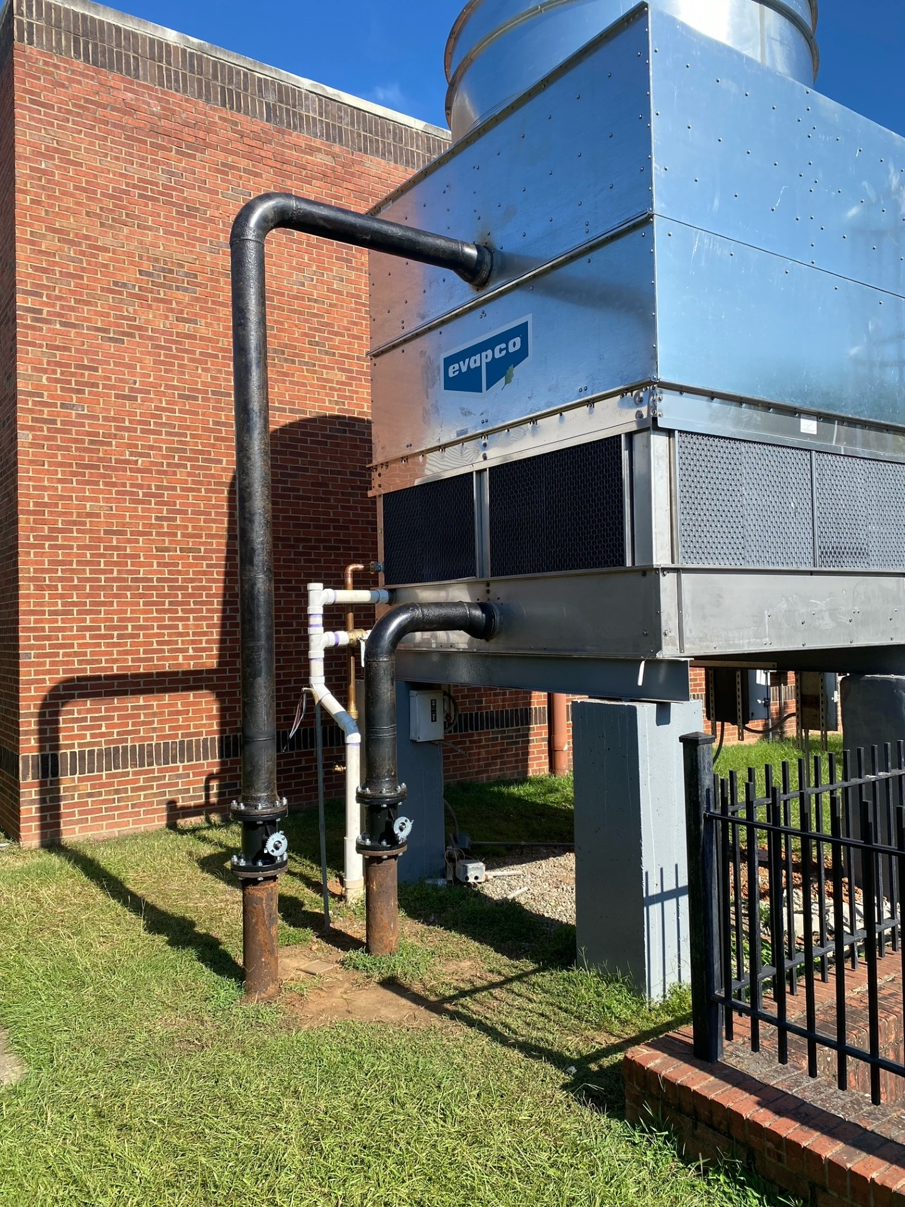
HVAC Cooling Tower – Downtown Elementary
Estimated Completion: Fall 2025

Slide 3
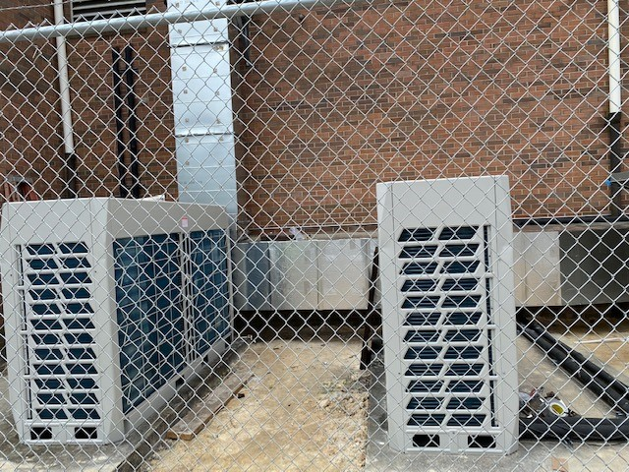
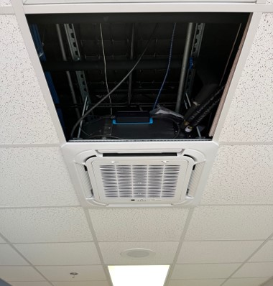
HVAC Replacement – Georgetown Elementary
Estimated Completion: Fall 2025

Slide 4
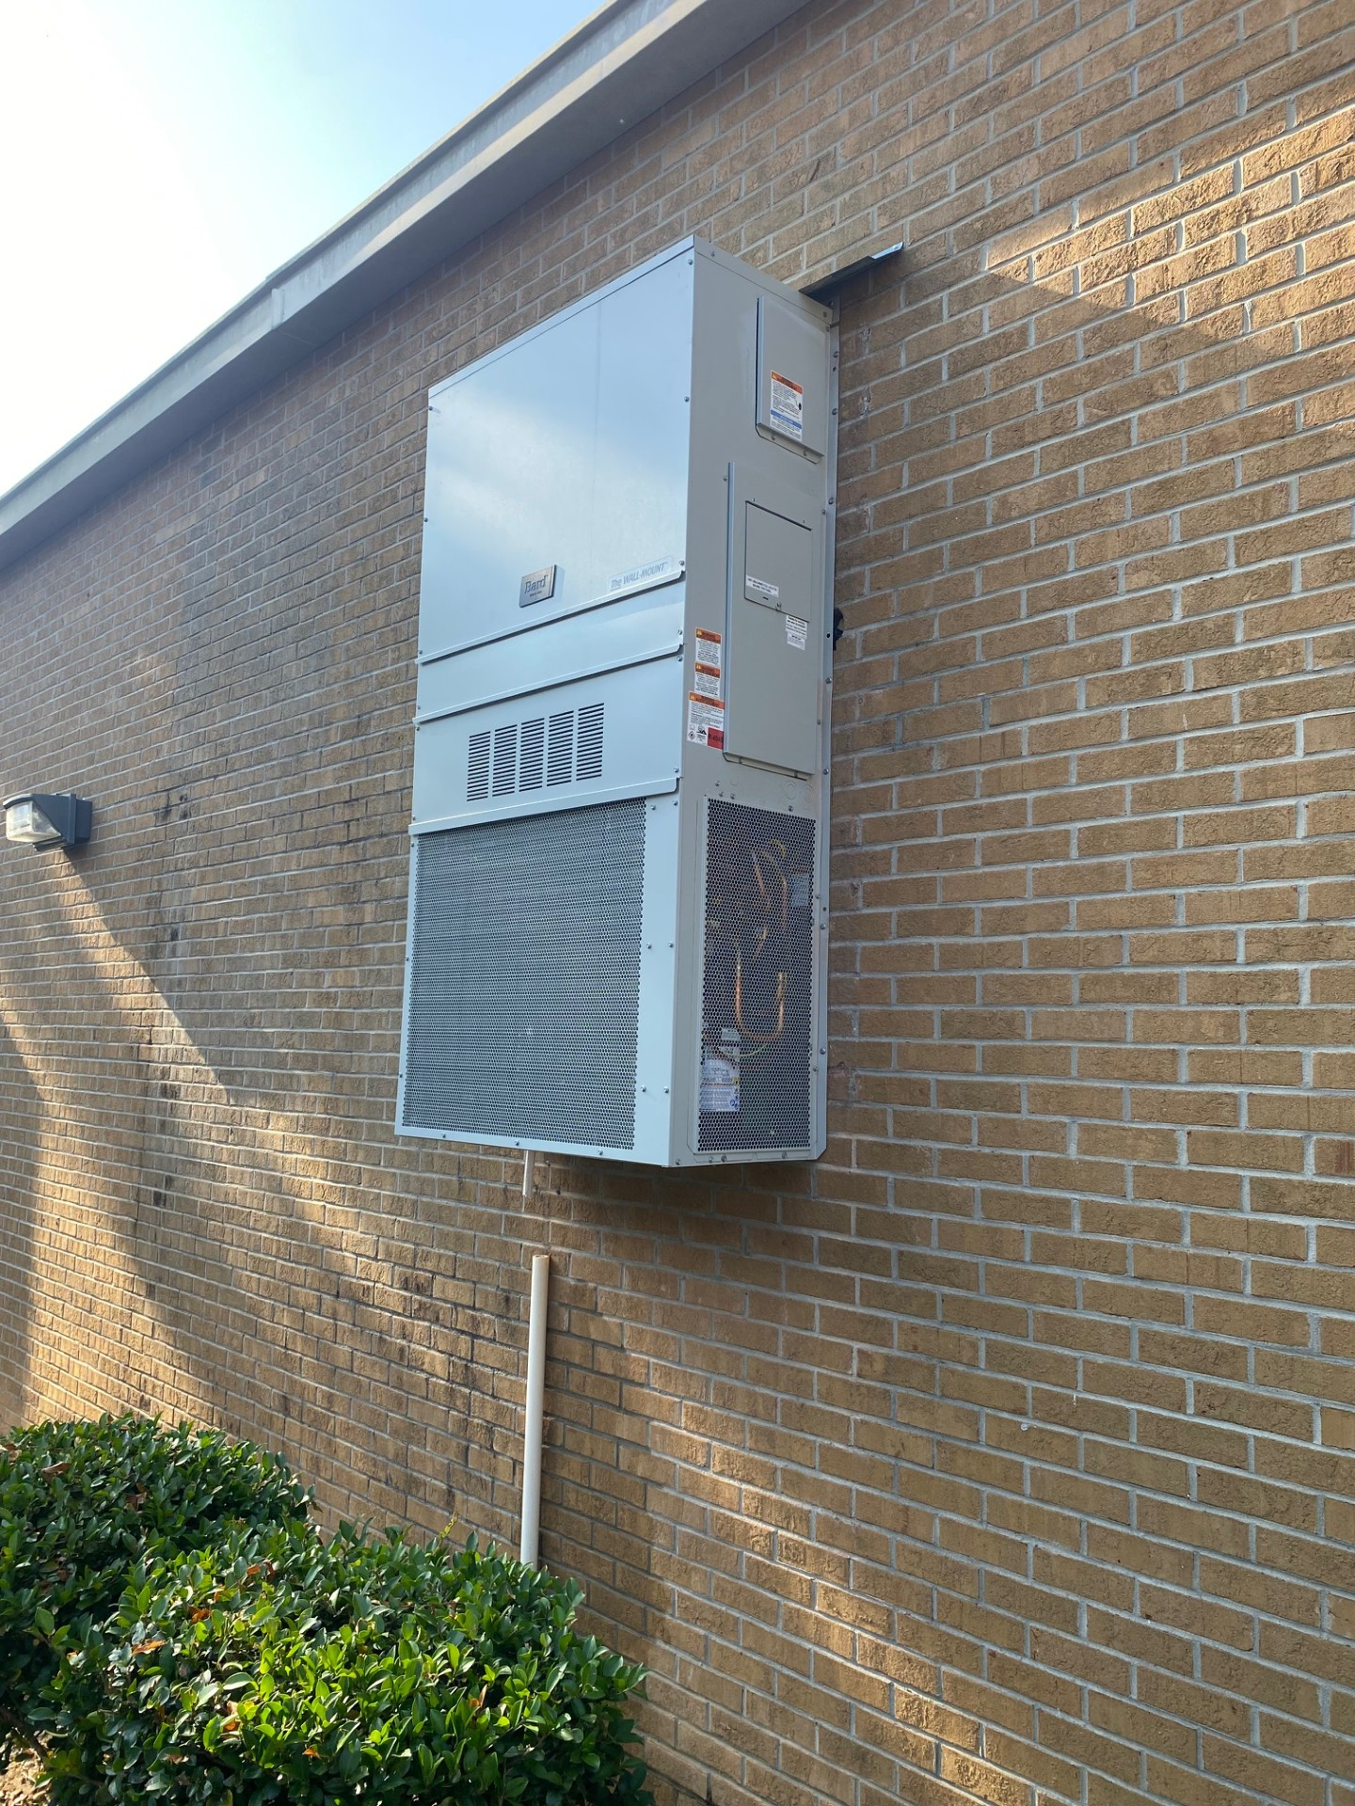
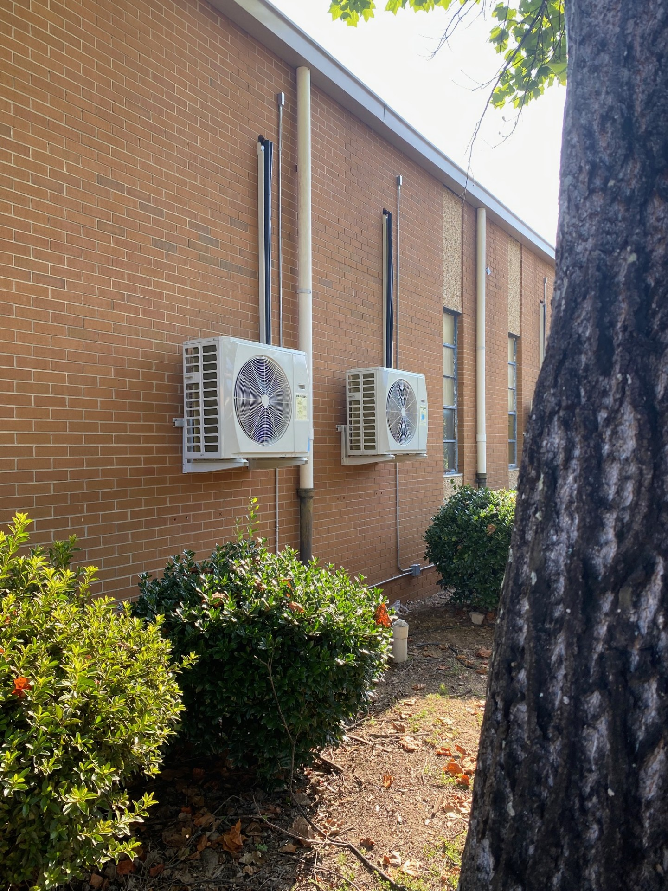
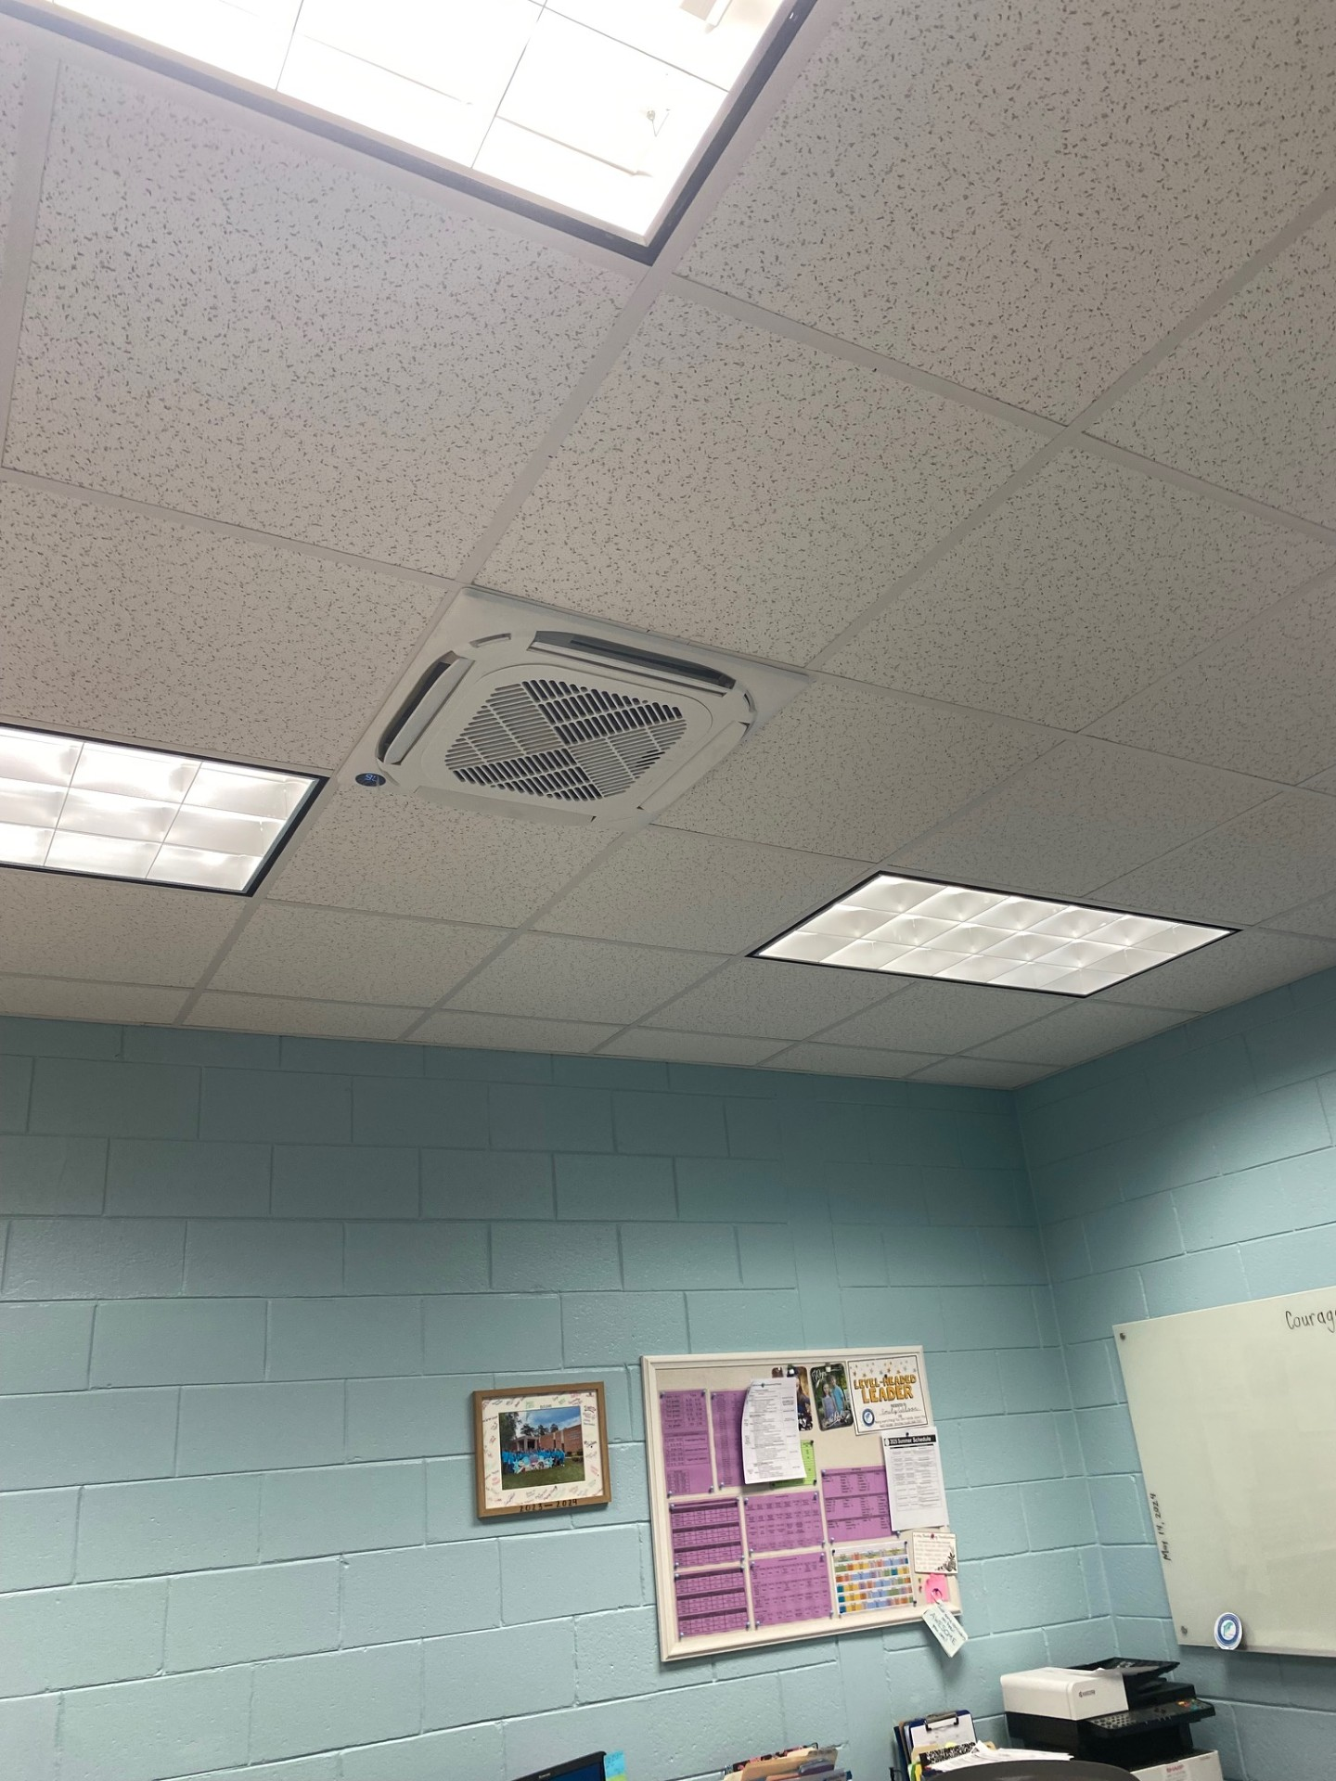
HVAC Replacement – Dimon, Fox, Richards and Rothschild
Estimated Completion: Winter 2025/2026

Slide 5
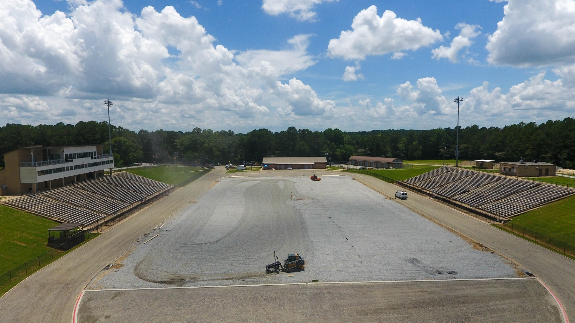
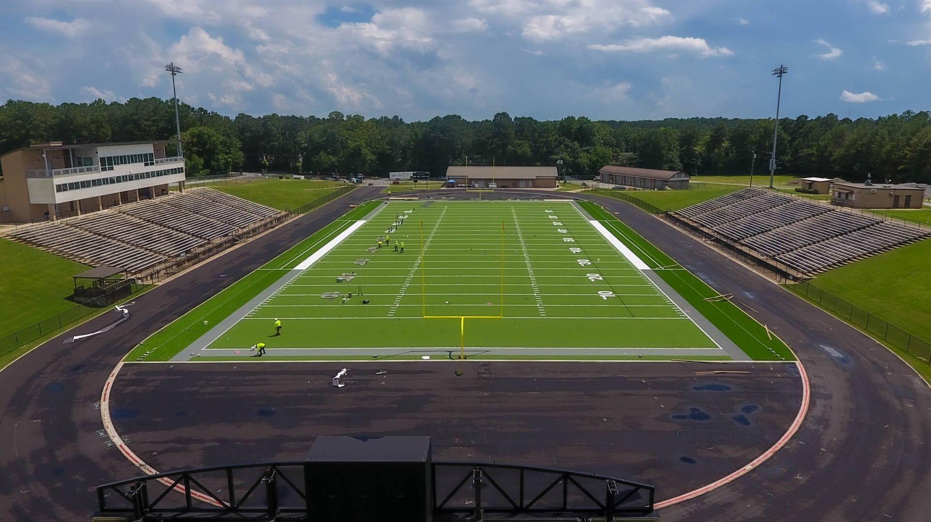
Kinnett Stadium Field and Track Project
Estimated Completion: Fall 2025

Slide 6
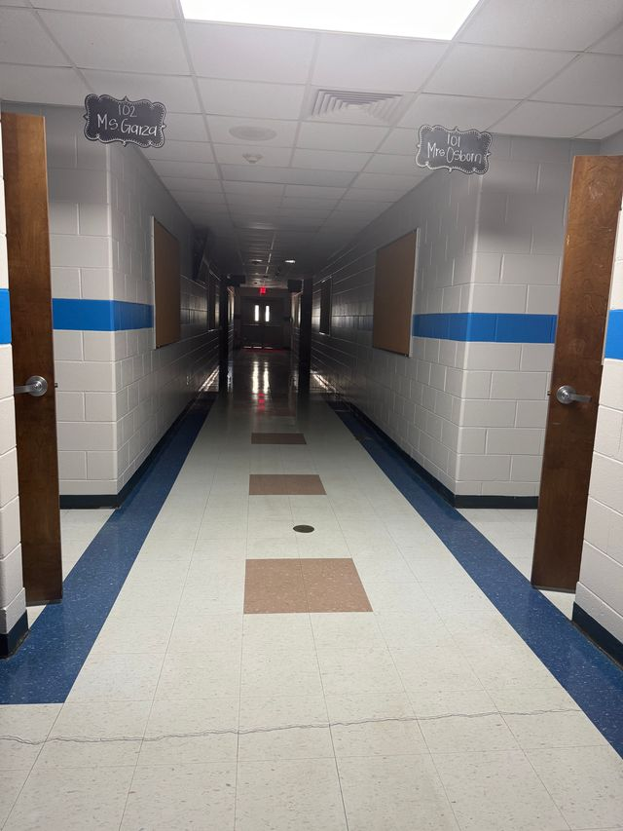
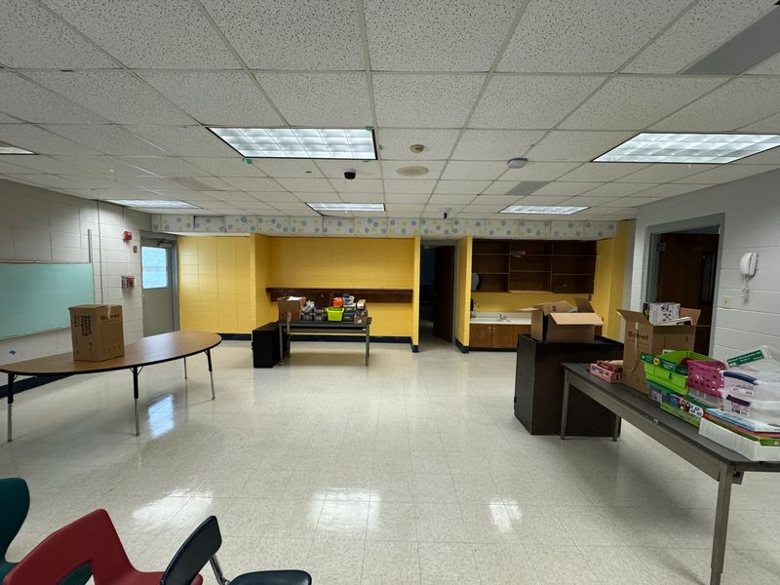
Painting Project – Allen Elementary
Estimated Completion: Winter 2025/2026
Hallway
Classroom

Slide 7
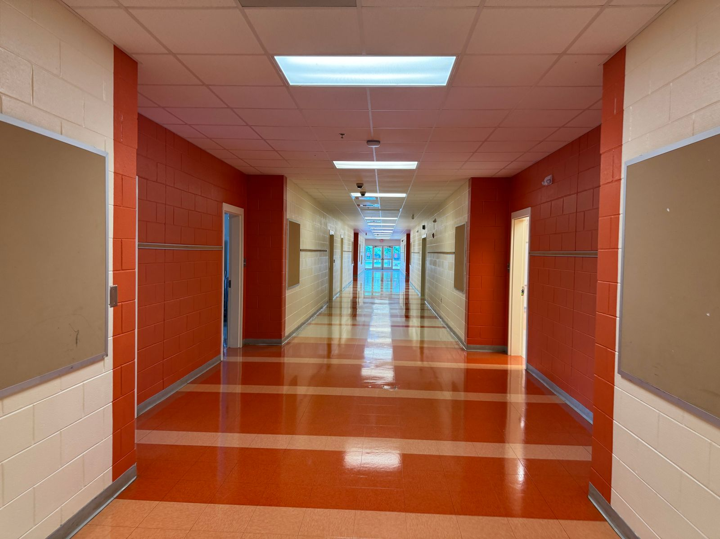
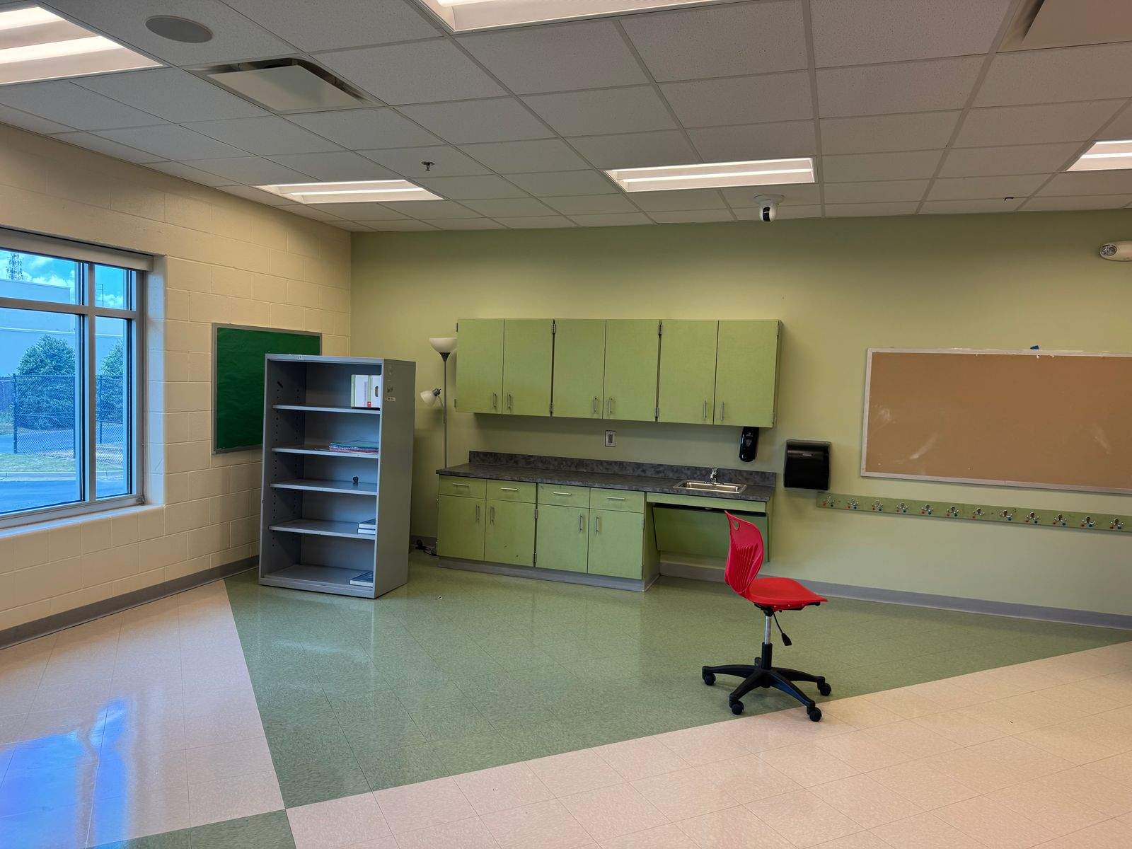
Painting Project – Dorothy Height Elementary
Estimated Completion: Winter 2025/2026
Hallway
Classroom

Slide 8
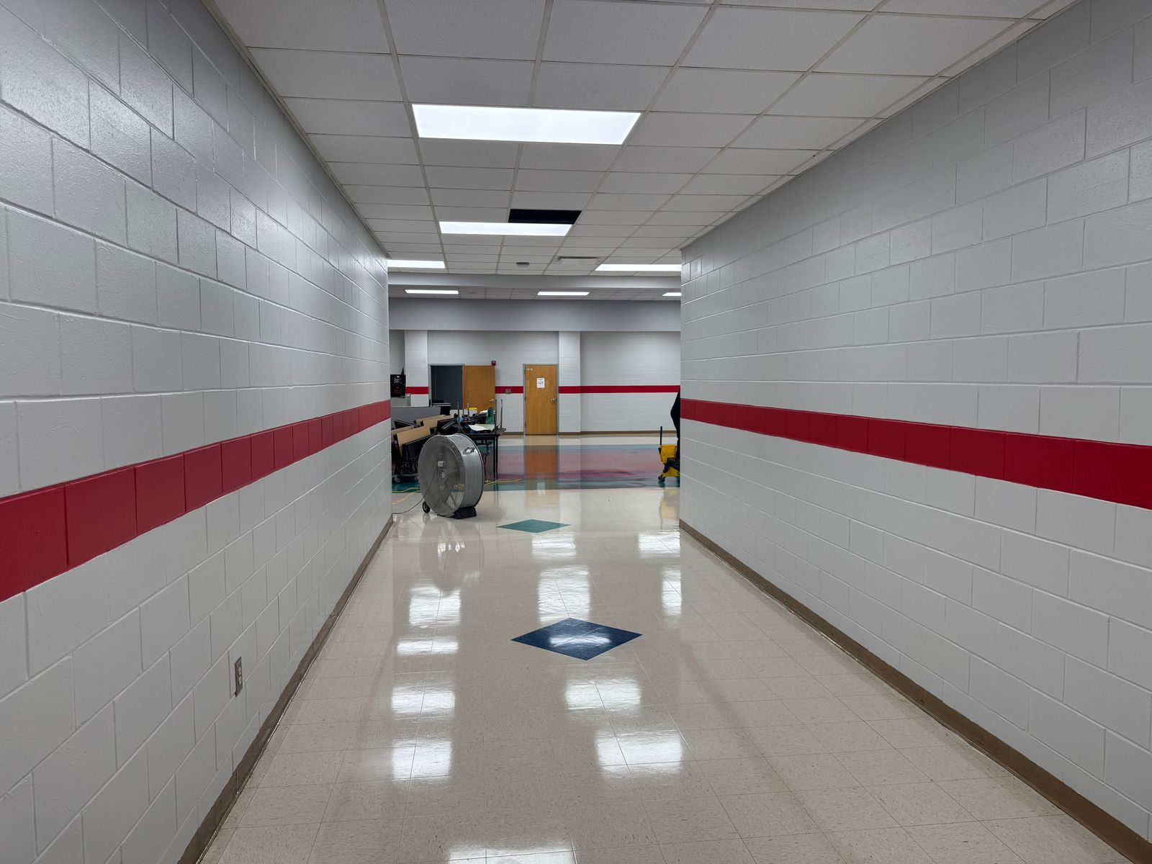
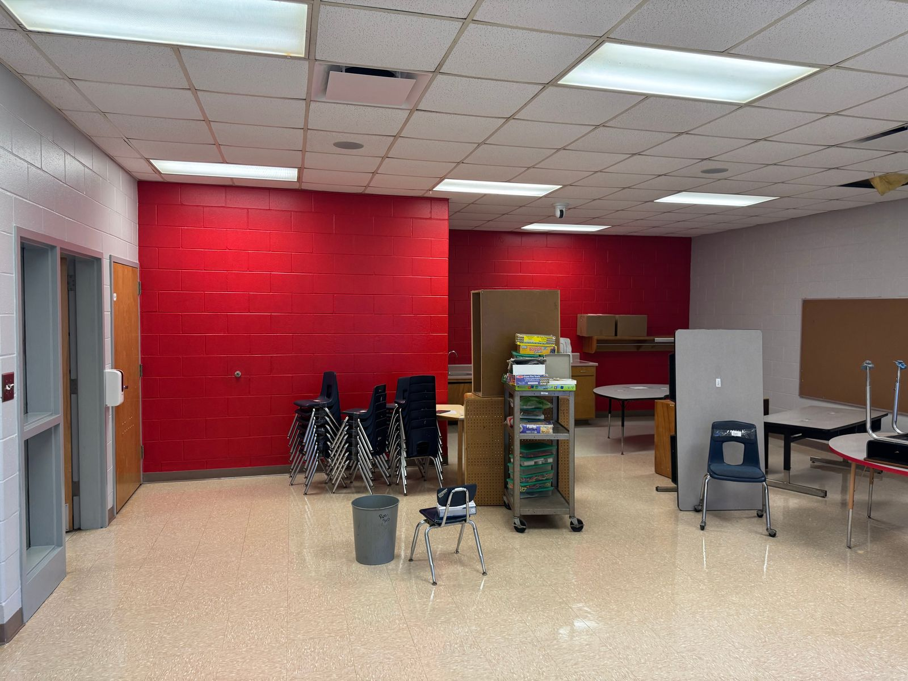
Painting Project – Fox Elementary
Estimated Completion: Winter 2025/2026
Hallway
Classroom

Slide 9
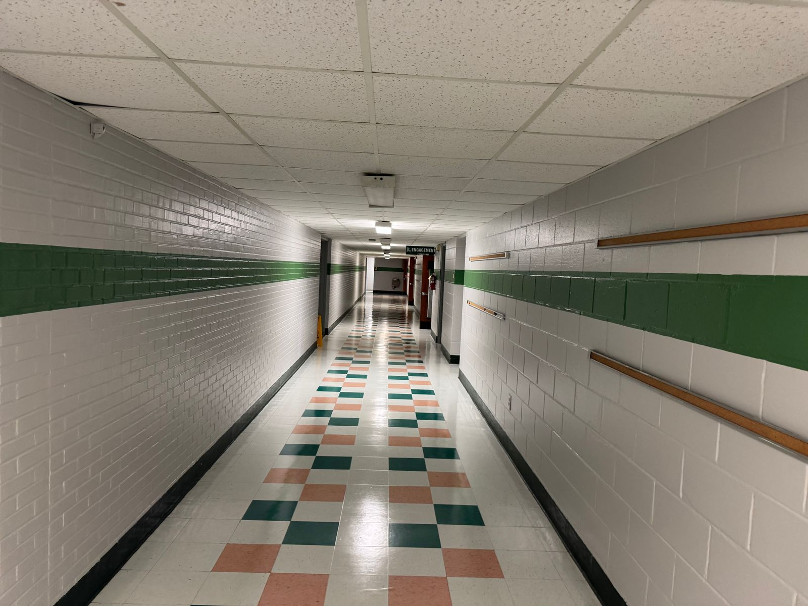
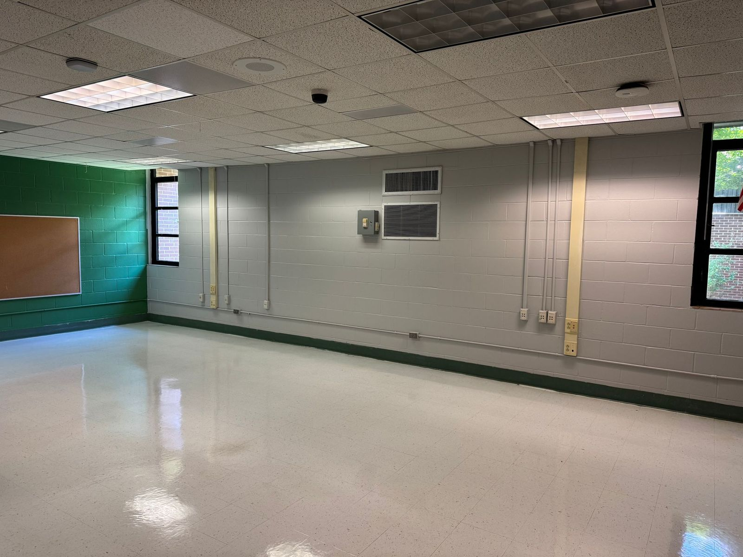
Painting Project – Gentian Elementary
Estimated Completion: Winter 2025/2026
Hallway
Classroom

Slide 10
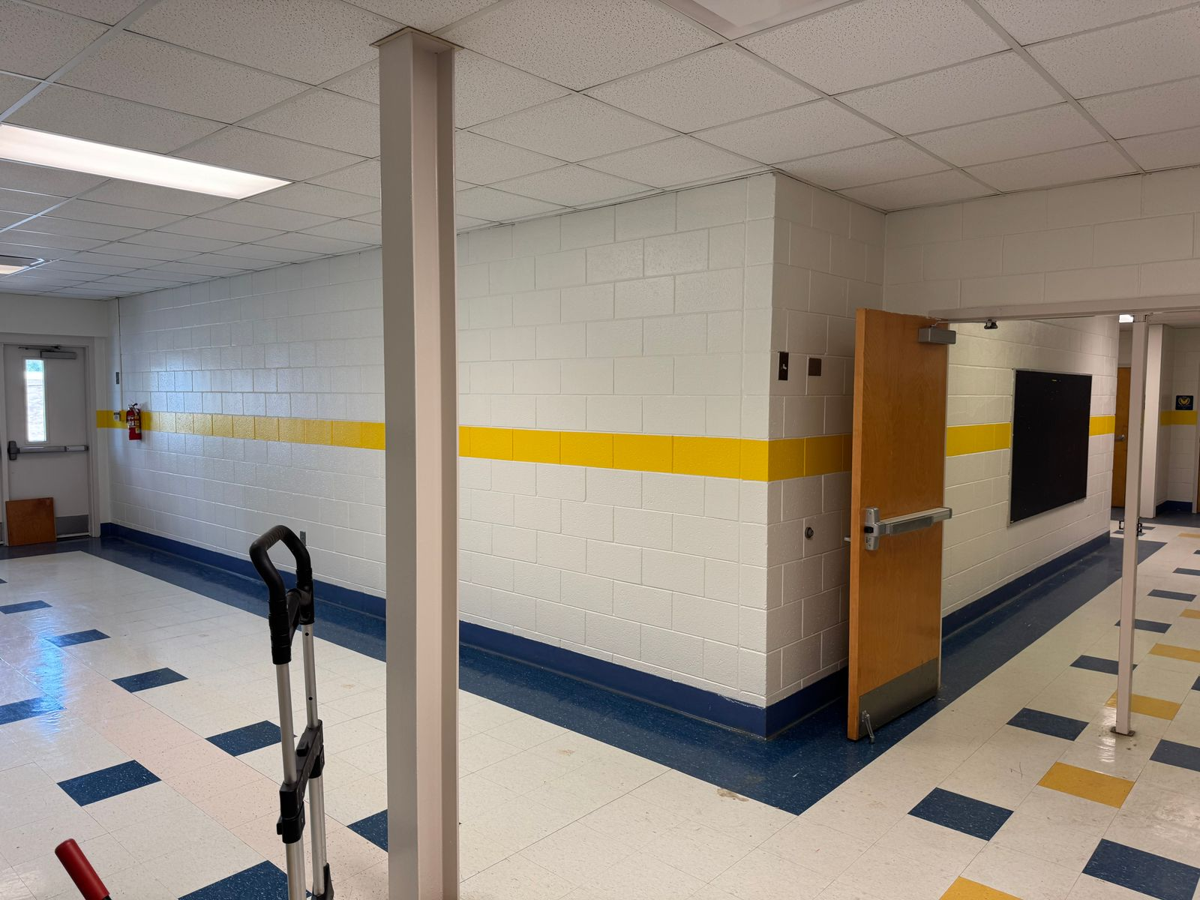
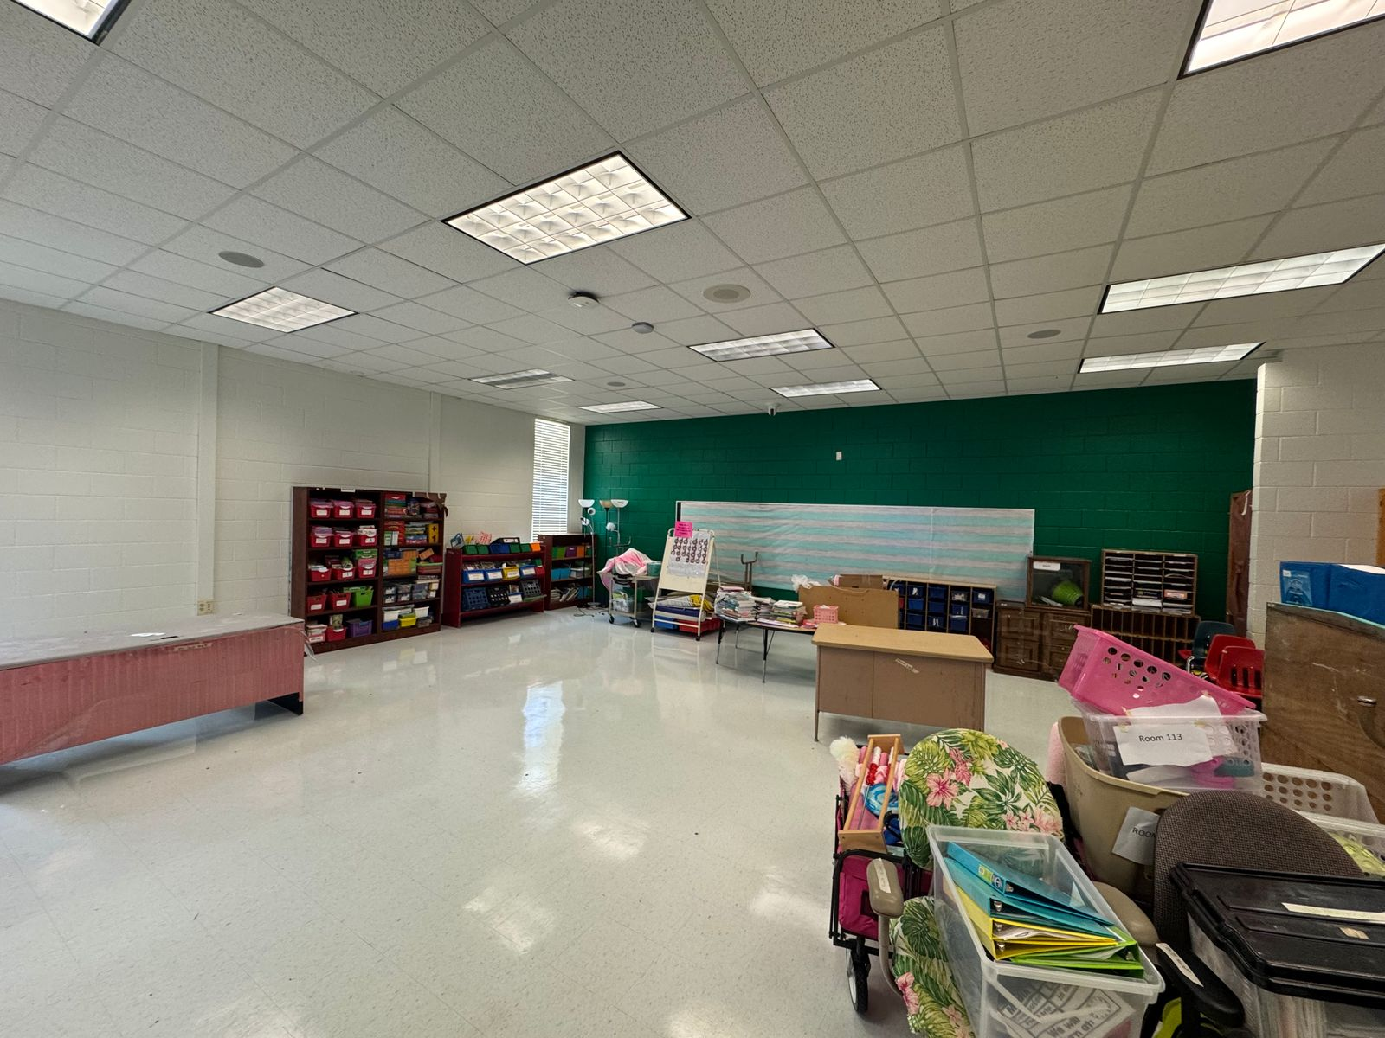
Painting Project – Georgetown Elementary
Estimated Completion: Winter 2025/2026
Hallway
Classroom

Slide 11
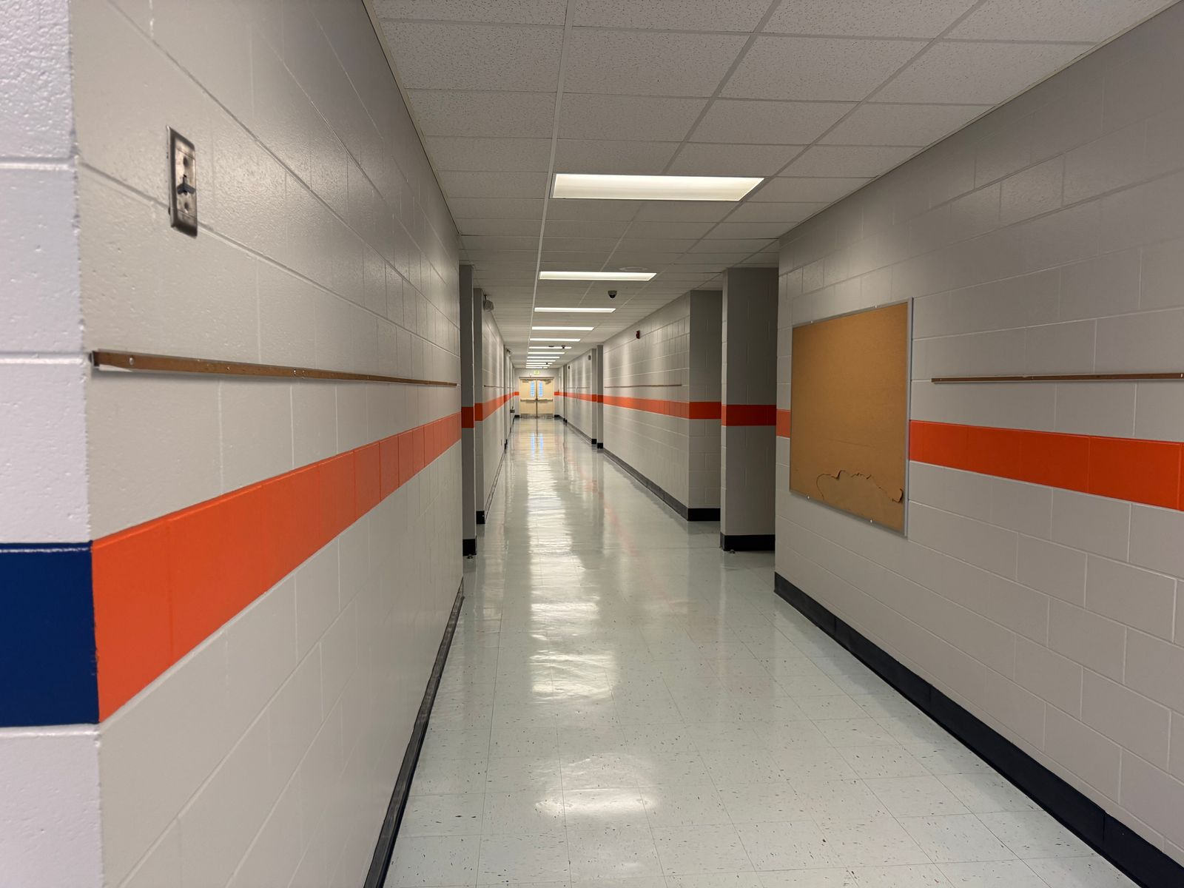
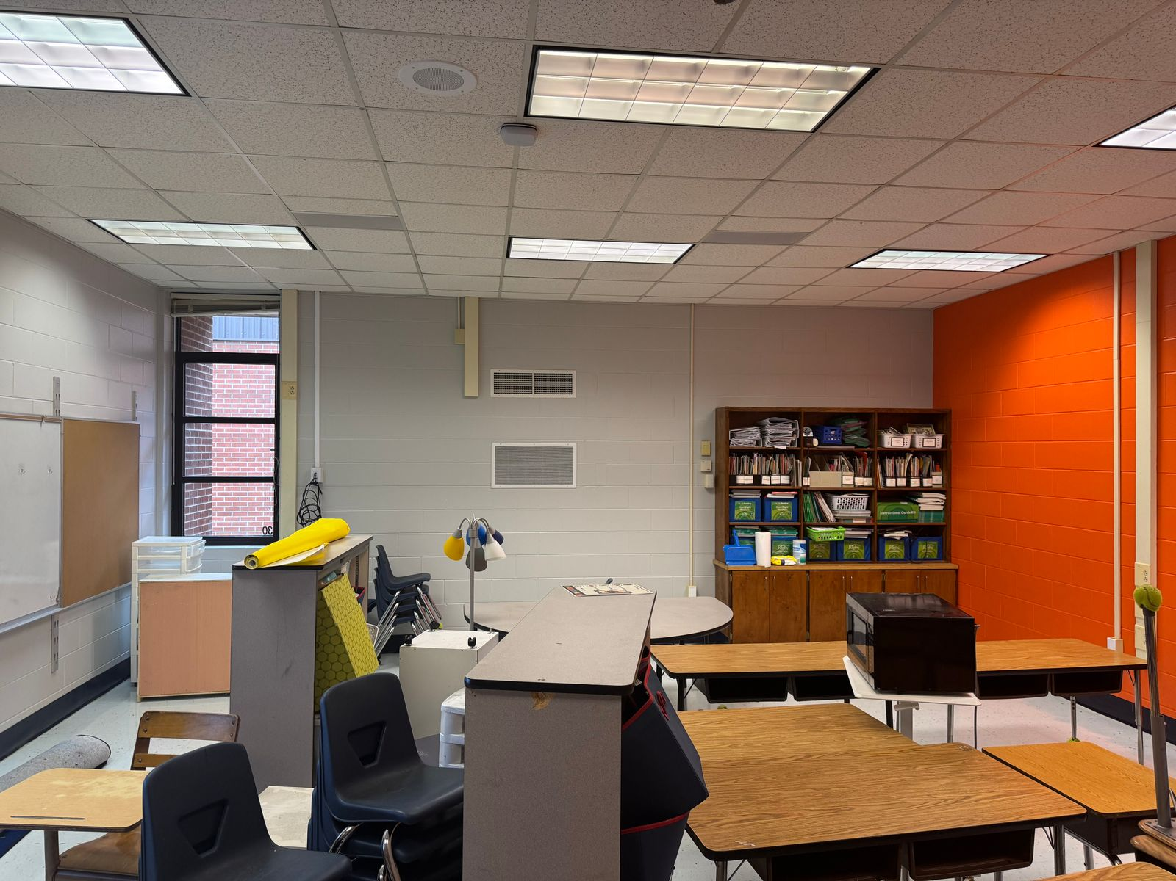
Painting Project – Mathews Elementary
Estimated Completion: Winter 2025/2026
Hallway
Classroom

Slide 12
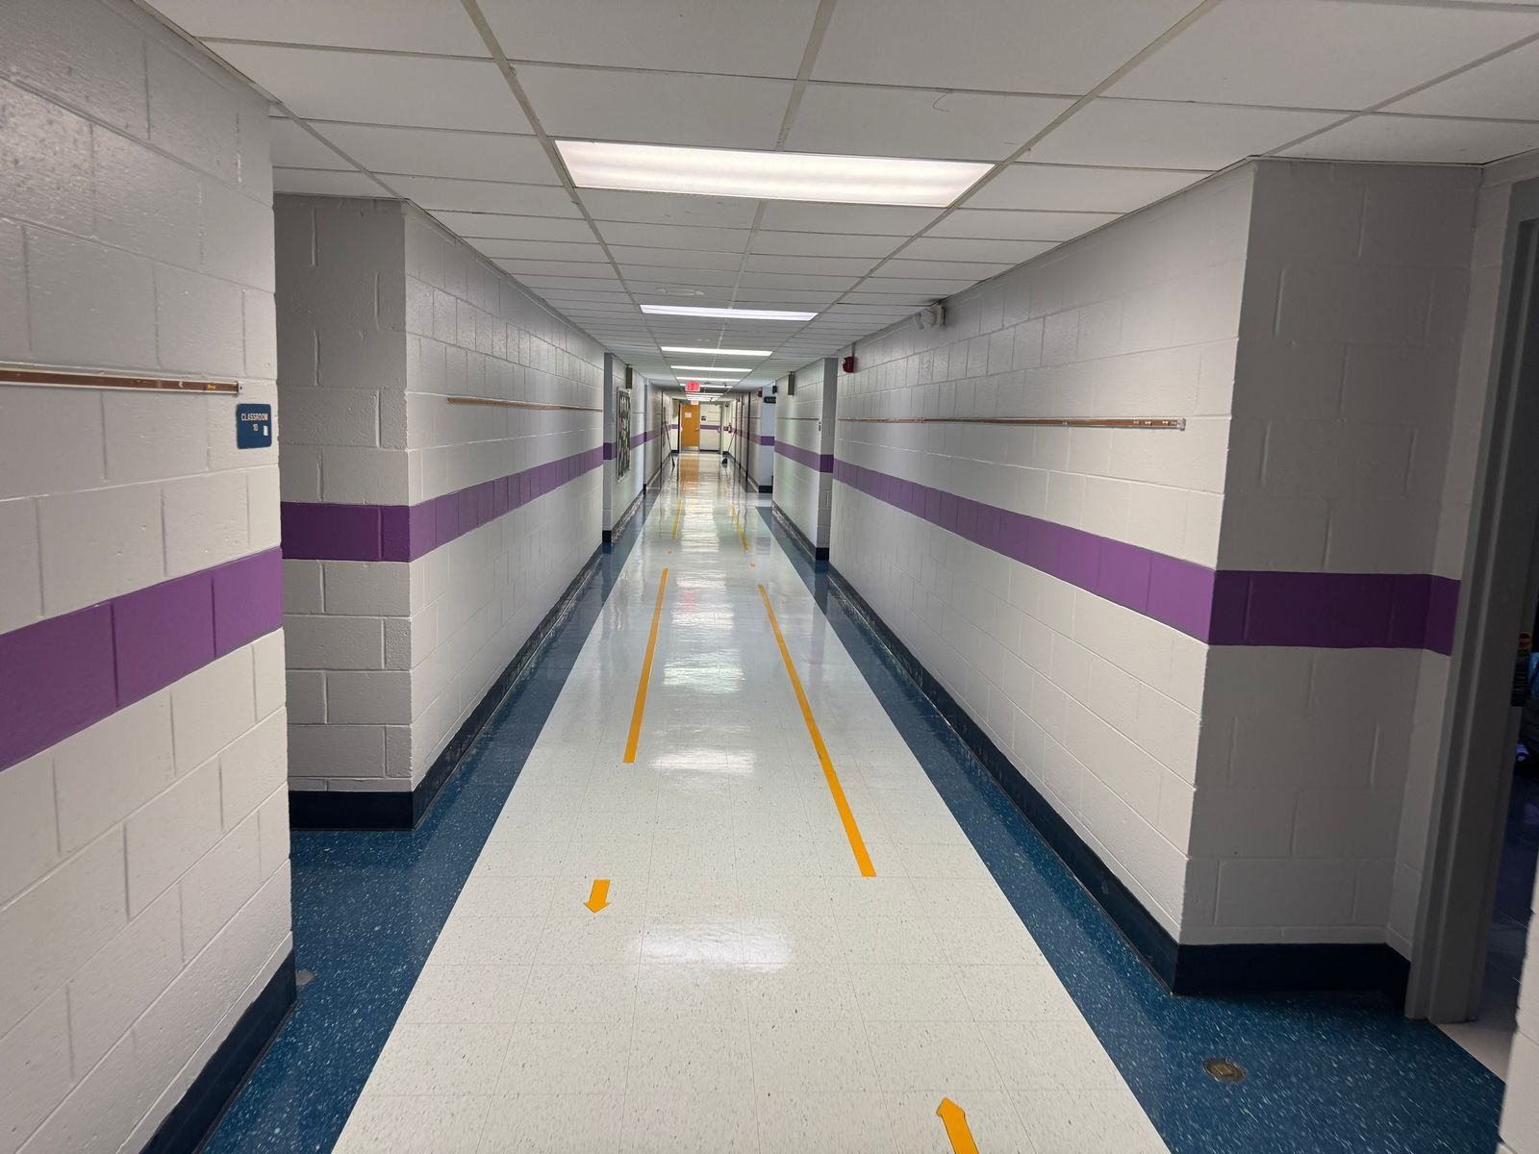
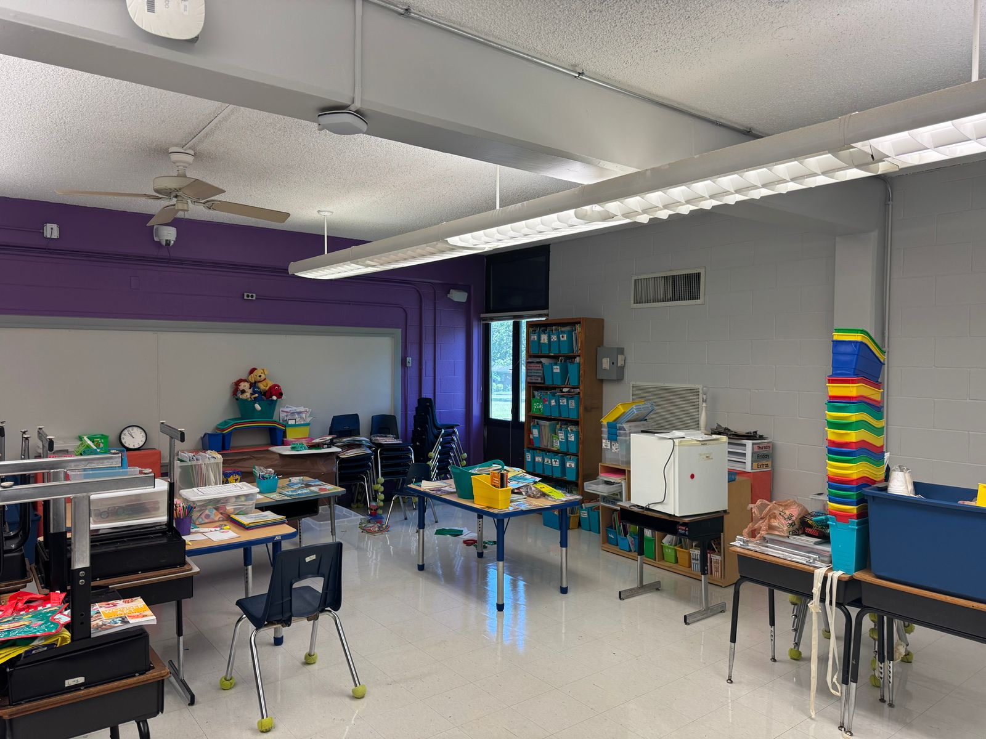
Painting Project – River Road Elementary
Estimated Completion: Winter 2025/2026
Hallway
Classroom

Slide 13
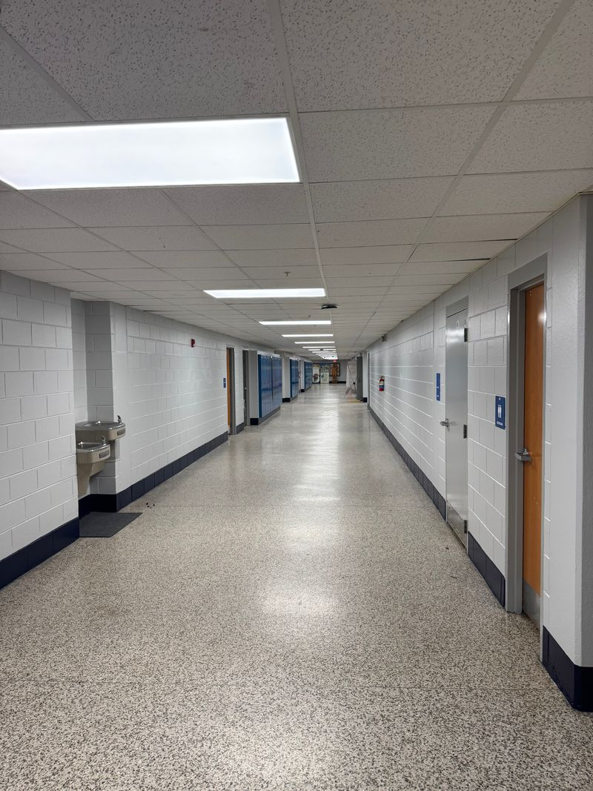
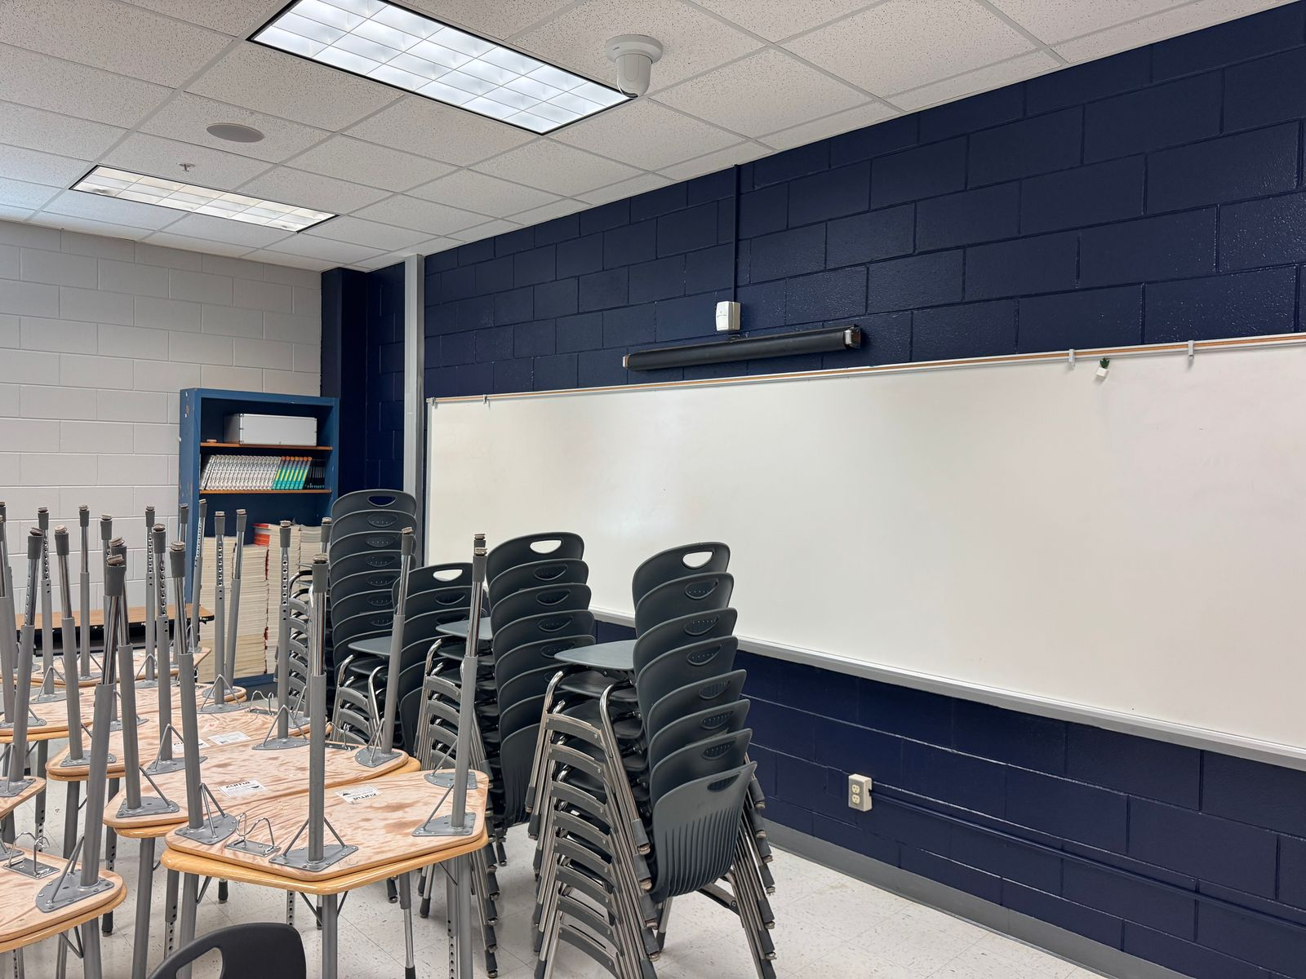
Painting Project – Kendrick High
Estimated Completion: Winter 2025/2026
Hallway
Classroom

Slide 14
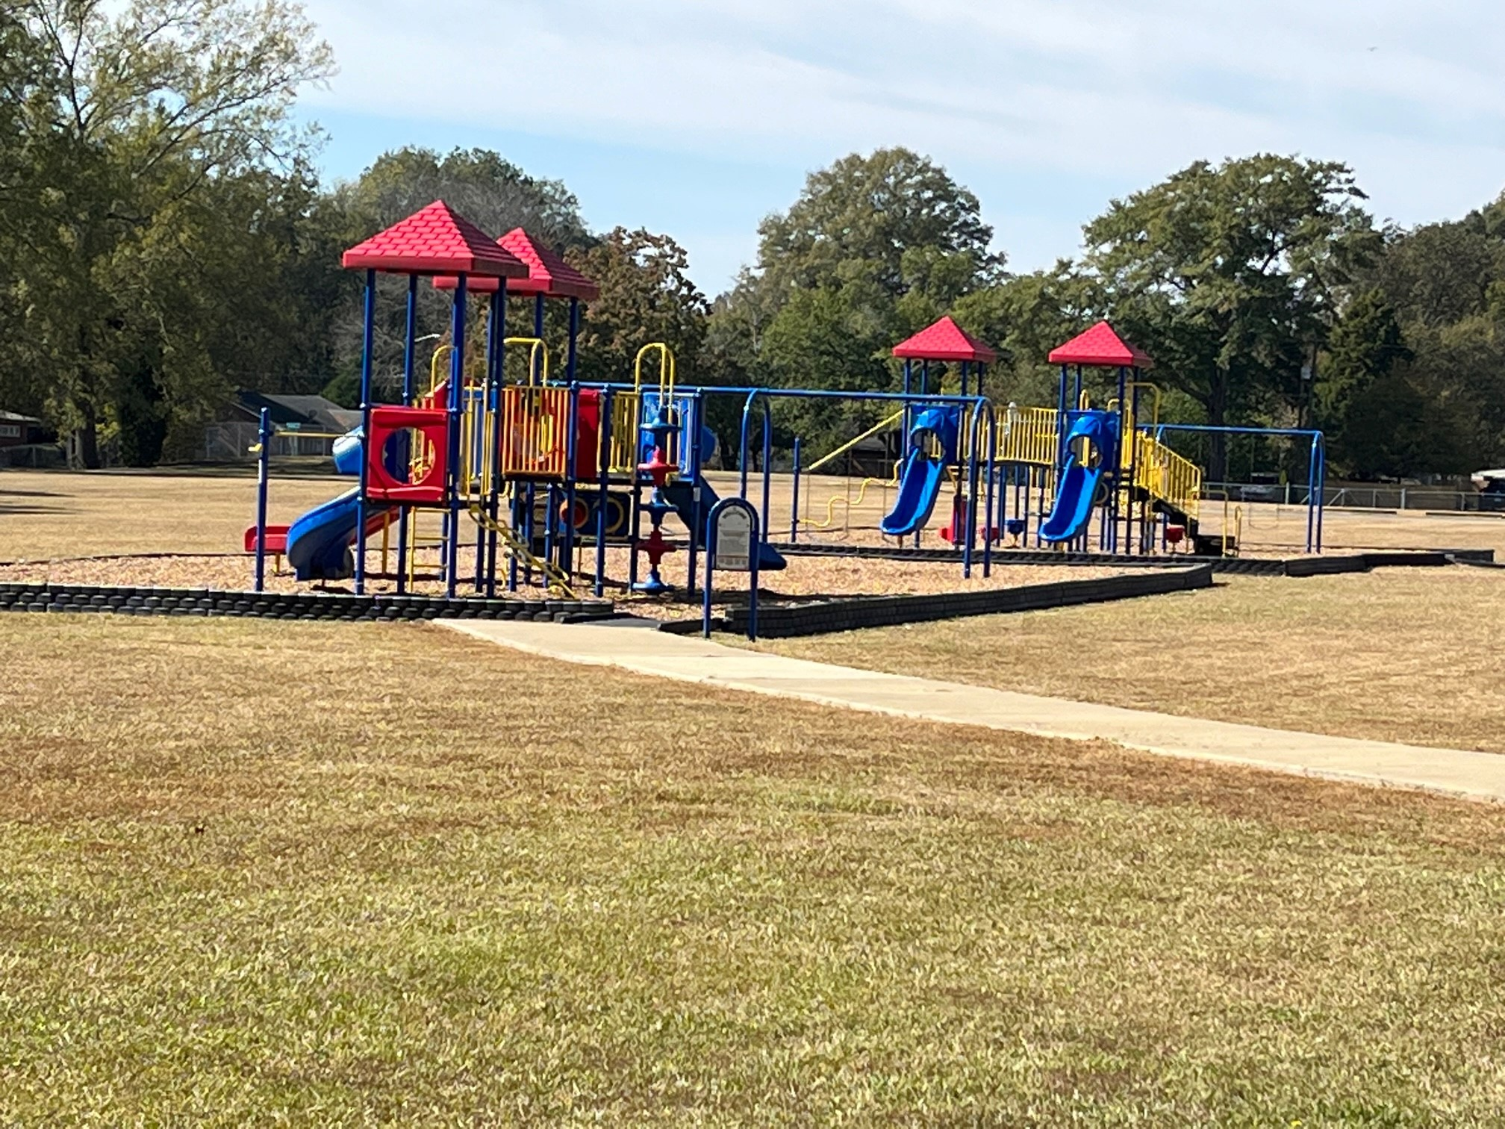
Playground Project – Allen, Dorothy Height, Fox, Hannan, Mathews, Midland Academy and North Columbus
Estimated Completion: Summer 2025

Slide 15
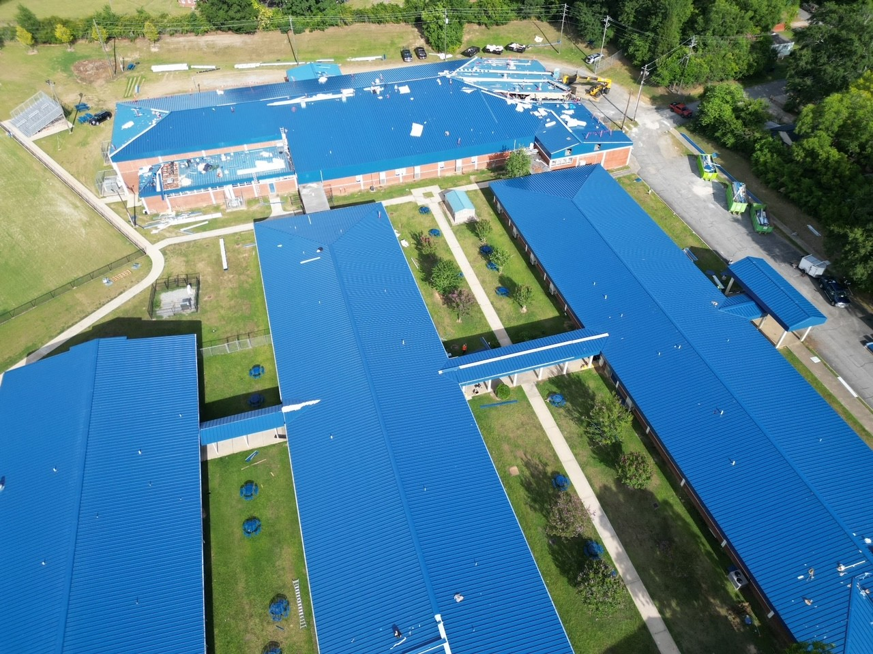
Roofing Project – Eddy Middle
Estimated Completion: Fall 2025

Slide 16
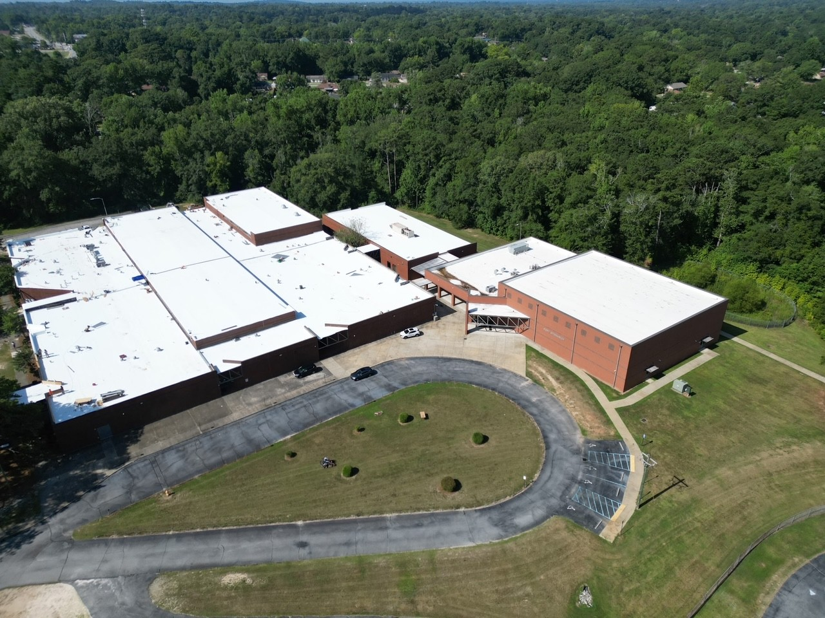
Roofing Project – Fort Middle
Estimated Completion: Fall 2025

Slide 17
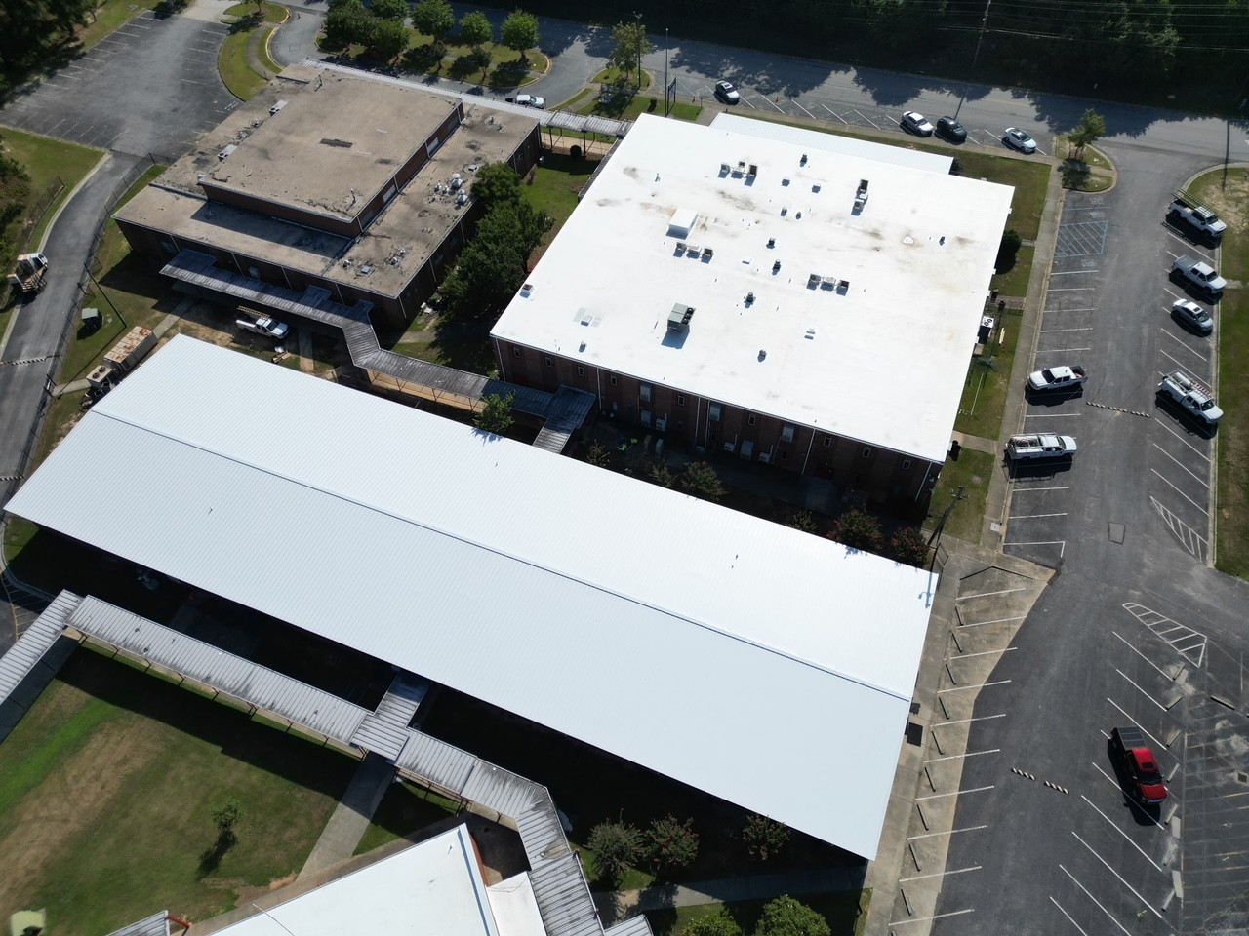
Roofing Project – Rothschild Middle
Estimated Completion: Fall 2025

Slide 18
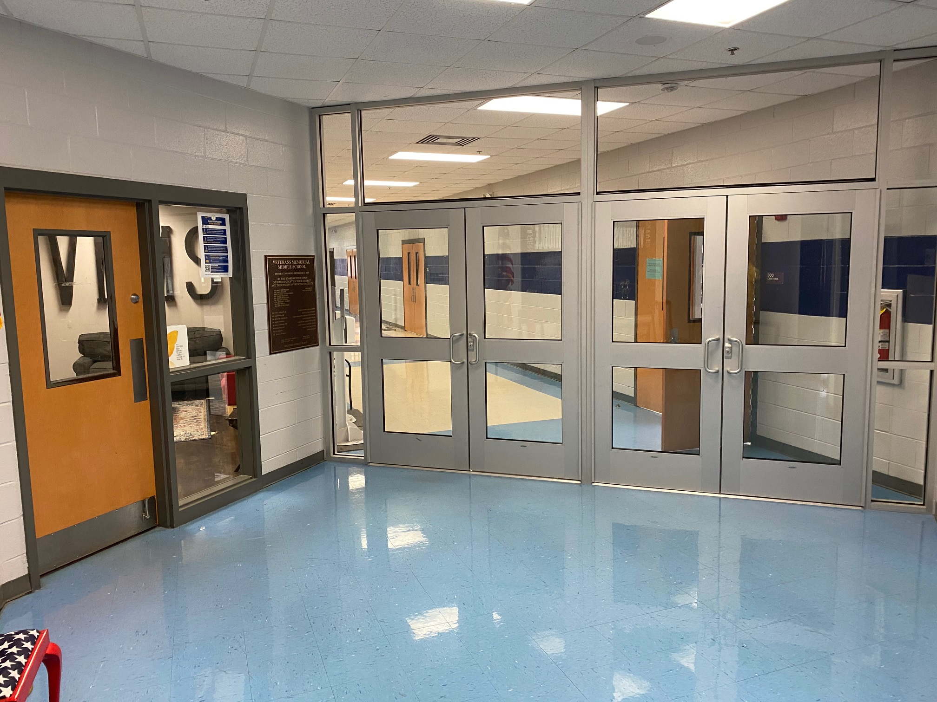
Secure Vestibules Project (Phase 1)
Estimated Completion: Fall 2025

Slide 19

Additional Projects
  Blackmon Road Middle HVAC Cooling Tower
    Estimated Completion (Phase 1): TBD
  Double Churches Elementary Upgrade
    Estimated Completion: TBD
  Kinnett Stadium Upgrade
    Estimated Completion: TBD

Slide 20
E-SPLOST

