Slide 1

2025-26 Budget Overview
Public Hearing
August 7th 2025
Martin Turney, Chief of Finance & Operations
Moriah Banasick, Executive Director of Finance & Budget

Slide 2


Outline
Budget Timeline
Summary of 2024-25
2025-26 General Fund
  Summary of Budget Factors
  Revenues/Enrollment
  Expenditures
  Fund Balance
2025-26 Other Funds
  Capital Projects
  Transportation
  Associated Student Body
  Debt Service
Next Steps
Appendix

Slide 3
Budget Timeline
Financial Advisory Core Team (FACT) Launch | December
Board of Directors’ Budget Guidelines | January
Budget Process with updates on District website | February
Legislature Regular Session ends (SINE DIE) | March
Superintendent’s Budget Review and Program Changes | April
Board of Directors’ Meeting | June
District Budget Completed | July
FACT Team – Final Meeting | July
Public Hearing – Proposed 2025-26 Budget | August
Budget Adoption | August

Slide 4

Summary of 2024-25
Ending Fund Balance
Estimated decrease in ending fund balance of $5.8M
  Due to planned single year increase in curriculum investment in Elementary Literacy, Middle School Math, and High School World History
Projected ending fund balance - $46.3M
  11% of 2024-25 budgeted expenditures

Slide 5
2024-25 Fund Balance Projection
2024-25 Estimated fund balance decline of $5.8M
5

Slide 6
Summary of Budget Factors
2025-26 Budgeted Revenues
Projected Enrollment: 18,489
  Equivalent to decline of 0.91%
  Approximately $4M decrease in revenue
Increases from the State Legislation
  Special Education: Increased multiplier to 1.16 resulting in approximately $1.4 million net gain—but a continued $9.5 million local gap
  Materials, Supplies, and Operating Costs (MSOC): Raised by $47 per student for an estimated gain of $860,000, still $8.7 million below actual costs
  Salary Funding: 2.5% cost of living adjustment/implicit price deflator (IPD), approximately $2.7M
  Local Levy Capacity: Estimated to increase $4M
General Fund
Revenues
$399,760,537

Slide 7
Revenues
General Fund
Three Primary Sources:
Other Financing Sources excluded
State of Washington – 67.8%
Local: Educational Programs/Operations (EP&O) Levy and Local Fees – 26%
Federal Government – 2.1%
Other financing sources represents the transfer in from the Capital Project Fund for allowable costs accounted for in the General Fund. This is not considered a primary funding source.
7

Slide 8
Federal Programs – Annual Funding Reminder
Accounts for $7.5M
87% of all Federal Funding
1.8% of total budget
Special Education (IDEA) $4.3M
Title I $1.4M
Child Nutrition $1.9M
Title II, III, IV $719K
NJROTC - Liberty $168K
Career & Technical Education (CTE) $200K
Total Federal Funding $8.7M
2.1% of total budget
Federal programs outlook remains uncertain beyond 2025–26
8

Slide 9
Enrollment
Historical & Projection
*Full Time Equivalent (FTE) basis - Includes Running Start, Alternative Learning, Transition to Kindergarten
9

Slide 10
Enrollment Trend
School Levels
10

Slide 11
Enrollment
Special Services
Increase of 15.6% from 2020-21 to 2024-25
Estimating enrollment to remain flat for 2025-26
11

Slide 12

Local Levy
Educational Programs & Operations (EP&O)
Annual levy increases help sustain enrichment programs and student supports beyond what is funded through state apportionment and base salaries
Calendar Year Levy Amounts
2025 |  | 2026
$62,039,358 |  | $70,000,000
 | Budget Year
 | 2024-2025
 | Anticipated Collection
 | Fall 2025 | Spring 2026
 | 47% | 53%
 | $29,394,248 | $36,831,298
 | Budgeted Levy Revenue
 | $66,225,546
2025 Voter Approved Levy $67,000,000
  Maximum Authority $62,039,358
2026 Voter Approved Levy $70,000,000
  Maximum Authority $70,000,000

Slide 13
Summary of Budget Factors
2025-26 Budgeted Expenditures
Curriculum Implementations
  MS 6th & 7th grade Social Studies
  HS Global Studies & Civics
  MS/HS Spanish/French
  HS Advanced Math & Bridge to Algebra
Materials, Supplies, Operating Costs
  Costs continue to outpace state increases
    Example: Insurance increase of $670K (11%)
Collective Bargaining Costs
  Ongoing Issaquah Education Association (IEA) contract bargaining introduces financial uncertainty, affecting planning timelines and implementation of initiatives
  Estimated cost growth exceeds state revenue
Enrollment-Driven Funding Pressures
  Continued declines, close monitoring and realignment
General Fund
Expenditures
$417,847,463*
*Budgeted expenditures include capacity. Actual expenditures projected to be approximately $406M.

Slide 14
Strategic Budget Alignment for 2025-26
Start, Stop, Continue
Realigning investments to reflect equity priorities, enrollment shifts, and fiscal sustainability
Investments to Advance Strategic Goals
Refocused funding to support students and operational equity
    Expansion of Dual Language to middle school
    Development of new CTE (Aerospace) and AP pathways
    Increased capacity for preschool and care programs
    Targeted paraeducator support for student transportation
    Launch of the Equity-Based Budget Framework to guide resource allocation
      Estimated net increase: $2.1M
14

Slide 15
Strategic Budget Alignment for 2025-26
Start, Stop, Continue
Structural Reductions for Sustainability
Rebalancing to maintain long-term fiscal health
    Return curriculum investment to baseline of $3M annually
    Sunset obsolete supplies and outdated contracts
      Estimated decrease of $2.7M
- See April 10, 2025 board meeting for details on “continue” items
- Does not include all budget adjustments (e.g. enrollment related staffing adjustments)
15

Slide 16
Expenditures
General Fund
Three Primary Categories:
Classroom – 56.2%
Support Services– 18.5%
Special Services– 13.8%
16

Slide 17
Expenditures
Special Services
$57.8M
17

Slide 18
Expenditures
Materials, Supplies, and Operating Costs
2025-26 Budget vs State Funded
See Appendix H for additional detail
18

Slide 19
Expenditures
Transportation
2025-26 Budget vs State Funded
19

Slide 20
2025-26 Ending Fund Balance
Projected ending fund balance is $40 million, but subject to change due to:
  Ongoing collective bargaining negotiations with IEA
  Potential adjustments in federal funding levels
  Evolving costs (e.g., insurance, operating costs)
The district will actively monitor and adjust to maintain compliance with fund balance policy (3–7% unrestricted)
20

Slide 21
Navigating Financial Complexity: Strategic Response in Uncertain Times
  Persistent Funding Gaps: State increases (SPED, MSOC) help, but fall short of covering actual cost growth
    MSOC Example: Insurance premiums rose over 11%, a $670K increase
  Expenditures Outpace State Support: Staffing levels and operating costs exceed state apportionment, collective bargaining outcomes will further shape financial obligations
  Enrollment & Broader Funding Declines Continue: Continued declines are driving structural budget pressure and revenue loss
  Federal Support Uncertainty: Potential loss of federal programs that could reduce district revenues and increase reliance on local funds beyond 2025-26
  Strategic Response Is Underway: The 2025–26 budget emphasizes sustainability, compliance, and the foundation for a 2–4 yr financial plan aligned with long-term projections
21

Slide 22
2025-26 General Fund
Beginning Fund Balance | $ 46,284,637
Revenues | $ 399,760,537
Expenditures | $ 417,847,463
Ending Fund Balance | $ 28,197,711
Projected Ending Fund Balance* | $ 40,000,000
*Although the budget shows a draw-down of fund balance from $46.3 to $28.2M, the district is projecting a decrease of $6.3 million to $40 million.
22

Slide 23
Capital Projects Fund
Key Budget Development Factors
Capital Projects Oversight Committee
  Started in early spring
  Includes a broad cross-section of the community, including individuals with construction, finance, engineering, and educational backgrounds
  Support the district’s long-term facilities planning efforts through feedback and oversight of current projects
    More information available on the website, Capital Projects Oversight Committee
New High School Project
  Planning continues for a new high school, scheduled to open in August 2027
  Currently funded with $146 million in available resources
  Expanding access to modern, purpose-built environments that support innovative teaching and learning
23

Slide 24
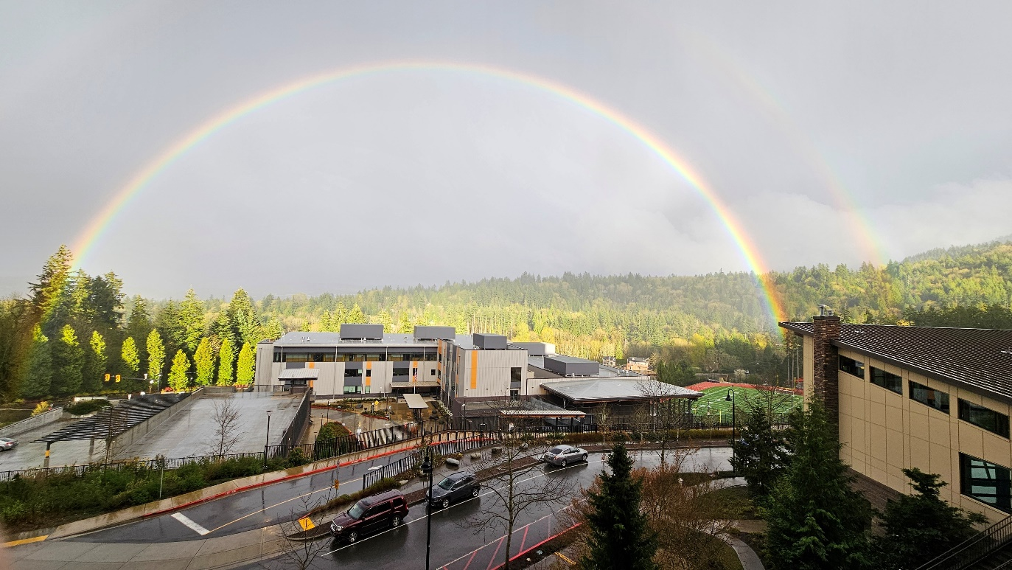
2025-26 Capital Projects Fund
Beginning Fund Balance | $ 137,508,660
Revenues | $ 39,905,999
Expenditures/Other Uses | $ (176,337,453)
Ending Fund Balance | $ 1,077,206
24

Slide 25
Transportation Fund
Key Budget Development Factors
Electric Bus Grants
Dept of Ecology
  $846,952 awarded
  Three large electric buses
  Infrastructure
Originally awarded in 2024-25
25

Slide 26
2025-26 Transportation Fund
Beginning Fund Balance | $ 11,155,492
Revenues | $ 3,486,956
Expenditures | $ (4,800,000)
Ending Fund Balance | $ 9,842,448
26

Slide 27
2025-26 Debt Service Fund
Beginning Fund Balance | $ 32,715,262
Revenues | $ 68,718,530
Expenditures | $ (66,925,531)
Ending Fund Balance | $ 34,508,259
27

Slide 28
2025-26 Associated Student Body Fund
Beginning Fund Balance | $ 3,209,341
Revenues | $ 15,109,730
Expenditures | $ (15,109,730)
Ending Fund Balance | $ 3,209,341
28

Slide 29
Next Steps and Additional Information
August 21st - Board of Directors Meeting
    2025-26 Budget Resolution Presented to Board for Possible Action. Resolution will include:
      Total Revenue and Expenditures by Fund
      Four Year Financial Forecast
      MSOC Certification as attachment for signature
Additional Information
    Supplemental budget information, including the full Draft Budget (F195) and Annual Budget Guide, are available on the Finance & Budget webpage.
29

Slide 30
    Thank you
Martin Turney
Chief of Finance & Operations
turneym@issaquah.wednet.edu
Moriah Banasick
Executive Director of Finance & Budget
banasicka@issaquah.wednet.edu
30

Slide 31
Appendix A
31

Slide 32
Appendix B
32

Slide 33
Appendix C
33

Slide 34
Appendix D
34

Slide 35
Appendix E
35

Slide 36
Appendix F
36

Slide 37
Appendix G
Administrative Cost Comparison
37

Slide 38
Appendix H
38

