Slide 1





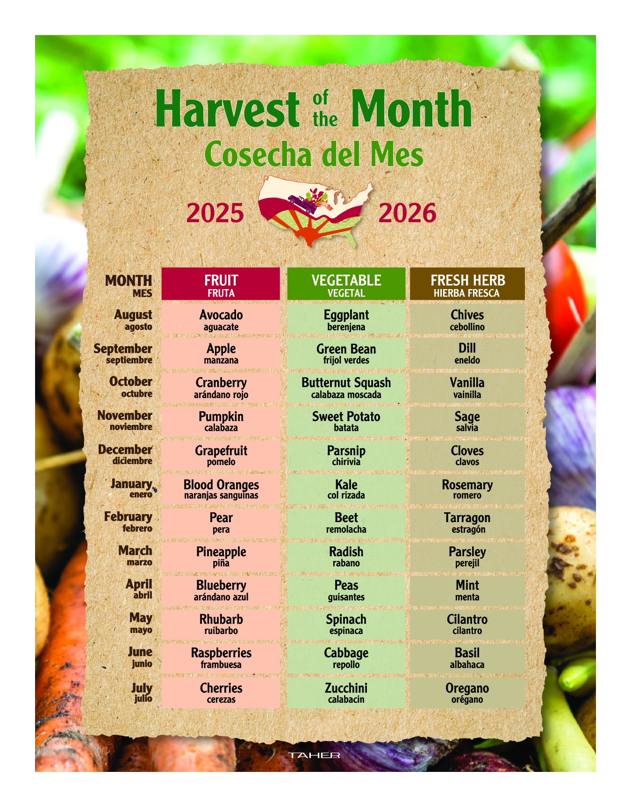

YOUR FOOD SERVICE PROGRAM FOR THE 2025-2026 SCHOOL YEAR
Taher, Inc. welcomes you to the new school year!
August 2024
August 2025
August 2024
August 2024
For Parents & Students at
Monroe-Gregg School District
We are excited to be starting our 2025-2026 year serving the students and families of the Monroe-Gregg School District. Headquartered in Minnetonka, Minnesota, Taher, Inc. has maintained a matchless reputation based on standards of quality, driven by trained chefs, providing value, integrity, and customized professional services. Our lunch and a la carte items will be prepared and served on‐site by your local food service team, including new Food Service Director, Alexa Beltz. We are looking forward to the start of the school year with you!
https://apps.apple.com/us/app/taher-food-4-life/id1022478099
HIGHLIGHTS of the Dining Program include:
LUNCH ~ each day we will offer:
Hot Entrees with Sides
Daily Grab and Go Specials
Fruit and Vegetable Bar with a Composed Salad
Deli Sandwich, Wrap or Salad Special of the Day
Monthly Limited Time Offers and Promotions Created by our Chefs
Check out our Menus on the Food4Life App in early August.
HARVEST OF THE MONTH ~ HEALTHY TO A “T” NEWSLETTER
We promote our Harvest of the Month Program to expose students to fresh, healthy foods and to have the experience of trying new items they may not normally try at home. Educational flyers are hung in the café with fun facts aimed to garner interest and attention to the food we are featuring.
FOOD4LIFE® APP
Download our Food4Life App to have access to our menus and nutritional information for each school your children attend.
WHAT WE WILL FEATURE FOR YOU
2025-2026 MEAL PRICES
LUNCH
Elementary School $x.xx
Middle School $x.xx
High School $x.xx
Free $x.xx
Reduced $x.xx
Adult $x.xx
Milk of Carton $0.xx
Taher’s Food4Life® menu offerings incorporate the following:
Chef-developed, made-from-scratch items that are trans-fat free.
Fruit and vegetable selections that complement our menu offerings.
Frequent special activities and events like our Limited Time Offering meals
and seasonal specials to build excitement and fun.
A dedicated and trained staff who focus on customer service, attention to detail
and a desire to serve people in a friendly and welcoming atmosphere.
We look forward to serving you and your families this school year.
Please feel free to reach out to Alexa Beltz at abeltz@m-gsd.org with any questions.
The dining program needs the support of students and the entire school community to succeed!
Please support the dining program through your patronage.

