Slide 1



The New Look of Infinite Campus

Slide 2

What is the “The New Look”?
“Simplified Navigation”
Responsive “User Interface” Design
It is more ADA Compliant
You can create a list of your favorite tools
“Intuitive” Related Tools Menu
Navigable Breadcrumbs
Robust In-Tool Person Search
Unified Search Menu
Person Information Card
Custom Menu Placements

Slide 3
Navigation
Year, Calendar and Structure Settings
Main Menu – Toggle the Style from List to Fly Out
  Will default to list on smaller screens
New Groupings and Menu Names
Breadcrumbs
  Now on right side instead of left side
Related Tools
  Replaces tab style
Favorite and Recent Tools
Search Context Dialog Boxes
Custom Tool Placement
  Links setup in multiple places by Campus Administrators
Many tools getting updated to a newer interface

Slide 4
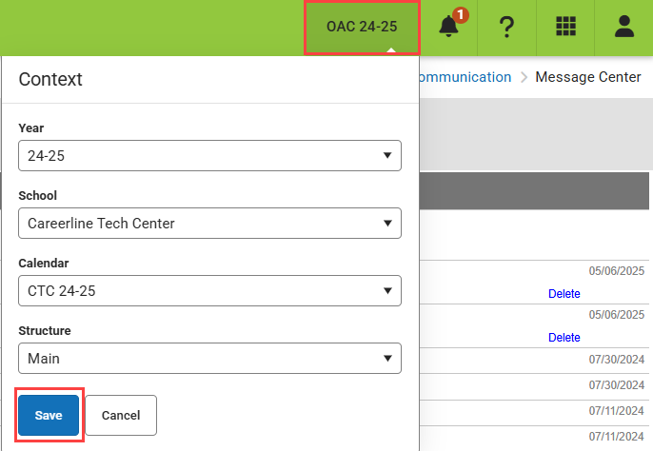
Navigation – Year, Calendar, Structure
The Year and Calendar selection moved to right hand side
  Make sure you are in correct year, calendar and/or structure

Slide 5
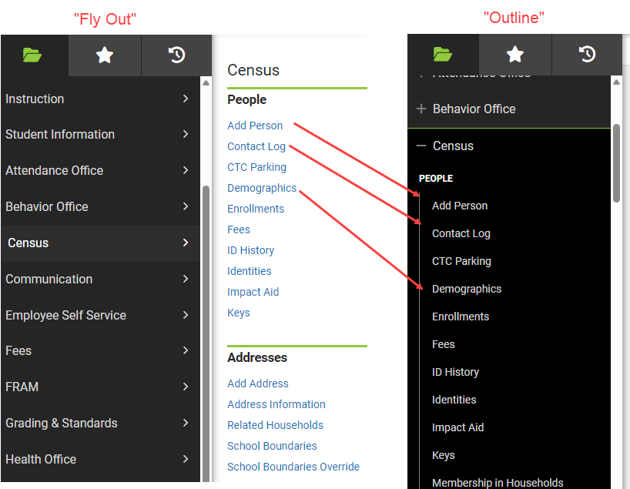
Navigation – Menu Styles
“Fly Out” Version
  Mouse over to get to menus
  For larger screens
“List View” Version
  For smaller screens
  Will automatically revert to this when browser window is too small

Slide 6
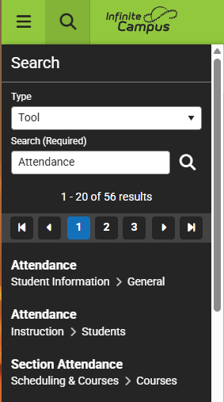
Navigation – Groupings/Menus
Groupings now more by functionality
  All Attendance functions under Attendance, etc.
Numerous tools have had a name change
  Alphabetized under main headings
Tool Search is best option to find a tool

Slide 7
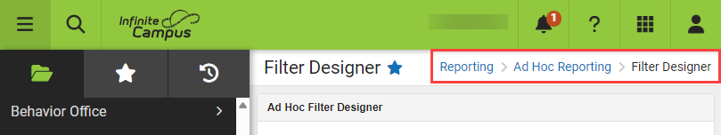
Navigation – Breadcrumbs
Breadcrumbs will fill in at the top right
Allows you to navigate more freely

Slide 8
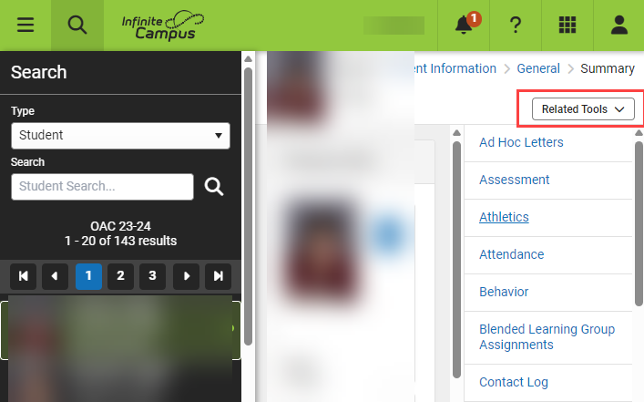
Navigation – Related Tools
Related Tools appear on the right-hand side of a selected tool
  Example: Student Information > Summary shows the rest of Student Information tools
  Think of them like tabs in the old look
  Toggle related tools on or off for more screen real estate

Slide 9
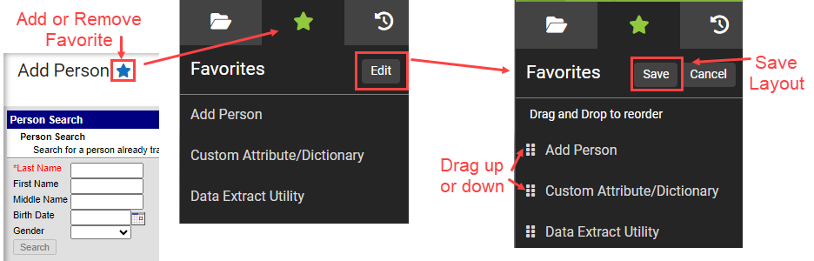
Navigation – Favorites
Create your own “Favorites” menu
  When tool is up, click the “Star” next to the tool
  Can arrange the tools in whatever order you like
  Can get to be a long list
  Names can be confusing at times

Slide 10
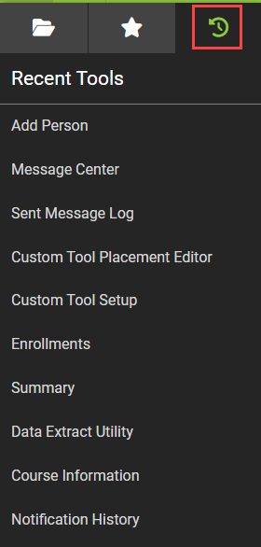
Navigation – Recents
The most recent 10 tools used will be displayed

Slide 11
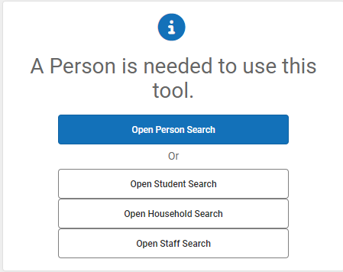
Navigation – In-Person Searching
Moving between tool contexts, a Search request may be made
  Example: Course Information and you switch to Census Demographics
Must do a search to find the right context to edit

Slide 12
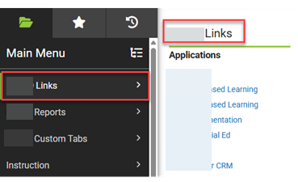
Navigation – Custom Tool Placements
Custom Tool Placements in Custom Menus can be created
  Multiple Locations – look for OAISD Reports Heading

Slide 13
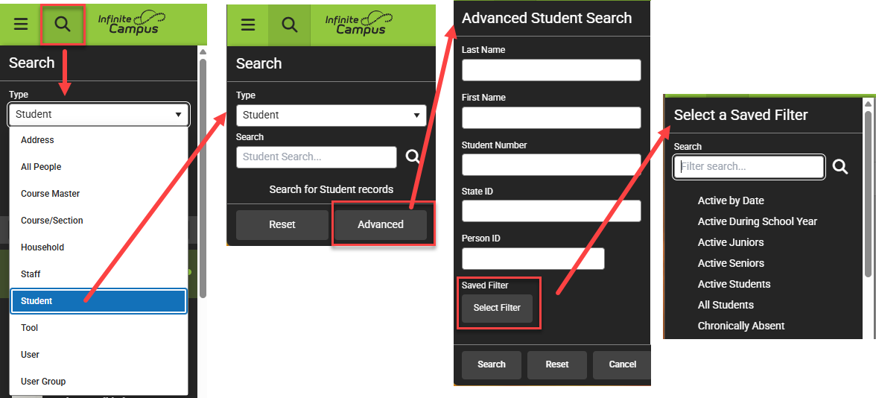
Navigation – Unified Search
Searching is all in one place
  Click the Magnifying Glass Icon in main bar
  Search Address, Household, Student, Staff, All People
  Advanced button to do a more specific search
  Select Filter to use an Ad Hoc Filter to search

Slide 14
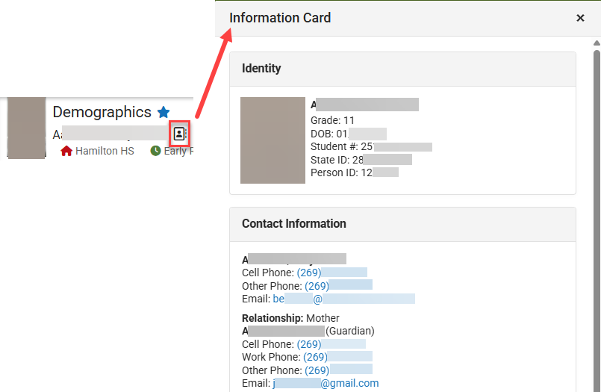
Navigation – Person Information Cards
When a person is selected there is an information card available
  Depending on the person it will display basic demographic information and contact information

