Slide 1

Medford Affordable Housing Trust Action Plan
Draft Plan Presentation

Slide 2
Agenda
Introductions
  Survey
Presentation
  Affordable Housing Trust (AHT) background
  Data
  Affordable Housing Definitions & Resources
AHT Action Plan
Next Steps and Questions

Slide 3
Introductions
Who is here today?
Notes:
Warm-up questions:
Stand up if you …
- Have a Medford library card
- Have had eggplant parm from Bob's Italian
- If you went to school in Medford
- If you’ve ever paid rent in Medford
- If you've worked in Medford
- Have kayaked on the Mystic River
- Have been to the Chevalier
- Have you ever been to a city meeting before

Slide 4
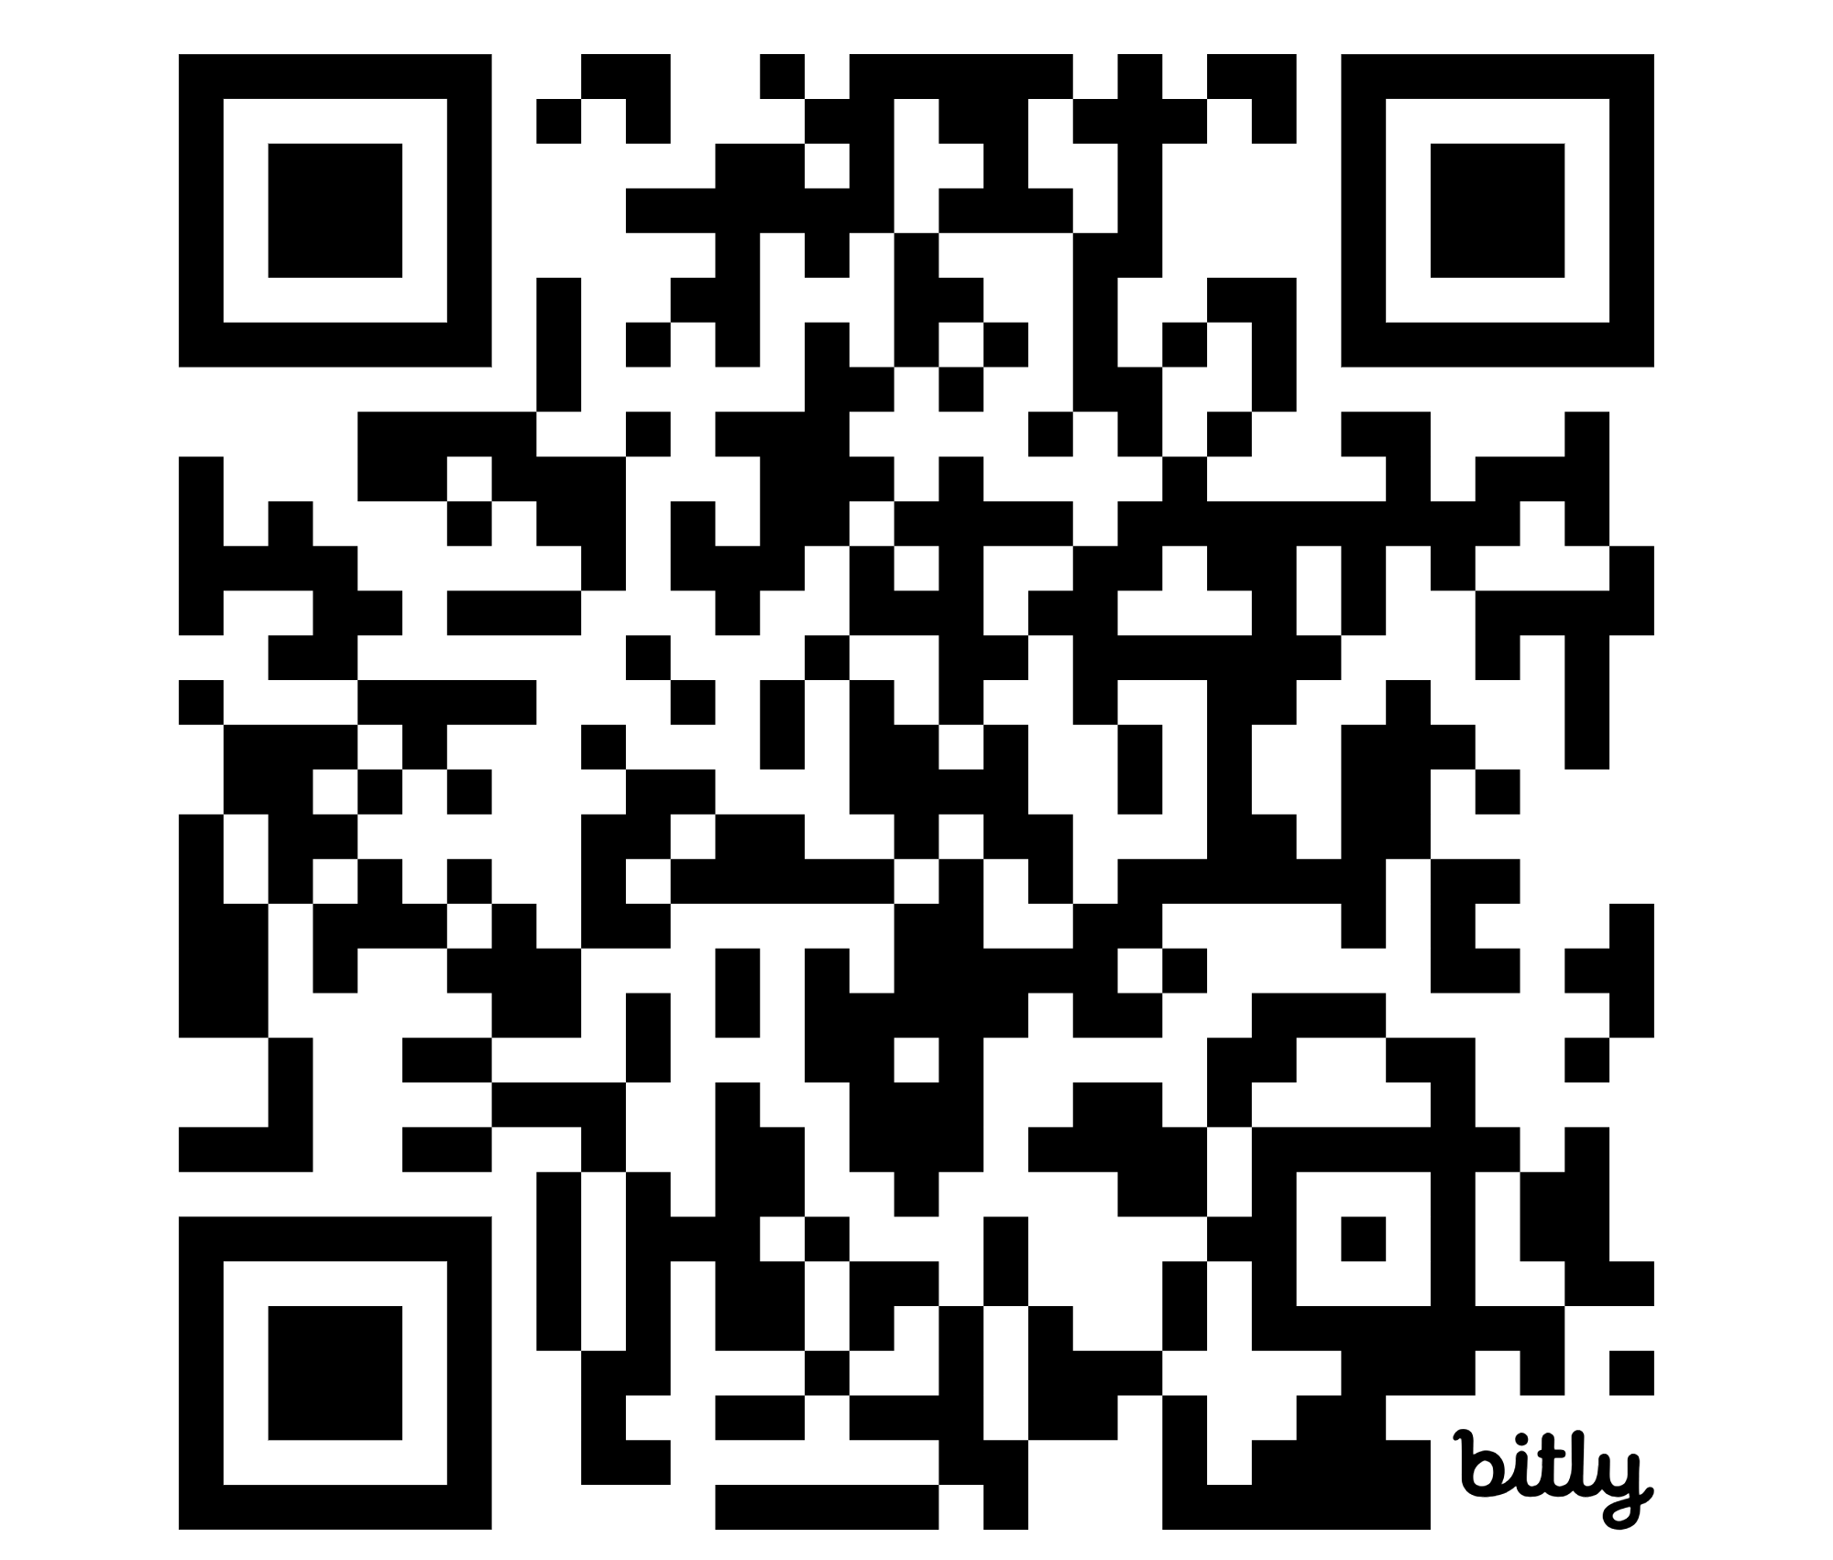
Introductions
Please take a moment to let us know who is participating in the meeting by completing our anonymous socio-demographic survey.
OR Type the URL
bit.ly/AHTsurvey

Slide 5
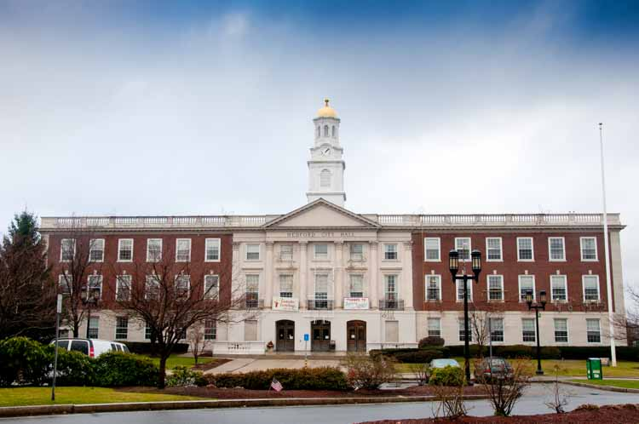
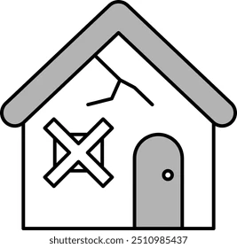


Affordable Housing Trust Background
Notes:
The Affordable Housing Trust was created by City Council in 2024. It is a way to pool money from different sources to spend on affordable housing projects. It is also possible for the Trust to hold and convey property that is meant to be dedicated to affordable housing.
The Board of Trustees was appointed last fall. This board has the responsibility of determining how to spend money that comes into the Trust. The Board can also have other roles, such as advocating for policies or being a liaison to affordable housing developers.
The role of the Trust is to fund and facilitate affordable housing – not to acquire and own property long-term.
The first job of the AHT Board is to prepare an Action Plan which is kind of like a business plan – setting goals and guiding what the Trust focuses on in the next five years.
This is why we are here today. Your input will help to set the direction for the Trust Board to act on.

Slide 6
MAHT 5 Year Plan Process
September – December, 2024: evaluated market data and policy context
December – January, 2025: conducted focus groups with affordable housing stakeholders
February – March: gathered public input through community meeting and survey
April – June: AHTF Board drafted Action Plan
July: Public review of Draft Plan
First Year Action
April: AHTF secured $300,000 from CPA
May: AHTF released RFP for affordable housing construction grant
August: Applications Due
September: Grant funds to be committed

Slide 7
Medford Housing Policy Timeline
CPA Adopted in 2015
Housing Production Plan adopted in 2021
Medford Comprehensive Plan adopted in 2023
Zoning Phase 1 adopted in 2023
Affordable Housing Trust adopted in 2024
Zoning Phase 2+, other initiatives ongoing
Notes:
Before we get into talking about the AHT Action Plan, we’ll start with an overview of what the City has done to support affordable housing in recent years, to put this effort in context.
Adopting CPA gave Medford the first local dedicated revenue stream for affordable housing. To date, the CPC has dedicated almost one-third of CPA revenue on affordable housing – about $3.7M. But it has been challenging to find partners to apply for affordable housing and to collaborate successfully. (We will hopefully see some of our first units be completed this year.)
While trying to recruit partners to use our affordable housing funds, the CPC heard feedback that Medford would be a more inviting place to build affordable housing if we had a housing plan and zoning that articulated what the City wants development to look like, and more funds to put on the table.
Over the past five years we have made significant progress – adopting a Housing Production Plan in 2021, the Comprehensive Plan in 2023, and have been tackling zoning one step at a time, implementing the vision described in these plans.

Slide 8
Housing Strategies and Initiatives
Amend zoning | Wellington Station, Corridors and Neighborhood Zoning, Affordable infill zoning
Build on City-owned lots | Small lots, Medford Square, Wellington air rights
Facilitate housing development | Partnerships with nonprofits Medford Housing Authority redevelopment
Support households | Housing rehab, downpayment assistance, rental assistance programs Recruit/assist landlords renting to voucher holders and low income tenants
Advocate for affordable housing | Fair housing, tenants rights, and displacement prevention Build community support for affordable housing Identify additional sources of revenue for MAHT
Potential MAHT Initiatives
Notes:
Summarizing some of the goals that are tackled in the plans and initiatives over the past five years, we have been amending zoning, exploring opportunities to build on City-owned lots, fostering partnerships with nonprofits and the Medford Housing Authority to develop affordable housing, developing housing stability programs to help households access and stay in their homes, and building capacity to advocate for affordable housing.
On this list I have highlighted in blue the types of initiatives that the AHT might have a role in carrying out.

Slide 9


Data Highlights
Who lives in Medford?
Over 4,000 more young adults between 2010-2020
More nonfamily households
(i.e., roommates)
More people of color, immigrants
Smaller proportion of people with disabilities
?
Notes:
That brings us to developing this Housing Trust Action Plan. Before coming to talk to you all we have delved into data to understand our housing needs. Here are some of the big takeaways.
This may or may not be an actual photo of my new next door neighbors.
Growth in young adults (ages 20-34) while all other ages declined or stayed the same.
Corresponding growth in nonfamily households
Increasing racial/ethnic diversity might be due to Medford’s relative affordability compared to some neighboring communities.
Smaller than average share of people with disabilities might be due to the age and condition of our housing stock.

Slide 10
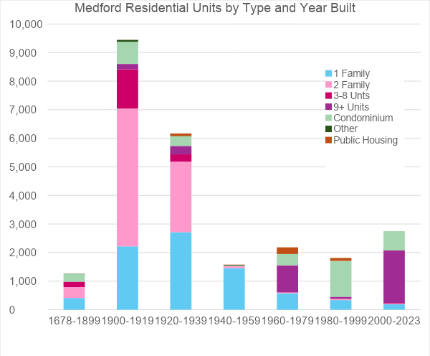
What does Medford’s housing look like?
Diverse
Old
Large
Expensive
Notes:
This table illustrates our assessor’s database. The bars represent periods of time, the colors different types of housing. Here’s what it tells us:
We have diverse housing – majority is multifamily. 47% is renter-occupied
Most small multifamily is around 100 years old.
Assessed values have increased by 50-60% between 2017-2024.
Newer units are increasingly large and expensive.
Value per unit is lower as the number of units increases.
Lack of smaller-sized units – only 15% have one bedroom, compared to 28% of 1-person households. Moreover, a lot of those roommates would probably prefer living alone if they could.

Slide 11


Who is struggling with housing costs in Medford?
Around 5,500 households are below 50% AMI, of whom 2/3 are housing cost-burdened.
33% of all homeowners are over age 65.
Median income for seniors is $44,000.
Seniors experiencing highest rate
of cost burden.
Median household income for
renters is rising rapidly, reflecting
what it requires to move in.
Notes:
The pictures represent two groups who are most feeling it.
Additional data for context:
Median household income for all households is around $115,000
We have about 22,000 households.
25% are below 50% AMI, and 15% are 50-80% AMI
Renters in the $50k-$75K income range have the highest rate of housing cost burden.

Slide 12
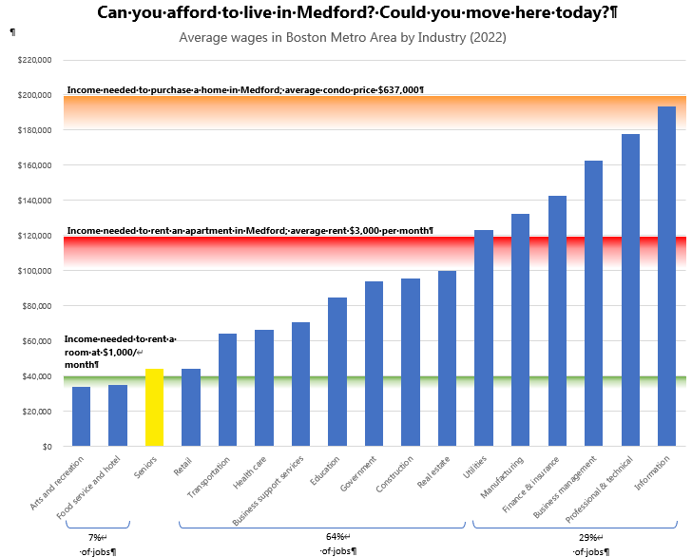
Notes:
This chart may be hard to read from where you are, but it illustrates how far out of reach housing is becoming in Medford.
The blue columns represent the average wage for each industry in the greater Boston region. The yellow column represents the average income of senior-headed households.
The orange row shows the income needed to be able to afford the average priced condo. Red shows the income needed to be able to afford the average market rate rent in Medford, and the green line is the income needed to be able to afford to rent a room.
There are no industries for which the average income is sufficient for a single income household to be able to buy a condo in Medford. About 29% of jobs pay enough to afford market rent on one income but homeownership would be out of reach.
About 64% of jobs pay less than what is needed to be able to afford rent on one income. This is why we see so much of our housing stock being occupied by roommates. In fact, apartments are priced under the assumption that each bedroom will rent to one of these workers. This puts families with children – especially single-parent families at a severe disadvantage.
About 7% of jobs pay less than a person needs to be able to rent a room.

Slide 13
What is Affordable Housing?
Naturally-occurring affordable housing: housing that is less expensive than typical market-rate units but is not protected or guaranteed.
Affordable Housing: Should cost less than 30% of the income of households who earn below a specific level. Rent is typically below market rent. AHT is providing financial assistance to developers to create Affordable Housing.
Inclusionary/40B Development: Some units in mixed income developments are priced to be affordable to low/moderate income households (typically 80% AMI)
Subsidized Housing: A portion of rent is covered through government funding. Rent is based on income.
Notes:
Now I will turn to talk about affordable housing, and what resources we currently have to address this need. First we will start with some definitions.
Naturally occurring affordable housing is really just housing that has depreciated in value. When it changes hands, or the owner invests in repairs and updates, it will almost inevitably rise to market level.
“Affordable housing” is defined as housing that costs less than 30% of someone’s income. Since many households don’t have a high enough income to afford housing, as we saw earlier, some kind of housing program, subsidy, or restriction is needed so that lower income households can afford housing.
One method of creating affordable housing is to require a portion of new units being constructed to be priced at a level that lower income households can afford. This is what Inclusionary Zoning and Chapter 40B both aim to create.
AMI means Area Median Income. I will get into this more on the next slide.
The most deeply affordable housing is typically provided by housing authorities. The cost of rent is set at 30% of a household’s income no matter what their income is, and the government subsidizes the remaining cost. This may be provided through public housing or housing vouchers.

Slide 14
Income Limits
Household incomes that qualify for affordable or subsidized housing are based on income limits set by HUD.
Income limits and affordability levels for specific programs vary. The following are examples of common income thresholds for 2024/2025.
Household Size | ONE | TWO | THREE | FOUR | FIVE | SIX
30% AMI (most Public Housing or Section 8) | $34,300 | $39,200 | $44,100 | $48,950 | $52,900 | $56,800
60% AMI (“Deeply Affordable”) | $68,520 | $78,360 | $88,140 | $97,920 | $105,780 | $113,640
80% of AMI (“Affordable”) | $83,384 | $95,296 | $107,208 | $119,120 | $128,650 | $138,179
100% of AMI (“Moderate ” or “Workforce”) | $104,230 | $119,120 | $134,010 | $148,900 | $160,812 | $172,724
Notes:
Income limits define who housing is affordable for. Various programs set affordability at specific levels depending on the number of people in a household and specific program guidelines. These are based on median incomes for the greater Boston Region which is defined by HUD. This table shows examples of typical income limits.

Slide 15
Subsidized Housing Inventory (SHI)
851 public housing units
700 project-based Section 8 housing
289 40B developments
170 units in mixed income developments
30 units owned/managed by affordable housing organizations
49 units administered by DDS/DMH
Total of 2,089 units, or 8.12%
Not counted in Subsidized Housing Inventory
~987 Mobile Housing Vouchers administered by Medford Housing Authority
Notes:
The state maintains a list of housing units in every community that are affordable to households earning up to 80% AMI. This is called the Subsidized Housing Inventory. The state has set a goal that each community should have at least 10% of its housing eligible to include on this list.
What our affordable housing inventory looks like today:
Public housing units are those subsidized units I mentioned earlier. These are affordable to people at the 30% AMI level.
Mixed income developments are the affordable units included in private developments. 289 are in the Fellsway 40B development that was approved but not built yet. The remainder were created through development agreements that predate the Inclusionary Zoning ordinance (which has not yet created any units in its first five years. First two inclusionary developments are still in the permitting pipeline.) Additional 350 40B units are in the pipeline but won’t show up on the SHI until they are built. This will bring Medford up to 9.5% AMI. These are all affordable at the 80% AMI level.
Units owned/managed by affordable housing organizations have different levels of affordability and different styles or target populations.

Slide 16
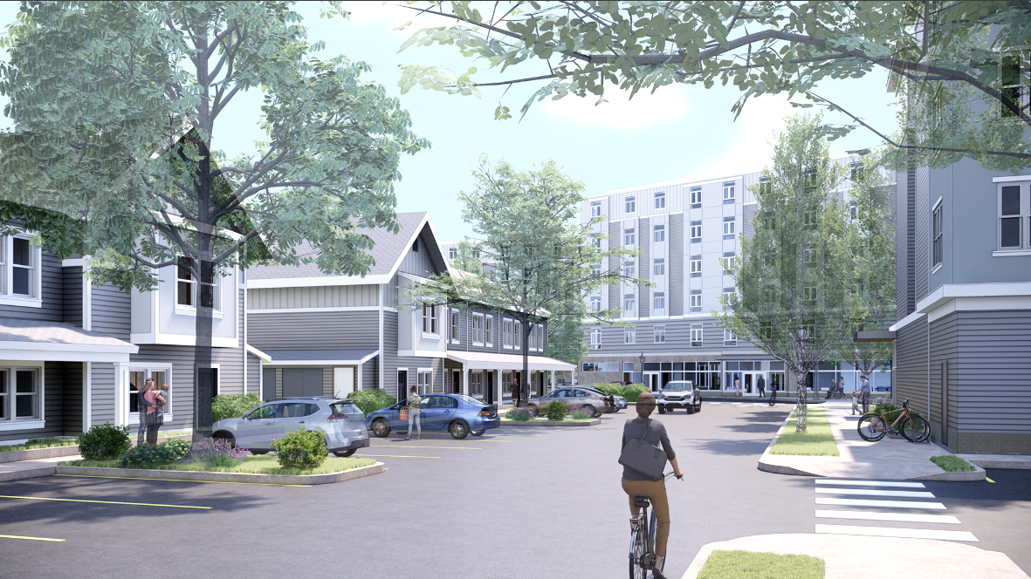
Existing Funding Resources
CPA total annual revenue
about $2M. Over 8 years City
has spent about $4M on
affordable housing
CDBG ($1.4M) and North
Suburban HOME Consortium
($2.3M among 8 communities)
Notes:
So far we have two sources of public money to support affordable housing development in Medford.
CPA is primarily local revenue which comes from a small surcharge on local property taxes, partially matched with state funds. About $2M per year since 2017 have been spent almost equally between 3 program areas.
CDBG and HOME are federal funds. CDBG pays for a number of programs and improvements that benefit low income people. Affordable housing is one category of what we can spend CDBG on. HOME funds are specifically for affordable housing. We share a $2.3M allocation among 8 communities that are part of the North Suburban HOME Consortium.

Slide 17
Action Plan

Slide 18
Mission Statement
To create and preserve community housing, including affordable homeownership and rental opportunities and other forms of housing assistance for low and moderate income residents in Medford.

Slide 19
Affordable Housing Trust Fund Goals
Promote a welcoming, diverse, intergenerational, and inclusive city with a mix of housing choices that offer diverse options to residents with varying needs and preferences.
Use financial and property resources to address local housing needs and meet production goals established in the housing production plan, and to preserve the affordability of existing affordable homes.
Foster safe, well-designed, accessible and sustainable housing. Integrate affordable and diverse housing options throughout the city.
Expand local capacity to implement housing initiatives by building partnerships with mission-driven organizations and developers seeking to build affordable housing.
Increase communication about housing resources across the community.

Slide 20
Priority Actions
Build affordable housing in partnership with mission-driven organizations and developers seeking to build affordable housing as well as Medford Housing Authority.
Preserve and convert existing housing to long-term affordability.
Support existing homeowners and first-time homebuyers.
Fund housing stability programs.
Prioritize funding for units affordable to households with lower incomes.

Slide 21
Priority Actions cont.
Build a relationship with the Community Preservation Committee.
Advocate for affordable housing development and policies that maximize the resources available to meet the city’s housing needs.
  Explore and act upon funding opportunities for the Trust
  Work with developers to build support and navigate approval process
  Work with partner organizations to establish programs that meet local needs
  Support initiatives to expand tenant protections and stabilize existing tenancies
  Provide guidance on affordable housing projects funded through CPA program

Slide 22
AHTF Potential Revenue Sources
Anticipated Resources
Community Preservation Act
Inclusionary Zoning Ordinance
Linkage Payments
Negotiated Developer Payments
Other potential sources
PILOT
Appropriations
Special ordinance
Voluntary donations and contributions
Loan payments and resale of affordable units
Affordable housing resale fee
Other municipal revenues
Real estate transfer fee
Sale of City-Owned Properties

Slide 23
Next Steps
Email comments to kbuckingham@medford-ma.gov by August 7
Present the Action Plan at City Council in September
Monthly Affordable Housing Trust Meetings on the first Wednesday of each month
Support initiatives when they come up
If you want to get involved there is an open seat on the AHT Board

Slide 24
Questions?

Slide 25
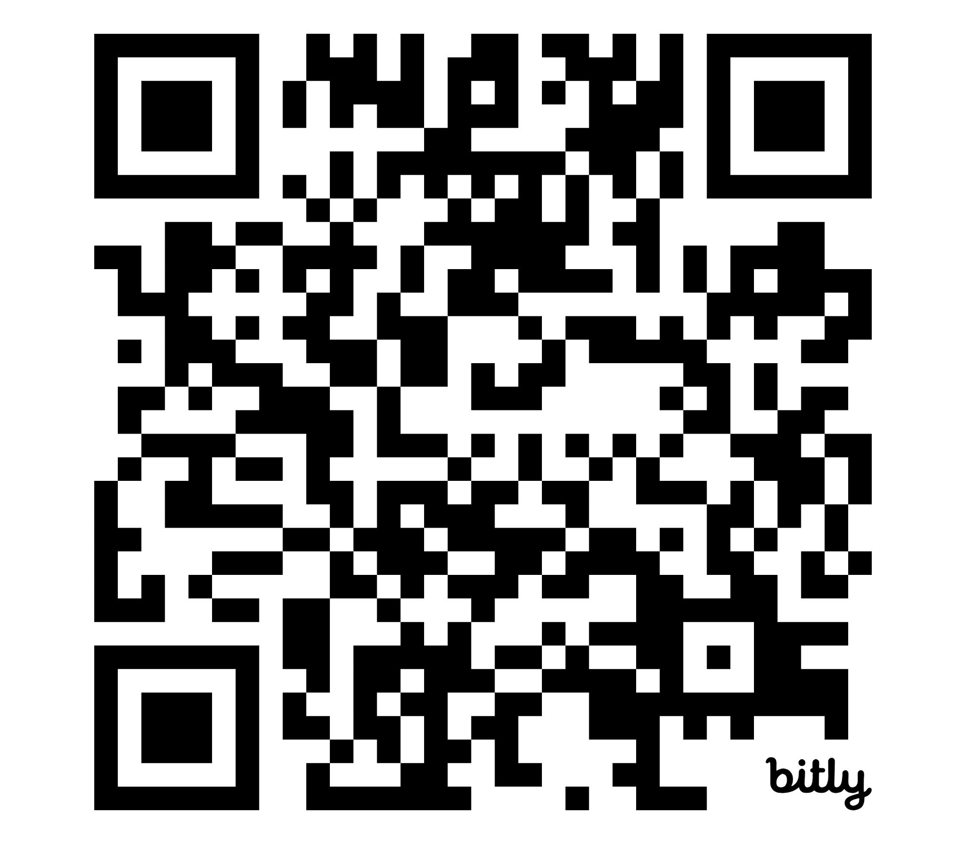
Thank You
For further questions, email kbuckingham@medford-ma.gov
OR Type the URL
bit.ly/AHTFund

