Slide 1
Back of the Net
Travel
August 2025

Slide 2
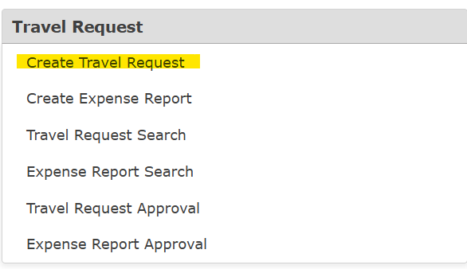
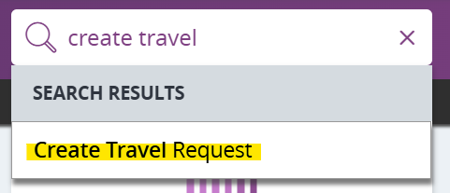
Put Your Best Foot Forward
  All Travel will need to go through ERP via Travel Request
  From your Entry Point go to Travel Request and then Create Travel Request or search travel in the search bar

Slide 3
Don’t Miss Kick-Off
  To ensure all travel paperwork is complete and approved by all appropriate staff, please start your Travel Request at least 21 business days in advance of the Travel
  All Travel Requests MUST be in the Travel department no later than 5 business days in advance of the Travel
    If submitted late, travel will be processed as time permits
      But no travel advances can be made
    The traveler needs to be prepared to pay out of pocket and be reimbursed after the trip

Slide 4
Starting XI
  All travel costs will be encompassed in this travel request
    No need to do separate POs for registration, air fare or rental car
  A Travel Tool is available on the Travel website
    This can be used to assist in determining allowable costs
    Travel Recommendation: Your traveler fills out the Travel Tool prior to you entering the Travel Request.

Slide 5
Employee Travel

Slide 6
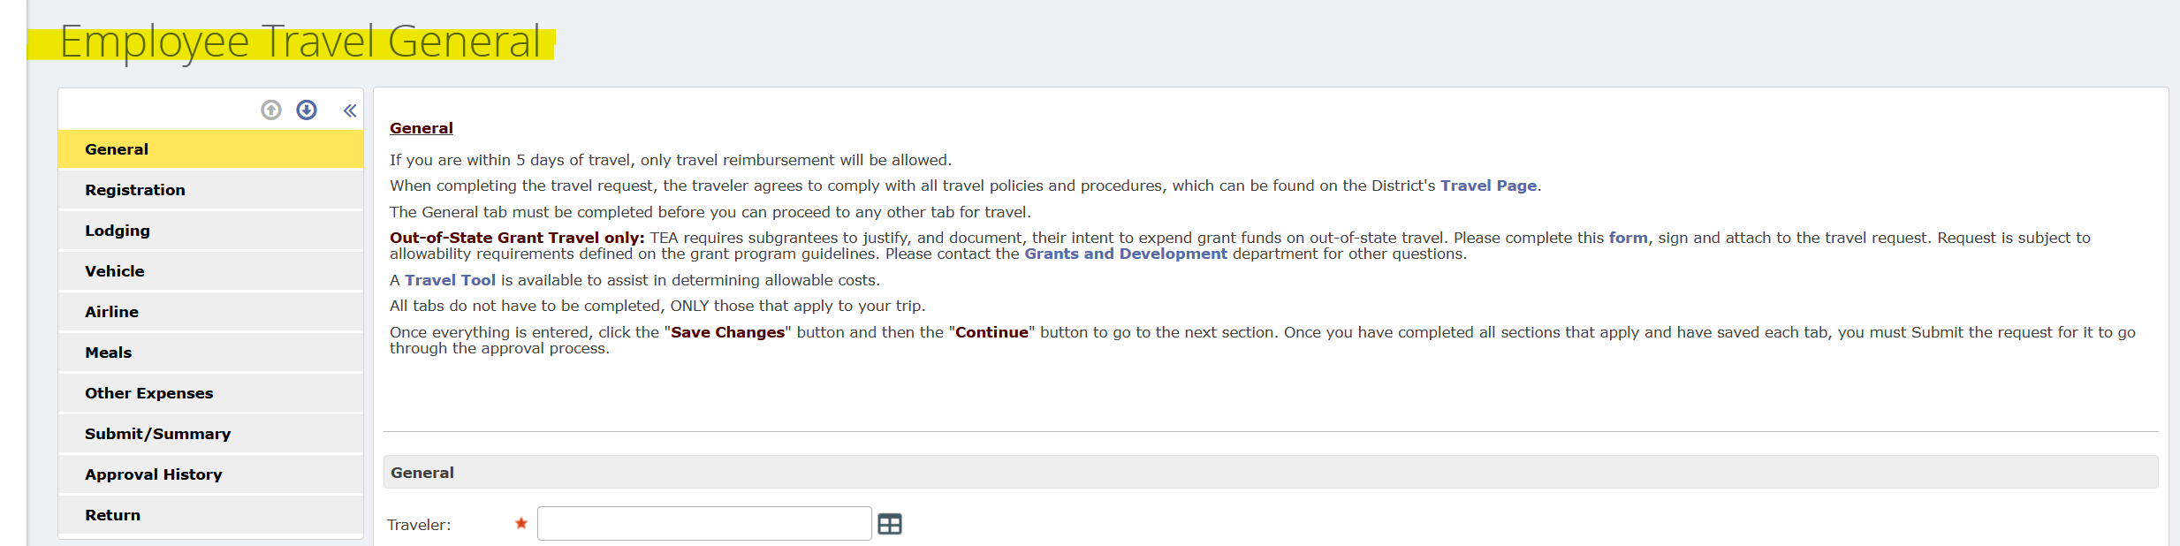
General Tab
All Employee, Student, Athletics, Board Member Travel Requests will start on the Employee Travel General

Slide 7
General Tab
The General Tab must be completed first. The following information will be needed:
  Name of Traveler
  Activity (Conference/Class Name)
  Destination – State and City (Please use the city of the class/conference, not the closest big city)
  Departure Date and Time – Meal Allowances will be determined by the departure time
    For travel by air, the departure time will be 2 hours before the flight

Slide 8
General Tab
The following information will be needed (cont):
  Return Date and Time – Meal Allowances will be determined by the departure time
    For travel by air, the return time will be 2 hours after the flight
  Will an advance of expenses be expected?
    The travel request must be entered at least 5 days before the travel to allow for an advance

Slide 9
General Tab
The following information will be needed (cont):
  Account Type
    Non-Employee – Key Officials and Board Members
    Employee – All FWISD employees traveling without students
    Employee/Student – Athletics
    Student – All other student Travel
  Budget Number
    This budget number will transfer to all tabs

Slide 10
General Tab
Once the General Tab has been completed, select:
  Save Request
  Continue

Slide 11
General Tab
Once Continue has been selected, ERP will go to the next tab.
Each tab begins with:
Do you need to enter __________?
If you select Yes, you will fill out that tab
If you select No, ERP will go to the next tab

Slide 12
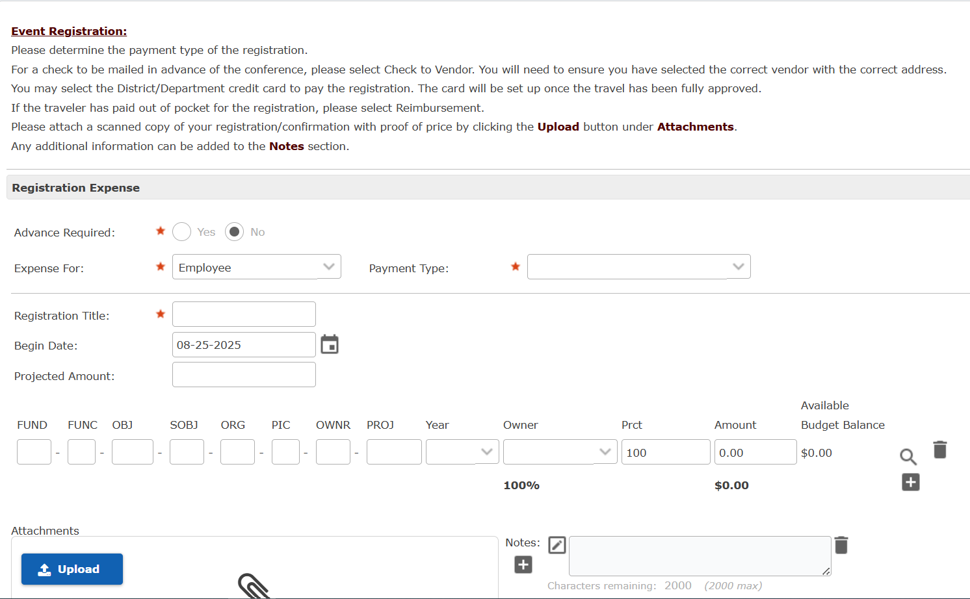
Registration Tab

Slide 13
Registration Tab
Advance Required
  Typically an advance will not be required for registration
Expense For
    Non-Employee – Key Officials and Board Members
    Employee – All FWISD employees traveling without students
    Employee/Student – Athletics
    Student – All other student Travel

Slide 14
Registration Tab
Payment Type
  Employee Credit Card
    Only use if the employee has a FWISD credit card in their name
  District Credit Card – do not use
  Department Credit Card
    Will allow you to select a Travel/AP card in your possession
  Reimbursement
    If the traveler has paid in Advance
  Check to Vendor

Slide 15
Registration Tab
Payment Type
  Check to Vendor – usually needed if the registration needs to be pre-paid
    Enter Vendor Name and Remit to
    Route To
      Send to vendor – will mail directly to the vendor
      Hold for Pickup – if your traveler needs to take the check to the conference
      Return to Requester – to send the check to the campus/department
  Needed by date

Slide 16
Registration Tab
Projected Amount
  Enter amount of registration
Budget Number
  This will be completed if the account number was entered on the General tab, but it can be changed
  Can be charged to multiple budgets
    For multiple budgets, please enter the amount to be charged to each budget

Slide 17
Registration Tab
Upload
  Please attach completed registration/confirmation that shows name of attendee and price
Notes
  Please add any additional information that is needed
If your traveler is attending more than one conference during the same time, Save and Add/Edit another
Select Save and Continue to go the next tab

Slide 18
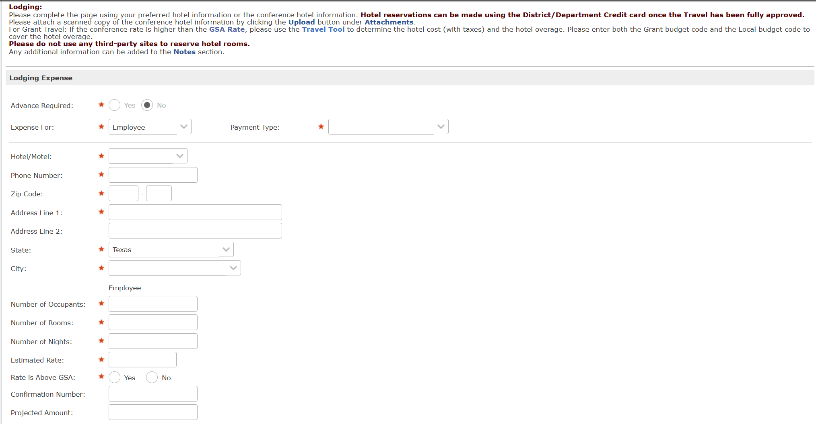
Lodging Tab

Slide 19
Lodging Tab
Advance Required
  Typically an advance will not be required for Lodging
Expense For
    Non-Employee – Key Officials and Board Members
    Employee – All FWISD employees traveling without students
    Employee/Student – Athletics
    Student – All other student Travel

Slide 20
Lodging Tab
Payment Type
  Employee Credit Card
    Only use if the employee has a FWISD credit card in their name
  District Credit Card – do not use
  Department Credit Card
    Will allow you to select a Travel/AP card in your possession
  Reimbursement
    If the traveler has paid in Advance
  Check to Vendor

Slide 21

Lodging Tab
Hotel/Motel – select Other
Enter Other Hotel/Motel Name
Phone Number, Zip and Address – can be found on the hotel website
Number of Occupants – if more than one occupant per room, please add names of people sharing the room in the Notes

Slide 22
Lodging Tab
Number of Rooms – typically for student or Athletic travel
Number of Nights
Estimated Rate – please make sure to include taxes
Rate is above GSA
  The GSA rate can be found on the Travel Tool

Slide 23
Lodging Tab
Hotel
Conference proof must be uploaded to the Lodging tab
    This is typically found on the conference website, but an email from the conference will work

Slide 24
Lodging Tab
Hotel
In the event that a conference hotel rate exceeds the allowable rate, travelers are required to reimburse the District the difference between the hotel rate and the allowable rate if conference hotel rate confirmation documentation is not provided to the Purchasing department.
From the Travel Manual:
  Hotel advance/reimbursement shall be for actual conference/convention rates at designated conference/convention hotels or for the most reasonable accommodations available pursuant to District practices and procedures and in accordance with the Texas Comptroller of Public Accounts (Texas Mileage Guide).
  Unauthorized or disapproved costs and expenses incurred by an employee become the sole responsibility of that employee and shall not be paid or reimbursed by the District. The final approval or disapproval of the business office may be reviewed by the Superintendent or designee(s).

Slide 25
Lodging Tab
Hotel
Example: The traveler is attending a conference in Houston:
GSA Rate – federal/state government rate = $135
Conference Rate – rate contracted by the conference/convention with a hotel = $215
Rate Paid – the amount over the maximum documented conference hotel rate = $265
  If the traveler does not provide conference/convention documentation, the traveler will owe for the amount over the GSA Rate - $80 + $50 per night plus applicable taxes. If it is a documented conference/convention hotel, the traveler will owe $50 per night plus applicable taxes.

Slide 26
Lodging Tab
Confirmation Number
  Please do not make reservations until the travel request has been completely approved
  Should be added when the Actual expenses are reconciled
  The assigned travel card can be used to make the reservation
  If a deposit is required, please make that into the Notes so the card can be set up for that deposit in advance
Projected Amount
  From the Travel Tool

Slide 27
Lodging Tab
Projected Amount
  From the Travel Tool
Please do NOT use any third party sites to reserve hotel rooms. They will charge your card at the time of reservation and will not be able to take the state taxes off.

Slide 28
Lodging Tab
Budget code
  This will be completed if the account number was entered on the General tab, but it can be changed
  Can be charged to multiple budgets
    For multiple budgets, please enter the amount to be charged to each budget
For Grant travel, the grant will only pay the GSA rate, a 199 budget must be provided
  The Travel Tool can assist with the amount necessary for the hotel overage

Slide 29
Lodging Tab
Upload
  Please attach conference hotel proof
Notes
  Please add any additional information that is needed
If your traveler is staying at another hotel during the same trip, Save and Add/Edit another
Select Save and Continue to go the next tab

Slide 30
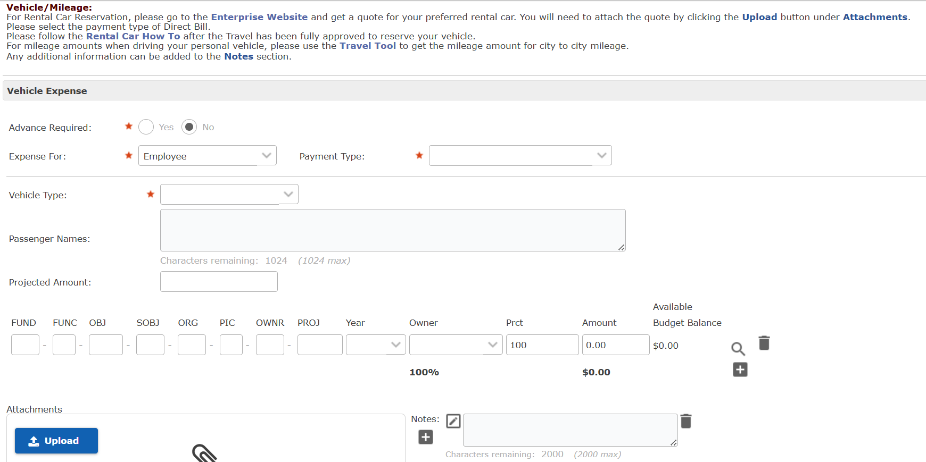
Vehicle/Mileage Tab

Slide 31
Vehicle/Mileage Tab
No advance allowed for Mileage
Expense For
    Non-Employee – Key Officials and Board Members
    Employee – All FWISD employees traveling without students
    Employee/Student – Athletics
    Student – All other student Travel
Payment Type
  Reimbursement – for driving personal vehicle
  Direct Bill – for rental cars

Slide 32
Vehicle/Mileage Tab
Vehicle Type
  Personal – traveler will drive their personal vehicle
  Projected Mileage
    The Travel Tool can assist with providing the amount of miles and ERP will calculate the amount for mileage
  Mileage will be reimbursed at the full amount – No gas/fuel expenditures are allowed on the travel card

Slide 33
Vehicle/Mileage Tab
Vehicle Type
  Rental – please follow all Rental Car instructions on the Travel website
Rental Company
  Enterprise
Confirmation Number
Projected amount – from the confirmation

Slide 34
Vehicle/Mileage Tab
Passenger Names
  If travelers will be riding together, please list all names
Budget code
  This will be completed if the account number was entered on the General tab, but it can be changed
  Can be charged to multiple budgets
    For multiple budgets, please enter the amount to be charged to each budget

Slide 35
Vehicle/Lodging Tab
Upload
  Please attach rental car confirmation
Notes
  Please add any additional information that is needed
If your traveler is renting more than one car during the same trip, Save and Add/Edit another
Select Save and Continue to go the next tab

Slide 36
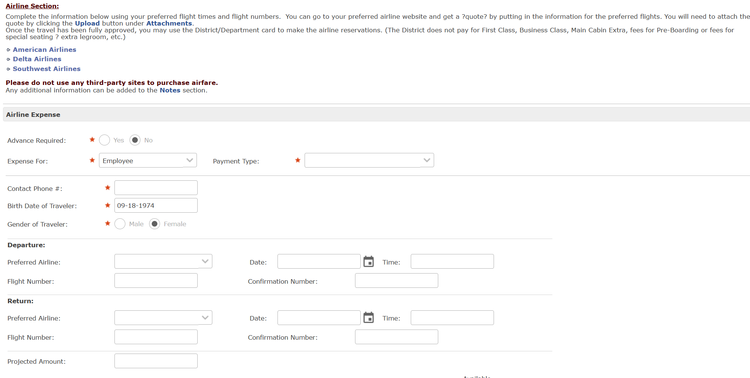
Airline Tab

Slide 37
Airline Tab
Please do not make any airline reservations until the travel request is completely approved
To get a “quote” go to www.aa.com, www.delta.com or www.southwest.com, whichever carrier you prefer and select the flights (just like if you were personally traveling). Don’t put anything on hold, but print the price to attach in ERP

Slide 38
Airline Tab
Expense For
    Non-Employee – Key Officials and Board Members
    Employee – All FWISD employees traveling without students
    Employee/Student – Athletics
    Student – All other student Travel

Slide 39
Airline Tab
Payment Type
  Employee Credit Card
    Only use if the employee has a FWISD credit card in their name
  District Credit Card – do not use
  Department Credit Card
    Will allow you to select a Travel/AP card in your possession
  Reimbursement
    If the traveler has paid in Advance

Slide 40
Airline Tab
Contact Phone number – traveler cell phone number
Birth Date of Traveler
Gender of Traveler

Slide 41
Airline Tab
Departure
Preferred airline
Flight number
Date
Time
Confirmation number
  Should be added when the Actual expenses are reconciled

Slide 42
Airline Tab
Return
Preferred airline
Flight number
Date
Time
Confirmation number
  Should be added when the Actual expenses are reconciled

Slide 43
Airline Tab
Budget code
  This will be completed if the account number was entered on the General tab, but it can be changed
  Can be charged to multiple budgets
    For multiple budgets, please enter the amount to be charged to each budget

Slide 44
Airline Tab
Upload
  Please attach “quote from major airline website
Notes
  Please add any additional information that is needed
If your traveler needs more than one flight during the same trip, Save and Add/Edit another
Select Save and Continue to go the next tab

Slide 45
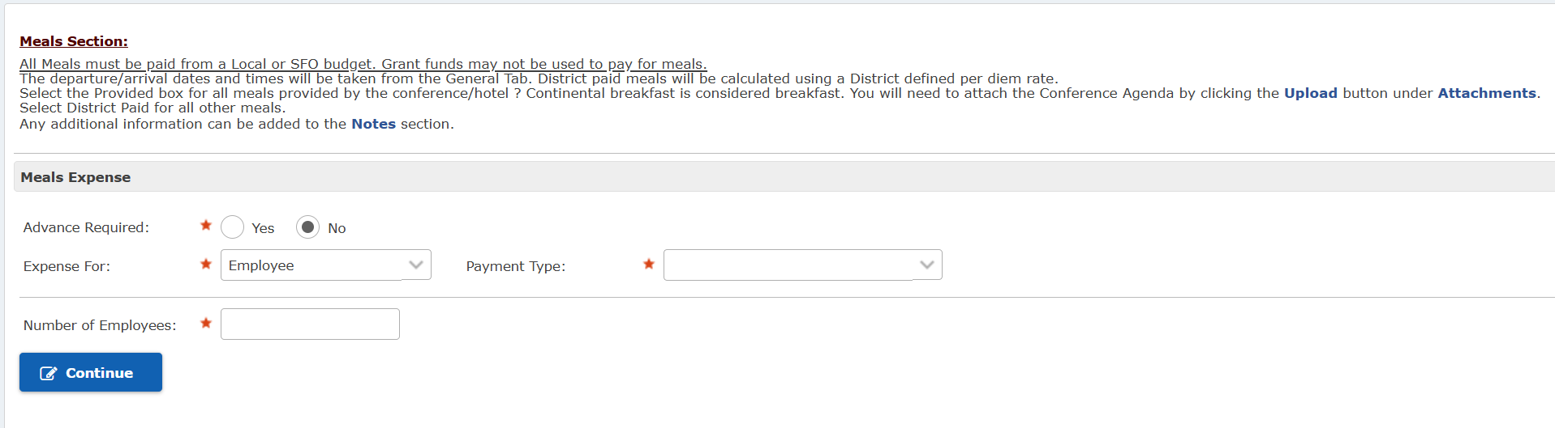
Meals Tab

Slide 46
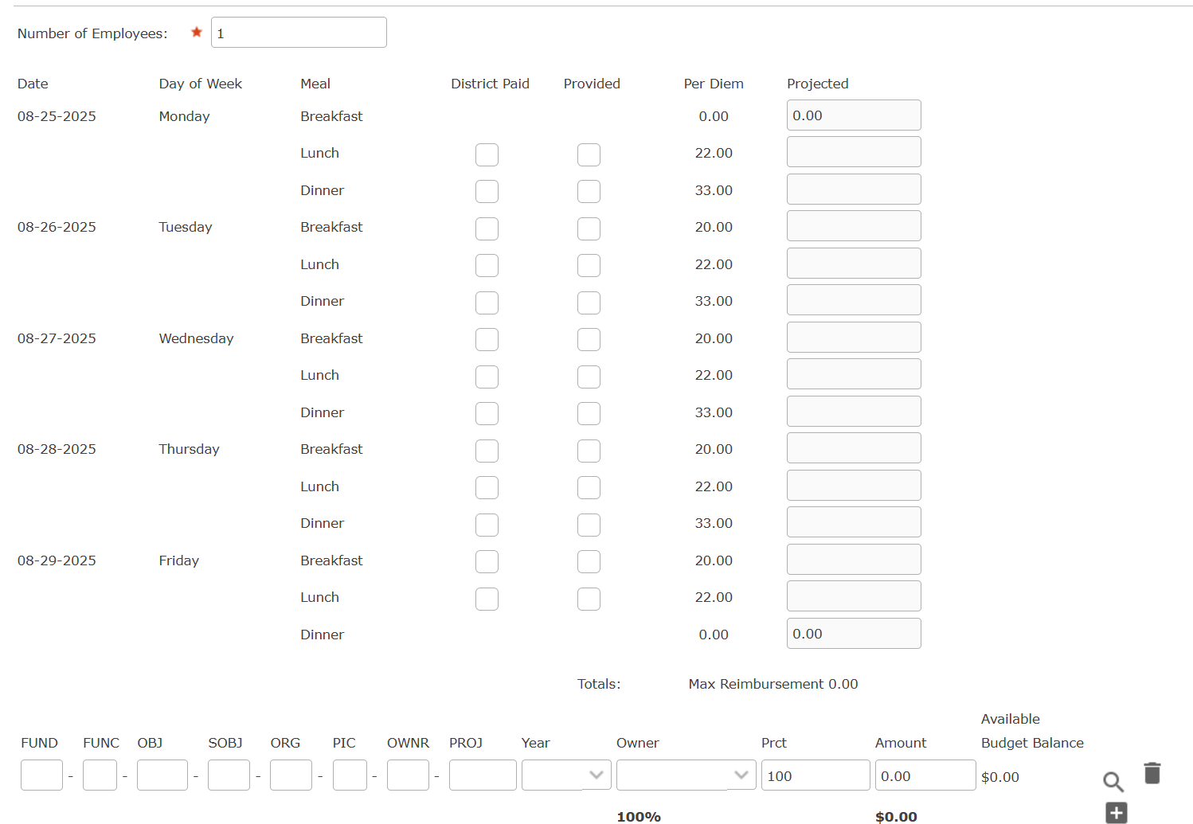
Meals Tab

Slide 47
Meals Tab
All meals must be paid from a Local or SFO budget
District paid meals will be calculated using a District defined per diem rate
An advance via direct deposit will be issued if the travel is entered at least 5 days in advance of the travel
  ATM Fees will no longer be necessary

Slide 48
Meals Tab
The dates and times from the General tab will determine which meals are allowed during the travel.
Select District paid, if the District will pay the traveler
Select Provided, if the conference/class/hotel is providing the meal

Slide 49
Meals Tab
Budget code
  This will be completed if the account number was entered on the General tab, but it can be changed
  Can be charged to multiple budgets
    For multiple budgets, please enter the amount to be charged to each budget

Slide 50
Meals Tab
Upload
  Please attach conference agenda
Notes
  Please add any additional information that is needed
Select Save and Continue to go the next tab

Slide 51
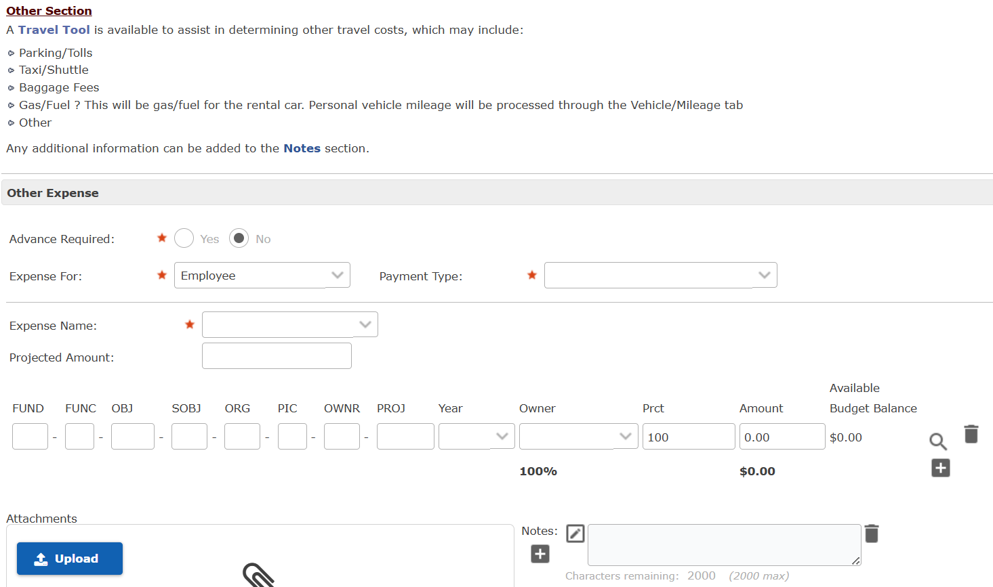
Other Tab

Slide 52
Other Tab
Advance Required - No
Expense For
    Non-Employee – Key Officials and Board Members
    Employee – All FWISD employees traveling without students
    Employee/Student – Athletics
    Student – All other student Travel

Slide 53
Other Tab
Payment Type
  Employee Credit Card
    Only use if the employee has a FWISD credit card in their name
  District Credit Card – do not use
  Department Credit Card
    Will allow you to select a Travel/AP card in your possession
  Reimbursement
    If the traveler has paid in Advance

Slide 54
Other Tab
Other Expenses
Parking/Tolls
Taxi/Shuttle
Baggage Fees
Gas/Fuel – for rental car
Other

Slide 55
Other Tab
Baggage Fees – usually $80 per round trip – $40 /bag – more can be entered if needed
Gas/Fuel – please estimate how much gas will be necessary
When determining other costs, please take into account, hotel parking costs, city travel to, expected tolls, etc

Slide 56
Other Tab
Budget code
  This will be completed if the account number was entered on the General tab, but it can be changed
  Can be charged to multiple budgets
    For multiple budgets, please enter the amount to be charged to each budget

Slide 57
Other Tab
Upload
  Please attach any necessary information
Notes
  Please add any additional information that is needed
Only one Expense Name can be added at a time. If multiple other expenses are needed, select Save and Add/Edit Another
Once completed, select Save and Continue to go the next tab

Slide 58
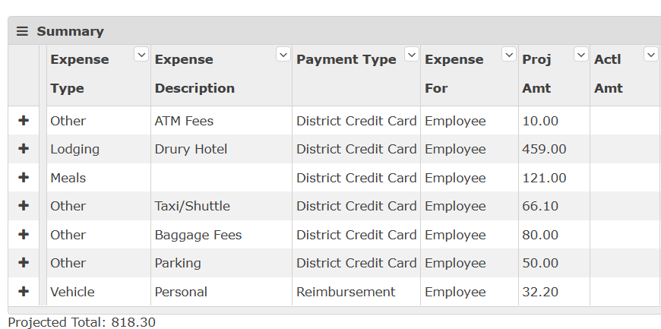
Submit/Summary Tab
Please review the Summary of costs

Slide 59
Submit/Summary Tab
Verify amounts, payment types, account numbers, etc
Once complete, select Submit
The Travel Request will follow the travel workflow for all approvals – no paper needed

Slide 60
Travel Department
The travel department will review the fully approved travel. If airline tickets are needed to be purchased or hotel deposit made, the card will be set up immediately and will notify the traveler and person who entered the travel request.
Otherwise, the card will be set up 5 days in advance of the travel

Slide 61
Travel Department
All travel cards will be housed at the campus/department
Each campus/department will store all cards where they can be locked up
Please create a system to know who has been issued which card, when the card was picked up and returned.

Slide 62
Student/Athletics Travel

Slide 63
Student Travel
When entering student travel, you will need to select Account type of Students
You will need to enter the number of students traveling on the Meals tab and the number of hotel rooms on the Lodging tab.

Slide 64
Athletics Travel
When entering student travel, you will need to select Account type of Employee/Student
You will need to enter the number of students traveling on the Meals tab and the number of hotel rooms on the Lodging tab.

Slide 65
Student/Athletics Travel
Difference between the types
  Athletic department has designated a meal amount per student

Slide 66
Expense Reports

Slide 67
Expense Reports
After the trip, the person who entered the travel request will have to enter all the actual costs on the Expense report.

Slide 68
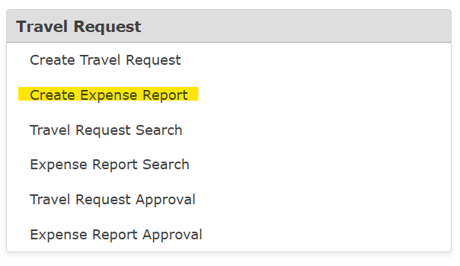
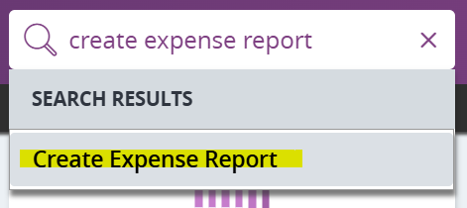
Expense Reports
  All Travel expenses will need to be reconciled in ERP via
  Expense Report
  From your Entry Point go to Travel Request and then Create Expense Report or search travel in the search bar

Slide 69
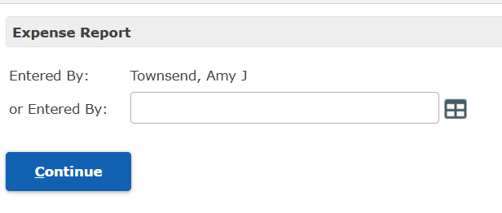
Expense Reports
On the Search Screen, enter the name of the person who entered the Travel Request
Then Select Continue
Requestor Name

Slide 70
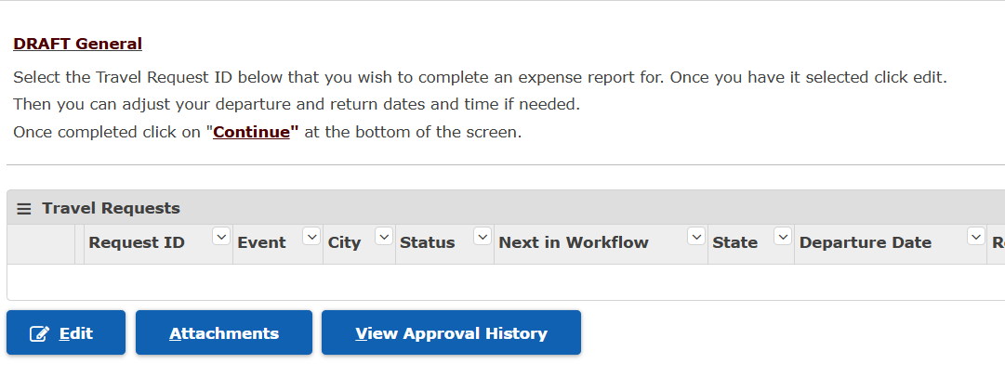
General Tab
  Select Travel Request
  Then Edit

Slide 71
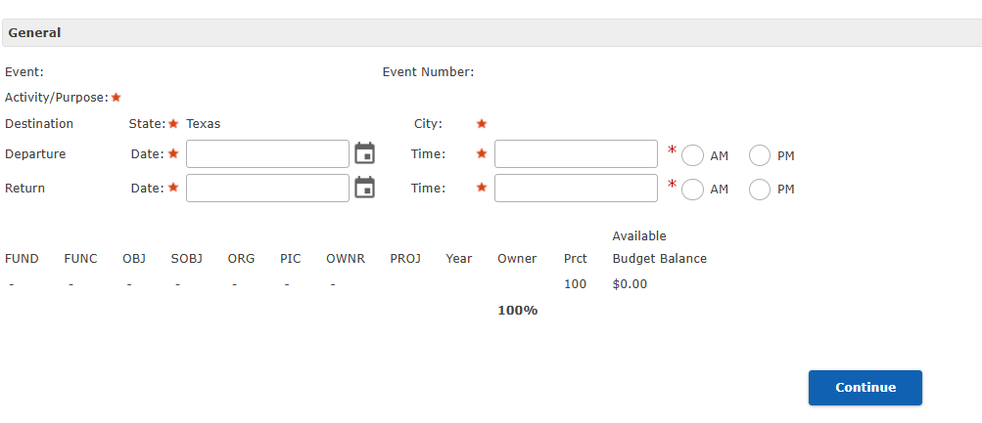
General Tab
  Verify/Change Departure and Return dates and times – only change if times change
  Verify the budget code
  Select Continue

Slide 72
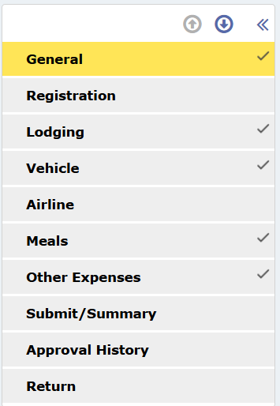
Expense Reports
Select each checked tab
ERP will ask Do you need to enter ________?
If you select Yes, you will go to that screen
If you select No, you will not go that screen

Slide 73
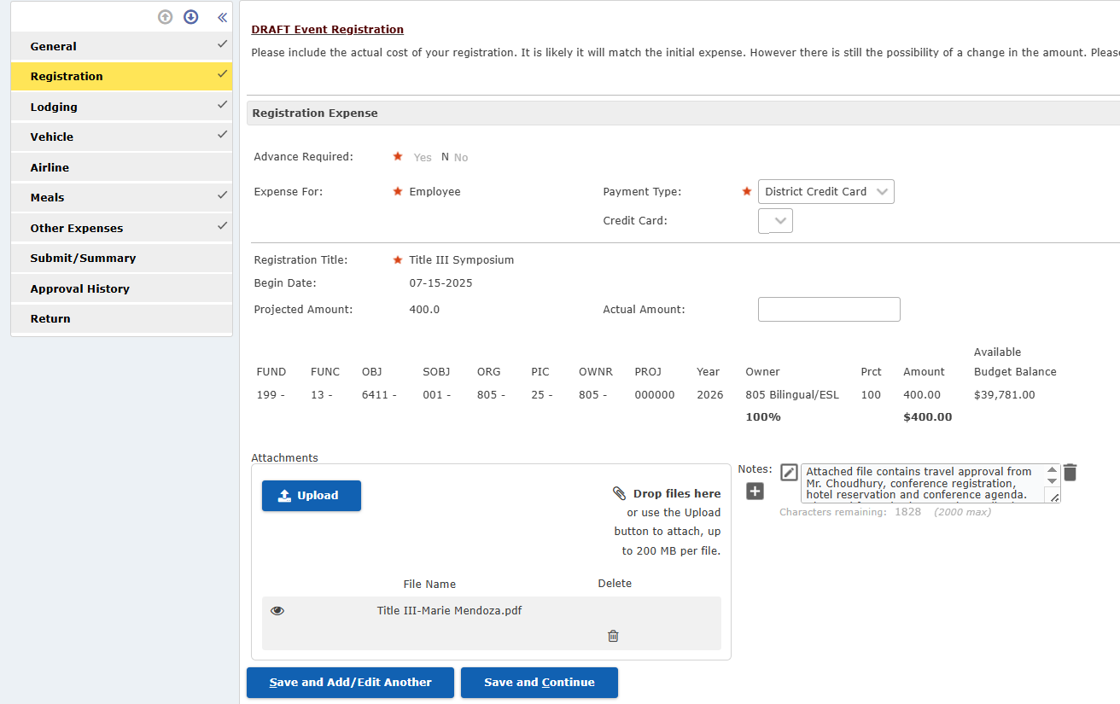
Registration Tab
  Add the Actual Amount of the Registration – even if the amount is the same
  Upload any new documents
  Add Notes for any new details
  Select Save and Continue
400.00

Slide 74
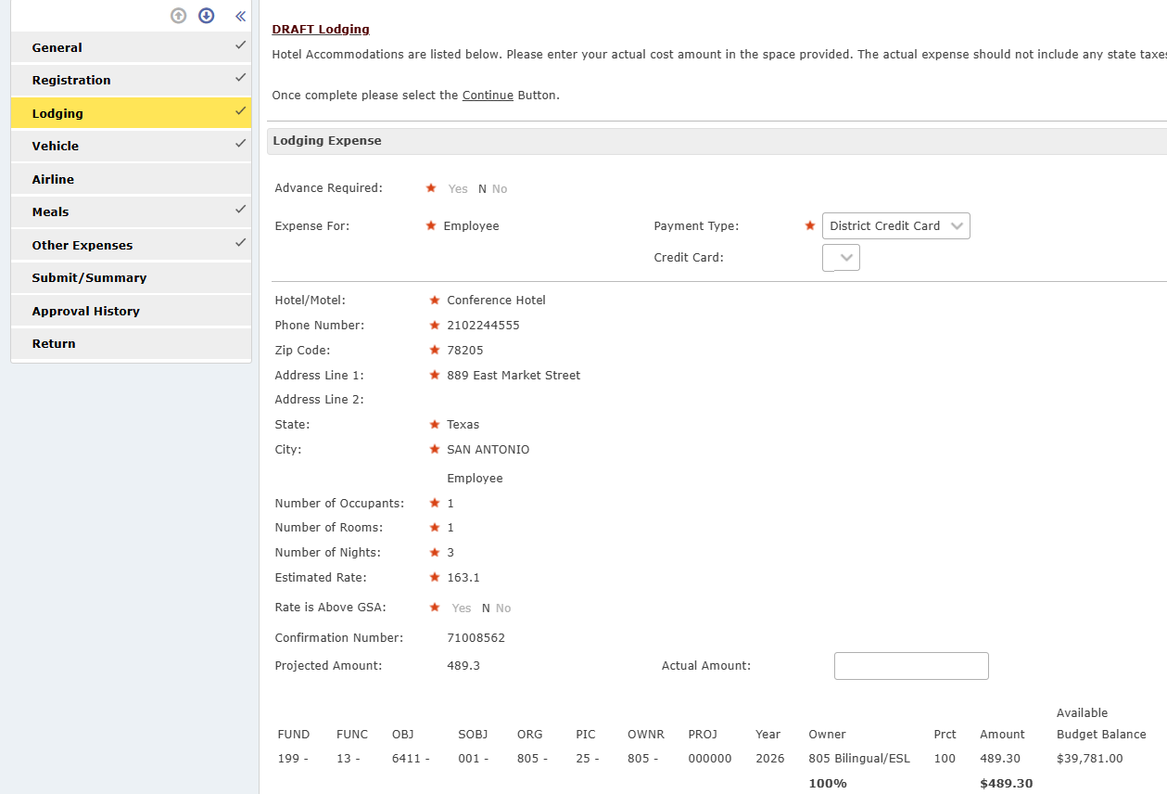
Lodging Tab
  Add the Actual Amount of the Lodging – even if the amount is the same
  If Parking is included, remove that amount from the total – it will go on other expenses
  Upload the hotel folio
  Add Notes for any new details
  Select Save and Continue
450.00

Slide 75
Vehicle Tab
Personal Vehicle
  If your traveler drove their vehicle, the actual amount will be the same amount as the mileage
  If they did not drive, the actual amount will be zero

Slide 76
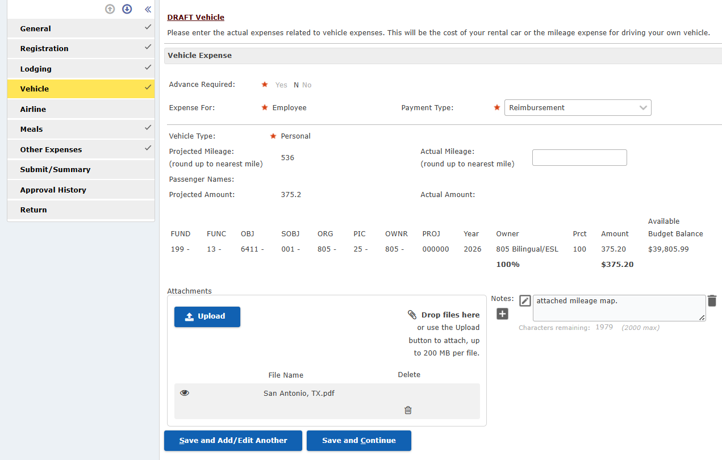
Vehicle Tab
  Add Notes for any new details
  Select Save and
  Continue
536

Slide 77
Vehicle Tab
Rental Car
  If your traveler used a rental car, you will enter the amount of the rental car cost in the Actual Amount field
  Upload a copy of the rental car bill

Slide 78
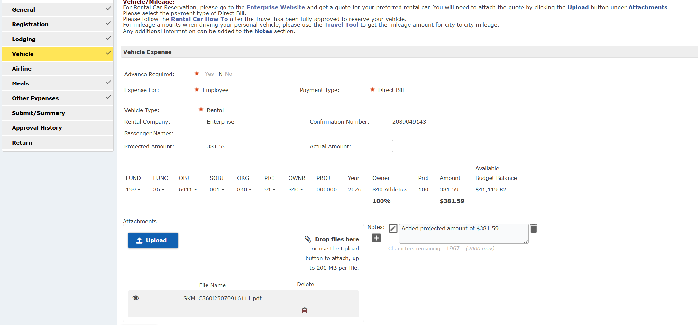
Vehicle Tab
Rental Car
  Add Notes for new details
  Select Save and
  Continue
352.78

Slide 79
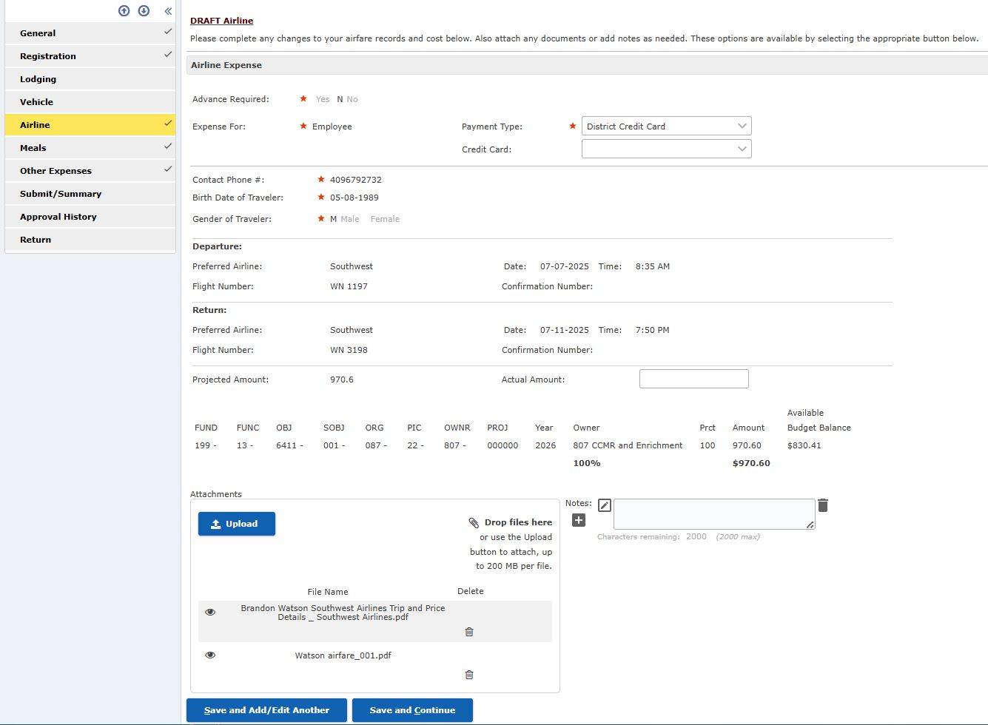
Airline Tab
If the traveler uses the travel card for airline tickets, please enter the actual amount of the ticket in the Actual Amount field.
Upload itinerary with name of traveler and price of ticket
Select Save and Continue
970.60

Slide 80
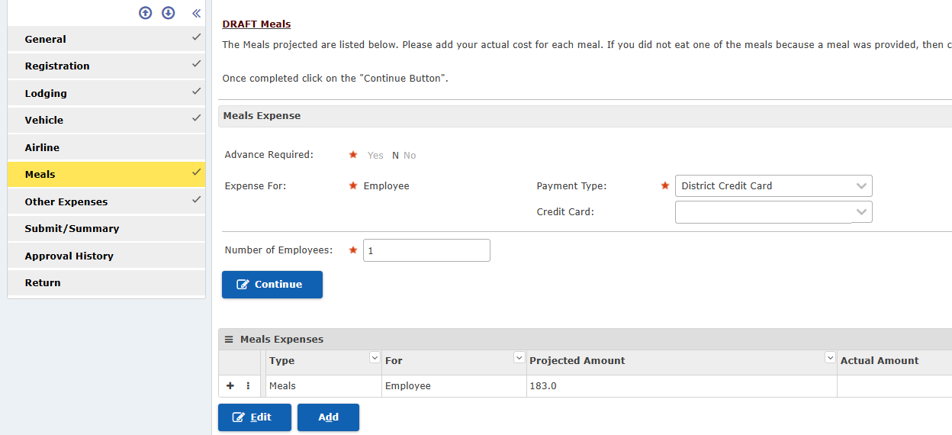
Meals Tab
If the traveler was advanced meals for travel
Select Continue

Slide 81
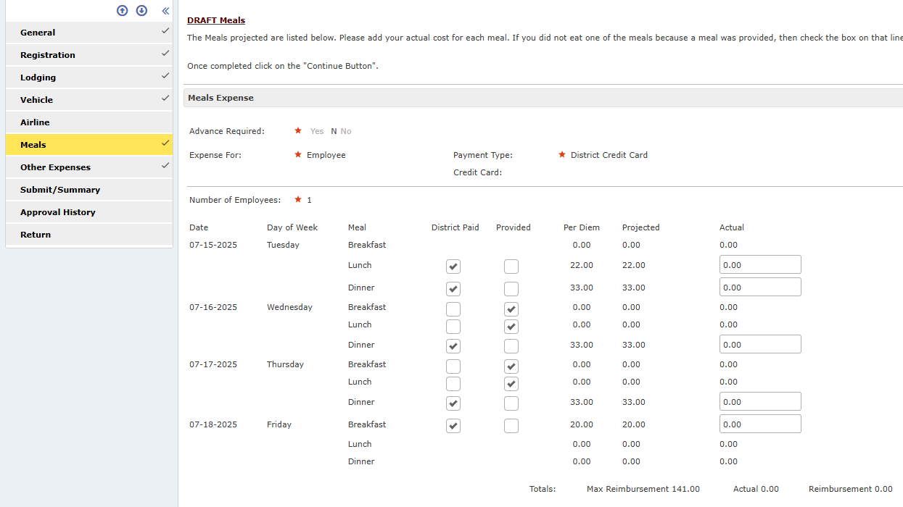
Meals Tab
If any additional meals were provided, by the hotel or the conference/class, please check the correct box – District paid or Provided
Then put the Actual
amounts (the same as the
Projected amount) in the
Actual column

Slide 82
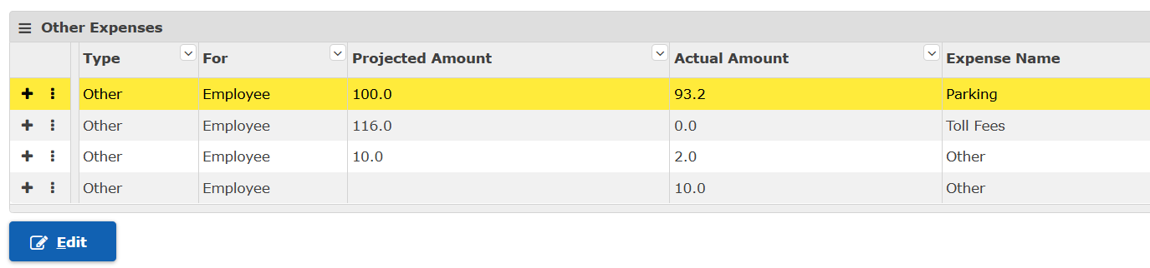
Other Tab
There may be multiple Other Expenses
Go to the bottom of the Other tab and select the line
Select Edit
Each type of expense will need to be reviewed and saved

Slide 83
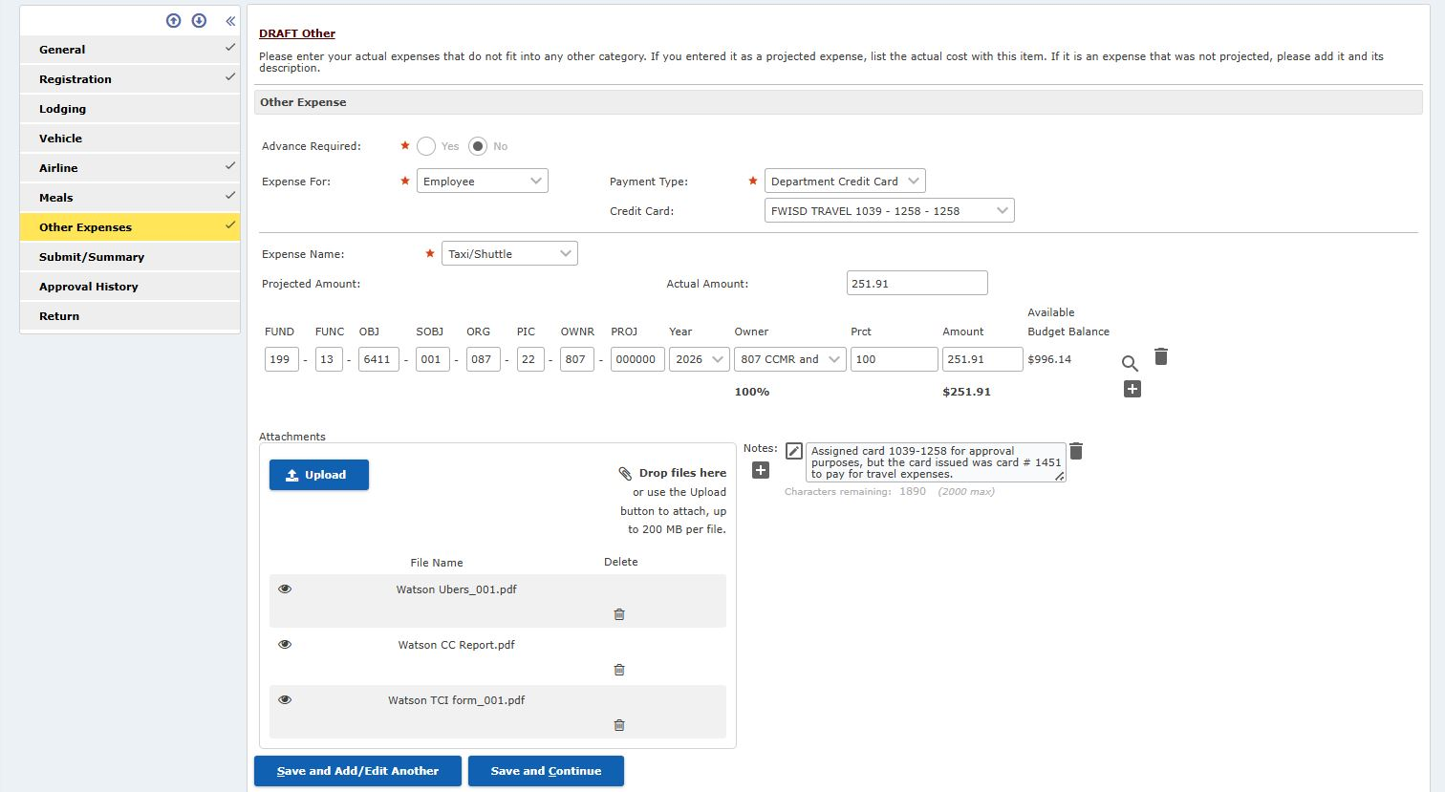
Other Tab
Please enter the actual amounts for each expense
Upload receipts for all charges made on the travel card

Slide 84
Other Tab
When reconciling other expenses, please be sure to edit all projected expenses. To edit a new other expense, select a new expense and select Edit
Once all projected expenses have been reconciled, select Save and Continue
Upload the completed Travel Card Agreement – with any Other expense category
Add Notes for any additional details

Slide 85
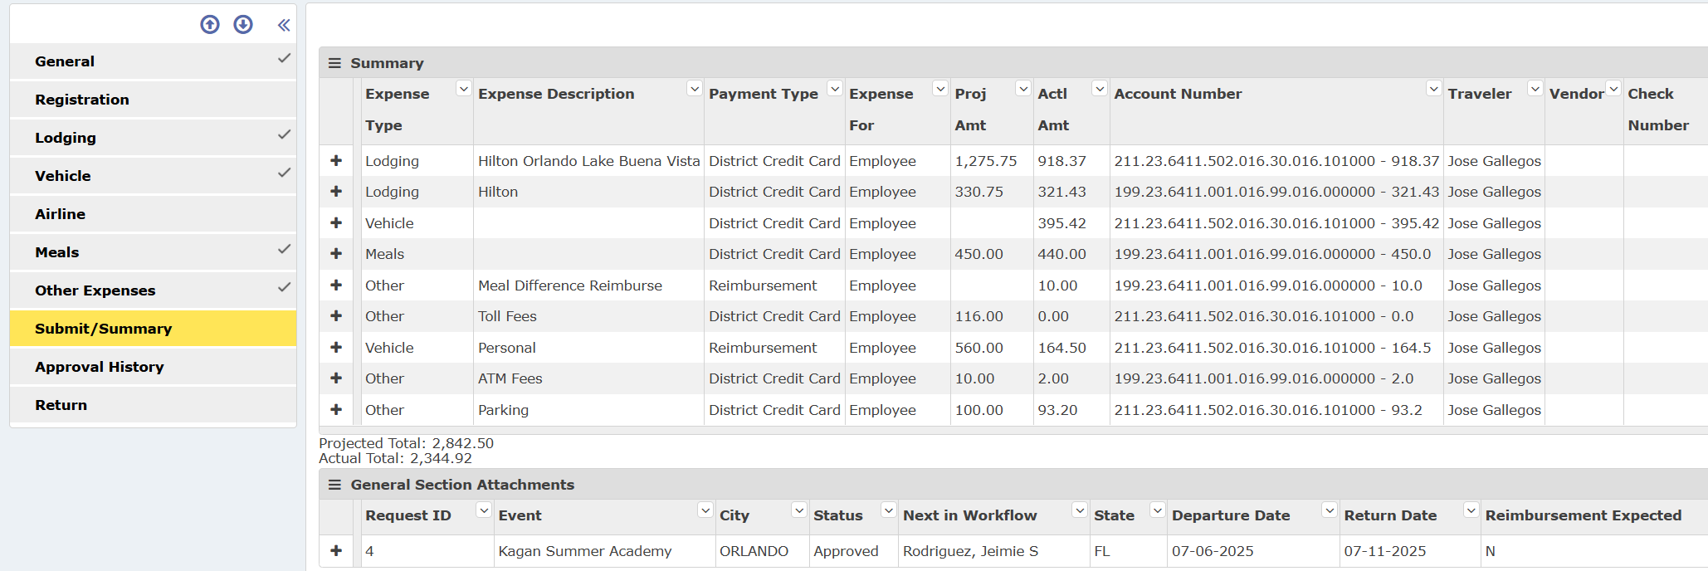
Submit/Summary Tab
Please review the Summary of costs

Slide 86
Submit/Summary Tab
Verify amounts, payment types, account numbers, etc
Once complete, select Submit
The Expense Report follow the travel workflow for all expense approvals – no paper needed

Slide 87
Travel Department
The travel department will review the fully approved expense reports for completeness and allowability.
Travel will make necessary changes and submit

Slide 88
Things to Remember

Slide 89
Things to Remember
Every campus/department should have a primary point of contact for their travelers – Travel Liaison
  Someone who Travel will communicate with when there are changes
  Someone at the campus/department to fill out the travel request in ERP

Slide 90
Things to Remember
Begin travel process as EARLY as possible
Travel requests must be submitted for approvals up the chain of command at least 21 business days in advance
Travel paperwork must be submitted to Travel no later than 5 business days in advance
  If paperwork is not received within the 5 business day period, the travel will be processed as time permits
  The traveler needs to be prepared to pay out of pocket for the travel costs and be reimbursed once they return with all receipts.
All receipts, the District credit card and other travel paperwork needs to be returned to the campus/department travel liaison within 5 business days of the trip ending.

Slide 91
Things to Remember
No meal or hotel funds are provided for travel within the Metroplex
  Student/Athletics travel is the exception
  Metroplex is considered Tarrant and Dallas counties and all contiguous counties
No meal funds are provided for one day trips

Slide 92
Things to Remember
  The online booking websites (www.hotels.com, www.booking.com, etc) typically:
    Charge the credit card in advance
    Do not provide an itemized receipt
    Will not return Texas state occupancy tax
      The traveler will owe the 6% state hotel tax to FWISD

Slide 93
Things to Remember
For toll tag receipts, please go into your toll account and print the charges for your travel dates
Tips are not allowed on taxi/shuttles, etc

Slide 94
Things to Remember
Only the traveler is authorized to use the travel card
Pictures of receipts are acceptable
If the traveler is resigning/leaving the District soon after the trip, please notify Travel so that reconciliation can be completed as quickly as possible

Slide 95


Slide 96
Travel Personnel
Amy Townsend
  817-814-2217
  817-874-5992 (cell)
  Amy.townsend@fwisd.org
Loidy Jimenez Carvalho
  817-814-2218
  Loidy.jimenezcarvalh@fwisd.org
Nancy Henze
  817-814-2201
  Nancy.henze@fwisd.org
Rachel Schur
  817-814-2204
  Rachel.schur@fwisd.org
Meshawndra Smith
  817-814-2203
  Meshwandra.smith@fwisd.org
Roberta Woodard
  817-814-2202
  Roberta.woodard@fwisd.org

