Slide 1


Slide 2

Booster Club Guidelines
Updated 01/25/2021

Slide 3

Incorporation
Non-profit Corporations
Encouraged to incorporate under the Texas Business Organizations code, but not required
Not all non-profit corporations are entitled to exemption from state or federal taxes
Form 202 – Certificate of Formation Nonprofit Corporation is necessary to incorporate a booster club
Organizations forming under an existing umbrella shall follow the parent organization’s procedures

Slide 4
Federal and State Filings
Federal Tax Exempt Status
Form 1023 – Application for Recognition of Exemption Under Section 501(c)3 of the Internal Revenue Code must be completed to file for federal tax exemption
Form 8718 – User Fee for Exempt Organization Determination Letter Request should accompany the application
  Depending on the anticipated annual gross receipts the fee may be $300, $750 or $900
Upon acceptance, the determination letter should be kept in a safe place
Must also file for an employer identification number on Form SS-4 – Application for Employer Identification Number

Slide 5
Federal and State Filings
State Tax Exempt Status
Must apply for an exemption from sales and franchise tax from the Texas State Comptroller’s office
Annual Filing Requirements
If exempt from federal income tax under section 501(a), must determine if filing an annual Form 990, Return of Organization Exempt from Income Tax is necessary
  Consult tax professional or the IRS for assistance
Unrelated Business Income (UBI)
If gross income from UBI is over $1,000 must file Form 990-T – Exempt Organization Business Income Tax Return

Slide 6
Organization
Must develop and maintain bylaws
Bylaws should contain:
  Detail of the rules of membership
  Organization’s fiscal year
  Organizational structure
  Detail of the creation and approval, by its membership, of an annual budget
  Method used to elect officers
  Only active members in good standing can hold office or vote
  A two one-year consecutive term maximum that members can serve as the President or Treasurer
  One family member may serve as an officer at the same time, unless serving as co-chairs in the same office which limits the family’s vote to one

Slide 7
Organization
Bylaws should contain (cont.):
  Members shall not serve as President of a parent organization and President of a booster club concurrently during the same year
  Members shall not serve as Treasurer of a parent organization and President of a booster club concurrently during the same year
  Employees of the District shall not serve in a financial capacity of a booster club or other parent organization (treasurer, fund-raising chairperson or check signer)
There are an array of bylaw templates and samples that can be found on the internet and edited to meet the booster club standards

Slide 8
Organization
At a minimum, booster clubs shall elect the following officers:
President
Vice President
Secretary
Treasurer
Officers shall be elected annually in accordance with the bylaws.
At no time should officers be appointed without the input and approval of the membership.

Slide 9
Organization
President
Preside at all meetings
Meet with designated campus representative
Meet with treasurer to review financial position
Select officer who is not a signer on the account to receive the bank statements at their home address. The designee should review all bank activity for reasonableness.
Schedule annual audit of records
Report annual audit results to the District’s Internal Audit Department within 30 days of completion

Slide 10
Organization
Vice President
Preside at meetings in the absence of the president
Perform administrative functions delegated by the president
Secretary
Maintain record of the minutes, approved bylaws and standing committee rules
Maintain current membership and committee listing

Slide 11
Organization
Treasurer (strongly recommended to have accounting background)
Authorized custodian of the funds of the association
  All persons authorized to handle funds of the association should be covered by a fidelity bond in an amount based upon the organization’s annual income
Issue a receipt for all monies received and deposit funds weekly
Present current financial report to the organization within 30 days of the previous month end; including bank statements, bank reconciliations and financial statements
Maintain accurate and detailed account of all financial transactions
File sales tax reports as required by the comptroller’s office
File annual IRS form 990, 990-N or 990-EZ

Slide 12
Organization
Meetings
Notice for all meetings should be posted at the campus 72 hours prior to the meeting
  Shall include the date, time and items to be discussed
All membership meetings should take place on school premises
The campus principal or other school sponsor should attend all booster club meetings
  Business determined at meetings without adequate campus representation shall be considered null and void
Record Keeping
The secretary and treasurer shall turn records over to incoming officers within 30 days of election
Records should be kept for 10 years for audit purposes

Slide 13
Organization
Rules for Dissolution
A resolution shall be adopted stating that the question of dissolution be submitted to a vote at a special meeting of member with voting rights
At least 30 days prior to the meeting, written notice shall be given to each voting member
Must determine the distribution and usage of treasury monies and other assets before dissolution
To comply with IRS guidelines, funds should be distributed within the framework of the organization’s original purpose

Slide 14
Financial Information
Annual budget should be created and approved by the membership
Changes during the year to the budget should be approved by the membership
Business addressed during meetings should be approve and reflected in minutes
Should adopt an accounting package or computerized accounting method
Liability Insurance
Required to purchase liability insurance
  Coverage to consider general liability, officer’s liability, business personal property and fidelity coverage
Cost varies depending on the amount of coverage, but is generally reasonable
Minimum insurance is defined by local regulations

Slide 15
Liability Insurance
An original certificate of insurance, endorsed to add Irving ISD* as an additional named insured with waiver of subrogation in favor of the District, shall be submitted to the Operations Manager or designee prior to any use of a IISD facility. The policy must reflect that it is primary and not contributory with any insurance maintained by the District and may not be canceled prior to the conclusion of the event. Requirements for insurance limits of liability are:
Commercial General Liability General Aggregate $1,000,000
Pro/Comp/Ops Aggregate $1,000,000
Personal and Advertising $500,000
Each Occurrence $1,000,000
Fire Damage $100,000
Medical Expense $5,000
*Irving Independent School District 2621 W. Airport Freeway Irving, TX 75062

Slide 16
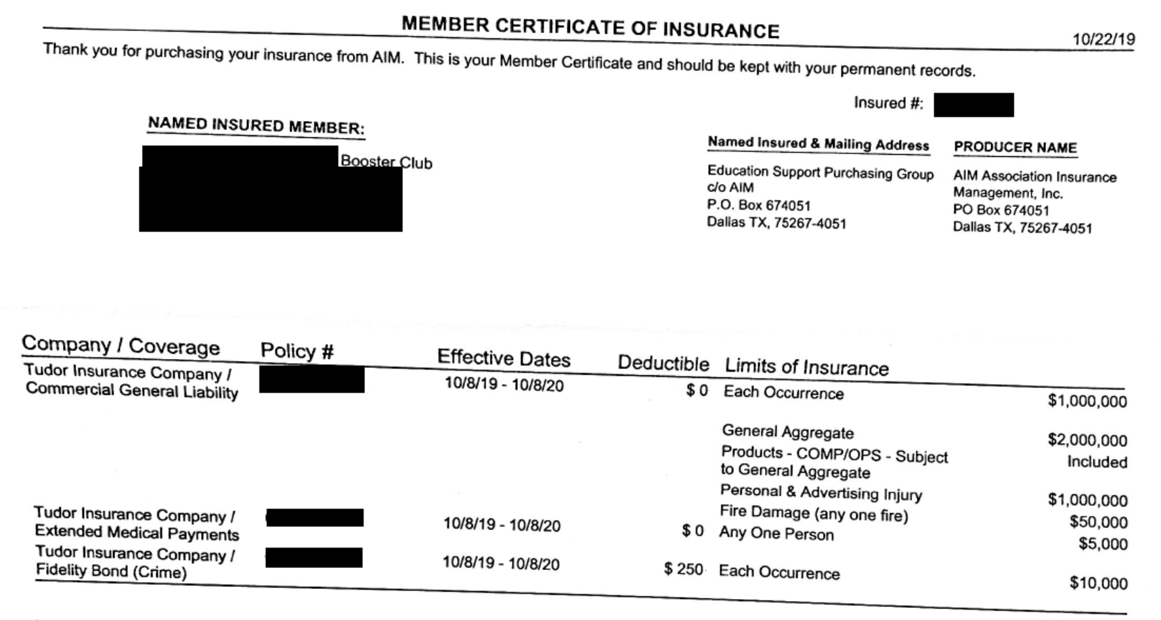
Certificate of Insurance EXAMPLE

Slide 17
Internal Controls
Control over Bank Accounts
Required to establish a checking account at a bank or credit union
At least three individuals should be on the signature card
Checks must require the signature and authorization of two club officers
Another individual, not a signer on the account, should review the bank statement for reasonableness and compliance with Treasurer Reports, the budget and ongoing business
Bank statements should be reconciled within 30 days of the date of the statement
A second officer, not involved in the financial aspects, should review and sign off on the completed bank statement

Slide 18
Internal Controls
Control over Cash and Receipts
All cash collections received must be deposited upon receipt
Funds must have supporting documentation indicating the source and amount of funds
Cash should be adequately safeguarded at all times
At no time should funds collected be maintained at a member’s home
Balance funds collected the day of the event, prepare deposit documentation and submit to a bank or bank nigh drop for deposit

Slide 19
Internal Controls
Control over Disbursements
A fundraiser application must be completed and submitted to the campus principal for approval prior to all fundraisers
Checks must have supporting documentation signed by the President or Vice President
Blank checks should not be issued.
Actual receipts should be requested, and a reimbursement be processed

Slide 20
Internal Controls
Budgetary & Oversight Controls
A budget should be established and approved at the beginning of the school year
At each meeting, the treasurer should provide a written financial report that includes:
  Bank account balance
  Receipt and disbursement activity since the last meeting
  Budget versus actual receipts and expenditures
A fundraiser recap should be prepared at the completion of all fundraisers to determine the profitability
An audit of the organization’s financial records should be completed at the end of each fiscal year

Slide 21
Financial Information
Cash Receipt Procedures
Make sure the cash receipt documentation total matches the deposit total
File the cash receipt verification along with a copy of the deposit slip
For large deposits have two individuals independently count the currency and initial the deposit slip. The two individuals should be present when the deposit bag is sealed.
Bank Reconciliation
Balance indicated on the monthly bank statement should be reconciled to the bank account balance in the general ledger as of the last day of the month
Cancelled checks should be reviewed

Slide 22
Financial Information
Disbursement of Funds
All disbursement requests should be compared to the budget
Disbursements outside of the scope of the budget or line items that exceed the approved budget require a vote by the general membership
Direct payments to District employees and the purchase of alcoholic beverages are not permitted
A disbursement voucher should be completed for all expenditures
Supporting documentation (invoices, receipts) should be attached to the disbursement form and filed

Slide 23
Financial Information
Disbursement of Funds - University Interscholastic League (UIL)
UIL rules limit the ability of students to accept gifts.
No gifts or purchases that individually benefit students shall be made outside of UIL guidelines for any student governed under UIL rules
Athletic booster club disbursements require approval of the campus athletic coordinator
1099 Requirements
Payments for services in excess of $600 to an individual must be reported annually on a form 1099
Must secure a W-9 from the provider at the time of service
Issue a form 1099 to qualifying vendors performed in the calendar year by January 31st

Slide 24
Fundraising
A fundraiser application should be completed and approved by the campus principal
Fundraisers should be planned and carried out by the parents, not students
Individual accounts that are earmarked for a particular individual my not be maintained
Cannot require a member to participate in fund-raising activities
Members cannot be required to sell or raise a certain amount
May develop specific criteria that must be met for a benefit to be given to a member
Fundraisers should not co-mingle with campus fundraisers

Slide 25
Fundraising
Raffles
Each ticket must have the name and address of the organization, name of an officer, price of ticket and description of each prize valued at $10 or more
A prize can’t be valued in excess of $50,000
A raffle prize may not be cash or a negotiable instrument (check, money order, etc.)
Must have the prizes in possession before beginning the raffle or post a bond
Only members of the booster club can sell tickets. Students may not sell raffle tickets
The winner must pay income tax on any prize. If the value exceeds $600, a form 1099 should be issued to the recipient
Raffles may not be conducted the District’s property

Slide 26
Fundraising
Bingo
Obtain rules from Texas Lottery Commission
Some rules include:
  A person may not be denied because of race, color, creed, religion, national origin, sex, or disability, or because the person is not a member of the licensed authorized organization conducting the Bingo game
  A prize may not exceed $750 in any single game or $2,500 in the aggregate per occasion
  Door prizes may not exceed $250 per occasion
  All bingo supplies must be purchased from a licensed distributor
  A 5% fee must be collected from the person(s) who wins the bingo prize
  Cannot be held on the District’s property
  Alcohol may not be served

Slide 27
Sales Tax
Taxable Status of Purchases
Must provide a valid signed exemption certificate when claiming state sales tax exemption
Must apply for own exemption status - the District’s exemption status may not be used
Meals purchased by the organization for athletic teams, bands, etc. on authorized school trips are exempt if the organization contracts for the meals

Slide 28
Sales Tax
Collection and Remittance of Sales Tax
When making sales, sales tax must be collected
The organization can add tax to the item’s selling price or absorb the tax in the item’s selling price
Organizations do not need to collect sales tax on the following:
  Admission tickets
  Club memberships
  Food and drinks sold at school functions
Sales tax should be filed in accordance with the Comptroller’s guidelines

Slide 29
Donations
District staff shall not accept or solicit any gift, favor, service, or other benefit that could reasonably be construed to influence the employee’s discharge of assigned duties and responsibilities
Students are also discouraged from accepting gifts of value. Students in UIL activities shall not accept gifts except as provided by UIL Constitution and Contest Rules
Donations to the District become the sole property of the District
Donations should be earmarked for a specific purpose

Slide 30
Miscellaneous
All food and beverage sales on Irving ISD premises during the school day are governed by USDA and state rules and regulations
If a question cannot be resolved at the campus level, the appropriate Assistant Superintendent should be contacted for clarification
Failure to follow policies and procedures of the District may result in refusal by the campus principal to allow related activities on campus
It should not be a practice to store funds on campus for safekeeping. Irving ISD is not responsible for any funds left on campus
District employee and student planning and preparation for booster club activities shall occur outside the school day
Upon dissolution, a private termination letter ruling should be requested from the IRS

Slide 31
References & Resources
Irving ISD Website www.irvingisd.net
  Booster Club & Parent Organization Guidelines PDF
Internal Revenue Service www.irs.gov
UIL www.uil.Texas.edu
State Comptroller www.window.state.tx.us
Secretary of State www.sos.state.tx.us

