Slide 1
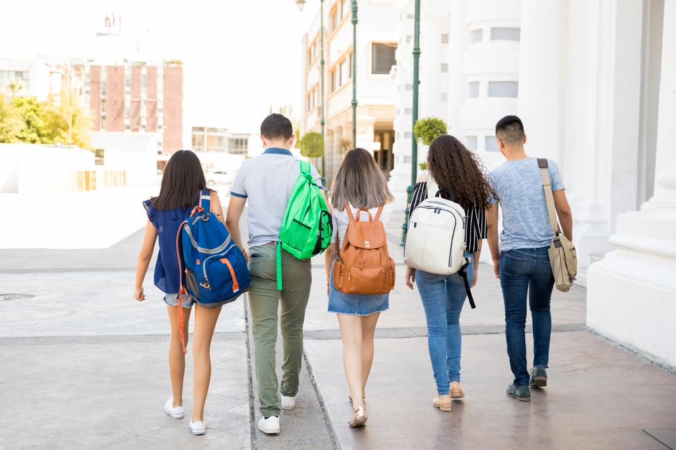

Objectives:
  Students will have raised awareness about the realities of teen dating violence
  Students will have raised awareness about the realities of human trafficking.
WE EXPECT YOU TO:
  Have an open mind to receive this information
  Hold yourself and others to a high standard of respect for us and other students
WHAT YOU CAN EXPECT FROM US:
  we will uphold confidentiality
  we will hold a space for respect for you and all of your questions

Slide 2


Millsap High School
TEEN DATING VIOLENCE
Freedom House of Parker County and Crossroads Youth Program
12th Grade

Slide 3
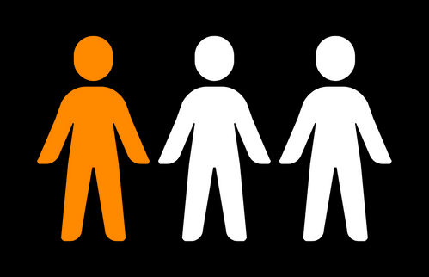
IT IS ESTIMATED THAT
Teen Dating Violence
33%
OF TEENS
a pattern of physical, sexual, emotional/verbally abusive or controlling behaviors within a romantic relationship among teens
will experience emotional, physical, or sexual abuse from a romantic partner before graduating highschool
(3)

Slide 4
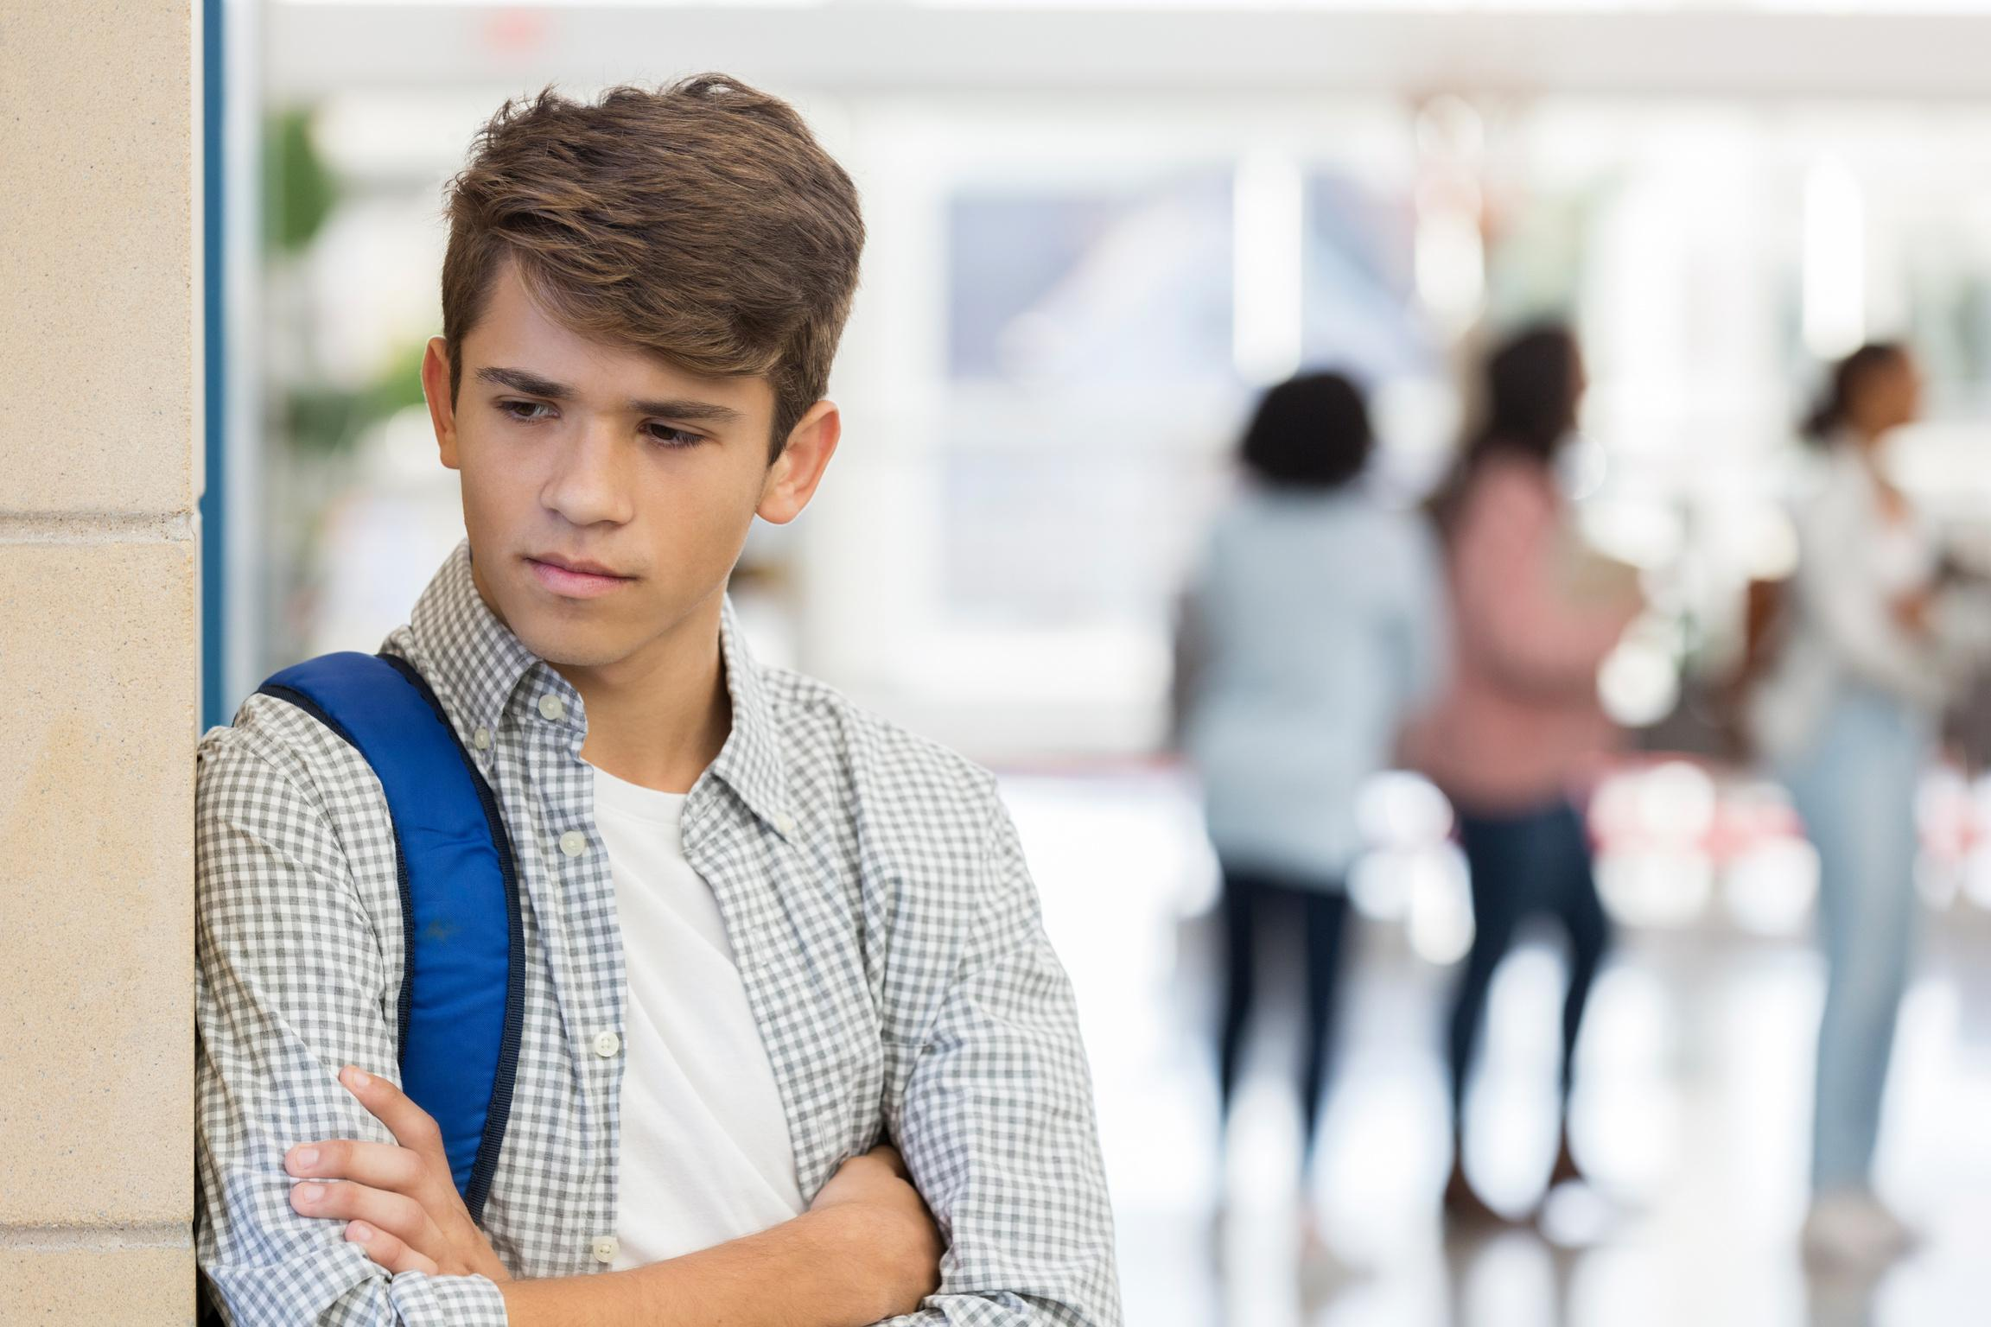
Greater Effects of Teen Dating Violence
Teens who experience dating violence are at an increased risk of:
  anxiety
  depression
  antisocial behaviors
  suicidal thoughts and intentions
  substance abuse disorders
Teens who experience dating violence are statistically more likely to be involved in abusive relationships as adults, as well.
(3)

Slide 5
WHAT ARE SOME CHARACTERISTICS OF A HEALTHY RELATIONSHIP?
WHAT ARE SOME CHARACTERISTICS OF AN UNHEALTHY RELATIONSHIP?

Slide 6
HEALTHY
UNHEALTHY
  communication
  respect
  trust
  honesty
  equality
  enjoy time together
  able to enjoy time away from your partner
  mutual decisions
  financial partners
  lacking communication
  disrespect
  lack of trust
  dishonesty
  one partner tries to take control
  always spending time with your partner
  pressure to do things you are not comfortable with
(1)

Slide 7
CHARACTERISTICS OF AN ABUSIVE RELATIONSHIP
  communicating in a hurtful or threatening way
  mistreating
  manipulating
  repeatedly accusing the other of cheating, when it is not true
  forcing you to do things you are not comfortable with
  controlling
  denying that their behaviors are abusive
  isolating their partner from other
(1)

Slide 8
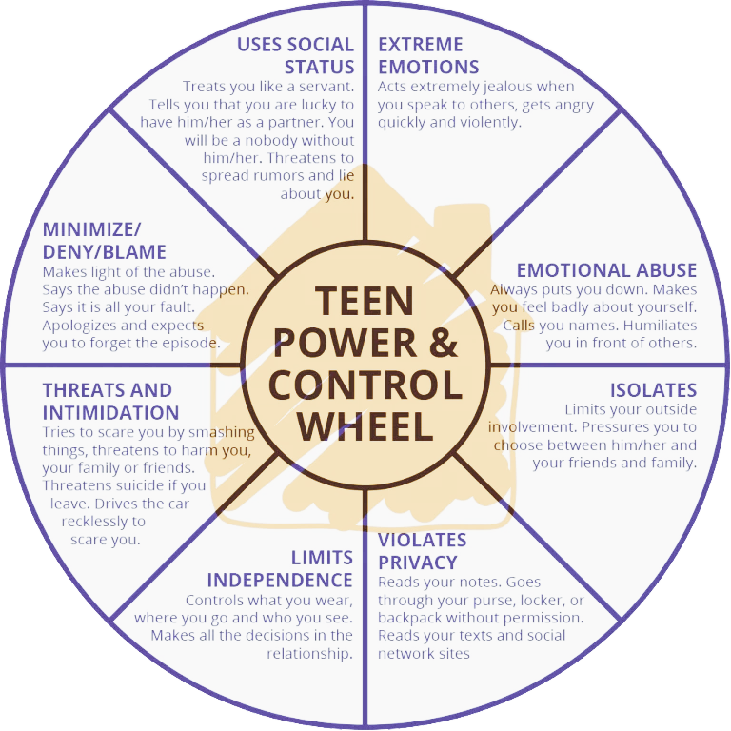
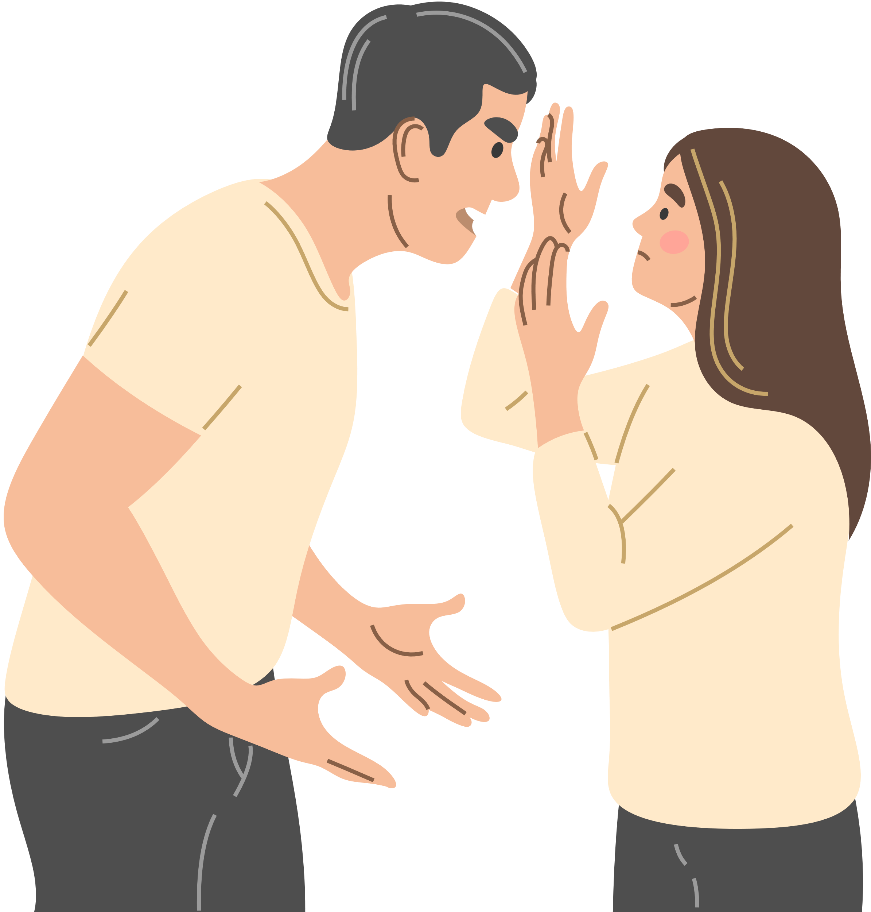
SOME COMMON TACTICS ABUSERS USE TO
maintain power and control
(2)

Slide 9
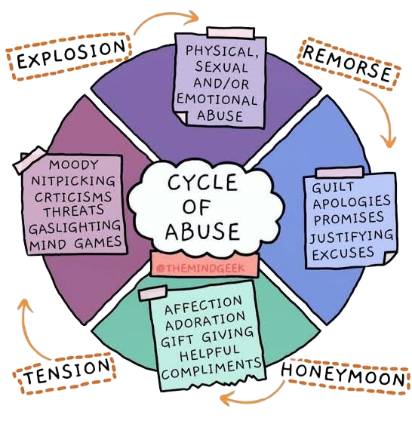
the cycle of abuse
IT IS A LOOP THAT IS EASY TO GET STUCK IN
ABUSERS USE THE “REMORSE” STAGE TO REGAIN THEIR VICTIMS TRUST, AND GUILT THE VICTIM INTO STAYING IN THE RELATIONSHIP. THEN THE CYCLE REPEATS ITS SELF OVER AND OVER AGAIN
(4)

Slide 10
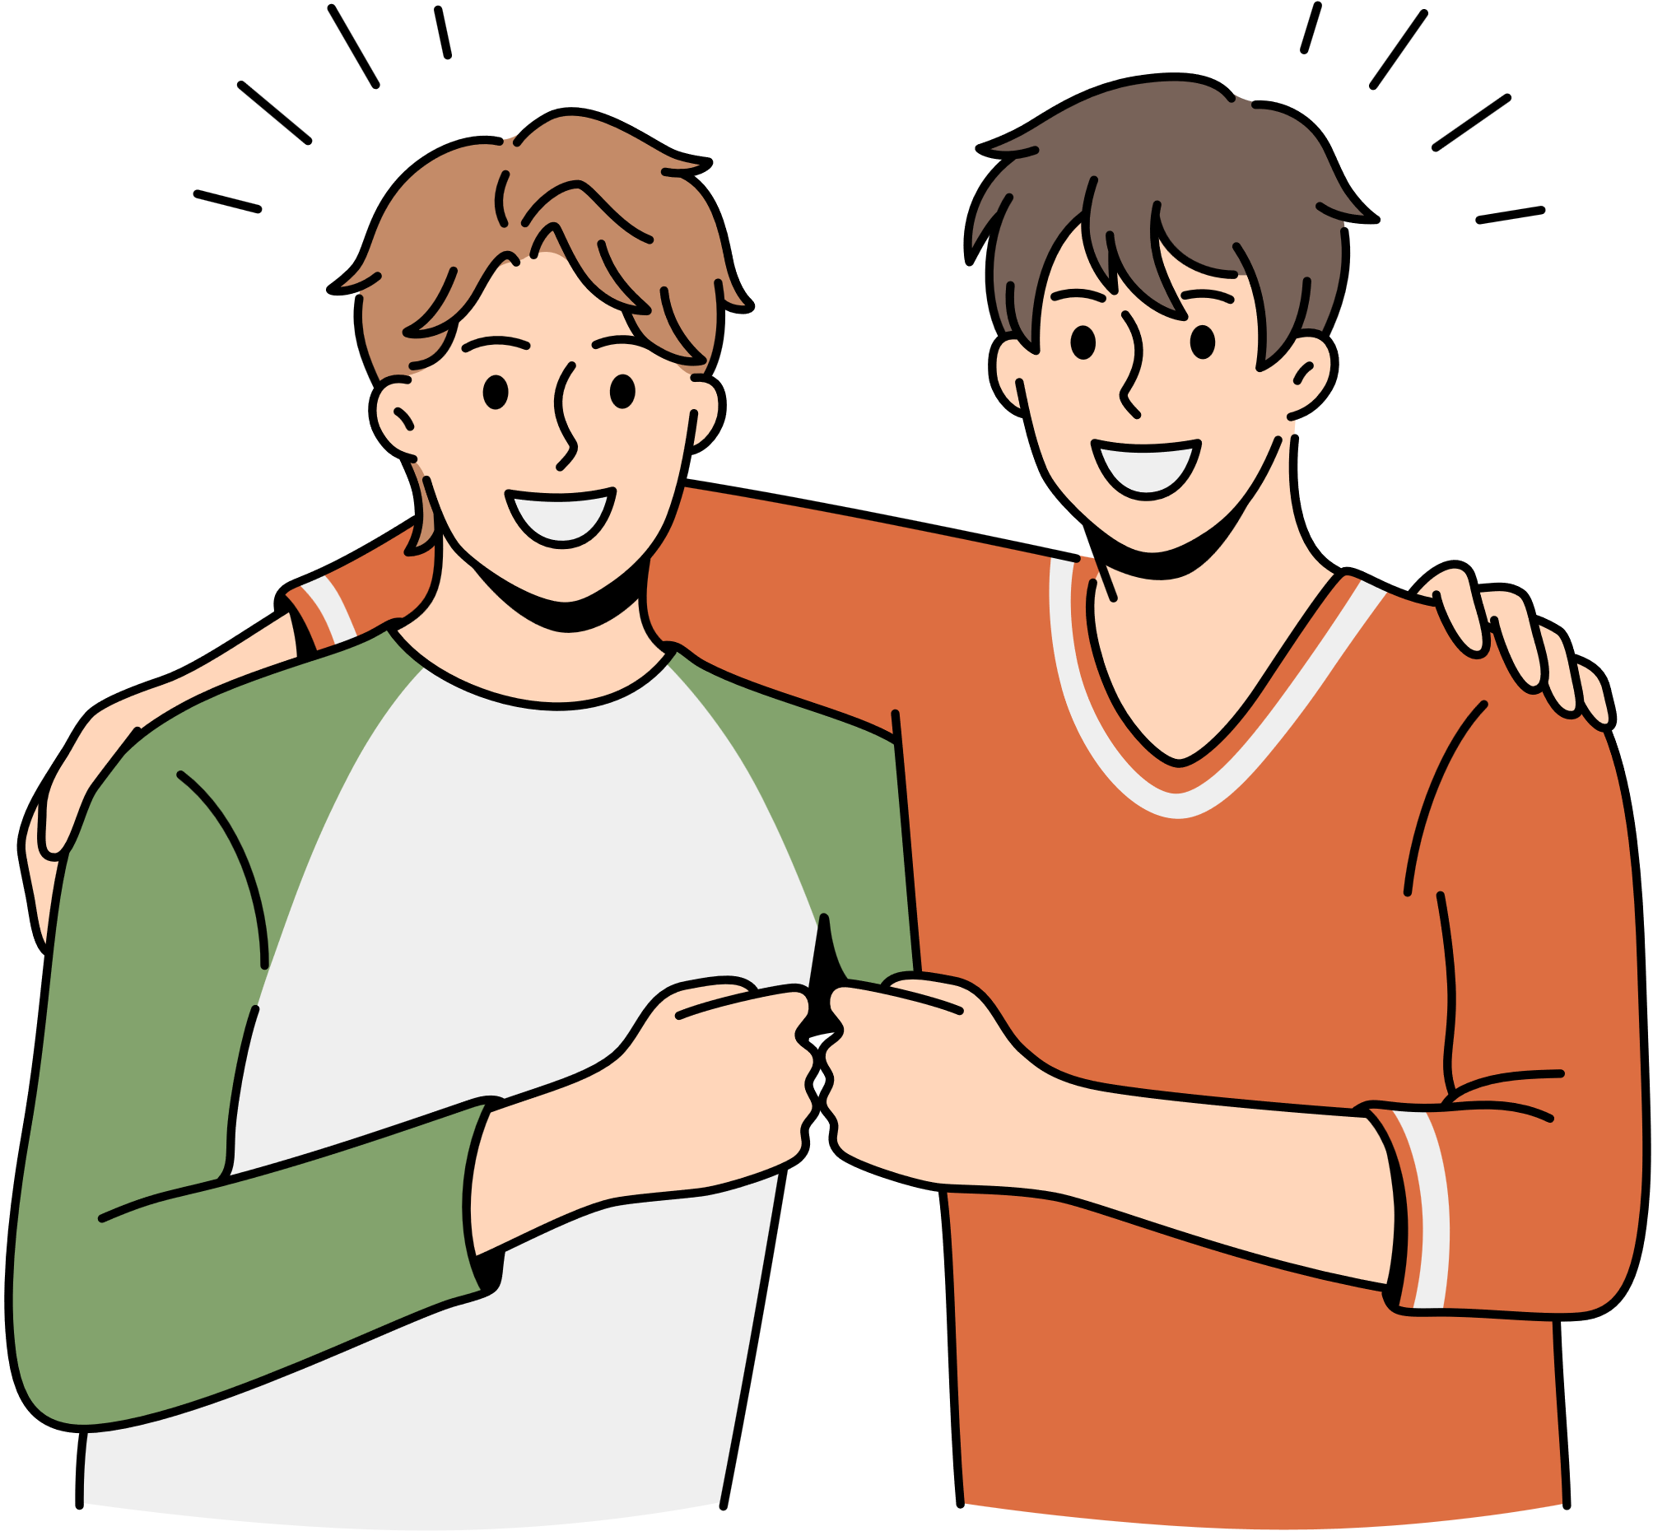

Your partner will not be able to meet every single one of your needs
Outside friendships are crucial to maintaining healthy romantic relationships
Reminders
your relationship should not be your only source of happiness
your relationship does not define you

Slide 11
nobody is immune
TO DATING VIOLENCE
all genders
all races
all social classes
ANYBODY CAN BE EFFECTED BY TEEN DATING VIOLENCE, BUT IT IS NEVER THE VICTIMS FAULT

Slide 12
Teen Dating Violence Statistics:
  1 in 3 girls in the US is a victim of physical, emotional, or verbal abuse from a dating partner, a figure that far exceeds rates of other types of youth violence.
  1 in 10 high school students has been purposefully hit, slapped or physically hurt by a boyfriend or girlfriend.
  81% of parents believe teen dating violence is not an issue or admit they don’t know it’s an issue.
  Teens who suffer dating abuse are subject to long-term consequences like alcoholism, eating disorders, thoughts of suicide, & violence behavior.
  ·50% of young people who experience rape or physical or sexual abuse will attempt to commit suicide.
(3)

Slide 13
IMPORTANT REMINDERS
IF YOU ARE EXPERIENCING ANY FORM OF ABUSE
YOU ARE NOT ALONE
IT IS NEVER YOUR FAULT
YOU DO NOT OWE ANYONE ANYTHING
REACH OUT TO A TRUSTED ADULT

Slide 14
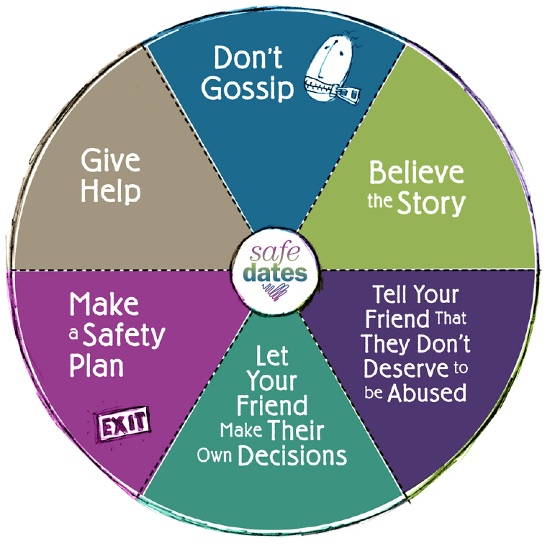
YOUR ROLE AS A BYSTANDER
  Believe them
  Remind them that it is not their fault and they do not deserve the abuse
  Remember that they are going to make their own decision
  Help them with a safety plan
  Offer help and support
  Do not gossip!

Slide 15
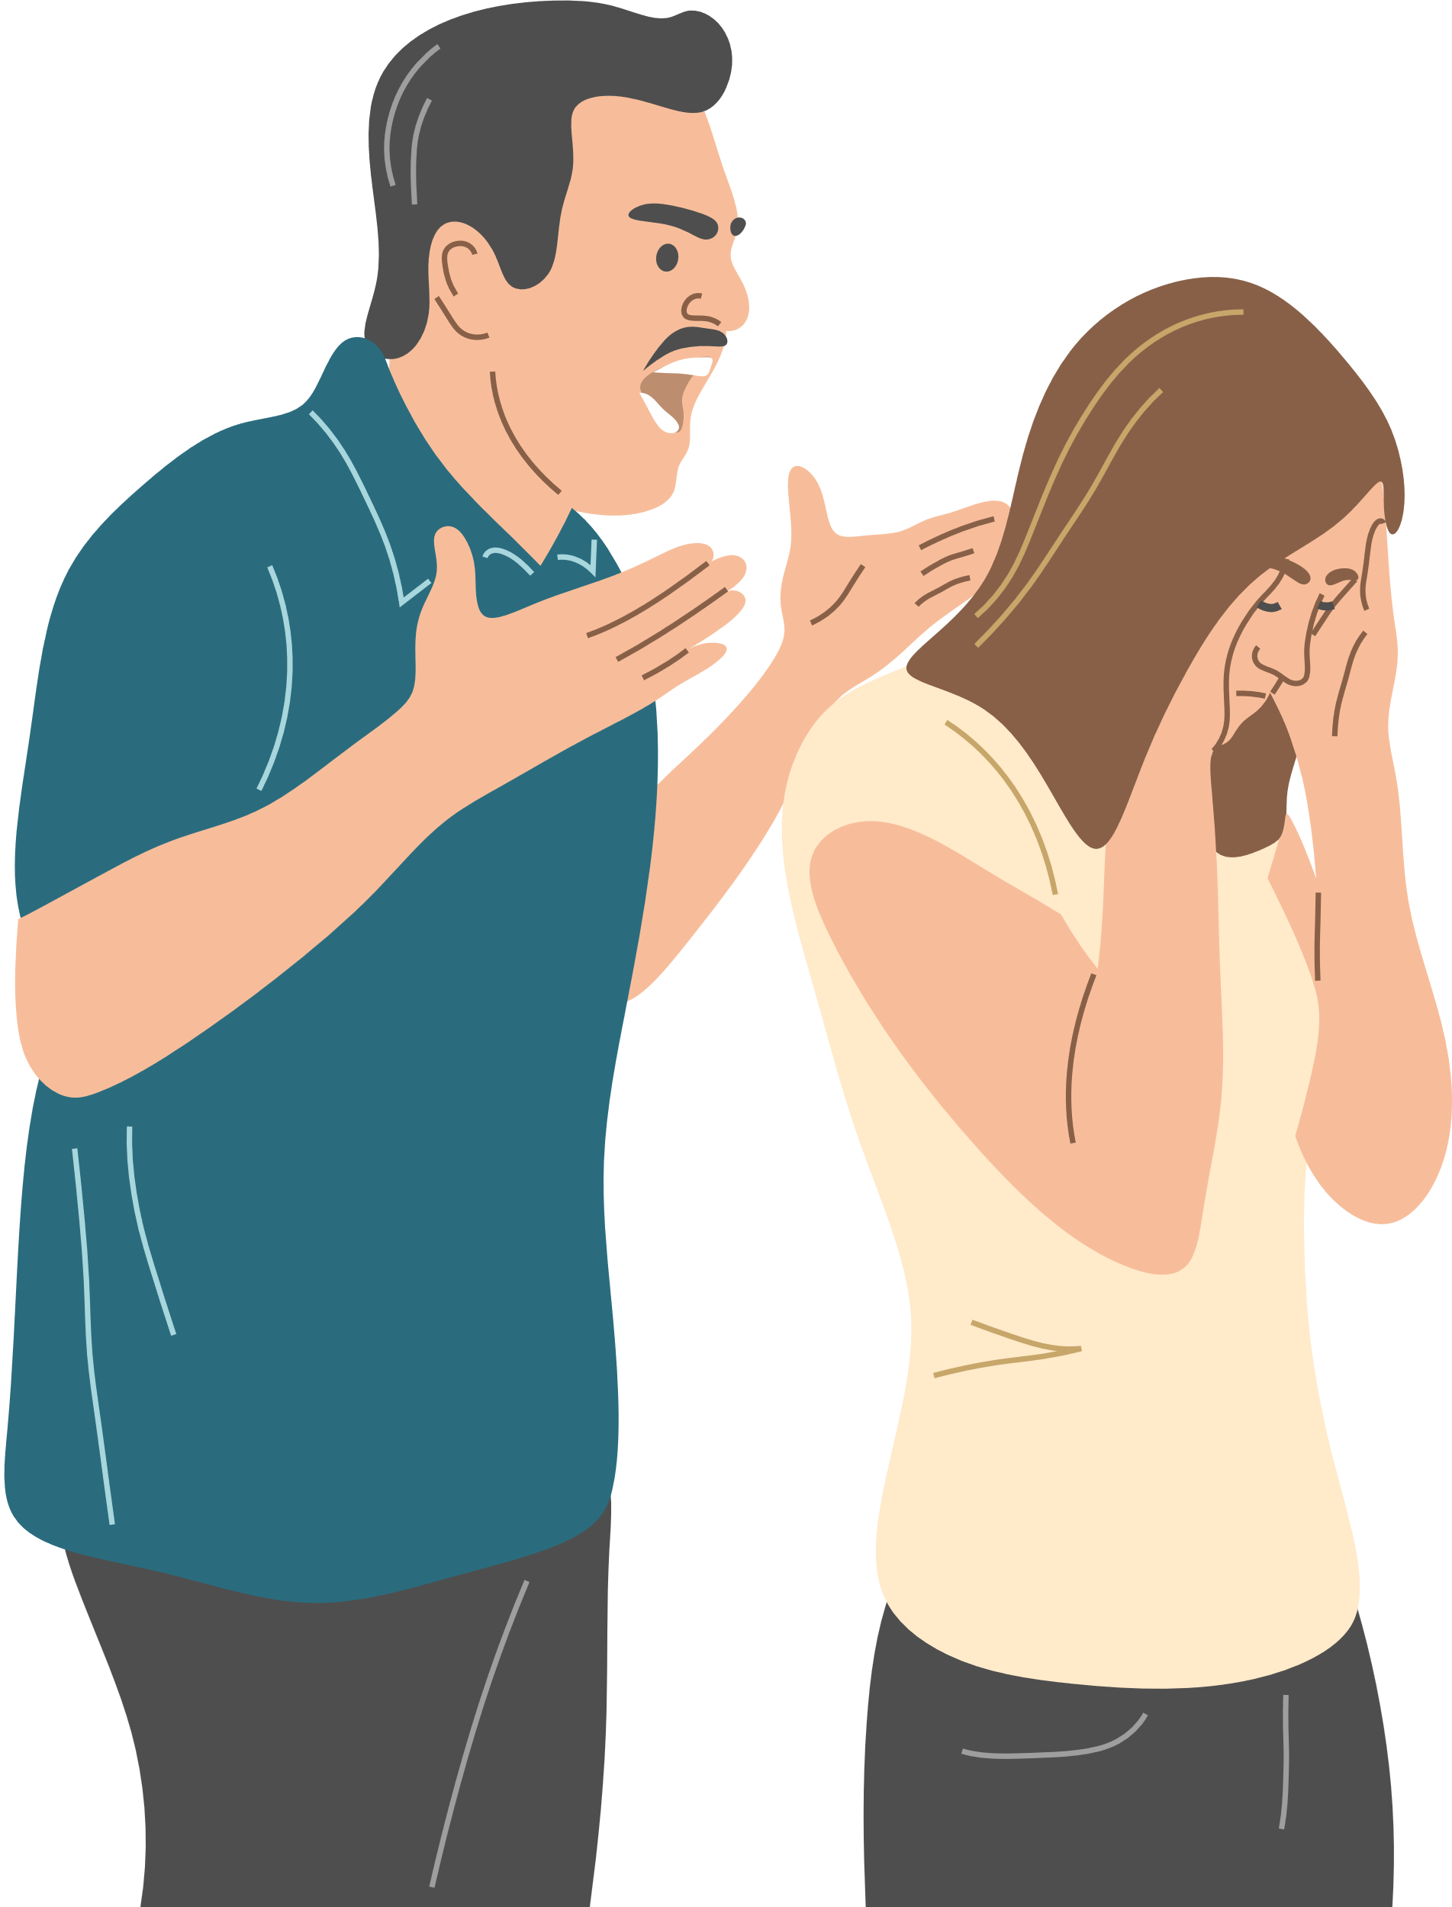
THE STIGMA THAT SURROUNDS ABUSE
stigma: a set of negative and often unfair beliefs that a society, or group has about something

Slide 16
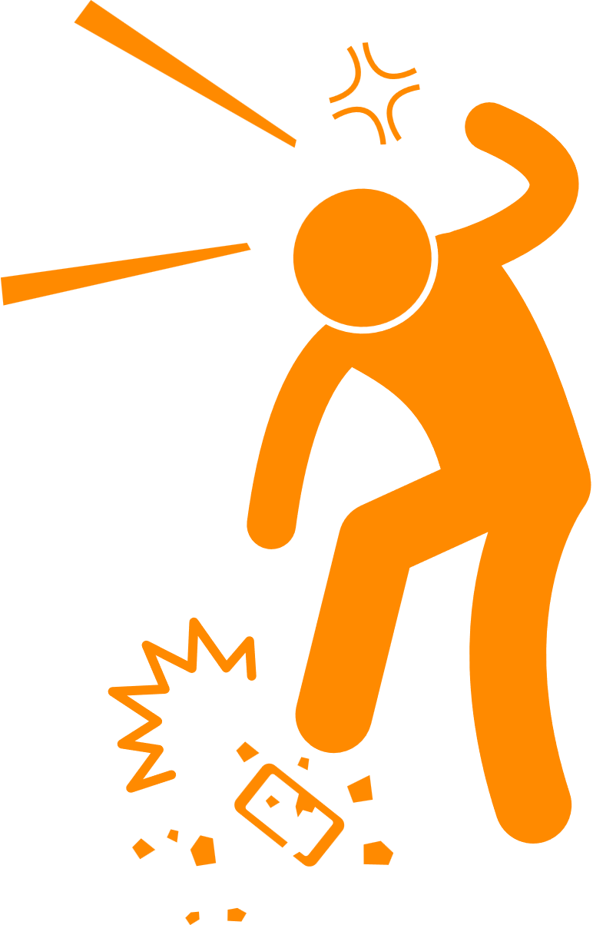
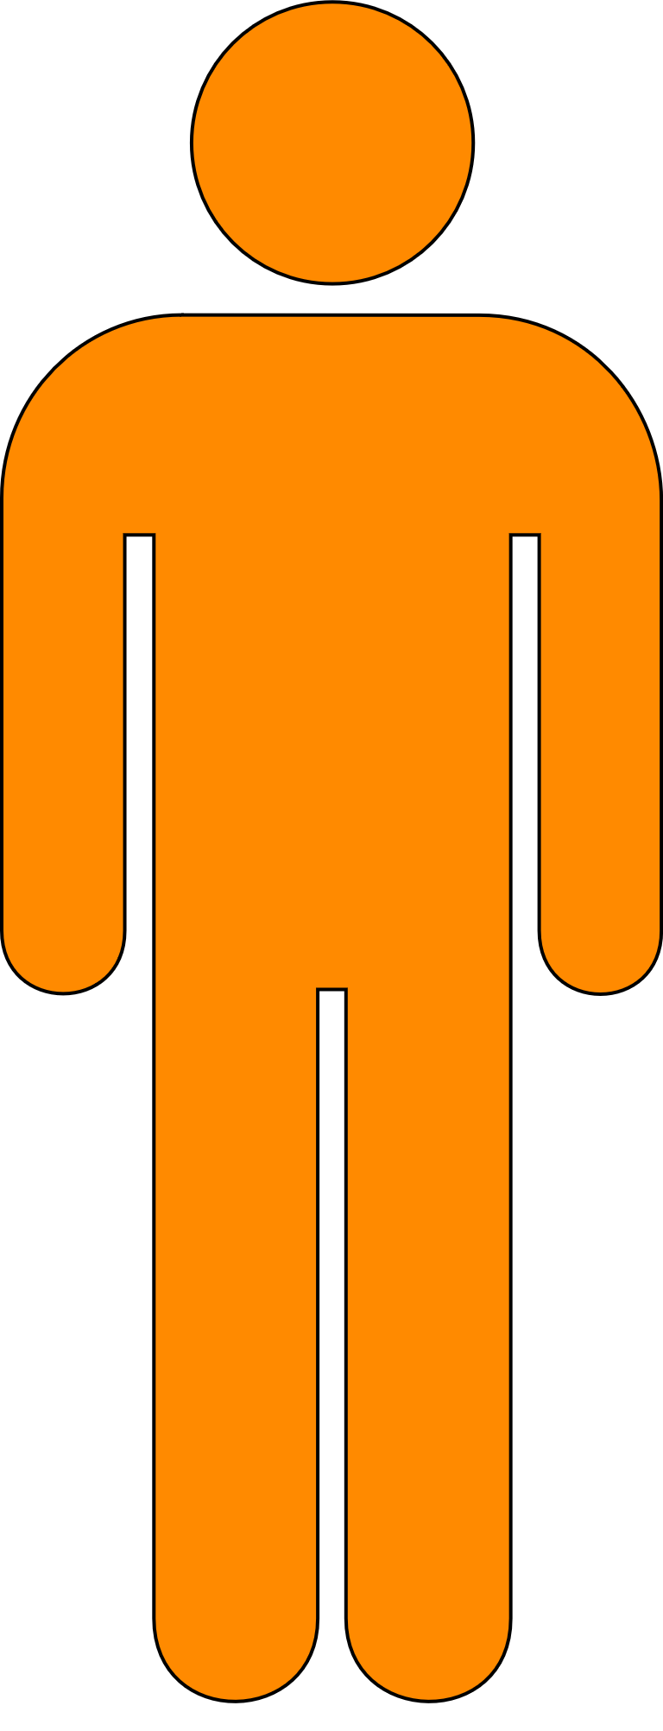

COMMON STIGMAS THAT SURROUND DOMESTIC VIOLENCE
“if it was really THAT bad, they could leave”
“they should work on being a better partner so they do not provoke the abuser”
“Men are never abused, that would make them weak”

Slide 17
WHY IS A
STIGMA HARMFUL?
only 1/3 teens who experience dating abuse report it, or tell anybody about it
Other people’s negative views and stereotypes about abuse victims makes it harder for victims to feel comfortable speaking up about abuse, or seek help in any way
(3)
this then leads to isolation, which is harmful and helps continue the abuse cycle

Slide 18
WHY LEAVING ISN’T ALWAYS THAT EASY
EMOTIONAL REASONS
RELIGIOUS REASONS
  TRAUMA BONDS WITH THE ABUSER
  FEELING EMOTIONALLY DEPENDENT ON THE ABUSER
  FEELING LIKE YOU HAVE ALREADY INVESTED SO MUCH INTO THE RELATIONSHIP
  PURITY CULTURE
  EMPHASIS ON THE IDEA THAT MARRIAGE IS PERMANENT/ NOT BELIEVING IN DIVORCE
  FEELING LIKE THE ABUSE IS A PART OF “GOD’S WILL”
PHYSICAL REASONS
PRACTICAL REASONS
  FEAR OF STALKING, OR ESCALATING THE SITUATION
  FEAR OF HARM TO CHILDREN OR OTHER PEOPLE
  THREATS, INTIMDATION, COERCION
  FINANCAL REASONS
  HAVING A FAMILY WITH THEIR ABUSER
  LIVING SITUATIONS

Slide 19
  BE CONFIDENT- YOU KNOW WHAT IS BEST FOR YOU!
  SAFETY PLAN
  SAFETY NETWORK/
ACCOUNTABILITY GROUP
  INITIATE THE CONVERSATION- BE BRIEF AND CLEAR THAT THIS IS
NON NEGOTIABLE
  GO NO CONTACT AND DO
NOT BREAK IT!
  TRUST YOUR GUT, REMEMBER WHY YOU LEFT, AND PUT YOURSELF FIRST!!
TIPS FOR LEAVING AN UNHEALTHY RELATIONSHIP

Slide 20
YOU DESERVE TO BE HAPPY AND HEALTHY!

Slide 21
DATING BILL OF RIGHTS
I HAVE THE RIGHT TO
  BE RESPECTED
  MAKE MY OWN CHOICES
  SAY “YES”, “NO”, OR “MAYBE”
  WITHDRAWL MY CONSENT AT ANY TIME
  HAVE MY VOICE HEARD
  HAVE MY OWN TIME
  HAVE MY OWN FRIENDSHIPS
  PROTECT MY DIGITAL PRIVACY
  END RELATIONSHIPS WITHOUT GUILT OR FEAR
(3)

Slide 22
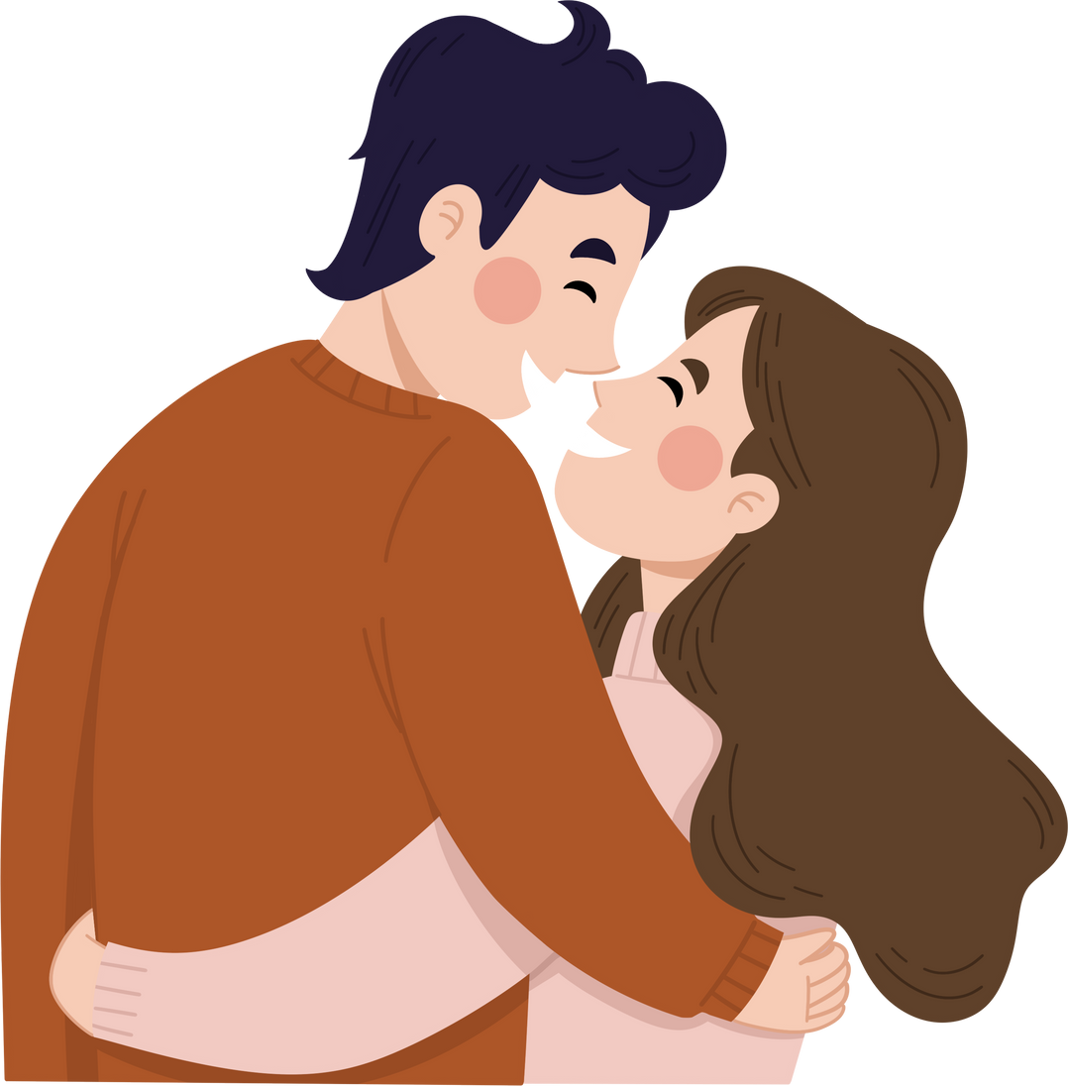
FINAL REMINDERS:
  YOU ARE NOT ALONE
  YOUR FEELINGS ARE ALWAYS VALID
  LEAVING IS NOT ALWAYS EASY
  YOU DESERVE HAPPINESS
  YOU ARE ALLOWED TO WANT TO LEAVE A RELATIONSHIP SIMPLY BECAUSE IT IS NOT FULLFILLING. EVEN HEALTHY REALTIONSHIPS DO NOT ALWAYS WORK OUT IN THE LONG RUN AND THAT IS OK!

Slide 23
RESOURCES:
  Love Is Respect. (n.d.). Relationship spectrum. Love Is Respect. https://www.loveisrespect.org/everyone-deserves-a-healthy-relationship/relationship-spectrum/
  Teen Empowerment - Control Wheel - Signs of Abuse | Family Crisis Center - South East Iowa. (2021, November). Family Crisis Center. https://familycrisiscenteriowa.org/teen-dating/teen-power-control-wheel/
  Love is Respect. (2018, September 10). loveisrespect.org. Loveisrespect.org. https://www.loveisrespect.org/
  Cameron, M. (2024, October 7). October is Domestic Violence Awareness Month - Prevention Partners of Northern Middlesex. Prevention Partners of Northern Middlesex. https://preventionpartnersnm.org/dv-awareness-month/

Slide 24
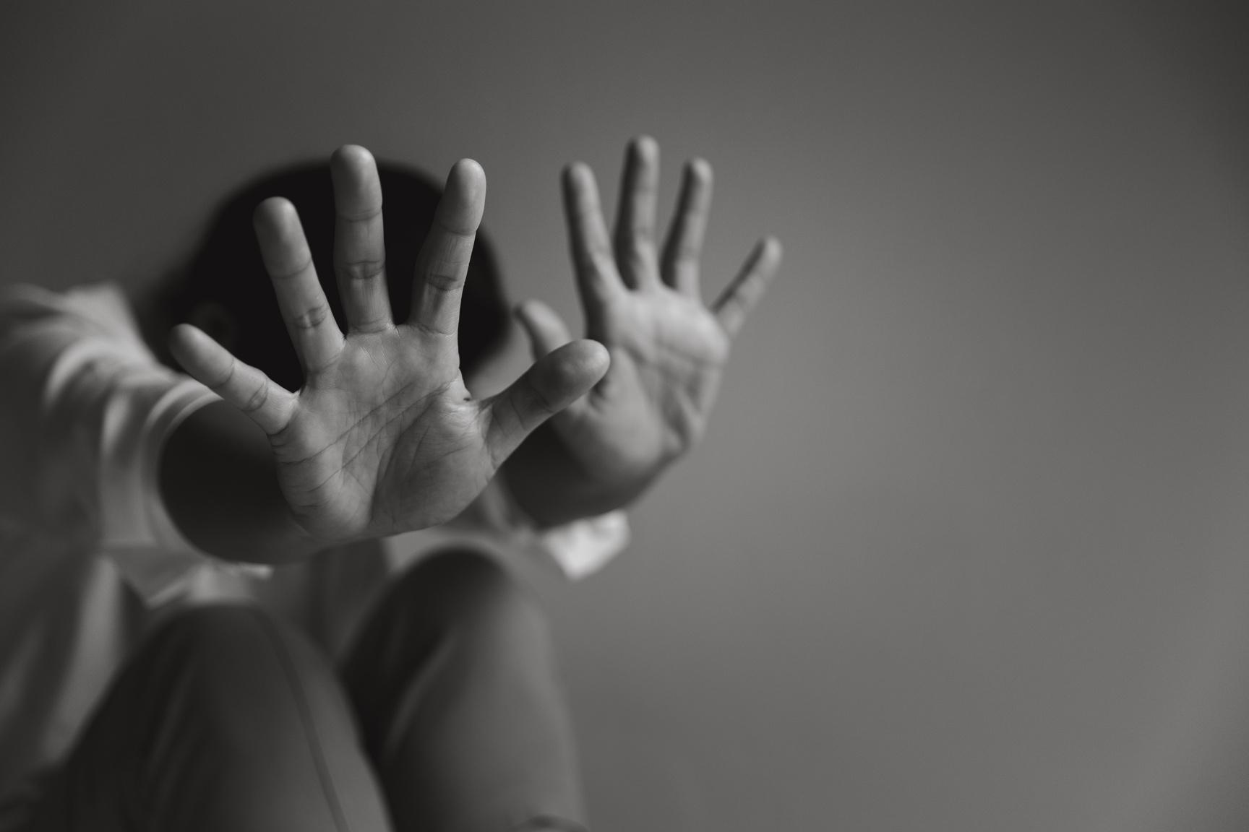
Milsap High School
HUMAN TRAFFICKING
Freedom House of Parker County & Crossroads Youth Program
12th Grade

Slide 25
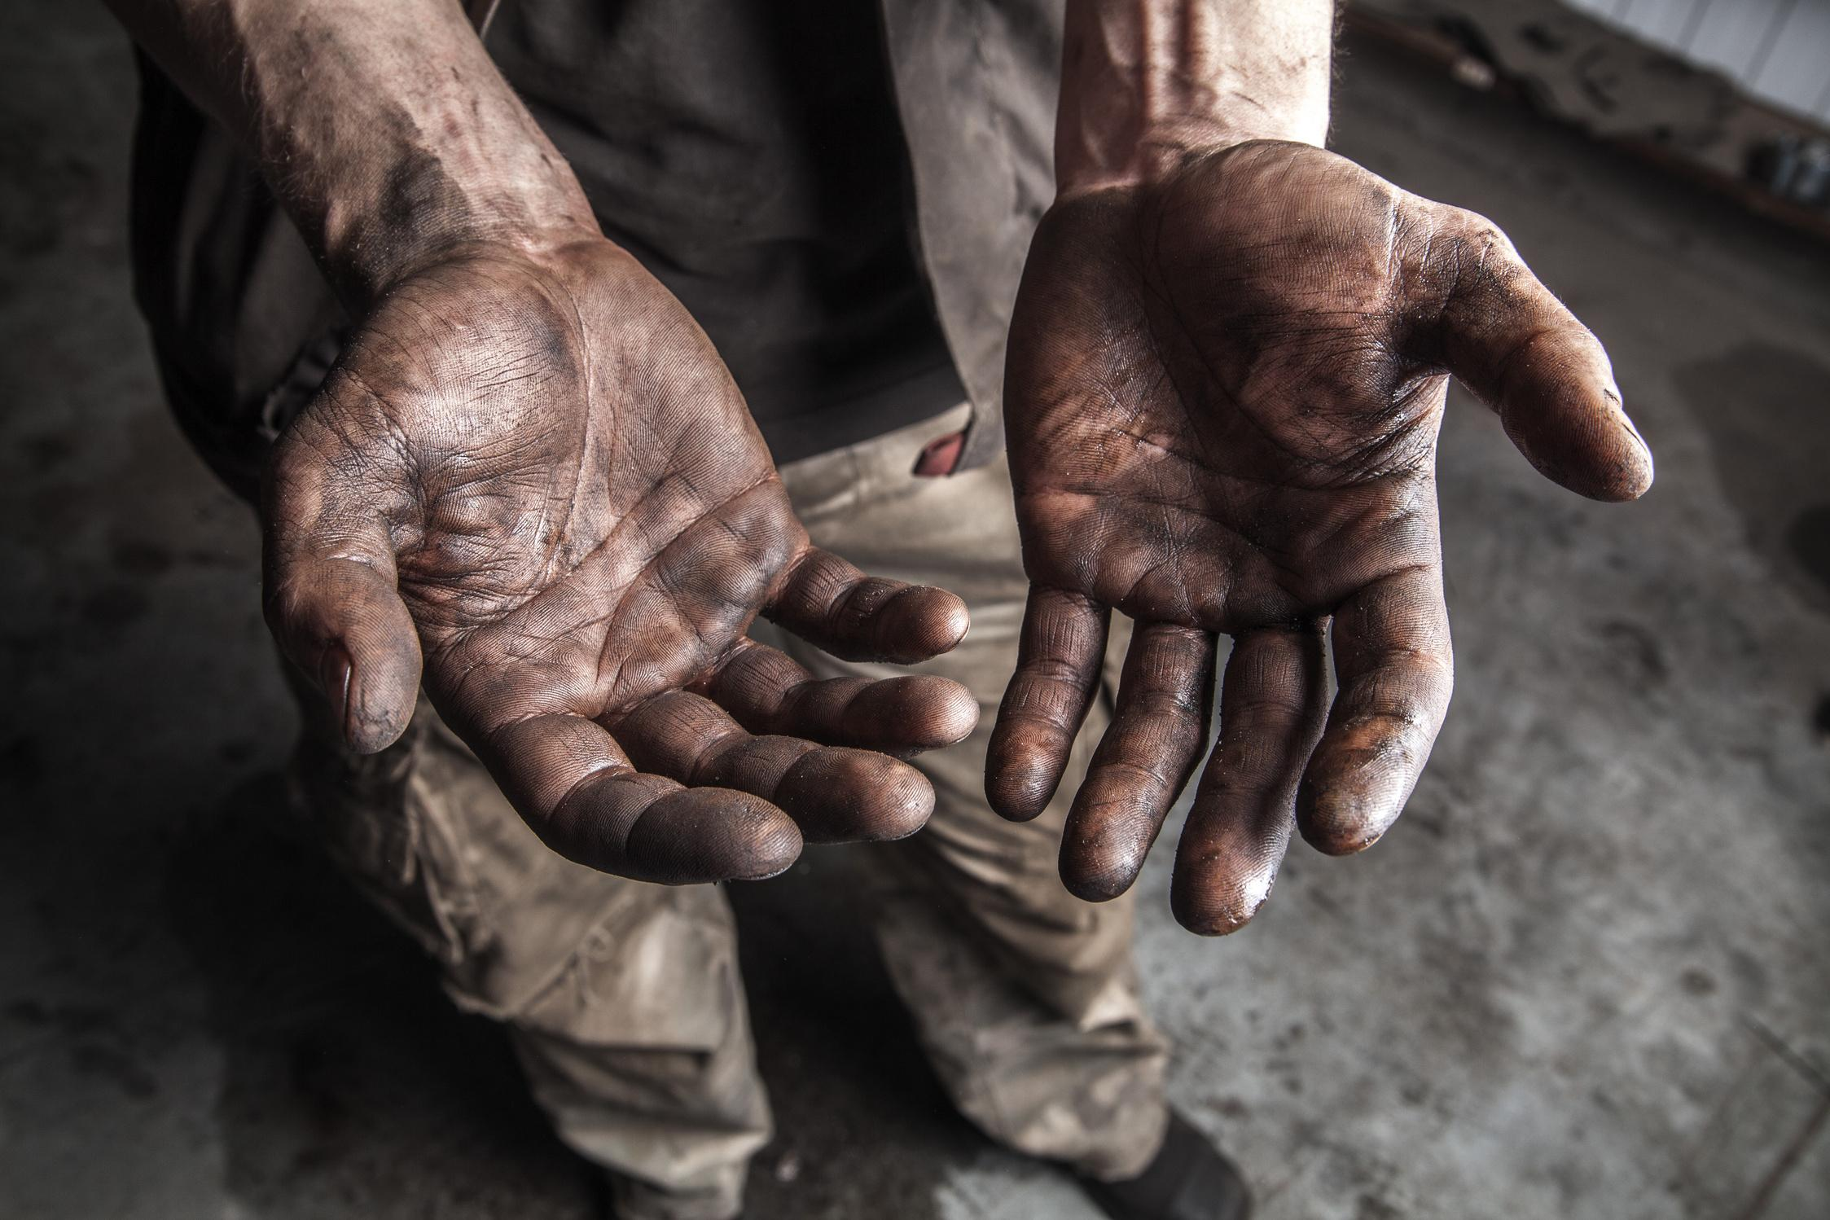
What is
Human Trafficking?
the use of force, fraud, or coercion to compel someone to perform labor or a commercial sex act
(1)

Slide 26
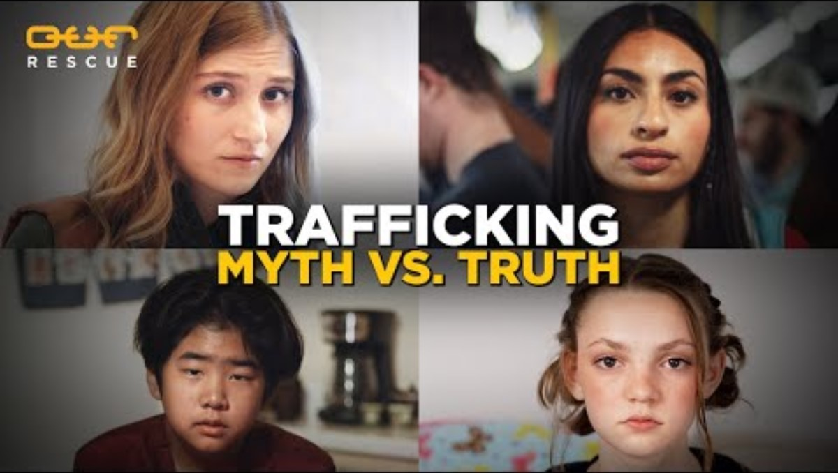

Slide 27
HOW DO THEY MAINTAIN CONTROL?
WHO ARE THE TRAFFICKERS?
THEY FILL A VOID
  Traffickers make promises (that they often do not fullfill) that are aimed at meeting the needs of their target in order to impose control
ANYBODY!
COMMON TACTICS
  Perpetrators span all racial, ethnic, and gender demographics. Some use their privilege, wealth, and power as a means of control while others experience the same socio-economic oppression as their victims.
  Emotional and or physical abuse and or threats
  isolation from friends, family, others
  economic or financial abuse
VICTIMS FEEL TRAPPED
  they may fear leaving for numerous different reasons including psychlogical trauma, shame, emotional attachment, and/ or threats to themselves, their family or friends
(2)

Slide 28
Risk
Factors
  Disability
  Economic stress (e.g., debt, ransom/extortion, unemployment, underemployment)
  Fear of authority and law enforcement
  Housing instability, including history of running away or experiencing homelessness as a youth
  Immigration status
  Lack of family, community, or social support for navigating identity including but not limited to 2SLGBTQIA+2
  Limited familiarity with opportunities and limitations within U.S. systems (e.g., legal, social service, etc.)
  Limited or inaccurate understanding of labor rights
  Recent migration or displacement
  Any other indicator of vulnerability, or a void the trafficker can “fill”
characteristics at the biological, psychological, family, community, or cultural level that precede and are associated with a higher likelihood of negative outcomes.
(4)
(1)

Slide 29
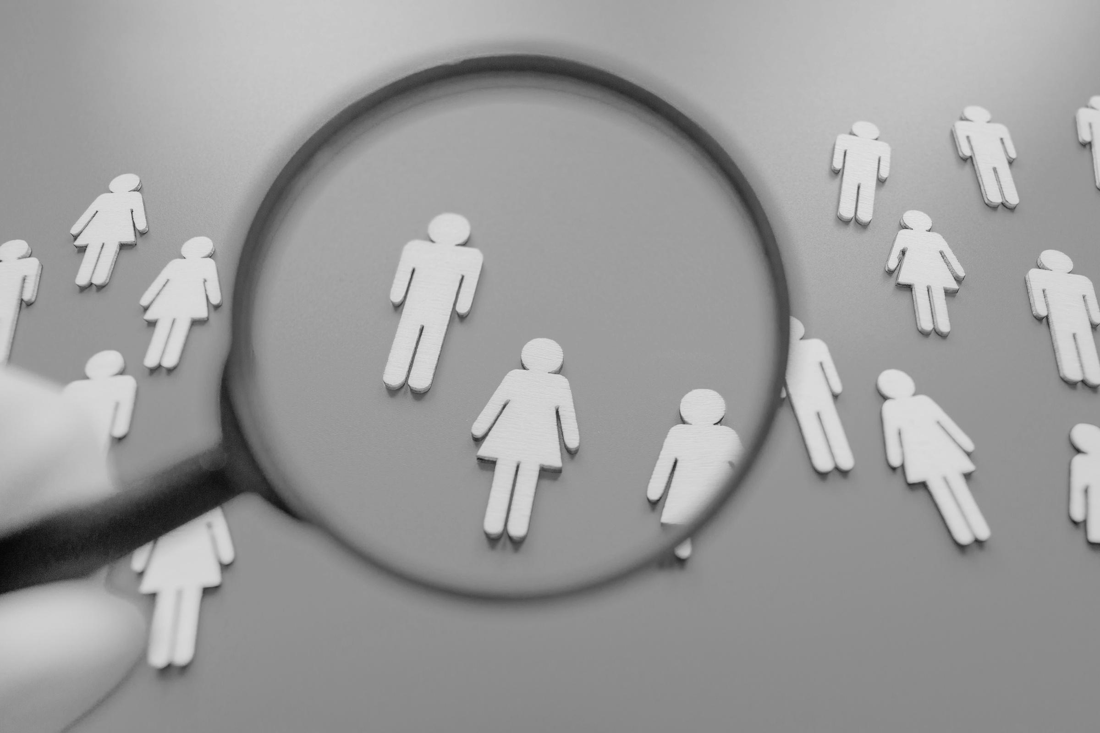

Individual Impacts of Human Trafficking
Trafficking victims may endure
  physical violence
  forced labor
  sexual violence
  deprivation of basic needs
  victims often experience severe physical, psychological and emotional trauma resulting from their exploitation
  This trauma can have long-lasting effects on their mental health, self-esteem and ability to trust others.
  This also sometimes hinders their ability to feel confident in reporting or seeking help
(5)

Slide 30

Other Impacts of Human Trafficking
Community
Impact
Social Stigma
  Human trafficking perpetuates cycles of
    exploitation
    poverty
    vulnerability
  It drives organized crime which destabilizes communities and undermines laws.
  Trafficked victims often face stigma, discrimination and social rejection due to misconceptions about their experiences.
  This can further isolate them from support networks and prevent them from getting the help and services they need.
(5)

Slide 31
Resources:
  A Public Health Approach to Preventing Human Trafficking. (n.d.). https://acf.gov/sites/default/files/documents/otip/HHS%20Human%20Trafficking%20Prevention%20Framework_Final.pdf
  Polaris. (2024). Myths, facts, and statistics. Polaris. https://polarisproject.org/myths-facts-and-statistics/
  Human Trafficking | Myth vs. Truth. (n.d.). Www.youtube.com. https://www.youtube.com/watch?v=7P6-chWY41s
  SAMHSA. (2019). Risk and protective factors. In Substance Abuse and Mental Health Services Administration. https://www.samhsa.gov/sites/default/files/20190718-samhsa-risk-protective-factors.pdf
  Human Trafficking. (2025, February 8). Ice.gov. https://www.ice.gov/about-ice/hsi/investigate/human-trafficking

