Slide 1
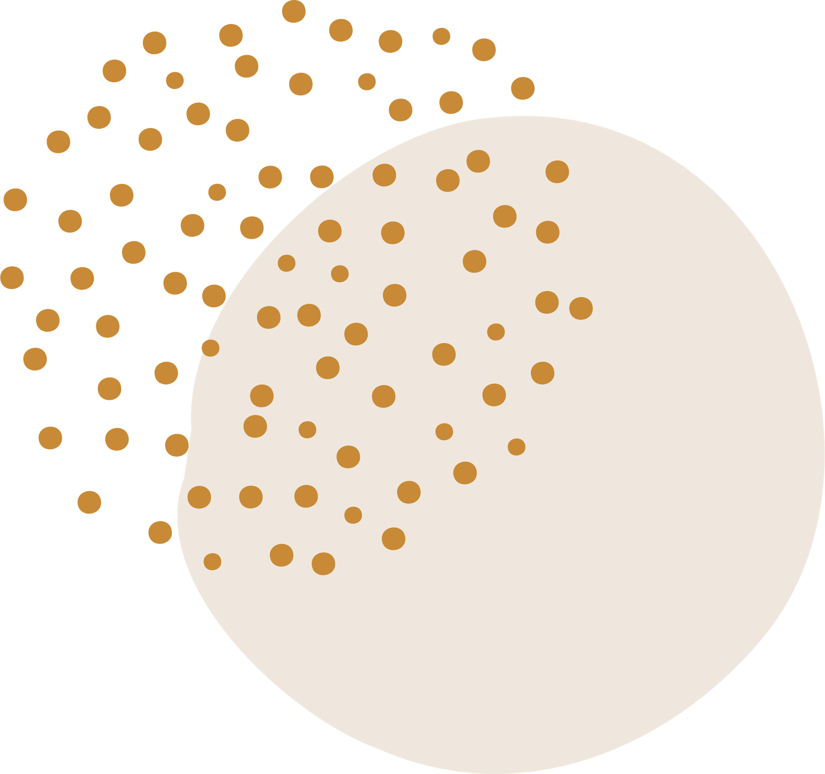
Sexting & Human Trafficking
FOR MILLSAP HIGH SCHOOL
11TH GRADE

Slide 2

Who are we?
Freedom House of Parker County
& Crossroads Youth Program

Slide 3
Today's Presentation
WE EXPECT YOU TO:
  Have an open mind to receive this information
  Hold yourself and others to a high standard of respect for us and other students
WHAT YOU CAN EXPECT FROM US:
  We will uphold confidentiality
  We will hold a safe space for you and all of your questions

Slide 4
Today's Presentation
OBJECTIVES:
  Students will explore real life impacts of “sexting”
  Students will deepen their understanding of Human trafficking on a local and global scale

Slide 5

Part One: Sexting
WHAT IS SEXTING?
WHY IS IT A BIG DEAL?
DIGITAL ABUSE AND EXTORTION

Slide 6

What is Sexting?
SEXTING:
the consensual exchange of sexually suggestive messages, or images
Sexting can feel exciting, romantic and fun, which are all normal feelings BUT we are going to talk about some reasons why sexting may not be the best idea!

Slide 7
Teens may sext for different reasons, including:
  To please a romantic partner
  Because they feel pressured to do so
  To deepen a connection
  For sexual enjoyment
  To feel better about themselves
(4)
Sexting can have negative consequences, including:
  A picture or video is shared or posted without the sender’s consent
  The sender feeling regret or shame
  Public embarrassment or bullying
  Legal consequences
  Blackmail (sometimes called “sextortion”)
(4)

Slide 8




  about 50% of young people who have a phone have used it to take some sort of intimate image of themselves
  once you send something, you no longer have control of the situation
  as a minor, sexting can be considered possession and distribution of child pornogrophy and can have harsh legal consequences - Yes, even if it is your own pictures

Slide 9

86%
Why is Sexting such a big Deal?
percent of image-based abuse cases, involve a perpetrator that had some kind of personal relationship with the victim, such as an ex partner.

Slide 10
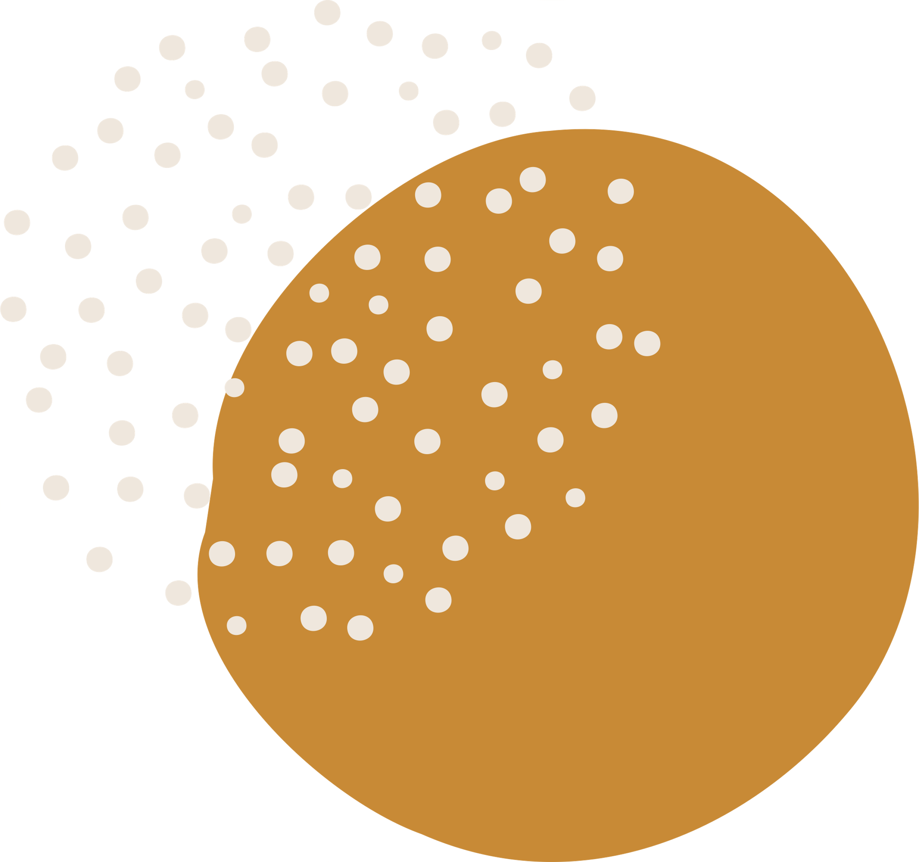
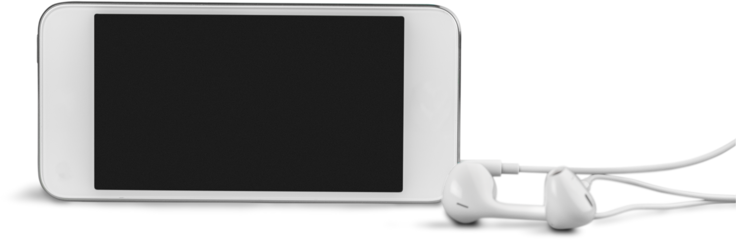
Other Dangers
you never truly know who you are talking to online!

Slide 11
  50% of people are unaware of what image-based abuse is
Image-Based Abuse
(1)
  94% of Americans believe that their images are completely safe with their partner
a control tactic which involves a mixture of digital abuse and sexual abuse. Digitally distributing nude or sexual content without consent. AKA “revenge porn”
(1)
  86% of image-based abuse cases, the perpetrator had a personal relationship with the victim, such as an ex-partner
(1)
  10% of ex partners have threatened to expose their ex’s intimate images- 60% of those who threaten it actually follow through
(1)
  90% of image based abuse victims are women
(1)

Slide 12
the most prevelant age group is 16-29 year olds
93% report significant emotional distress
(1)
Effects of Image Based- Abuse
82% report occupational or social issues or impairments in other aspects of life
(1)
51% report having suicidal thoughts
(1)

Slide 13

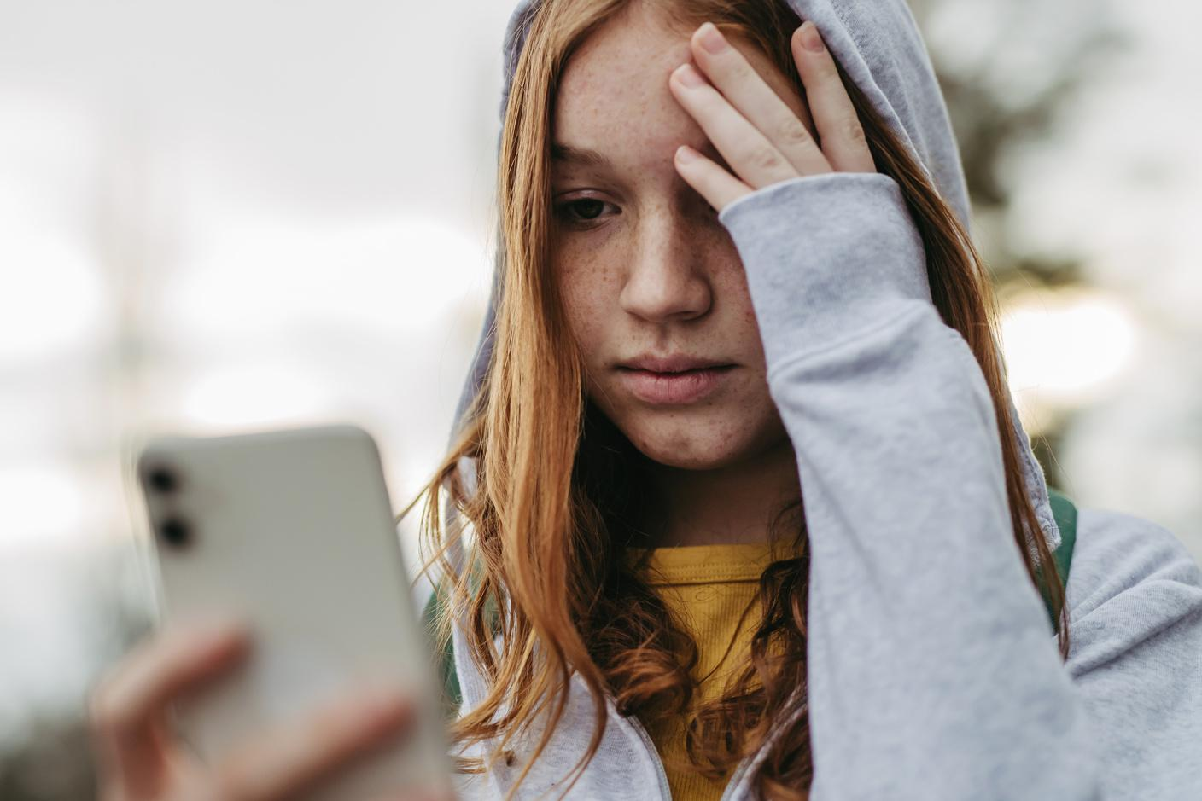
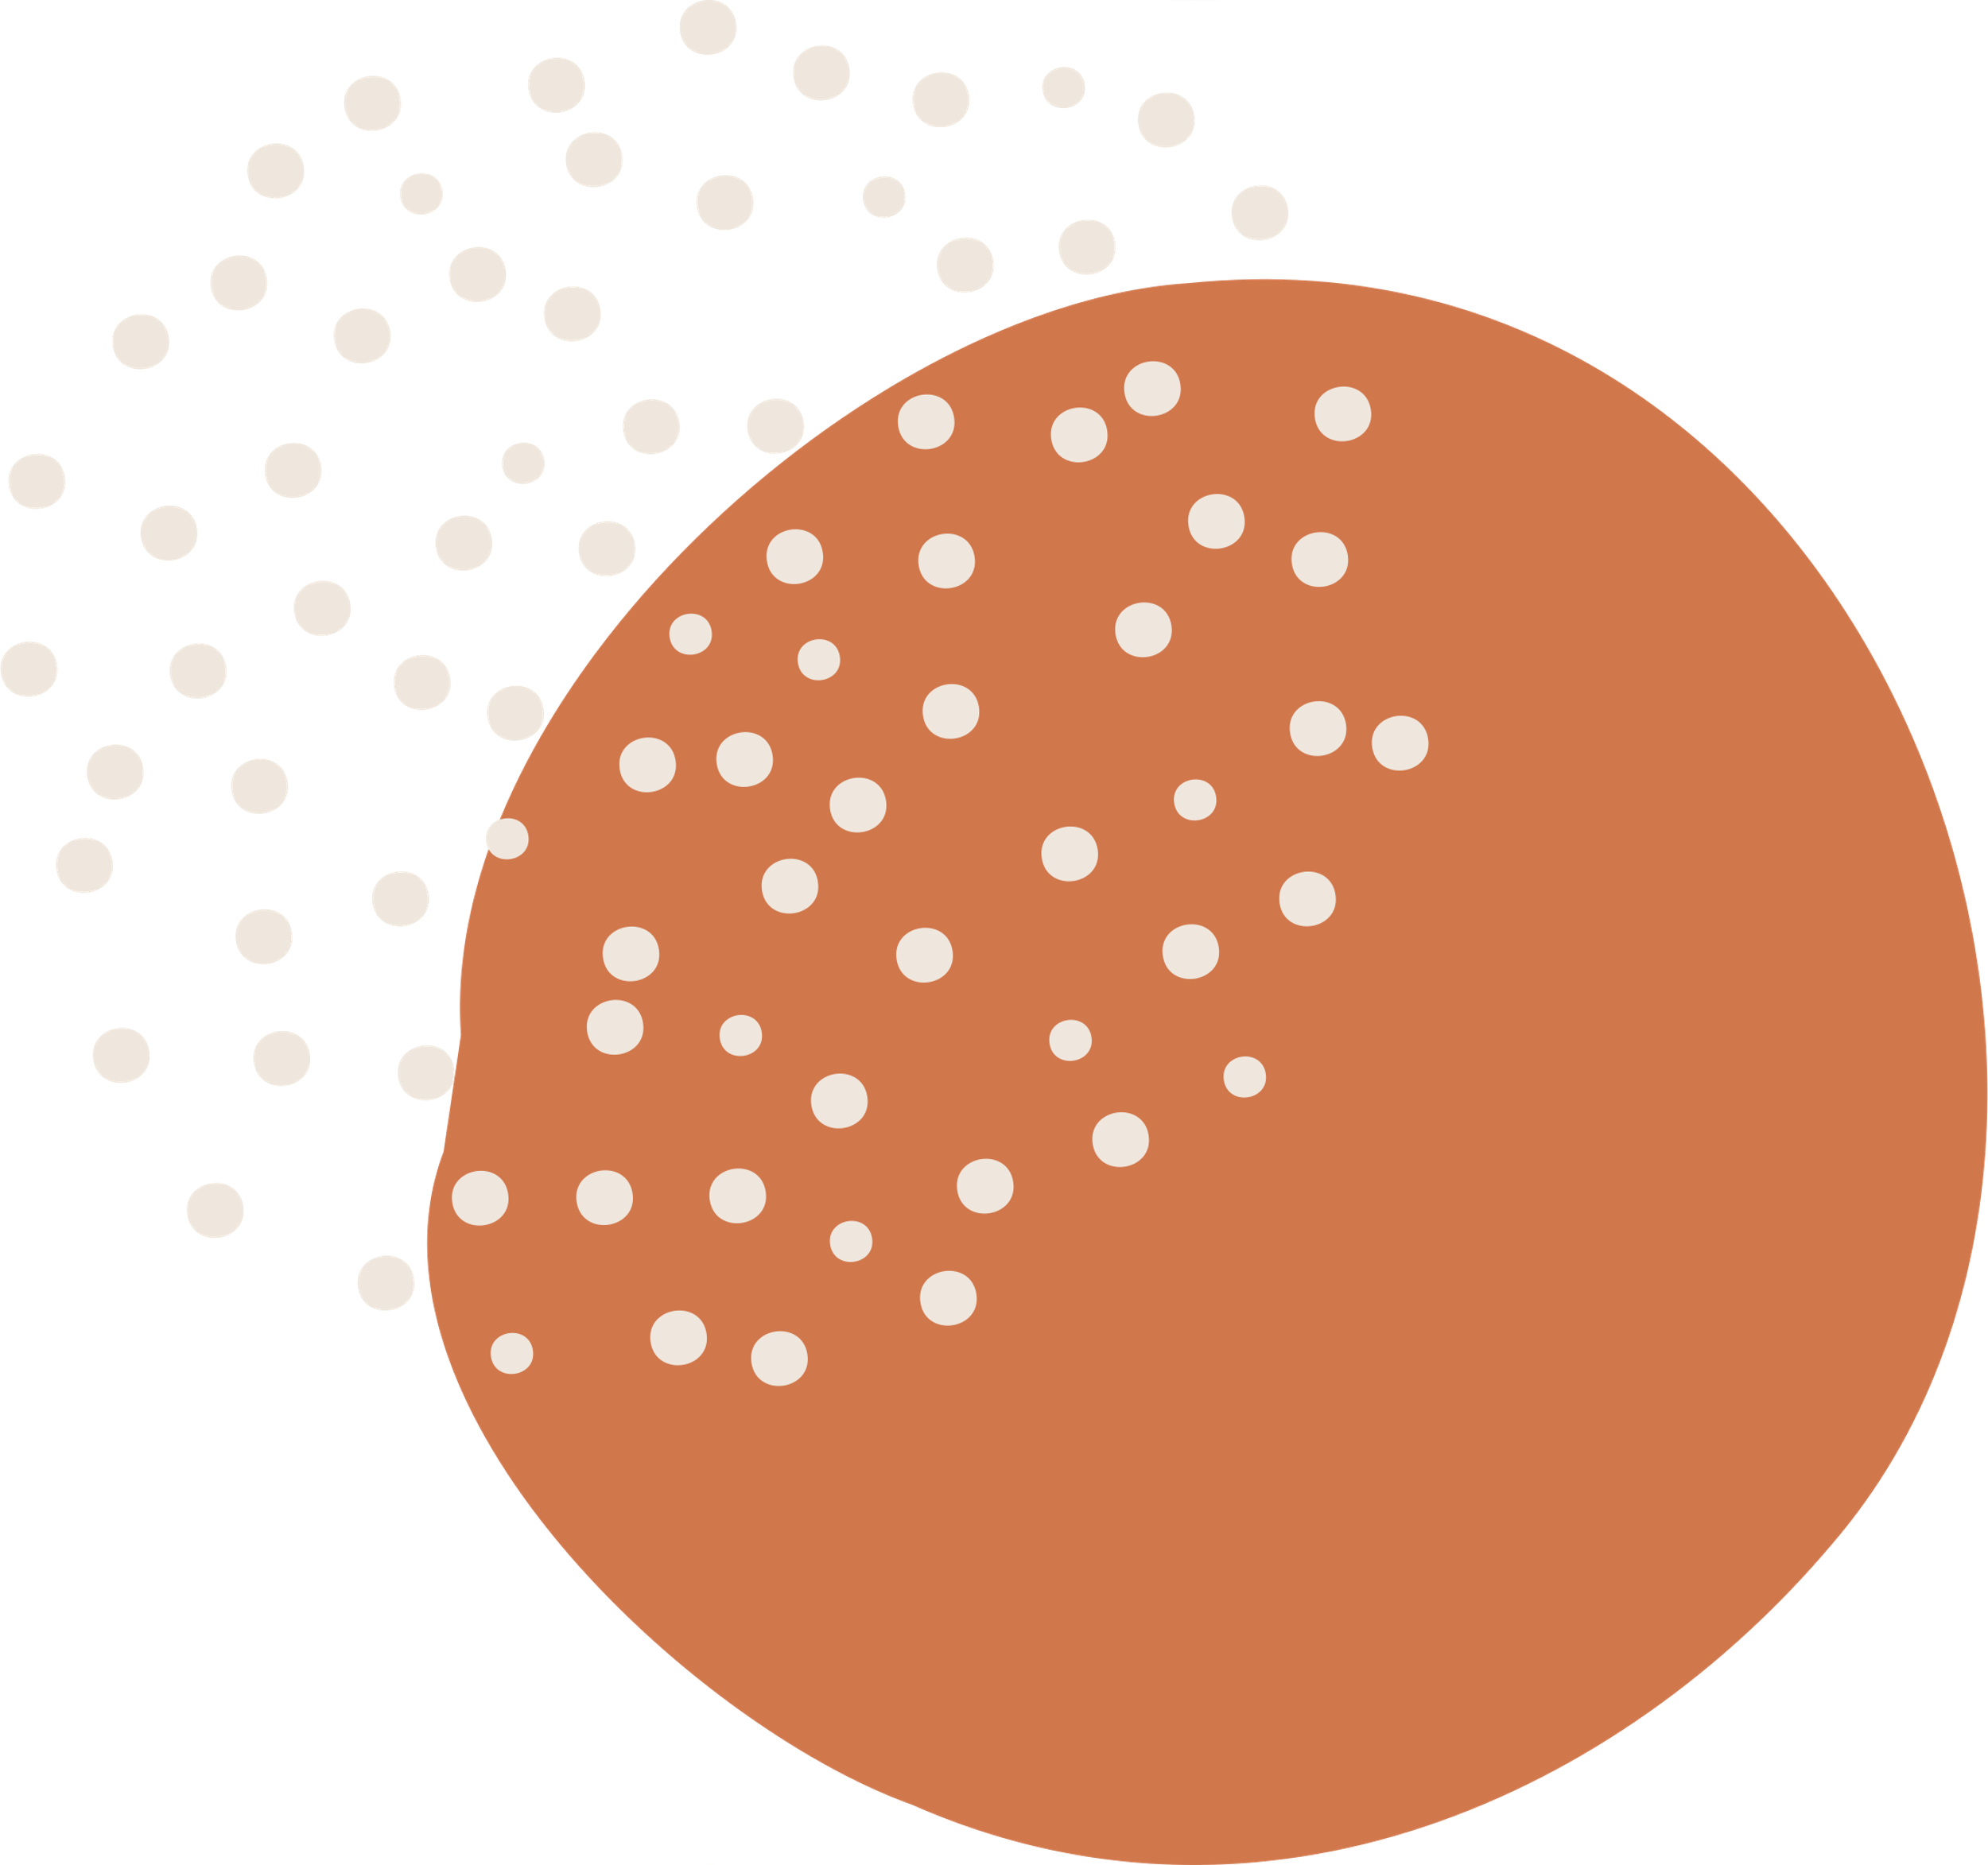
Digital Abuse
  Digital abuse happens when one person uses technology to maintain power and control over another
  1 out of every 4 teens are harassed online
  Abusers have found that phones and technology make it much easier to gain access to and harm their victim
Sextortion
  Extortion in which a perpetrator threatens to expose sexually compromising information (ex. private images or videos of the victim) unless the victim meets certain demands

Slide 14
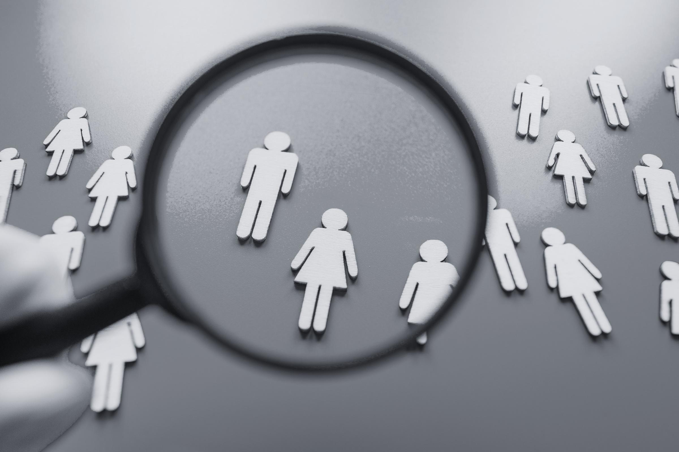
Part Two:
Human Trafficking
WHAT IS HUMAN TRAFFICKING?
GLOBAL, AND LOCAL STATISTICS
RISK & PROTECTIVE FACTORS

Slide 15

What is human trafficking?
the use of force, fraud, or coercion to compel someone to perform labor or a commercial sex act
(2)

Slide 16
How do they
maintain control?
THEY FILL A VOID
(3)
Who are the traffickers?
  Traffickers make promises (that they often do not fullfill) that are aimed at meeting the needs of their target in order to impose control
COMMON TACTICS
(3)
ANYBODY!
  Emotional and or physical abuse and or threats
  isolation from friends, family, others
  economic or financial abuse
Perpetrators span all racial, ethnic, and gender demographics. Some use their privilege, wealth, and power as a means of control while others experience the same socio-economic oppression as their victims.
VICTIMS FEEL TRAPPED
(3)
  they may fear leaving for numerous different reasons including psychlogical trauma, shame, emotional attachment, and/ or threats to themselves, their family or friends
(3)

Slide 17
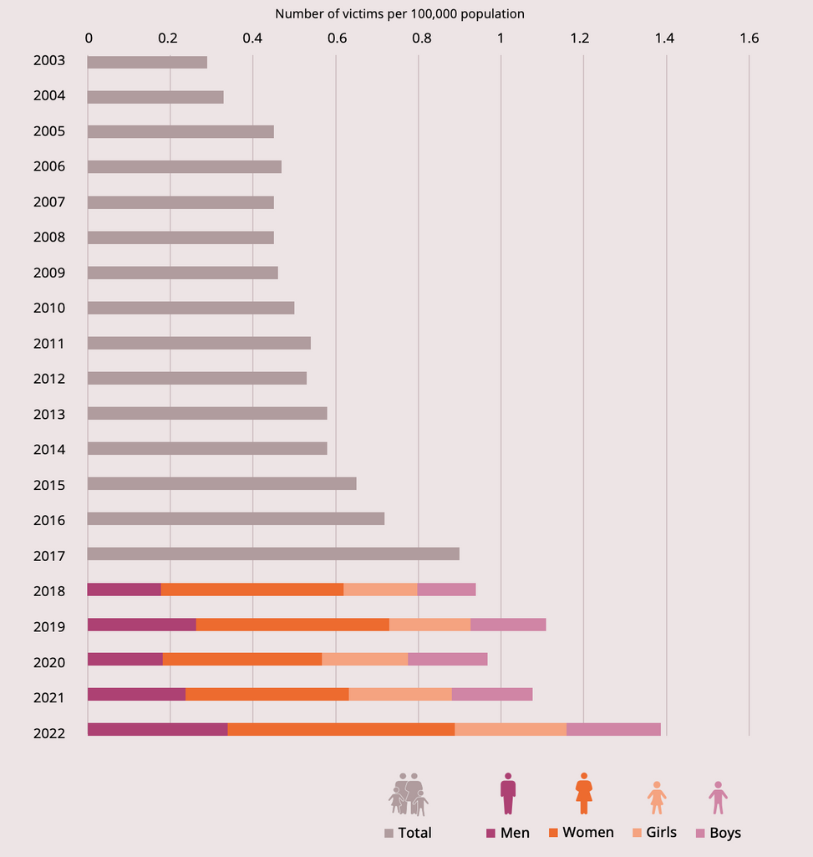
Global Trends
  in 2019, children made up 31% of trafficking victims
  as of 2022, children make up 38% of trafficking victims- and it is expected that this number will continue to increase
  Girls (22% of all victims) are mostly trafficked for sexual exploitation while boys (16% of all victims) are mostly trafficked for other exploitation reasons like forced criminality
  Globally, Human Trafficking generated about $150 Billion Dollars each year
(6)
(6)
(6)
(6)
(6)

Slide 18
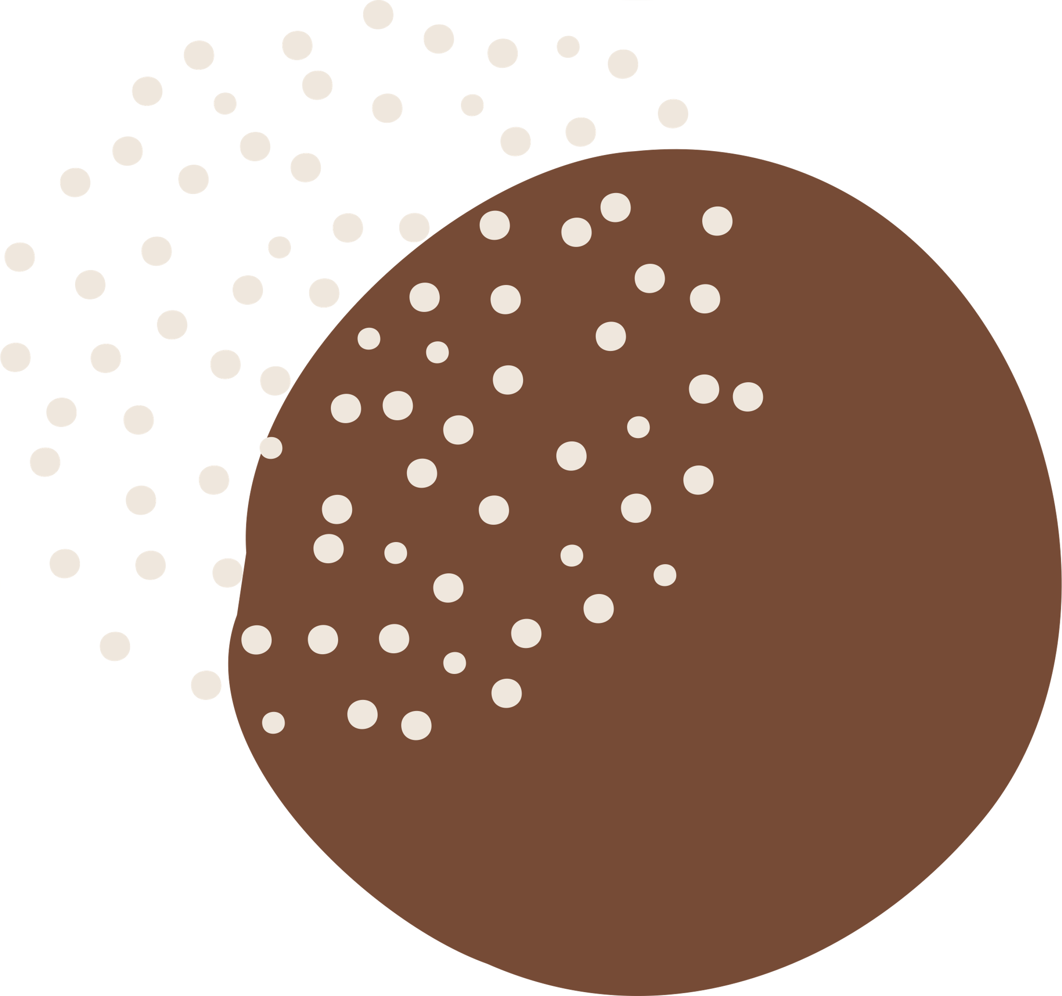
As of 2024, in the USA
  estimated 24,000 victims of human trafficking
  75% are estimated to be female
  40%are estimated to be minors (under the age of 18)
  All 50 states were affected by human trafficking in 2024
(7)
(7)
$10 billion
About
(7)
is made from Human Trafficking in the USA alone, every year
(5)
(7)

Slide 19
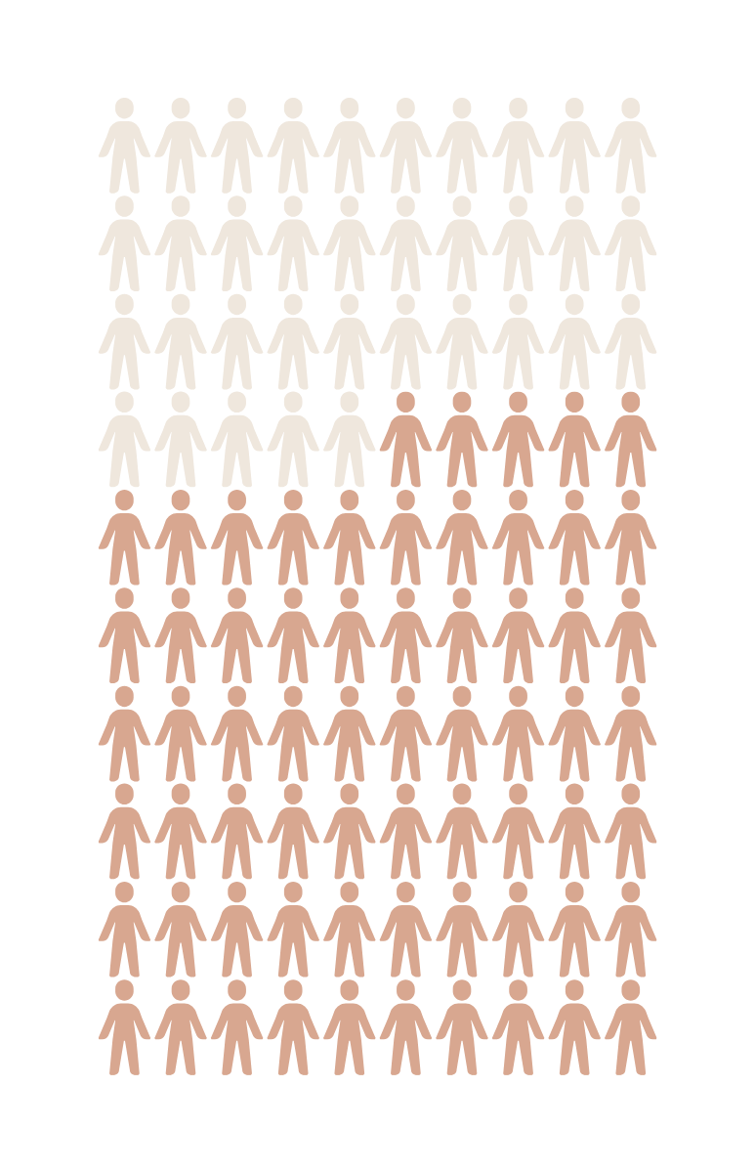
Texas Statistics
  Texas is the second largest hub for human trafficking in the United States
  The DFW region makes of 35% of all commercial exploitation cases in Texas
  Illegal Sex trade is a 99 million dollar industry in Dallas alone
(5)
(5)
(5)

Slide 20

What sets trafficking apart from other types of abuse?
  The manipulation tactics and ways of maintaining power and control are very similar
  The key word is “commercial” which means that human trafficking, whether it is labor or sex trafficking, is all about money!

Slide 21
True or False?
Most victims of human trafficking are randomly targeted or exploited by strangers

Slide 22
False!!
About 86% of human trafficking victims are recruited by an employers, intimate partner, family member, or caregiver.

Slide 23
  Disability
  Economic stress (e.g., debt, ransom/extortion, unemployment, underemployment)
  Fear of authority and law enforcement
  Housing instability, including history of running away or experiencing homelessness as a youth
  Immigration status
  Lack of family, community, or social support for navigating identity including but not limited to 2SLGBTQIA+2
  Limited familiarity with opportunities and limitations within U.S. systems (e.g., legal, social service, etc.)
  Limited or inaccurate understanding of labor rights
  Recent migration or displacement
  Any other indicator of vulnerability, or a void the trafficker can “fill”
Risk Factors
characteristics at the biological, psychological, family, community, or cultural level that precede and are associated with a higher likelihood of negative outcomes.
(8)
(2)

Slide 24
Characteristics associated with a lower likelihood of negative outcomes or that reduce a risk factor’s impact. Protective factors may be seen as positive countering events.
(8)
Protective Factors
  Financial literacy
  Knowledge of human trafficking, rights, and resources
(2)

Slide 25


Contact Us:
Amerson Meyers
Youth Advocate
amersonm@freedomhousepc.org
Cell: 817-565-4030
1149 Fort Worth Hwy
Weatherford, Tx 76086
24 Hour Hotline: 817-596-8922
Office: 817-596-7543
Britney Oaks
Sexual Assault Advocate
BritneyO@freedomhousepc.org
Destinee Palacios
Client/Child Advocate
DestineeP@freedomhousepc.org
Adriana Alvarez
Bilingual Advocate
adrianaa@freedomhousepc.org

Slide 26
Resources
  END REVENGE PORN revenge porn statistics *. (n.d.). https://www.cybercivilrights.org/wp-content/uploads/2014/12/RPStatistics.pdf
  A Public Health Approach to Preventing Human Trafficking. (n.d.). https://acf.gov/sites/default/files/documents/otip/HHS%20Human%20Trafficking%20Prevention%20Framework_Final.pdf
  Polaris. (2024). Myths, facts, and statistics. Polaris. https://polarisproject.org/myths-facts-and-statistics/
  Sexting and Teens. (2025). Aacap.org. https://www.aacap.org/AACAP/Families_and_Youth/Facts_for_Families/FFF-Guide/Sexting_and_Teens-142.aspx
  https://refugeforwomen.org/wp-content/uploads/2024/01/North-Texas-Trafficking-Stats-V2.pdf
  https://www.unodc.org/documents/data-and-analysis/glotip/2024/GLOTIP2024_BOOK.pdf
  (2025, January 16). Steps to Hope. Steps to Hope. https://www.stepstohope.org/blog/understanding-the-numbers-behind-human-trafficking-in-the-usa
  SAMHSA. (2019). Risk and protective factors. In Substance Abuse and Mental Health Services Administration. https://www.samhsa.gov/sites/default/files/20190718-samhsa-risk-protective-factors.pdf

