Slide 1
10th Grade: (DATE(s) March 24, 25, 26, 27, or 28
Students will learn about the realities of teen dating violence, the dangers of human trafficking, identify types of school violence, and keeping safe online.

Slide 2





FREEDOM HOUSE OF PARKER COUNTY
Teen Dating Violence,
Human Trafficking, School Violence, & Online Safety
MILSAP HS
10th Grade

Slide 3
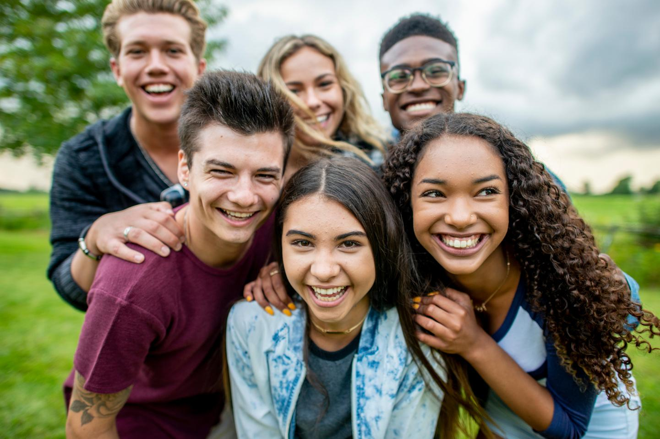

This Presentation
What we expect you
Have an open mind to recieve this information
Hold yourself and others to a high standard of respect for us and other students
What you can expect from us
We will uphold confidentiality
We will hold a space for respect for you and all of your questions
Objectives
Students will learn about the realities of teen dating violence, the dangers of human trafficking, identify types of school violence, and keeping safe online.

Slide 4


Part 1:
Teen Dating Violence
1/3
a pattern of physical, sexual, emotional/verbally abusive or controlling behaviors within a romantic relationship among teens
of teens will become a victim of Teen Dating Violence
experiencing dating violence as a teen has numerous negative affects on your well being now, and as you grow into an adult

Slide 5
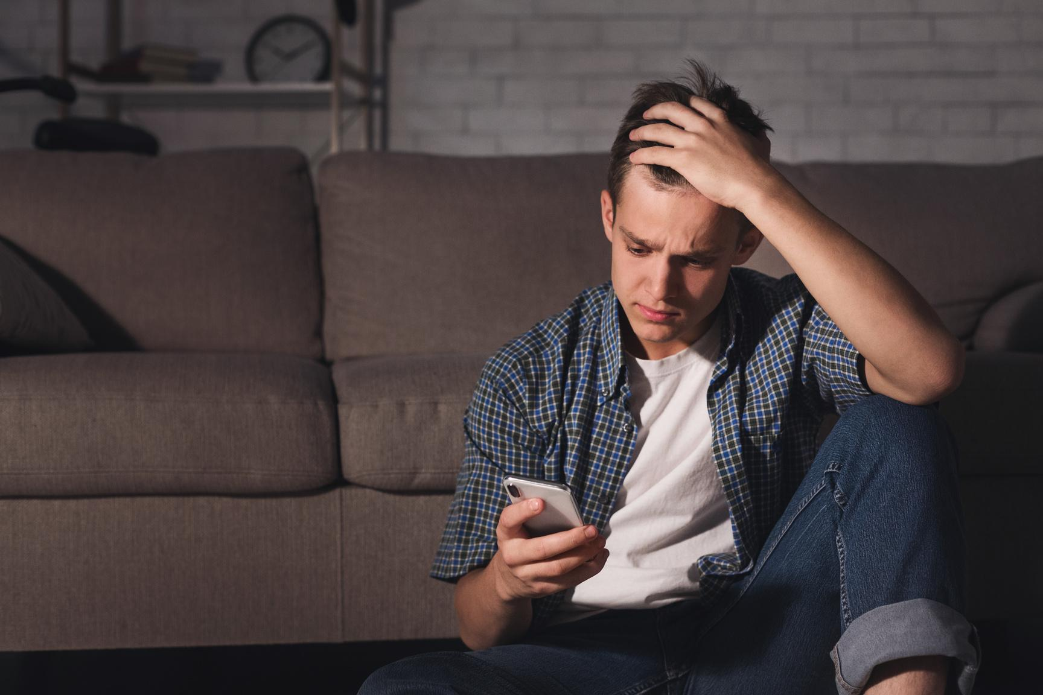

Greater Effects of Teen Dating Violence:
Teens who experience dating violence are statistically at an increased risk of:
  Anxiety
  Depression
  Antisocial Behaviors
  Substance Abuse Disorders
  Suicidal Thoughts/ Intentions
  Be Involved in Abusive Relationships as an Adult

Slide 6
HEALTHY
UNHEALTHY
  communication
  respect
  trust
  honesty
  equality
  enjoy time together
  able to enjoy time away from your partner
  mutual decisions
  financial partners
  lacking communication
  disrespect
  lack of trust
  dishonesty
  one partner tries to take control
  always spending time with your partner
  pressure to do things you are not comfortable with

Slide 7
CHARACTERISTICS OF AN ABUSIVE RELATIONSHIP
  communicating in a hurtful or threatening way
  mistreating
  manipulating
  repeatedly accusing the other of cheating, when it is not true
  forcing you to do things you are not comfortable with
  controlling
  denying that their behaviors are abusive
  isolating their partner from other

Slide 8
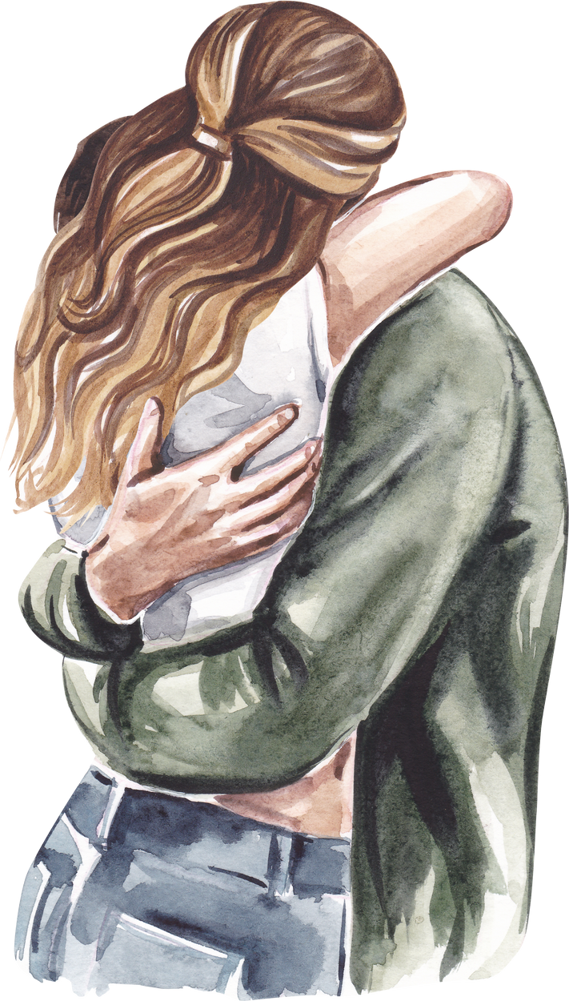
The Dating Bill of Rights:
I HAVE THE RIGHT TO
  BE RESPECTED
  MAKE MY OWN CHOICES
  SAY “YES”, “NO”, OR “MAYBE”
  WITHDRAWL MY CONSENT AT ANY TIME
  HAVE MY VOICE HEARD
  HAVE MY OWN TIME
  HAVE MY OWN FRIENDSHIPS
  PROTECT MY DIGITAL PRIVACY
  END RELATIONSHIPS WITHOUT GUILT OR FEAR

Slide 9
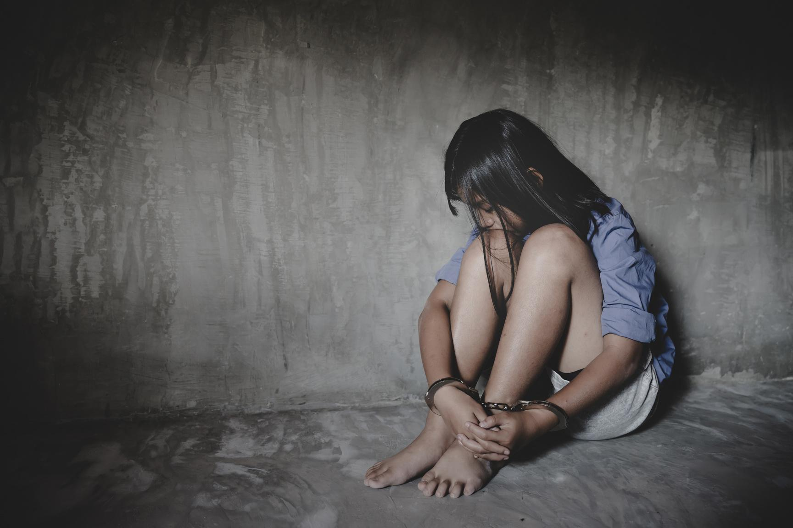

Part 2:
Human Trafficking
the use of force, fraud, or coercion to compel someone to perform labor or a commercial sex act (trafficking frame work)
  Child Exploitation for Commerical Sex
  Debt Bondage
  Organ Trafficking
  Forced labor
  Involuntary Domestic Servatude
  Involuntary Commercial Sex for Adults

Slide 10
HOW DO THEY MAINTAIN CONTROL?
WHO ARE THE TRAFFICKERS?
THEY FILL A VOID
  Traffickers make promises (that they often do not fullfill) that are aimed at meeting the needs of their target in order to impose control
ANYBODY!
COMMON TACTICS
  Perpetrators span all racial, ethnic, and gender demographics. Some use their privilege, wealth, and power as a means of control while others experience the same socio-economic oppression as their victims.
  Emotional and or physical abuse and or threats
  isolation from friends, family, others
  economic or financial abuse
VICTIMS FEEL TRAPPED
  they may fear leaving for numerous different reasons including psychlogical trauma, shame, emotional attachment, and/ or threats to themselves, their family or friends
(2)

Slide 11
Risk
Factors
  Disability
  Economic stress (e.g., debt, ransom/extortion, unemployment, underemployment)
  Fear of authority and law enforcement
  Housing instability, including history of running away or experiencing homelessness as a youth
  Immigration status
  Lack of family, community, or social support for navigating identity including but not limited to 2SLGBTQIA+2
  Limited familiarity with opportunities and limitations within U.S. systems (e.g., legal, social service, etc.)
  Limited or inaccurate understanding of labor rights
  Recent migration or displacement
  Any other indicator of vulnerability, or a void the trafficker can “fill”
characteristics at the biological, psychological, family, community, or cultural level that precede and are associated with a higher likelihood of negative outcomes.
(4)
(1)

Slide 12


Individual Impacts of Human Trafficking
Trafficking victims may endure
  physical violence
  forced labor
  sexual violence
  deprivation of basic needs
  victims often experience severe physical, psychological and emotional trauma resulting from their exploitation
  This trauma can have long-lasting effects on their mental health, self-esteem and ability to trust others.
  This also sometimes hinders their ability to feel confident in reporting or seeking help
(5)

Slide 13
Part 3:
School Violence
any type of violence that occurs in a school setting
Bullying/ Cyberbullying
Physical Violence
Weapon Violence and Gang Violence
Sexual Violence

Slide 14

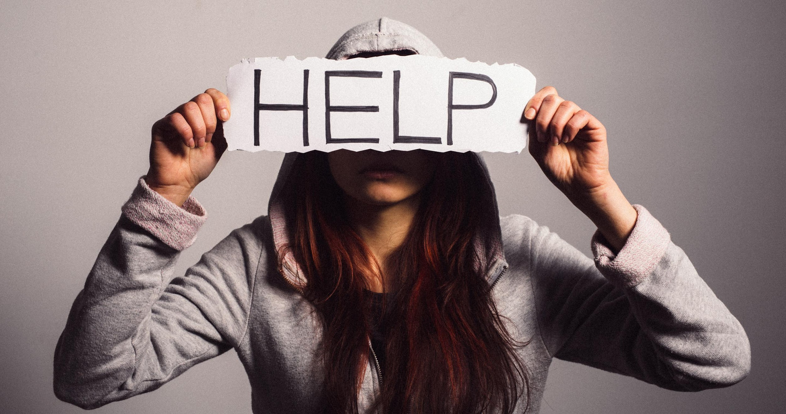



Behaviors that may signal that someone needs help
AGENDA
Lack of interest or poor performance in school
Absence of age-appropriate anger control skills
Seeing self as always the victim
Persistent disregard for or refusal to follow rules
Cruelty to pets or other animals
Artwork or writing that is bleak or violent or that
depicts isolation or anger
Talking constantly about weapons or violence
Obsession with violent games and/or TV shows
Lack of enthusiasm, energy or motivation
Carrying a weapon to school
Overreacting to criticism
Restlessness and agitation
Bullying
Misplaced or unwarranted jealousy
Involvement with or interest in gangs
Withdrawal from friends and activities

Slide 15






WHAT CAN YOU DO ABOUT IT?
01
Check in on your friends
03
Create a safe and welcoming enviroment in school
02
Report any threats, talk of suicide or harm to a trusted adult
04
If you are struggling with your mental health, please reach out for help

Slide 16
Part 4:
Online Safety
Quick Statistics
95% of U.S. Teens have access to a smart phone (NIH)
More than 3 hours daily on social media teens are twice as likely to experience poor mental health
Among teens age 13-19, the average time spent on social media is 4.8 hours a day (APA)
⅓ children can be expected to encounter unwelcome sexual experience online before age 18
Online Enticement has increased by 300% between 2021 to 2023 (NCMEC)
45% of teens said they felt online porn gives “helpful” information about sex

Slide 17


Benefits of Online Access
Connection & Community
Learning and Access to Information
Creativity and Expression
Advocacy and Social Awareness
Mental Health Support and Resources
Stress Relief & Entertainment
Problem Solving & Critical Thinking

Slide 18


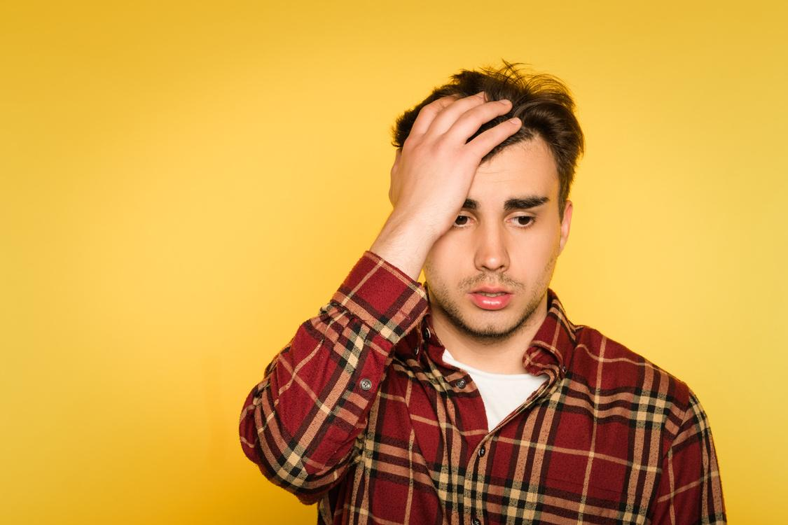
Mental Health Concerns
correlated with increased online usage
Constant Comparison and FOMO
Emotional Regulation
Attention and Focus

Slide 19






ONLINE DANGERS
Exposure to Inapproriate Content
Cyberbullying
Online Enticement
& Sextortion
Artifical Intelligence

Slide 20

Online Grooming
Grooming: building a relationship, trust, and emotional connection with a chosen victim in order to manipulate, exploit, and abuse them
The biggest danger when it comes to the internet, is that not everybody is always who they say they are. Online predators hide behind a screen and can pretend to be anyone they want

Slide 21


CONTACT US!
Amerson Meyers
Youth Advocate
amersonm@freedomhousepc.org
Cell: 817-565-4030
1149 Fort Worth Hwy
Weatherford, Tx 76086
24 Hour Hotline: 817-596-8922
Office: 817-596-7543
Britney Oaks
Sexual Assault Advocate
BritneyO@freedomhousepc.org
Destinee Palacios
Client/Child Advocate
DestineeP@freedomhousepc.org
Adriana Alvarez
Bilingual Advocate
adrianaa@freedomhousepc.org

