Slide 1



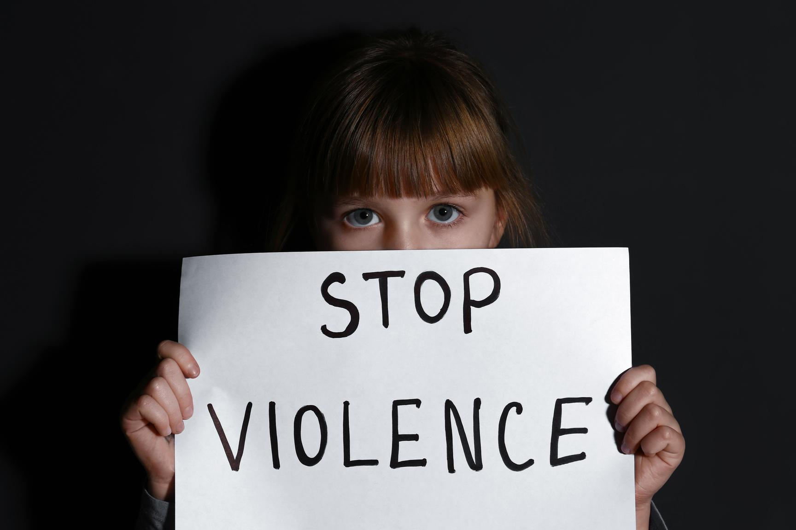
RECOGNIZE
THE SIGNS!
of Abuse & Grooming
9th Grade Millsap HS Presentation

Slide 2
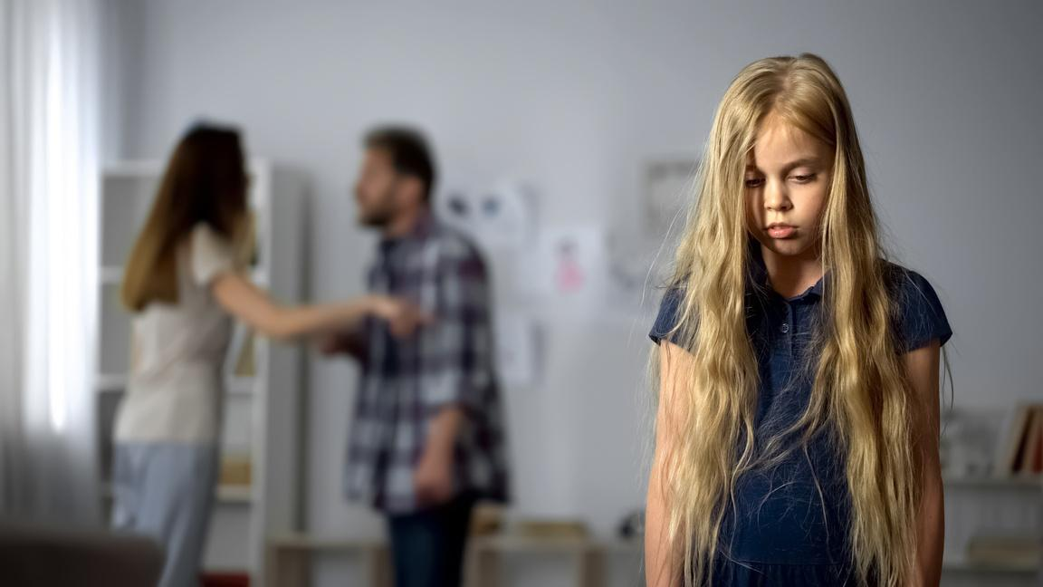
WHAT IS CHILD ABUSE AND GROOMING ?
Child Abuse: Any intentional harm or mistreatment to a child under 18 years old is considered child abuse.
Grooming: A deliberate process by which offenders gradually initiate and maintain Sexual Relationships with victims in secrecy.
PHYSICAL ABUSE
SEXUAL ABUSE
EMOTIONAL ABUSE
MEDICAL ABUSE
NEGLECT

Slide 3

How big is the problem of Child Abuse?
  1 in 4 girls and 1 in 13 boys in the U.S. are estimated to experience child abuse
  1 billion children globally are estimated to experience sexual violence
  More than 550,000 children are known to U.S. authorities to be abused.
  An estimated 558,899 children (unique incidents) were victims of abuse and neglect in the U.S. in 2022, the most recent year for which there is national data.
  That’s 8 children out of every thousand.

Slide 4


How does child abuse affect kids?
Possible Risk Outcomes
Child abuse hurts minds, bodies, and futures.
The trauma of child abuse causes children to lose their sense of safety and trust in the world and harms their relationships. Left untreated, the trauma of child abuse can lead to:
  Mental health problems like depression, anxiety and PTSD symptoms
  Behavioral changes like substance use disorders, risky sexual behaviors, or increased risk for violence against oneself and others
  Physical health problems like infections, injuries, or even heart disease or diabetes later in life.
Lack of progress in school
Depression
Substance Abuse
Suicide Attempts

Slide 5

Child abuse is deadly.
  In 2022, an estimated 1,990 children died from abuse and neglect in the United States
  This number is consistently on the rise over the previous five years
  Boys have a higher child fatality rate at 3.26 per 100,000 compared to girls at 2.25.
  African-American child fatalities (6.37 per 100,000) is over three times greater than that of white children (1.99), and nearly four times greater than Hispanic children (1.68).
Child abuse is costly to society.
  Nearly half of all U.S. children experience at least one type of childhood trauma.
  This exacts a toll on children, their caregivers, and their community, and our country as a whole also pays a price. Quite literally: In addition to the physical, emotional, and social costs of child abuse, it also carries economic costs

Slide 6
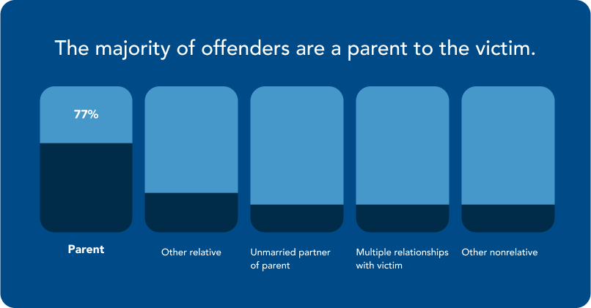
Where and how does child abuse happen?
Most child victims are abused by a parent.
  In 2022, a reported 434,000 perpetrators abused or neglected a child.
  In substantiated child abuse cases 76% of children were victimized by a parent or legal guardian.

Slide 7

Grooming Behaviors
Low-Risk or Potentially Normal Behaviors and Factors
  Activities planned alone with a child, or without other adults present
  Extra attention paid to a certain child
  Spending a lot of time or communicating often with a certain child
  Showing a certain child love or affection
  Telling a child they love them or the child is special
  Showing favoritism or calling the relationship with a child “special”
  Giving a child compliments often
  Seeming charming, nice, or likeable
  Inviting a child on overnight stays or outings outside the family
  Giving a child special rewards or privileges
  Engaging in childlike activities with a child outside the family
  Low child confidence/self-esteem
  Loneliness or isolation
  Psychological or behavioral troubles
  Feeling needy
**When a certain adult’s relationship with a child includes several of these, they are an indication to take a closer look**

Slide 8
Grooming Behaviors
Moderate-Risk Behaviors and Factors
  Talking to a child about a child’s sexual experiences or relationships
  Using inappropriate sexual language/telling dirty jokes around a child
  Teaching a child sexual education outside a formal role to do so
  Providing a child with drugs or alcohol
  Getting close to a child’s family to gain access to the child
  Lack of adult supervision for a child
  Lack of parental closeness/parents not a resource
  Giving a child special gifts, rewards, or privileges (except family members)
**While these factors were found to be usually present in genuine grooming cases, they don’t always indicate abuse**
**Context Matters**

Slide 9
Grooming Behaviors
Red Flags: High-Risk Behaviors
  Increasingly sexualized touching of a child over time
  Seemingly innocent or non-sexual touching of a child
  Accidental touching or distraction while touching a child
  Nudity in front of a child or watching a child undressing or while naked
  Showing a child pornographic magazines, images, or videos
  Talking to a child about past sexual experiences
  Separating or isolating a child from their peers and family
**These behaviors are always concerning and should prompt a discussion with the child’s parents and institutional leaders, and most often a report of possible child abuse to authorities**

Slide 10
HOW WE HELP
Freedom House
We provide a wide variety of services including:
  Emergency Shelter
  24 Hour Hotline
  Advocacy
  Counseling/ Therapy
  Legal Aid
  Transportation
  Court accompaniment
  And many more!
is a domestic violence and sexual assault service provider in Parker County Texas.
1149 Fort Worth Hwy
Weatherford, Tx 76086
24 Hour Hotline: 817-596-8922
Office: 817-596-7543

Slide 11


Contact us:
1149 Fort Worth Hwy
Weatherford, Tx 76086
24 Hour Hotline: 817-596-8922
Office: 817-596-7543
Amerson Meyers
Youth Advocate
amersonm@freedomhousepc.org
Cell: 817-565-4030
Destinee Palacios
Client/Child Advocate
DestineeP@freedomhousepc.org
Britney Oaks
Sexual Assault Advocate
BritneyO@freedomhousepc.org
Adriana Alvarez
Bilingual Advocate
adrianaa@freedomhousepc.org

