Slide 1
The Big Five Presents: Lockdown/Barricade
Think-on-Your-Feet Peet and the Slimeville Monsters
TK-3rd Grades
2023-2024 School Year

Slide 2
About This Deck
The contents of this deck accompany the Big Five book, Think-on-Your-Feet Peet and the Slimeville Monsters.
The question prompts were created to use as discussion questions during class read aloud of the book.
The deck includes definitions for Big Five-specific vocabulary words.
The Activity Booklet can be used during the read aloud, as an additional classroom activity, or as a take home activity.
Teachers may use and customize the content of this deck as appropriate.

Slide 3
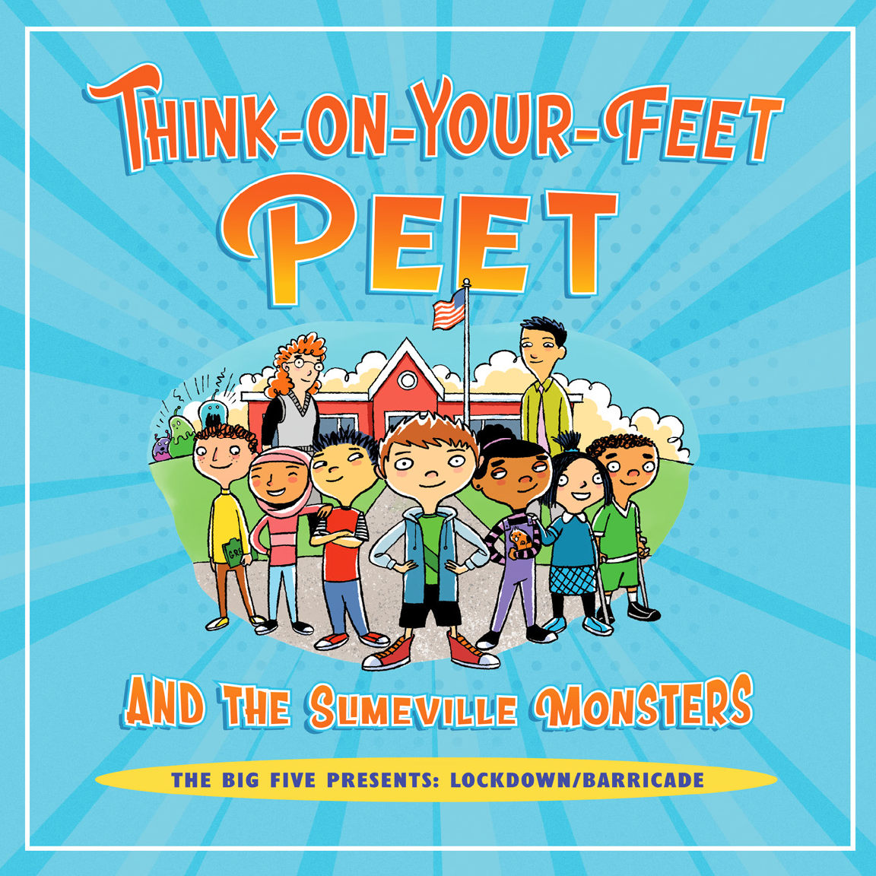
What do we know about this book from the cover?

Slide 4


The Big Five
Immediate Action Response
Shelter in Place
Drop, Cover, and Hold On
Secure Campus
Lockdown/Barricade
Evacuation
Notes:
Briefly review the Big Five Immediate Action Responses
Show students the Big Five Posters
Remind students that when we need to respond, the teacher will guide them and help them know what to do.
Throughout the year, you might remember that we do Drills, these drills help us practice the Big Five
Practicing helps us remember what to do
Reading this book and talking about this helps us learn how to Lockdown/Barricade

Slide 5
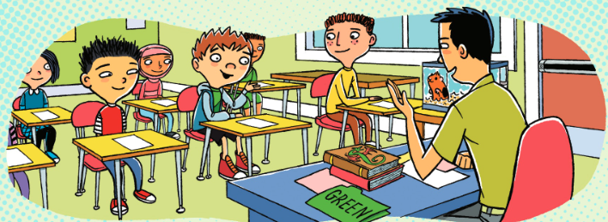
Page 1: What is the school called? Does it seem like this school is similar to ours?
Page 2-3: How are you similar to Peet? How are you different?
Page 5: What was “not normal” on this day?

Slide 6
intruder
A person who enters a building, grounds, etc. without permission
Page 7: Turn and Talk: Who is the intruder the author is referring to?
Notes:
Students may identify other words to use for intruder, like bad guy or villain.

Slide 7
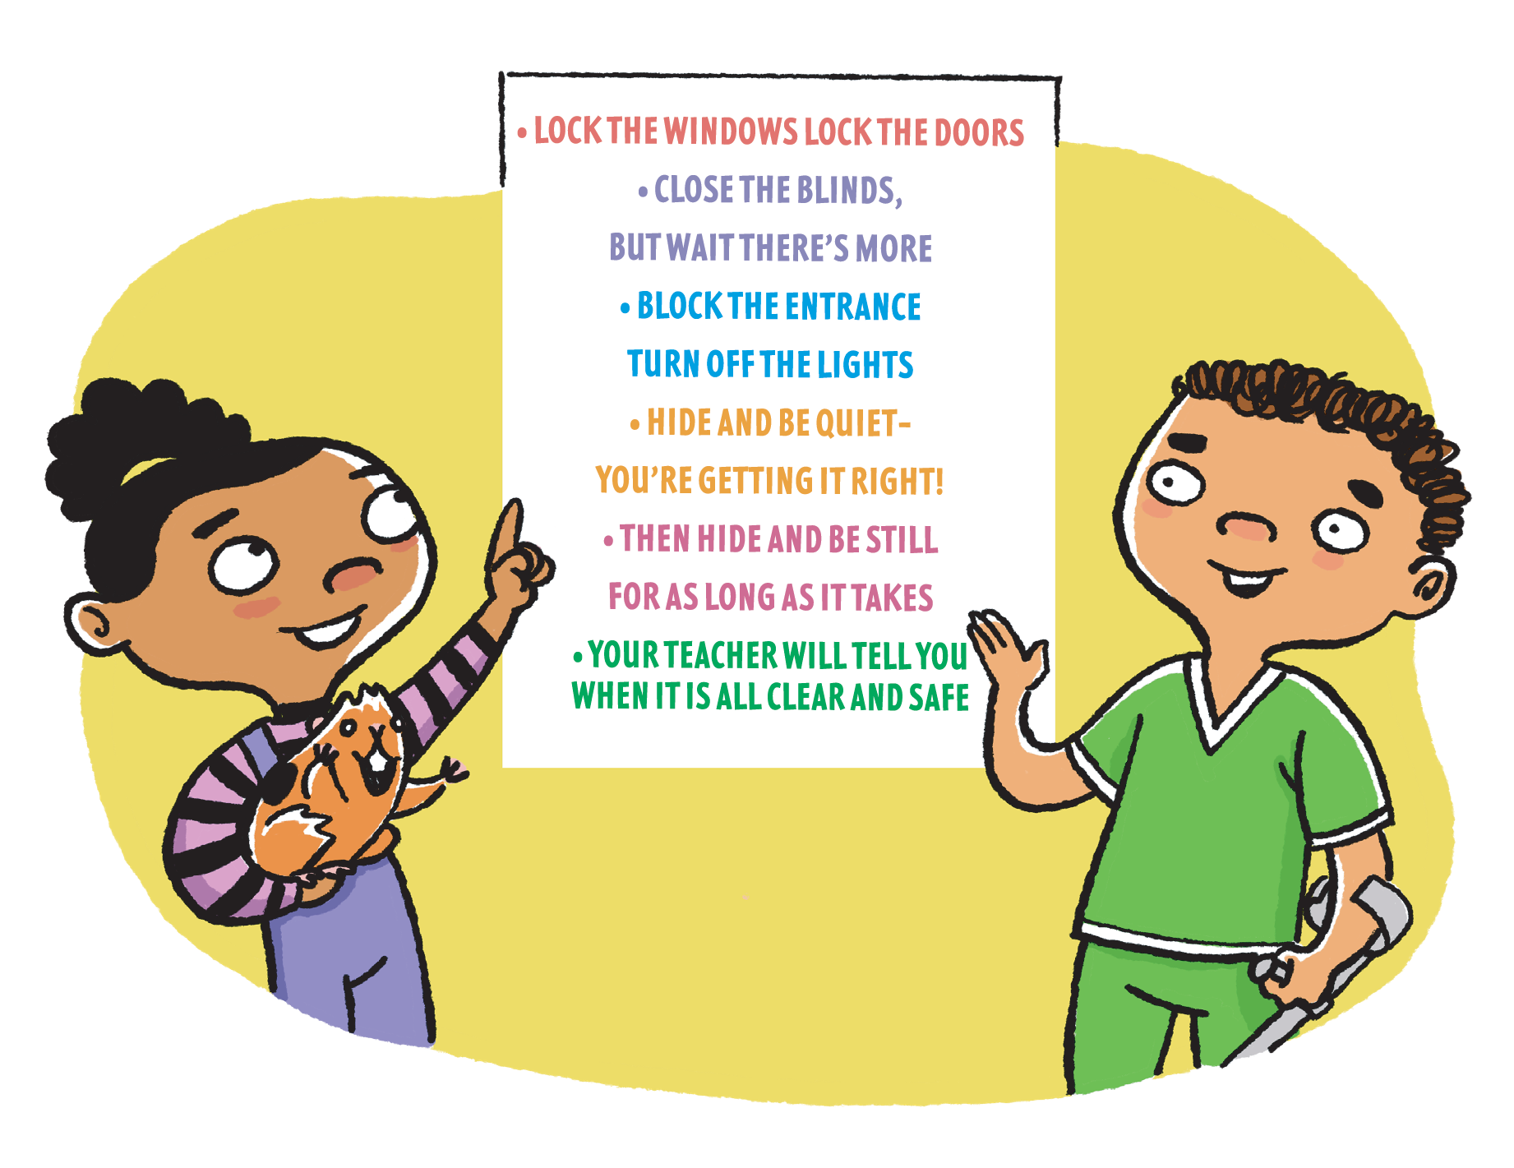
Page 8 - What does Mr. Lee want the students to practice?
Lock the windows. Lock the doors.
Close the blinds, but wait there’s more.
Block the entrance. Turn off the lights.
Hide and be quiet. You’re getting it right!
Then hide and be still for as long as it takes.
Your teacher will tell you when it is all clear and safe.
Notes:
This is a good time to practice a choral read of the poster. This supports language development for all students, in particular English Learners.
Point out to students where the windows and doors to be closed and locked are.
Show students how to close the blinds and turn off the lights.
If you want, you can show students what might be used to “block the entrance”
Point out hiding spaces to students. Students can also offer up ideas of where to hide in their classroom.

Slide 8
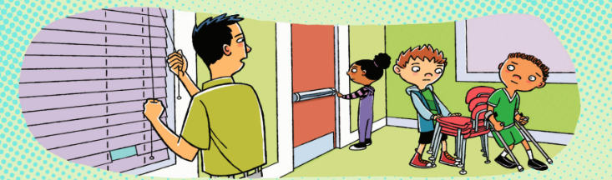
Page 9-10: What are the children preparing to do?
Page 12: What did Peet do to help? (How did Peet think on his feet?)
Page 13: What happened to Ms. Penny after barricading the door?
Notes:
Teacher models to students what might be and can be used to barricade.
Students can give examples of what can be used in their classroom to barricade the door.
Extension: Teacher can write these ideas down on poster paper for later reference.

Slide 9
barricade
Any barrier that obstructs passage
Notes:
https://www.ldoceonline.com/dictionary/barricade

Slide 10
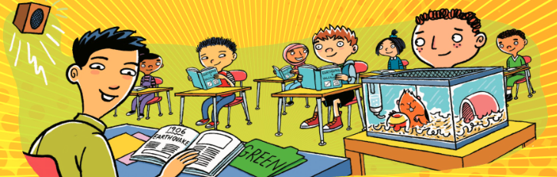
Page 15-16: Who came to help?
What did the Principal say?
What makes it “clear and safe?”
Page 18: How did the students show teamwork?

Slide 11

Pages 19-20: What did the Slimeville Monsters want?
What would Ms. Penny like to do?
Page 21: What do you think Peet will do next?

Slide 12

Page 22: Peet did some experimenting! What do you think the surprise could be?
Can you predict what Peet might do next? What would you do next?

Slide 13
lockdown
a security measure taken during an emergency to prevent people from leaving or entering a building or other location
Notes:
https://www.ldoceonline.com/dictionary/lockdown

Slide 14
Lock the windows. Lock the doors.
Close the blinds, but wait there’s more.
Block the entrance. Turn off the lights.
Hide and be quiet. You’re getting it right!
Then hide and be still for as long as it takes.
Your teacher will tell you when it is all clear and safe.
Notes:
You can have the students read this aloud one more time.
Extension: EL Strategy: Create gestures and act out each line with students.

Slide 15
Page 25: How did Peet solve a problem for the Slimeville Monsters?
Draw/ Illustrate the Poster
Write/ Illustrate new pictures for the text
Write/ Illustrate a new adventure for Think on your Feet, Peet
Notes:
If you would like, you can extend the lesson by having students engage further.
The Activity Booklet can also be used

Slide 16
Thank You!

