Slide 1
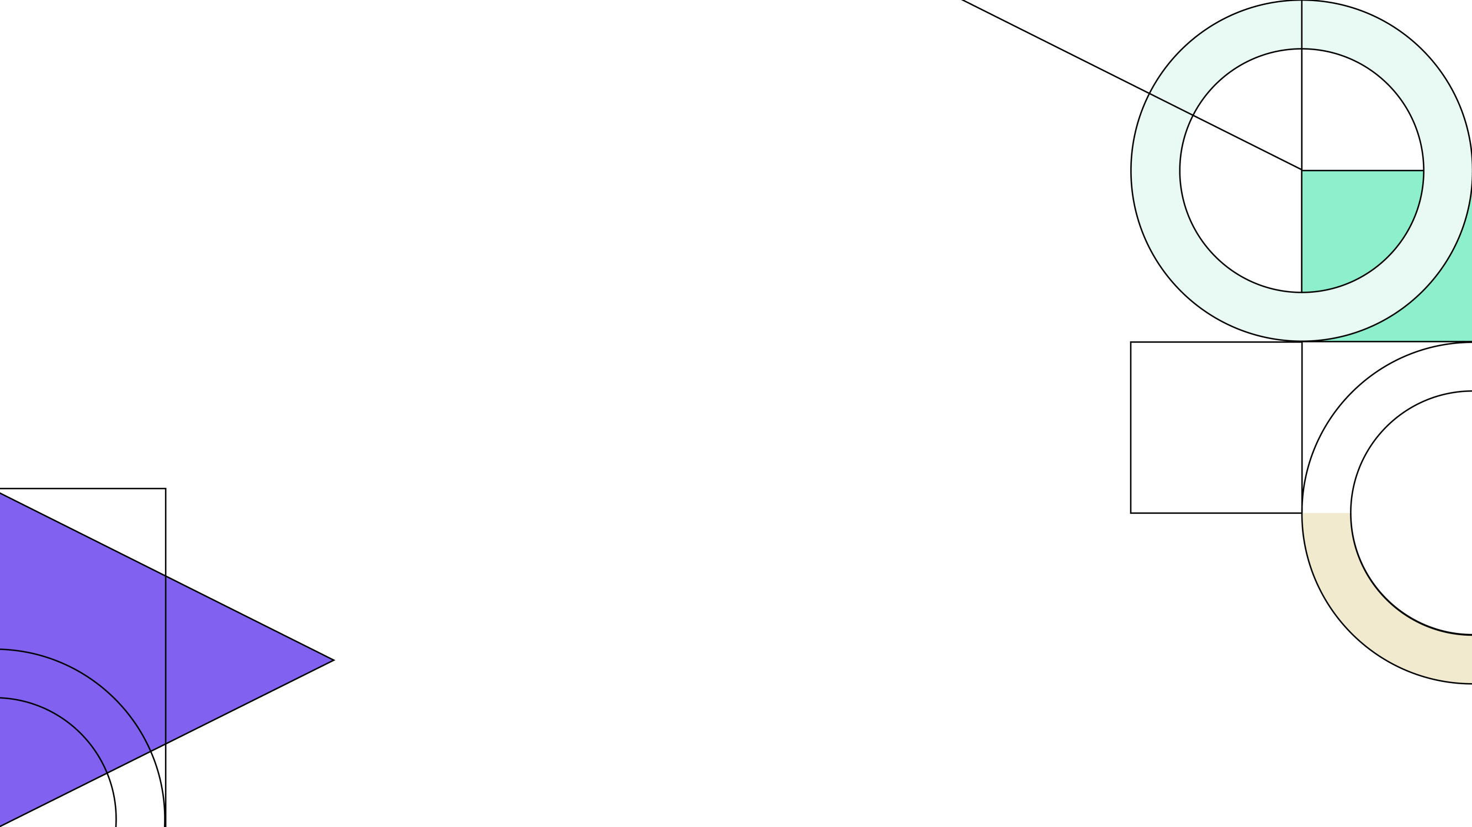


Fall 2024 Demographic Report
October 21, 2024

Slide 2

Local Economic Conditions
Unemployment Rate, Aug 2019 – Aug 2024
14
13.1
Unemployment Rate, Year Over Year
12
US
3.9
11.2
4.4
10
Texas
4.2
4.4
8
Killeen-Temple MSA
4.7
5
6
5
4.7
4
4.4
Bell Co.
5.1
3.6
2
Coryell Co.
4.8
5
0
4.1
4.3
Aug-19
Oct-19 Dec-19 Feb-20 Apr-20 Jun-20 Aug-20 Oct-20
Dec-20 Feb-21
Apr-21
Jun-21 Aug-21 Oct-21 Dec-21 Feb-22 Apr-22 Jun-22 Aug-22 Oct-22 Dec-22 Feb-23 Apr-23 Jun-23 Aug-23 Oct-23 Dec-23 Feb-24 Apr-24 Jun-24 Aug-24
Lampasas Co.
Killeen-Temple MSA
Texas
0
1 2 3
Aug-23 Aug-24
4
5
6
2

Slide 3



BISD Housing Market Analysis
Total Home Sales in Belton ISD, 2014 – August 2024
3,000
2,500
2,000
1,500
2,829
2,372
2,455
2,398
1,000
2,034
2,110
987
1,848
1,940
1,654
1,730
500
0
2014
2015
2016
2017
2018
2019
2020
2021
2022
2023
YTD 2024
Sources: Metrostudy & Bell County Deed Transactions
3

Slide 4


Belton ISD Home Price Analysis
Avg. New v. Existing Sale Price, 2014 – August 2024
$450,000
$400,000
$350,000
$300,000
$250,000
$200,000
$150,000
$100,000
$50,000
$0
 | Avg New Home | Avg Existing Home
2014 | $218,700 | $183,532
2015 | $213,627 | $190,880
2016 | $219,784 | $192,190
2017 | $225,969 | $200,046
2018 | $249,917 | $213,496
2019 | $240,928 | $231,016
2020 | $265,153 | $235,399
2021 | $277,424 | $235,719
2022 | $329,824 | $293,326
2023 | $379,918 | $310,990
YTD 2024 | $394,004 | $343,608
2014
2015
2016
2017 2018
Avg New Home Price
2019 2020
Avg Existing Home Price
2021
2022
2023
YTD 2024
The average new home sale price in Belton ISD has risen 80% in the last
10 years, an increase of more than $175,300
The average existing home sale price in BISD has increased 87%, an increase of more than $160,000

Slide 5
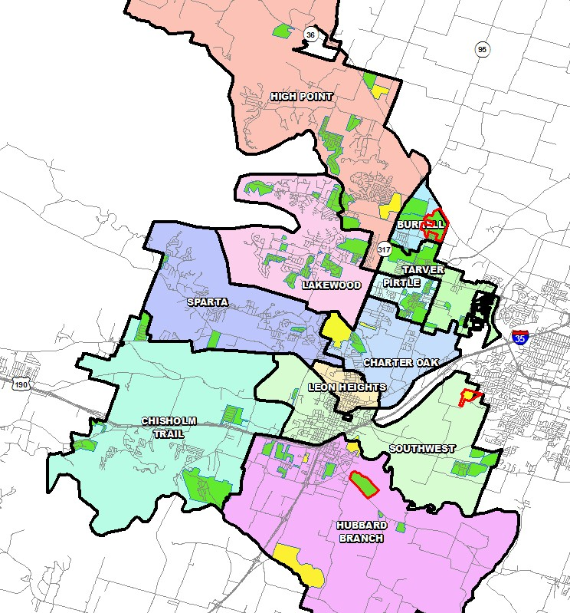
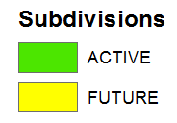

District Housing Overview
The district has 53 actively building
subdivisions
Within Belton ISD there are 8 future subdivisions
Of these, groundwork is underway on more than 340 lots within 3 subdivisions

Slide 6
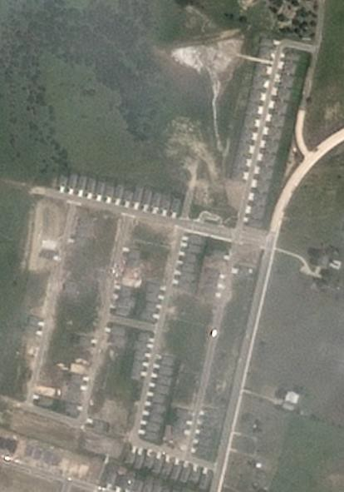
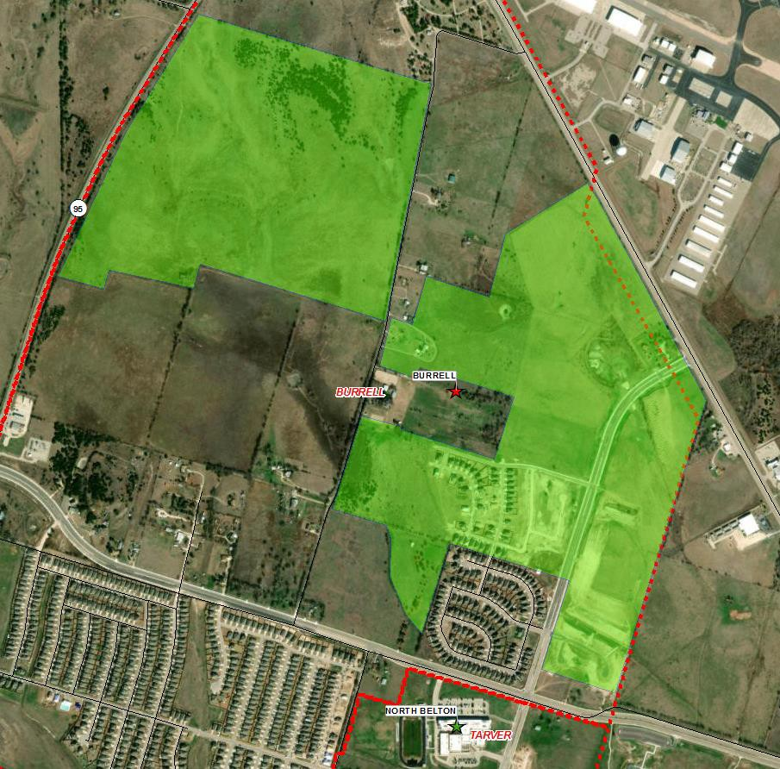
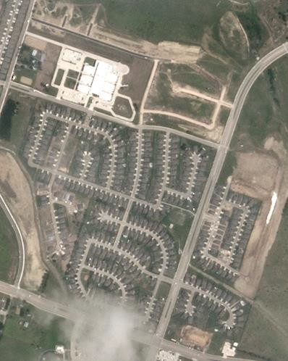
Northpointe
May 2024
Residential Activity
658 total lots
Approx. 227 future lots
Approx. 308 vacant developed lots
Approx. 15 homes under construction
Approx. 108 occupied homes
Closed 52 homes in last 12 months
$260K+
Current Student Yield = 0.602
May 2024
North Gate
563 total lots
Approx. 225 future lots
Approx. 52 vacant developed lots
Approx. 29 homes under construction
Approx. 257 occupied homes
Groundwork underway for 93 lots in Phase 6 Sec 1 & 34 lots in Phase 4; estimated delivery late 2024
$280K+
Current Student Yield = 0.953

Slide 7
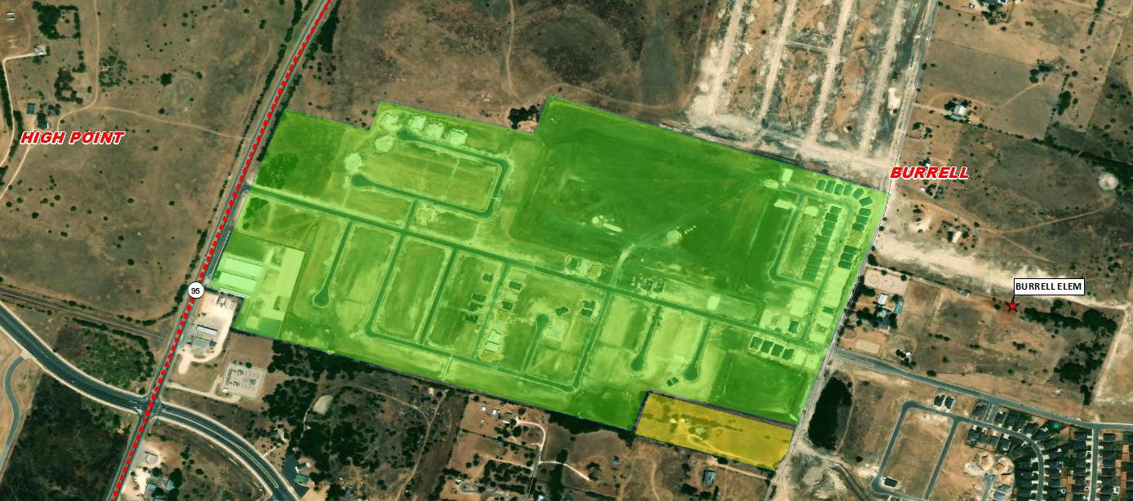
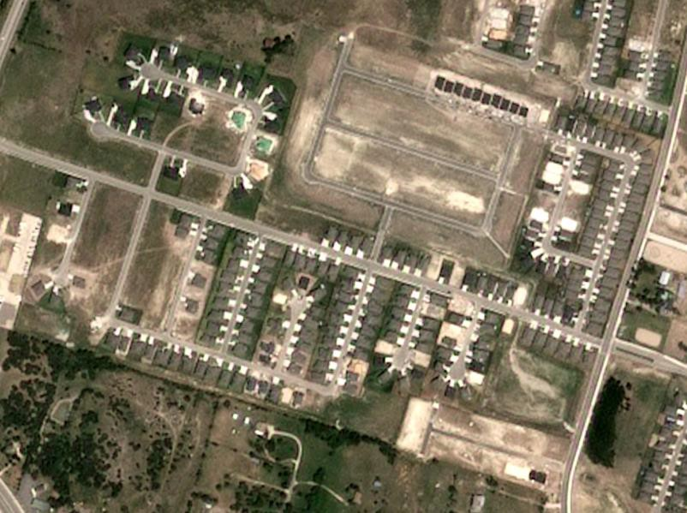
Mesa Ridge
Residential Activity
425 total lots
Approx. 207 vacant developed lots
Approx. 36 homes under construction
Approx. 182 occupied homes
Closed 79 homes in last 12 months
Permitted 34 homes in last 6 months
$217K+
Current Student Yield = 0.824
July 2024
North Ridge Townhomes
65 total townhome lots
Approx. 61 vacant developed lots
Approx. 4 townhomes under construction
Homebuilding began June 2024
Anticipate first residents early 2025

Slide 8
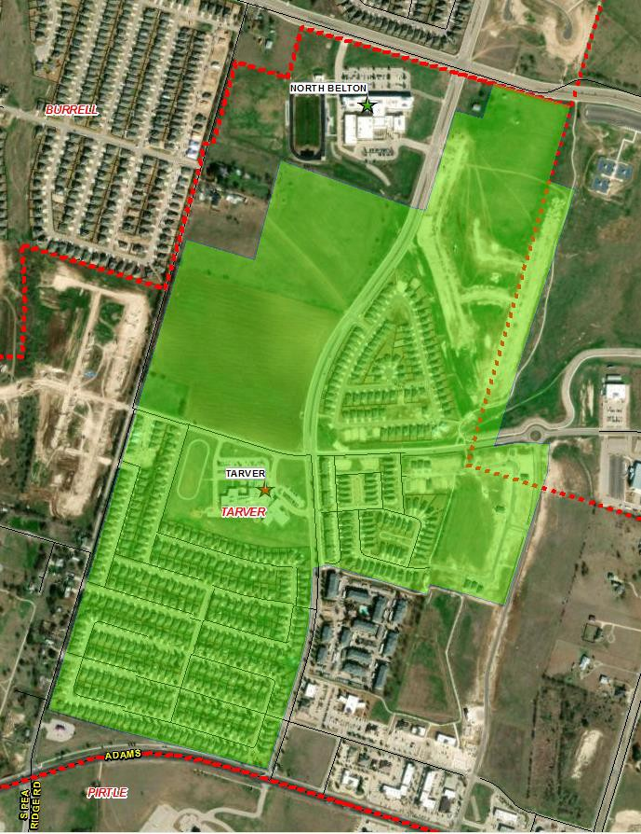
Residential Activity
Westfield
1,123 total lots
Approx.172 future lots
Approx. 84 vacant developed lots
Approx. 9 homes under construction
Approx. 858 occupied homes
$274K+
Current Student Yield = 0.569

Slide 9
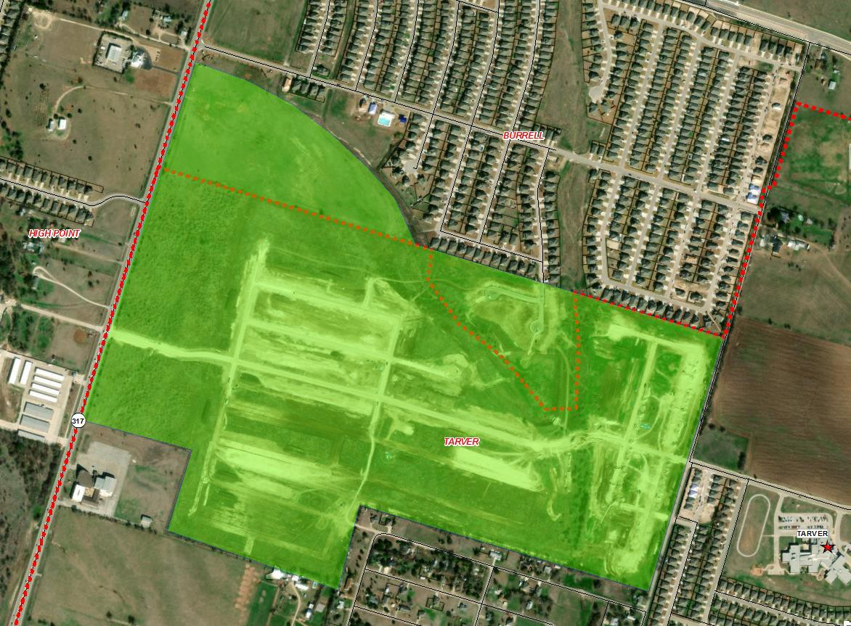
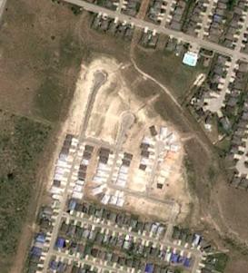
Residential Activity | Lake Pointe Terrace 686 total lots Approx. 45 vacant developed lots Approx. 46 homes under construction
 | Approx. 595 occupied Closed 87 homes in la Final lots delivered for Spring 2024 $300K+ Current Student Yield | homes st 12 months homebuilding = 0.602
July 2024
9

Slide 10
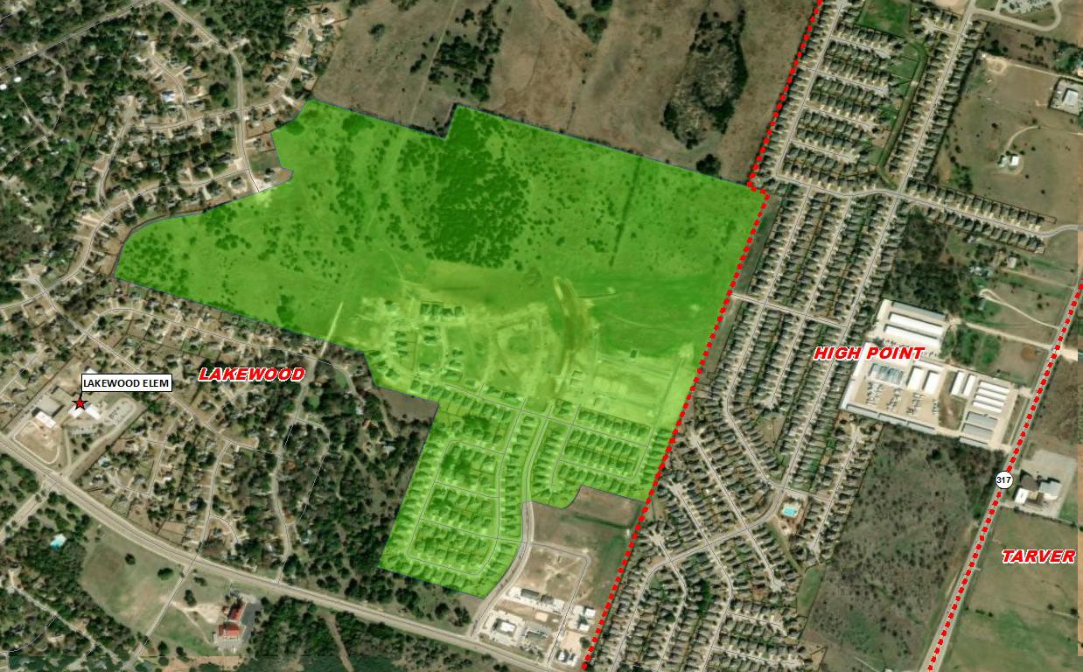
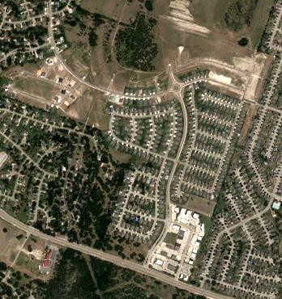
Residential Activity
The Grove at Lakewood Ranch
600 total lots
Approx. 27 future lots
Approx. 204 vacant developed lots
Approx. 19 homes under construction
Approx. 350 occupied homes
Closed 20 homes in last 12 months
Phase 7 (41 lots) & Phase 8 (120 lots) delivered for homebuilding Spring 2024
$170K - $300K
Current Student Yield = 0.714
July 2024
10

Slide 11
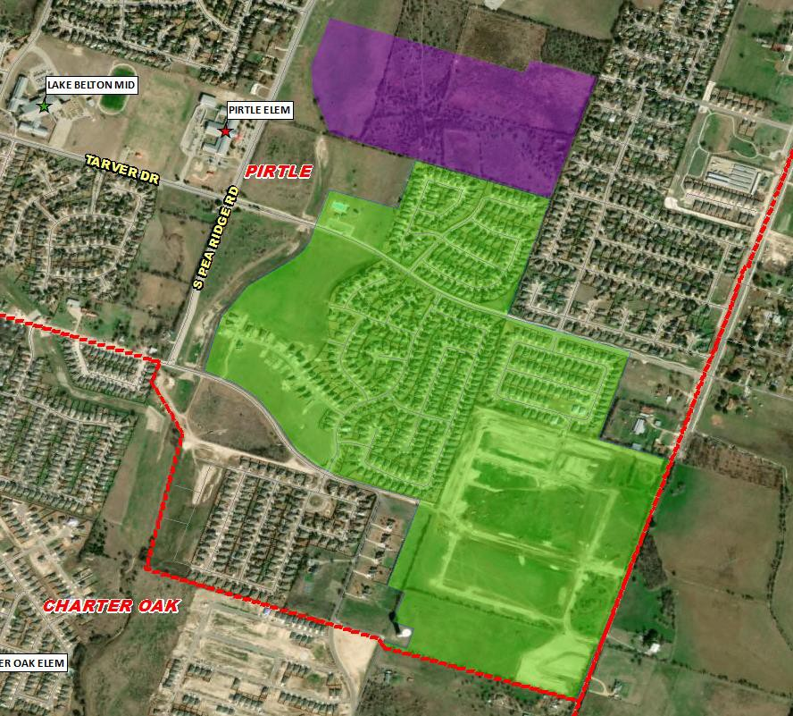
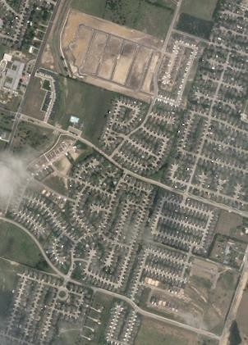
Residential Activity
Fresh Meadows
263 total single-family rental homes
May 2024
under construction
First homes completed Spring 2024
Phase 2 (184 lots) delivered for homebuilding May 2024
70 permits issued in last 6 months
$2,045 - $2,395 per month
Hills of Westwood
1,128 total lots
Approx. 350 future lots
Approx. 131 vacant developed lots
Approx. 23 homes under construction
Approx. 624 occupied homes
114 lots in Phase 14 delivered for
homebuilding late Spring 2024
Issued 34 permits in last 6 months
$300K+
Current Student Yield = 0.569
11

Slide 12
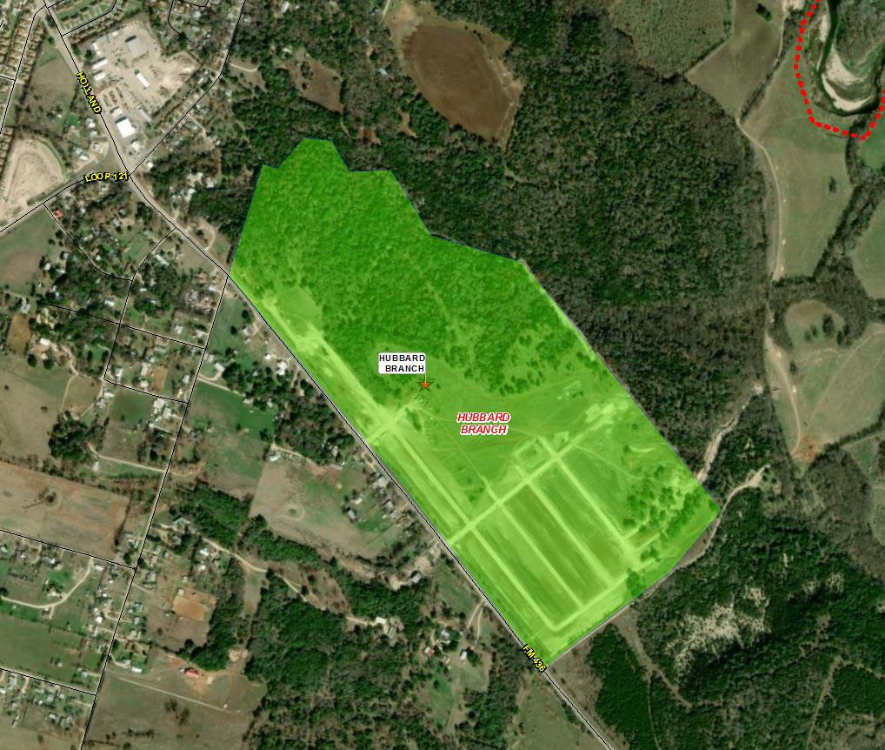
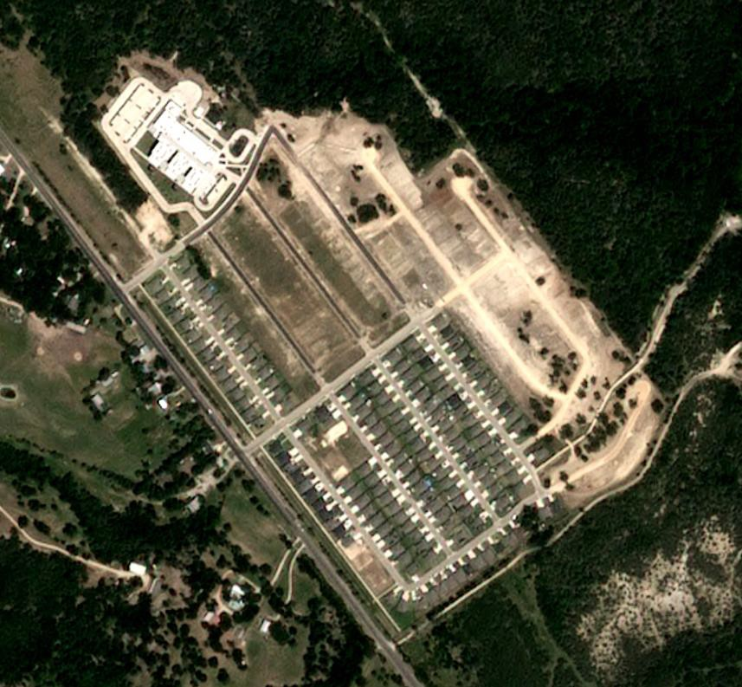
Residential Activity
July 2024
Hubbard Branch
500 total lots
Approx. 125 future lots
Approx. 220 vacant developed lots
Approx. 1 home under construction
Approx. 154 occupied homes
Phase 2 (170 lots) delivered for homebuilding October 2024
Initial groundwork underway on remaining lots
Anticipate building 50 – 60 homes per year
$340K+
Current Student Yield = 0.506
12

Slide 13
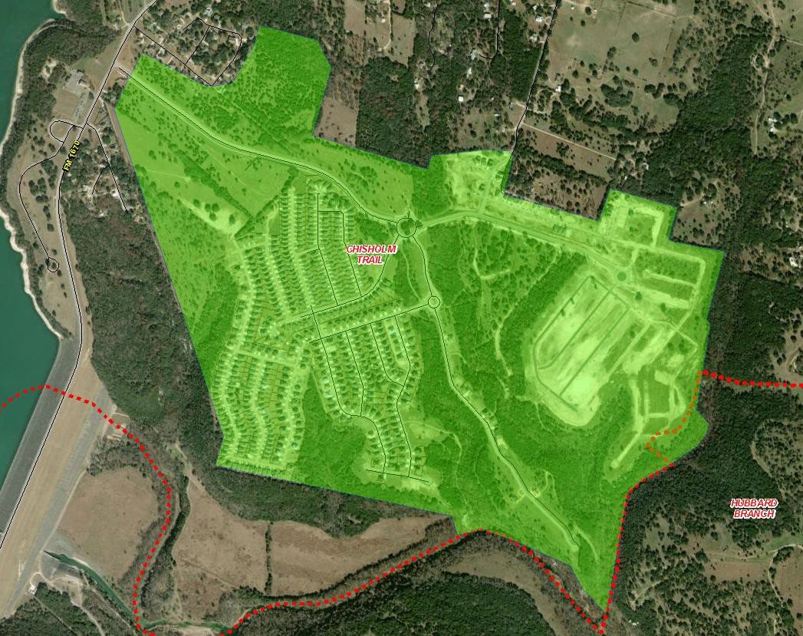
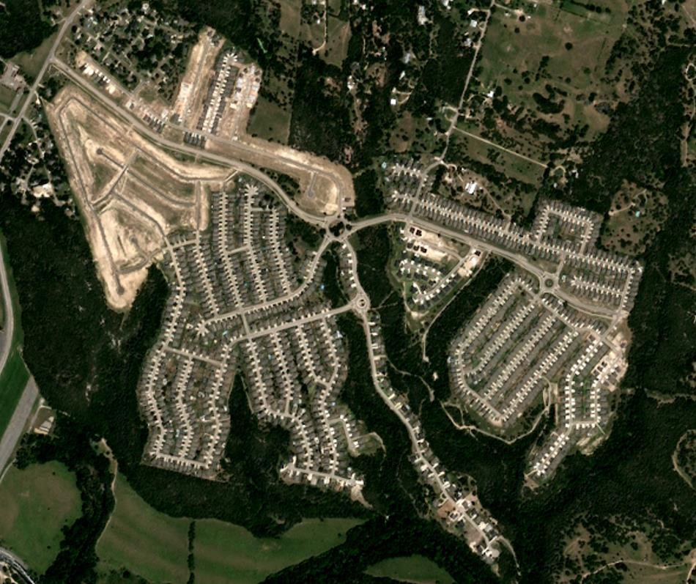
Residential Activity
July 2024
Three Creeks
1,500 total lots
Approx. 355 vacant developed lots
Approx. 72 homes under construction
Approx. 1,073 occupied homes
Final lots in Phase 10 (287 lots) delivered for homebuilding Spring 2024
Building 100 – 125 homes per year
DR Horton
$340K - $550K
Current Student Yield = 0.581

Slide 14
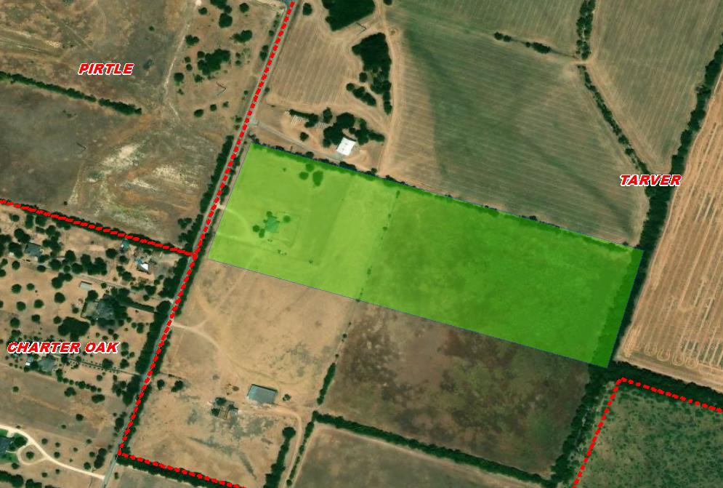
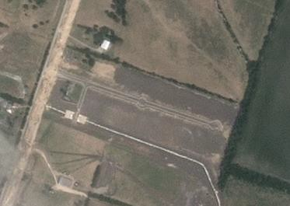

Residential Activity
May 2024
Wilma’s Way
30 total lots
Approx. 29 vacant developed lots
Approx. 1 home under construction
Homebuilding started mid 2024
Mid $300K+

Slide 15
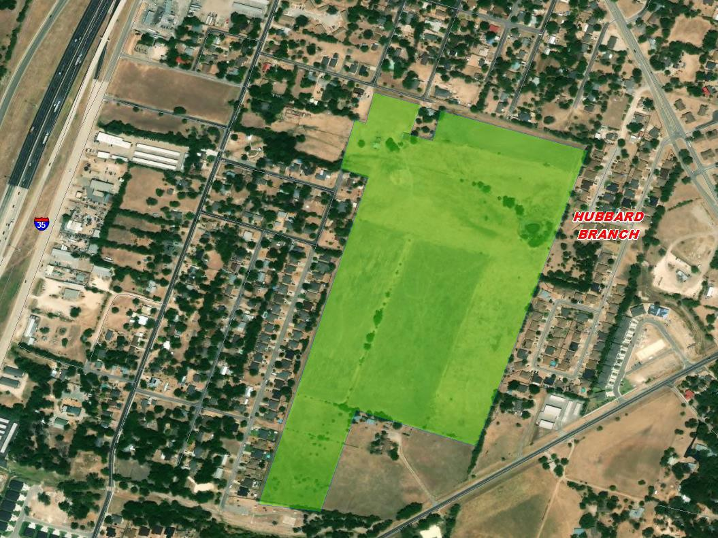
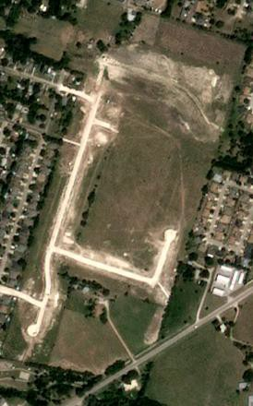
Residential Activity
Hidden Trails
256 total lots
Approx. 155 future lots
Approx. 98 vacant developed lots
Approx. 3 homes under construction
Phase 1 (101 lots) delivered for homebuilding mid 2024
July 2024

Slide 16
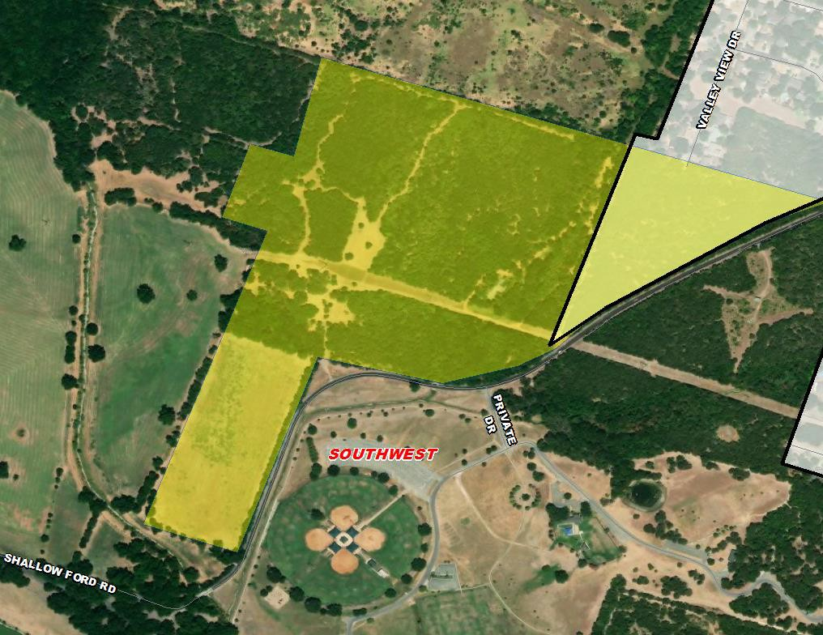
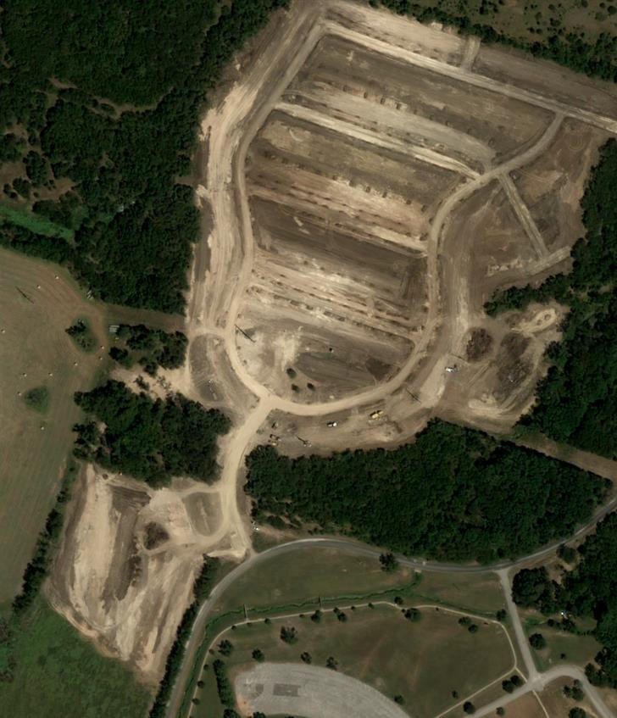
Residential Activity
The Preserve at Lions Park
•
304 total future lots
August 2024
Prelim plat approved Nov 2023
Final plat Phase 1 (121 lots) approved Aug 2024; groundwork underway

Slide 17
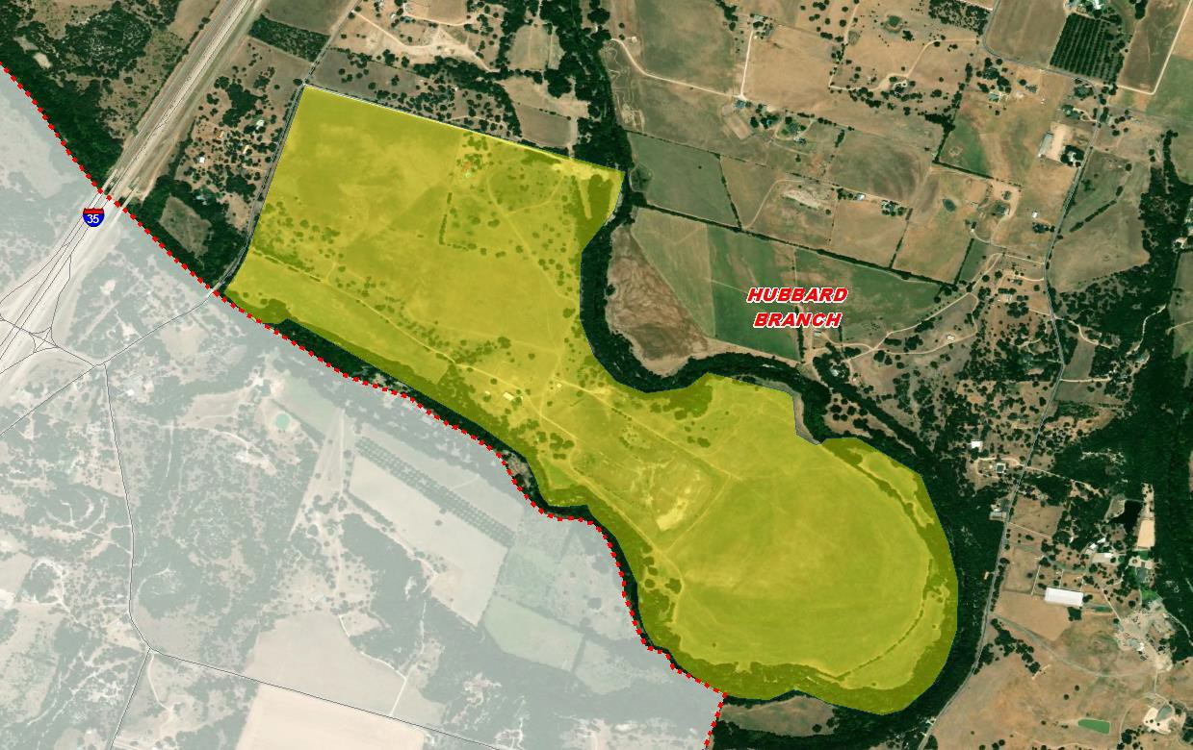
Residential Activity
River Farm
1,750 total future lots
500-acre master planned community with amenities such as a large clubhouse, event facilities, lengthy trail system, and sports facilities
Will include future elementary school
Anticipate groundwork early 2025

Slide 18
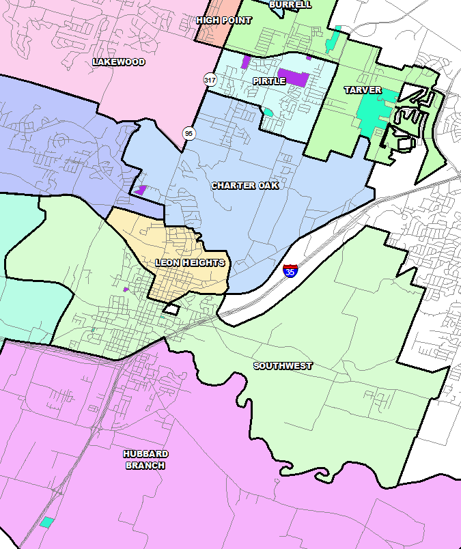
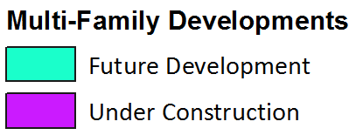
Multi-Family Housing Overview
There are currently 657 units under construction in the district
Within Belton ISD there are more than 700 future multi-family units in the planning stages
Of these units, approx. 100 units are age- restricted and will not impact BISD’s student yield
18

Slide 19
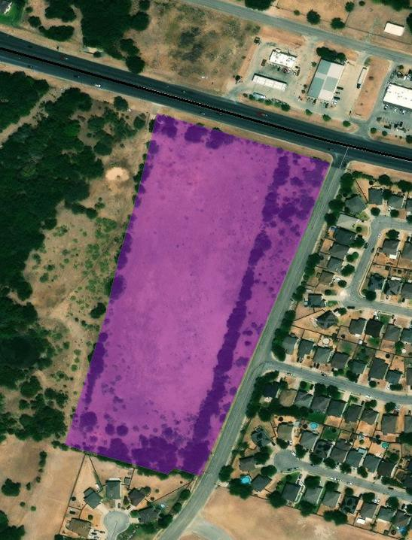
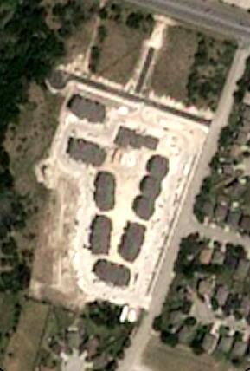

Multi-Family Activity
July 2024
Cypress Creek Apartments
180 units under construction
Started May 2023
Anticipated lease date Nov 2024

Slide 20
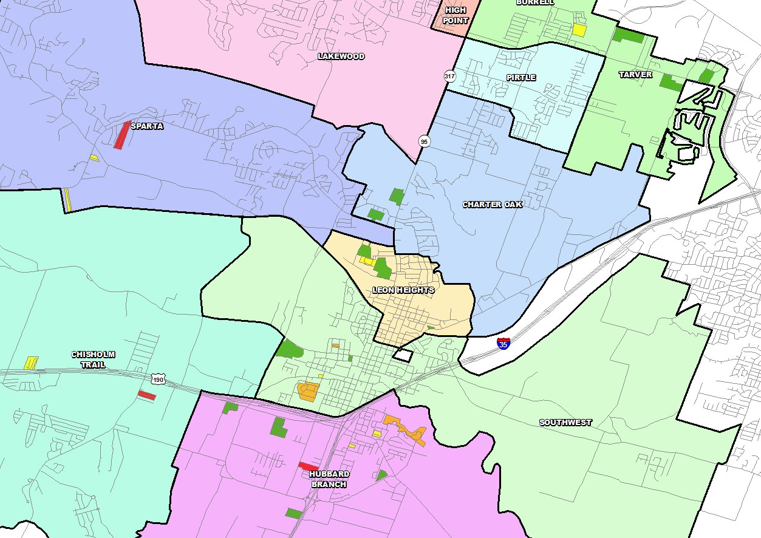
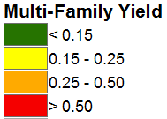

Multi-Family Yield
Within Belton ISD there are currently 742
students residing in 3,460 multi-family units
The district average multi-family yield is 0.214
< 0.25
0.25 – 0.50
0.50 – 0.75
> 0.75

Slide 21


Student Yield by Housing Type
Single Family Yield
0.628
Multi-Family Yield 0.214
BISD Student Yield by Housing Type
0.7
0.613
0.614
0.618
0.616
0.612
0.6
0.604
0.637
0.602
0.628
0.6
0.5
0.4
0.383
0.369
0.337
0.318
0.291
0.294
0.305
0.267
0.3
0.254
0.214
0.2
0.1
0
2015/16
2016/17
2017/18
2018/19
2019/20
2020/21
2021/22
2022/23
2023/24
2024/25
Single Family Yield
Multi-Family Yield

Slide 22
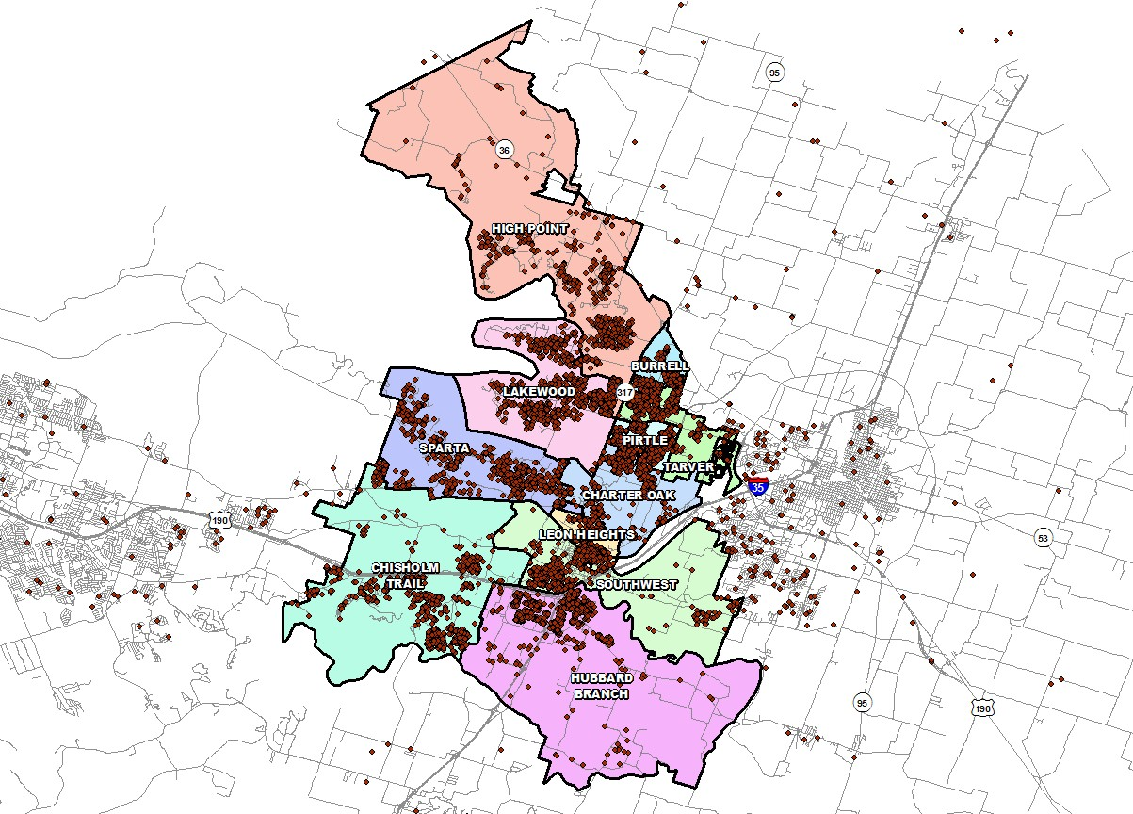
Student Density
Currently, 533 students live outside of the district
This represents 3.9% of the students enrolled
3,722 students, or roughly 27% of the district population resides within Belton city limits
5,967 students, or roughly 44% of the district population resides in Temple city limits

Slide 23
Newcomers and Leavers
+101
+111
+9
1,700
1,672
1,650
1,600
1,571
1,550
1,545
1,544
1,535
1,500
1,450
1,434
1,400
1,350
1,300
2022/23
2023/24
Newcomers Leavers
2024/25

Slide 24


Annual Enrollment Change
YEAR | EE | PK | K | 1st | 2nd | 3rd | 4th | 5th | 6th | 7th | 8th | 9th | 10th | 11th | 12th | Total | Total Growth | % Growth
2020/21 | 61 | 304 | 900 | 893 | 883 | 886 | 900 | 924 | 971 | 980 | 1,080 | 1,033 | 1,030 | 915 | 849 | 12,609 | 423 | 3.5%
2021/22 | 63 | 378 | 876 | 954 | 974 | 913 | 958 | 969 | 993 | 1,045 | 1,056 | 1,226 | 1,048 | 1,027 | 846 | 13,326 | 717 | 5.7%
2022/23 | 72 | 453 | 895 | 936 | 974 | 1,016 | 975 | 984 | 1,011 | 999 | 1,041 | 1,148 | 1,152 | 1,029 | 959 | 13,644 | 318 | 2.4%
2023/24 | 93 | 426 | 898 | 928 | 955 | 994 | 1,047 | 1,013 | 1,008 | 1,055 | 1,043 | 1,157 | 1,073 | 1,120 | 998 | 13,808 | 164 | 1.2%
2024/25 | 92 | 398 | 805 | 914 | 949 | 969 | 1,004 | 1,066 | 1,024 | 1,035 | 1,058 | 1,148 | 1,133 | 1,023 | 1,086 | 13,704 | -104 | -0.8%
Yellow box = largest grade per year Green box = second largest grade per year
YEAR | EE | PK | K | 1st | 2nd | 3rd | 4th | 5th | 6th | 7th | 8th | 9th | 10th | 11th | 12th | ELEM | MID | HIGH
3-YR Avg. | 1.141 | 1.024 | 0.974 | 1.041 | 1.021 | 1.026 | 1.036 | 1.028 | 1.026 | 1.025 | 1.014 | 1.100 | 0.951 | 0.969 | 0.958 | 1.021 | 1.022 | 0.994
2021/22 | 1.161 | 1.490 | 0.971 | 1.017 | 1.068 | 1.110 | 1.109 | 1.061 | 1.079 | 0.910 | 0.886 | 1.061 | 0.715 | 0.754 | 0.993 | 1.056 | 0.958 | 0.881
2022/23 | 1.143 | 1.198 | 1.022 | 1.068 | 1.021 | 1.043 | 1.068 | 1.027 | 1.043 | 1.006 | 0.996 | 1.087 | 0.940 | 0.982 | 0.934 | 1.042 | 1.015 | 0.986
2023/24 | 1.292 | 0.940 | 1.003 | 1.037 | 1.020 | 1.021 | 1.031 | 1.039 | 1.024 | 1.044 | 1.044 | 1.111 | 0.935 | 0.972 | 0.970 | 1.025 | 1.037 | 0.997
2024/25 | 0.989 | 0.934 | 0.896 | 1.018 | 1.023 | 1.015 | 1.010 | 1.018 | 1.011 | 1.027 | 1.003 | 1.101 | 0.979 | 0.953 | 0.970 | 0.997 | 1.013 | 1.001
District enrollment decreased by 104 students from the previous 2023/24 School Year. Kindergarten
enrollment hasn’t been in the low 800s level since the Fall of the 2018-19 school year.
The two largest grade groups have remained consistently in the High School grade levels the last several
years.
The highest cohort increases from last year are in the 1st, 2nd, 7th, and 9th Grade levels.

Slide 25
Ten Year Forecast by Grade Level – Low
Year | EE | PK | K | 1st | 2nd | 3rd | 4th | 5th | 6th | 7th | 8th | 9th | 10th | 11th | 12th | Total | Total Growth | % Growth
2020/21 | 61 | 304 | 900 | 893 | 883 | 886 | 900 | 924 | 971 | 980 | 1,080 | 1,033 | 1,030 | 915 | 849 | 12,609 | 423 | 3.5%
2021/22 | 63 | 378 | 876 | 954 | 974 | 913 | 958 | 969 | 993 | 1,045 | 1,056 | 1,226 | 1,048 | 1,027 | 846 | 13,326 | 717 | 5.7%
2022/23 | 72 | 453 | 895 | 936 | 974 | 1,016 | 975 | 984 | 1,011 | 999 | 1,041 | 1,148 | 1,152 | 1,029 | 959 | 13,644 | 318 | 2.4%
2023/24 | 93 | 426 | 898 | 928 | 955 | 994 | 1,047 | 1,013 | 1,008 | 1,055 | 1,043 | 1,157 | 1,073 | 1,120 | 998 | 13,808 | 164 | 1.2%
2024/25 | 92 | 398 | 805 | 914 | 949 | 969 | 1,004 | 1,066 | 1,024 | 1,035 | 1,058 | 1,148 | 1,133 | 1,023 | 1,086 | 13,704 | -104 | -0.8%
2025/26 | 92 | 360 | 857 | 832 | 935 | 970 | 986 | 1,027 | 1,082 | 1,046 | 1,039 | 1,161 | 1,113 | 1,097 | 987 | 13,584 | -120 | -0.9%
2026/27 | 92 | 375 | 911 | 880 | 845 | 948 | 980 | 999 | 1,022 | 1,102 | 1,054 | 1,146 | 1,114 | 1,072 | 1,056 | 13,596 | 12 | 0.1%
2027/28 | 92 | 385 | 924 | 950 | 902 | 864 | 963 | 1,002 | 1,009 | 1,039 | 1,104 | 1,158 | 1,109 | 1,072 | 1,032 | 13,605 | 9 | 0.1%
2028/29 | 92 | 400 | 964 | 954 | 971 | 918 | 876 | 986 | 1,028 | 1,024 | 1,043 | 1,214 | 1,118 | 1,069 | 1,034 | 13,691 | 86 | 0.6%
2029/30 | 92 | 410 | 1,001 | 989 | 973 | 985 | 928 | 891 | 1,032 | 1,024 | 1,029 | 1,148 | 1,169 | 1,077 | 1,031 | 13,779 | 88 | 0.6%
2030/31 | 92 | 420 | 1,028 | 1,031 | 1,012 | 988 | 1,002 | 946 | 896 | 1,046 | 1,027 | 1,132 | 1,110 | 1,125 | 1,039 | 13,894 | 115 | 0.8%
2031/32 | 92 | 440 | 1,061 | 1,052 | 1,048 | 1,023 | 997 | 1,016 | 940 | 912 | 1,050 | 1,130 | 1,093 | 1,070 | 1,084 | 14,008 | 114 | 0.8%
2032/33 | 92 | 450 | 1,088 | 1,087 | 1,066 | 1,050 | 1,025 | 1,007 | 1,019 | 957 | 915 | 1,156 | 1,090 | 1,054 | 1,031 | 14,087 | 79 | 0.6%
2033/34 | 92 | 460 | 1,107 | 1,116 | 1,099 | 1,065 | 1,049 | 1,037 | 1,017 | 1,037 | 960 | 1,006 | 1,115 | 1,049 | 1,017 | 14,226 | 139 | 1.0%
2034/35 | 92 | 465 | 1,101 | 1,134 | 1,132 | 1,104 | 1,069 | 1,061 | 1,050 | 1,035 | 1,042 | 1,056 | 970 | 1,074 | 1,010 | 14,395 | 169 | 1.2%
Yellow box = largest grade per year
Green box = second largest grade per year

Slide 26
Ten Year Forecast by Campus – Low
 |  | Current | ENROLLMENT PROJECTIONS
Campus | Capacity | 2024/25 | 2025/26 | 2026/27 | 2027/28 | 2028/29 | 2029/30 | 2030/31 | 2031/32 | 2032/33 | 2033/34 | 2034/35
BELTON EARLY CHILDHOOD | 628 | 490 | 452 | 467 | 477 | 492 | 502 | 512 | 532 | 542 | 552 | 557
EARLY CHILDHOOD TOTALS | 628 | 490 | 452 | 467 | 477 | 492 | 502 | 512 | 532 | 542 | 552 | 557
BURRELL ELEMENTARY | 800 | 472 | 511 | 550 | 591 | 621 | 653 | 694 | 707 | 708 | 711 | 714
CHARTER OAK ELEMENTARY | 800 | 606 | 619 | 617 | 600 | 611 | 626 | 643 | 650 | 659 | 675 | 682
CHISHOLM TRAIL ELEMENTARY | 792 | 760 | 730 | 716 | 716 | 703 | 702 | 723 | 740 | 752 | 766 | 773
HIGH POINT ELEMENTARY | 792 | 563 | 533 | 502 | 488 | 500 | 490 | 510 | 528 | 542 | 556 | 568
JOE PIRTLE ELEMENTARY | 792 | 570 | 568 | 570 | 558 | 569 | 572 | 602 | 632 | 661 | 695 | 728
LAKEWOOD ELEMENTARY | 792 | 576 | 553 | 526 | 515 | 491 | 491 | 499 | 508 | 514 | 521 | 524
LEON HEIGHTS ELEMENTARY | 265 | 183 | 169 | 161 | 157 | 152 | 153 | 157 | 161 | 165 | 170 | 174
HUBBARD BRANCH ELEMENTARY | 800 | 516 | 524 | 538 | 572 | 616 | 657 | 710 | 758 | 796 | 835 | 874
SOUTHWEST ELEMENTARY | 540 | 416 | 411 | 416 | 432 | 440 | 454 | 474 | 493 | 489 | 483 | 485
SPARTA ELEMENTARY | 685 | 549 | 509 | 497 | 491 | 491 | 484 | 493 | 499 | 499 | 503 | 504
TARVER ELEMENTARY | 792 | 496 | 480 | 470 | 485 | 475 | 485 | 502 | 521 | 538 | 558 | 575
ELEMENTARY TOTALS | 7,850 | 5,707 | 5,607 | 5,563 | 5,605 | 5,669 | 5,767 | 6,007 | 6,197 | 6,323 | 6,473 | 6,601
Elementary Absolute Change |  | -59 | -100 | -44 | 42 | 64 | 98 | 240 | 190 | 126 | 150 | 128
Elementary Percent Change |  | -1.02% | -1.75% | -0.78% | 0.75% | 1.14% | 1.73% | 4.16% | 3.16% | 2.03% | 2.37% | 1.98%
Green box = 95% capacity Yellow box = over capacity

Slide 27
Ten Year Forecast by Campus – Low
 |  | Current | ENROLLMENT PROJECTIONS
Campus | Capacity | 2024/25 | 2025/26 | 2026/27 | 2027/28 | 2028/29 | 2029/30 | 2030/31 | 2031/32 | 2032/33 | 2033/34 | 2034/35
LAKE BELTON MIDDLE SCHOOL | 916 | 802 | 766 | 728 | 720 | 720 | 732 | 677 | 634 | 609 | 634 | 670
NORTH BELTON MIDDLE SCHOOL | 1,000 | 981 | 1,009 | 1,043 | 1,038 | 1,022 | 1,002 | 973 | 978 | 988 | 1,028 | 1,058
SOUTH BELTON MIDDLE SCHOOL | 1,000 | 663 | 693 | 724 | 731 | 731 | 732 | 722 | 703 | 704 | 736 | 758
BELTON MIDDLE SCHOOL | 971 | 659 | 687 | 671 | 651 | 610 | 607 | 585 | 575 | 578 | 604 | 629
MIDDLE SCHOOL TOTALS | 3,887 | 3,105 | 3,155 | 3,166 | 3,140 | 3,083 | 3,073 | 2,957 | 2,890 | 2,879 | 3,002 | 3,115
Middle School Absolute Change |  | -1 | 50 | 11 | -26 | -57 | -10 | -116 | -67 | -11 | 123 | 113
Middle School Percent Change |  | -0.03% | 1.61% | 0.35% | -0.82% | -1.82% | -0.32% | -3.77% | -2.27% | -0.38% | 4.27% | 3.76%
BELTON HIGH SCHOOL | 2,607 | 1,767 | 1,756 | 1,748 | 1,719 | 1,746 | 1,745 | 1,733 | 1,744 | 1,704 | 1,652 | 1,643
BELTON NEW TECH HIGH SCHOOL | 500 | 290 | 274 | 252 | 238 | 243 | 246 | 243 | 242 | 240 | 230 | 226
LAKE BELTON HIGH SCHOOL | 2,500 | 2,310 | 2,305 | 2,365 | 2,391 | 2,423 | 2,411 | 2,407 | 2,368 | 2,364 | 2,282 | 2,218
HIGH SCHOOL TOTALS | 5,607 | 4,367 | 4,335 | 4,365 | 4,348 | 4,412 | 4,402 | 4,383 | 4,354 | 4,308 | 4,164 | 4,087
High School Absolute Change |  | 19 | -32 | 30 | -17 | 64 | -10 | -19 | -29 | -46 | -144 | -77
High School Percent Change |  | 0.44% | -0.73% | 0.69% | -0.39% | 1.47% | -0.23% | -0.43% | -0.66% | -1.06% | -3.34% | -1.85%
BELL COUNTY JJAEP | 0 | 35 | 35 | 35 | 35 | 35 | 35 | 35 | 35 | 35 | 35 | 35
ALTERNATIVE CAMPUS TOTALS |  | 35 | 35 | 35 | 35 | 35 | 35 | 35 | 35 | 35 | 35 | 35
DISTRICT TOTALS | 17,344 | 13,704 | 13,584 | 13,596 | 13,605 | 13,691 | 13,779 | 13,894 | 14,008 | 14,087 | 14,226 | 14,395
District Absolute Change |  | -104 | -120 | 12 | 9 | 86 | 88 | 115 | 114 | 79 | 139 | 169
District Percent Change |  | -0.76% | -0.88% | 0.09% | 0.07% | 0.63% | 0.64% | 0.83% | 0.82% | 0.56% | 0.99% | 1.19%
Green box = 95% capacity Yellow box = over capacity

Slide 28
Ten Year Forecast by Grade Level – Mid
Year | EE | PK | K | 1st | 2nd | 3rd | 4th | 5th | 6th | 7th | 8th | 9th | 10th | 11th | 12th | Total | Total Growth | % Growth
2020/21 | 61 | 304 | 900 | 893 | 883 | 886 | 900 | 924 | 971 | 980 | 1,080 | 1,033 | 1,030 | 915 | 849 | 12,609 | 423 | 3.5%
2021/22 | 63 | 378 | 876 | 954 | 974 | 913 | 958 | 969 | 993 | 1,045 | 1,056 | 1,226 | 1,048 | 1,027 | 846 | 13,326 | 717 | 5.7%
2022/23 | 72 | 453 | 895 | 936 | 974 | 1,016 | 975 | 984 | 1,011 | 999 | 1,041 | 1,148 | 1,152 | 1,029 | 959 | 13,644 | 318 | 2.4%
2023/24 | 93 | 426 | 898 | 928 | 955 | 994 | 1,047 | 1,013 | 1,008 | 1,055 | 1,043 | 1,157 | 1,073 | 1,120 | 998 | 13,808 | 164 | 1.2%
2024/25 | 92 | 398 | 805 | 914 | 949 | 969 | 1,004 | 1,066 | 1,024 | 1,035 | 1,058 | 1,148 | 1,133 | 1,023 | 1,086 | 13,704 | -104 | -0.8%
2025/26 | 92 | 388 | 857 | 863 | 948 | 991 | 1,007 | 1,038 | 1,082 | 1,058 | 1,049 | 1,161 | 1,113 | 1,097 | 987 | 13,731 | 27 | 0.2%
2026/27 | 92 | 400 | 911 | 917 | 887 | 980 | 1,021 | 1,032 | 1,032 | 1,124 | 1,077 | 1,157 | 1,114 | 1,072 | 1,056 | 13,872 | 141 | 1.0%
2027/28 | 92 | 420 | 924 | 988 | 948 | 928 | 1,019 | 1,054 | 1,038 | 1,070 | 1,138 | 1,183 | 1,120 | 1,072 | 1,032 | 14,026 | 154 | 1.1%
2028/29 | 92 | 416 | 964 | 994 | 1,019 | 985 | 962 | 1,053 | 1,077 | 1,075 | 1,086 | 1,252 | 1,143 | 1,080 | 1,034 | 14,232 | 206 | 1.5%
2029/30 | 92 | 434 | 1,001 | 1,030 | 1,023 | 1,054 | 1,016 | 988 | 1,097 | 1,116 | 1,091 | 1,194 | 1,206 | 1,101 | 1,042 | 14,485 | 253 | 1.8%
2030/31 | 92 | 450 | 1,028 | 1,074 | 1,064 | 1,058 | 1,094 | 1,046 | 989 | 1,136 | 1,132 | 1,200 | 1,154 | 1,161 | 1,062 | 14,740 | 256 | 1.8%
2031/32 | 92 | 463 | 1,061 | 1,096 | 1,102 | 1,097 | 1,090 | 1,121 | 1,036 | 1,026 | 1,153 | 1,245 | 1,158 | 1,112 | 1,119 | 14,971 | 230 | 1.6%
2032/33 | 92 | 477 | 1,088 | 1,131 | 1,122 | 1,127 | 1,121 | 1,111 | 1,124 | 1,076 | 1,040 | 1,268 | 1,200 | 1,116 | 1,072 | 15,165 | 195 | 1.3%
2033/34 | 92 | 490 | 1,107 | 1,161 | 1,155 | 1,146 | 1,150 | 1,146 | 1,124 | 1,165 | 1,093 | 1,144 | 1,224 | 1,155 | 1,076 | 15,428 | 262 | 1.7%
2034/35 | 92 | 498 | 1,137 | 1,181 | 1,189 | 1,183 | 1,173 | 1,176 | 1,161 | 1,165 | 1,182 | 1,202 | 1,104 | 1,180 | 1,113 | 15,736 | 309 | 2.0%
Yellow box = largest grade per year Green box = second largest grade per year

Slide 29
Ten Year Forecast by Campus – Mid
 |  | Current | ENROLLMENT PROJECTIONS
Campus | Capacity | 2024/25 | 2025/26 | 2026/27 | 2027/28 | 2028/29 | 2029/30 | 2030/31 | 2031/32 | 2032/33 | 2033/34 | 2034/35
BELTON EARLY CHILDHOOD | 628 | 490 | 480 | 492 | 512 | 508 | 526 | 542 | 555 | 569 | 582 | 590
EARLY CHILDHOOD TOTALS | 628 | 490 | 480 | 492 | 512 | 508 | 526 | 542 | 555 | 569 | 582 | 590
BURRELL ELEMENTARY | 800 | 472 | 520 | 567 | 616 | 653 | 692 | 733 | 747 | 748 | 751 | 759
CHARTER OAK ELEMENTARY | 800 | 606 | 629 | 636 | 627 | 645 | 664 | 683 | 690 | 699 | 715 | 726
CHISHOLM TRAIL ELEMENTARY | 792 | 760 | 741 | 740 | 750 | 739 | 743 | 764 | 781 | 796 | 813 | 827
HIGH POINT ELEMENTARY | 792 | 563 | 543 | 522 | 513 | 531 | 520 | 542 | 561 | 576 | 590 | 608
JOE PIRTLE ELEMENTARY | 792 | 570 | 578 | 590 | 586 | 602 | 606 | 638 | 673 | 706 | 742 | 778
LAKEWOOD ELEMENTARY | 792 | 576 | 561 | 543 | 535 | 515 | 518 | 528 | 539 | 544 | 551 | 557
LEON HEIGHTS ELEMENTARY | 265 | 183 | 174 | 166 | 163 | 158 | 158 | 163 | 168 | 173 | 180 | 187
HUBBARD BRANCH ELEMENTARY | 800 | 516 | 533 | 556 | 599 | 649 | 696 | 753 | 802 | 840 | 885 | 929
SOUTHWEST ELEMENTARY | 540 | 416 | 419 | 430 | 453 | 466 | 485 | 503 | 522 | 518 | 511 | 517
SPARTA ELEMENTARY | 685 | 549 | 517 | 512 | 511 | 517 | 515 | 523 | 530 | 530 | 534 | 536
TARVER ELEMENTARY | 792 | 496 | 489 | 486 | 508 | 502 | 515 | 534 | 554 | 570 | 593 | 615
ELEMENTARY TOTALS | 7,850 | 5,707 | 5,704 | 5,748 | 5,861 | 5,977 | 6,112 | 6,364 | 6,567 | 6,700 | 6,865 | 7,039
Elementary Absolute Change |  | -59 | -3 | 44 | 113 | 116 | 135 | 252 | 203 | 133 | 165 | 174
Elementary Percent Change |  | -1.02% | -0.05% | 0.77% | 1.97% | 1.98% | 2.26% | 4.12% | 3.19% | 2.03% | 2.46% | 2.53%
Green box = 95% capacity Yellow box = over capacity

Slide 30
Ten Year Forecast by Campus – Mid
 |  | Current | ENROLLMENT PROJECTIONS
Campus | Capacity | 2024/25 | 2025/26 | 2026/27 | 2027/28 | 2028/29 | 2029/30 | 2030/31 | 2031/32 | 2032/33 | 2033/34 | 2034/35
LAKE BELTON MIDDLE SCHOOL | 916 | 802 | 772 | 741 | 740 | 748 | 776 | 732 | 694 | 677 | 713 | 757
NORTH BELTON MIDDLE SCHOOL | 1,000 | 981 | 1,016 | 1,061 | 1,073 | 1,077 | 1,086 | 1,078 | 1,092 | 1,112 | 1,156 | 1,189
SOUTH BELTON MIDDLE SCHOOL | 1,000 | 663 | 697 | 735 | 750 | 763 | 782 | 797 | 783 | 794 | 827 | 847
BELTON MIDDLE SCHOOL | 971 | 659 | 692 | 684 | 671 | 638 | 648 | 638 | 634 | 645 | 674 | 703
MIDDLE SCHOOL TOTALS | 3,887 | 3,105 | 3,177 | 3,221 | 3,234 | 3,226 | 3,292 | 3,245 | 3,203 | 3,228 | 3,370 | 3,496
Middle School Absolute Change |  | -1 | 72 | 44 | 13 | -8 | 66 | -47 | -42 | 25 | 142 | 126
Middle School Percent Change |  | -0.03% | 2.32% | 1.38% | 0.40% | -0.25% | 2.05% | -1.43% | -1.29% | 0.78% | 4.40% | 3.74%
BELTON HIGH SCHOOL | 2,607 | 1,767 | 1,756 | 1,752 | 1,732 | 1,775 | 1,792 | 1,797 | 1,846 | 1,829 | 1,814 | 1,844
BELTON NEW TECH HIGH SCHOOL | 500 | 290 | 274 | 253 | 240 | 247 | 252 | 252 | 256 | 258 | 254 | 253
LAKE BELTON HIGH SCHOOL | 2,500 | 2,310 | 2,305 | 2,371 | 2,412 | 2,464 | 2,476 | 2,505 | 2,509 | 2,546 | 2,508 | 2,479
HIGH SCHOOL TOTALS | 5,607 | 4,367 | 4,335 | 4,376 | 4,384 | 4,486 | 4,520 | 4,554 | 4,611 | 4,633 | 4,576 | 4,576
High School Absolute Change |  | 19 | -32 | 41 | 8 | 102 | 34 | 34 | 57 | 22 | -57 | 0
High School Percent Change |  | 0.44% | -0.73% | 0.95% | 0.18% | 2.33% | 0.76% | 0.75% | 1.25% | 0.48% | -1.23% | 0.00%
BELL COUNTY JJAEP | 0 | 35 | 35 | 35 | 35 | 35 | 35 | 35 | 35 | 35 | 35 | 35
ALTERNATIVE CAMPUS TOTALS |  | 35 | 35 | 35 | 35 | 35 | 35 | 35 | 35 | 35 | 35 | 35
DISTRICT TOTALS | 17,344 | 13,704 | 13,731 | 13,872 | 14,026 | 14,232 | 14,485 | 14,740 | 14,971 | 15,165 | 15,428 | 15,736
District Absolute Change |  | -104 | 27 | 141 | 154 | 206 | 253 | 256 | 230 | 195 | 262 | 309
District Percent Change |  | -0.25% | 0.20% | 1.03% | 1.11% | 1.47% | 1.78% | 1.76% | 1.56% | 1.30% | 1.73% | 2.00%
Green box = 95% capacity Yellow box = over capacity

Slide 31


Key Takeaways
Belton ISD Enrollment Projections
16,000
Belton ISD enrollment decreased by 104 students between 2023/24 and Fall 2024/25. The Kindergarten Class this year is much lower than it has been in the last 5 years.
Based on the current sales, BISD is forecasted to close more than 1,480 homes by the end of 2024
The district has 8 future subdivisions with over 4,950 lots in the planning stages
Groundwork is underway on more than 340 lots within 3 subdivisions
Belton ISD’s enrollment is anticipated to be within a range of 13,750 to 14,400 within the next five years and is anticipated to be within a range between 14,400 to 15,750 within the next ten years
15,736
15,500
15,000
14,500
14,485
14,395
14,000
13,779
13,704
13,500
13,000
12,500
12,000
Low Mid

