Slide 1
Private and Charter Leaders
Update and Office Hours
San Mateo County Response Team for Schools
SMCOE and San Mateo County Health
August 6,2021

Slide 2
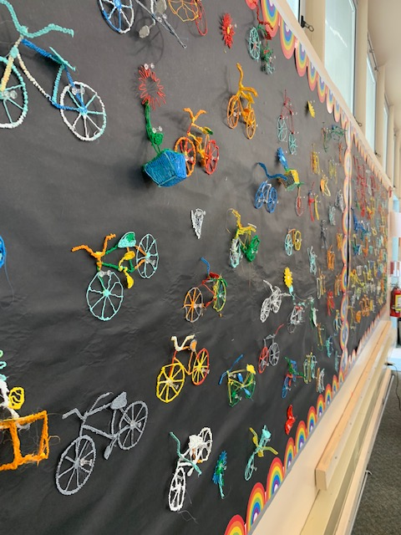
Agenda for Today’s Call
County Response Team Introductions
COVID-19 Conditions
Proactive Planning
Pandemic Recovery Framework
SMCOE Trainings and Support
Questions

Slide 3
21-22
Schools C-19 Response Team
Bonnie Holland- Communicable Disease, Clinical Supervisor, San Mateo County Health
Candace Hill, Public Health Nurse – CD School Liaison, CD, SMC Health
Jill Vandroff, SMCOE Coordinator, Health and Wellness
Patricia Love, SMCOE Executive Director, Strategy and Communications
Nancy Magee, County Superintendent

Slide 4
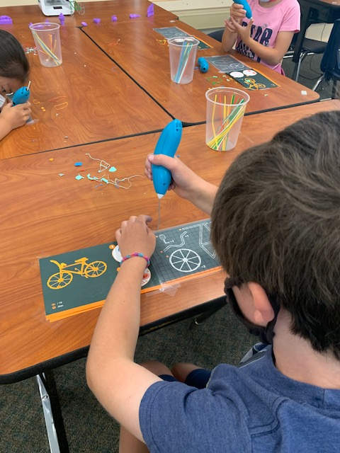
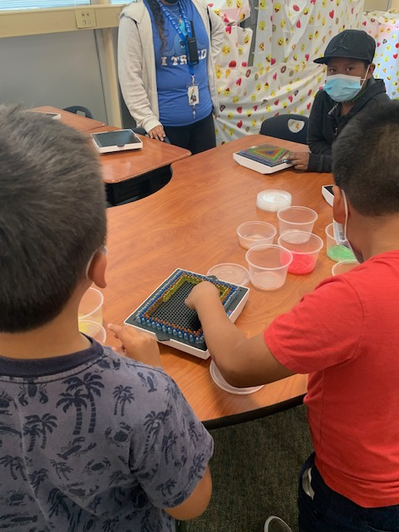
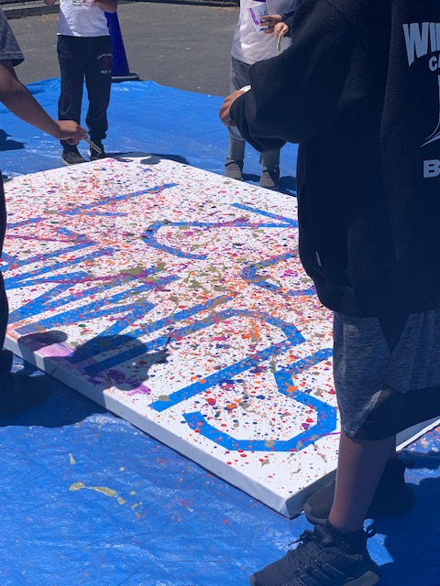
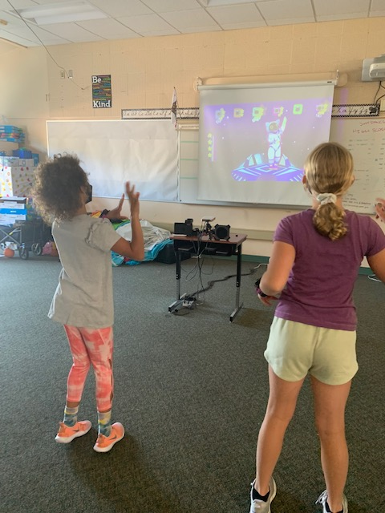
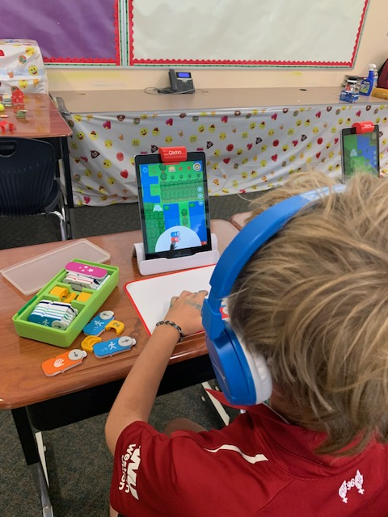
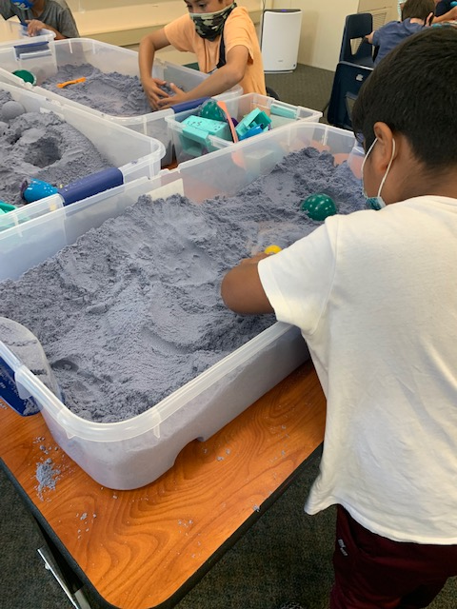

Slide 5
Current COVID-19 Conditions
90% Vaccinated for Population 12 + years
68% of 12-17 year-olds are vaccinated
US Case Rate: 134/100K population
SMC Case Rate: 12.9/100K population
Alameda-Contra Costa-SF = 2X rate of SMC
Spread is largely among unvaccinated
Case rate is 6X for unvaccinated over vaccinated
Death rate remains low

Slide 6

Proactive Planning
Delta Variant is active: there will be positive cases among school population
Pandemic Recovery Framework
(PRF) is North Star
Strong Protocols for Schools
Protocols are geared for In-Person Learning
Vaccination and Testing are Key

Slide 7

Guidance for Schools - PRF
Reflects the guidance of:
San Mateo County Health
California Department of Public Health (CDPH)
Centers for Disease Control and Prevention (CDC)
Cal/OSHA
Most restrictive guidance prevails

Slide 8
Vaccination
Vaccination: Key strategy
Promote it
SMC Health and CDPH resources
Vaccination verification: Allowed
Follow FERPA process
Non provided = not vaccinated

Slide 9
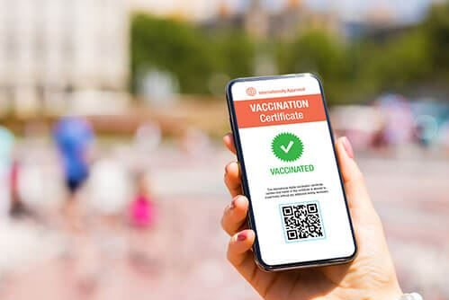
Mandating Vaccinations
Messaging Matters
WHAT YOU CAN DO:
Follow guidance in PRF:
Encourage vaccination
Collect proof of vaccination status
Require non vaccinated to participate in COVID testing

Slide 10
Masks
Required indoors by everyone > 2 years
Vaccination status doesn’t matter for now
Medical exemptions apply, but must wear a non-restrictive alternative
Schools must enforce requirement
Schools should offer education alternative
Masks required at school events off site
Required on buses
Recommended outdoors if not vaccinated/crowded
Staff not vaccinated may request respirators

Slide 11
Other Layers
Ventilation – stay on it, promote fresh air
  Smoke days – shut doors windows, filter and circulate inside air
Hand hygiene – teach and provide time
Case reporting and contact tracing – like last year COVID19_SchoolTeam@smcgov.org
Stay home when sick – new mantra
  Advise all to get tested, symptoms improve
  See PRF for more details

Slide 12
Testing
Review CDPH planning tool
Recommendations not requirements
Determine goals:
Keeping Track of COVID-19
Preventing Outbreaks
Managing Outbreaks
Keeping Kids in School
Different options: PRC, Antigen, free State options
Want more? See summary, attend testing meeting

Slide 13
Note on Response Testing
Fully vaccinated people should get tested if symptomatic
CDC now recommends that fully vaccinated people be tested 3-5 days after exposure
People who have tested positive within the past 3 months do not need to get tested following an exposure if they are asymptomatic
Be sure to read and follow the PRF

Slide 14
Modified Quarantine
When all were masked in an indoor or outdoor school setting or school bus, unvaccinated student close contacts may attend school for in-person instruction if they:
Are asymptomatic
Continue to appropriately mask, as required
Undergo at least twice weekly testing, and
Continue to quarantine for all extracurricular activities at school and in the community setting
Note: Being able to conduct antigen testing at school would be helpful in this case

Slide 15
Not the Focus this Year
Cohorting
Physical distancing – except while eating (maximize)
Limiting gatherings – not required, but keep in mind
No need to limit food service approaches to single use items and packaged meals
Screening at the door, taking temperatures, apps
Excluding visitors – but have a plan for allowing them
Disinfection – only when case within last 24 hours

Slide 16

COVID Safety Plans
Update and Post
  Cal/OSHA COVID Prevention Prog (CPP)
  School/District Safe Return to School Plan
    Alert SMCOE Response Team w/ link
    SMCOE will link and post all San Mateo County Safe Return Plans

Slide 17
Upcoming Training for Schools
Thursday, August 12th, 9 a.m. – PRF Office Hours
Friday, August 13th, 10 a.m. – COVID Testing
Friday, August 13th, 2 p.m. – PRF Office Hours
Monday, August 16th, 9:30 a.m. – COVID Testing
Tuesday, August 17th, 1:00 p.m. – PRF/Testing OH

Slide 18
Status of Instruction -
All Schools Report
Beginning January 25, all schools must report:
•In-person instruction is provided full-time
•In-person instruction is provided only part-time
•In-person instruction and services provided pursuant to the CDPH Cohorting Guidance
•Distance learning only
Report every two weeks
Posted on State dashboard
Sent note yesterday – see next slide

Slide 19
Reporting on Instruction
Report via a web form
Register first:
  https://arcg.is/1Smz1z0
  Access code (key): E#9!yD4ZHmjr2pg
  State webinar today at 1 p.m.
  Link

Slide 20
Questions?

