Slide 1

^{Our School Wellness Policy:}
^{What Parents Need To Know}
Be A
School Wellness
Champion
Fresh Fruit

Slide 2
Helping Kids Learn, Grow, and Be Healthy
Together, parents, school staff, and students can create
a healthy school nutrition environment
Better health = better learners
Kids with healthier eating patterns and
enough physical activity tend to:
Have better grades
Remember what was
taught in class
Behave better in class
Miss less school time

Slide 3



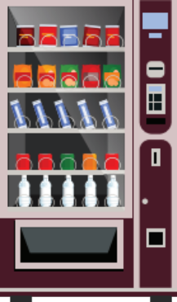


School Wellness Policy
A wellness policy helps create a healthy school environment.
Our wellness policy talks about:
Nutrition education
Physical activity
Foods and drinks sold to students
Nutrition promotion
Food and beverages, not sold, but provided to students
Food and beverage
marketing
Informing the community, leadership, and more

Slide 4

Our Wellness Policy
Learn more! Read the full policy at:
www.madriverschools.org
School
Wellness Policy

Slide 5


Importance of Nutrition Education
Gives students the knowledge, skills, and confidence to make healthy eating choices.
Nutrition education may include:
teaching about healthy meal patterns
reading Nutrition Facts labels
identifying sources of added sugars, saturated fats
Get involved! Ask your teacher how you can
support nutrition education in the classroom.

Slide 6


^{Nutrition Promotion}
Encourage students to make healthy nutrition choices
How can you get involved?
Volunteer to help with a taste test and come have breakfast or lunch with your child.

Slide 7
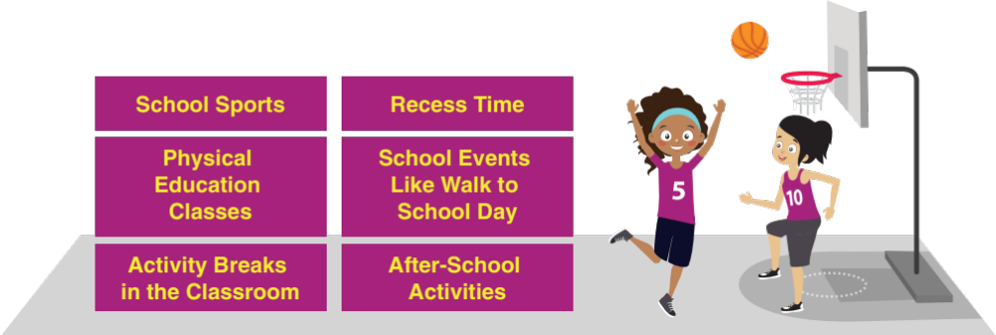
Physical Activity & Physical Education
We want kids to have the opportunity to be physically active at school.
Recommended physical activity for children and adolescents = 60 minutes or more each day.
Notes:
Students who are physically active tend to have better grades, school attendance, and classroom behaviors. So we need to support keeping our kids physically active while they are in school. This can be accomplished through physical education classes, recess time, brain breaks in the classroom, after-school activities like school sports, and other school events like walk to school day.
The Physical Activity Guidelines for Americans recommends 60 minutes or more of physical activity each day for children and adolescents.
To help kids reach this recommendation, we include the following goals in our policy:
[insert specifics from your wellness policy and/or edit the examples below]
Some examples include:
All elementary students in each grade will receive physical education for at least 90 minutes per week throughout the school year. Physical activity during the school day (including but not limited to recess, physical activity breaks, or physical education) will not be withheld as punishment for any reason.
Through formal shared-use agreements, indoor and outdoor physical activity facilities will be open to students, their families, and the community outside of school hours.
Celebrate and promote annual Walk to School Day and Bike to School Day.
Parents can share new ideas on increasing physical activity and mark their calendars for events coming up to volunteer and/or participate.
Speaker Notes: Ask the audience about other ways they have heard of adding physical activity in the school setting or how they promote extra-curricular activities.

Slide 8
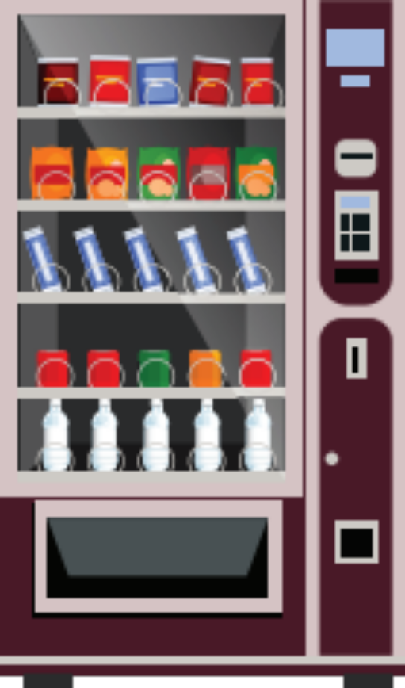

^{Our School Wellness Policy}
Our wellness policy supports healthy school breakfasts and lunches.
All other food and drinks sold in school during the school day must follow the Smart Snacks standards.

Slide 9


^{Keeping Fundraisers Healthy}
At our school, we make our fundraising efforts healthy
and fun, such as:
Walk-a-thons or fun runs
Jump-rope-a-thon,
dance-off, or dance party
Selling fruits and vegetables
Help us come up with
new ideas for a healthy fundraiser!

Slide 10

^{Understanding Food and}
^{Beverage Marketing}
Where have you seen advertising in our school?
We want images and messages in our school to support healthy choices.
Get involved!

Slide 11

Other School-Based Activities
Help implement our policy and promote wellness through other school-based activities, including:
If you have a green thumb, help us in our school garden.
Connect with a local farmer and coordinate a field trip.
Help plan a wellness event (School 5k, Fit Family Friday, etc.).
Get involved!
Please contact
[insert contact name]

Slide 12

Wellness Committee
Parents have the power — let your voice be heard!
Join our Wellness Committee!

Slide 13

Making It a Team Effort
Lots of people have a hand in supporting student health!
Let your voice be heard!
Refer to your handout for more information.

Slide 14

We Need Parents!
Tell us how our school is promoting good nutrition and physical activity or how it can improve. Email us at missi.stammen@madriverschools.org
Team up with other parents to plan a school event promoting healthy food choices and physical activity!
Be a positive role model! Show your child how to make healthy food choices and be active.

Slide 15
Finding Our Wellness Policy
Find our wellness policy on our Web site:
www.madriverschools.org
From the home page, select “Administration”, then from the drop down you will want to select “Board of Education” – Bylaws & Policies
  From the Bylaws & Policies link select “8000 Operations – po8510 Wellness”
Read the full policy to see how it supports our work to build a culture of wellness at {insert name of school/district}.

Slide 16

Thank you
Thank you for your time and commitment
to wellness in our school!

