Slide 1
Third Grade Read to Achieve
Nashville Elementary
Nash County Public Schools

Slide 2
Reading in 3rd Grade
A Parent’s Guide to
“Read to Achieve”

Slide 3
What is Read to Achieve
“Read to Achieve” is a North Carolina legislative act that states:
All students must be proficient readers by the end of third grade. In other words, your child must read on a third grade level by the end of this school year to be promoted to the fourth grade.
Students who are not proficient readers by the end of third grade must be given extra support.

Slide 4
Why does reading proficiency matter?

Slide 5

Reading Drives all instruction!
If a student has difficulty in the subject of reading, he/she will have trouble reading and understanding information in Science, Social Studies and Math. It will also be hard for him/her to read and understand instructions and directions for classwork and tests/projects.

Slide 6
How will proficiency be determined?

Slide 7

3rd grade reading proficiency is determined by:
3rd Grade BOG
mClass (BOY, MOY, EOY)
3rd Grade EOG
RtA Retake 1

Slide 8
Beginning-of-grade test
(BOG)

Slide 9
Beginning-of-Grade Test (BOG)
3rd Grade is the only grade that takes the Reading BOG.
Test data is used as a baseline
No standardized test data from other years, since EOGs begin in the 3rd grade
BOG results provide a student level, ranging from 1 to 5.
Levels 3, 4, and 5 are considered “Proficient”
Levels 4 and 5 reflect “College and Career Readiness” - which shows that a student is on track to enter into the Job Market or Higher Education after High School

Slide 10
Other Assessments

Slide 11
OTher Assessments (PRoficiency 725 Lexile Level)
mClass
Includes nonsense words, real words, Fluency (Words per minute & accuracy), MAZE (choose the word that fits correctly in the sentence) and Vocabulary
Given BOY, MOY, and EOY
Students who are showing red or yellow in any of the these components will receive intervention.

Slide 12
End of year Assessments

Slide 13
End of year assessments
3rd Grade Reading EOG
Read to Achieve Alternate Assessment: A reading test created by the Department of Public Instruction (If needed to determine proficiency)

Slide 14
Frequently Asked Questions

Slide 15
What if a student doesn’t show proficiency by the end of the school year?
If a student does not pass any of the assessments, he/she will be invited to attend Summer Scholars during the summer to help acquire the skills needed to be proficient.
If a student does not show proficiency after Summer Scholars, that student will receive a “retained reading” label on his/her record.
The student will be placed in a fourth grade classroom, where he/she will receive intensive reading interventions in small groups to close skill gaps while also receiving fourth grade reading instruction.
A reading assessment will be administered in November of fourth grade year. If the student shows proficiency, the “retained reading” label will be removed from his/her record.

Slide 16
2023 Summer Scholars
Nashville Elementary is a location for this year’s Summer Scholars.
Summer Scholars was after July 4th this year.

Slide 17
How to help your child

Slide 18

READ!!!!
Read with your child. Practice makes perfect and the only way to get better at reading is to read.
Help your child find a book that interests him/her, and listen to him/her read daily.

Slide 19
Practice Skills!!!!
Edmentum (Exact Path)
Utilizes adaptive diagnostic assessments paired with individualized learning paths to promote academic growth. Diagnostic given BOY, MOY, and EOY.
Students use weekly to practice skills they are not proficient in. The program gives progress checks where students earn trophies if they are progressing. This can be completed at home and at school.

Slide 20
Build Stamina!!!!
Students are familiar with online resources to improve their reading and stamina. Those resources include Exact Path and Xtra Math(for Math). Both resources are available to use at home.
RtA practice passages and questions can be accessed online.
https://www.dpi.nc.gov/media/9879/open

Slide 21
Stay involved!
Teachers update grades in Powerschool weekly. Show your support to your student by celebrating successes and working on ways to improve weak areas. If your student knows that you will see their grade within a few days they are more likely to try their best on every assignment.

Slide 22
Any questions?

Slide 23
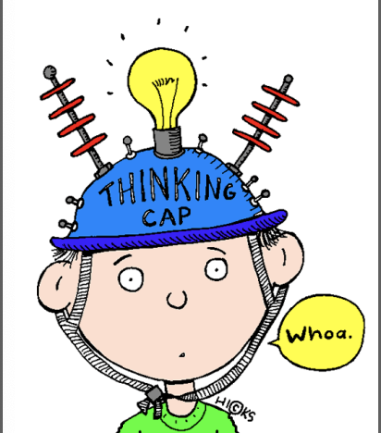
Questions about read to achieve?
We realize this is a LOT of information!
If you have questions or need help at any time, please contact your child’s reading teacher.

