Slide 1
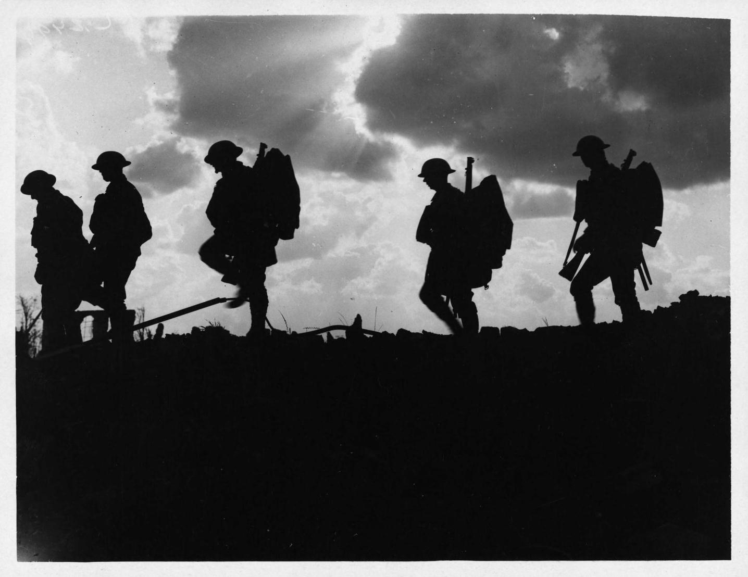
America on the World Stage:
Fresh Approaches to Understanding and Teaching World War I
Michael S. Neiberg

Slide 2
If I Say World War I….
http://www.youtube.com/watch?v=uk37TD_08eA
http://www.youtube.com/watch?v=aECBz2--kUk&feature=related

Slide 3
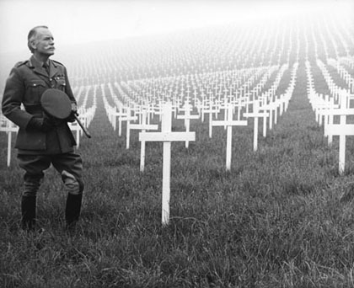
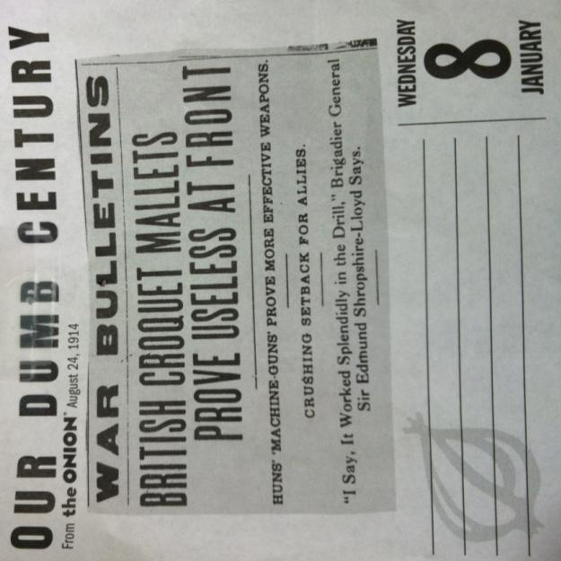
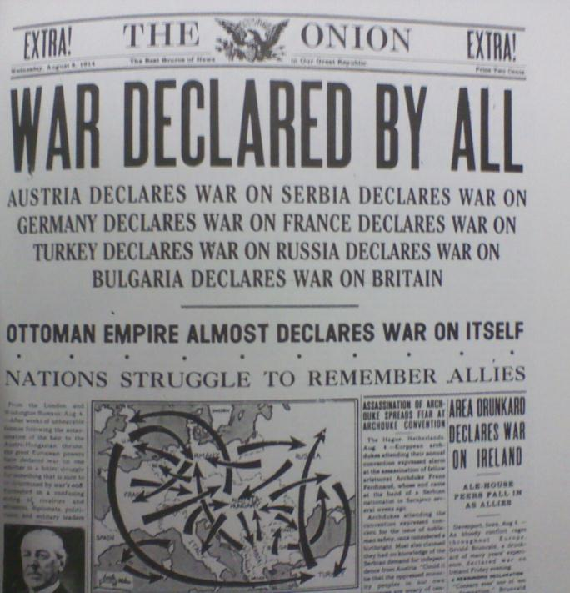
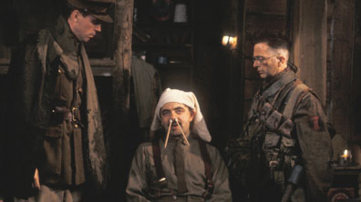

Slide 4
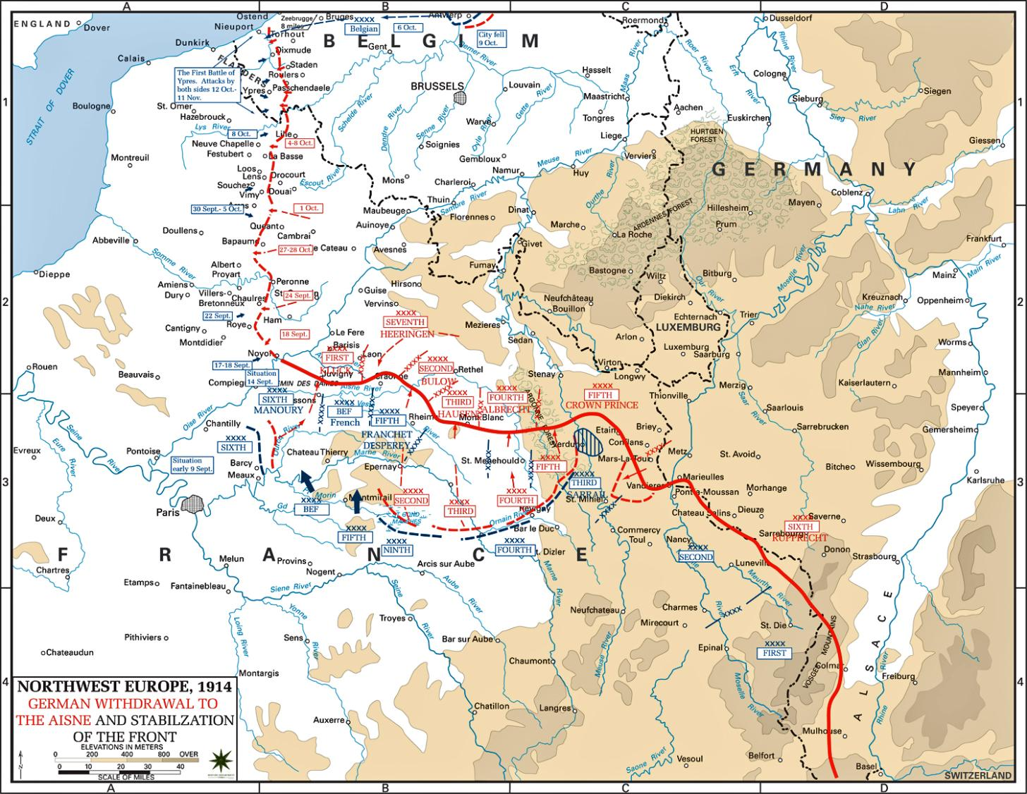

Slide 5
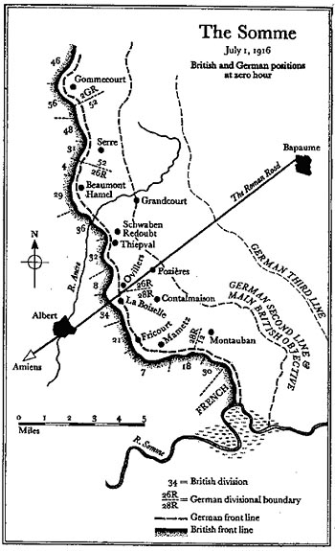
Waterloo lasted one afternoon. The Somme lasted four and a half months.
There were 25,000 British and 24,000 Prussian/Allied casualties at Waterloo.
There were 623,907 British/French casualties and 465,000 German casualties at the Somme
Waterloo to the same scale

Slide 6
Duration of Battle

Slide 7
Battle Casualties

Slide 8
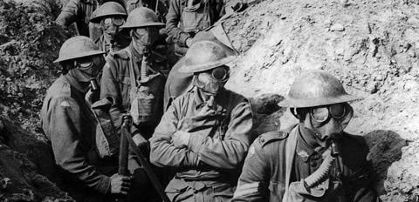
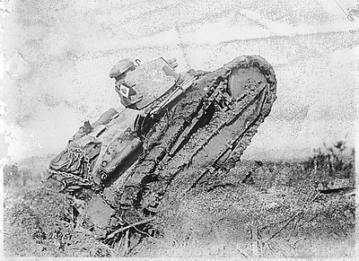
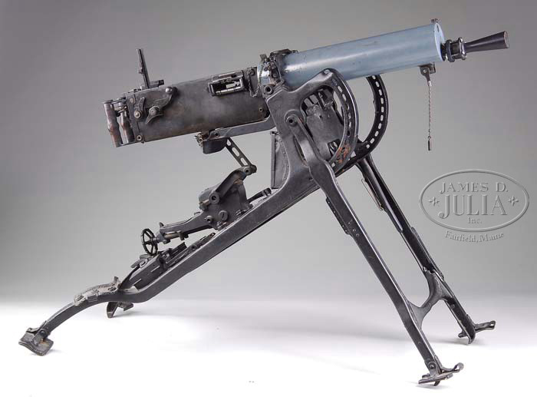
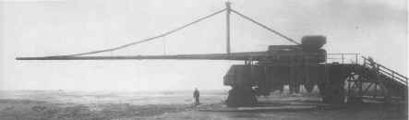

Slide 9
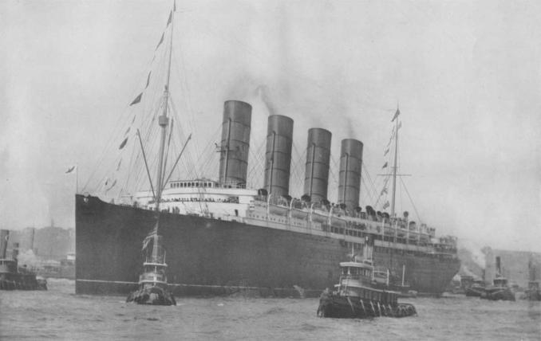
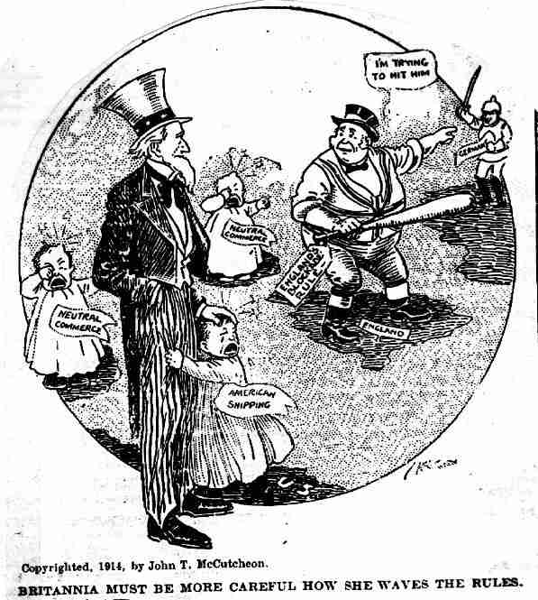
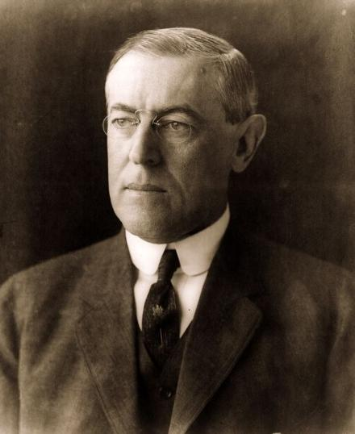
America in World War I

Slide 10
Three Key Points
1. USA part of a global system
2. USA went to war because of a combination of its values and interests
3. USA divided politically
None of this is, of course, new!

Slide 11
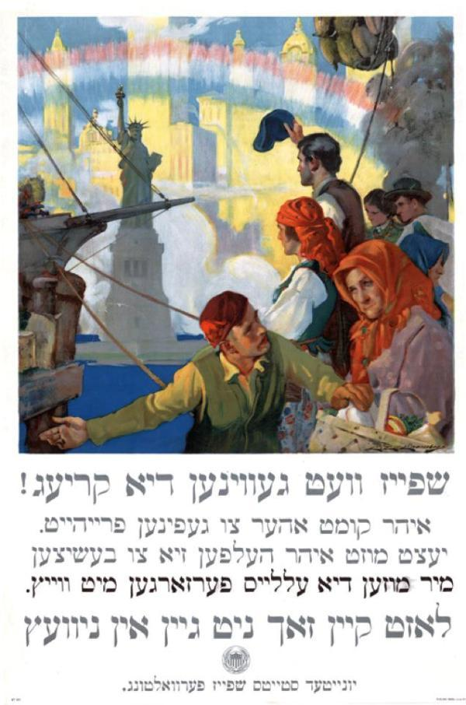
US in a Global World
Economics
Immigration
Culture

Slide 12
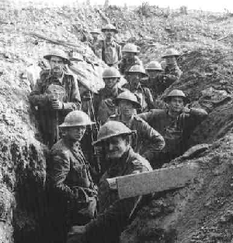
American Reactions to the Outbreak
“Again and ever, I thank Heaven for the Atlantic Ocean” – US Ambassador to Britain, Walter Hines Page, July 29, 1914 describing “The Great Smash”

Slide 13
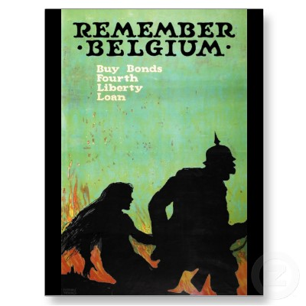
American outrage at atrocities
Who is to blame?
How should the US react?

Slide 14
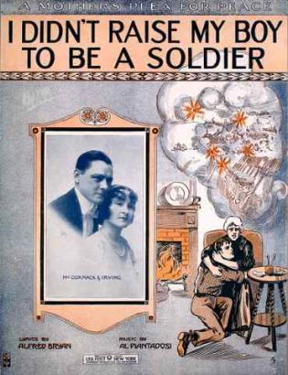
Neutrality
What did the term mean?
Equal impact on all sides?
No impact on the war at all?
Total US freedom of action?

Slide 15
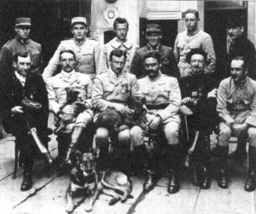
American Reactions
Arouse our compatriots from the doubt of neutrality to a comprehension of the vital issues at stake – the safety of Liberty, the preservation of Democracy.
The Lafayette Escadrille

Slide 16
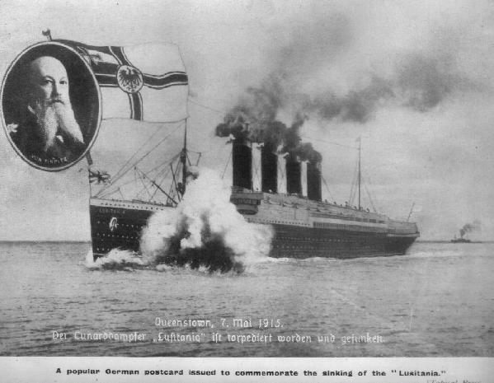
The Germans are killing people. The British are merely inconveniencing them – Wilson on the two blockade strategies.

Slide 17
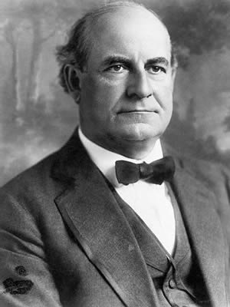
American Reactions to the War,
1915-1917
… you have prepared for transmission to the German Government a note in which I cannot join without violating what I deem to be an obligation to my country, and the issue involved is of such moment that to remain a member of the Cabinet would be as unfari to you as it would be to the cause which is nearest to my heart, namely, the prevention of war – Bryan’s resignation letter to Wilson, June 8, 1915.
William Jennings Bryan

Slide 18
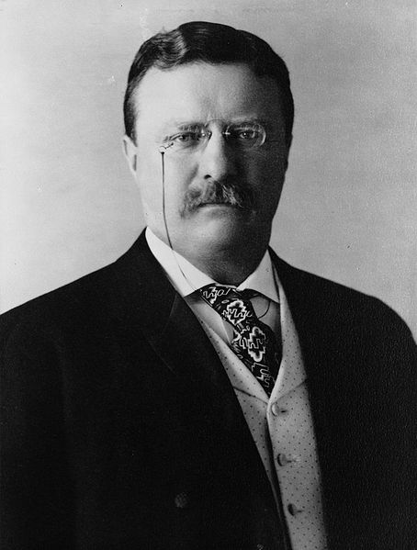
American Reactions to the War,
1915-1917
“If he (Wilson) does not go to war with Germany, I shall skin him alive” - Roosevelt to Massachusetts Senator Henry Cabot Lodge in the wake of the Zimmerman Telegram
Theodore Roosevelt

Slide 19
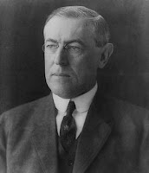
American Reactions to the War,
1915-1917
“There is such a thing as a man being too proud to fight” – Wilson, 1915.
“The man too proud to fight is in practice always just proud enough to be kicked” – Roosevelt’s response.
Woodrow Wilson

Slide 20
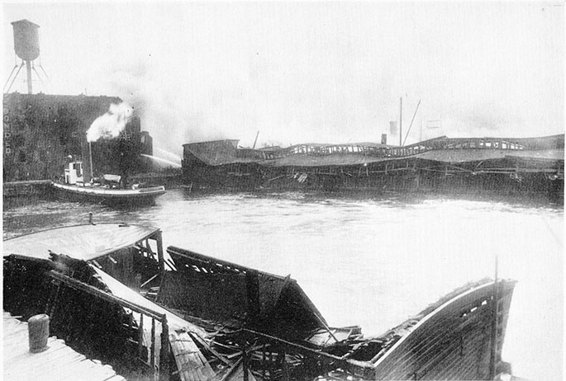
German Aggression
July 30, 1916 “Black Tom” explosion in Jersey City
So powerful it broke windows in Manhattan and was felt in Philly
Seven killed; $2m in damage to Statue of Liberty
German agents involved; one arrested, one escaped to Germany.

Slide 21
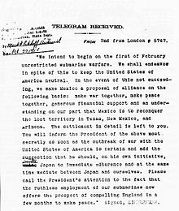
Zimmerman Telegram
Released to US population in late February, 1917
German agents had been running guns into Mexico
Played on US fears of both Germany and Mexico

Slide 22
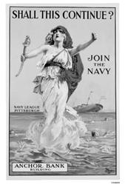
Return of USW
Sinking of three ships in March, all with loss of US life
Russian Revolution
By March 20, Wilson’s cabinet was unanimous for war

Slide 23
America’s Role?
Wilson supported a “peace without victory”
“A War to End All Wars”
“Make the World Safe for Democracy”
Use the American Army to solve Europe’s problems through reason and morality
Roosevelt sought to use US military might to punish Germany
Use the war to make America a world power
Roosevelt wanted to lead a division personally
All of his sons fought, one was killed

Slide 24
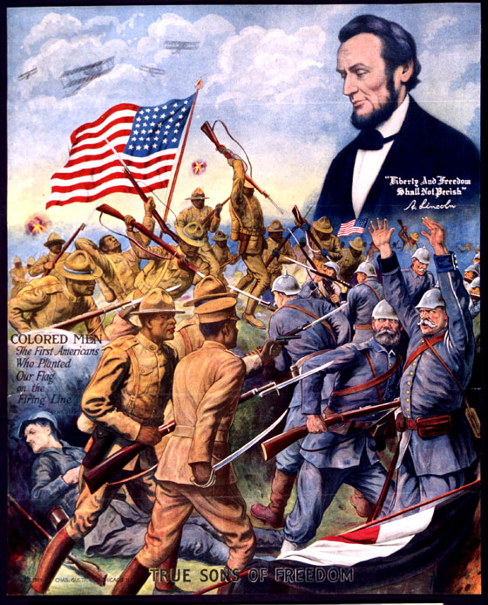
Conclusions
Let’s get away from Wilson
World War I not so different from wars that came before or after
There is a lot to study and a lot to learn

Slide 26
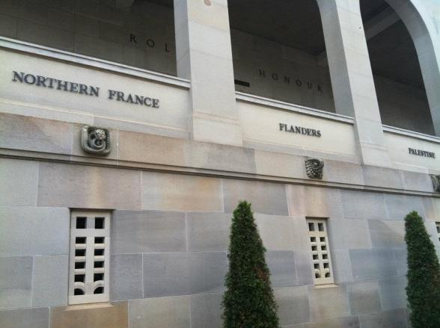
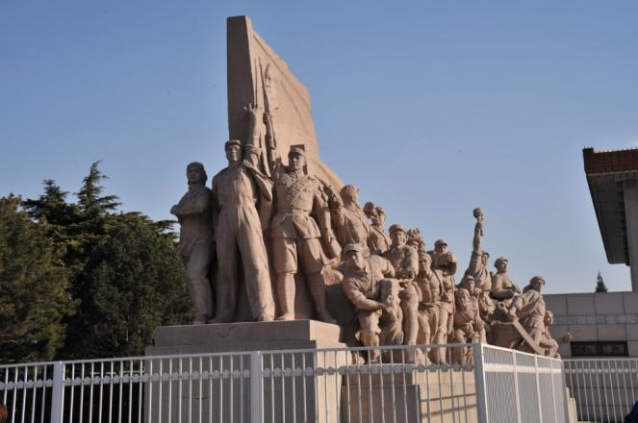
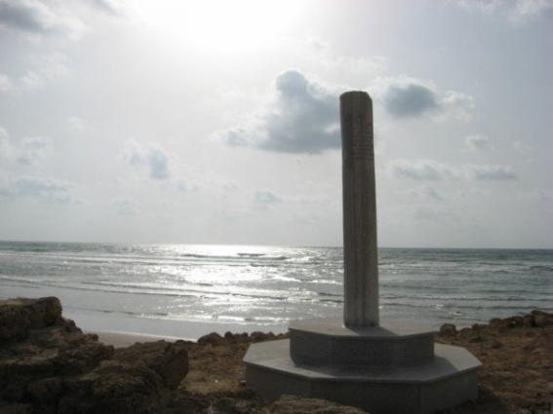
How to Teach World War I
Canberra, Australia
Always keep a global perspective
Tel Aviv, Israel
Beijing, Tiananmen Square

Slide 27
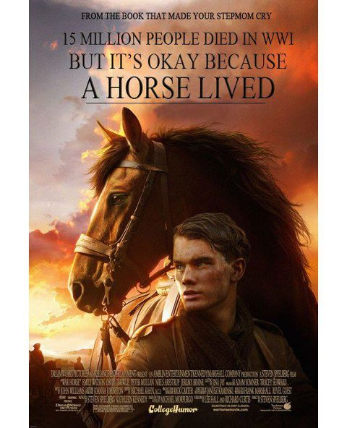
Avoid Easy Stereotypes
Get people of 1914 out of the “stupid box”
Some new answers emerging, especially about Russia, Ottoman Empire
Avoid presentism

Slide 28
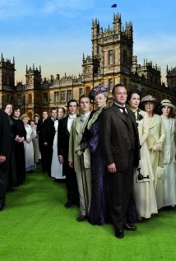
Look for Complexity
Keep reading, they get smarter
Nationalism just one identity
Look for connections and linkages

Slide 29
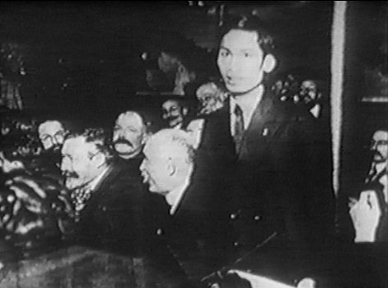
Don’t See 1918 as an End
Fascism, Depression, World War II, Nazis, Holocaust, Cold War all tied to 1914
“Long War” idea
Europe’s Second “Thirty Years War”

