Slide 1
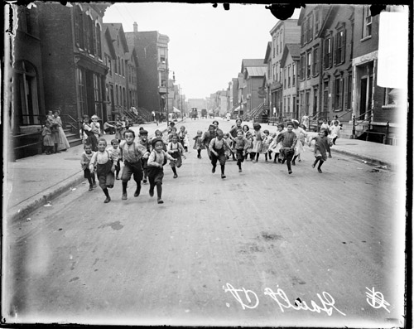
Children in the City of the Progressive Era
James Marten
“TAH: America on the World Stage

Slide 2
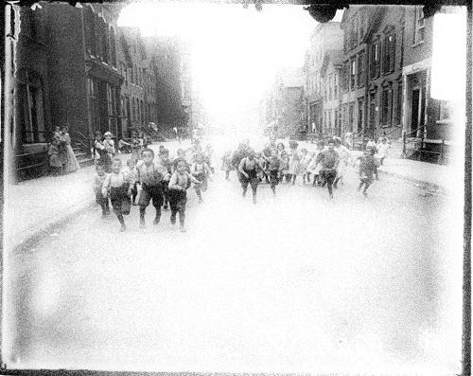
The Child and the City: The Chicago Child Welfare Exhibit, 1911
Introduction to Progressivism
Changing Attitudes about Children
Studying Children
Urban Reformers
The Campaign Against Child Labor
Cultures of Children and Youth

Slide 3
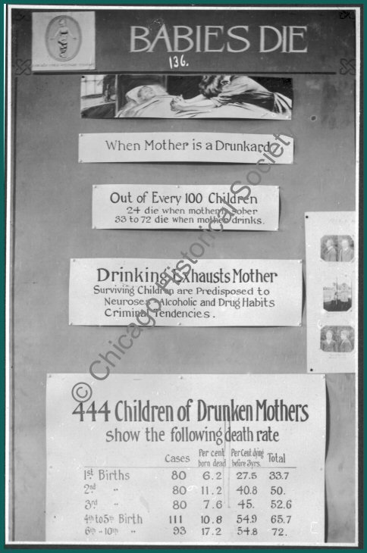
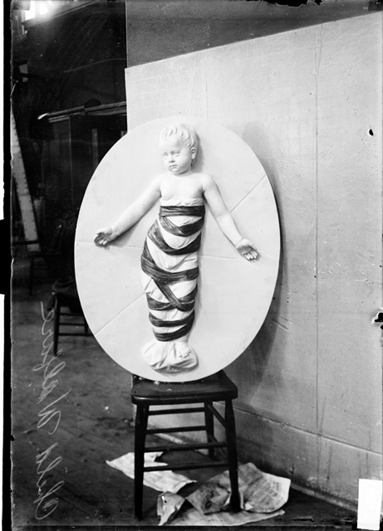
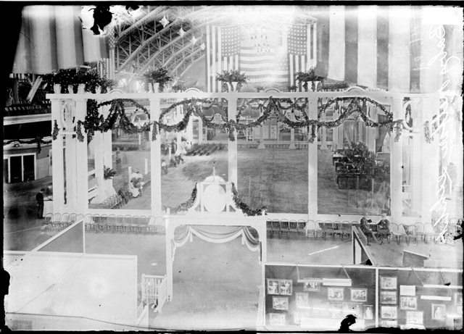
“A Is for Adenoids”
The Chicago Child Welfare Exhibit, 1911
Notes:
SLIDE: Child Welfare Exhibit 1911
On a hot day in May 1911, Susan Glaspell, a Chicago journalist and playwright, turned down the chance to go for a drive and went instead to the Chicago Coliseum, where she toured the Child Welfare Exhibit.
--NYC version
---Jane Addams and others, McCormick family
Glaspell at first went "because I thought I ought to go. One should know all that one should about those things, said I to myself." As a result, "with a pleasing sense of my own virtue," she joined tens of thousands of other Chicagoans streaming into the sweltering old building.
As soon as she arrived, she discovered the exhibit to be a compelling demonstration of the conditions facing city children. "It was a great thing to do—thus to assemble the thing before our very eyes; the full horror of conditions as they are now, what is being done, what might be done, will be done, this makes us hope."
Glaspell strolled past booths, posters, and demonstrations created by hospitals and schools, settlement houses and Boys Clubs, parks administrators and orphanages.
--Chicago Health Department exhibit--annoyed by a flashing red light, until realizing that each flash represented the death of a child some place in the world from a preventable disease. That moment of realization was not "spoiled" by "preaching." Here, Glaspell wrote, as they did throughout the Exhibit, the posters and displays "told it in a way that gets you. I watched woman after woman stand before it and then turn away with dimmed eyes." The Exhibit was designed to inspire exactly that mixture of grief and interest, to create awareness as well as outrage.
--Three hours; she’s people watching
--she took particular meaning from "watching the people as they did their seeing. One could fairly see the thoughts forming in their minds as they looked from things as they are to things as some wise brave men and women are struggling to make them."
--Exhibit “doesn't spare our feelings in showing how bad things are now." Nevertheless, "you come away more inspired than disheartened, for it had shown you that great things are being done for children, and that the end is not yet."
--She closed with a graceful summary of what the Exhibit, seen in its most optimistic light, had accomplished: "The Child Welfare exhibit is a meeting ground for adults. It is a breeding place for thoughts. It is Science placing her gifts in the outstretched hands of Democracy."
READING: A IS FOR ADENOIDS

Slide 4
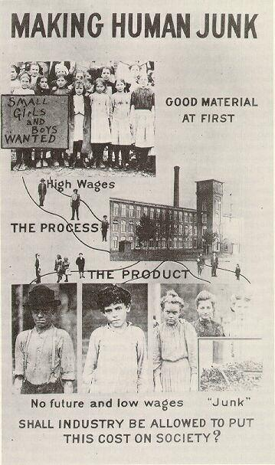
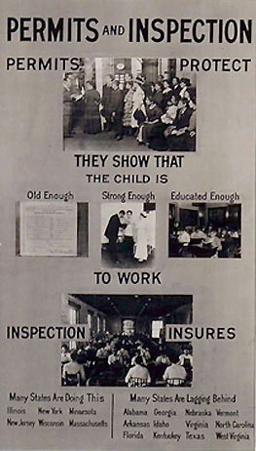
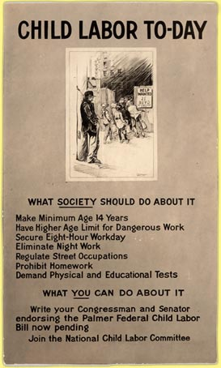

Slide 5
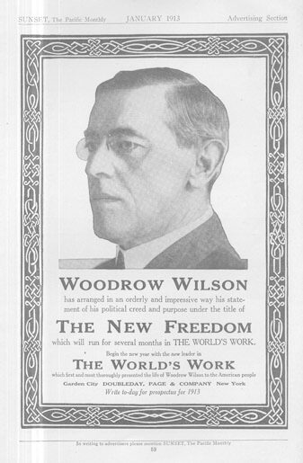
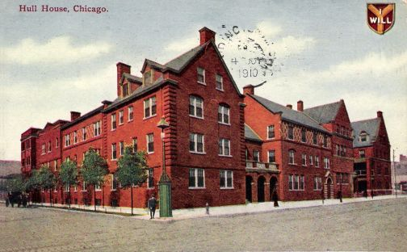
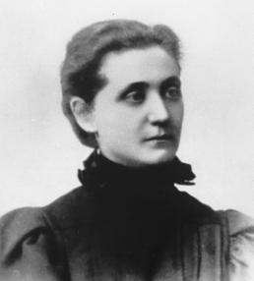
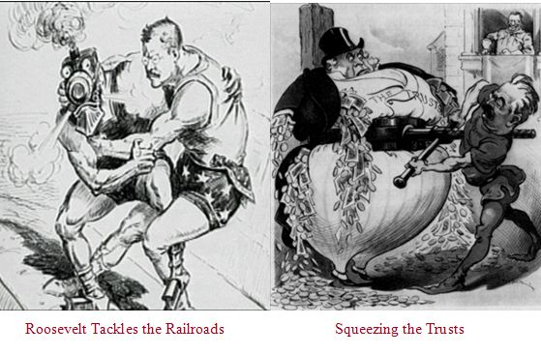
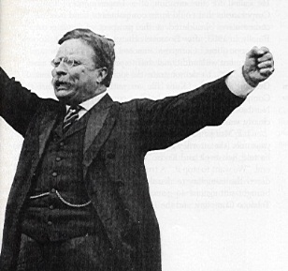
Introduction to Progressivism
Science, Reason, and Research
Government action
“Square Deal”
1909 White House
Conference on Dependent
Children
“New Freedom”
Progressive Icons: TR, WW, and Jane Addams
Notes:
SLIDE: Introduction to Progressivism: NOT STRICTLY URBAN, BUT MANY PROGRAMS FIT NATURALLY INTO CITY ENVIRONMENT.
Glaspell's elegant phrase—"science placing her gifts in the outstretched hands of Democracy"—captured perfectly the ways that early twentieth century reformers hoped they could improve the lives of American children.
--Height of the "Progressive Era," which lasted from the 1890s through the First World War.
--unique historical period, the first of several periods of reform and innovation in the twentieth century.
--Progressive Icons:
--Uniting all Progressives was what Roosevelt called a "fierce discontent of evil"—those people and forces that worked against fairness, justice, and equality in the United States.
—one must first find out what is wrong before one can change it
—capacity of professionally trained experts to manage and reform social problems.
--local, state, and federal governments must take the lead in establishing a fair economy, raising the standard of living for everyone, and in bringing the nation's vast resources to bear on the many problems facing Americans, especially in the crowded cities.
Progressive reforms at the national level ranged from regulating trusts to lowering tariffs on imports; from women's suffrage to the prohibition of alcohol; from regulating the packaging of food and the sale of drugs to preserving the environment. At the state level, Progressives established processes for holding referendums to consider legislation and for recalling elected officials and regulated child labor. At the local level, reformers in many cities reduced the size of city councils and hired city managers to break the power of corrupt political bosses and made public utilities out of urban transportation, power, and sewer systems.
There were many causes and inspirations for this coming together of diverse political parties and interest groups. Some were concerned by the soaring number of foreigners flooding American cities, others by the expanding gulf between the rich and poor, still others by the disorder caused by political corruption and labor strife. Although Progressives did not completely ignore rural America, they were far more interested in the chaotic cities bursting with immigrants and social problems. Many acted out of compassion for the less fortunate, while some feared that without reform, without a coherent approach to poverty, crime, political corruption, and urban hygiene, to name only a few targets of change, society was in danger of falling apart. The only solution was to impose discipline and fairness on society.
--They were engaged, in the famous words of the historian Robert H. Wiebe, in a "search for order," and the programs they designed to confront the many problems of the cities reflected that imperative.
Child welfare became the issue that most Progressives could agree on.
--juvenile justice, playgrounds, pensions for widowed mothers, health care, housing, even child labor laws received almost unanimous support from the various branches of the Progressive movement.
--As innocent victims and as the hope for America's future, children had to be protected. They represented all that was good about the country, and the way that they were treated reflected the nation's values and priorities.

Slide 6
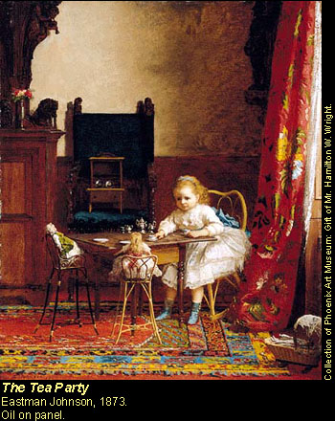
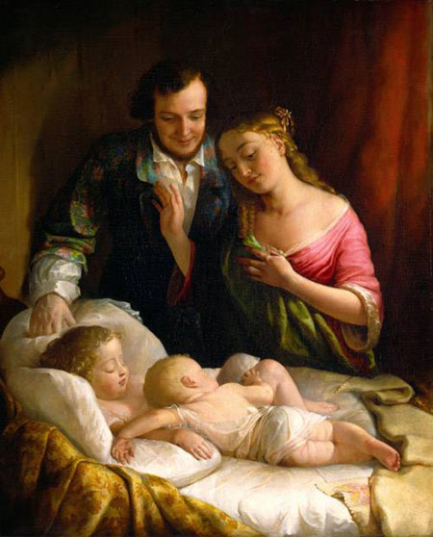
New Attitudes about Children
Eastman Johnson and
Lilly Martin Spencer
Zelizer, Pricing the Priceless Child
Devine, “A Right View of the Child”
Notes:
SLIDE: Changing Attitudes About Children
. . . reflected the shift in ideas about children that had been developing for decades before the Progressive era. Although only a minority of American children could enjoy it, this optimistic, nurturing, and child-centered ideal became a powerful model to which many Americans aspired. More importantly, the assumptions it contained were applied by most urban reformers at the end of the nineteenth and beginning of the twentieth centuries to the problems facing city children. At least some reformers believed that there was an "ideal" childhood, and that society's goal should be to enable all children to live that ideal.
The rise of this "child-nurture" philosophy of childrearing
--child-centered
--protected
--extended
--emotional assets rather than economic (class, urban vs rural)
--material well-being
DESCRIBE PAINTINGS: MODEL that reformers have held up ever since
Family size
Births per 1000:
1800: 55
1850: 43.3
1900: 30.1
1920: 26.9
1940: 18.6
2000: 13.9
--emotional investment in children was reflected among individuals in the increasing importance placed on expensive funerals and other symbolic manifestations of affection and devotion.
--At the community level, it was reflected in the public outrage over the deaths of children in automobile and streetcar accidents during the first two decades of the twentieth century.
--Vivian Zelizer, Pricing the Priceless Child

Slide 7
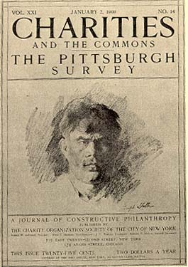
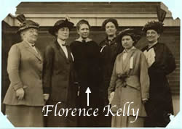
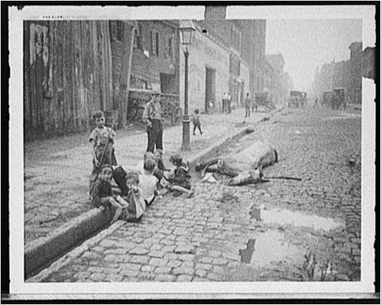
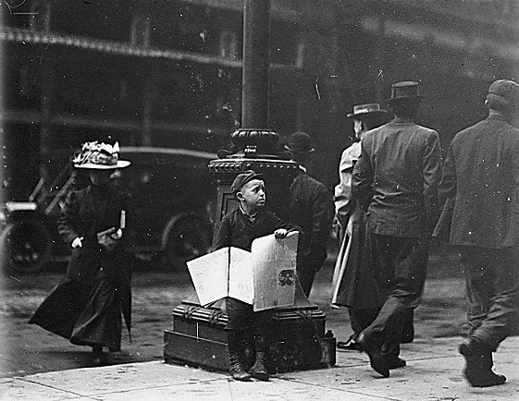
Studying Children
Kelly: A Right to Childhood
Notes:
Slide: Studying Children
A hallmark of the Progressive approach was a compulsion to do research, to identify and articulate problems before developing solutions.
--numerous studies they conducted on child labor.
--The most popular subjects of this research were newsboys. At least sixteen studies were conducted of newsboys (sometimes including other street traders), in cities from New York to Cincinnati and from Dallas to Milwaukee between 1910 and 1925.
--Although many thousands more children worked in southern mills (in small towns or rural areas), in northern sweatshops, and in tenement apartments, where they worked with their parents doing "home work," one of the most prominent faces of child labor for urban Americans were the ubiquitous newsboys, who from the 1850s through the 1920s were responsible for selling millions of newspapers each day.
--Supposedly romantic, carefree lives, dime novels and movies
--image of spunky entrepreneurs
--Newsboys became the symbol of the ways that city children were often denied the kind of childhoods that middle class reformers believed every child had the "right" to enjoy. Worse, they showed how easy it was for boys to slip into a world of dissolution and crime, which could lead to serious problems for the entire society. "If we do not lift him up," wrote one anxious organizer of newsboys, "he will pull us down."
--Studies of youth’s free time
--reports based on interviews with juvenile delinquents, surveys of school children, and the comments of teachers, social workers, and parents, researchers
--cities as small as Springfield, Illinois, and as large as Cleveland, Ohio, and Los Angeles,
--found that the lack of recreational options led children to inappropriate behavior and even to crime
-- boys and girls idling away their time and, in many cases, descending into juvenile delinquency, which many advocates for recreational reform assumed would be the end result of unsupervised play.
--A Cleveland boy interviewed at the State Industrial School claimed that he spent at least eleven hours a day "in the streets, at the movies, in the railroad yards, and at the pool hall. He also liked going to burlesque shows for the "good jokes" and dancing, and to a local amusement park. Without a playground in their neighborhood or a baseball team to fulfill his interest in the sport, he turned to petty thievery, breaking into freight cars and stealing fruit and, in one escapade, ten cases of ginger ale. His first trip to the State Industrial School was for chronic truancy and being "a general nuisance in the neighborhood"; the second was for breaking into cars. That this boy was out of control seemed confirmed by his statement, "My people never knew, when I left home in the morning, whether I was going to school or not." All of this had happened before he turned fifteen.
--The inadequacy of recreational facilities; highlighted in the story of an eleven-year-old girl who "never drew books from the library, never used playgrounds, and did not know what a park looked like." She was in court because of her relationship with men who worked at the railroad freight yard. The men gave the girl and her friends toys, candy, money, and coal (for their families) in return for unnamed sexual favors. The poignant interview ended with the girl being asked how often she went to the woods: "I don't know what a woods is," she replied.
Such stories led reformers to argue that a crisis was at hand: Florence Kelley, one of the leading advocates for children at the turn-of-the-century, coined a phrase in 1905 that would provide another motto and a goal for advocates for children and youth during this period and beyond when she asserted that Americans must mobilize to protect "a right to childhood."

Slide 8
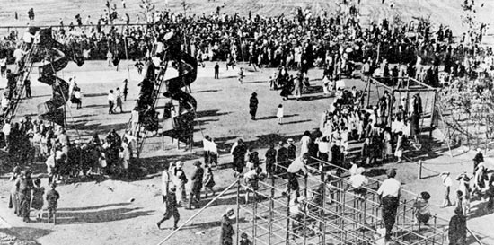
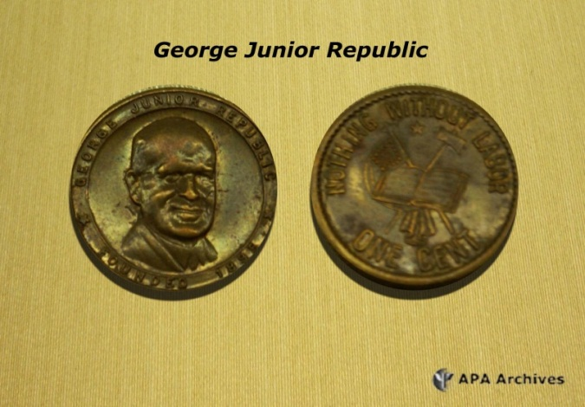
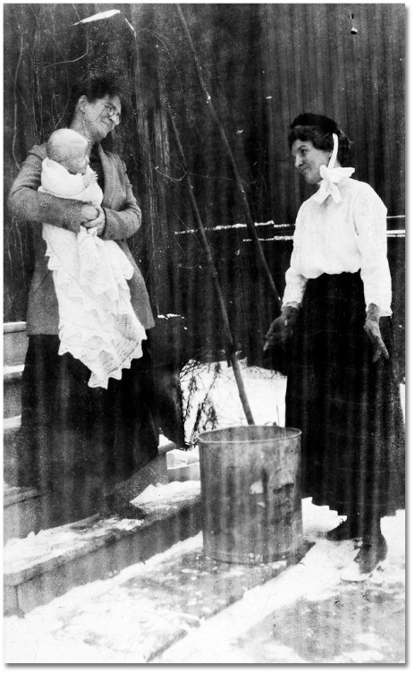
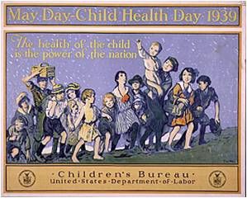

Notes:
Next slide: playgrounds
Although Progressives targeted most aspects of children's lives, the campaigns that were most relevant to urban youngsters dealt with children's health, juvenile justice, and child labor.
--Settlement Houses: 1889 Jane Addams founded one of the first Settlement Houses in the United States in an old mansion on Chicago's West Side: Hull House
--Became a center of child welfare efforts in Chicago. kindergarten in the 1890s and, in 1893, Chicago's first public playground. Over the years, its clubs, rural camps, day cares, and other services for the young became extremely popular. The settlement house movement expanded rapidly, until by 1910 there were more than 400 settlements around the country.
--Departments of Health in a number of cities sent visiting nurses into slum neighborhoods, set up aid stations (sometimes called "baby tents") to provide clean, well-ventilated, temporary child care, and instructed young girls in nutrition, personal hygiene, and rudimentary child development as part of the so-called "Little Mothers' Movement."
The culmination of the campaign to bring the resources of the federal government to bear on children's health was the creation of the United States Children's Bureau within the Department of Commerce and Labor in 1912.
—the first federal agency in the world dedicated to the children
—conducted research on child labor and health issues, published pamphlets on childrearing and nutrition, and sponsored events celebrating infant and children's health.
--published scores of studies, some hundreds of pages long, on childcare, child heath, and child labor
--initiated "Baby Week Campaigns," providing flyers, publicity, how-to bulletins, posters, and other items to state and local organizations. Organizations ranging from public health departments to the Camp Fire Girls, agricultural college extension services to women's groups, hospitals to county governments, and churches to Chambers of Commerce, sponsored Baby Week events. Generally held during a single week in the spring of the year, the events varied dramatically from community to community, but they generally included exhibits, lectures, stereopticon shows, and demonstrations on nutrition, the importance of pasteurized milk, creating healthy environments (with adequate ventilation and screened windows, for instance), vaccinations, clothing, and traffic safety. Many baby weeks included competitions for the best slogans, most creative posters and poetry, and essays on child health. Some held "better mothers" contests whose winners earned the best score on childcare examinations. Awards were also given to the healthiest babies, who were presented at festive pageants and featured in laudatory newspaper articles. Indeed, the baby contests became one of the most popular—and, because of the exploitative nature of showing off cute babies, controversial—parts of the campaign.

Slide 9
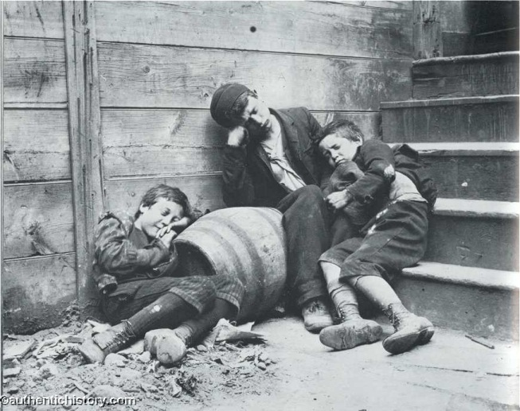
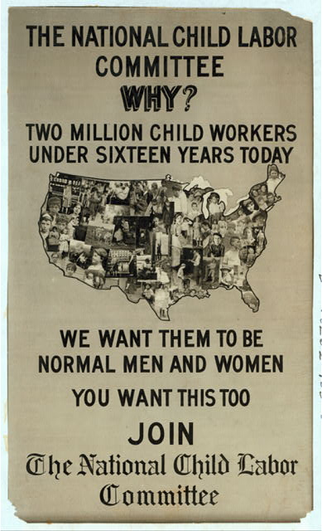
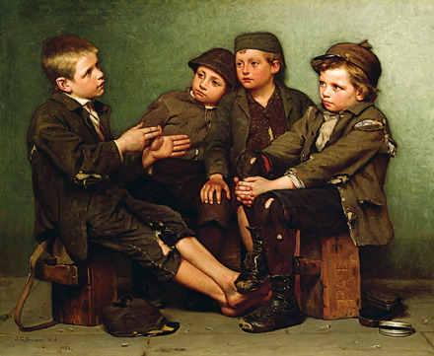
The Campaign Against Child Labor
Jacob Riis, “Street Arabs in Night Quarters,” 1890
John George Brown, “A Tough Story,” 1886
James Schmidt, Industrial Violence and the Legal Origins of Child Labor
Reading: “The Story of My Cotton Dress”
Notes:
The Campaign Against Child Labor
A third major priority for Progressive-era child savers was the campaign against child labor, which became one of the movement's largest efforts. GOALS: Pass laws that required registration of street traders, toughened rules for school attendance, restrict ages of factory workers.
--Between 1870 (the first year in which the United States census recorded child labor) and 1900, the percentage of children between the ages of ten and fourteen who worked for wages increased from 16 percent to 22 percent (it was probably higher), and those figures did not account for the tens of thousands who labored in the "street trades" or as tenement-bound "homeworkers."
-- An early-twentieth century study of several cities discovered 17,669 children selling newspapers alone; the Department of Commerce estimated that in 1916 that "junkers"—mostly children—collected $265 million worth of scrap metal and ten million pounds of wastepaper. Untold thousands did home work in the meager apartments they shared with their families, producing clothing, placing snaps and buttons on cards, stringing rosary beads, setting stones in cheap jewelry, packaging shoe laces, and making artificial flowers, often for no more than five cents per hour.
--injuries and long-term health problems caused by working in coal mines, cotton mills, and foundries,
--lack of educational and cultural opportunities available to child workers.
LOCAL EFFORTS:
--19th century: trade unions had advocated restrictions on child labor, argued that work deprived children of equal access to education and that the low wages paid children depressed the wages of working adults.
-- National Consumers League
--many other humanitarian and philanthropic organizations—from church groups to women's clubs and from settlement houses to social service organizations—joined the fight.
--By the turn of the century, child labor committees had been formed in New York, Alabama, and several other states and by 1903 significant child labor legislation had been passed in a number of states.
NATIONAL MOVEMENT
-- National Child Labor Committee (NCLC) formed in 1904
--publicity for and to mobilize the public, labor unions, and politicians against child labor. publications highlighted the damage that full-time work could do to children, from lost limbs to respiratory diseases, from bent backs to undeveloped minds.

Slide 10
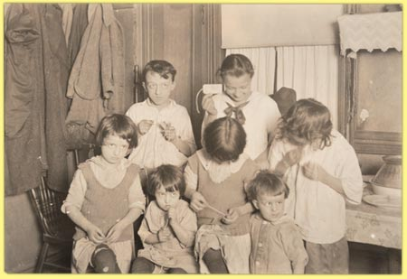
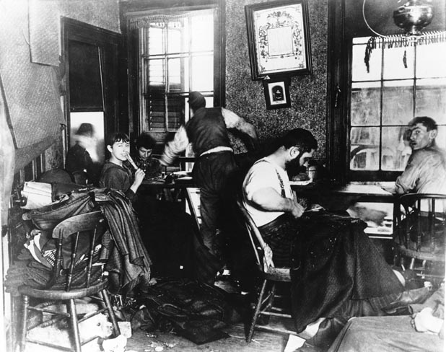
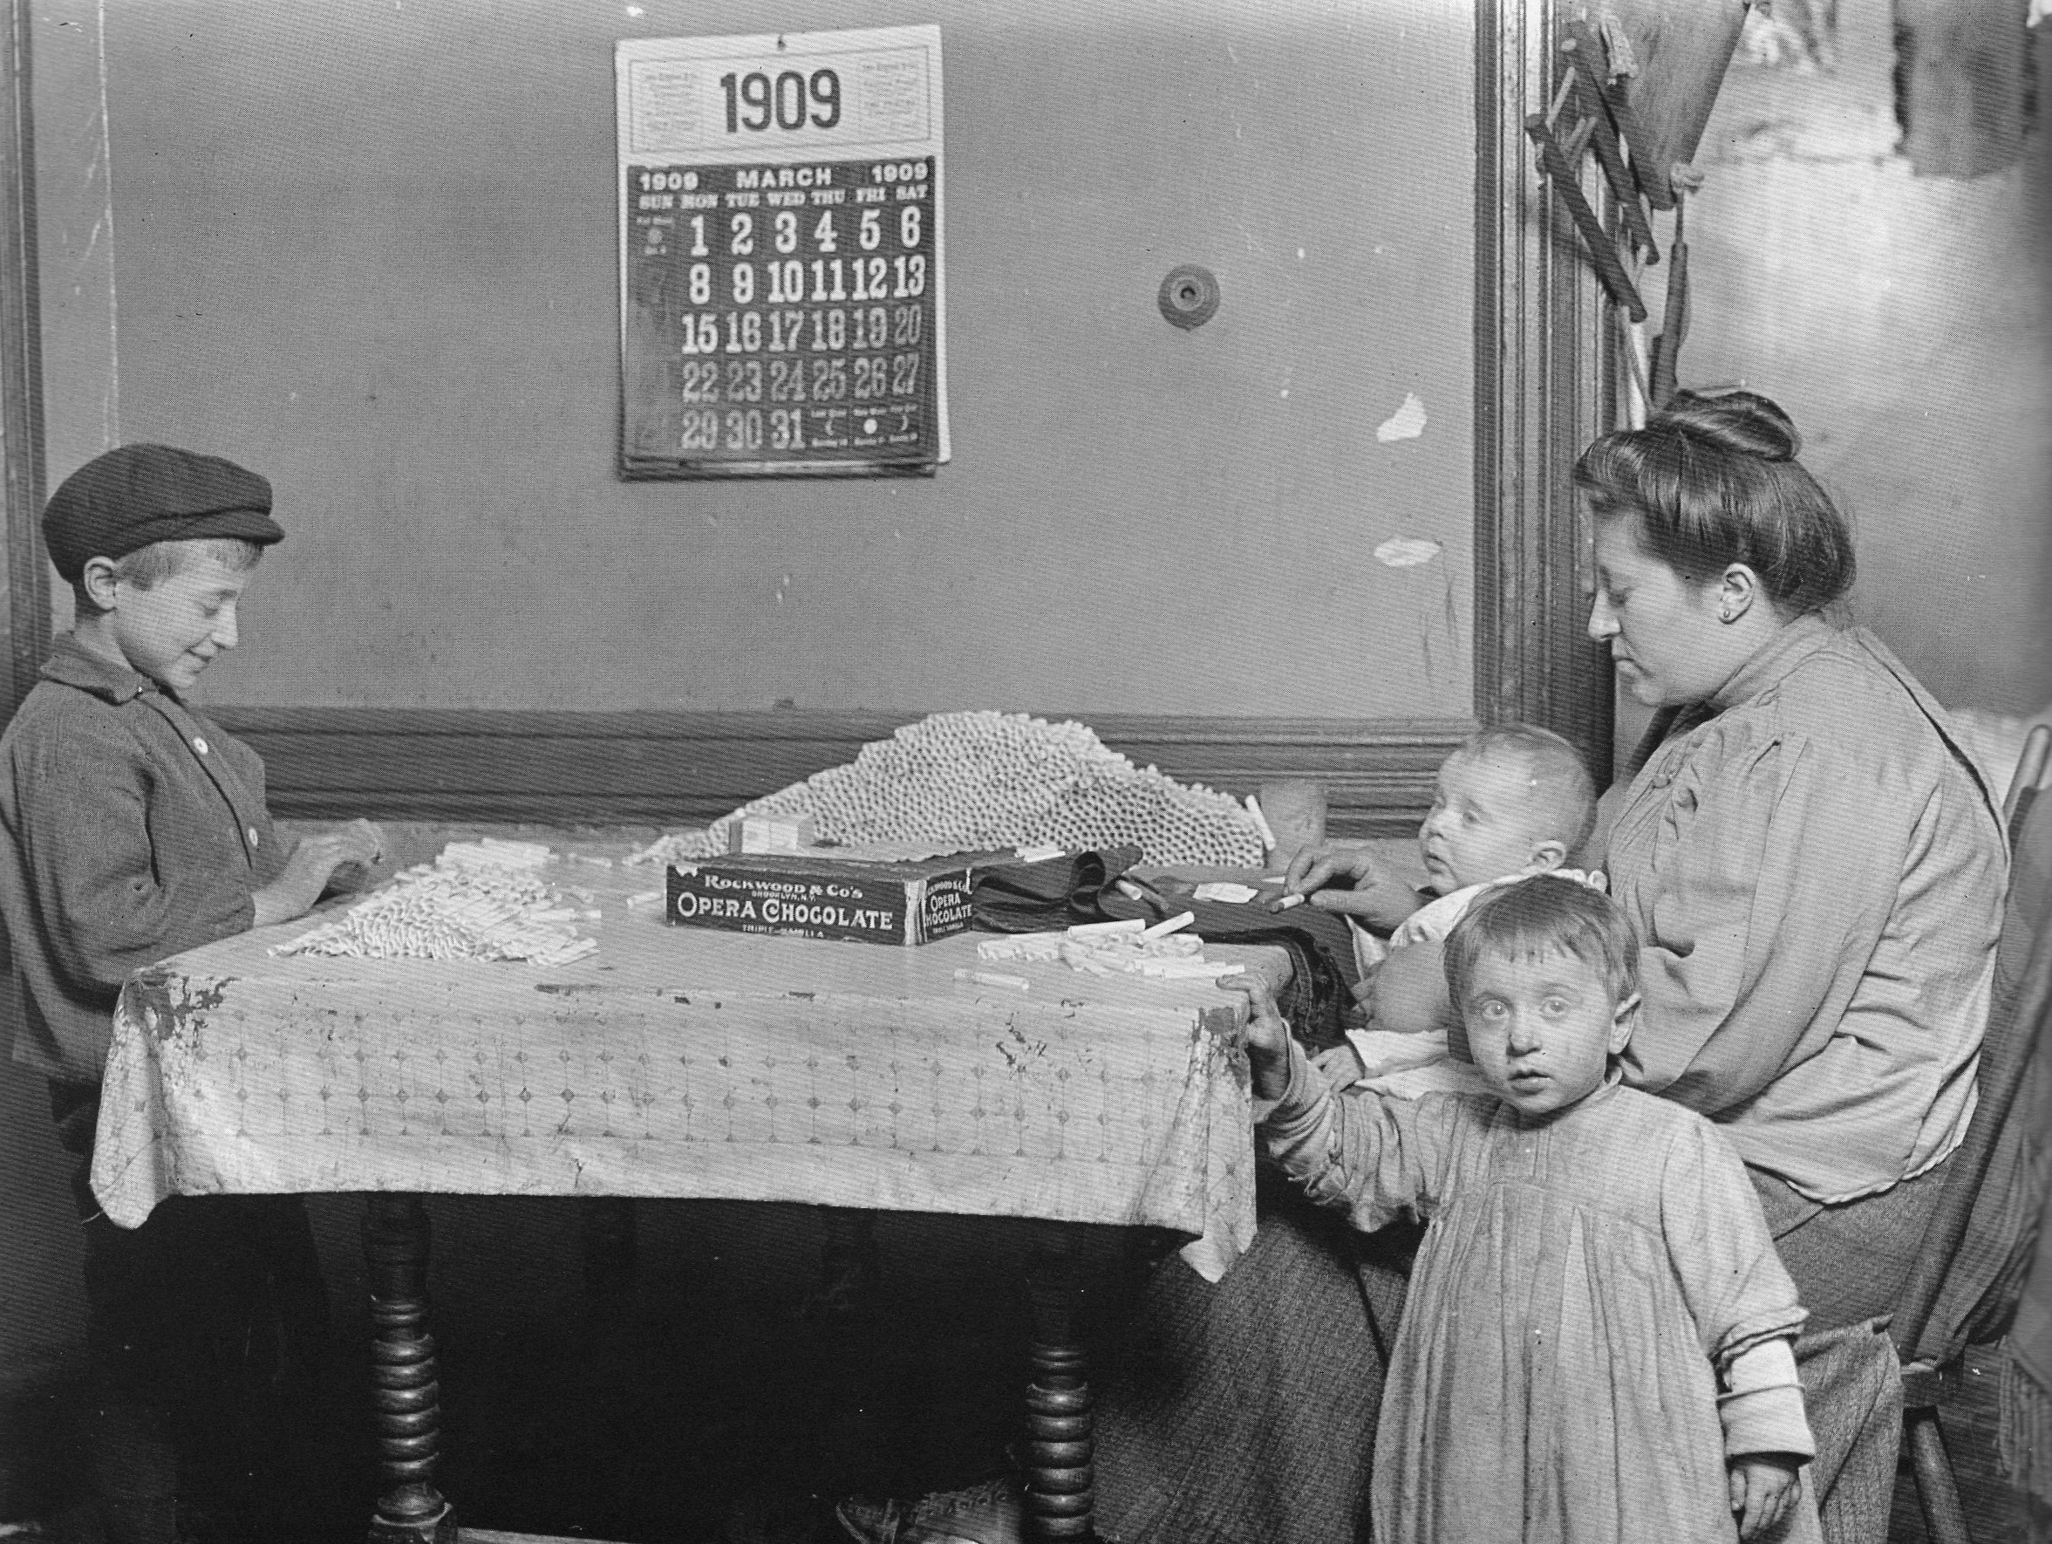
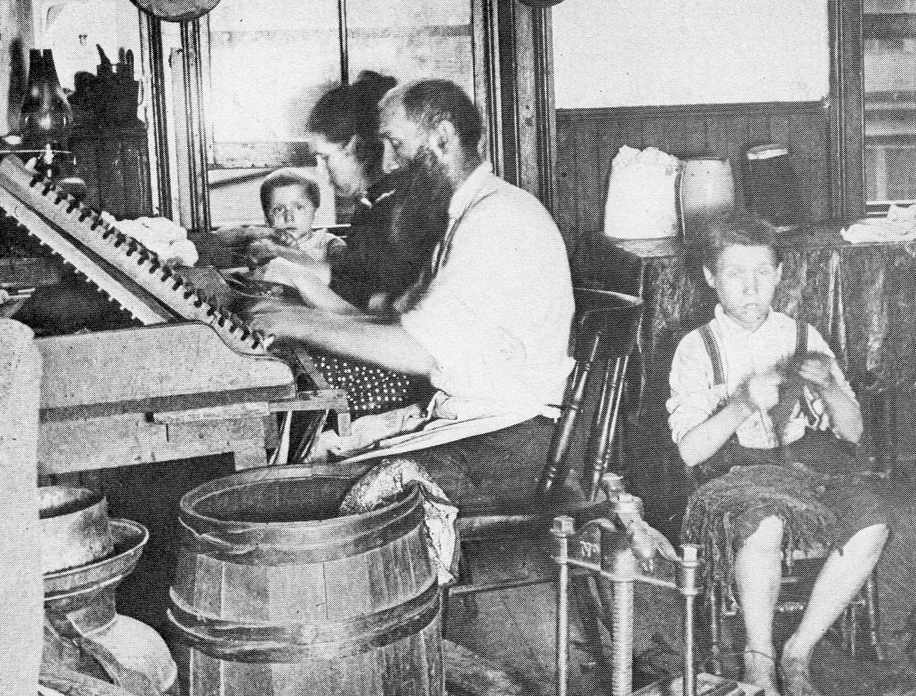
Clockwise:
Stringing Milk Tags
Sewing Knee Pants
Rolling Cigarettes
Rolling Cigars
Notes:
NEXT SLIDE: HOME WORKERS
-- Through investigations and publicity garnered by the work of pioneering photographers like Lewis Hine, the NCLC promoted the enforcement of existing child labor laws and the passage of stricter regulations.
--TARGET: a minimum age of fourteen for working in factories and sixteen in mines; an eight-hour day for fourteen and fifteen-year-old industrial workers; and no night work for youth under the age of sixteen.
--The resulting Keating-Owen Act of 1916 carried great symbolic value—it incorporated most NCLC goals—but applied to only a fraction of the children employed in the United States. Many southerners opposed the law because it projected federal power into the states, but other fought against it because they believed children were better off working in factories than idling on streets, and argued that until there were enough schools for youngsters to attend—southern states lagged far behind northern states in providing post-elementary education for their children—they should continue working.
--The U. S. Supreme Court ruled the Keating-Owen Act unconstitutional only nine months after its passage. Effective federal regulation of child labor would not be implemented until the Fair Labor Standards Act of 1938.

Slide 11
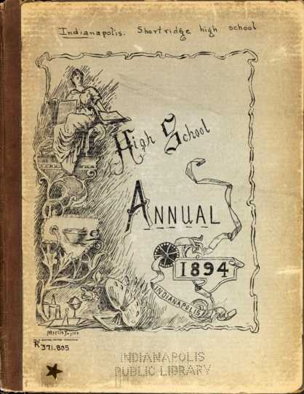
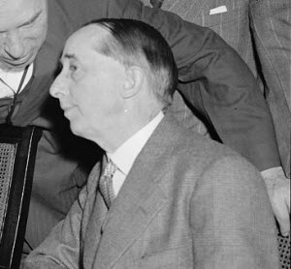
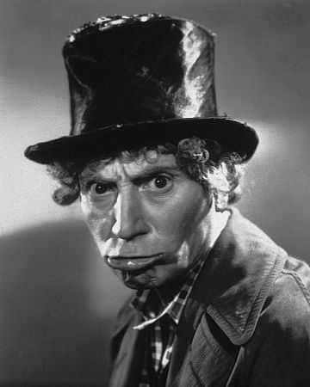
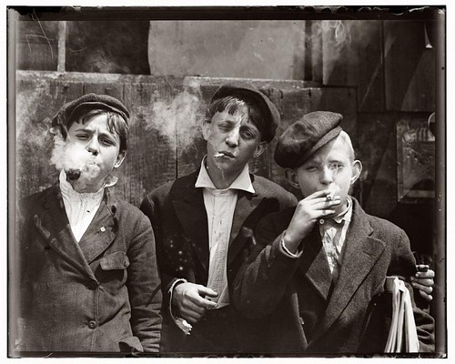
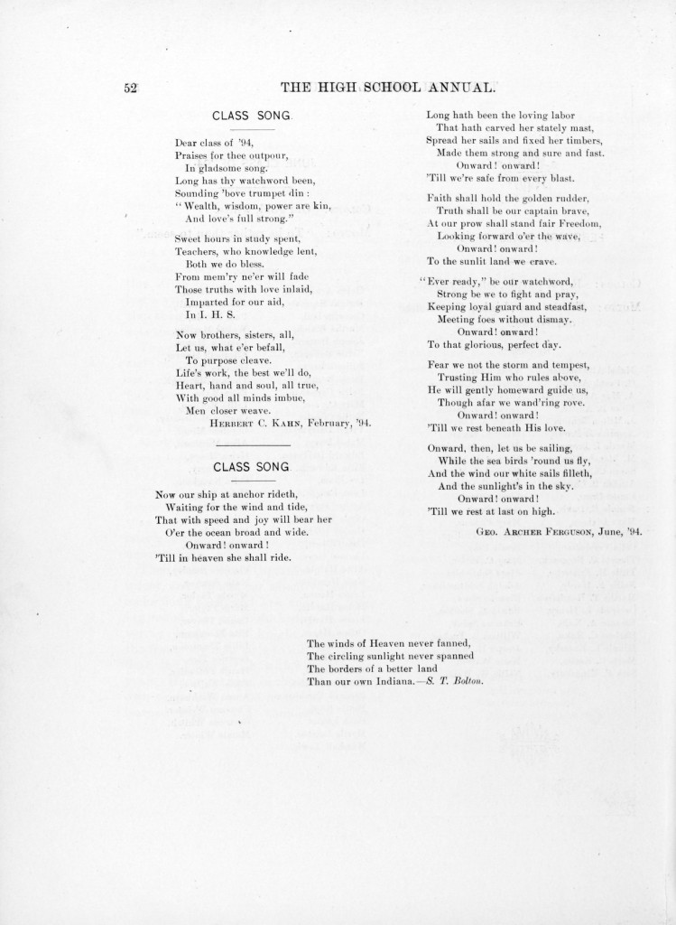
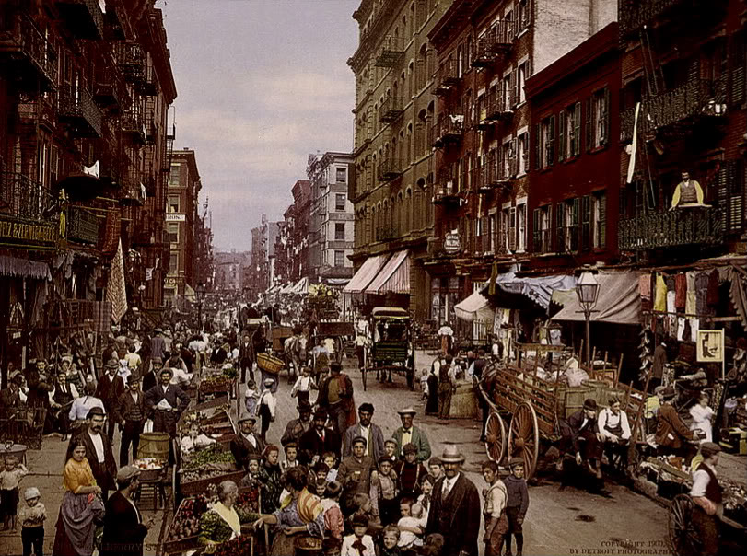
Cultures of Children and Youth
Notes:
SLIDE: Cultures of Children and Youth
--As in all times, there were many childhoods in the cities of the Progressive era America
--Two examples, from cities:
--burgeoning high schools. The first American high school, Boston English, appeared in 1821.
--the number of high schoolers increased dramatically during the late nineteenth and early twentieth centuries, from 72,000 in 1870 to over two million in 1920.
--Perhaps a third of all fourteen-to-seventeen-year-olds attended high school in 1920 and about 16 per cent actually graduated.
--YOUTH CULTURE shaped by organizations and activities: Students established sports teams and debating societies, published school newspapers and yearbooks, ran student governments, and organized dances and other social occasions. Over time school administrators took over most student activities in American high schools, establishing conferences for sports teams, requiring coaches, conductors, and other advisors of student activities to be members of the faculty, limiting participation in official activities (especially sports) to students in good academic standing, and censoring student publications. This created a regulated, safe, and structured place that could not have been more different than the wild and woolly environment of the streets.
Only a small minority of teenagers actually attended school, however, and another form of youth culture also flourished on city streets, which became playgrounds for stickball, marbles, hide and seek, and nameless improvised street games. The crowded working class and immigrant neighborhoods became communities of children, where older siblings watched out for and trained younger children; where games with elaborate rules evolved; where "turf" wars between children of different ethnic groups were common; where dead horses, fires, fights, and accidents provided street dramas to watch and to participate in; where discarded objects became improvised toys—bicycle wheels turned into hoops, bags full of rags into footballs, garbage pail lids into sleds. Girls claimed the stoops in front of tenements as their territory, where they played house (often while taking care of younger brothers and sisters), while boys owned the streets, where they competed for space with carriages, street merchants' carts, streetcars, and pedestrians. And every block or two they could find a place to watch a few cents they could watch a scratchy, soundless movie.
Two archetypal city boys represent these two vastly different youth cultures. Claude Bowers, who as an adult would be a well-known newspaper editor and columnist, historian, Democratic Party leader, and ambassador to Spain and Chile, attended Shortridge High School in Indianapolis in the 1890s. Claude kept a detailed diary with nearly daily reports of club and class activities. He and his friends were constantly on the go, attending lectures at local colleges and in the high school (speakers included Jane Addams; one day he came upon Booker T. Washington on the street and talked to him about his ideas for racial improvement!), playing poker, attending the opera and theater, and sightseeing in nearby villages. But Claude and his friends had time for school events, too, and he frequently mentioned the politicking for class offices, formal school debates, the publication of a school literary magazine and yearbook, mock trials, reading clubs, the formation of an oratorical association (he was elected president), the school's annual "Puritan supper" (a kind of Thanksgiving celebration), and other intellectual and social pursuits. He also managed to find time for girls, reporting late in his senior year that he and a friend "once more had engagements with the girls of the Spooners Club, and had a great time as usual, 50 kisses, 3 girls on lap, 25 embraces. Ye Gods! and still we live."
In New York, at about the same time, a little Jewish boy entered the youth culture of the streets. Adolph "Harpo" Marx, who would become the white-wigged, horn-honking, but otherwise silent member of the Marx Brothers comedy team, was one of those turn-of-the-century street kids about whom reformers worried so much. Harpo and his brothers Chico and Groucho virtually lived on the streets of New York. School came in a distant third or fourth in the priorities of the Marx brothers, who spent their time scrounging for money, gambling, and battling the Irish, German, and Italian boys whose neighborhoods bordered their own upper East Side Jewish enclave.
--Fighting with ethnic gangs
--"Individually and in gangs," Harpo recalled, "we accounted for most of the petty thievery and destruction of property on the upper East Side," and, as a result, they were "hounded," "harassed," and "chased" by policemen, who "every chance they got, happily beat the hell out of us."
Harpo spent a lot of time in Central Park, searching for lost tennis balls, "sledding" in wintertime on stolen dishpans, and ice-skating on a single hand-me-down skate. He also described swimming amid the floating garbage in the East River, making "snazzy" rings out of hairs yanked from brewery horses' tails, "swindling" ticket takers on the "El" in order to get to the Polo Grounds, where he could watch baseball games for free from a bluff overlooking left field (which was, unfortunately, the only part of the field he could see

Slide 12



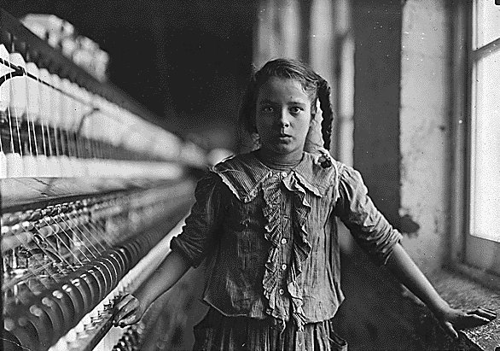
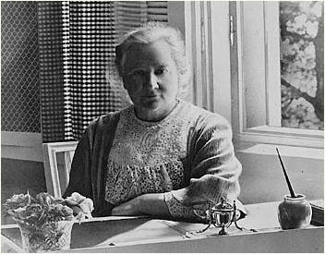
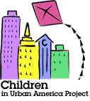
Resources and Global Contexts
“The Century of the Child”
Ellen Key (1909)
Google books edition
Child Labour in Britain
Child Labor in the American South: Lewis Hines
Children in Urban America Project
Global developments: Preventing cruelty, organizing time, mandating universal education, separating child crime, studying child needs, promoting population growth.
Ch
Notes:
--Swedish sociologist Ellen Key declared that the twentieth century would be "The Century of the Child," an era of understanding and compassion.
--education
--secular approach
--better parenting
American reformers embraced Key's optimism and call to rethink educational practices and frequently borrowed the phrase, which reflected their high hopes and serious purpose.

Slide 13
Though it may be reprehensible for the race to perish for lack of births, it is a more shameful thing to destroy the vitality, to dwarf the minds, to refuse the natural and necessary protection of childhood to the children who are born.
Edward T. Devine, “The Right View of the Child”
Notes:
Progressive era: gateway for modern childhoods, both in terms of the challenges presented to children and their parents, and the efforts to find solutions to the problems they faced.

