Slide 1
The American West in a Global Context
Omar Valerio-Jiménez
March 8, 2011

Slide 2
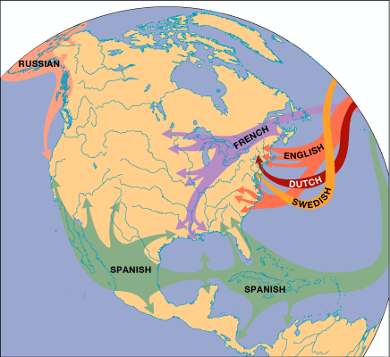
The Invasion of America

Slide 3
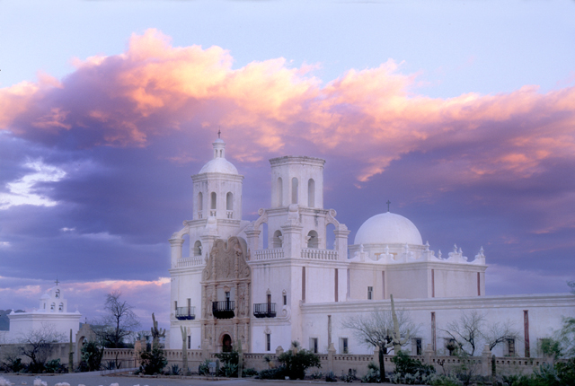
San Xavier del Bac (near Tucson, AZ)

Slide 4
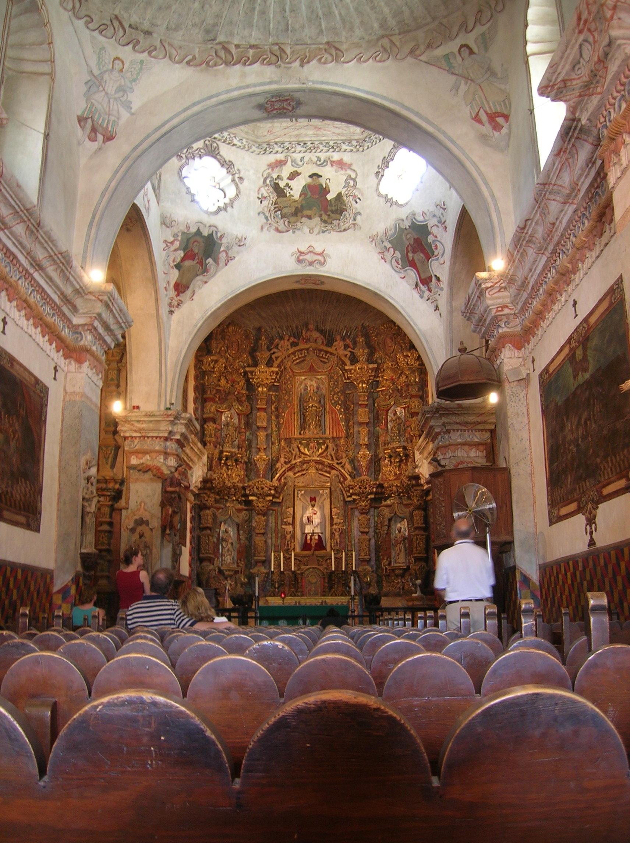
San Xavier
del Bac

Slide 5
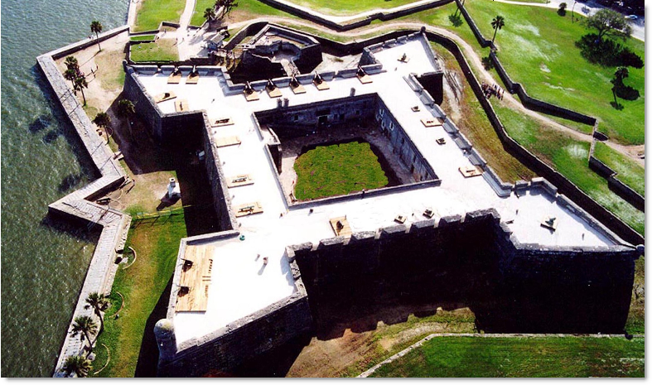
Castillo of San Marcos (St. Augustine, FL) - 1672

Slide 6
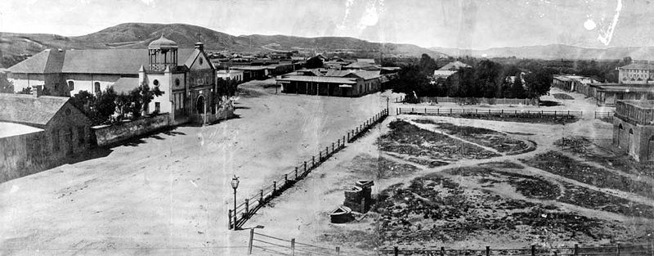
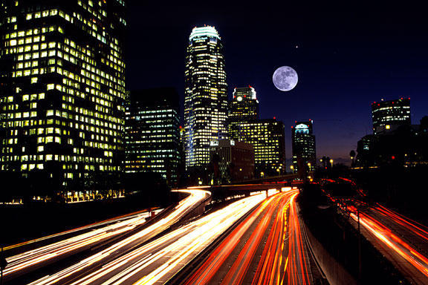
El Pueblo de Nuestra Señora la Reina de Los Angeles de Porciúncula (1781)
Los Angeles, CA

Slide 7
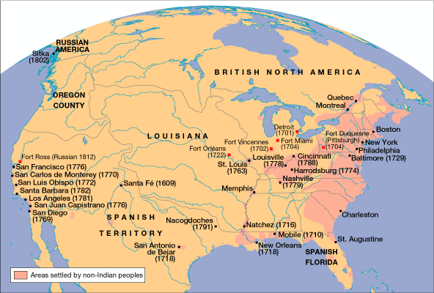
America in 1800

Slide 8
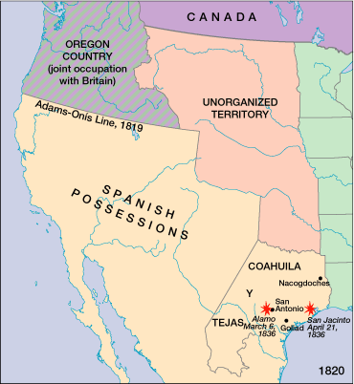
Texas: From Mexican Province to U.S. State, 1 of 3

Slide 9
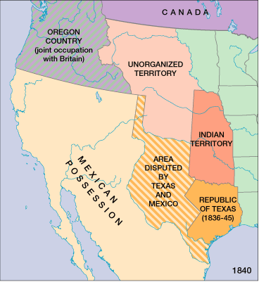
Texas: From Mexican Province to U.S. State, 2 of 3
Notes:
Map from Out of Many

Slide 10
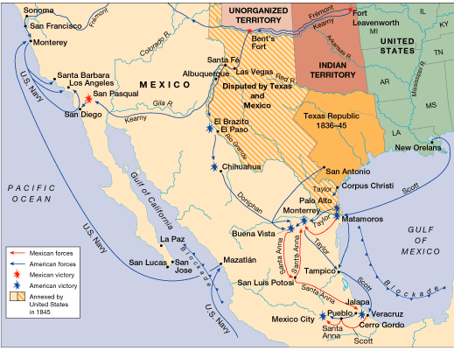
The U.S.-Mexican War, 1846–1848

Slide 11
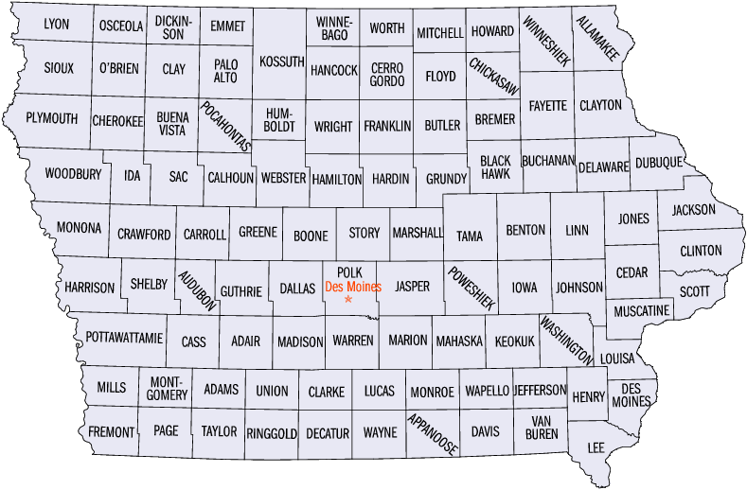

Slide 12
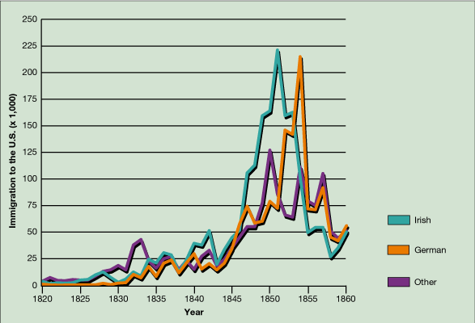
Immigration to the United States, 1820-1860

Slide 13
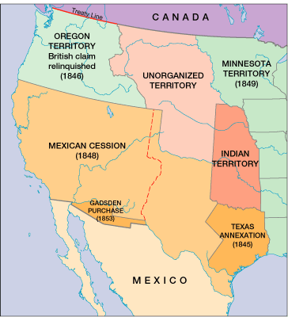
Territory Added, 1845–1853

Slide 14
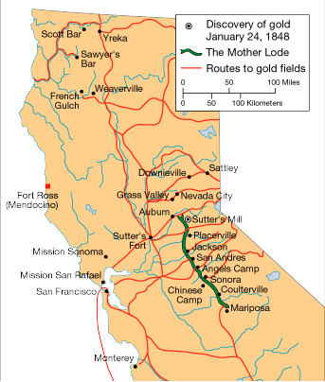
California in the Gold Rush

Slide 15
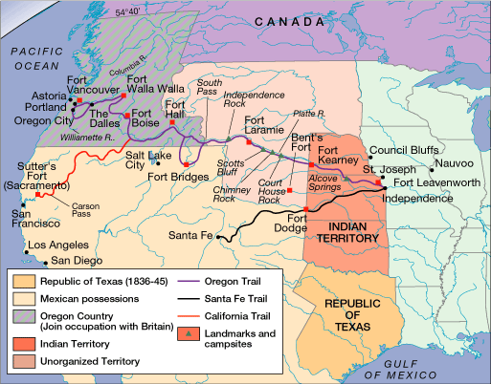
The Overland Trails, 1840

Slide 16
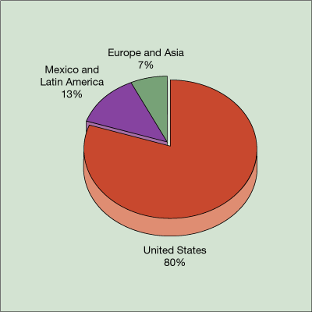
Demographic Background of Forty-Niners

Slide 17
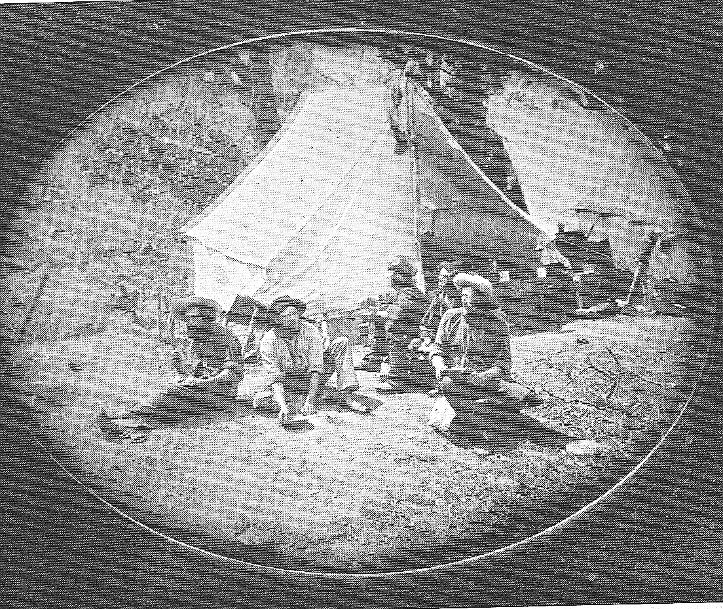
French Miners relaxing at lunch

Slide 18
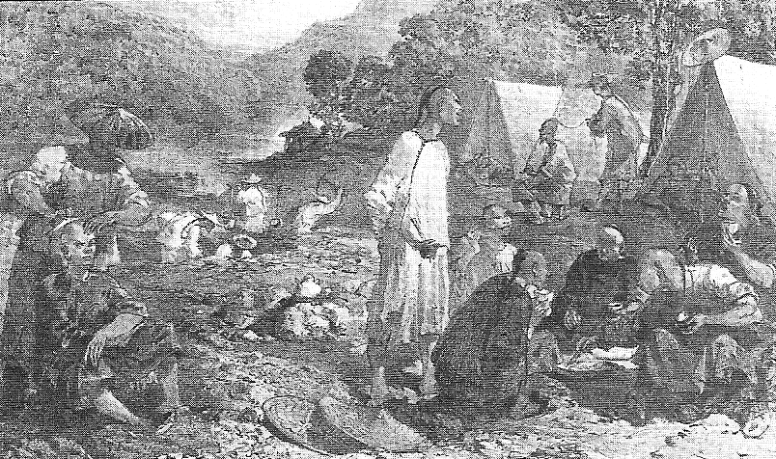
Domestic Scene at a Chinese Mining Camp

Slide 19
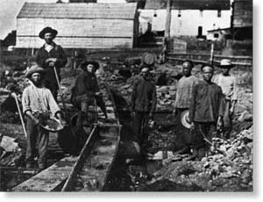
Anglo American and Chinese Miners

Slide 20
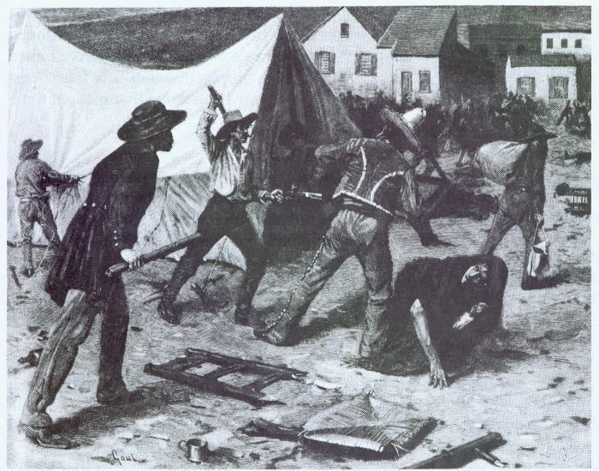
Vigilantes attaching Chilean miners in 1849

Slide 21
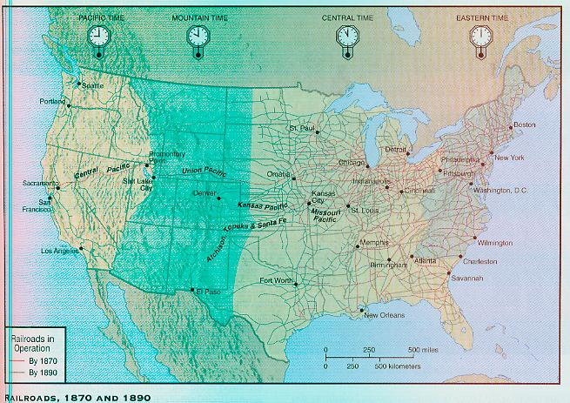

Slide 22
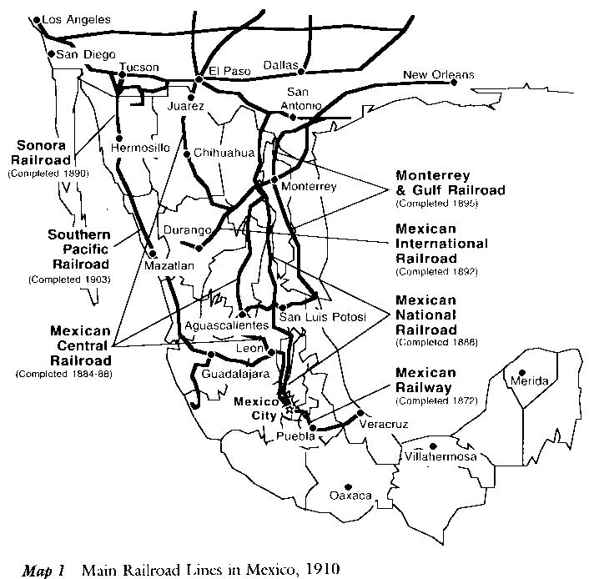

Slide 23
