Slide 1
Teaching US Religion in a Global Context
Dr. J.D. Bowers
Department of History
Genocide and Human Rights Institute
Northern Illinois University

Slide 2
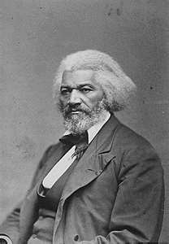
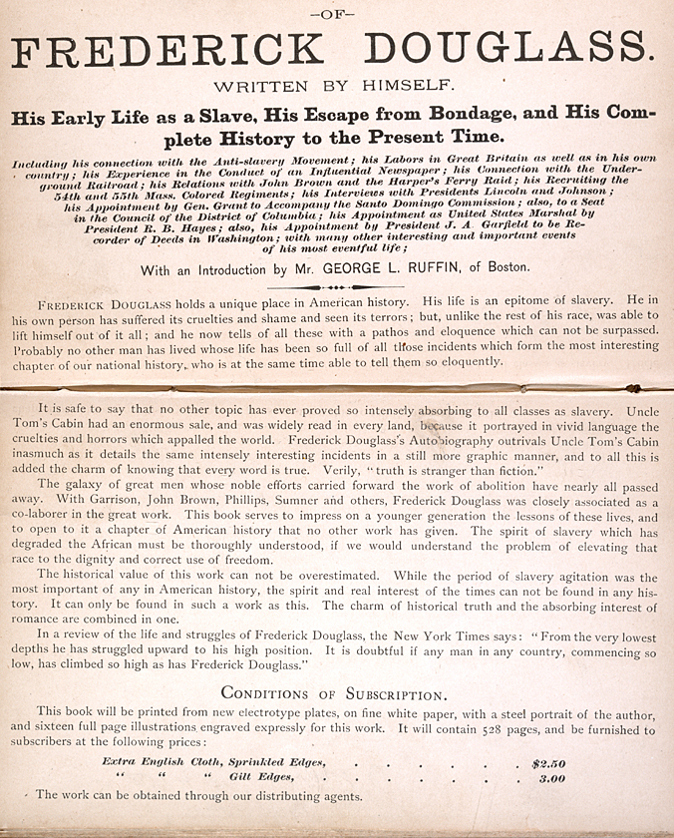
Frederick Douglass
See NHEC for a video version on teaching this topic
Notes:
National History Education Clearninghouse (www.teachinghistory.org) provides multiple examples of teaching historically.
The Douglass narrative, in two parts, can be found at: http://teachinghistory.org/best-practices/examples-of-historical-thinking/23495

Slide 3
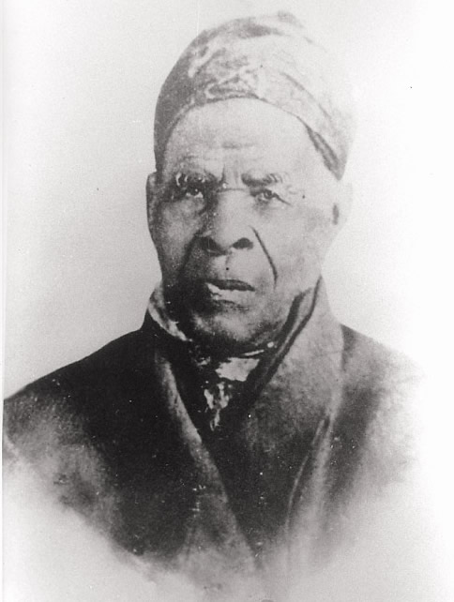
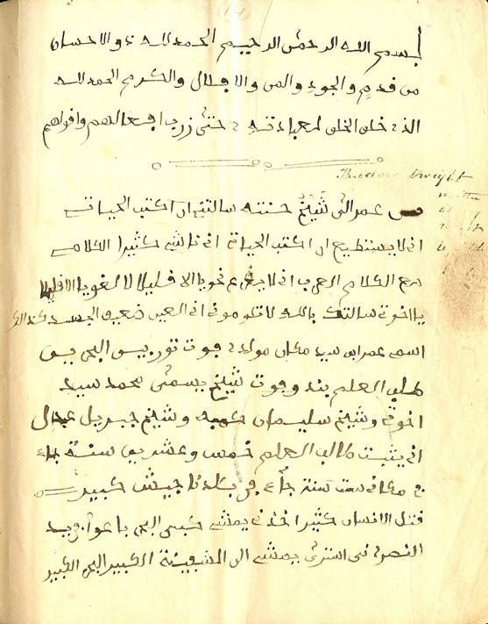
Omar ibn Said
"Uncle Moro" (Omeroh), the African (or Arab) Prince whom Genl. Owen bought, and who lived in Wilmington N.C. for many years, and died in Bladen Co. in 1864, aged about 90 years.
Notes:
http://www.saudiaramcoworld.com/issue/201002/the.life.of.omar.ibn.said.htm
Muslims comprised upward of 20 percent of African slaves brought to the United States, and like Said, a number of them impressed white Southerners with their proficiency in Arabic and their desire to maintain their observance of Islam’s requirement of five daily prayers. Both of these traits humanized them in the eyes of their owners—sometimes sufficiently to lead the owners to infer they were Arabs or noble Africans deserving of better treatment than other slaves, according to historian Allan D. Austin, who authored two books on the subject.

Slide 4
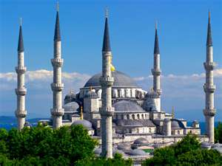
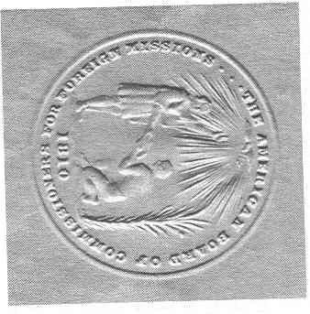
The Missionary Movement in Turkey

Slide 5
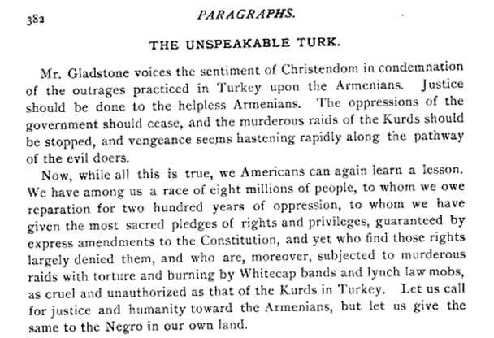
Hamidian Massacres
Notes:
The American Missionary Volume 0049 Issue 12 (Dec 1895), “Editorial” by Rev. C. J. Ryder, D.D. [pp. 382-383] in Journals: American Missionary (1878 - 1901) online.

Slide 6
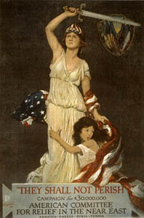
The Armenian
Genocide
The response by the American Comm. For Relief in the Near East was a legacy of the missionaries' conversion efforts and many missions gave Armenians, Greeks and Assyrians refuge.
It was the largest Christian-based relief effort in the nation’s history (the ACRNE was joined by the fledgling American Red Cross) until the efforts to aid Chinese citizens in the wake of the effects of World War II.

Slide 7
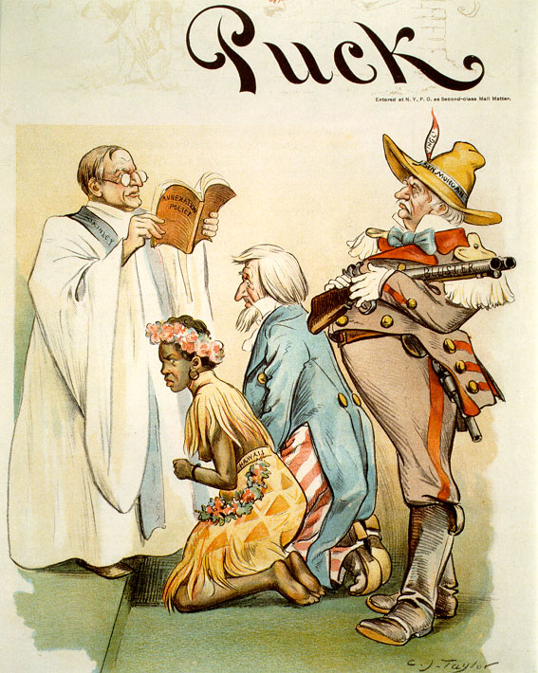
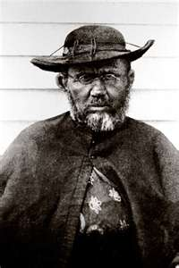

Slide 8
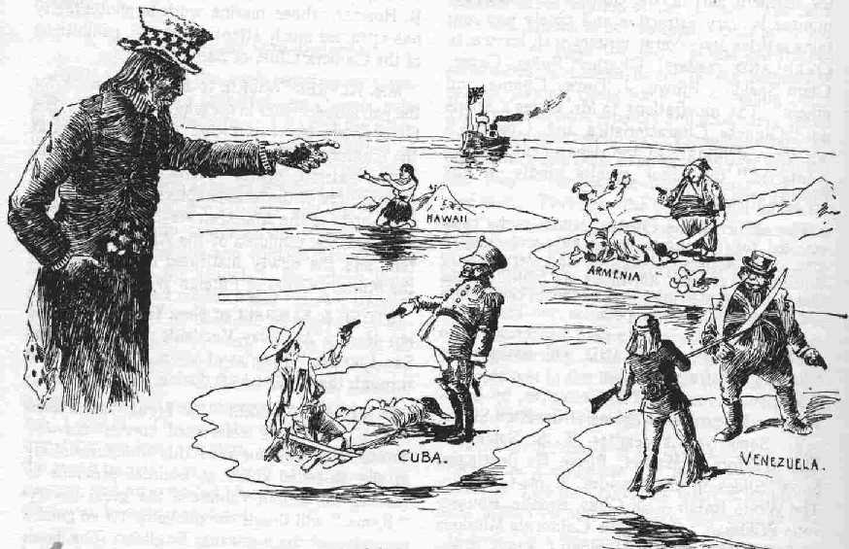

Slide 9
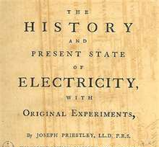
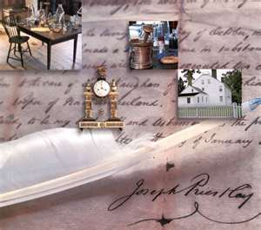

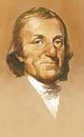
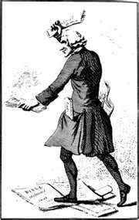
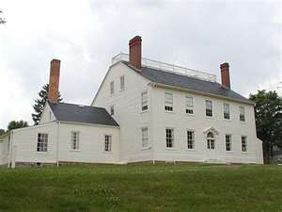

Slide 10
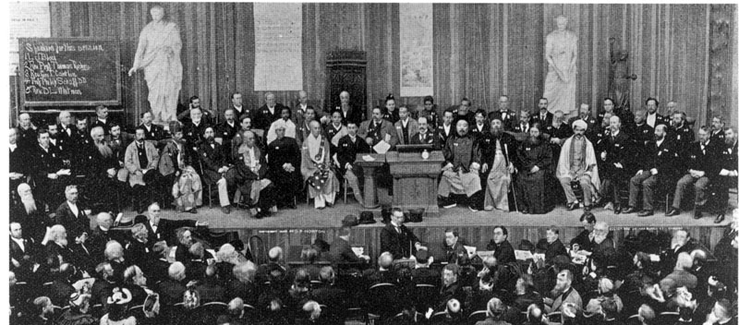
World Parliament of Religions

