Slide 1





Lynwood Unified School District
Presentation for
Board of Education
California Clean Energy Jobs Act (Proposition 39)
Energy Expenditure Plan (EEP)
Summary
    Ken Casey, BEP, CSDP
    Manager, Business Development-California
    949.929.4650
    kcasey@ameresco.com

Slide 2
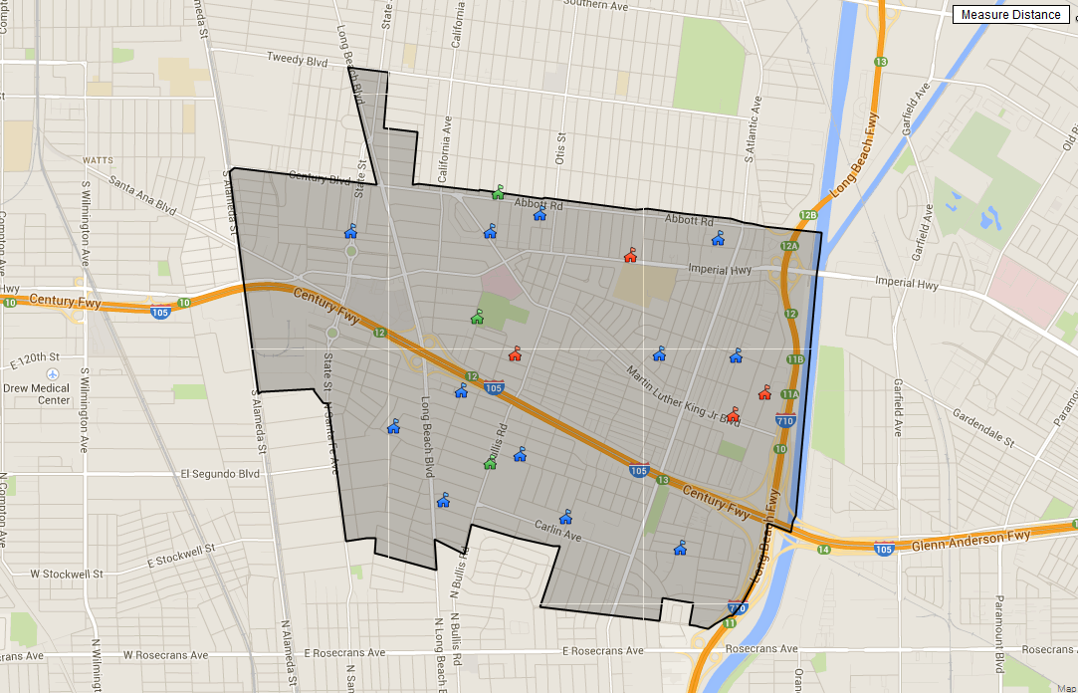

Presentation Outline
Introduction to Ameresco, Inc.
Pro 39, Conceptual Intent and Overview
Benchmarking Report, District’s Sites Ranked in Terms of Energy Inefficiency (Energy Utilization Index)
Pro 39, Program Utility Savings Summary
Three (3) year Financed Project, Site, Scope, Cost and Savings
Implementation Plan

Slide 3





Ameresco, Inc.
Ameresco Inc. is a leading independent engineering based design/build
Energy Services Company (ESCO) specializing in energy conservation,
sustainable facilities, and renewable energy generation with a particular focus in public institutions (k-16 education and the local, state and federal government sectors) throughout North America.
Developed over 450 Energy Performance Contracts with k-16 clients across North America, over the last 14 years
Top 10 Green Employers of 2012, The Green Job Bank, Ameresco, Inc., 2012
“America’s Best Small Companies”, Forbes 100 List, Forbes, 2011
Endorsed by the State of California, Department of General Services (DGS), US Department of Defense (DOD) and US Department of Energy (DOE)

Slide 4
California Clean Energy Job Act (Proposition 39)
In November, 2012 California voters approved the California Clean Energy Jobs Act, Proposition 39, which allocates funding to support energy efficiency and alternative energy projects, as well as improvements and repairs to help cut down on operating costs and improve health and safety conditions in public schools. Over the next five years, schools are slated to receive about $2.5 billion through the act.
Program Guidelines were approved and available to the public December, 2013
Lynwood USD annual allocation is $772,144, (5 year program) for a cumulative total of $3,860,720

Slide 5
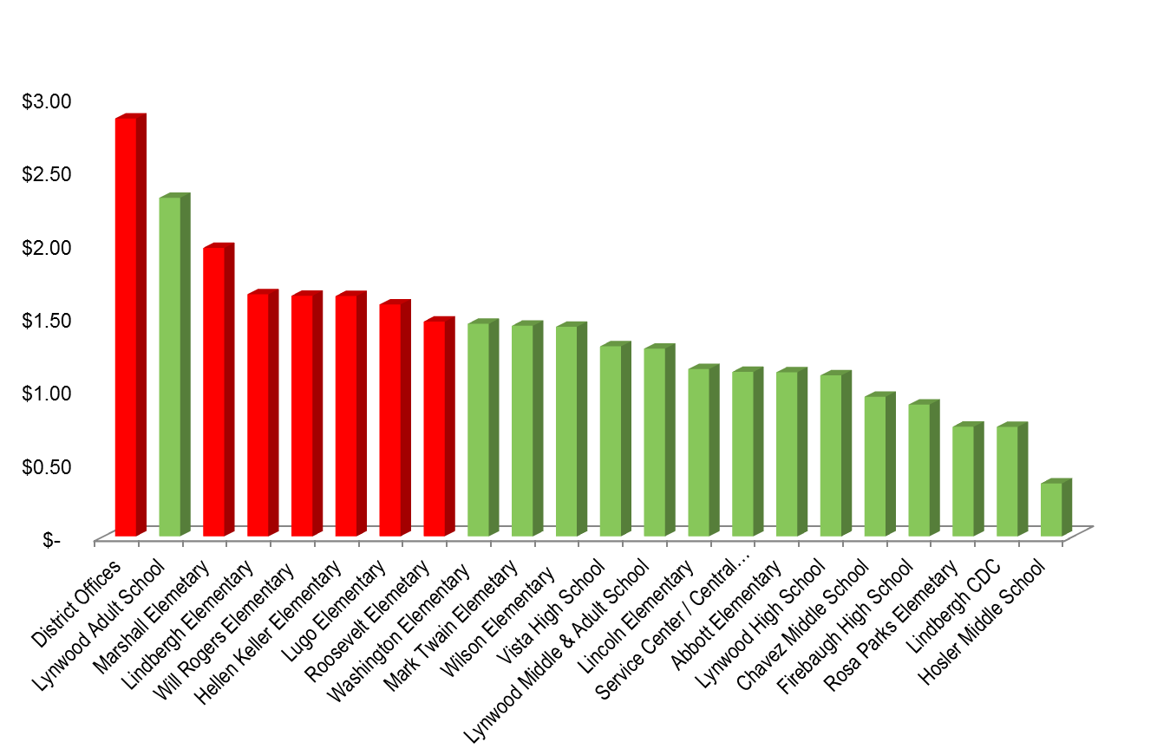



Lynwood USD’s Utility Cost Analysis
District Energy Cost Per Square Foot,
Benchmarking Analysis
(Year 2013)
Prop 39 Energy Efficiency Program Savings
Maximizing 5- year program Allocation at 5 sites
3 Year Financed Project sites

Slide 6
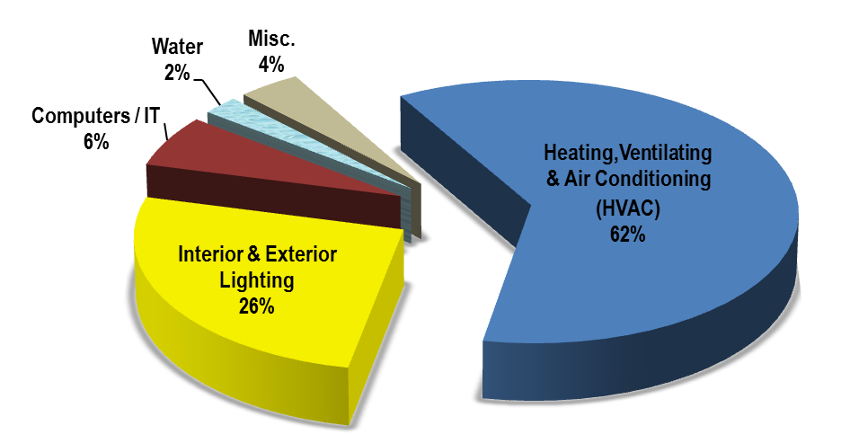
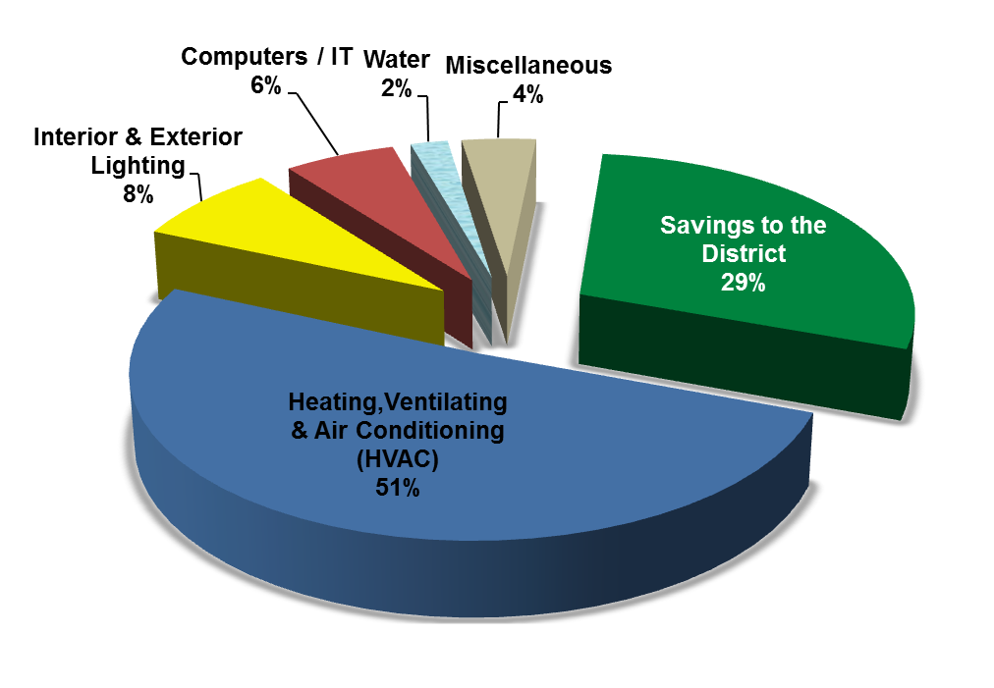
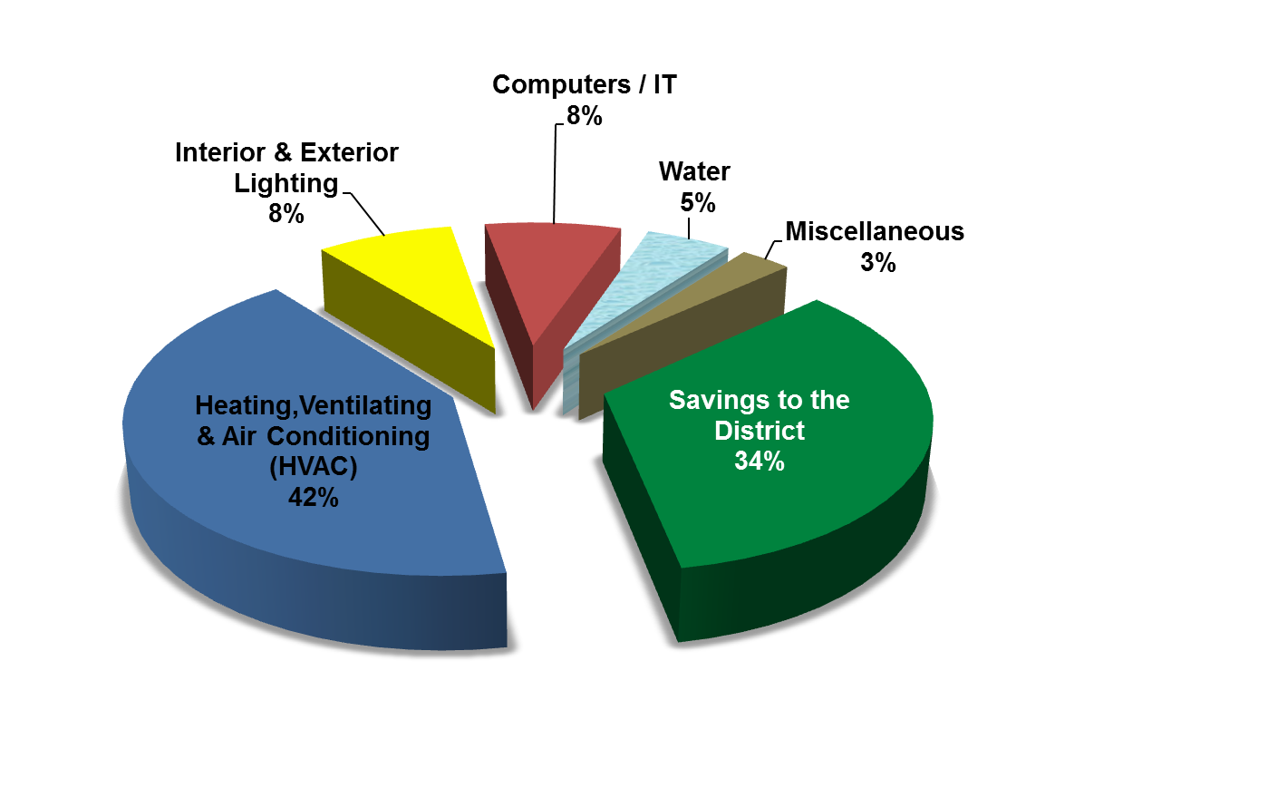
Prop 39 Utility Savings
2013 Prop 39 Energy Efficiency Program (EEP)
5-Year Plan Selected Sites (7) Utilities Costs
5-Year Prop 39
Energy Efficiency Program Plan (EEP) Savings
3 Year Self-Funding/Financed Project
Prop 39 EEP 3 Selected Sites
Maximum Savings & Upgrades
for those sites

Slide 7
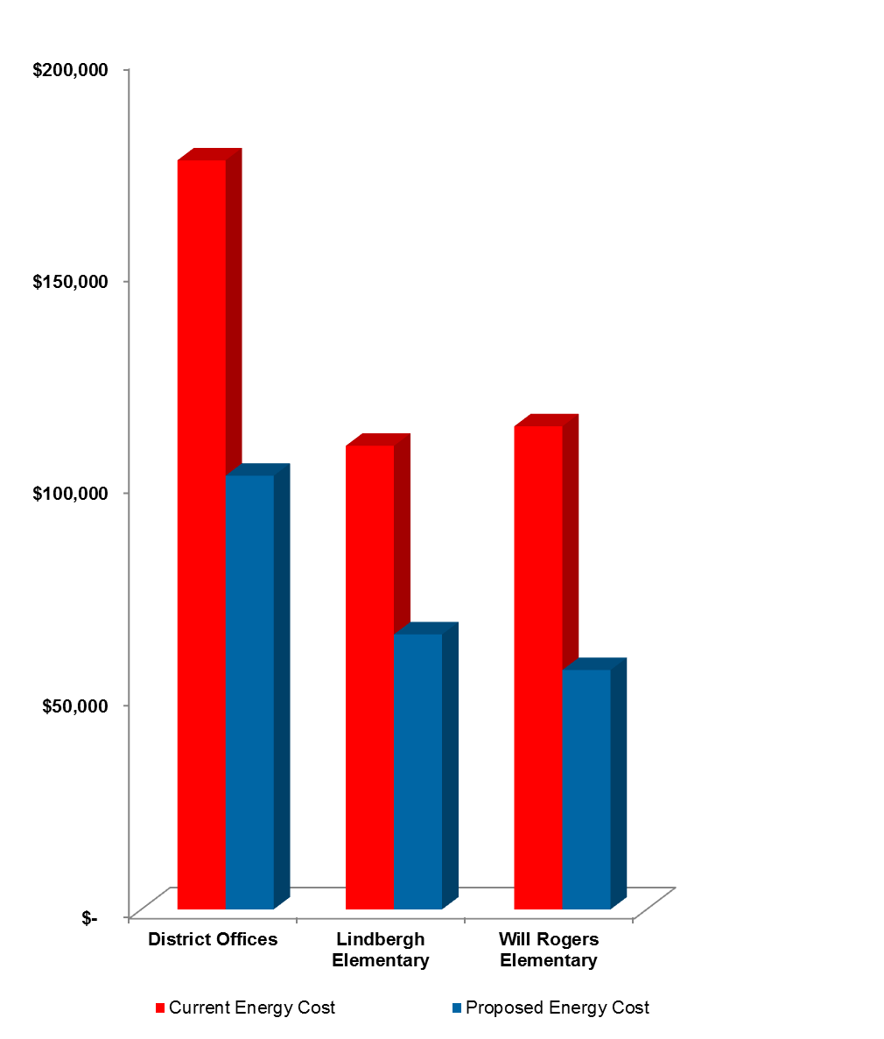



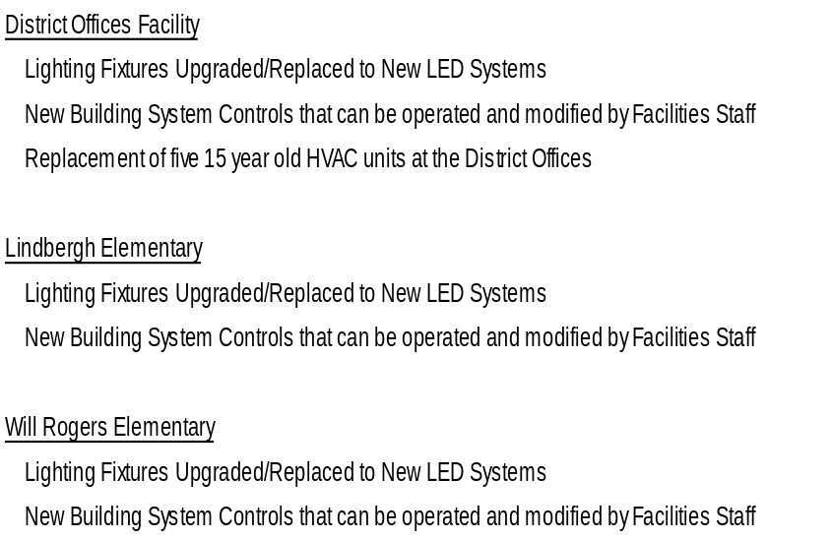
Prop 39 Energy Efficiency 3 Year Financed Project Savings
Sites Chosen for the 3 year Financed Project
that have
Immediate Maximum Impact
& Address Urgent Needs

Slide 8
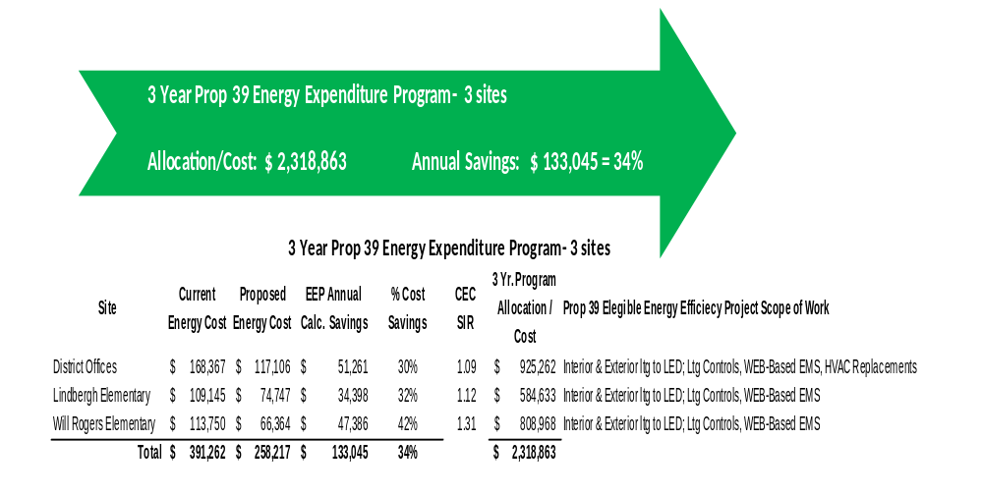
Phase I, 3 Year Program Highlights

Slide 9
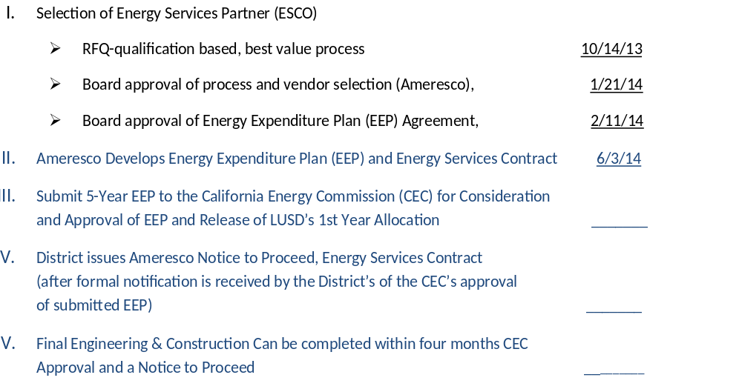
Implementation Plan

Slide 10



Thank You
Ken Casey, BEP, CSDP
Manager, California Business Development
T. 949.929.4650
E. kcasey@ameresco.com

