Slide 1
Firebaugh High School
Chinese Bridge Summer Camp – 2013
July 10th - 25th

Slide 2
Purpose
To enhance the understanding of the Chinese culture
To have “real life” experience in communicating with a second language
To gain another perspective of life, food, customs, activities, expectations, and leisure

Slide 3
This is a Chinese government sponsored program
  The Chinese National Office for Teaching Chinese as a Foreign Language (Hanban) / Confucius Institute organized this event every year.
Schools from around the country are selected to represent their local Hanban group (UCLA)
The costs of room, board, and transportation (domestically) were defrayed by the Chinese Government.

Slide 4
Students
Javier Gonzalez (12th)
Andrew Calloway (12th)
Marianne Meza (12th)
Alice Meza (10th)
Brenda Marroquin (12th)
Teachers involved:
  Mrs. Liu – Preparation/Logistics
  Mr. Espinoza – Adult Chaperone

Slide 5
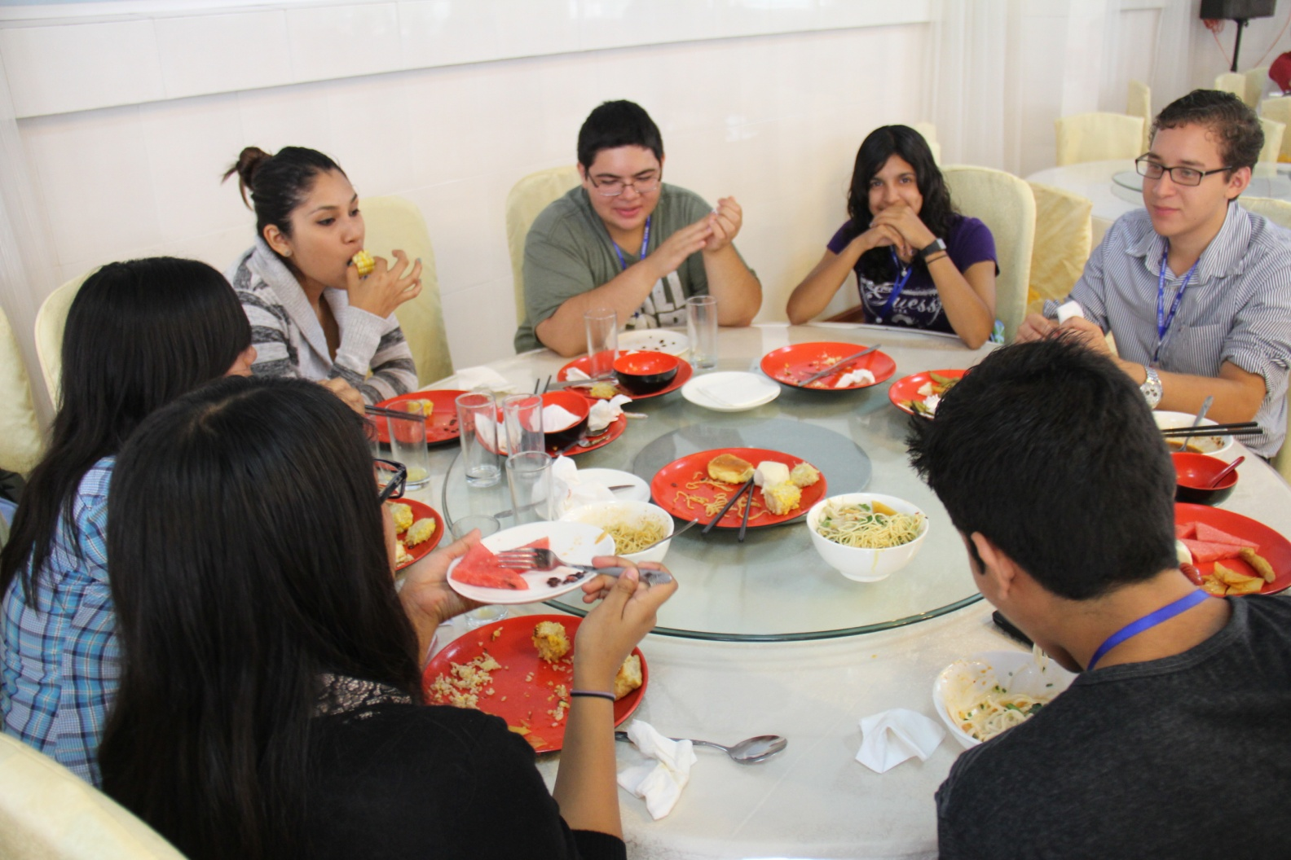
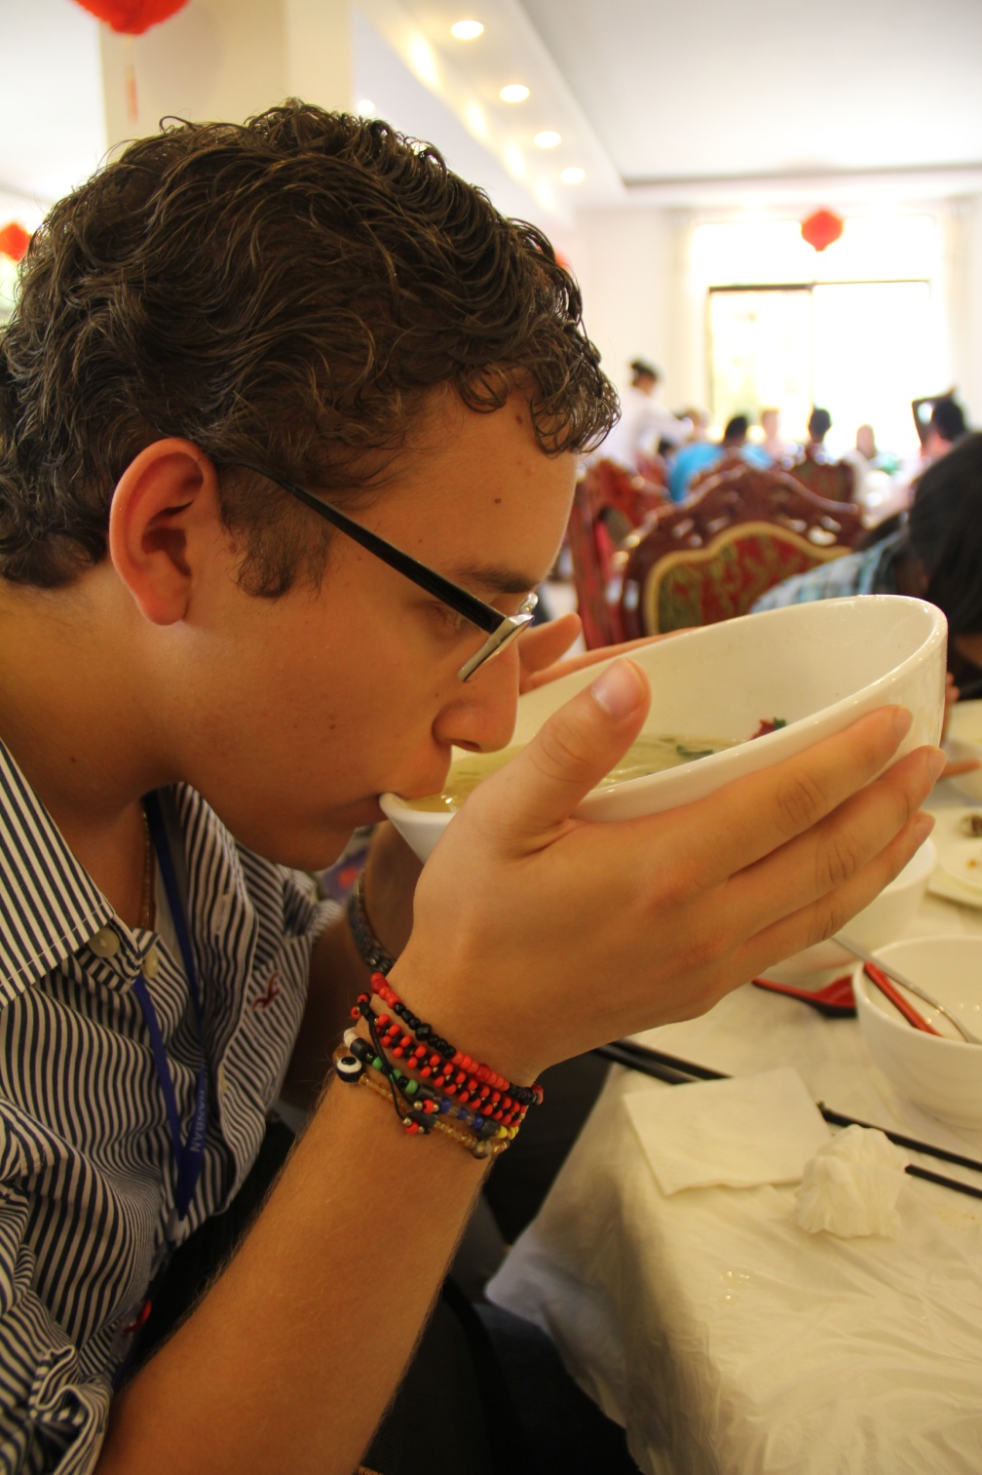
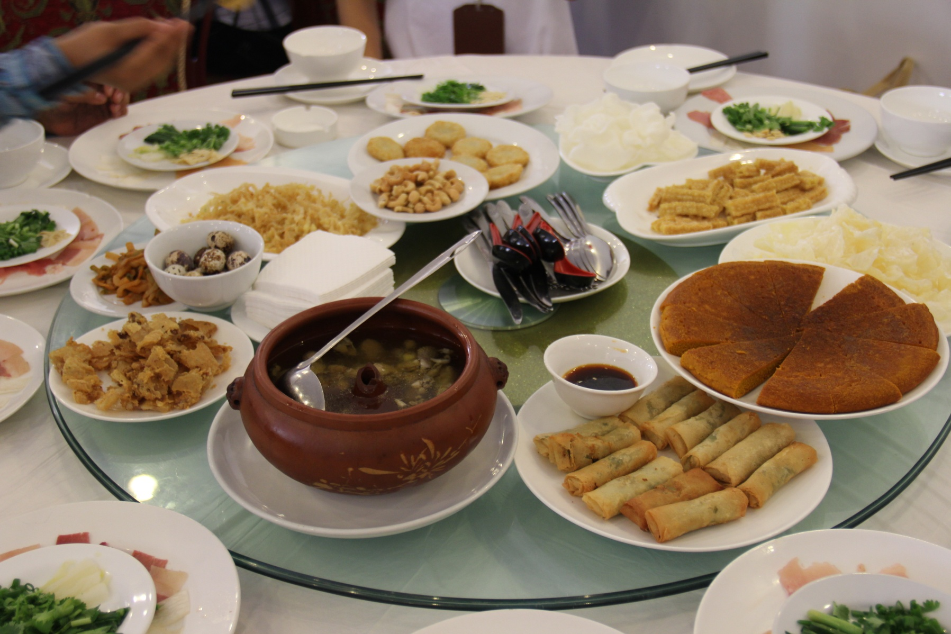

Food

Slide 6
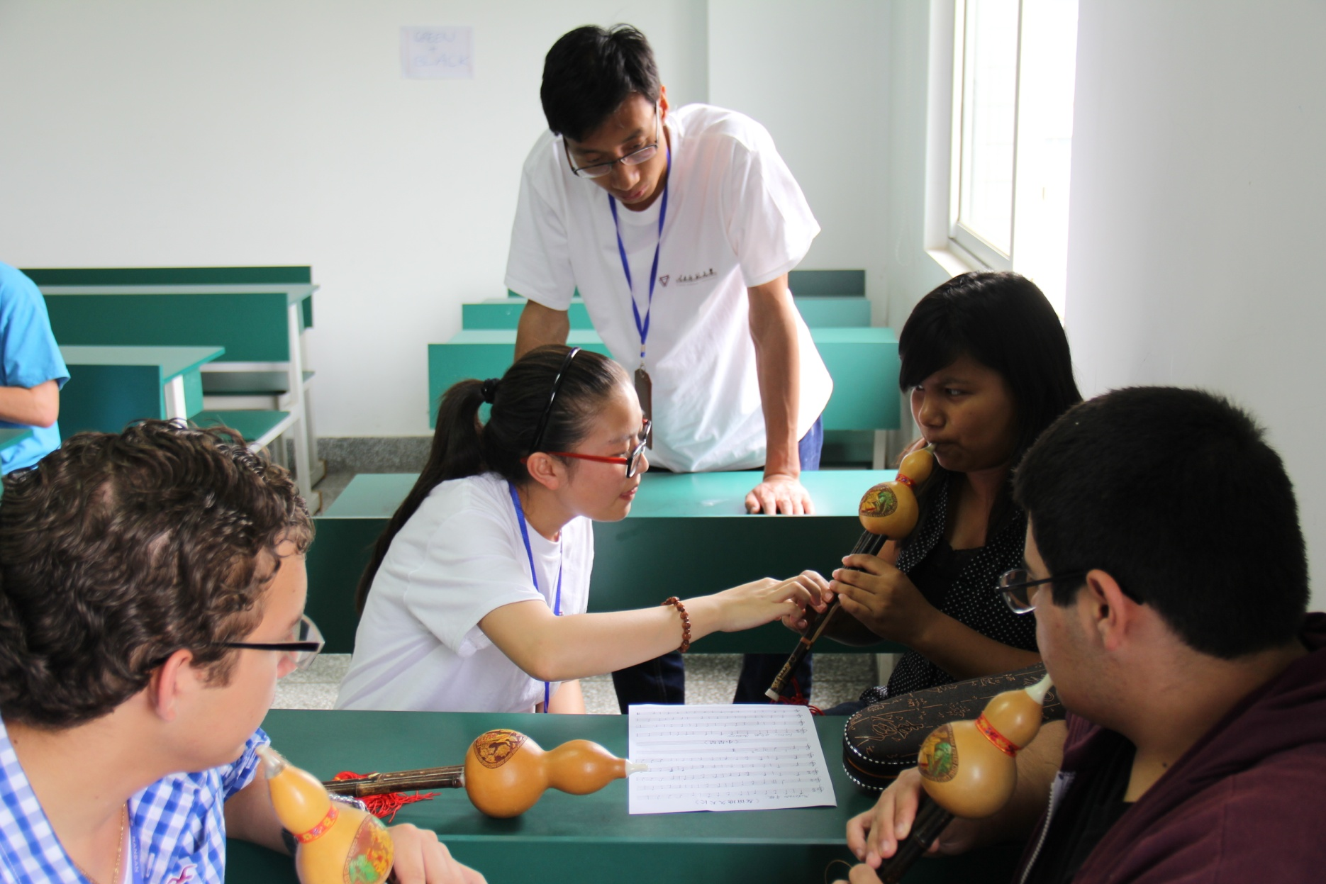
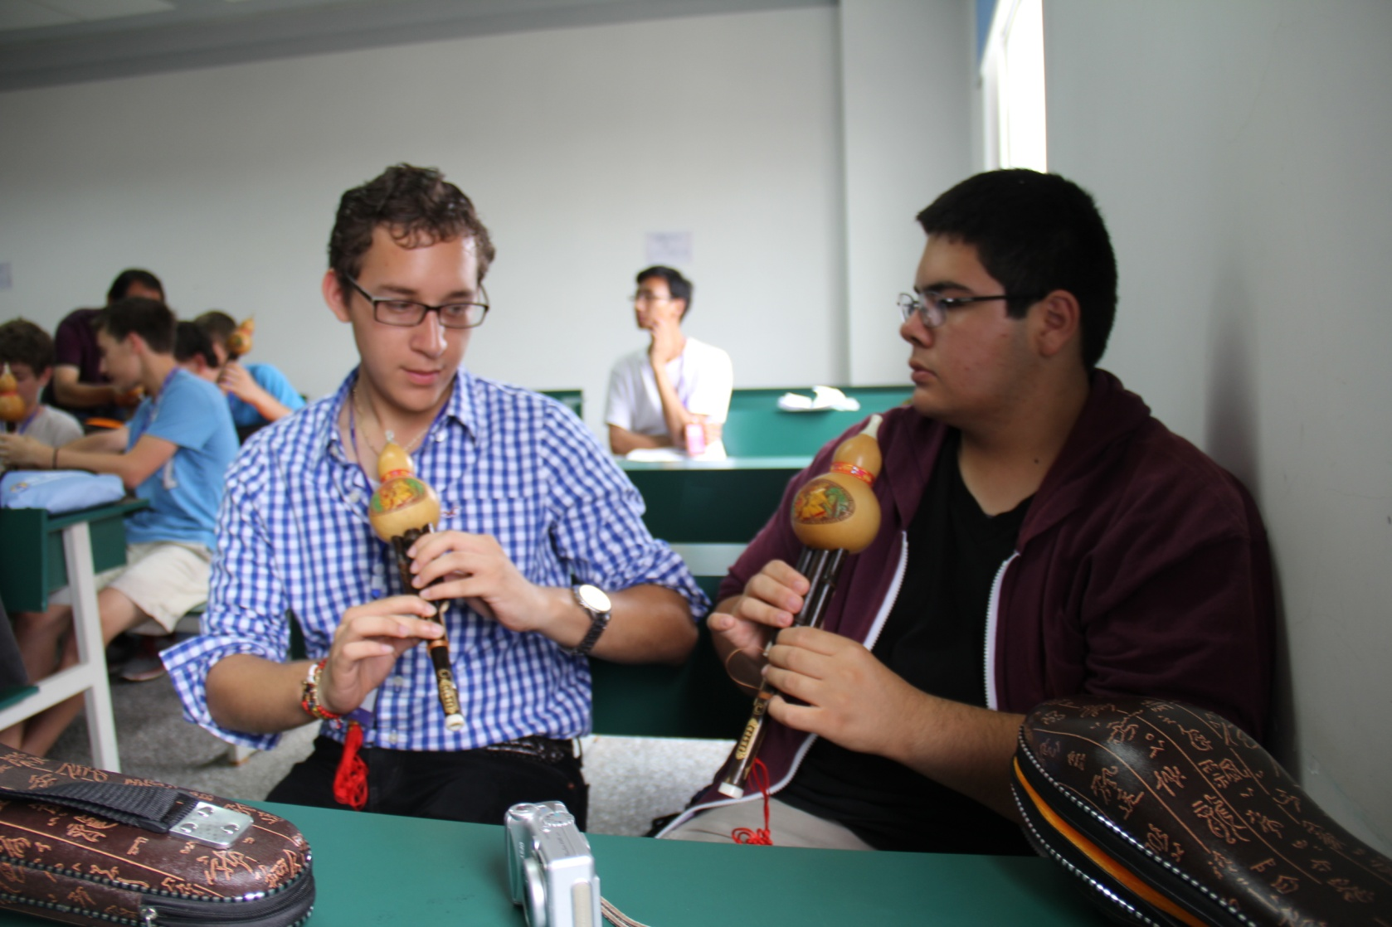
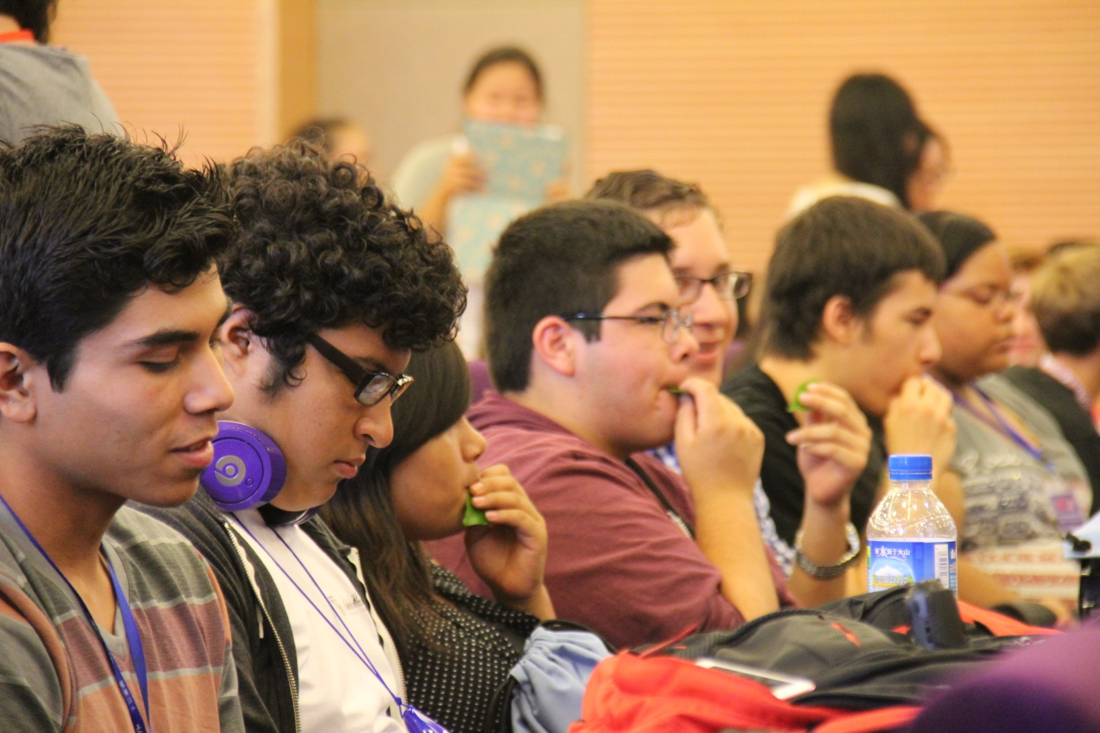
Academics

Slide 7
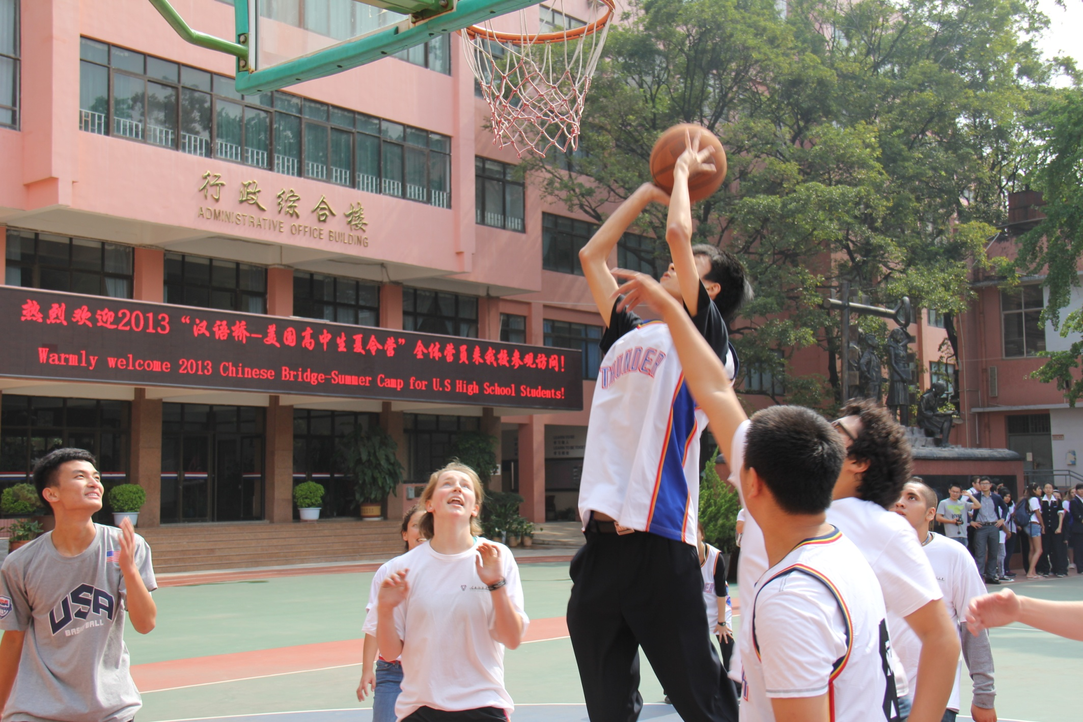
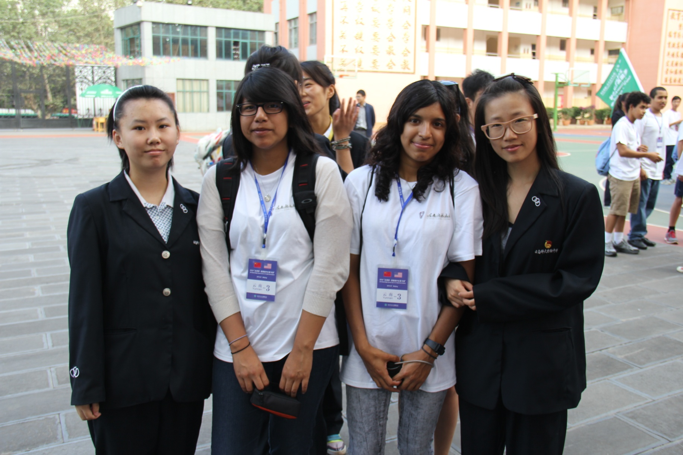
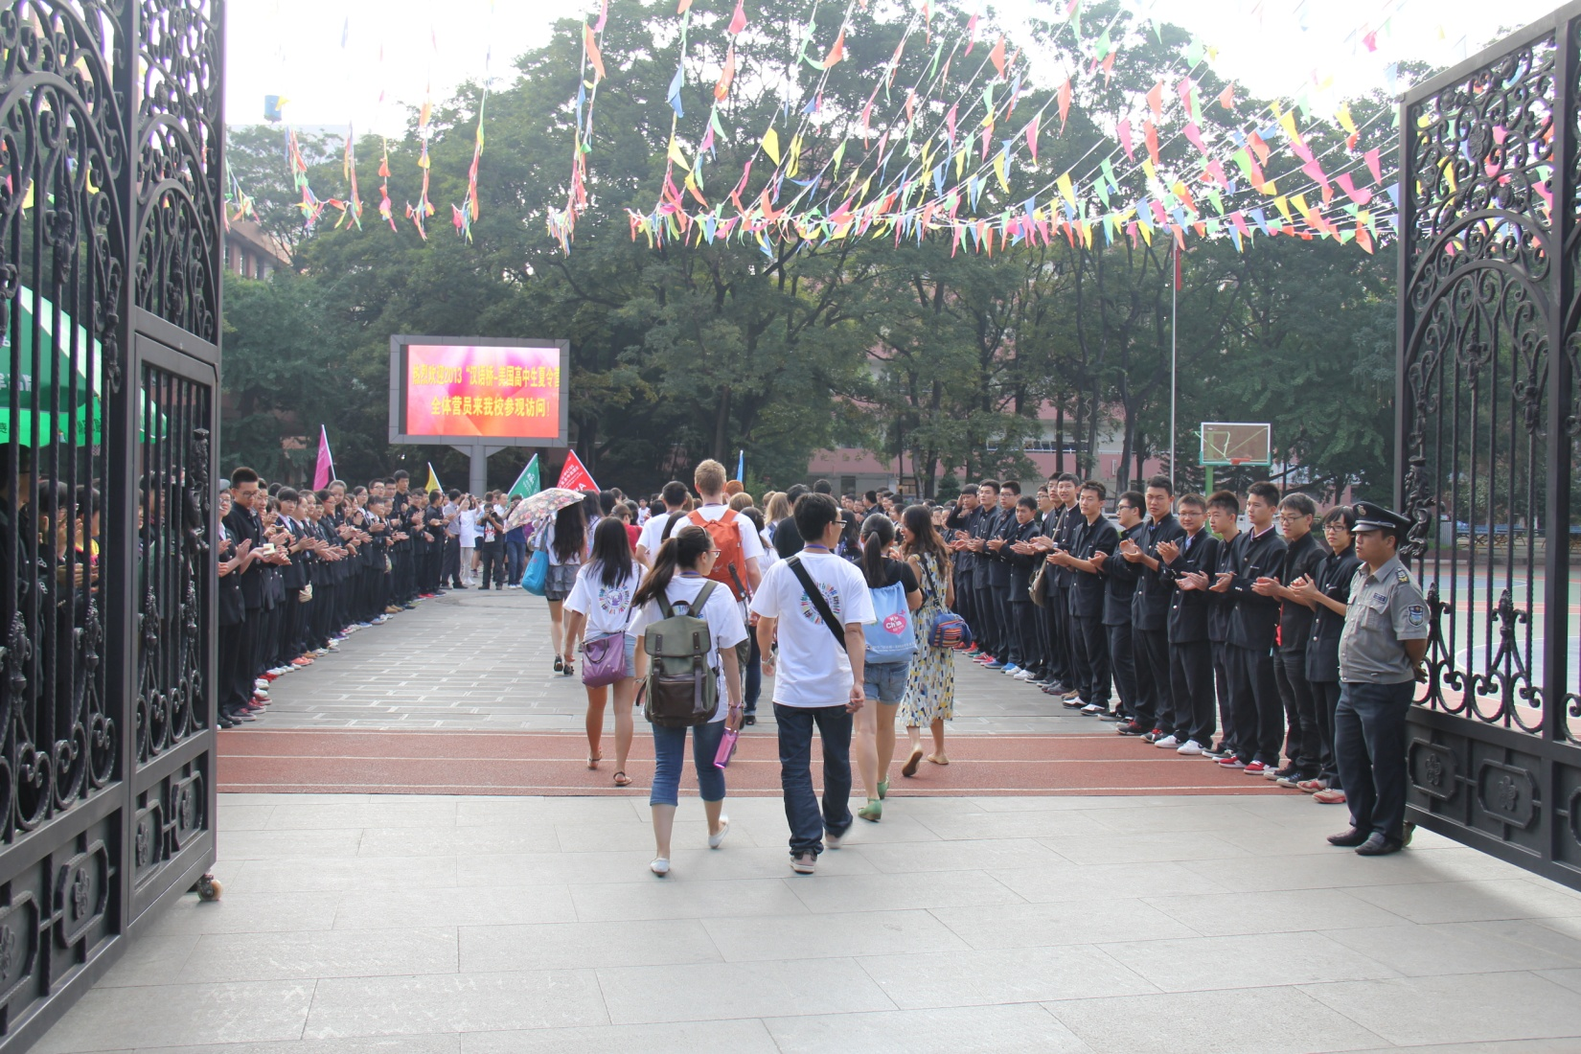
Academics

Slide 8
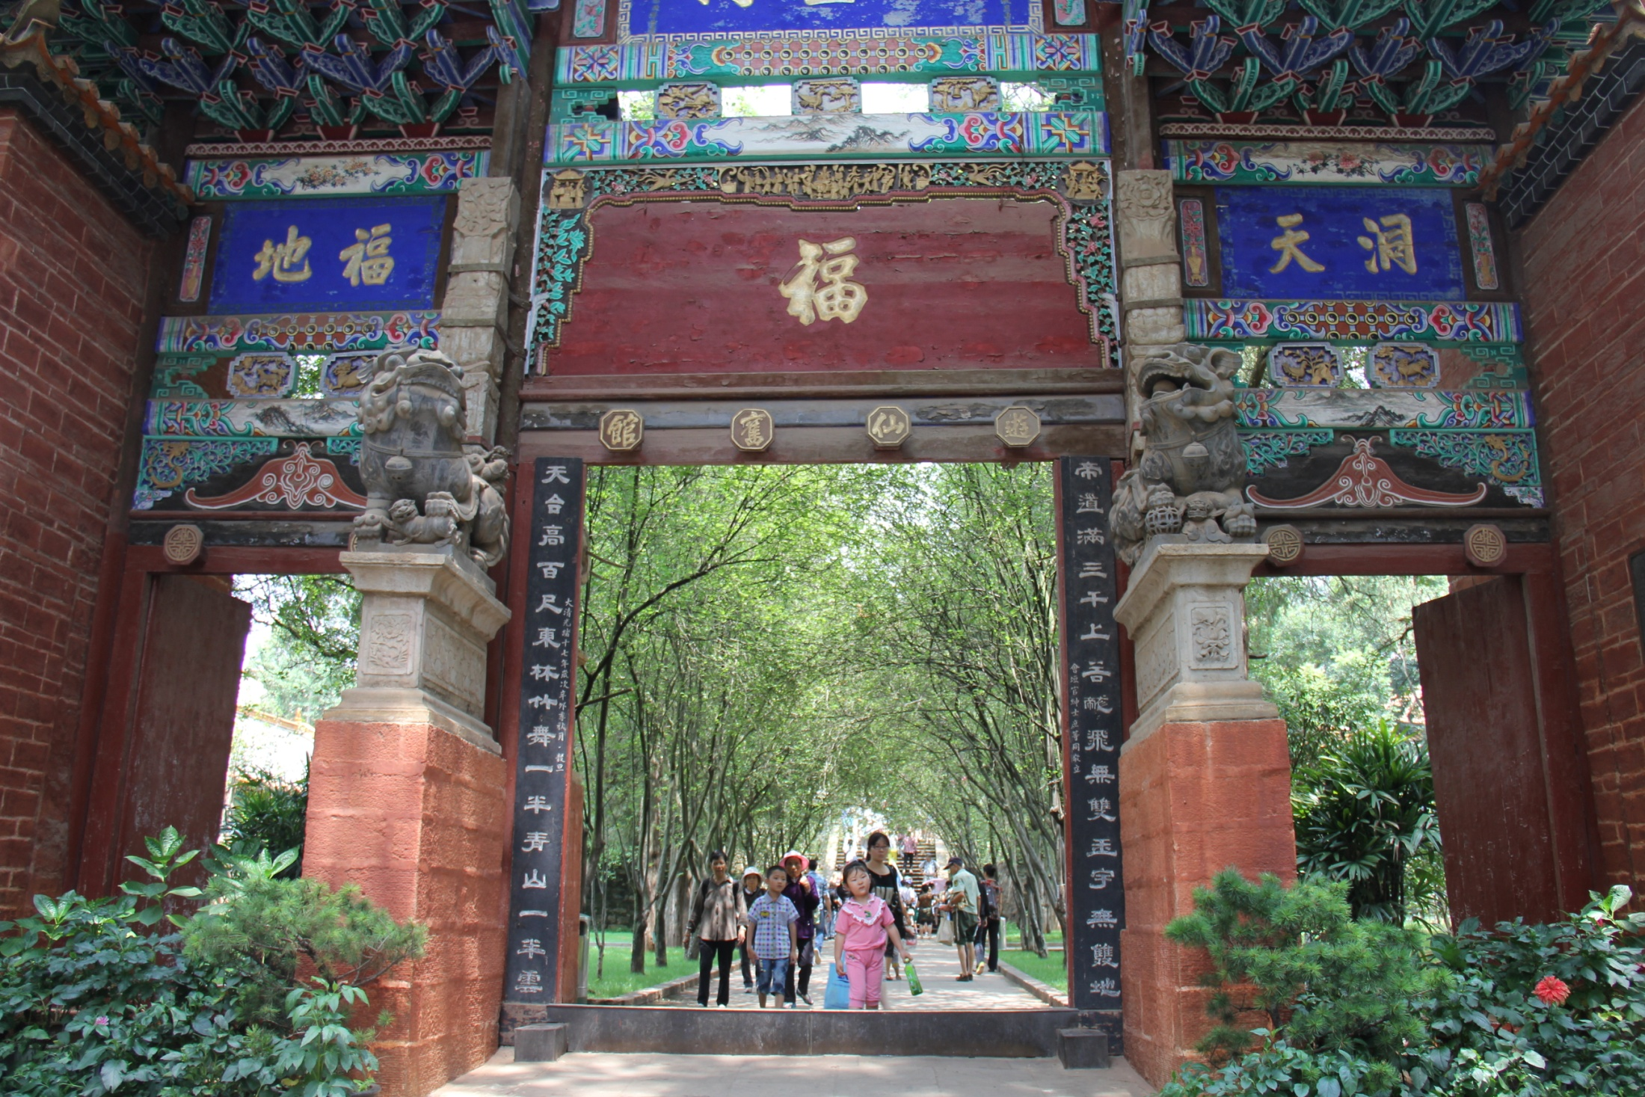
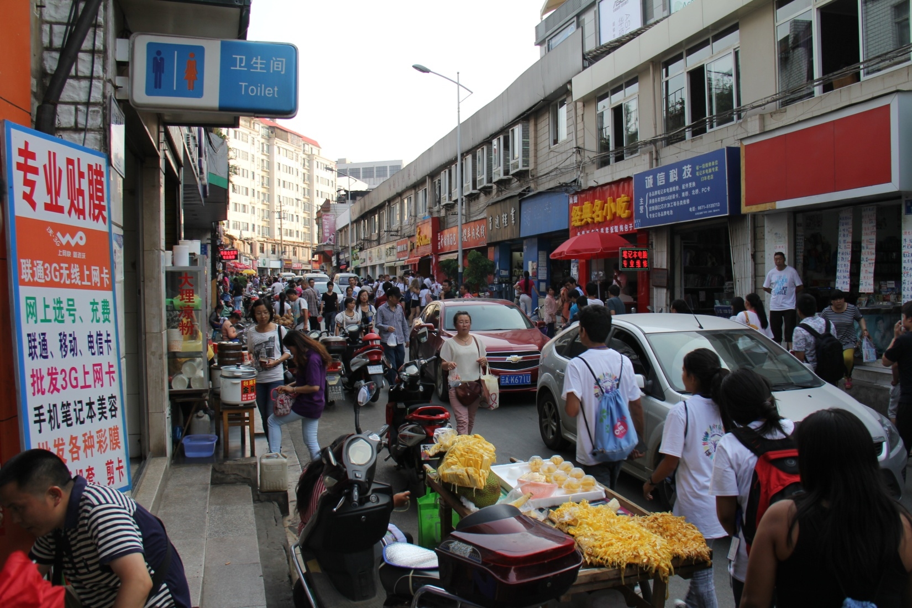
Other Images

Slide 9
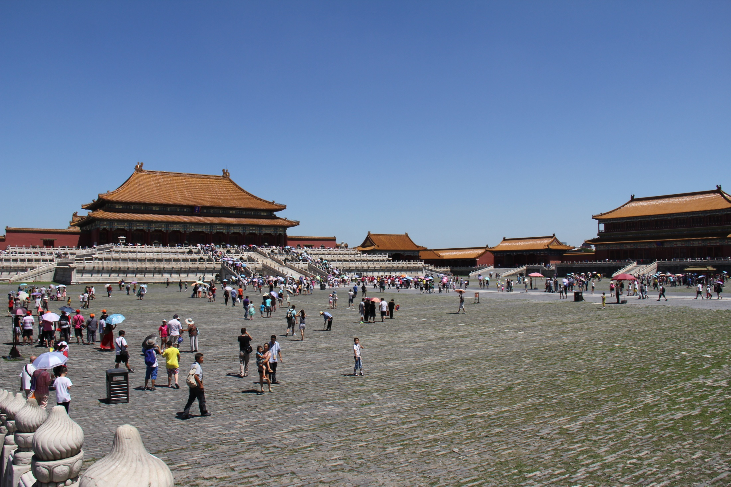
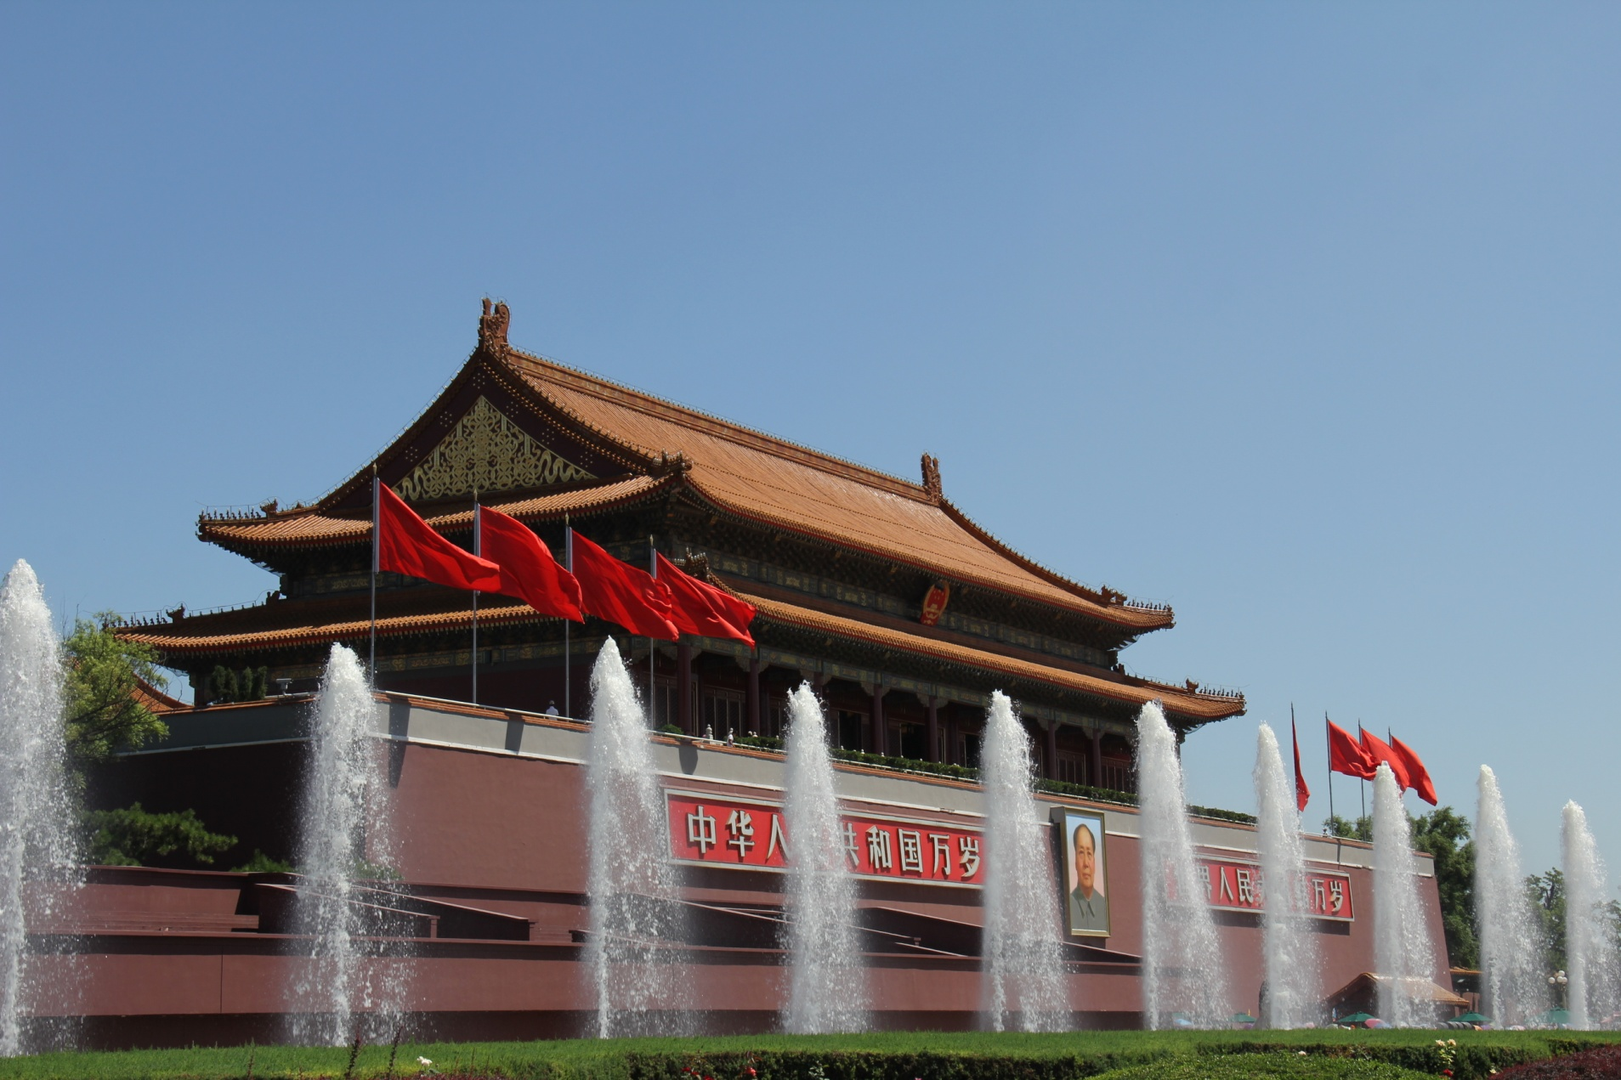
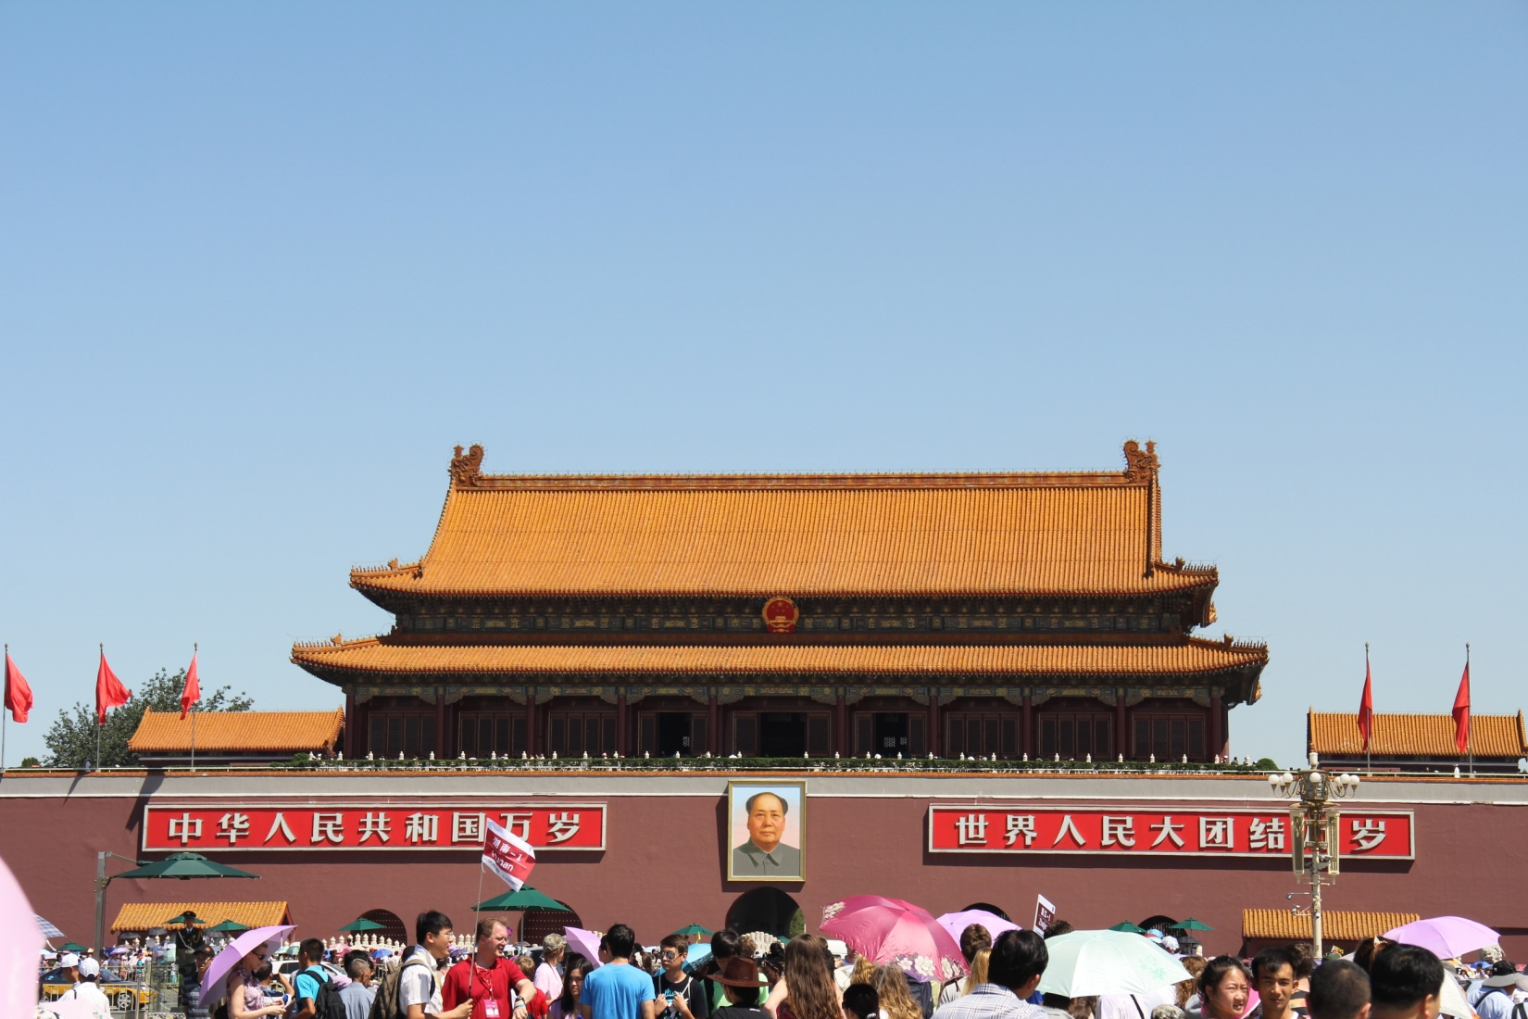

Slide 10
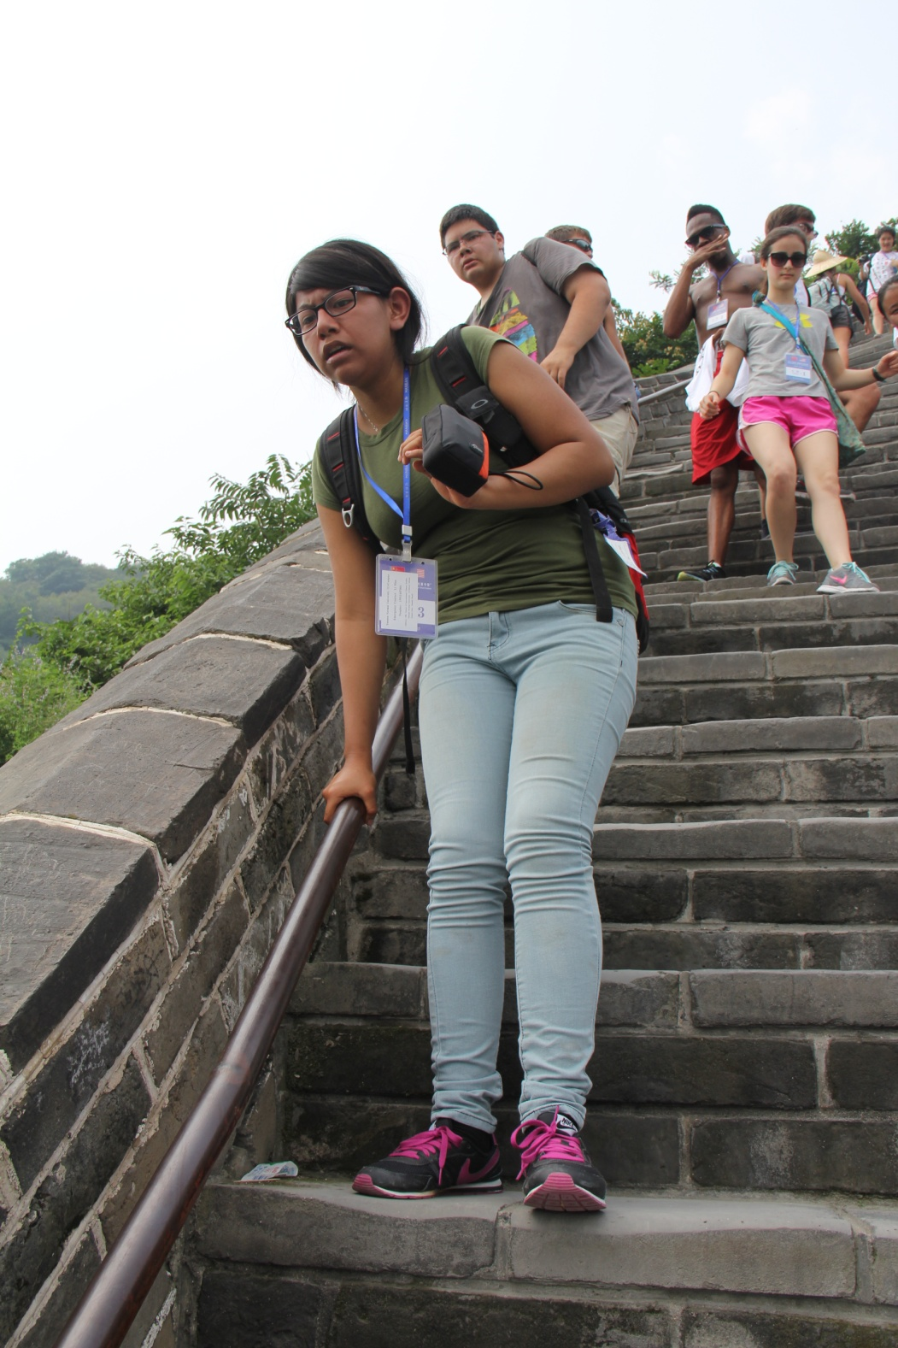
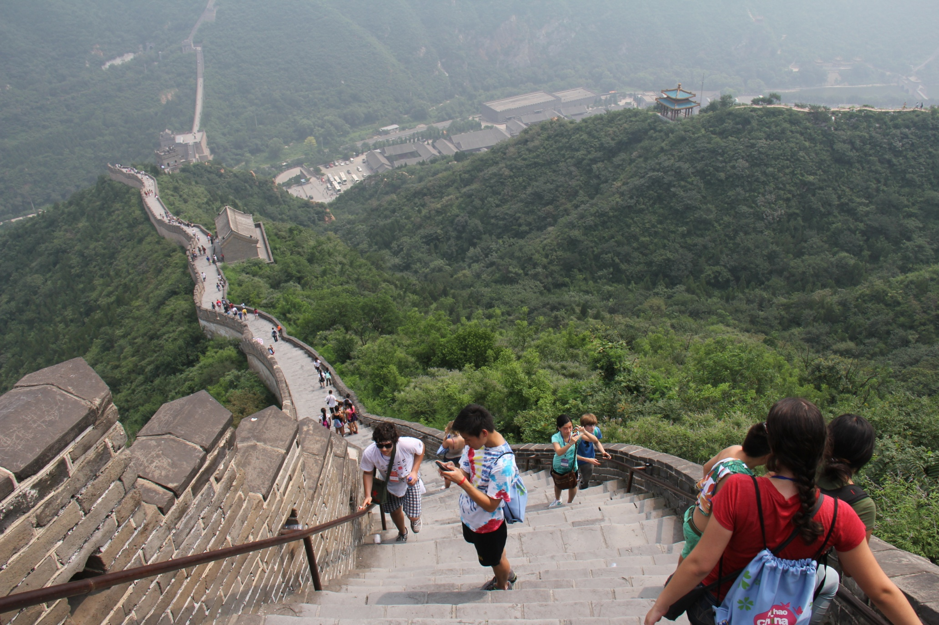

Slide 11
