Slide 1
2016-17
First Interim
December 13, 2016

Slide 2
Statutory Requirements
Public Disclosure of Financial Status:
  Budget by July 1
  Two Interim Updates by Dec 15 and March 15
  Interims provide opportunity to reflect changes since Budget Adoption and revised projections
Must Certify Financial Condition
  Positive = Will meet financial obligations in current and two subsequent fiscal years
  Qualified = May not meet financial obligations in current and two subsequent fiscal years
  Negative = Will not meet financial obligations in current and one subsequent fiscal year
  Qualified and Negative require additional reporting and results in LACOE oversight interventions

Slide 3
Lynwood USD First Interim Details
Positive Certification
We will have sufficient funds to meet financial obligations and maintain minimum 3% reserves in 2016-17 through 2018-19

Slide 4
Budget Preparation Timeline
FEBRUARY Budget Preparation Starts
JUNE LCAP and Budget Adoption
MAY LCAP and Budget Public Hearings
MAY Governor’s May Revision to the Budget Proposal
JUNE LCAP and Budget Adoption
JUNE State Budget Adoption
DECEMBER First Interim Adoption
JANUARY Governor’s Budget Proposal
MARCH Second Interim Adoption

Slide 5
Areas of Significant Budget Impact
STRS and PERS Increases
Proposition 55 – Extension of Temporary Taxes
Average Daily Attendance
Multi-year Considerations

Slide 6
STRS and PERS Increases
Both PERS and STRS were significantly underfunded
  $80.4 billion shortfall
State’s solution was to increase the State, employee, and employer contribution beginning in 2014-15
  Employer contribution increases by the largest amount over 8 years and funds most of the shortfall
    State total increase is 4.311% over 3 years
    Employee total increase is between 2.10% and 1.105% over 3 years
  Will restore STRS and PERS shortfalls within 30 years
Notes:
In January, the Governor acknowledged the $80.4 billion shortfall within CalSTRS, but did not provide a proposal to address the shortfall
CalSTRS is projected to run out of money in 2046
Difference for employee rates is for employees in plan prior to reform and after (benefits are slightly different)

Slide 7
STRS and PERS Increases
General Fund Impact (millions)
 | 13-14 | 14-15 | 15-16 | 16-17 | 17-18 | 18-19 | 19-20 | 20-21
STRS % | 8.25% | 8.88% | 10.73% | 12.58% | 14.43% | 16.28% | 18.13% | 19.20%
PERS % (est.) | 11.442% | 11.771% | 11.85% | 13.89% | 15.5% | 17.1% | 18.6% | 20.4%
Annual Increase | - | $0.5 | $1.3 | $1.8 | $1.7 | $1.7 | $1.7 | $1.3
Cumulative Increase |  | $0.5 | $1.8 | $3.6 | $5.3 | $7.0 | $8.7 | $10.0
Compounded Increase |  | $0.5 | $2.3 | $5.9 | $11.2 | $18.2 | $26.9 | $36.9
Notes:
In January, the Governor acknowledged the $80.4 billion shortfall within CalSTRS, but did not provide a proposal to address the shortfall
CalSTRS is projected to run out of money in 2046

Slide 8
Proposition 55 – Extension of Temporary Taxes
Prop 30 (Education Protection Act - November 2012) temporarily increased taxes
  Sales tax increase of 0.25% through 2016
  Income tax increase to wealthiest residents through 2018
Generates $7+ billion statewide annually
$19 million est. for Lynwood in 2016-17
Zero net increase for Lynwood USD
Each dollar from Prop 30 replaces a dollar we lost from the State’s General Fund
Prop 55 passed in November and extends the income tax increase through 2030
  Prevents potential revenue cuts

Slide 9
Average Daily Attendance
Budget projected 2016-17 funded ADA of 14,198
Actual 2016-17 funded ADA is 13,987
Budget set aside $2 million to address shortfall, pending finalized data
First Interim reflects loss in related LCFF funding
Expenditures reduced to reflect current staffing levels post-SERP
Notes:
Funded ADA is the greater of current of prior year ADA – in this case, 2016-17 is funded based on 2015-16 ADA
Auditors confirmed ADA data – will be presented in January

Slide 10
Multi-year Considerations
2016-17 One-time funds that will not recur
  Discretionary funds - $2.9 million
  ERP - $5.5 million
  Educator Effectiveness Grant - $100,000
Increases in Special Education costs
COLAs: 2016-17 – zero
2017-18 – 1.11%
2018-19 – 2.42%
Increase in LCFF to slow considerably

Slide 11
LCFF Increases - Implementation

Slide 12
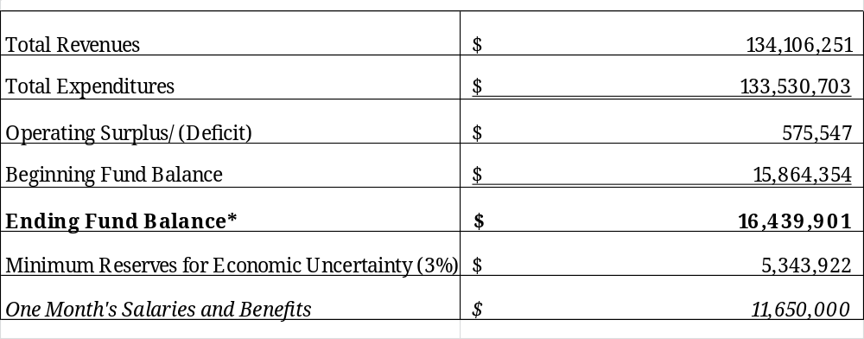
2016-17 First Interim
Unrestricted General Fund
Notes:
Revenues are less $17 million in contributions to restricted programs
Government Finance Officers Association recommends reserves equal to two months of operating costs – about 17%

Slide 13
Next Steps
Preparation of Second Interim for Spring adoption
  Year-to-date actuals as of January 31, 2017
  Governor’s January Proposal for the 2017-18 State Budget
  QUESTIONS?

