Slide 1


Slide 2
College and Career Readiness
Gudiel R. Crosthwaite, Ph.D.
Deputy Superintendent
March 14, 2017

Slide 3
Girls STEM
Women are making a difference, changing the world and transforming the future with Science, Technology, Engineering and Math.
Our Girls STEM Conference is an inspiring and fun day event for young women in grades 7-12 with a goals to foster equity and access, increase participation and advance young women into STEM education and careers.
On March 8th, 2017 we held our 2nd annual Girls STEM Conference where over 250 students participated in hands on STEM activities as well as engaging and informative panels comprised of representatives from organizations such as MESA, Northrop Grumman, Society of Women Engineers (USC) and many others.

Slide 4
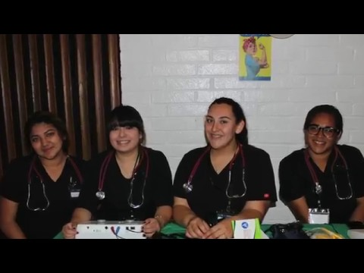

Slide 5
Girls STEM
Lynwood High
Abieiden Lopez
Karina Olivares
Paula Olivares
Alejandra Navarro
Rebeca Valdez
Jennifer Saldana
Firebaugh High
Harmony Esqueda
Kimberly Wenceslao
Kimberly Haro
Stephanie Baltazar
Giselle Villanueva
Karina Contreras

Slide 6
Career and Technical Education
A program of study that involves a multiyear sequence of courses that integrates core academic knowledge with technical and occupational knowledge to provide students with a pathway to postsecondary education and careers.
Ensure students are prepared for both college and career
Providing students a relevant college preparatory curriculum, career training and preparation through work based learning and, opportunities to earn college credits and industry recognized certifications.

Slide 7
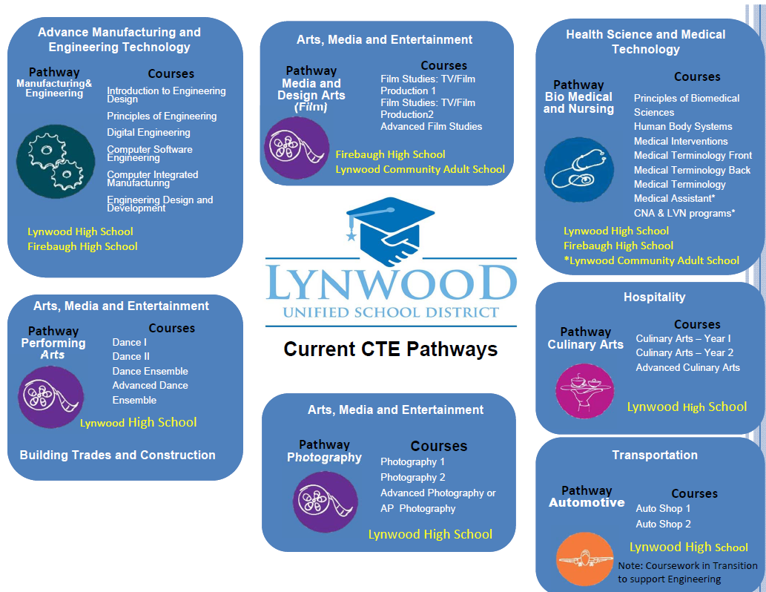
Notes:
Visual of current CTE Pathways

Slide 8
CTE Staff
Melissa Bejarano PLTW Biomedical Sciences
Rodney Conner Film & Video
Yervant Ghazarian Automotive Technology
Adel Montez Photography
Christian Munguia PLTW Engineering
Ashanee Hunter Medical Assistant
Joseph Powell Culinary Arts
Deena Smith PLTW Biomedical Sciences
John Ude PLTW Engineering
Brittany Washington Dance/Performing Arts
Michael Lorenzana CTE Counselor

Slide 9
CTE Staff
Jessica Cordova Columbia, Princeton, or UCLA
Alex Saravia SDSU, Poly SLO, Colorado School of Mines-Engineering
Hugo Vazquez Enlisted in the Armed Forces, Marines
Cesar Moreno UCLA
Brian Padilla CSU Long Beach
Angie Veliz UCLA
Notes:
PSAT Info
Fall (October) of 2016- All Juniors take the PSAT
Juniors LHS 492
Juniors FHS 358
850 Total
SAT Info
Spring March 2 2016- All Juniors take the SAT
SAT at LHS 528 students
SAT at FHS 375 students
SAT at Vista 30 students
933 Total

