Slide 1
Parent Information Session
Department of Exceptional Education
October 5, 2020

Slide 2

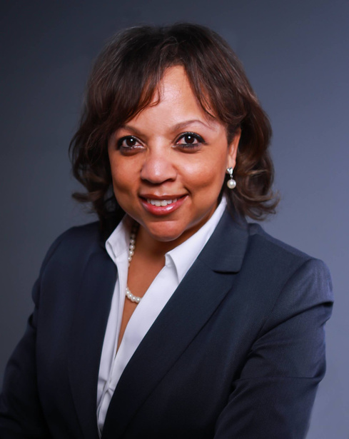

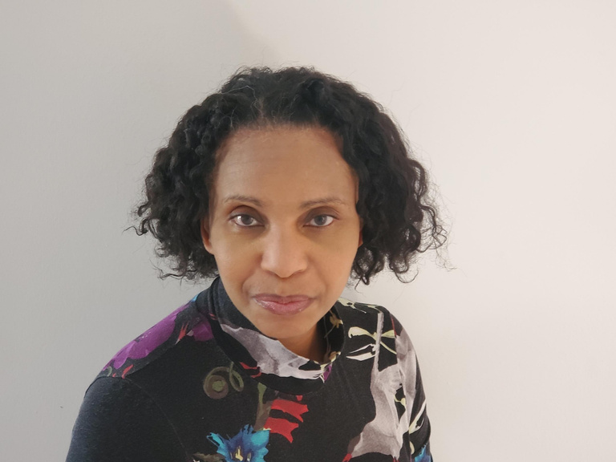
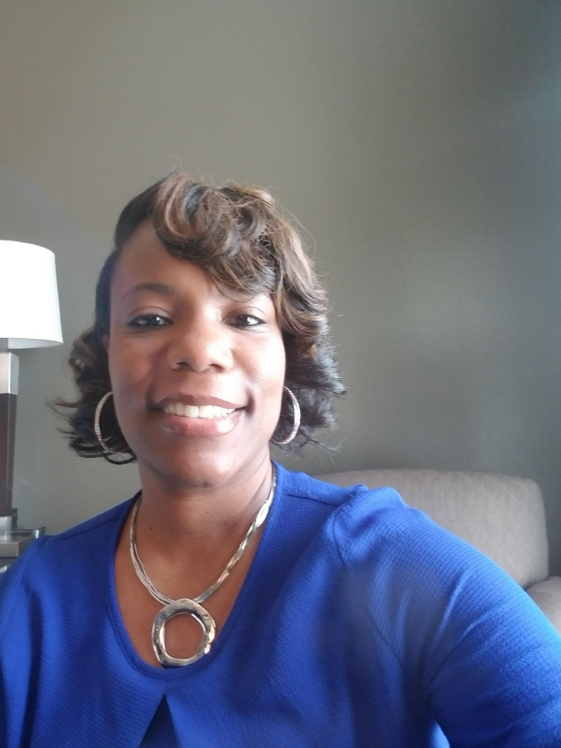
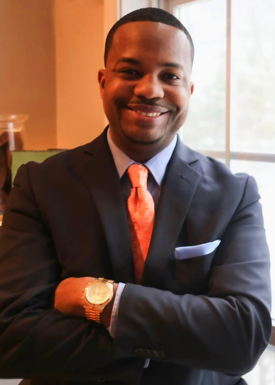
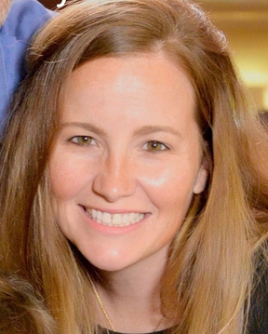
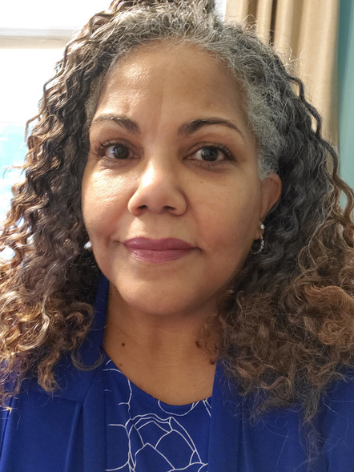
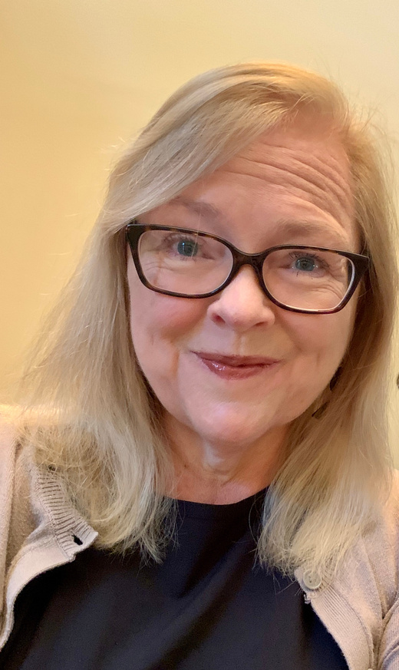
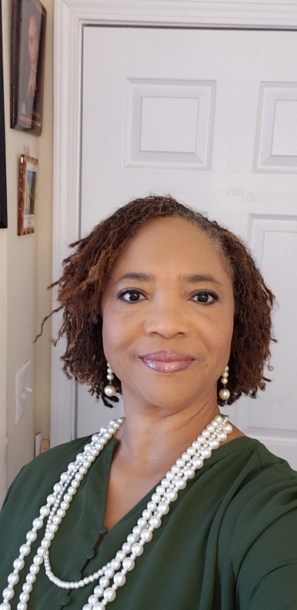
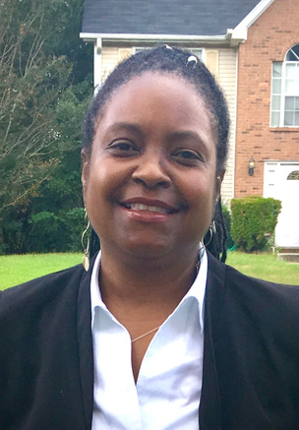
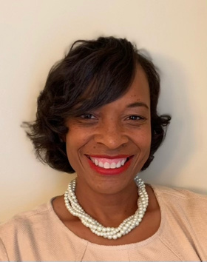
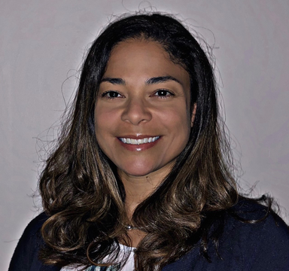
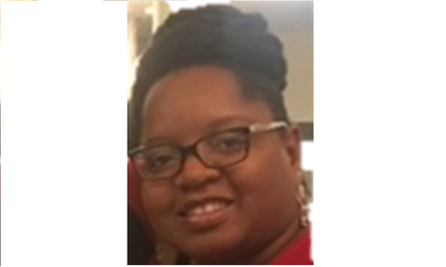
Presenters
Michele Summerlin, Ed.S.
Interim Executive Director
Prudencia A. Jacobs Ed.D
Coordinator III
Kiana King Ed.S.
Coordinator III
Darnell T. Logan, Ed.D.
Coordinator III
Ansley L. Smith, Ed.S.
Assistive Technology Specialist
Kimberly Y. Jones, Ed.S.,CCC-SLP
Coordinator II
Ann Van Buskirk, Ph.D
Psychologist
Diane Williams-Shirley Ed.S.
Coordinator II
Deborah Mitchell, Ed. D
Coordinator II
Rolanda Johnson Ed.S.
Coordinator II
Erin M. Baptiste, Ed.D
Coordinator II
Donnielle N. Howard-Thomas, Ed.D
Coordinator II

Slide 3

Agenda
Facilitating Home School Communication
Parent Mentor Partnership
Remote Learning Tips for Parents
Virtual Tools and Accessibility Features
Social Emotional Support for Parents/Caregivers

Slide 4
Facilitating Home School Communication
Kimberly Y. Jones, Jizel Alexis, Deborah Mitchell

Slide 5
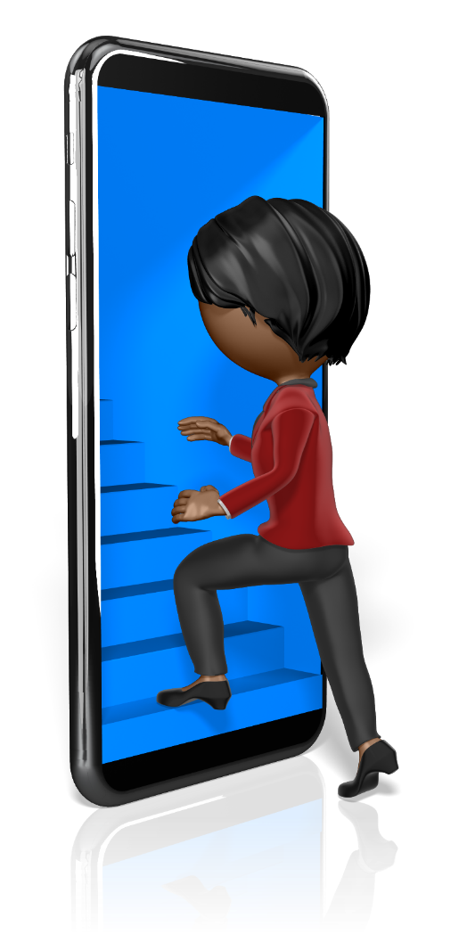
Two Ways to Find Us on District’s Website
https://www.dekalbschoolsga.org
Method 1
  Parents → Curriculum & Instruction → Special Education
Method 2
  Type “special education” in the Search bar

Slide 6



Who do I call when I have a question about my child’s IEP?
Who do I call when I have concerns about the bus?

Slide 7


Who do you call?
Start at your local school…
Special Education Teacher/Case Manager
Lead Teacher for Special Education
Assistant Principal
Principal

Slide 8


Who do you call?
Exceptional Education Coordinator (Elementary, Middle, High School)
Coordinator III (Elementary/Secondary)
Executive Director

Slide 9
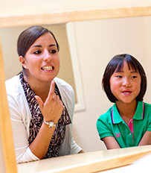
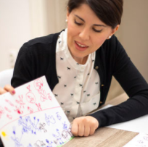
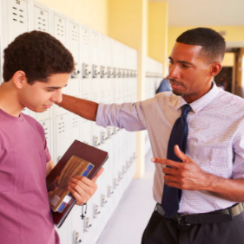
Who do you call?
Other School-Based Staff
Speech-Language Pathologist
and
Related Service Providers
School Psychologist
School Counselor
Social Worker

Slide 10
Parent Mentor Partnership
Demetra Williams and Alexandra Wright

Slide 11
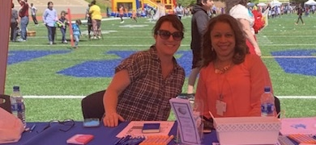
A Parent Mentor is a parent of a student with a disability. Your parent mentors have children who have attended a DCSD school.
Your Parent Mentors are:
Alexandra Wright Alexandra_Wright@dekalbschoolsga.org
Demetra Williams Demetra_Williams@dekalbschoolsga.org
Notes:
Alexandra…
Did you intend to use the same picture for your graphics?

Slide 12
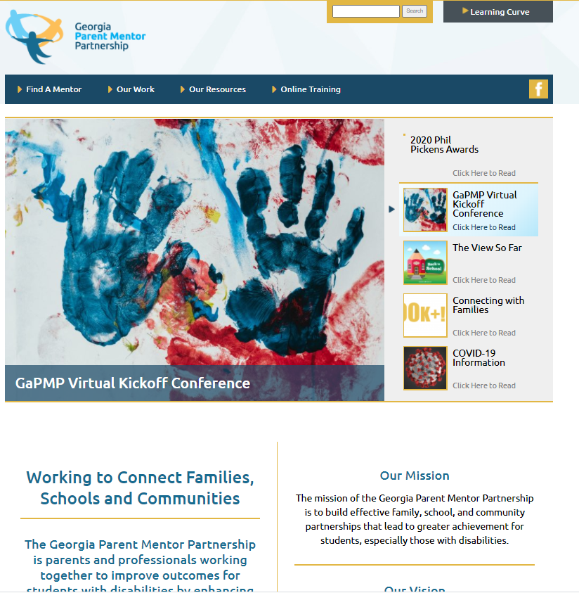
Our website
www.parentmentors.org
Contains a directory of every county in Georgia and their Parent Mentors
Resources for Families, Schools, Community and a list of our partners

Slide 13

Our Role
Parent Mentor Partnership (PMP) is a data-driven national model for family/school/community collaboration. The Georgia PMP encourages families of students with disabilities and/or other academic risks to be critical players in the school improvement process. The Georgia Department of Education launched this partnership to engage families of students with disabilities in the education process.
Today, the state/local partnership boasts nearly 90 trained parent leaders partnering with local school systems in family engagement initiatives.

Slide 14

Our Role
Together with educators and a group of family partners, the Parent Mentor Partnership (PMP) reaches more than 75 percent of the state’s students with Individualized Education Programs (IEPs), and thousands of other students considered at risk because of factors such as English as a Second Language, poverty and/or family social issues. This includes children in the 504 process and those in partnership with Title I.
The Parent Mentor Partnership consist of Parent Mentors with the goal of working with the school system and GaDOE to help increase the graduation rate for students with disabilities and engaging families in the education of their children.

Slide 15

Current Calendar: 2020-2021
Parent Information Session - Virtual October 5, 2020 5:30 pm-7:00 pm
Parent University Virtual January 2021
Make and Take Virtual February 2021
Exceptional Children’s Week TBD
Autism Month Event TBD April 2021
Parent Survey/Training TBD April 2021

Slide 16
Remote Learning Tips for Parents
Donnielle Howard-Thomas, Diane Williams-Shirley
Rolanda Johnson, Erin Broyard-Baptiste

Slide 17
Preschool Special Education

Slide 18
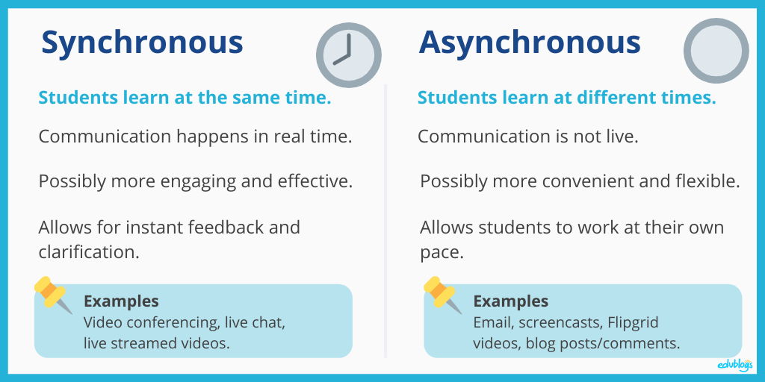
Preschool Special Education Virtual Learning

Slide 19
Preschool Special Education Virtual Framework
Virtual Morning Meeting and Circle Time
Whole Group Story
Centers/Weekly Activity Calendar
1:1 Instruction
Small Group

Slide 20
Curriculum and Instruction

Slide 21
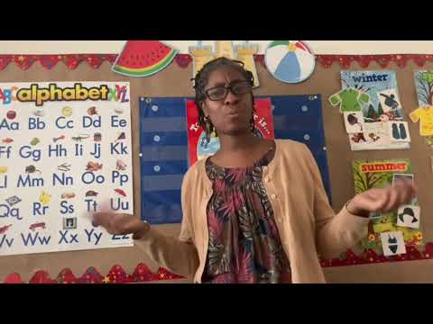
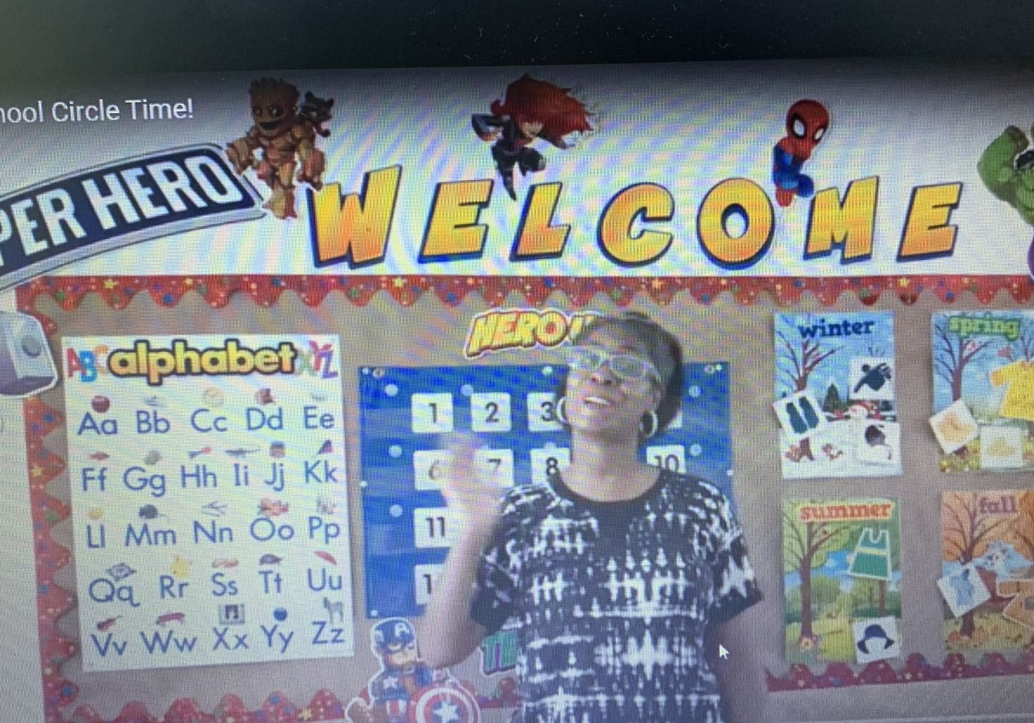
Virtual Circle Time https://www.youtube.com/watch?v=CFUN1M3oQoo&feature=youtu.be
Preschool Special Education Teacher
Patrice Benton-Manggrum

Slide 22
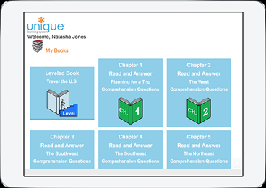
Unique Learning System
The Unique Learning System (ULS) is a comprehensive online curriculum covering a broad range of skills. Its differentiated levels and symbol-based instruction provides support for students using augmentative and alternative forms of communication. It targets instruction of developmentally appropriate skills and core state standards

Slide 23
Weekly Calendar
1. The weekly calendar is designed to provide parents with a variety of activities to support all the developmental domains.
2. Activities will be assigned for each skill area. Computer and non-computer based activity choices will be provided.
3. The activities added to the weekly calendar can also be specific to IEP objectives.
4. Teachers may modify activities to meet the instructional need of students.

Slide 24
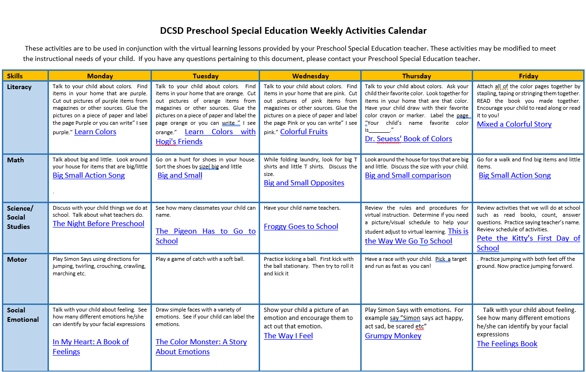
Preschool Special Education Weekly Calendar

Slide 25
Department of Exceptional
Education
Intellectual Disabilities
Virtual Learning Overview

Slide 26
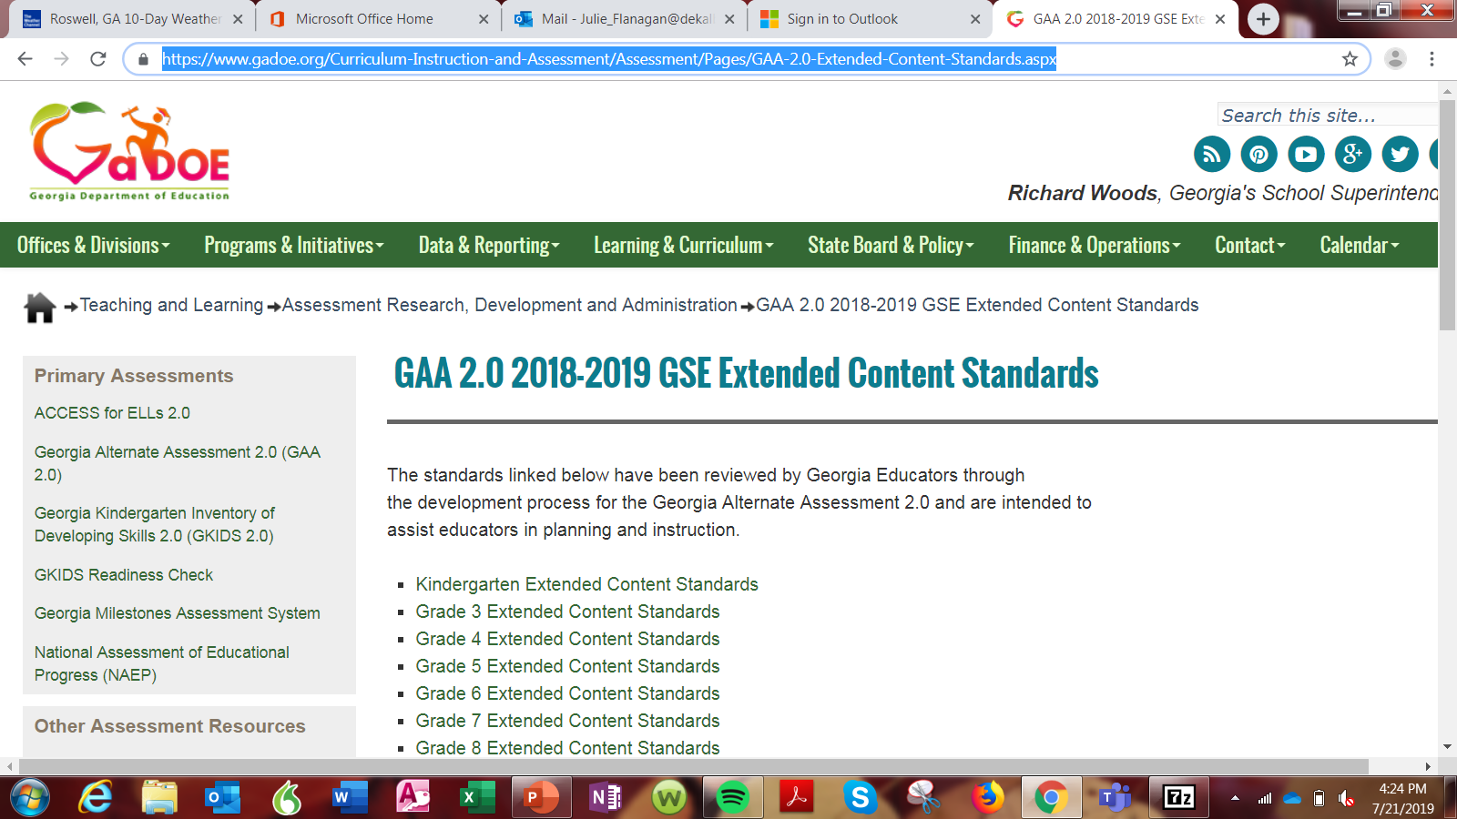
Curriculum
All students must be given access to Georgia Standards of Excellence (GSE).
GaDOE has provided extended standards for all required standards.
Notes:
The Individuals with Disabilities Education Act (IDEA) requires that students with disabilities have access to the general curriculum as well as an educational plan that meets their unique academic, developmental and functional needs. Instruction based on Georgia’s Standards are to be provided for all students. Students with the most significant cognitive disabilities can receive access to the curriculum through instruction that addresses IEP skills in the context of Georgia’s Standards and through instruction on relevant life skills.
While we are teaching virtually, standards still need to be addresses. The GAA Standard Timelines will be uploaded into your Office365 ID groups. Please download and use them to help when planning instruction.

Slide 27
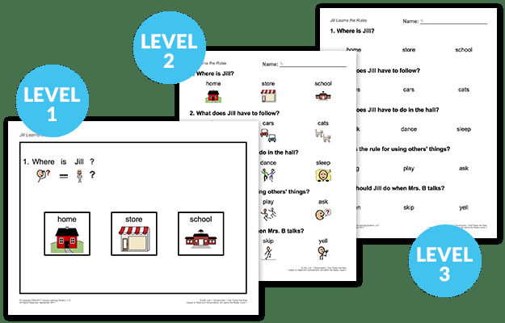
Unique Learning System
The Unique Learning System (ULS) is a comprehensive online curriculum covering a broad range of skills. Its differentiated levels and symbol-based instruction provides support for students using augmentative and alternative forms of communication. It targets instruction of developmentally appropriate skills and core state standards
Notes:
The Unique Learning System is curriculum program that has been designed specifically for children with special learning needs. While the foundation of Unique is the academic content standards (reading, writing, math, science and social studies), the lessons are modified to allow all students have a way to participate and learn. There is a strong emphasis on life skills that are embedded in each lesson.
Unique Learning System provides monthly units that teachers are able to access from the Unique website. Each month there is a new topic built around a science or social studies theme. There are four grade bands; Elementary, Intermediate, Middle School, and High School to address all classroom levels. Teachers are given the grade level band that matches the ages and grades of the children in their classroom.
To get a subscription for Unique Learning System/News-2-You please contact Julie Flanagan

Slide 28
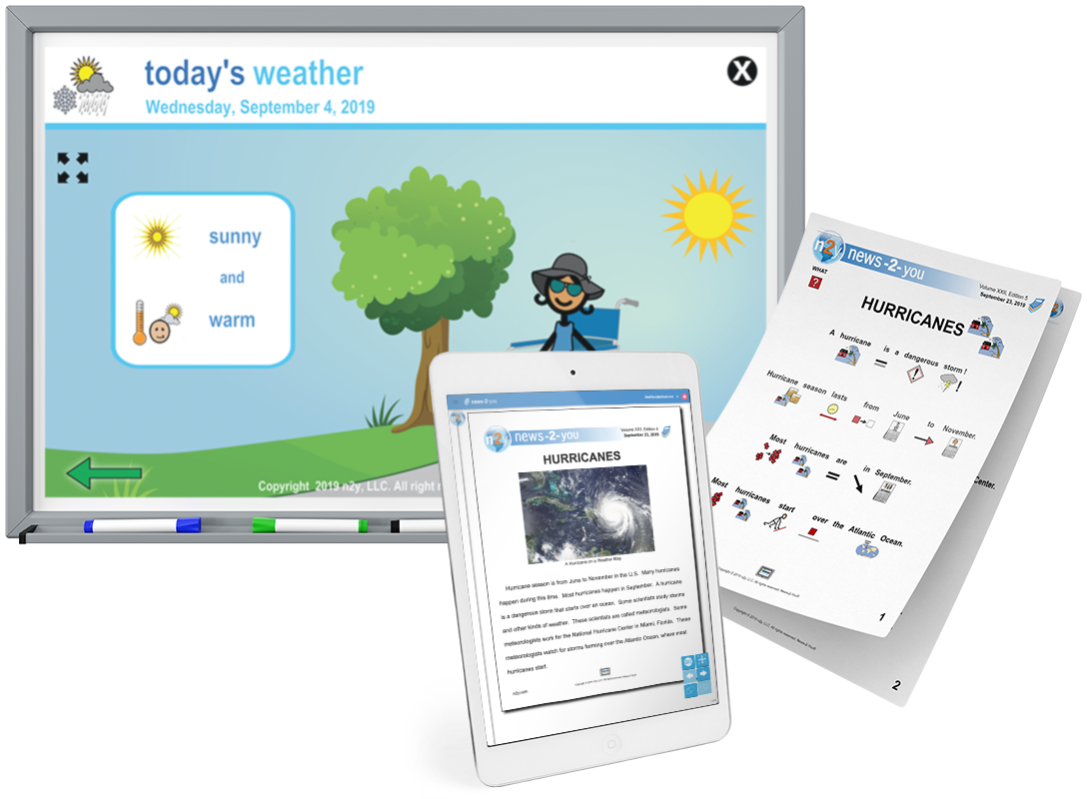
News 2 You
New-2-You is a digitally delivered newspaper that serves readers of all ages and reading levels. It is also tailored for individuals with special needs. The paper is published weekly and serves a wide range of reading comprehension skills, combining published and interactive standard based content in a format that is directly applicable in the classroom. News-2-You utilizes symbols throughout the newspaper, providing visual reinforcement for all content covered.
Notes:
Read Slide
To get a subscription for Unique Learning System/News-2-You please contact Julie Flanagan

Slide 29
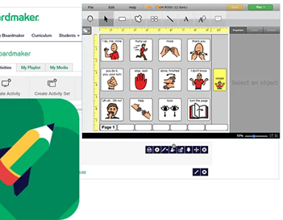
Boardmaker Online
Boardmaker Online is a web-based subscription service that allows users to create and edit activities. Users can also assign activities to students with data tracking, play activities from a web browser or on an iPad, track performance towards IEP goals and educational standards, access extensive collection of Common Core- aligned samples and Activity Packs.
Notes:
Boardmaker Online is a web-based subscription service that allows teachers to create and edit activities on any Windows or Mac computer. Teachers can also assign activities to students with data tracking, learning activities from a web browser or on an iPad*, track performance towards some IEP goals and educational standards, access standard aligned samples and activity packs.

Slide 30
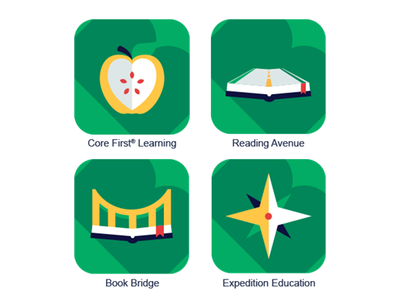
Core First Learning is a Boardmaker Instructional Solution that is specifically developed to foster increased language capacity and literacy growth in students with language impairments.
Reading Avenue is an accessible, all-inclusive, learn-to-read program for all students. Reading Avenue follows a path that builds foundational literacy skills with engaging topics and interactive instruction.
Book Bridge is Grade-Level Literature. Book Bridge is a curriculum to help students with special education needs meet modern academic standards for reading, writing, and vocabulary development.
Expedition Education provides a rigorous academic curriculum designed to transform students with special needs into readers, writers and thinkers. Build their knowledge of history, geography, STEM, and culture.
Notes:
Core First Learning -is a Instructional Solution that is specifically developed to foster increased language capacity and literacy growth in students with language impairments.
Reading Avenue -An accessible, all-inclusive, learn-to-read program for all students. Reading Avenue follows a path that builds foundational literacy skills with engaging topics and interactive instruction.
Book Bridge - is a curriculum to help students with special educational needs meet modern academic standards for reading, writing, and vocabulary development.
Expedition Education-provides a rigorous academic curriculum designed to transform students with special needs into readers, writers, and thinkers. Build their knowledge of history, geography, STEM, and culture.
It is recommended that you view instructional webinars on the vendor sights to learn more about these programs.
You will need to contact Tiffany Paul for a subscription to Boardmaker online programs

Slide 31
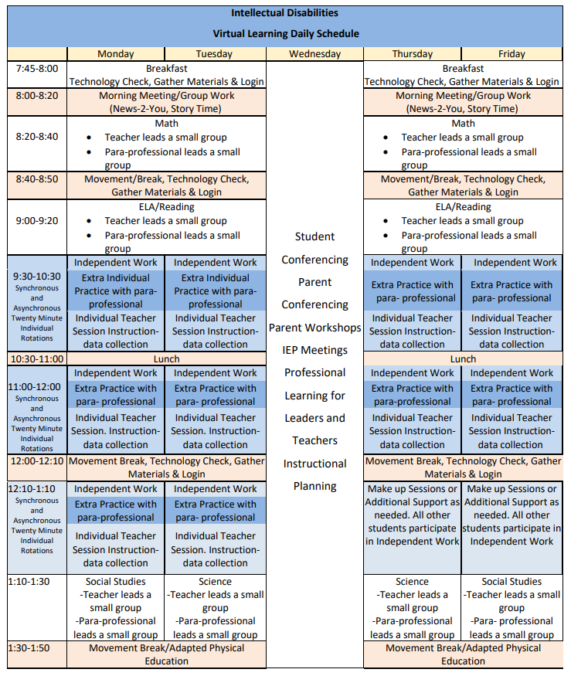
Suggested Intellectual Disabilities
Virtual Learning Schedule
Notes:
This is the District’s virtual schedule for parents of student’s that receive instruction in an Intellectual Disabilities program.

Slide 32

CLICK IN ANY OF THESE TEXT BOXES TO CHANGE THE TEXT SEEN IN THIS TEMPLATE. CUSTOMIZE IT TO FIT YOUR PERSONAL NEEDS.
Department of Exceptional
Education
Remote Learning Tips for Parents
CHANGE OUT THIS PICTURE OUT WITH YOUR OWN. TO DO SO CLICK ON THE IMAGE HIT DELETE. THERE WILL BE AN ICON IN THE MIDDLE OF THE PICTURE, CLICK ON IT, THEN FIND YOUR PICTURE AND INSERT.

Slide 33

Setting Your Student Up for Success
Modified Tips from Common Sense Education
Helpful tips to consider
  Consider creating a special, personalized corner of a room dedicated to learning, creating, and reading.
  A movable box or crate to hold school supplies and textbooks may allow students to easily locate materials
  Allow your child to help prepare the space for school, even if that means just putting a pencil box next to the device they'll be using.
  Getting the space ready will help them get ready to learn.
Notes:
First and foremost, we all want to come from a place of empathy for all stakeholders (students, parents, and teachers).
Remember that strong relationships with kids make for positive educational experiences.
Make a Space: Use a movable box or crate if space is precious. Let your kid help prepare the space for school, even if that just means putting a decorated pencil box next to the device they'll be using. Getting the space ready will help them get ready to learn.
Set a Routine: Have them follow a routine as if they're going to school (getting dressed, brushing teeth, etc.) instead of lying in bed in their pajamas, which could lead to less learning.
Breaks are really important, especially for kids with learning and attention issues, so make sure to build those in and break assignments into smaller pieces.
Expectations: Come up with a list of "must dos" and "may dos" together to cover the essentials and activities of choice.

Slide 34


Setting Your Student Up for Success
Modified Tips from Common Sense Education
Many students respond well to routine
  Teachers and parents understand that most students require structure. It's important to let them know what to expect.
  If a teacher/team recommends the use of a visual schedule, consider utilizing the schedule during remote learning as well. Some students can use a calendar, planner, or digital organizer to keep track of their daily schedule and assignments.
Work with the classroom teacher to help the student remain focused
  When your child is struggling to remain on task and focused, consider establishing a nonverbal or one-word cue to help get them back on track
Notes:
Review expectations
Ensuring that students sign on to the assigned platform during the scheduled times daily will help establish expectations.
Support the school and teachers by reviewing online etiquette and expectations during remote learning.

Slide 35
Setting Your Student Up for Success
Modified Tips from Common Sense Education
Encourage self-regulation techniques
  Talk to your child about what happens in their bodies when they feel frustrated, excited, or sad. This can help them recognize and manage their emotions.
Role Playing
  Elementary age students might respond to role playing. Cast your kid in the role of work partner, teacher, or researcher to help them stick to a task (and let you stick to yours!).
  Secondary age students may respond to a conversation about taking on more responsibility (like chores, self-regulation, etc.). These are tips to keep the kids focused, interested and balanced while learning from home.
Notes:
If the student has other devices at home, keep them out of their workspace if possible. This may mean shutting down phones, keeping phones in a designated place for the day, and putting away remotes.

Slide 36

Distance Learning Plan (DLP) Reminders
A DLP will be completed for all students with disabilities to address IEP programming/services, unless the child’s IEP can be implemented as written.
The DLP should be developed in the context of a meeting, unless the parent agrees to allow the District to develop and implement the DLP without a meeting.
The plan will describe how the student will access IEP services during remote learning.
Family engagement is critical to ensure that DLPs meet the needs of diverse learners.
The plan will be fluid and should be updated as needed.

Slide 37
Virtual Tools and accessibility features
Ansley Smith

Slide 38
Cool Tools for Virtual Learning
Ansley Smith, Ed.S.
DCSD Assistive Technology Specialist
Ansley_L_Smith@dekalbschoolsga.org

Slide 39

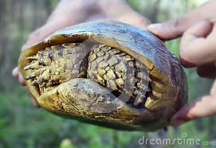
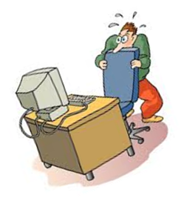
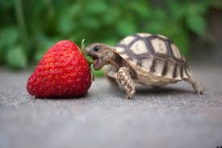
Do you sometimes feel like technology is moving like this...
And feel like doing this?
And you are moving like this?
Let's go over some cool tools to help you and your students!

Slide 40
Reading

Slide 41
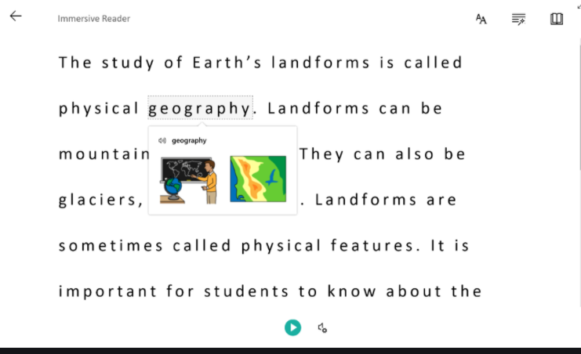
Microsoft Learning Tools
Immersive
Reader
You know it, girl!
Would you like to see a quick demo?
Allows a student to have text read aloud with simultaneous highlighting

Slide 42

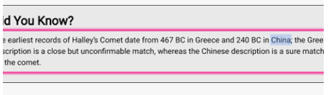

Chromebook Accessibility Feature
Select-to-Speak

Slide 43

Bookshare
FREE resource for all K-12 students with a print disability to obtain materials in an auditory format
Who qualifies? Students with a Reading Disability, Physical Impairment, and/or Vision Impairment
Allows qualifying students who need accessible educational materials to: ​
1. Engage in multi-modal reading of over 900,000 titles where they can see and hear words simultaneously (with highlighting)​
2. View books with large font on a screen
3. Read Braille (digital or hard copy)

Slide 44
Written Expression

Slide 45
Chromebook Accessibility Feature
Dictation

Slide 46
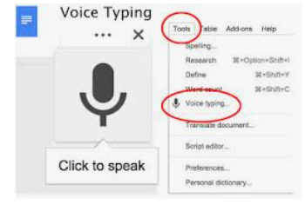
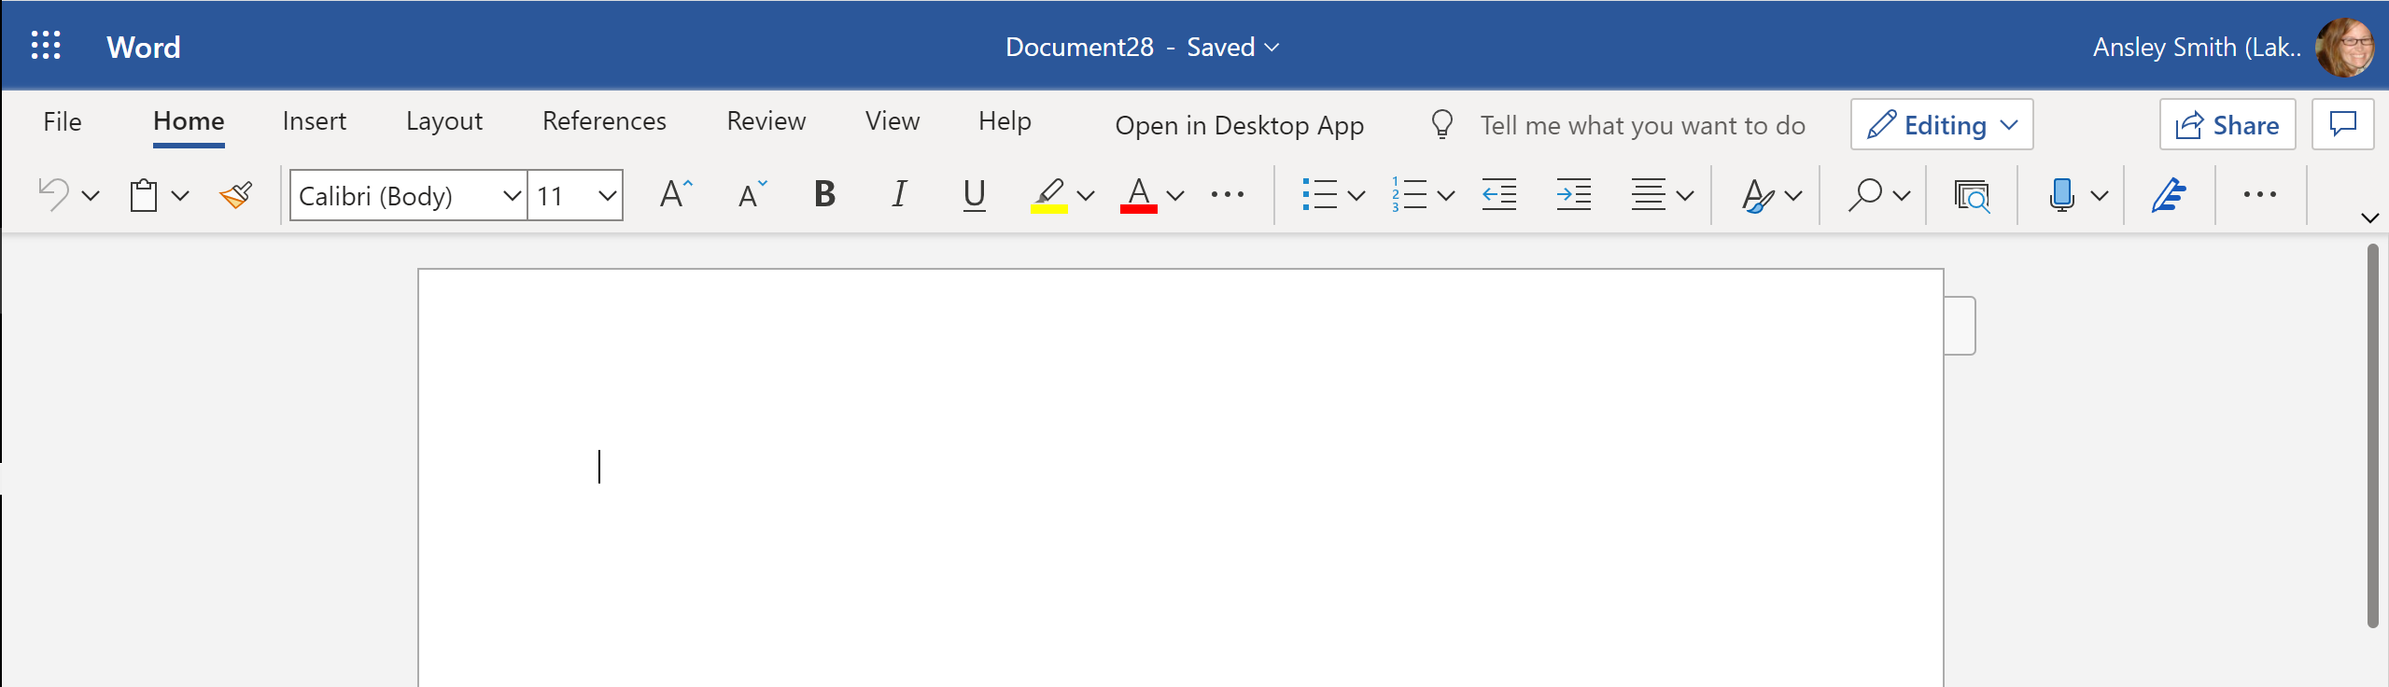
Google Voice Typing and Microsoft Dictate
Voice Typing in Google Docs
Dictate in Microsoft Word

Slide 47

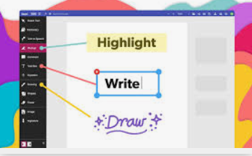
Kami electronic form-filler/ PDF annotator
Chrome extension

Slide 48
Social Emotional Support Parent/ Caregivers
Dr. Ann Van Buskirk

Slide 49
What do I need Right Now?
Self-preservation and Mental Health
As parents and caregivers, we understandably focus on the needs of the children
It is a selfless act to take care of ourselves as adults
Put your oxygen mask on first
Be gentle with yourself
It is important to check your battery life each day – some days we can do more than others
Acknowledge the good things that are still happening

Slide 50
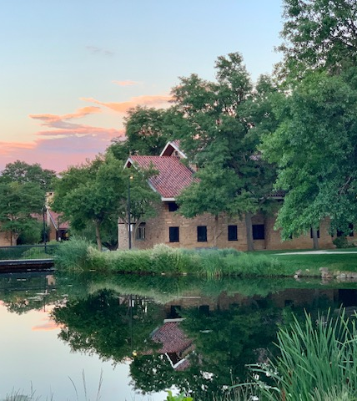
How are you Feeling?
Take a moment to breathe in and out, jot down your emotions and scan your body. How much gas is left in your tank today?

Slide 51
Pandemic Fatigue (while not a Diagnosis) is a real thing
43 percent of people surveyed reported that Covid-19 and the associated changes have had a negative effect (not just impact) on their mental health.
19 percent report that it has had a SEVERE effect.
What changes have you noticed in yourself over the last few months?
Notes:
increased feelings of anxiety *Trouble sleeping
worried and/or intrusive thoughts Agitation or restlessness
Inability to focus Trouble reading and/or writing
*Feelings of hopelessness or apathy - "why bother?" or "nothing really matters"
Increased tendency to personalize the behavior of others (everyone is more fragile and more easily hurt right now)
Low energy *Lost sense of humor
*Decreased emotional and behavioral regulation
Decreased feelings of connection with others, even others we like or love.

Slide 52
"Hard Things are Hard"
President Barack OBAMA
Give yourself, our children, and others grace during this challenging time
Give
Responses in
Alignment with
Compassion and
Empathy

Slide 53
Permission to be present, not perfect
Good things are still happening.
Notes:
If today is one of those days where you can't even, please let the strategies presented wash over you like warm water and try not to drown in the information shared. When and if you like, you can return to these slides to pick up more information or ideas of how to boost the neurochemicals that will engender feelings of well-being or happiness. If you're not feeling it, you are NOT the problem. Hard things are Hard (President Obama was right about this). Somedays flowers and butterflies bring me joy, and other days beauty is hard to take while living in a harsh and struggling world. I don't know what kind of day you're having.
Just like many of you, there are times that I feel seretonin coursing through my brain and I feel as if I can contribute to the greater good, and other days I find breathing to be an act of will. Receive what is useful and let go of the rest – the truth of the dialectical is that we are doing the best we can, and (sometimes) we can do better.

Slide 54
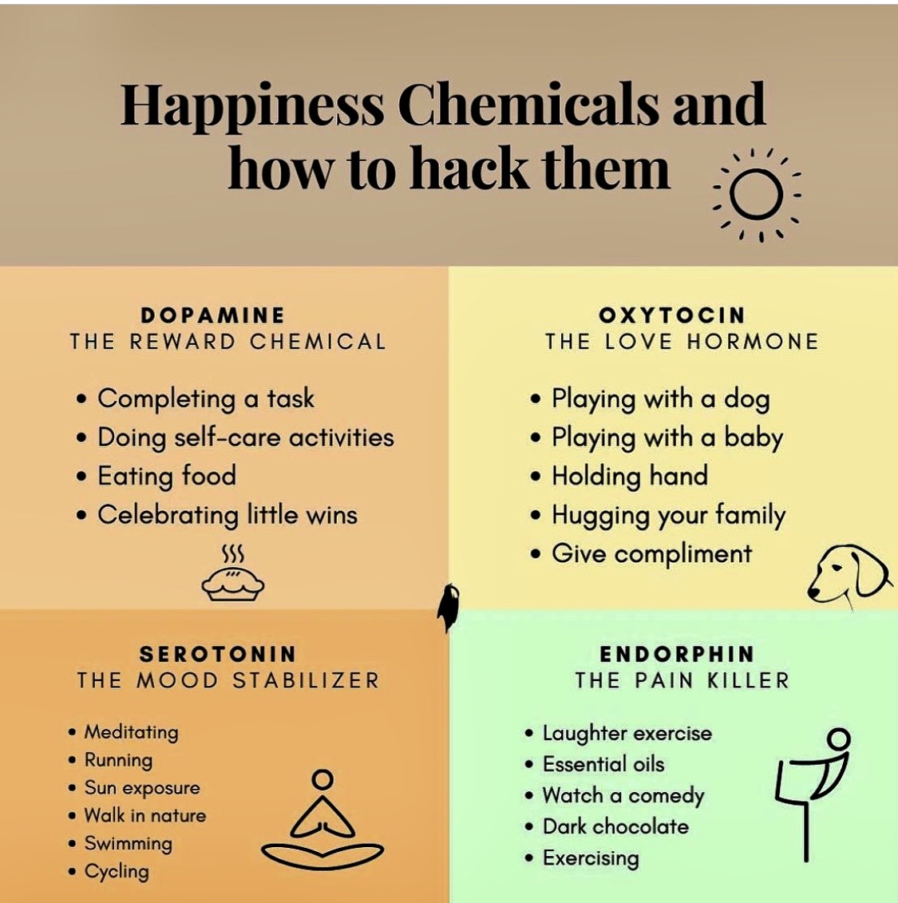
Better Living Through Chemistry
Begin each day checking on your battery life.
Ask yourself, “What do I need – in this moment, for this day, for this week?”
Be as kind to yourself as you would be to the person with whom you are most gentle,
Keep a gratitude journal 5 days a week for 30 days.
Share what is helping you with others.
If you need help, please reach out.
When you have the bandwidth, help someone else.

Slide 55

Supporting our children in remote learning during a pandemic is not easy. If you are tired and weary, you are not alone.
DCSD staff can provide information and resources that can assist you in supporting your students. Additional information regarding social emotional supports can be found on the district’s website.
"It is the responsibility of every adult... to make sure that children hear what we have learned from the lessons of life and to hear over and over that we love them and that they are not alone."
Marion Wright Edelman

