Slide 1
2025-2026
Budget Adoption

Slide 2
Wrapping Up
Revenue | 2024-25 Revised Budget | 2024-25 Estimated Finish
Local | 54,380,087 | 54,733,763
State | 72,756,038 | 75,776,408
Federal | 2,020,000 | 341,570
Total | 129,156,125 | 130,851,741
Expenses | 2024-25 Revised Budget | 2024-25 Estimated Finish
Payroll | 105,974,142 | 107,701,425
Contracted Services | 14,318,816 | 12,718,688
Supplies | 3,949,328 | 3,245,425
Misc. Operating | 4,349,952 | 3,573,783
Debt Service | 0 | 1,187,841
Capital Outlay | 761,967 | 1,005,042
Total | 129,354,205 | 129,432,206
Excess/Deficit | (198,080) | 1,419,536
Notes:
Add note about amount collected for PVS

Slide 3
Fund Balance Summary – General Fund
 | General Fund
Beginning Fund Balance | $37,544,009
2024-25 Total Excess | 1,419,536
Resolution to transfer to Capital Projects (technology) | (1,419,536)
Estimated Fund Balance as of June 30, 2025 | $37,544,009

Slide 4
Tax Rate Trend
2025-26 Legal Notice posted at $1.2552

Slide 5
Property Value Trend
2025-26 is May Preliminary Values

Slide 6
Enrollment

Slide 7

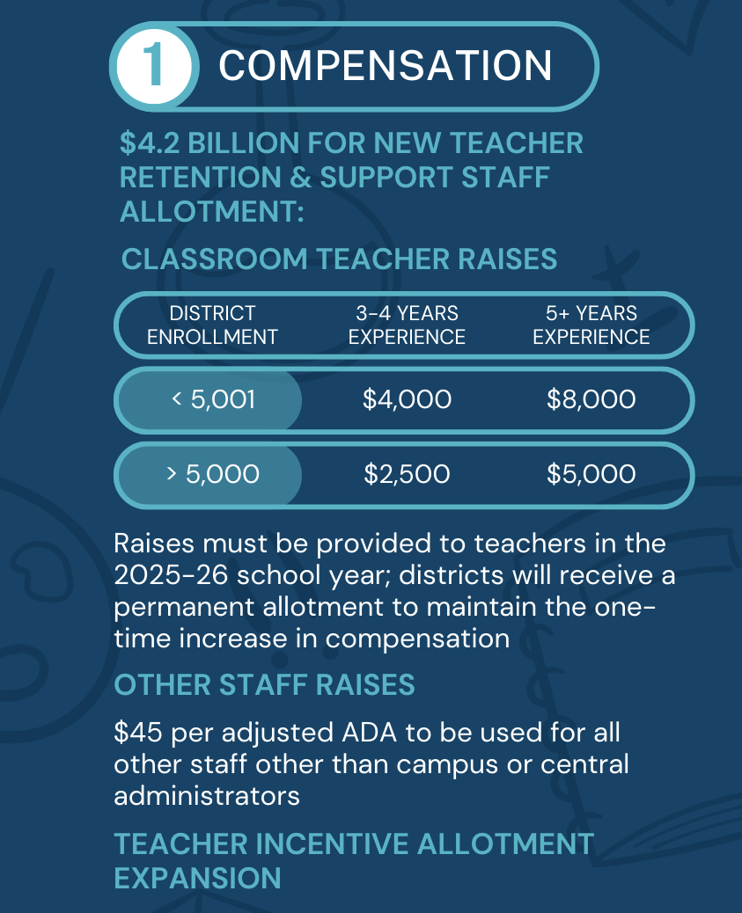
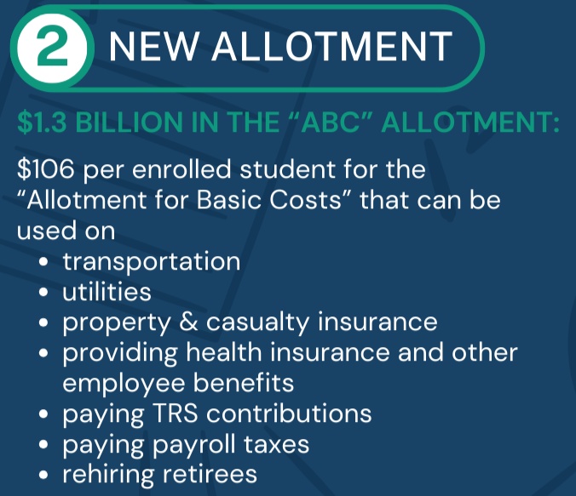

Slide 8
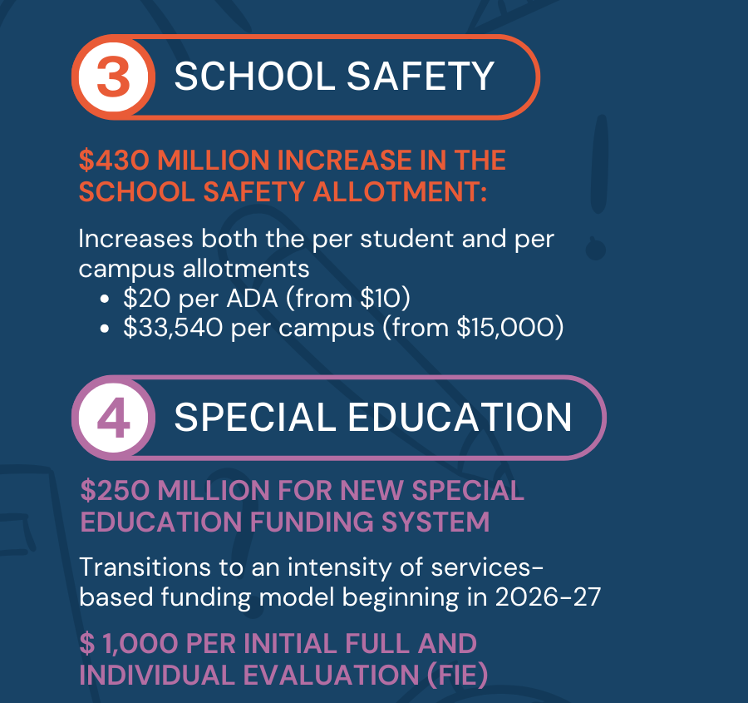
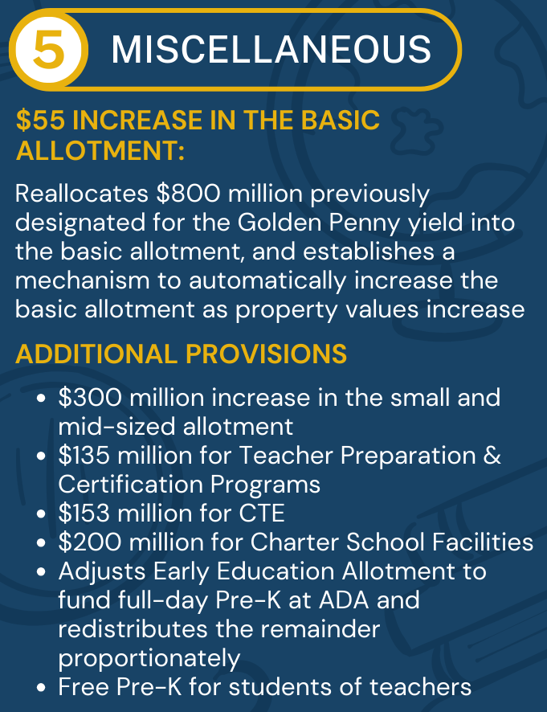

Slide 9
2025-26 Payroll Considerations
Teacher Matrix
  $60,000 – Beginning Pay
  Years 1-2
    $2,020
  Years 3-4 - HB 2
    $2,500
  Years 5+ - HB 2
    $5,000
Nurses/Librarians/SSO’s
  3% of midpoint
All Others:
  3% of midpoint
  Pay scale adjustments

Slide 10
General Fund
Revenue | 2025-26 Proposed
Local | 50,518,189
State | 84,136,819
Federal | 1,470,000
Total | 136,125,008
Expenses | 2025-26 Proposed
Payroll | 112,484,923
Non-Payroll | 23,562,220
Total | 136,047,143
Excess/Deficit | 77,865

Slide 11
Debt Service
Revenue | 2024-25 Revised Budget | 2024-25 Estimated Finish | 2025-26 Proposed
Local | 34,757,374 | 35,703,628 | 32,370,851*
State | 4,806,979 | 3,596,767 | 3,575,759
Total | 39,564,353 | 39,300,395 | 35,946,610
Expenses | 2024-25 Revised Budget | 2024-25 Estimated Finish | 2025-26 Proposed
Debt Service | 22,030,728 | 49,778,399 | 19,658,133
*Homestead exemption and hold harmless
**Bond defeasance

Slide 12
Food Service
Revenue | 2024-25 Revised Budget | 2024-25 Estimated Finish | 2025-26 Proposed Budget
Local | 2,952,000 | 3,050,756 | 3,264,309
State | 200,000 | 196,448 | 200,000
Federal | 4,492,407 | 4,435,369 | 4,657,137
Total | 7,644,407 | 7,679,573 | 8,121,446
Expenses | 2024-25 Revised Budget | 2024-25 Estimated Finish | 2025-26 Proposed Budget
Payroll | 3,799,365 | 3,634,558 | 3,744,557
Supplies/Operations | 5,402,350 | 4,552,289 | 4,418,722
Total | 9,201,715 | 8,186,847 | 8,163,279
Excess/Deficit | (1,557,308) | (507,275) | (41,833)
Fund Balance - $2,190,438

