Slide 1

Public Hearing for Fiscal Year 2025-26 Proposed Budget
Alum Rock Union Elementary School District
Board Meeting
June 12, 2025

Slide 2
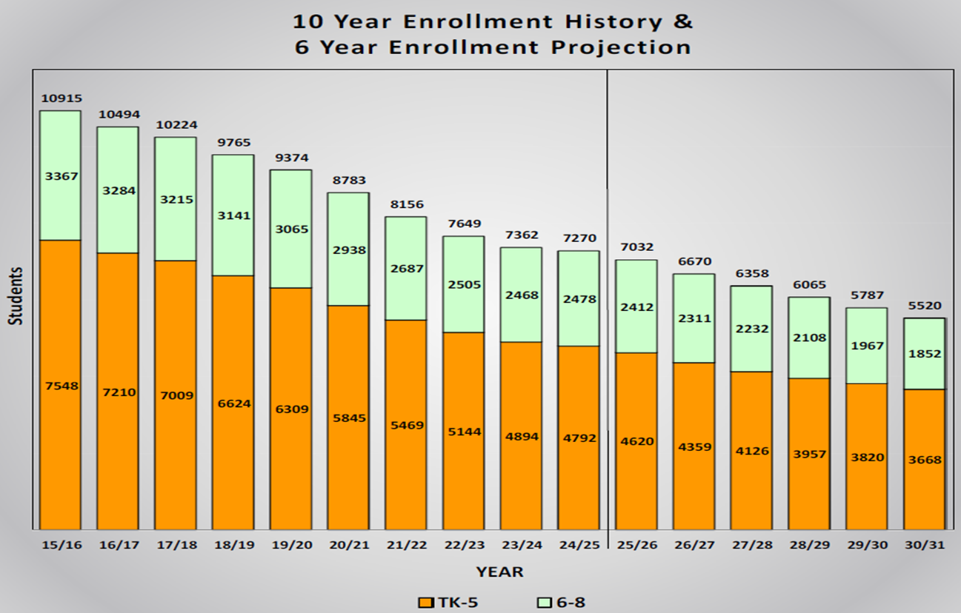
Key Assumptions – Enrollment History and Projections per SchoolWorks

Slide 3
Key Assumptions – Enrollment
    The MYP includes an additional potential 300 * student decrease (total decrease of approximately 540 students) due to school closures and projected enrollment drop.
* Most recent FY 25-26 enrollment information from Student Services.

Slide 4
Key Assumptions – Revenues Based on May Revision
Federal Revenue
Title I, II, III, IV = $3.7M
Special Education = $1.9M
State Revenue
    LCFF (Local Control Funding Formula) based on May Revision = $107.7M (Unrestricted)
    ASES (After School Education and Safety Program) = $2.1M (Restricted)
    Prop 28 Arts and Music Grant = $933K (Restricted)
    ELOP (Expanded Learning Opportunities Program) = $12.2M (Restricted)
    Lottery = $1.3M (Unrestricted)
    Lottery = $588K (Restricted)
    Local Revenue
    Parcel taxes of approximately $4.9M, each year
    Lease revenue of approximately $2.7M, each year

Slide 5
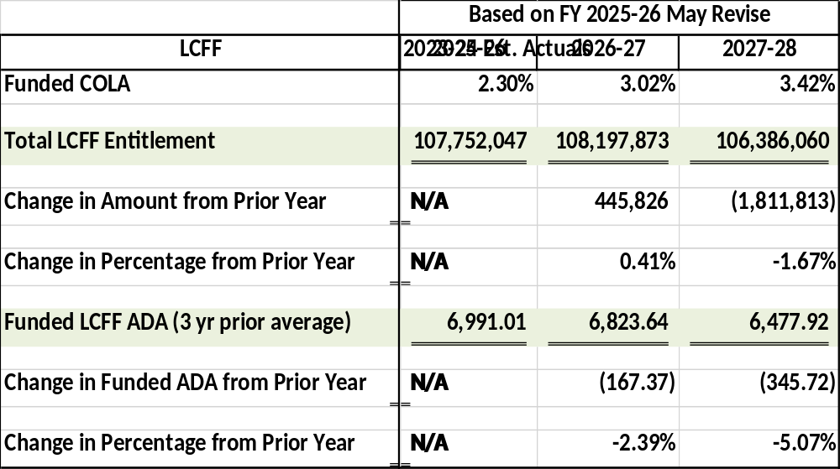
Key Assumptions – LCFF Revenue Based on May Revision

Slide 6
Key Assumptions – Expenditures
FY 2024-25
1% off salary schedule payment is not included in expenditures and fund balance yet. Cost is approximately $1.1M.
FY 2025-26
    Incorporates School Consolidation Plan and Fiscal Stabilization Plan including district office staffing reductions.
    We are on track with deficit spending of $9.4M.
    FY 2026-27
    Includes consolidation of Adelante I and II onto Fischer site.
    Includes reduction of 10 certificated FTEs to align with declining enrollment = $1.5M.
  FY 2027-28
    Includes reduction of 10 certificated FTEs to align with declining enrollment = $1.5M.

Slide 7
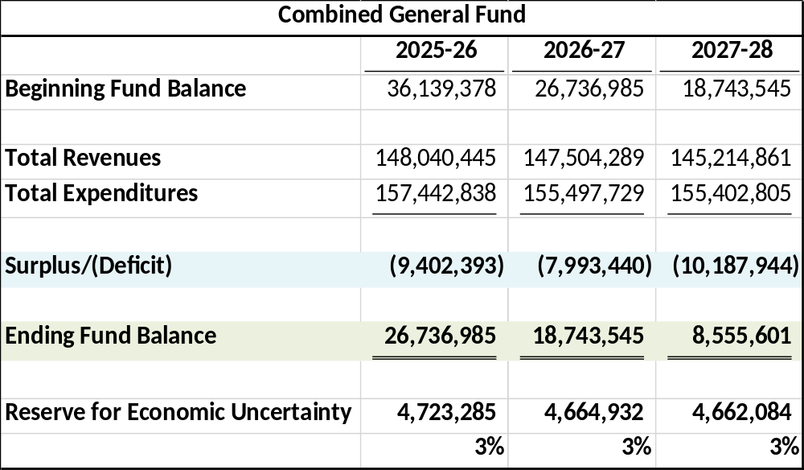
Combined General Fund Multi-Year Projection
(Unrestricted and Restricted)

