Slide 1
Slavery and the Slave Trade in Global Perspective
Philip Morgan
Johns Hopkins University
Charlottesville
September 13, 2010

Slide 2
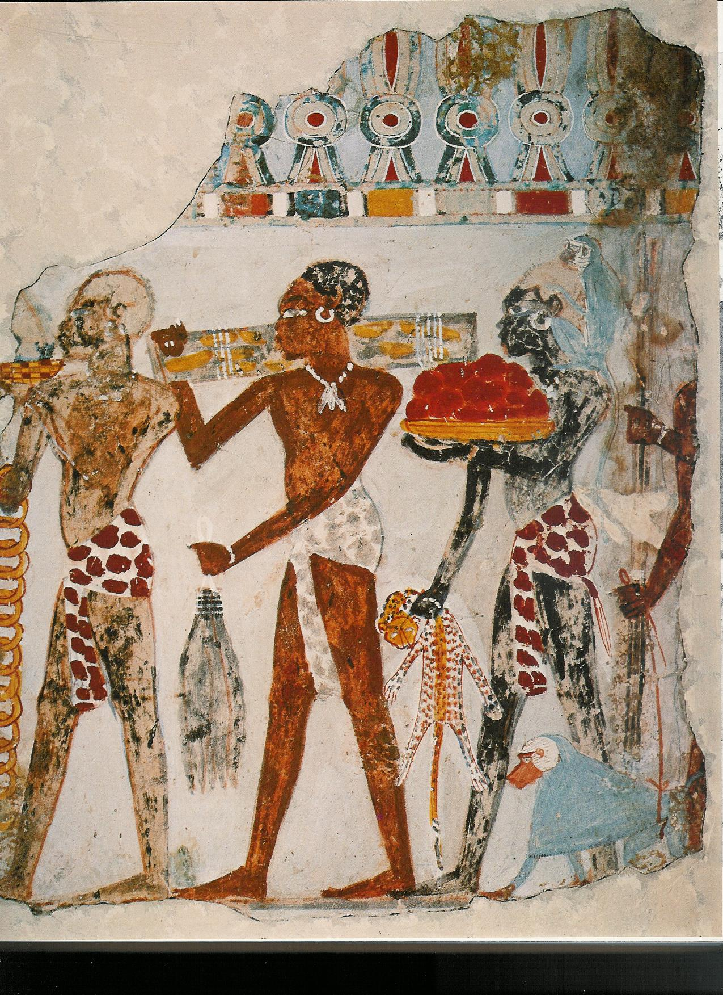
Offerings of African Products.
From Thebes fragment of mural painting c.1400 BCE

Slide 3
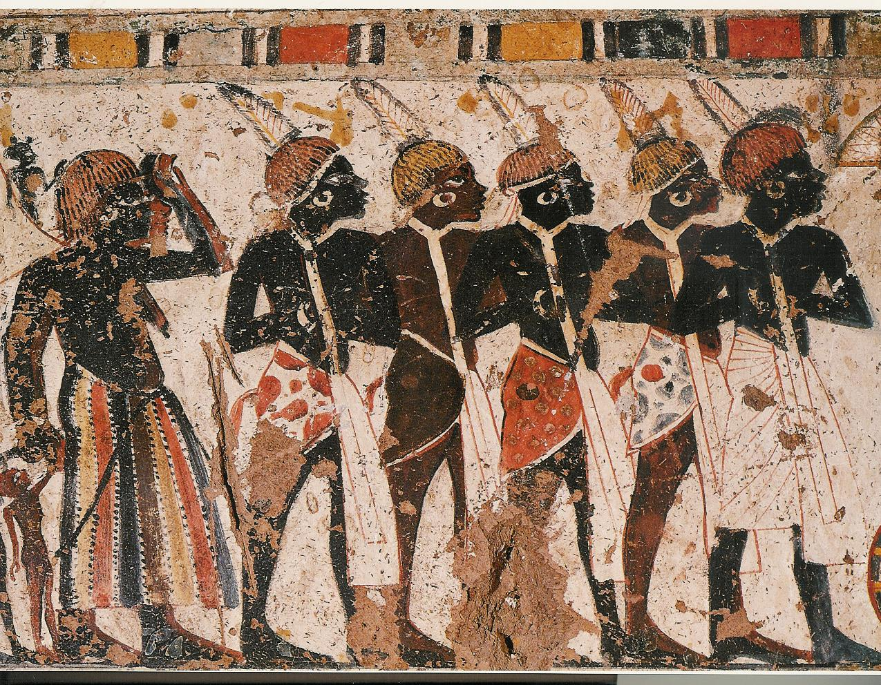
Bearing Tribute from the South to Tutankhamun. Mural Painting. Thebes, c 1342-1333 BCE

Slide 4
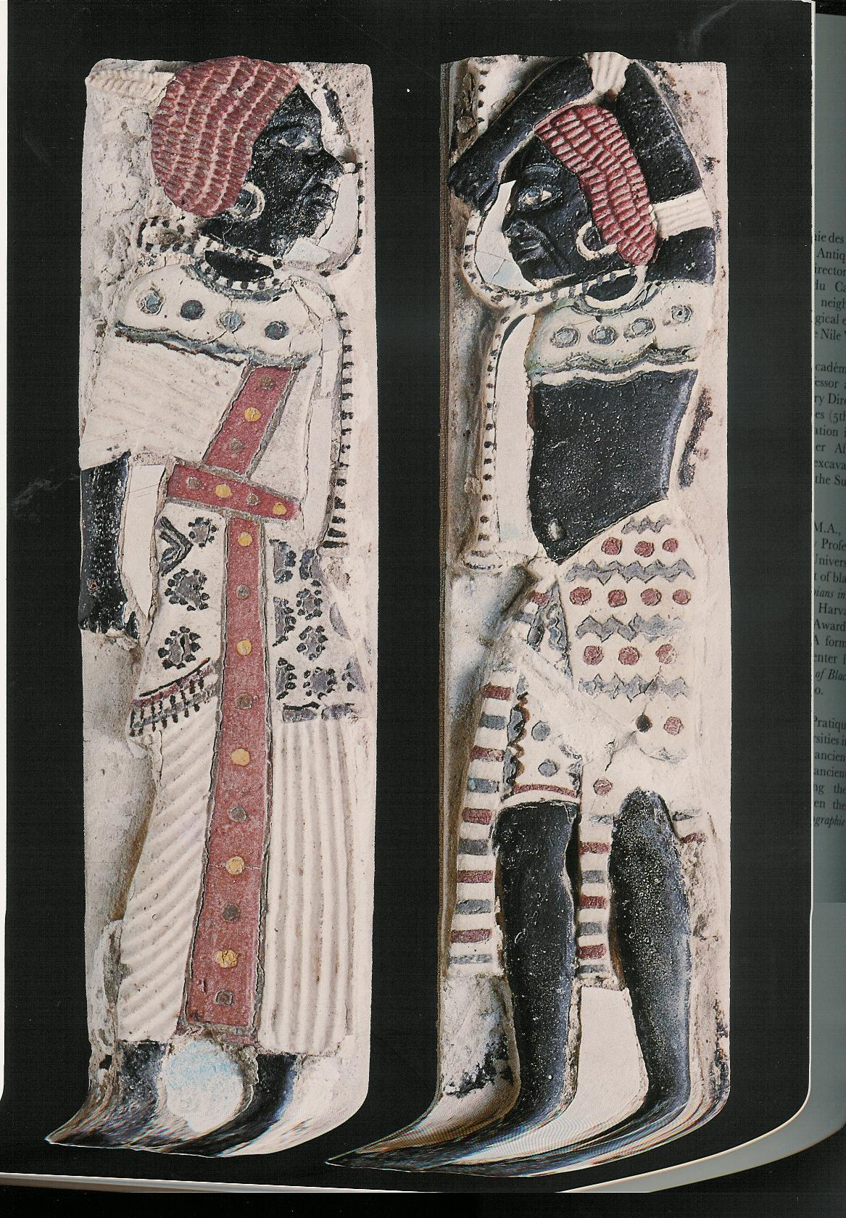
Black Prisoners.
Palace-Temple of Ramesses III c.1198-1166 BCE

Slide 5
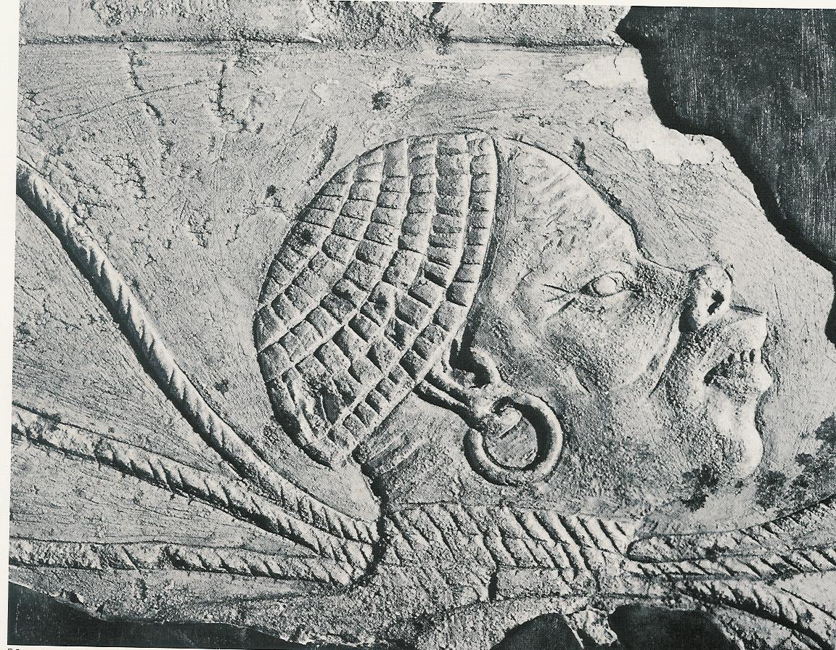
Head of prisoner. c. 1560-1314 BCE

Slide 6
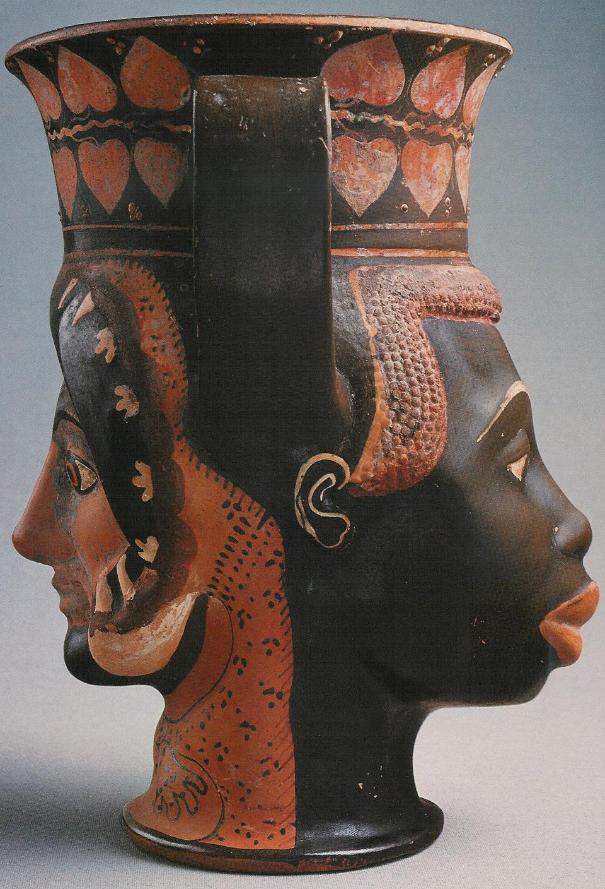
Kantharos (drinking cup) in the form of cojoined heads of a white woman and a black person.
5th century BCE

Slide 7
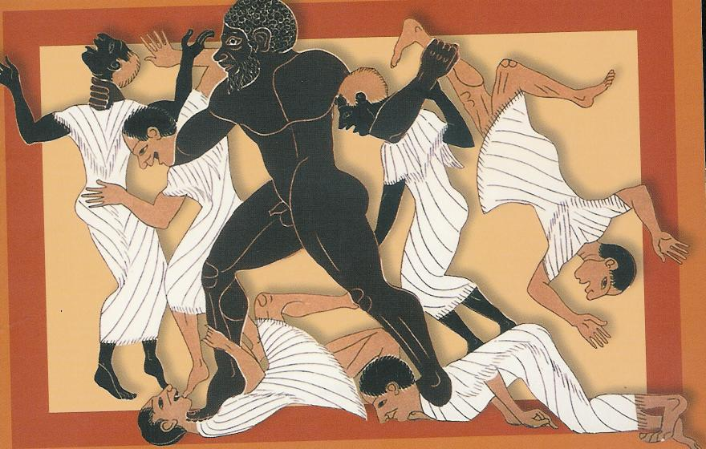
Caeretan black-figure hydria, Late Archaic Greek, c. 510 BCE

Slide 8
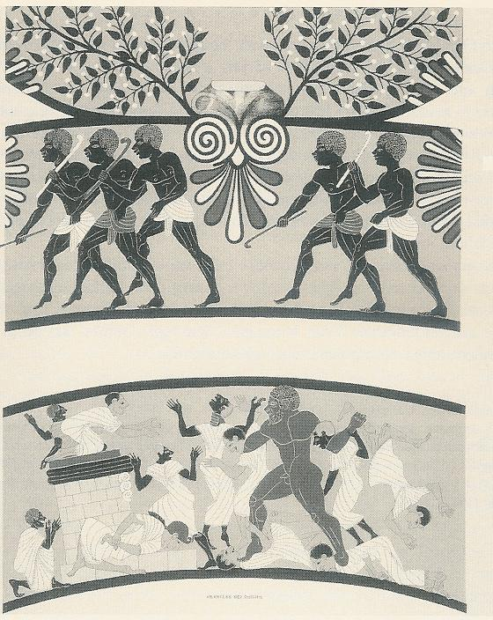
Caeretan black-figure hydria, Late Archaic Greek, c. 510 BCE—both sides of vase

Slide 9
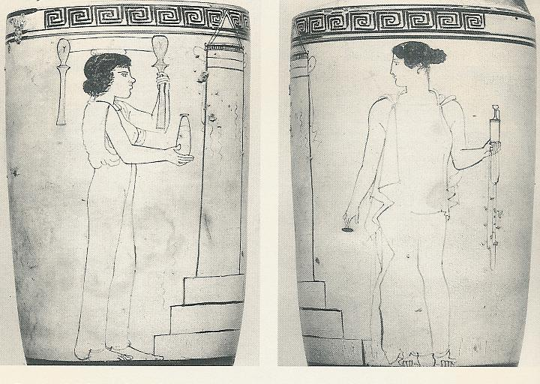
Attic White-ground Vase, Lekythos, 450-440 BCE

Slide 10
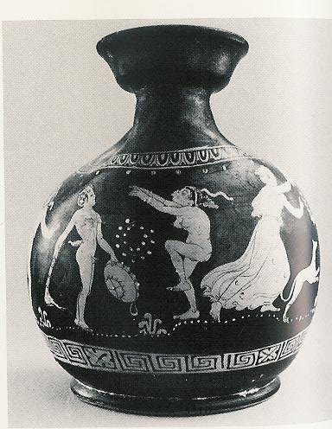
Askos: black woman dancing between a maenad and a satyr. 4th century BCE

Slide 11
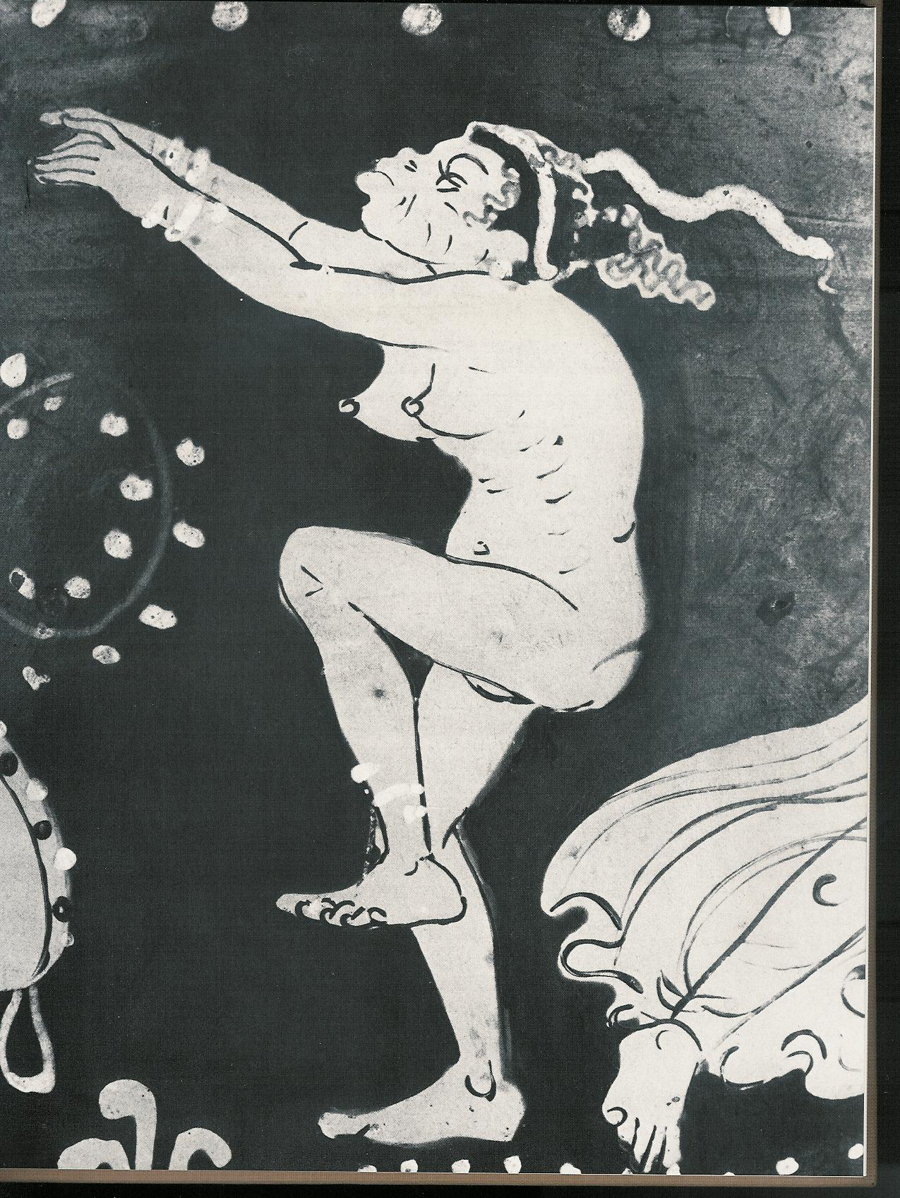
Detail of the black dancer

Slide 12
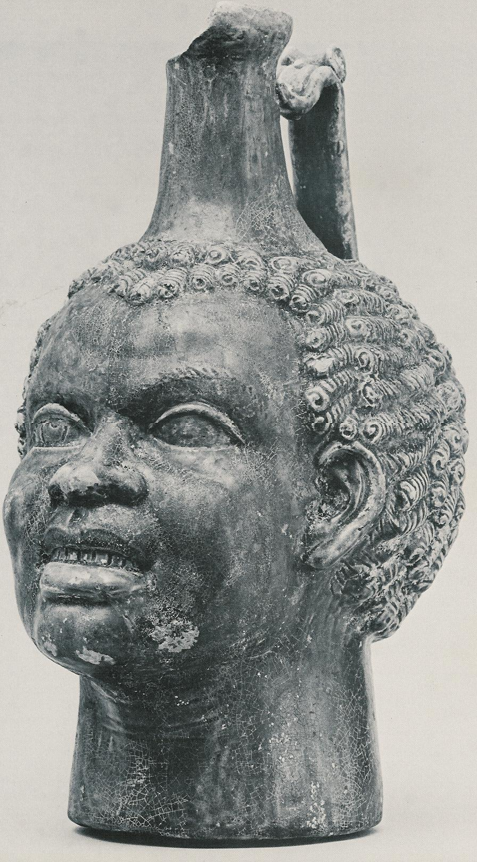
Terracotta Head.
2nd or 3rd century AD

Slide 13
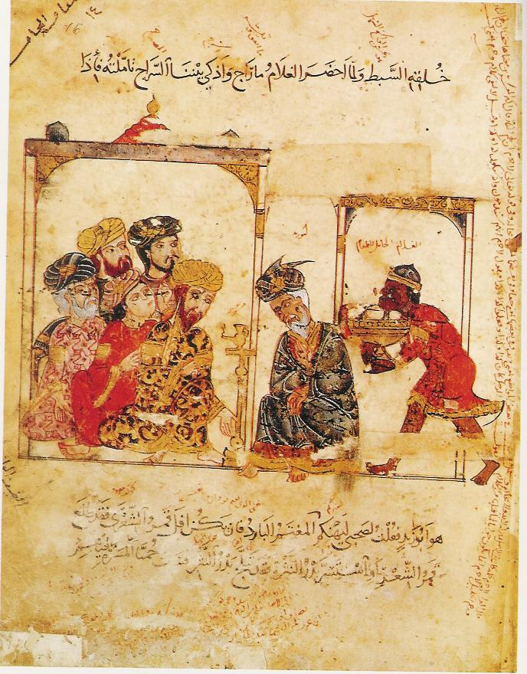
A slave bringing food. Probably Syria. 1222

Slide 14
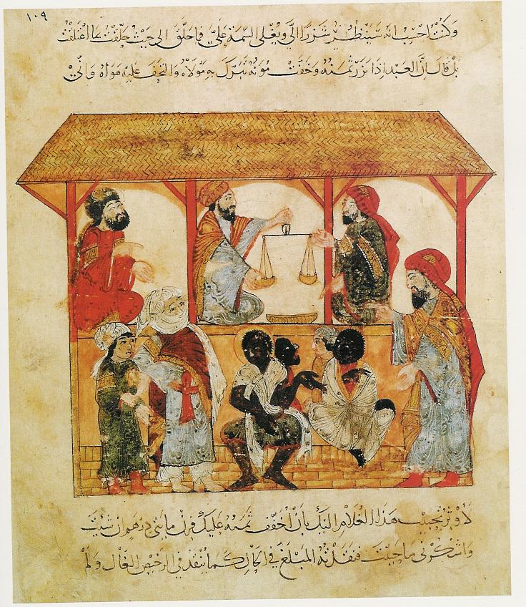
The slave market in Zabid, in the Yemen, 1237

Slide 15
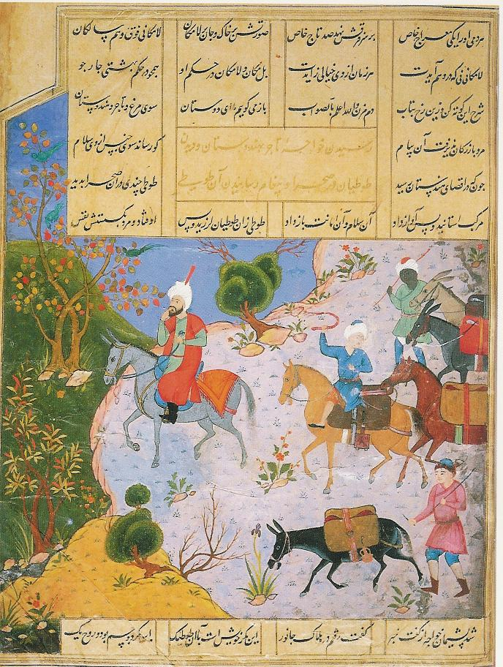
A merchant with attendants and packhorse drivers. Tabriz, Iran, c. 1530

Slide 16
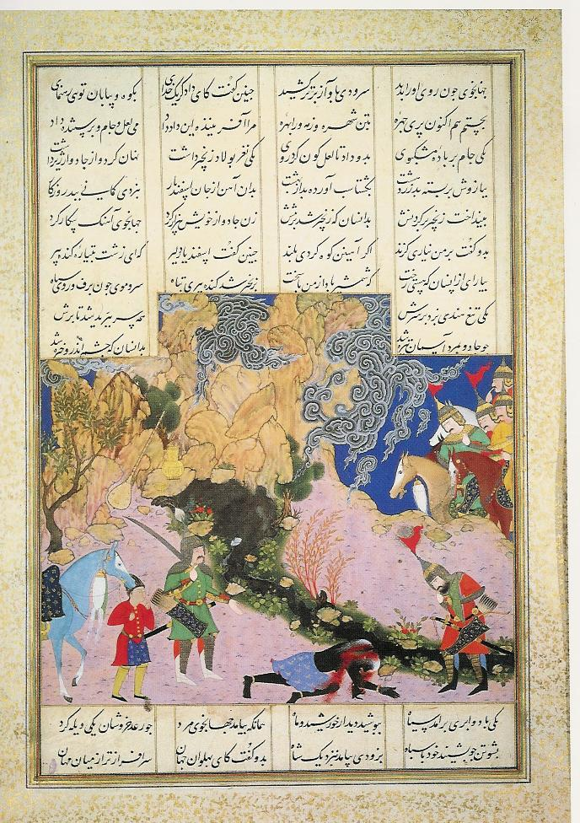
Persian hero (Isfandiyar) slaying the black sorceress. Iran. Early 16th century

Slide 17
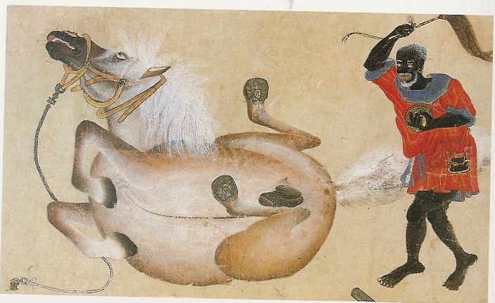
Magician. Istanbul. 15th century

Slide 18
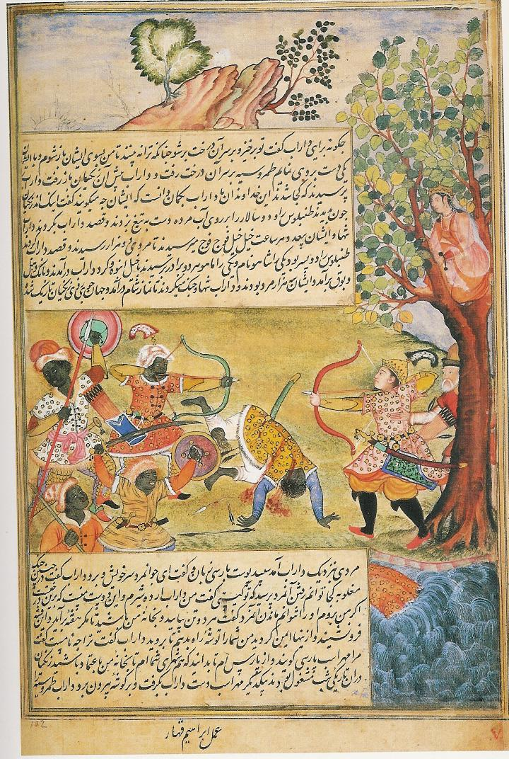
Persian hero fighting the Zanj (Bantu-speaking East Africans but sometimes black Africans in general). Mughal India. c. 1580-85

Slide 19
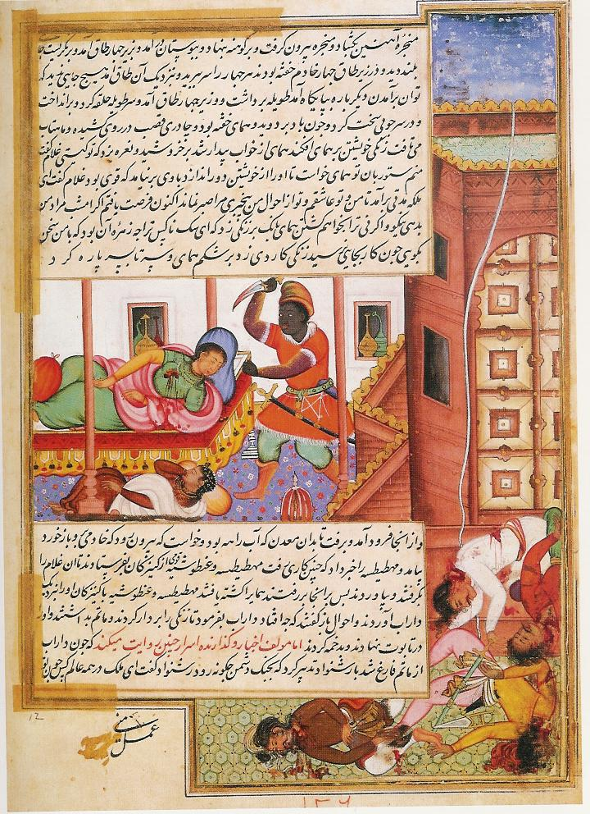
Groom murders his mistress. Mughal India. c.1580-85

Slide 20
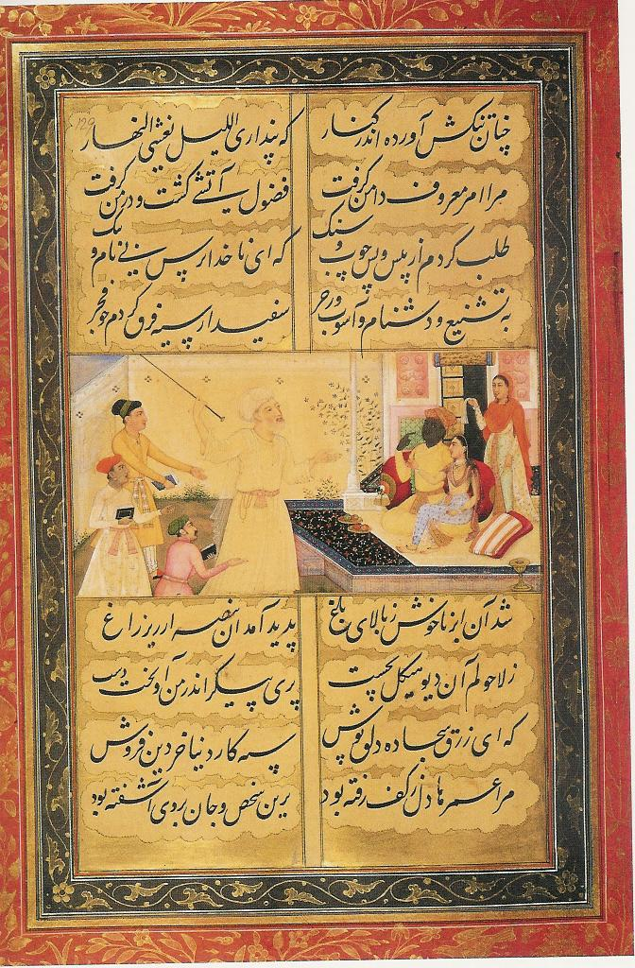
“The old man upbraids the Negro and the girl for flirting”
Mughal India.
1629

Slide 21
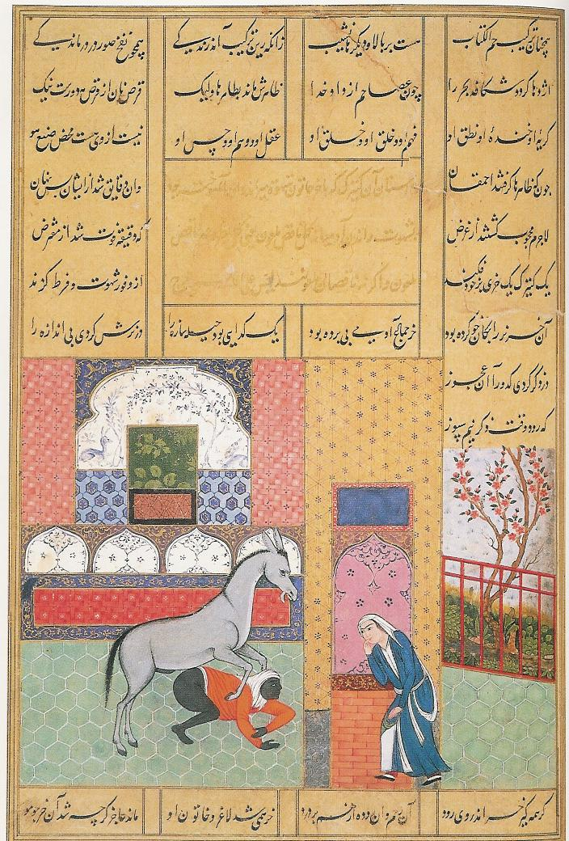
“The Woman who discovers her maidservant having improper relations with an ass.”
Tabriz, Iran. c. 1530

Slide 22
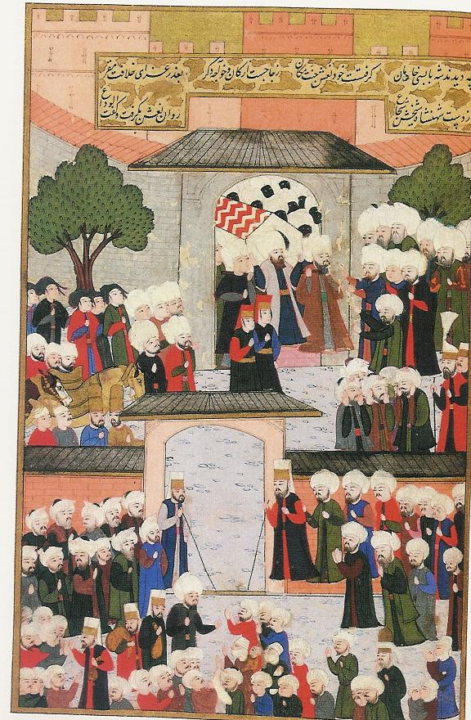
The funeral of the Sultan’s mother, with eunuchs in the background.
Istanbul, 1597

Slide 23
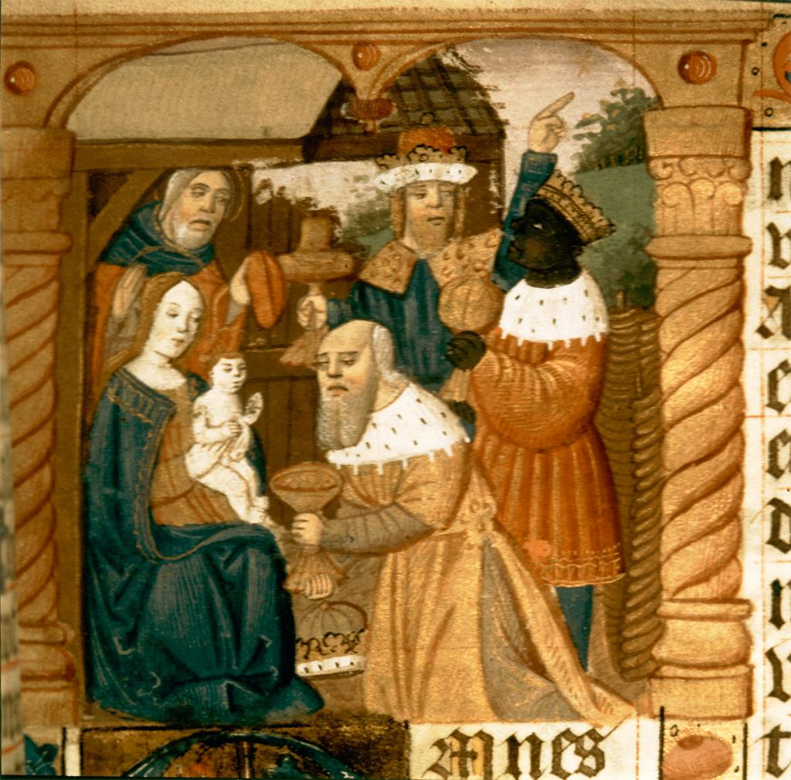
Illuminated Manuscript
Adoration of the Magi
France
15th century

Slide 24
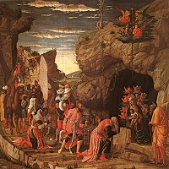
Andrea Mantegna, Adoration of the Magi, c. 1464

Slide 25
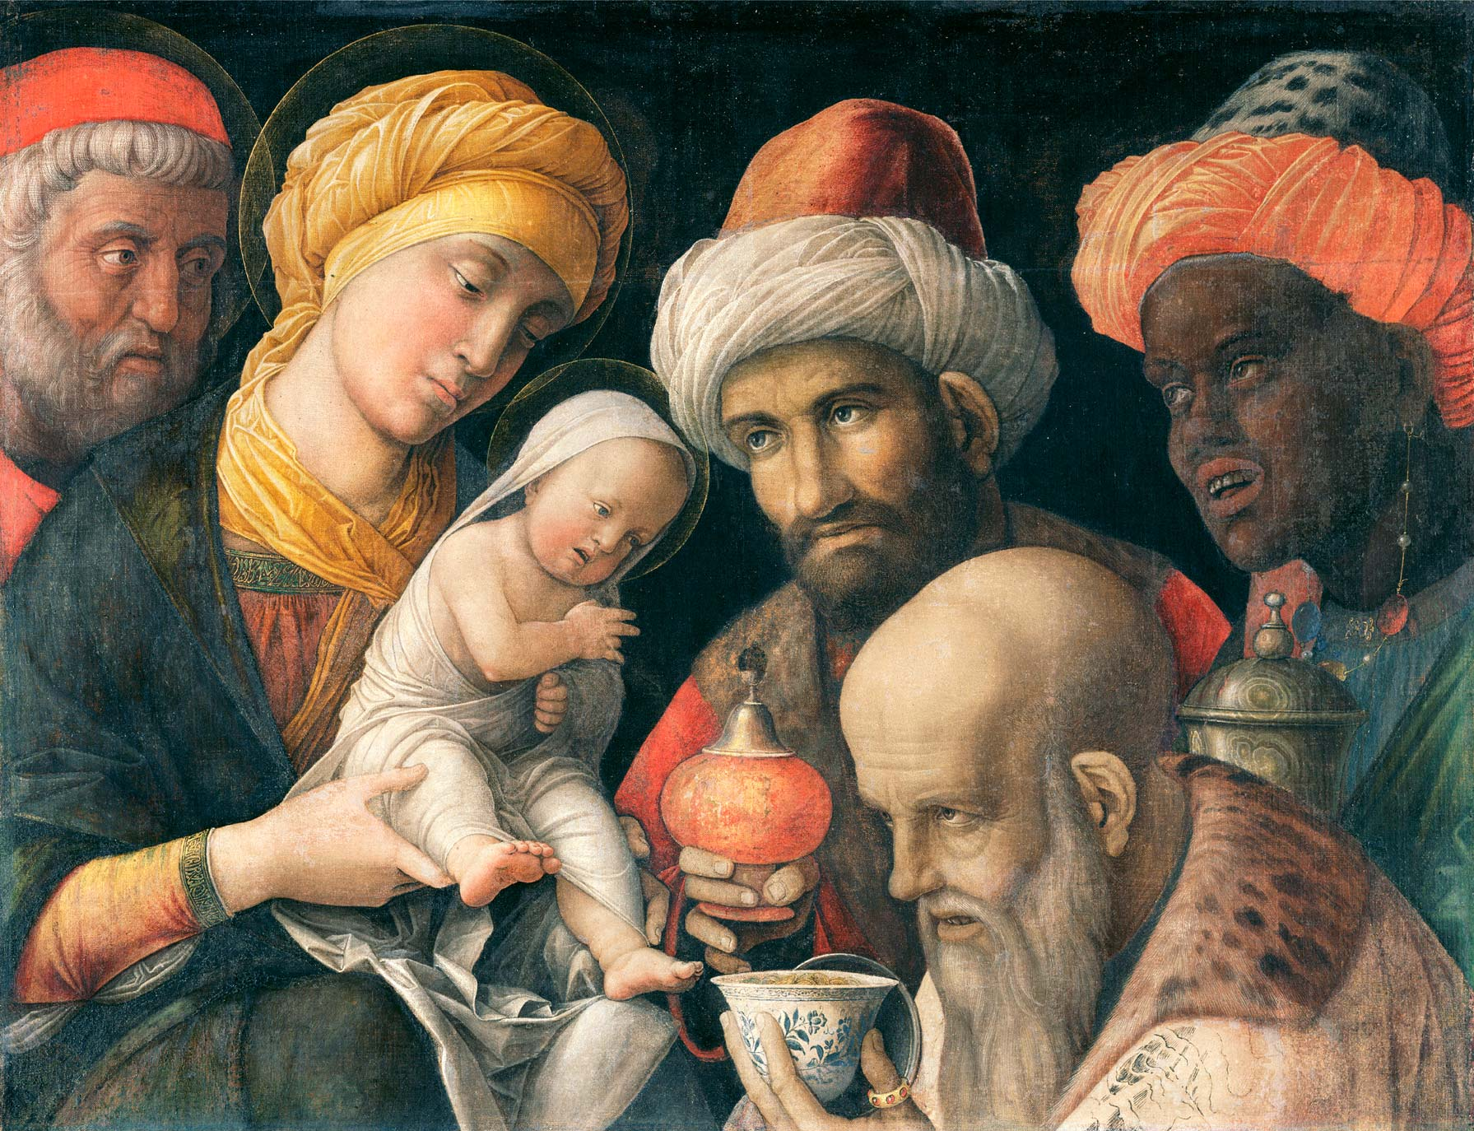
Andrea Mantegna, Adoration of the Magi, c. 1497-1500

Slide 26
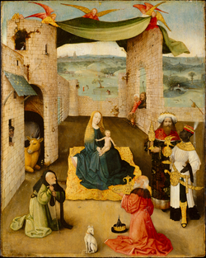
Hieronymus Bosch, Adoration of the Magi, c. 1470-75

Slide 27
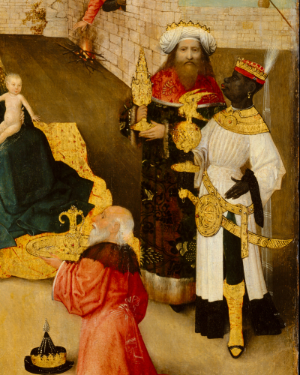
Close-up of Hieronymus Bosch, Adoration of the Magi, c. 1470-75

Slide 28
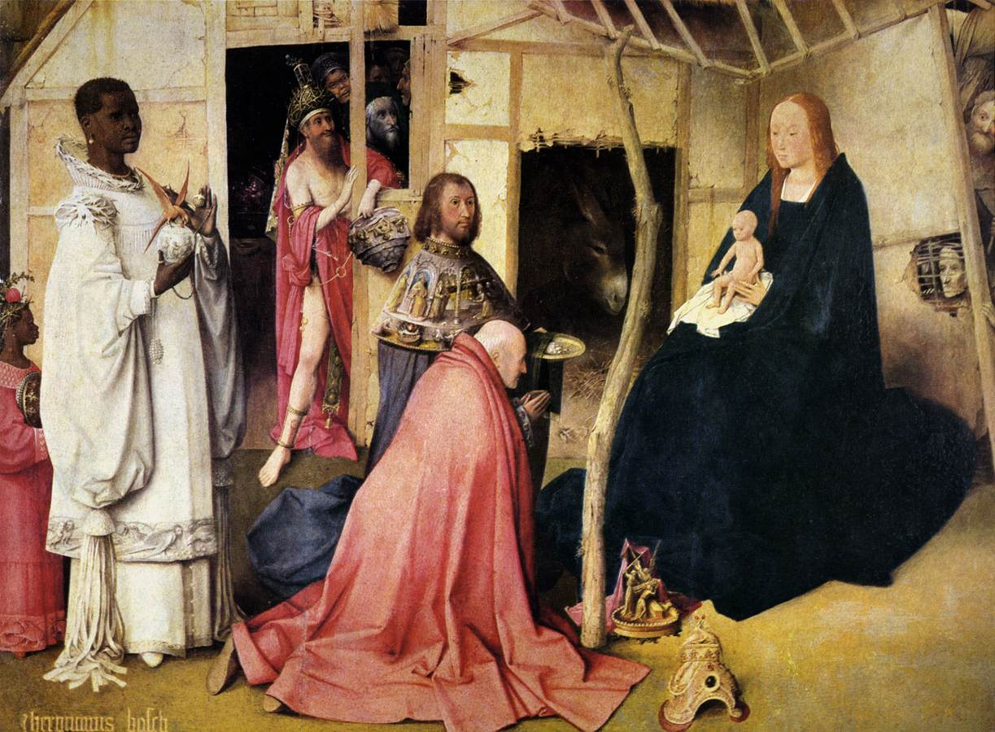
Hieronymous Bosch, Adoration of the Magi, c. 1490-1510
Notes:
Balthazar, black king or Magus, joining other two white Magi

Slide 29
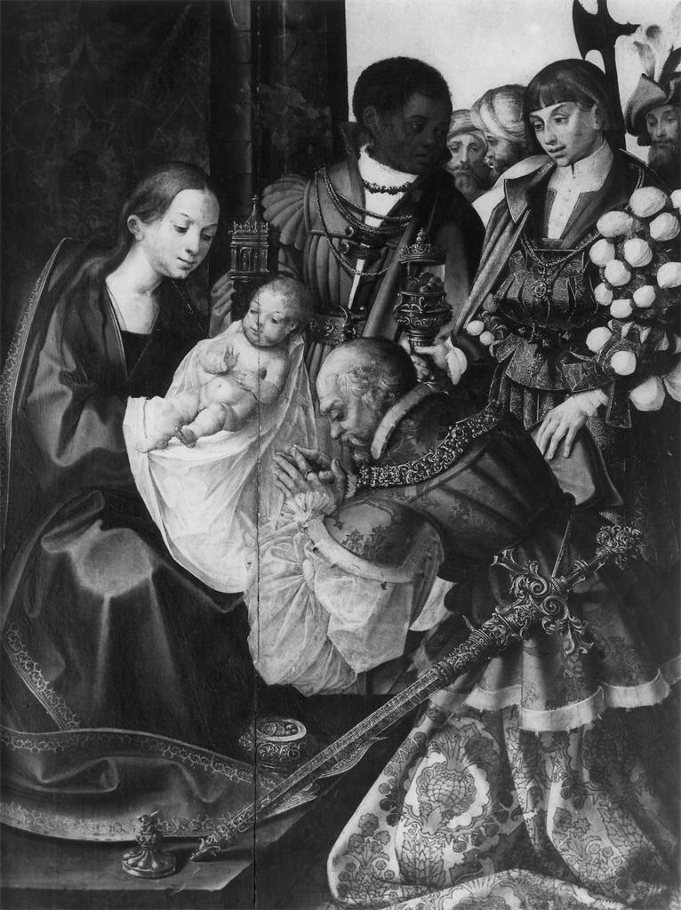
Gregorio Lopes, Adoration of the Magi
Portugal. early 16th century

Slide 30
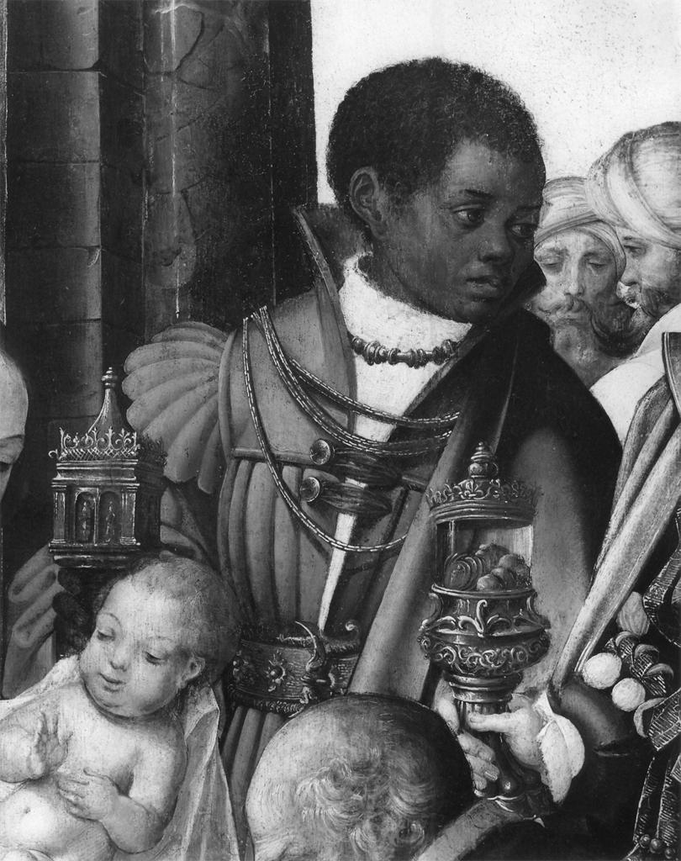
Close-up of Black King in Gregorio Lopes, Adoration of the Magi
Portugal. early 16th century

Slide 31
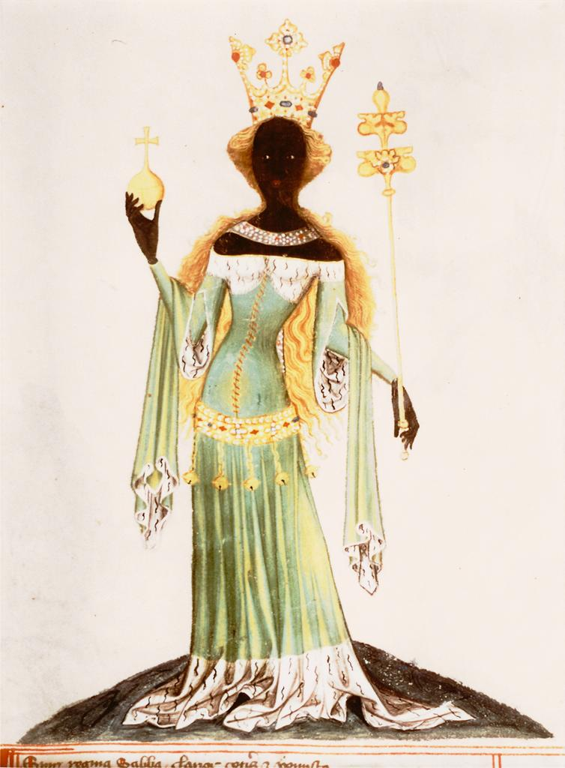
Illuminated manuscript
Bohemia early 15th century
Notes:
(Black Queen of Sheba with long flowing blond hair; skin painted by a later hand.)

Slide 32
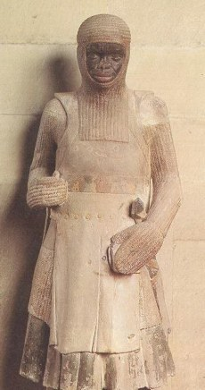
Saint Maurice, St. Mauritius Cathedral, Magdeburg, c. 1240-50

Slide 33
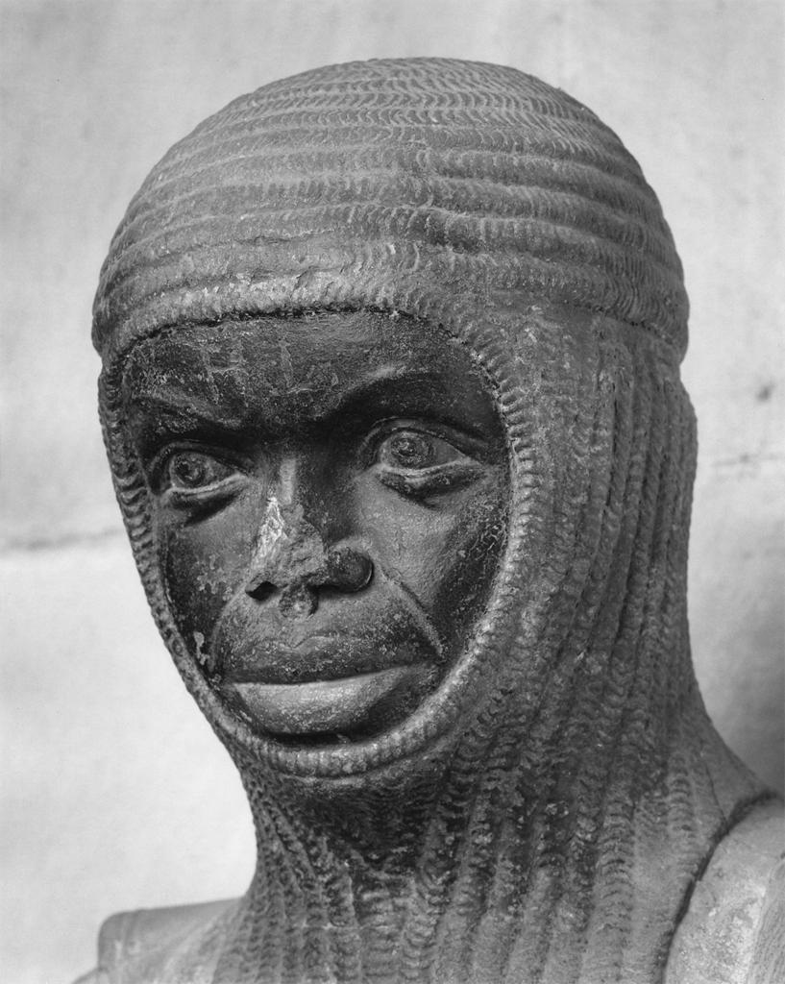
Detail of St. Maurice
Germany
13th century

Slide 34
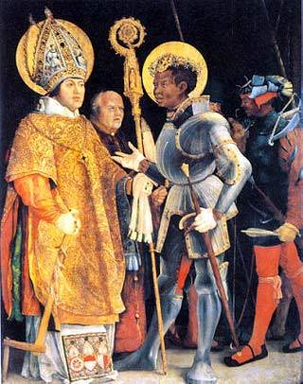
Matthias Grunewald, Meeting of Saint Erasmus and Saint Maurice, c. 1517-23

Slide 35
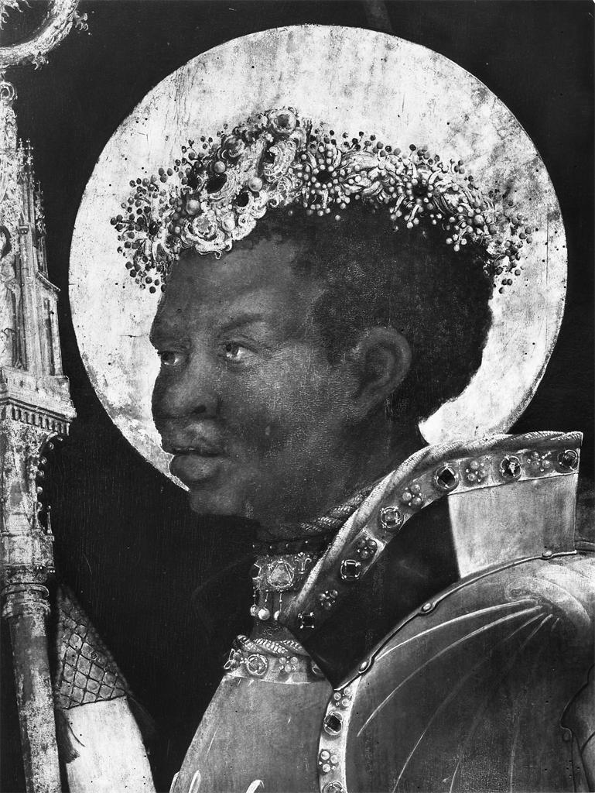
Close-up of St. Maurice in Matthias Grunewald, Meeting of Saint Erasmus and Saint Maurice, c. 1517-23

Slide 36
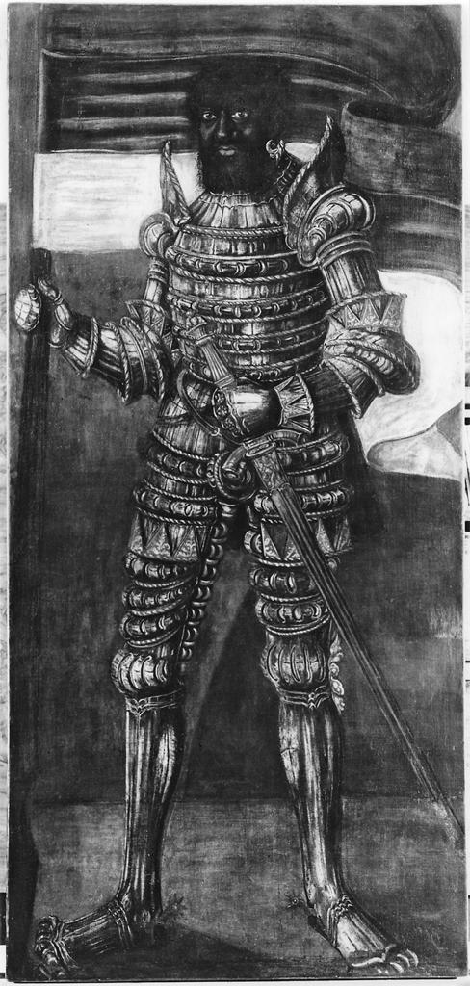
Hans Krell, a black knight holding a banner, perhaps St. Maurice
Germany
16th century
Notes:
Full-length figure of a black knight in elaborate armor holding a banner, representing Saint Maurice (?).

Slide 37
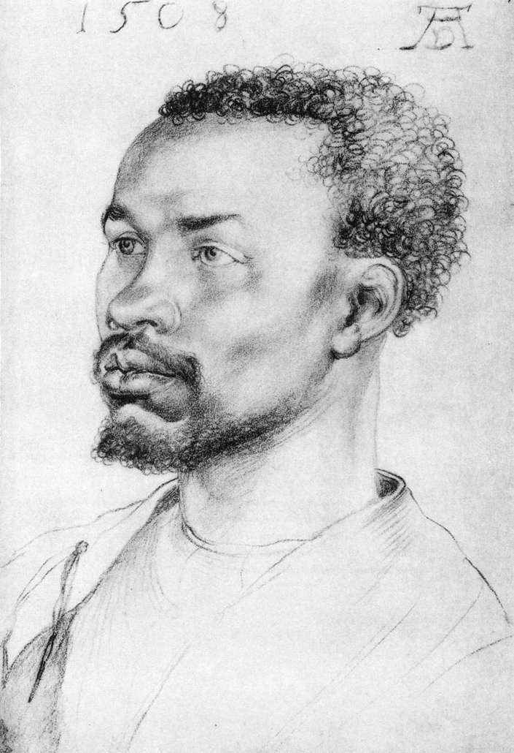
Albrecht Durer, Portrait of a “Negro,” 1508
Notes:
Portrait of a Negro was drawn during the Renaissance by the renowned German artist, Albrecht Dürer. The artist probably drew the picture from life, using as a model a man he encountered either while in Nuremberg or in Italy. Dignity, individuality.

Slide 38
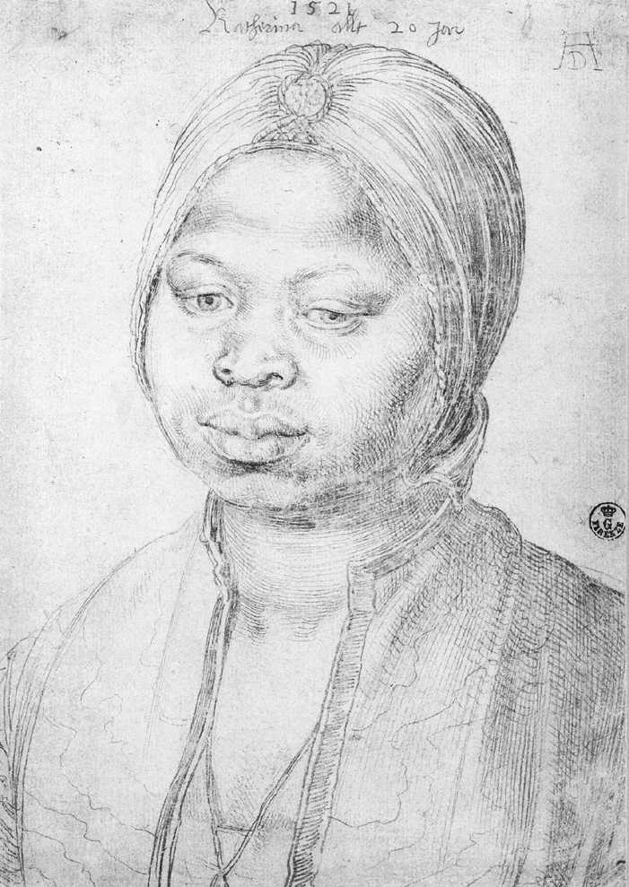
Albrecht Durer, Portrait of Katherina, 1521
Notes:
Because Durer was celebrated even during his lifetime and because he made notes during his sojourn in the Low Countries, we know the decisive moment when he became interested in a black person, individualized and named: the servingmaid of an agent of the King of Portugal. On the drawing he inscribed the name and age of the model. In 1521 Catherine was 20 years old. Wistful, lonely, melancholy, dignified look.

Slide 39
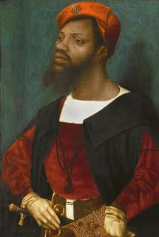
Jan Mostaert, Portrait of a Moor, c. 1525-30

Slide 40
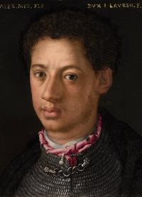
Workshop of Agnolo Bronzino, Portrait of Alessandro de’ Medici, after 1553

Slide 41
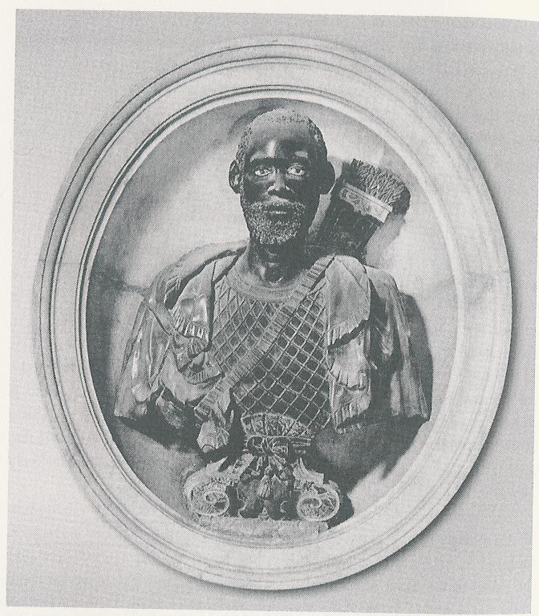
Francesco Caporale, Bust of Antonio Emanuele Funta called Nigrita, 1608

Slide 42
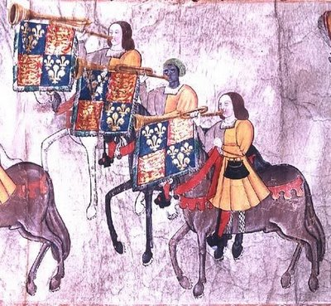
John Blanke, the Black Trumpet, 1511

Slide 43
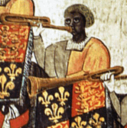
Close-up of John Blanke, the Black Trumpet, 1511

Slide 44
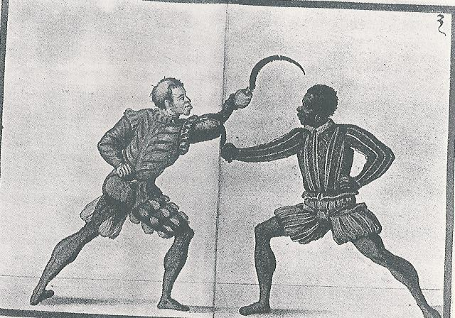
Jörg Breu the Younger, A Duel with Two Sickles, c. 1560

Slide 45
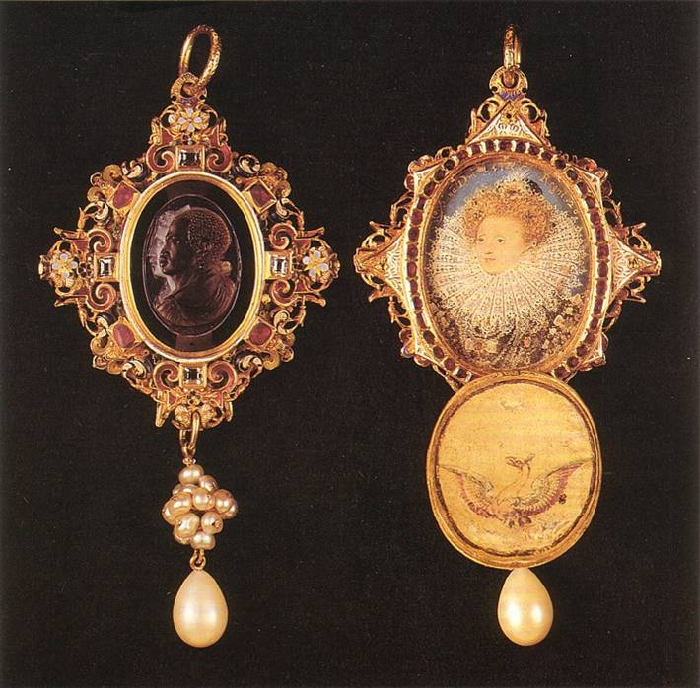
Drake Jewel, c. 1586-88
Notes:
Elizabeth’s gift to Sir Francis Drake is similarly evocative: one side is a locket with a portrait of the Queen by Nicholas Hilliard with a cover featuring on the interior her avian emblem, the phoenix. A miniature portrait was the single most frequent gift given by Elizabeth I to persons she would reward. It projected her image as monarch, equipped with state clothes and regalia and asserting a personal connection with the recipient as well as a political relationship. On another occasion Elizabeth I gave Drake a second miniature portrait, in which she stood at the focus of a sunburst, to use as a hat badge. That Drake, a commoner who rose to the position of state champion on the raid to Cadiz and Vice-Admiral of the Armada, was so honored marked his extraordinary place in the world.
More fascinating to present admirers of the Drake Jewel is the other side with the intaglio cut cameo of sardonyx featuring an African male bust in profile superimposed over the profile of a European. There is some debate whether the European is a regal woman or a Roman Briton of the sort William Camden was idealizing in his Britannia. It is not the face of any contemporary man—and certainly not Drake—for it is clean shaven. The symbolism here operates in two registers: a general imperial iconics in which the global range of imperium is figured in the equivalent faces of the African Emperor and the English Empress.
There is also a much more pointed symbolism meant particularly for Drake. The conjoint effort of Africa and the English will liberate the world from the power of Spain. Drake’s alliance with the Cimmarroons, runaway African slaves who intermarried with Natives, in Panama in 1576 led to his successful capture of the Spanish plate train crossing Panama. This act thrust Drake onto the world stage, secured him and the crown immense treasure, and gave the English forces in the Caribbean the character of liberators. In the West Indian invasion of 1585–1586, he planned to resurrect his alliance, as part of his design to assert English power in the Spanish main. It survived as one of the most potent scenes in the English imperial imagination, serving as the central action of the Sir William Davenant’s opera, “The History of Sir Francis Drake,” one of only two stage works permitted during the English Commonwealth, and a piece condoned personally by Oliver Cromwell, who also sought to liberate Spanish America from “tyranny & popery.” In the Americas Drake had learned the truth that Elizabeth I understood on the eastern side of the Atlantic—the defeat of Spain required a combination, and the hatred of tyranny brought together Anglo and African. Elizabeth’s cultivation of Mulay Ahmad al-Mansur (ruler of Morrocco from 1578–1603) in an alliance against their mutual enemy, Spain, was a diplomatic correlative to the martial alliance that Drake had forged in the jungles of the isthmus.

Slide 46
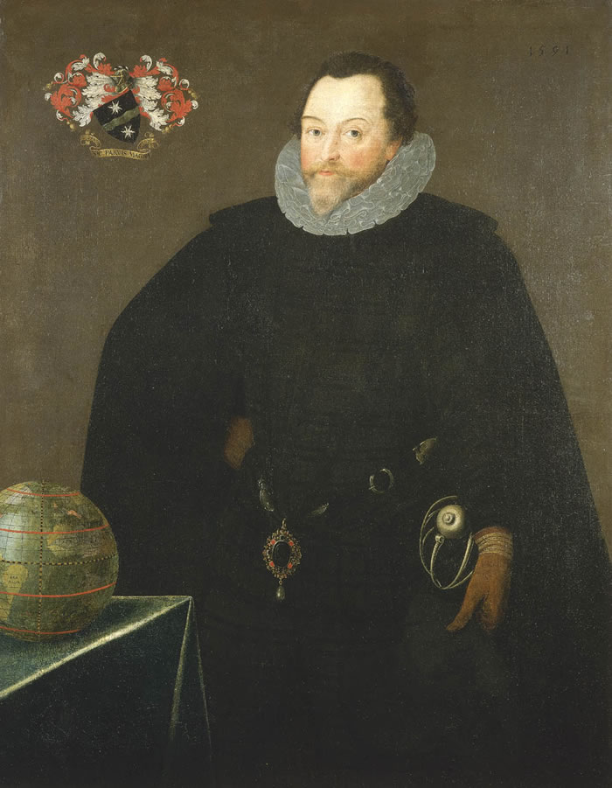
Marcus Gheeraerts the Younger, portrait of Francis Drake, 1591

Slide 47
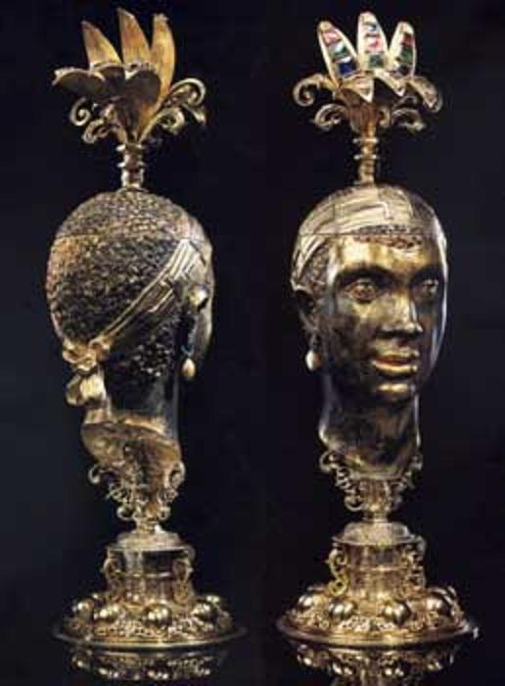
Christoph Jamnitzer, Moor’s Head, Nuremberg, c. 1600

Slide 48
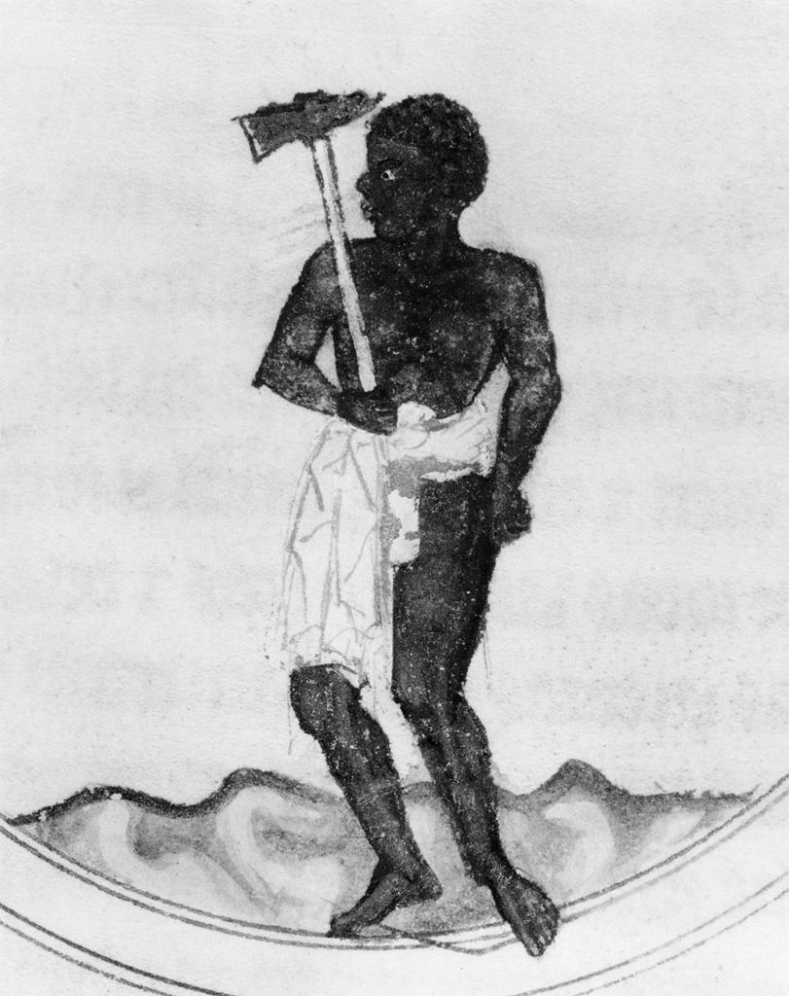
Illuminated manuscript
Spain
13th century
Notes:
Illumination. Lapidario of Alfonso X the Wise (1221--1284) (118 fols.), fol. 94v, left column: De la piedra que a nombre Sanguina. . . . (From the first side of the sign of the ram is the stone called Sanguina): Astrological symbol for the stone Sanguina. (In a circle, a black man in a short skirt, carrying a hammer, with a star above him.)

Slide 49
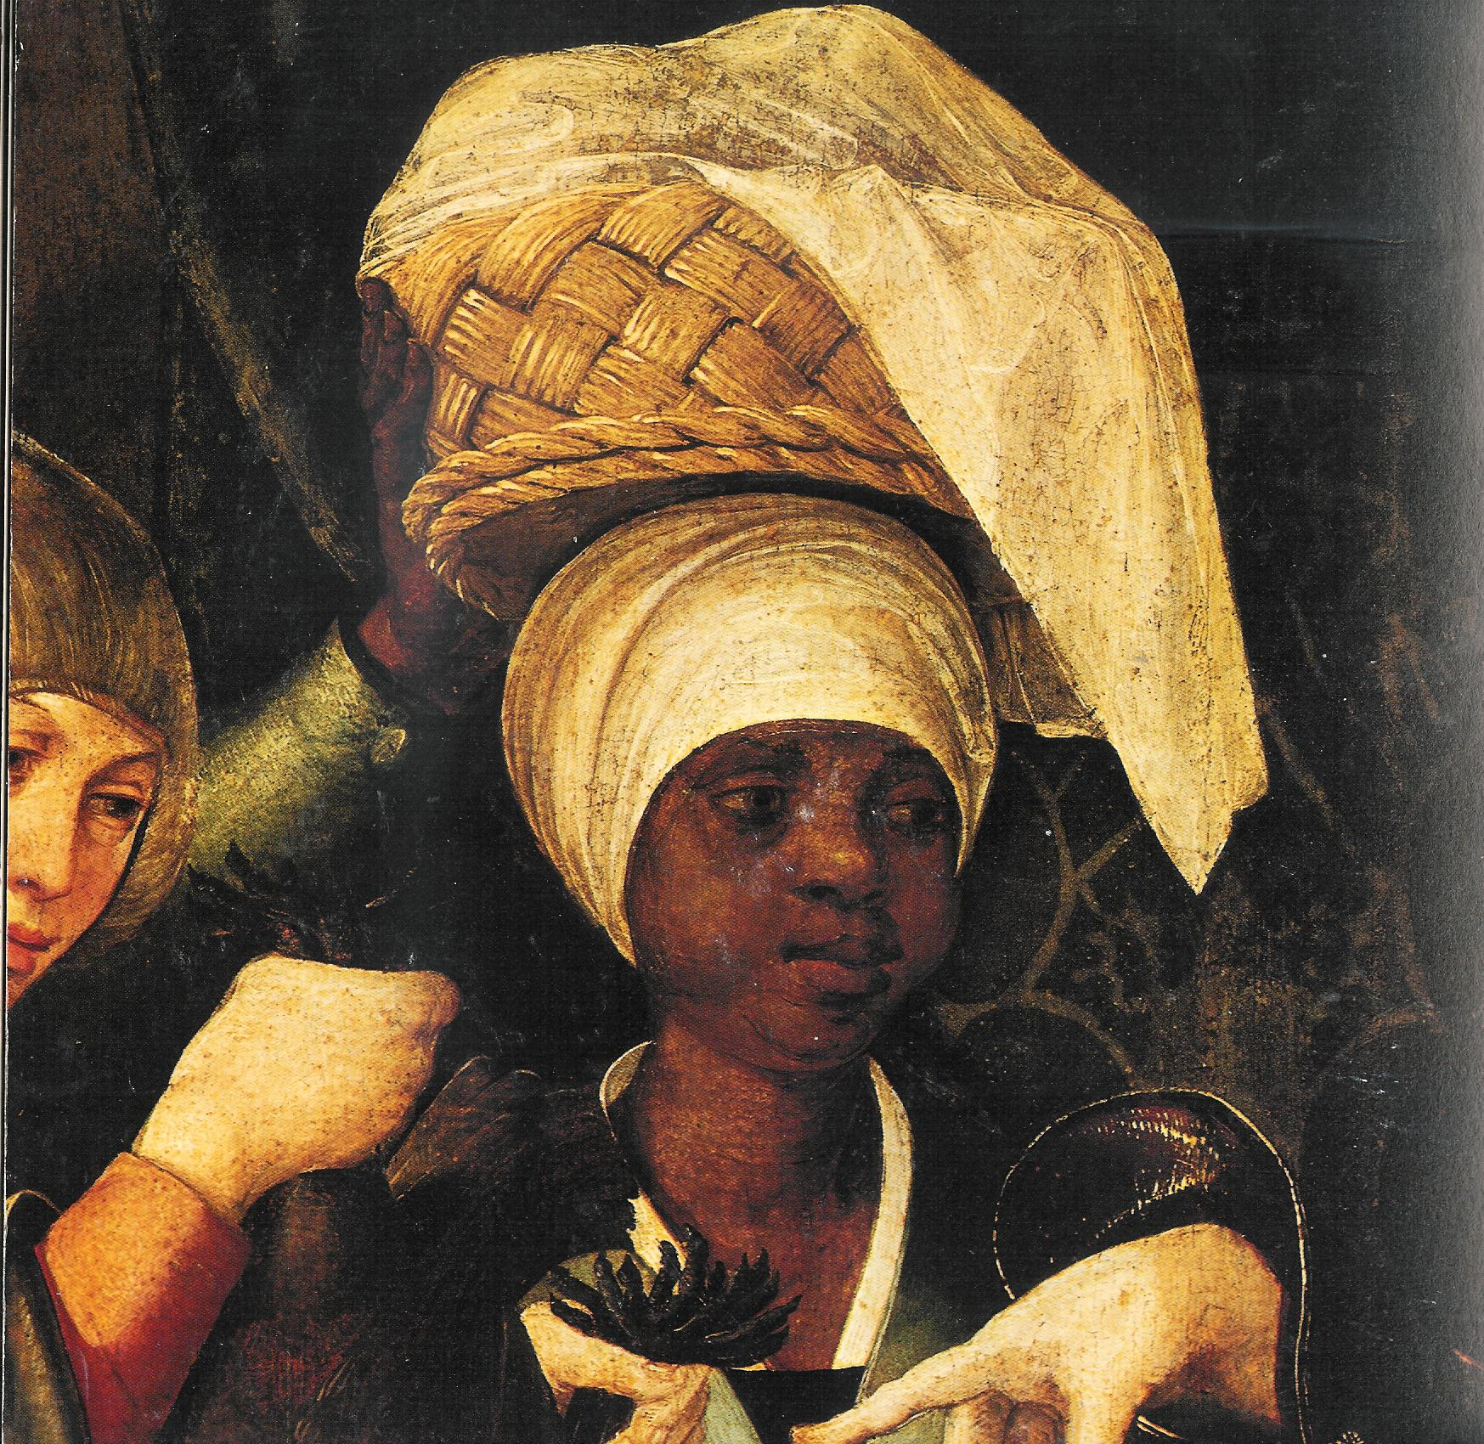
Workshop of Garcia Fernandes, The Birth of the Virgin (detail of black servant)
Lisbon early 16th century
Notes:
Black woman carrying a basket on her head.

Slide 50
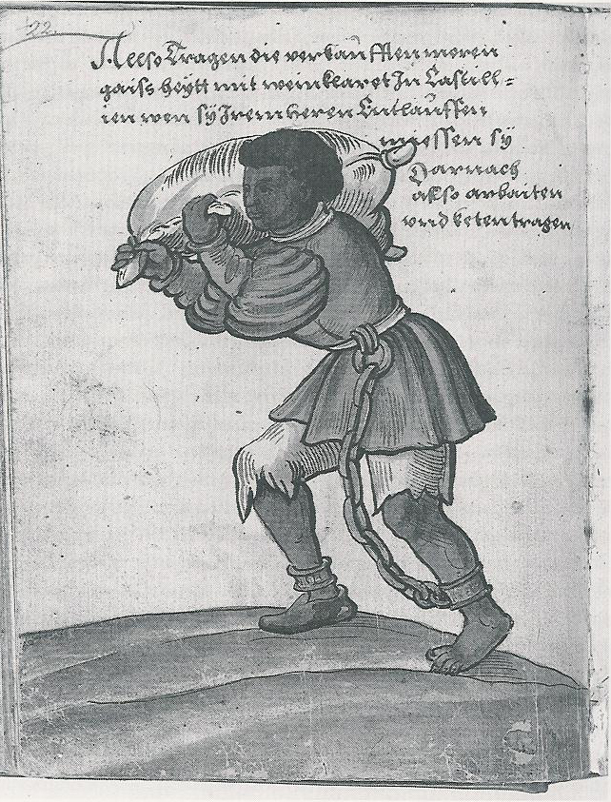
Christoph
Weiditz,
Black Slave
with a Wineskin
In Castile,
1529

Slide 51
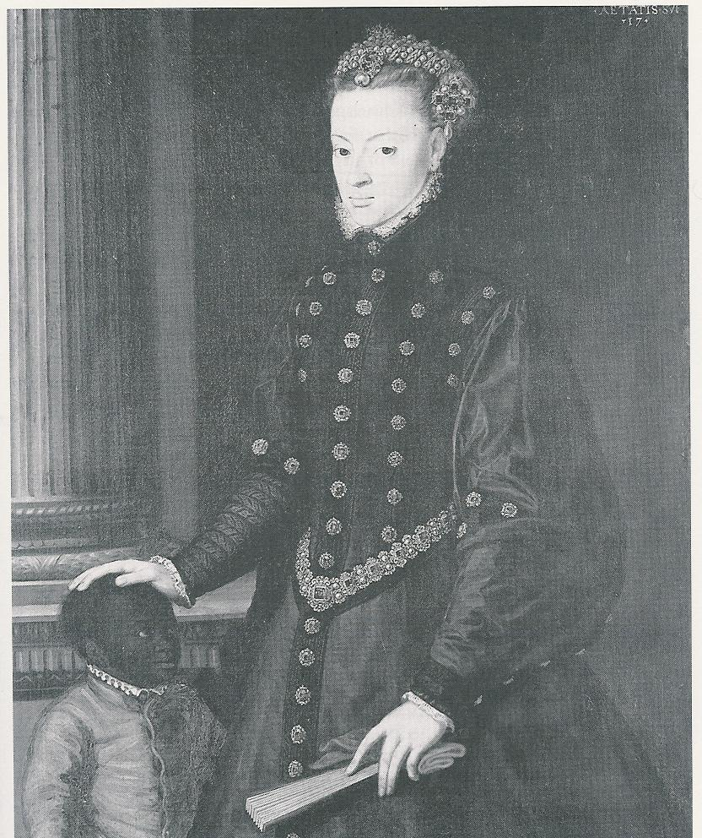
Cristóvão de Morais, Portrait of Juana de Austria with her Black Slave Girl, 1553

Slide 52

Isidro de Villoldo, The Miracle of the Black Leg, Spain, c.1539

Slide 53

AnonymousWood panel, Germany, 15th century, depicting the legend of “the Miracle of the Black Leg” featuring Sts Cosmas and Damian

Slide 54

Giotto in Padua, Flagellation, c. 1304-05

Slide 55

Andrea Briosco Riccio, Lamp, Italy, late 15th century
Notes:
Lamp in the form of the head of a black man, his mouth open and jutting forward to form a spout. Bronze.

Slide 56

Hans Burgkmair the elder,
Black Youth dressed in feather costume
Germany early 16th century
Notes:
Black youth dressed in feather costume with ax and shrunken head

Slide 57

Early Atlantic
Slave Trade to Western Europe and Atlantic Islands, primarily 15th-17th centuries

Slide 58

Anonymous, Alfama District, Lisbon, c.1560-80

Slide 59

Anonymous, Alfama District, Lisbon, c.1560-80
(black African being arrested—left side)

Slide 60

Anonymous, Alfama District, Lisbon, c.1560-80
(African/European dancing—right side)

Slide 61




Anonymous, Alfama District, Lisbon, c.1560-80
(Head-carrying figures—one central; others picked at random)

Slide 62

Anonymous, Alfama District, Lisbon, c.1560-80
(black cavalier--right side)
Notes:
Attributed to Cristovao de Figuerido and Garcia Fernandes, “The Santa Auta Retable: The Encounter of Prince Conan and St. Ursula” (detail with black musicians).

Slide 63

Anonymous, Alfama District, Lisbon, c.1560-80
(boat scene—black oarsman and musician—front center)

Slide 64
Anonymous, Alfama District, Lisbon, c.1560-80

Slide 65

The Mediterranean World, c. 1600

Slide 66

The Corsair City of Algiers

Slide 67

The Moorish ambassador to Queen Elizabeth I, 1600.

Slide 68

A Moroccan corsair ship and some captives

Slide 69

Spanish Man-of-War Engaging Barbary Corsairs, 1615

Slide 70

Lorenzo A. Castro, Seapiece: A Fight with Barbary Corsairs, late 17th century

Slide 71

An English Ship in action with Barbary Corsairs, c. 1680
Notes:
An action between an English two-decker and a Barbary two-decker, showing three small ships and four galleys. Although naval historians are unable to relate the action to a specific event, the painting significantly identifies the danger to English ships from such pirates during the 1660s and 70s and was initially thought to show the 'Kingfisher' in action in 1681. In the left foreground is an English two-decker, in starboard-bow view, with a light breeze from the port bow, firing guns on both sides. She flies a Union jack and a red ensign, and a pendant with the cross of St George at the main. In the middle-distance a little to the right is a Barbary two-decker, viewed from the port bow, on fire amidships and flying a dark flag at the main. Black smoke from the burning Barbary ship covers most of the left half of the painting. In the right foreground there is a galley sinking with only the forepart and the foremast showing, and a broad red pendant flying at the masthead. A galley or possibly some other lateen-rigged vessel is visible behind this, showing only the after part in starboard quarter view, including the after mast and its lateen sail. On the right the masts of one or two ships can be seen above the smoke.
The artist was the younger son of Willem van de Velde the Elder. Born in Leiden, he studied under Simon de Vlieger in Weesp and in 1652 moved back to Amsterdam. There he worked in his father's studio and developed the skill of carefully drawing and painting ships in tranquil settings. He changed his subject matter, however, when he came with his father to England in 1672, by working on views of royal yachts, men-of-war and on storm scenes. From 1672 the depiction of sea battles from the English side became a priority but unlike his father's they were not usually eyewitness accounts. However, from early 1674 both the van de Veldes were expressly patronized by Charles II for this purpose, the father to draw sea fights and the son - who was by far the more more accomplished painter - 'for putting the said Draughts into Colours'. After his father's death in 1693 he was officially engaged to be present at and record significant maritime events. He continued to run a substantial and influential studio until his own death and with his father, especially as a painter, he is regarded as founder of the English school of marine painting.

Slide 72

The frontispiece of John Ogilby’s Africa (London, 1670)

Slide 73

Slaves being disembarked in Algiers, from Pierre Dan, Historie van Barbaryen en des zelfs Zee-Rovers (Amsterdam, 1684)

Slide 74

White slaves being unloaded at Algiers, c. 1700

Slide 75

British Captives in Morocco, from Thomas Troughton, Barbarian Cruelty . . .(London, 1751)

Slide 76

Slaves to market in Algiers, 1684

Slide 77

Examining Slaves in the market, Algiers, 1684

Slide 78

Selling Slaves, 1684

Slide 79

Slaves in chains, 1684

Slide 80

“Turkish” Power and Cruelty: frontispiece to William Okeley’s captivity narrative, 1675

Slide 81

Slave Punishment, 1684

Slide 82

Beating slaves,
1684

Slide 83

Procession of freed slaves, 1684

Slide 84

Migration of Sugar Cultivation

Slide 85

The Caribbean

Slide 86

Taínos panning for Gold, Hispaniola, early 16th century, under encomienda system

Slide 87

Map of Brazil, Miller Atlas, 1519

Slide 88

Close-up on Brazilwood logging

Slide 89

Tupinamba cutting brazilwood

Slide 90

An Indian Worker. Tupí Woman and Child,
Albert Eckhout, c.1641
(note plantation house in the background)

Slide 91

Slave Trade out of Africa, 1500-1900

