Slide 1
PROGRESSIVE REFORM IN COMPARATIVE PERSPECTIVE

Slide 2

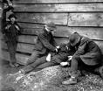
1. ECONOMIC JUSTICE--LABOR AND WAGE ISSUES as well as regulation of business

Slide 3
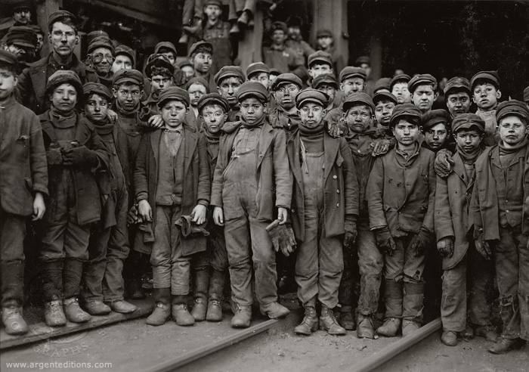

Slide 4
Settlement Houses
Jane Addams-Chicago
Lillian Wald-New York
Vida Scudder-Boston

Slide 5

PROGRESSIVES EXPOSE CHILD LABOR
NATIONAL CHILD LABOR COMMITTEE HIRES LEWIS HINE

Slide 6
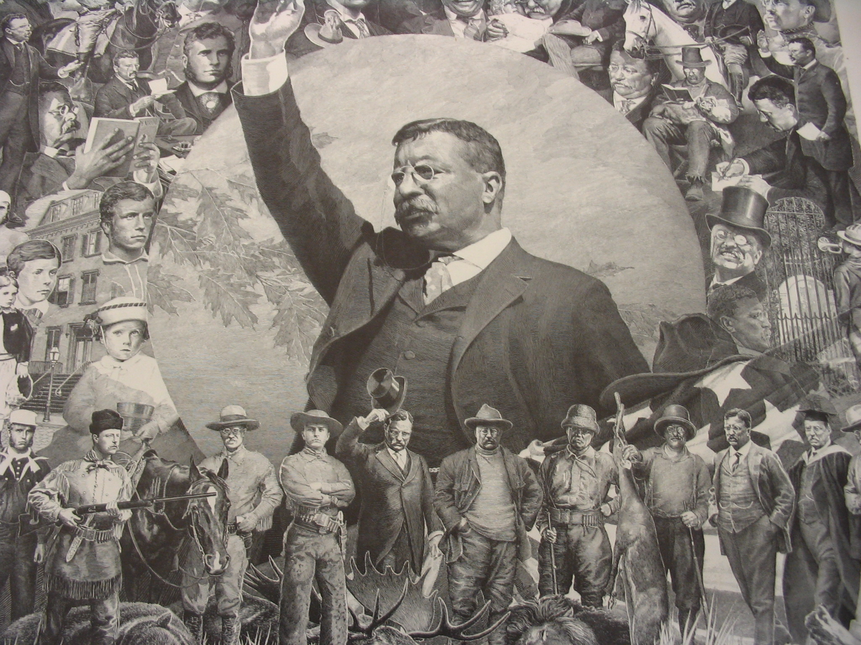
THEODORE ROOSEVELT 1901-1909

Slide 7
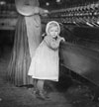
CHILD LABOR REFORM
DOCUMENT EXISTENCE OF WIDESPREAD EMPLOYMENT OF CHILDREN
CHILDREN HURT IN FACTORIES AND COAL MINES
BAN CHILD LABOR

Slide 8

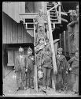
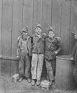
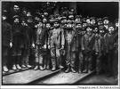
Congress refuses to stop child labor in 1906

Slide 9

U.S. PROTECTIVE LABOR LAWS
STATE LAWS LIMITING THE HOURS THAT WOMEN COULD WORK
COURTS OVERRULE MOST LEGISLATION “LIBERTY OF CONTRACT”

Slide 10



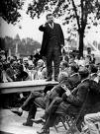
WOMEN’S TRADE UNION LEAGUE

Slide 11
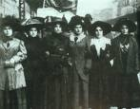
Women Workers from the International Ladies Garment Workers Union

Slide 12
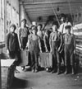
AMERICAN PROGRESSIVES DEFEND THE RIGHT OF WORKERS TO UNIONIZE
TR AND ANTHRACITE COAL STRIKE
1902

Slide 13
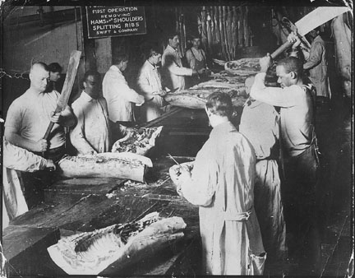

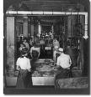

PROGRESSIVES DISCOVER MEAT PACKING PLANTS ARE UNHEALTHY

Slide 14

PROGRESSIVES EXPOSE DIRT IN FOOD MANUFACTURING
UPTON SINCLAIR,
THE JUNGLE
GENERAL FEDERAL OF WOMEN’S CLUBS SHOCK CONGRESS WITH IMPURE FOOD DISPLAY
TR LOBBIES FOR PURE FOOD AND DRUG ACT 1906

Slide 15
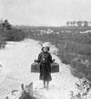
PROGRESSIVE PUBLIC HEALTH INNOVATIONS
PATENT MEDICINE POISONOUS
COCAINE IN MEDICINE
IODINE IN SALT

Slide 16

2. Reviving Democracy--CIVIC AND STATE REFORM
GOVERNOR
LAFOLLETTE
SCIENTIFIC RR RATES
Reform mayors
Good government groups fight bosses and machines

Slide 17
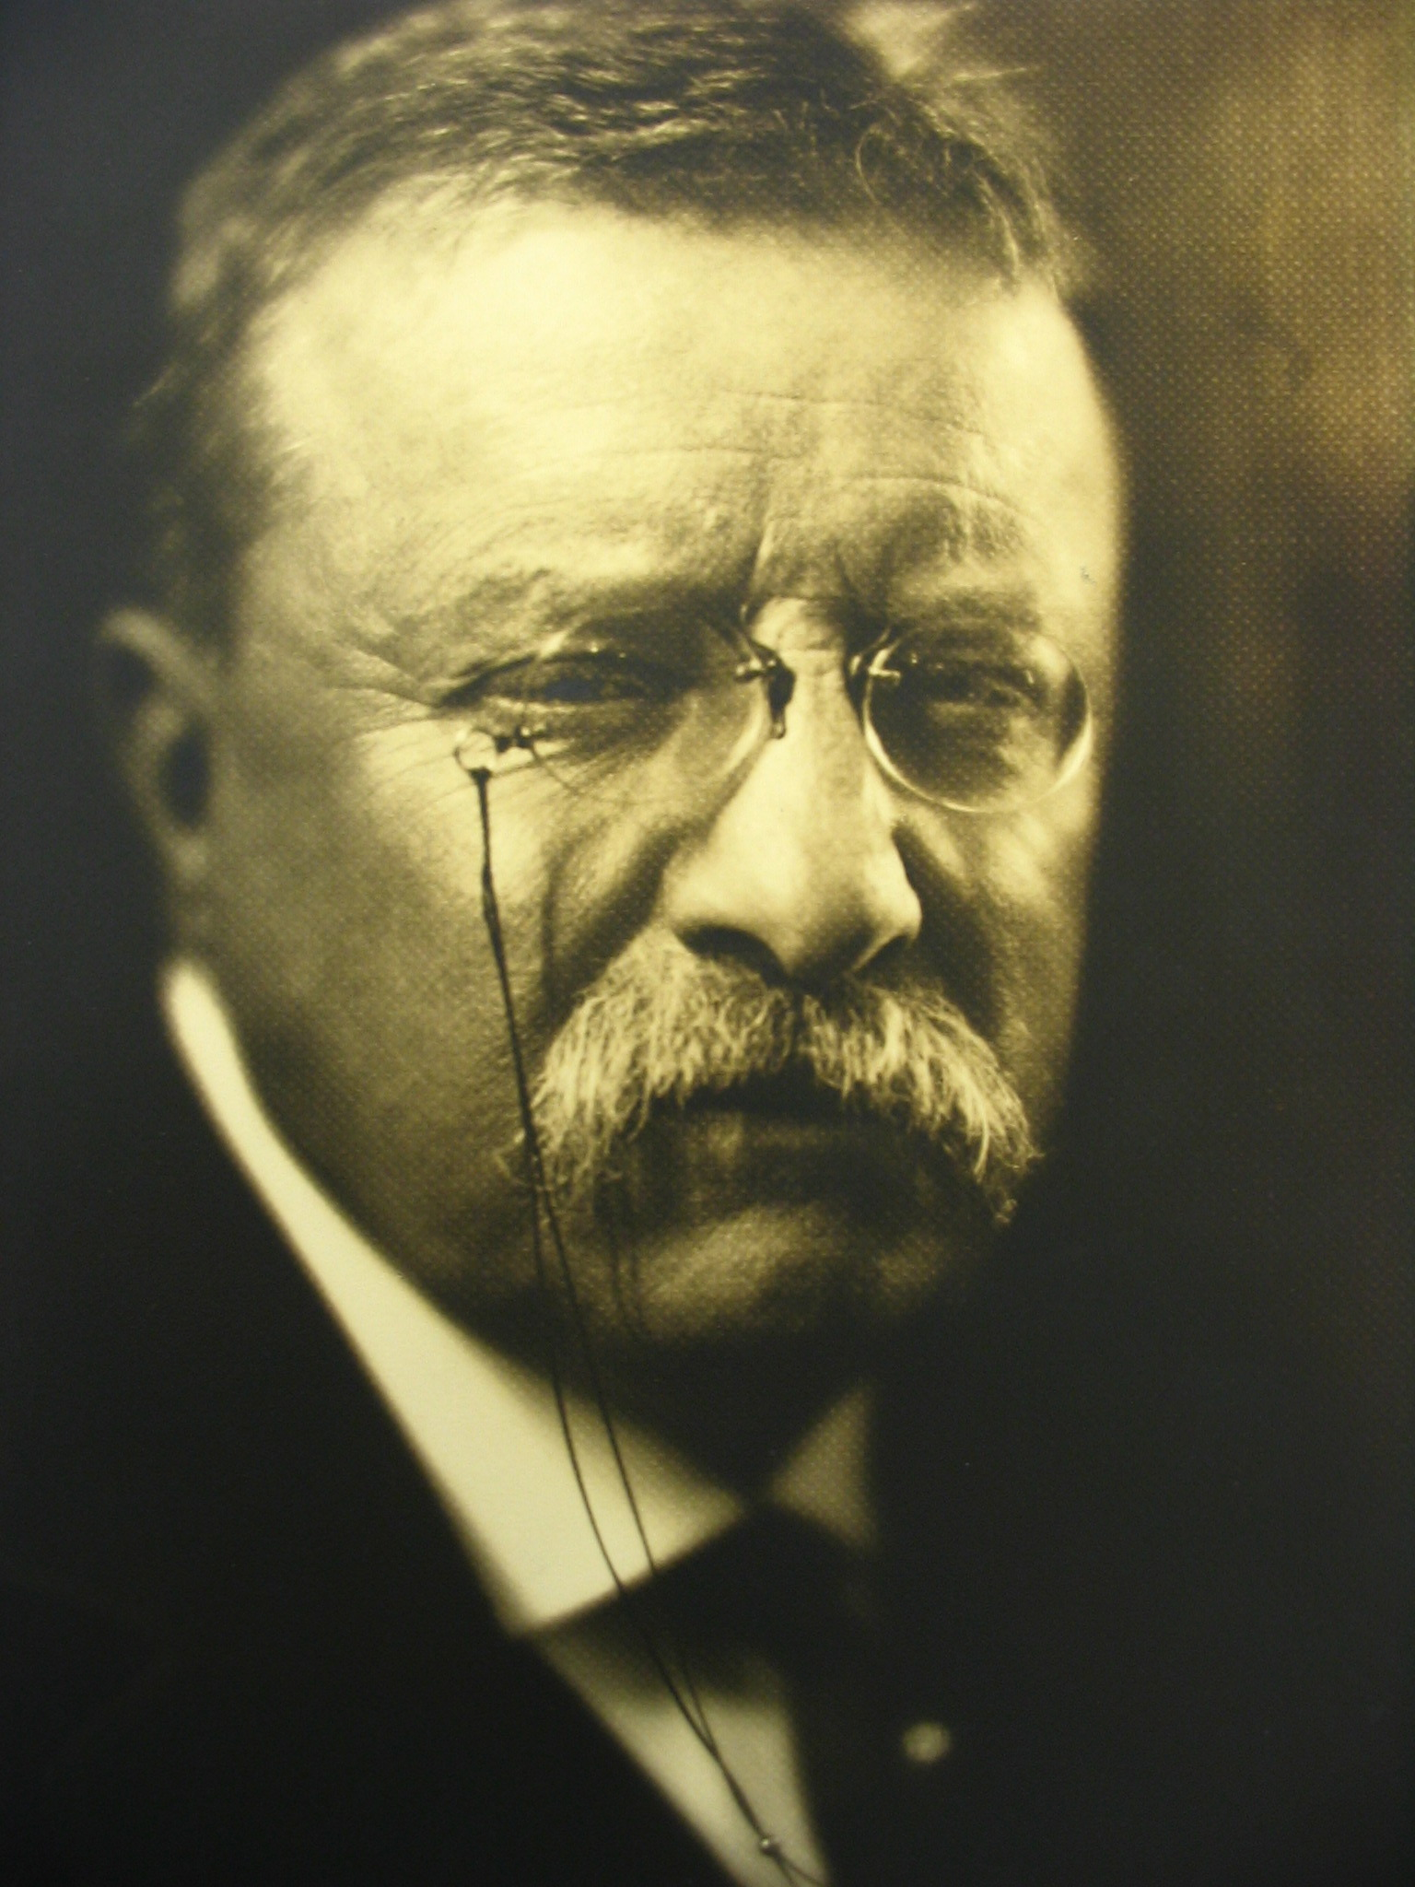
REVIVE PARTICIPATORY DEMOCRACY

Slide 18
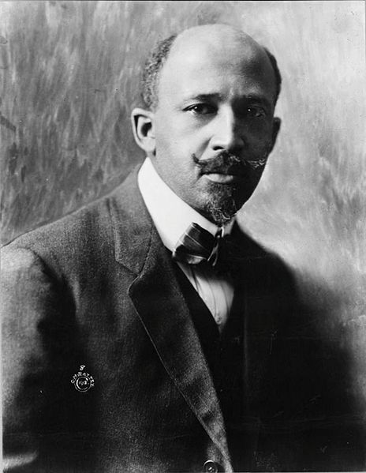
HOW INCLUSIVE SHOULD DEMOCRACY BE?

Slide 19
SUFFRAGE FINDS NEW ALLIES AND TACTICS

Slide 20
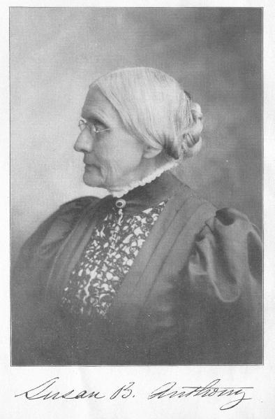
SUFFRAGE MOVEMENT STARTED LONG BEFORE PROGRESSIVE ERA
Anthony Amendment--federal vs. state campaigns?
Women’s political networks worked on a variety of issues
SUFFRAGE MOVEMENT STALLED UNTIL
PROGRESSIVE MOVEMENT AT ITS HEIGHT

Slide 21



3. CONSERVATION

Slide 22
4. Moral Reform
White slavery
Temperance
Banning of movies and books

Slide 23
The Varied REFORM GOALS for America’s Progressives
5. THE CREATION OF A WELFARE STATE TO PROTECT THE MOST VULNERABLE MEMBERS OF SOCIETY

Slide 24
PROGRESSIVE PARTY
1912
1. 8 HOUR DAY
2. 6 DAY WEEK
3. ABOLITION OF TENEMENT MANUFACTURE
4. IMPROVED HOUSING
5. BAN CHILD LABOR
6. CONSERVATION
7. 2 BATTLESHIP PER YEAR DEFENSE
8. FEDERAL SYSTEM OF OLD-AGE, ACCIDENT, HEALTH, UNEMPLOYMENT INSURANCE (WELFARE STATE)
9. SUFFRAGE

Slide 25
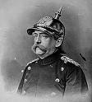
In Germany--Bismarck’s reforms were designed
to thwart socialism and “to
reconcile the working
classes to the authority of the state.”
OLD AGE PENSIONS
Workers’ compensation
Some disability benefits

Slide 26
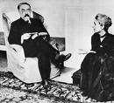

British Welfare State Ideas
Poor laws, mutual and friendly societies provide aid, People’s Budget-old age pensions, unemployment benefits and aid to sick
Great War--Labour Party National Minimums--some public ownership, minimum standard of living for all
1940s-more systematic start of NHS, welfare, and old age pension

Slide 27
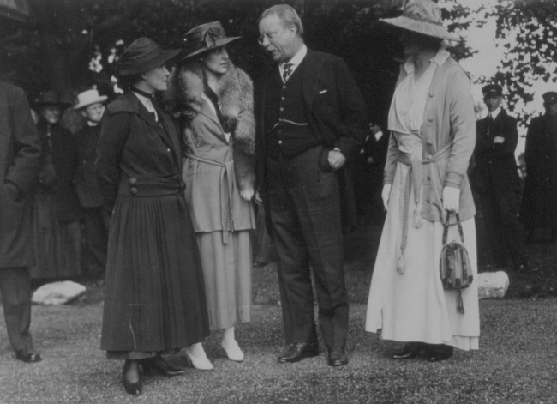

Slide 28
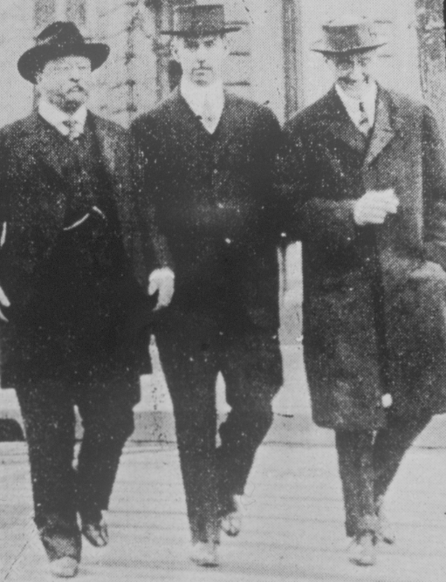

Slide 29

PROGRESSIVE ERA EMPLOYERS, LEGISLATURES, AND COURTS BLOCKED:
1. SHORTER HOURS
2. MINIMUM WAGES
3. UNEMPLOYMENT INSURANCE
SOCIAL SECURITY OR OLD AGE PENSIONS

Slide 30
AMERICAN PROGRESSIVE ACCOMPLISHMENTS BEFORE 1925
1. Cleaner city government
2. Parks, playgrounds, recreation expanded
3. Labor unions gained a foothold
4. Prohibition and suffrage in WWI
5. Trust-busting--business regulated
6. Pure Food and Drug Act
7.PRIMARIES, DIRECT ELECTION OF SENATORS, INITIATIVE, REFERENDUM
8. Aid to Minimum wage and pension movements and maternalism--Shepard-Towner Act
9. Under Wilson--Clayton Anti-trust Act, Federal Reserve Act, Federal Trade Commission

Slide 31
FRANCES PERKINS
FROM TRIANGLE SHIRTWAIST FIRE COMMISSION
FACTORY REGULATION
NEW YORK POLITICS in TWENTIES
FIRST WOMAN CABINET MEMBER--SOCIAL SECURITY ACT

Slide 33
VARIETIES OF AMERICAN PROGRESSIVE REFORM

