Slide 1
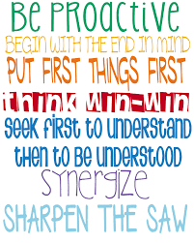
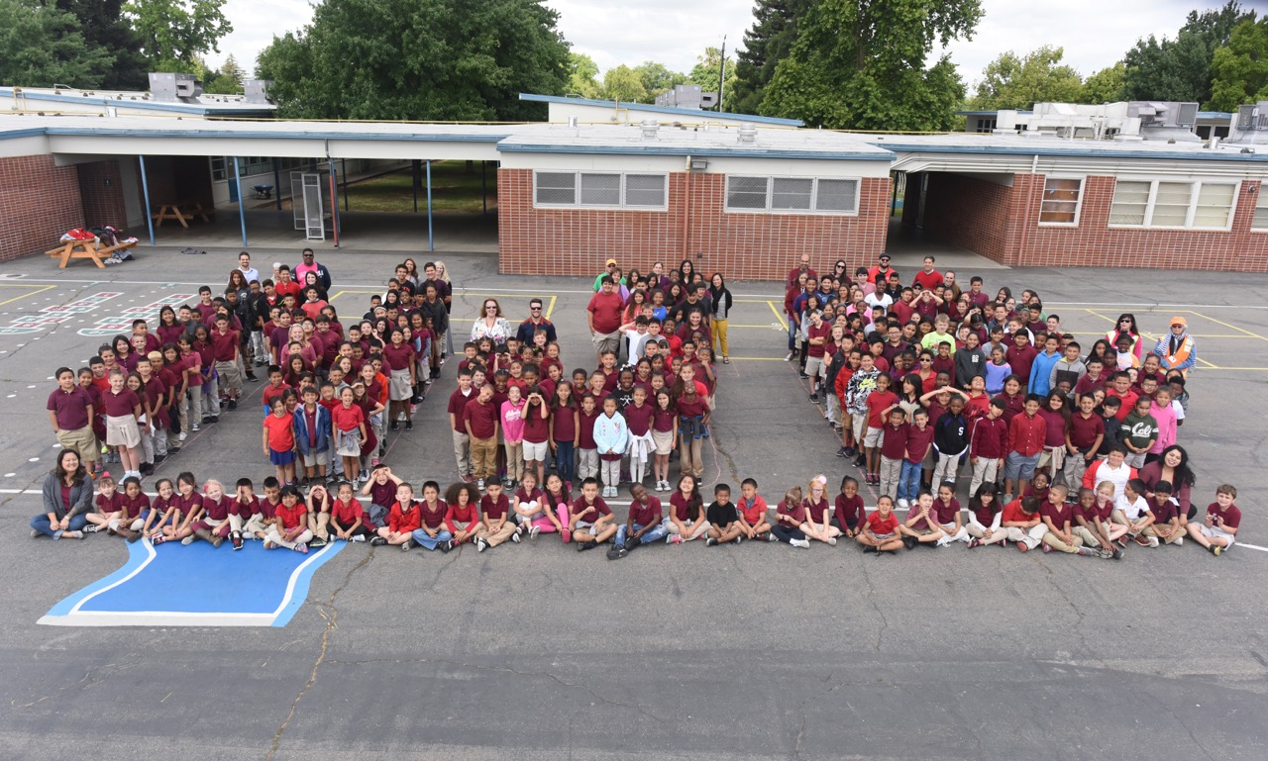
NJB: Parent Night
Christie Wells-Artman, Principal

Slide 2

The End in Mind
Introduce The Leader in Me.
Understand the importance of leadership skills.
Overview of the 7 Habits.
Share ideas for modeling the 7 Habits at home.

Slide 3

The Leader in Me

Slide 4
Overview of The Leader in Me
The Leader in Me:
Is a process designed to help teachers develop leadership skills in their students.
Helps students discover their unique strengths.
Gives all students an opportunity to shine—to become leaders.
Helps infuse the language of the 7 Habits into all the curriculum.

Slide 5
21st Century Skills
Creativity and Innovation
Critical Thinking and Problem Solving
Communication and Collaboration
Flexibility and Adaptability
Initiative and Self-Direction
Social and Cross-Cultural Skills
Productivity and Accountability
Leadership and Responsibility

Slide 6
The 7 Habits and Life Skills
What Parents and Business Leaders Want | 21st Century Life Skills | The 7 Habits of Highly Effective People®
INDEPENDENCE |  | Habits 1–3
Goal setting Organization Time management Planning | Initiative Responsibility Self-direction Personal productivity | Be Proactive® Begin With the End in Mind® Put First Things First®
INTERDEPENDENCE |  | Habits 4–6
Teamwork Conflict management Creativity Analytical skills | Problem solving Communication Collaboration Cross-cultural skills | Think Win-Win® Seek First to Understand, Then to Be Understood® Synergize®
RENEWAL |  | Habit 7
Fun Desire to learn Good health and hygiene | Meaningful work Emotional stability Technical skills | Sharpen the Saw® (Body, Heart, Mind, Spirit)

Slide 7
Developing Leaders
One Child at a Time

Slide 8
Rippling
Across the Globe

Slide 9

The 7 Habits of Highly Effective People

Slide 10
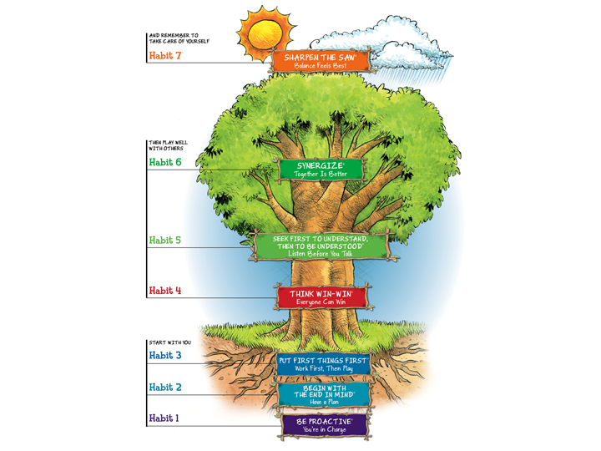

Slide 11
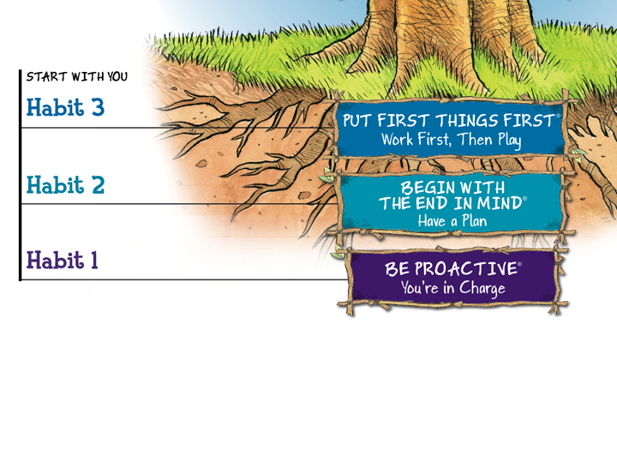

Slide 12
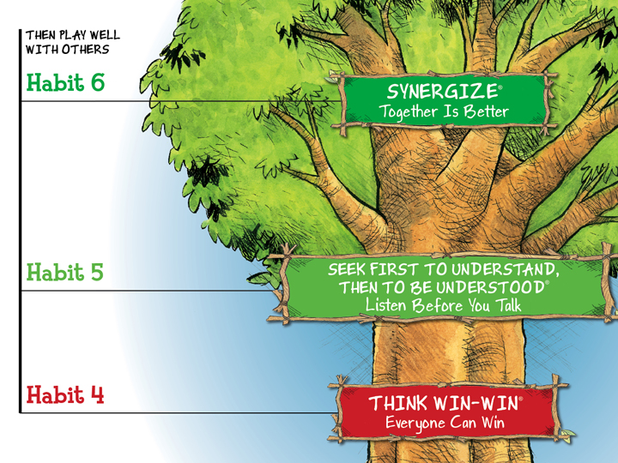
Muriel Summers

Slide 13
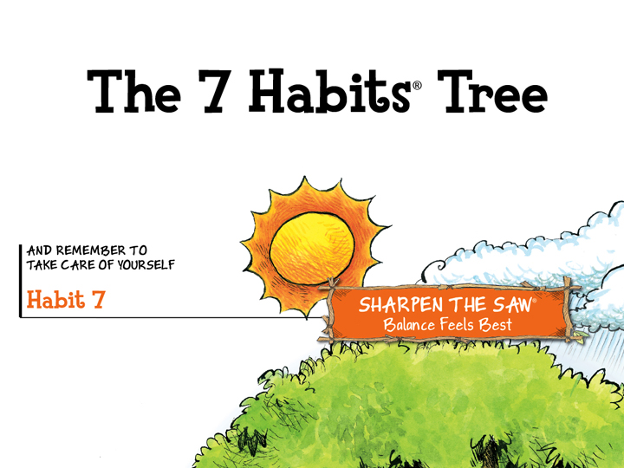
Muriel Summers

Slide 14
Kids Teach the 7 Habits

Slide 15
Habit 1: Be Proactive®
I am a responsible person. I take initiative. I choose my actions, attitudes, and moods. I do not blame others for my wrong actions. I do the right thing without being asked, even when no one is looking.

Slide 16
Habit 2: Begin With the End in Mind®
I plan ahead and set goals. I do things that have meaning and make a difference. I am an important part of my classroom and contribute to my school’s mission and vision. I look for ways to be a good citizen.

Slide 17
Habit 3: Put First Things First ®
I spend my time on things that are most important. This means I say no to things I know I should not do. I set priorities, make a schedule, and follow my plan. I am disciplined and organized.

Slide 18
Habit 4: Think Win-Win ®
I balance courage for getting what I want with consideration for what others want. When conflicts arise, I look for a win-win solution.

Slide 19
Habit 5: Seek First to Understand,
Then to Be Understood ®
I listen to other people’s ideas and feelings. I try to see things from their viewpoint (paradigm). I listen to others without interrupting; I listen with my ears, my eyes, and my heart. I am confident in voicing my ideas.

Slide 20
Habit 6: Synergize®
I value other people’s strengths and learn from them. I get along well with others; even people who are different than me. I work well in groups. I seek out other people’s ideas because I know that by teaming with others, we can create better solutions than what any one of us could alone. I look for Third Alternatives.

Slide 21
Habit 7: Sharpen the Saw ®
I eat right, exercise, and get enough sleep (body). I learn in lots of ways and lots of places, not just at school (brain). I spend time with family and friends (heart). I take time to find meaningful ways to help people (soul). I balance all four parts of myself.

Slide 22
Quote
“Leadership is communicating a person’s worth and potential so clearly that they are inspired to see it in themselves.”
—Dr. Stephen R. Covey

Slide 23
Rethinking Leadership

Slide 24
Thank You!

