Slide 1

Chula Vista Learning Community Charter (CVLCC)
2023-2024 Elementary School New Parent orientation
Creating Knowledge to Transform the World
Notes:
The Dream School opened its doors in the fall of 1998 as the district’s first start-up charter school.
School-wide 50/50 dual language program focused on skills students would need to become active members of the 21st Century.
The goal was to go beyond the classroom walls and experience education through a variety of lenses that will challenge traditional schooling to one of education that will transform our world.
Middle School 2011 & High School 2016

Slide 2
Vision
We believe in the full potential of each and every individual to act with integrity and to create their own knowledge.

Slide 3
Mission
At CVLCC, students are respected as intellectuals as they develop their individual authentic self. Our robust academic program is focused on expanding language, developing core ethics, and building knowledge across content areas.

Slide 4
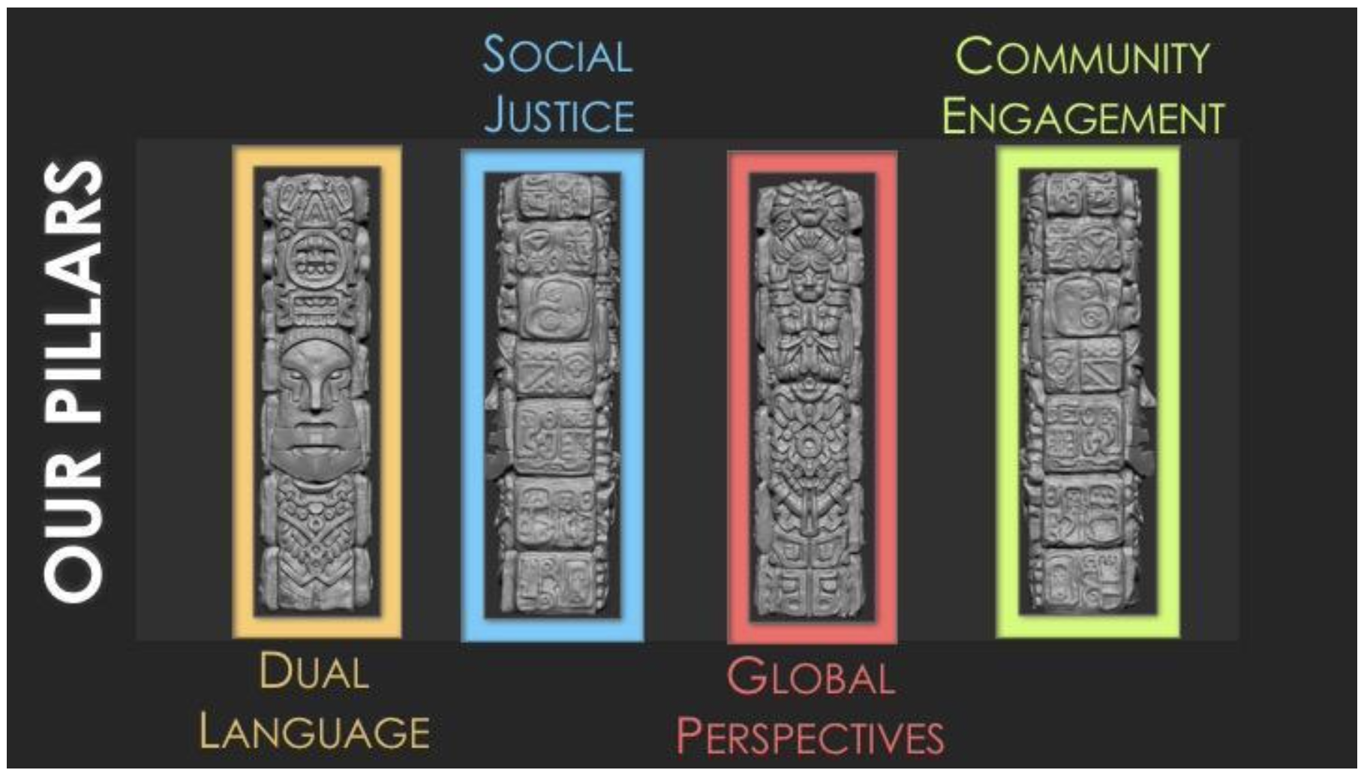
Chula Vista Learning Community Charter
Notes:
The Chula Vista Learning Community Charter School prides itself on the pillars of
dual language immersion, global perspectives, social justice and community engagement.
- Dual Language Immersion
The Chula Vista Learning Community Charter School is a 50/50 model connecting theory into practice by developing multi-literacy and multiculturalism. Language is an asset rather than a deficit and all stakeholders are language learners.
- Global Perspectives
The Chula Vista Learning Community Charter School provides learning opportunities to understand complex, social topics to support the intellectual, personal development of all students. It challenges learners to explore cultural perspectives to empathize with others. By promoting knowledge of human geography and having students challenge the status quo, they can critically assess the validity of commonly held assumptions about others. By producing committed global citizens, learners understand how events around the world are interconnected to allow for problem solving that transcends borders.
- Social Justice
The Chula Vista Learning Community Charter School highlights social justice through classroom pedagogy and curriculum. Students explore current events, critical race theory, diversity and participate in community service. Active learning comprises of self-reflection, knowledge acquisition, action with consciousness and personal transformation. Students develop their own understanding of the relation between individual and society.
- Community Engagement
The Chula Vista Learning Community Charter School differentiates between engagement and participation. Community members are engaged in the learning process with the purpose of supporting the academic and social emotional needs of all learners. Stakeholders are included in the processes to establish ethical responsibilities and are invested in the educational organization from the school to the home, community and world.
The school is committed to providing an innovative, supportive and safe environment for students, parents and community members. The school encompasses a transitional kindergarten through twelfth grade educational experience that challenges paradigms. Students create and articulate their knowledge in order to thrive in the global community, and creatively and critically transform their world.
Chula Vista Learning Community Charter School develops rigorous curriculum and assessments. High academic standards are implemented through action-oriented curriculum and instruction to engage learners in critical pedagogy. Curriculum is research-based, culturally inclusive, relevant and student-centered to develop each child’s full potential, while recognizing their authentic self. Our high expectations result in confident global citizens who are becoming:
Multi-literate
Reflective and inquisitive
Collaborative and independent critical thinkers
Passionate constructors of their own knowledge
Creators of their community
The Chula Vista Learning Community Charter School expanded the charter petition from servicing a Pre-Kindergarten through grade 6 to a Transitional Kindergarten through 12th grade. The educational program includes an integrated curriculum incorporating differentiated learning/teaching styles and is assessed regularly. High academic standards are utilized when implementing action-oriented curriculum and instruction. Curriculum is research-based and student-focused to develop individual perspective.
All programs provide a challenging academic process, which develops metacognitive skills and engages students in the habits of inquiry to compete in a global society. Students embrace ethical and social values by its commitment to service with compassion, in order to provide opportunities to develop and strengthen global competence and ethical leadership, foster peace and work for justice. Learning applications occur through real work settings, service learning assignments, project-based activities, and portfolio/authentic presentations. Expectations results in multi-literate, self-reliant, confident learners, and university bound adults. Students will be prepared to actively participate in a multicultural and global world community.

Slide 5
Instructional Focus
Our students will be able to clarify their thinking, process their ideas, and precisely communicate their understanding effectively both orally and in writing by increasing the quality and quantity of our students’ reading, writing, and problem solving across all content areas.

Slide 6
50/50 Dual Immersion
TK-6th Grade Program Overview
English Classroom
Spanish Classroom
50% of Instruction
English Language Arts
Mathematics
½ Science
50% of Instruction
Spanish Language Arts
Social Studies/History
½ Science
Notes:
Team Teaching
1 *English Teacher & 1 Spanish Teacher

Slide 7
50/50 Dual Immersion
Sample Schedule
Monday - Thursday
Friday (Minimum Day)
8:00am Morning Assembly
8:05am Mathematics
9:15am Recess
9:30am English Lang. Arts
10:45am Switch
10:50am Spanish Lang. Arts
12:15pm Lunch
1:00pm Social Studies/History
2:00pm MicroSociety
3:00pm Dismissal
8:00am Morning Assembly
8:05am Mathematics
9:15am Recess
9:30am English Lang. Arts
10:15am Switch
10:20am Spanish Lang. Arts
11:20am Social Studies/History
12:15pm Lunch
1:00pm Dismissal
Notes:
Team Teaching
1 *English Teacher & 1 Spanish Teacher

Slide 8
Transitional Kinder & Kindergarten
Beginning of Year Information
First day of School
Wednesday
July 19, 2023
Parent Orientation on the first day of school
First 9 days are minimum days for student assessment (sign up during the orientation)

Slide 9
Dual Language Advantage
English Learners and native English speakers in dual immersion programs do as well or better than their peers in other program models -Genesee et al., 2006; Thomas & Collier, 2002
Primary language instruction in English Learner programs promotes higher level of reading in English -Genesee et al., 2006; Thomas and Collier, 2002; Snipes, Soga, & Uro, 2007; August & Shanahan, 2006
Instruction in and of the primary language is more effective than English-only and leads to faster academic growth -Snipes, Soga, & Uro, 2007; August & Shanahan, 2006
Proficiency in two or more languages enhances educational and cognitive development -Thomas and Collier, 2002; Snipes, Soga, & Uro, 2007; August & Shanahan, 2006
Notes:
How can my child learn English if Spanish is taught for half of the day?

Slide 10

Academic Supports
Simultaneous Literacy / Transfer of Concepts
Designated and Integrated Language Development
Instructional Assistants
Support Teachers (Reading and Mathematics)
Notes:
How can my child learn English if Spanish is taught for half of the day?

Slide 11
CVLCC Policies for Success
Parents and students commit to our dual language program TK – 12th Grade
Students Engagement:
  Arrive at school on time, everyday
  Wear the required uniform everyday
Parents Engagement:
  Review Handbook & Sign Parent Compact
  Attend parent-teacher conferences
  Communicate regularly with both Teachers
  Volunteer and attend academic & social school events throughout the year

Slide 12
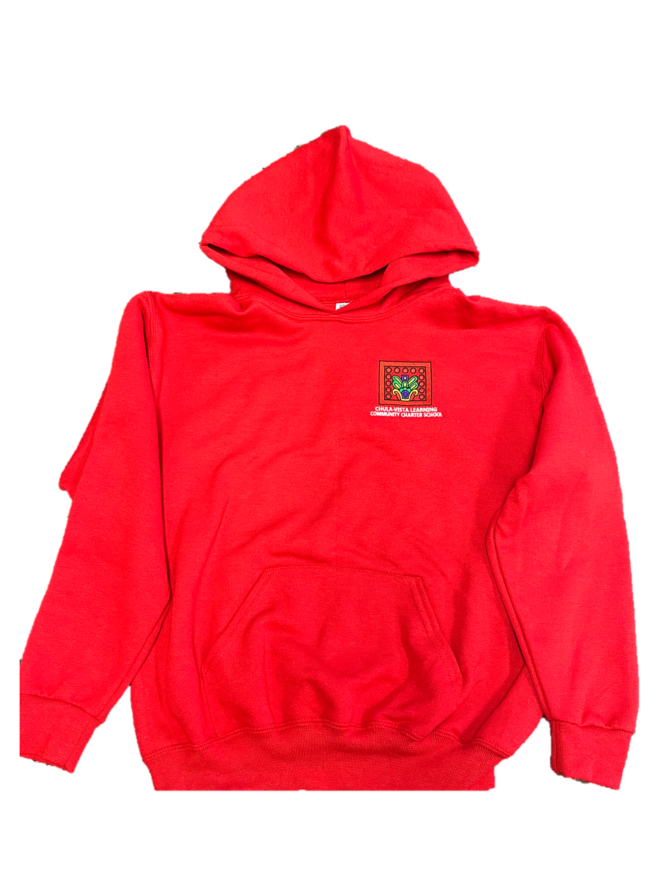
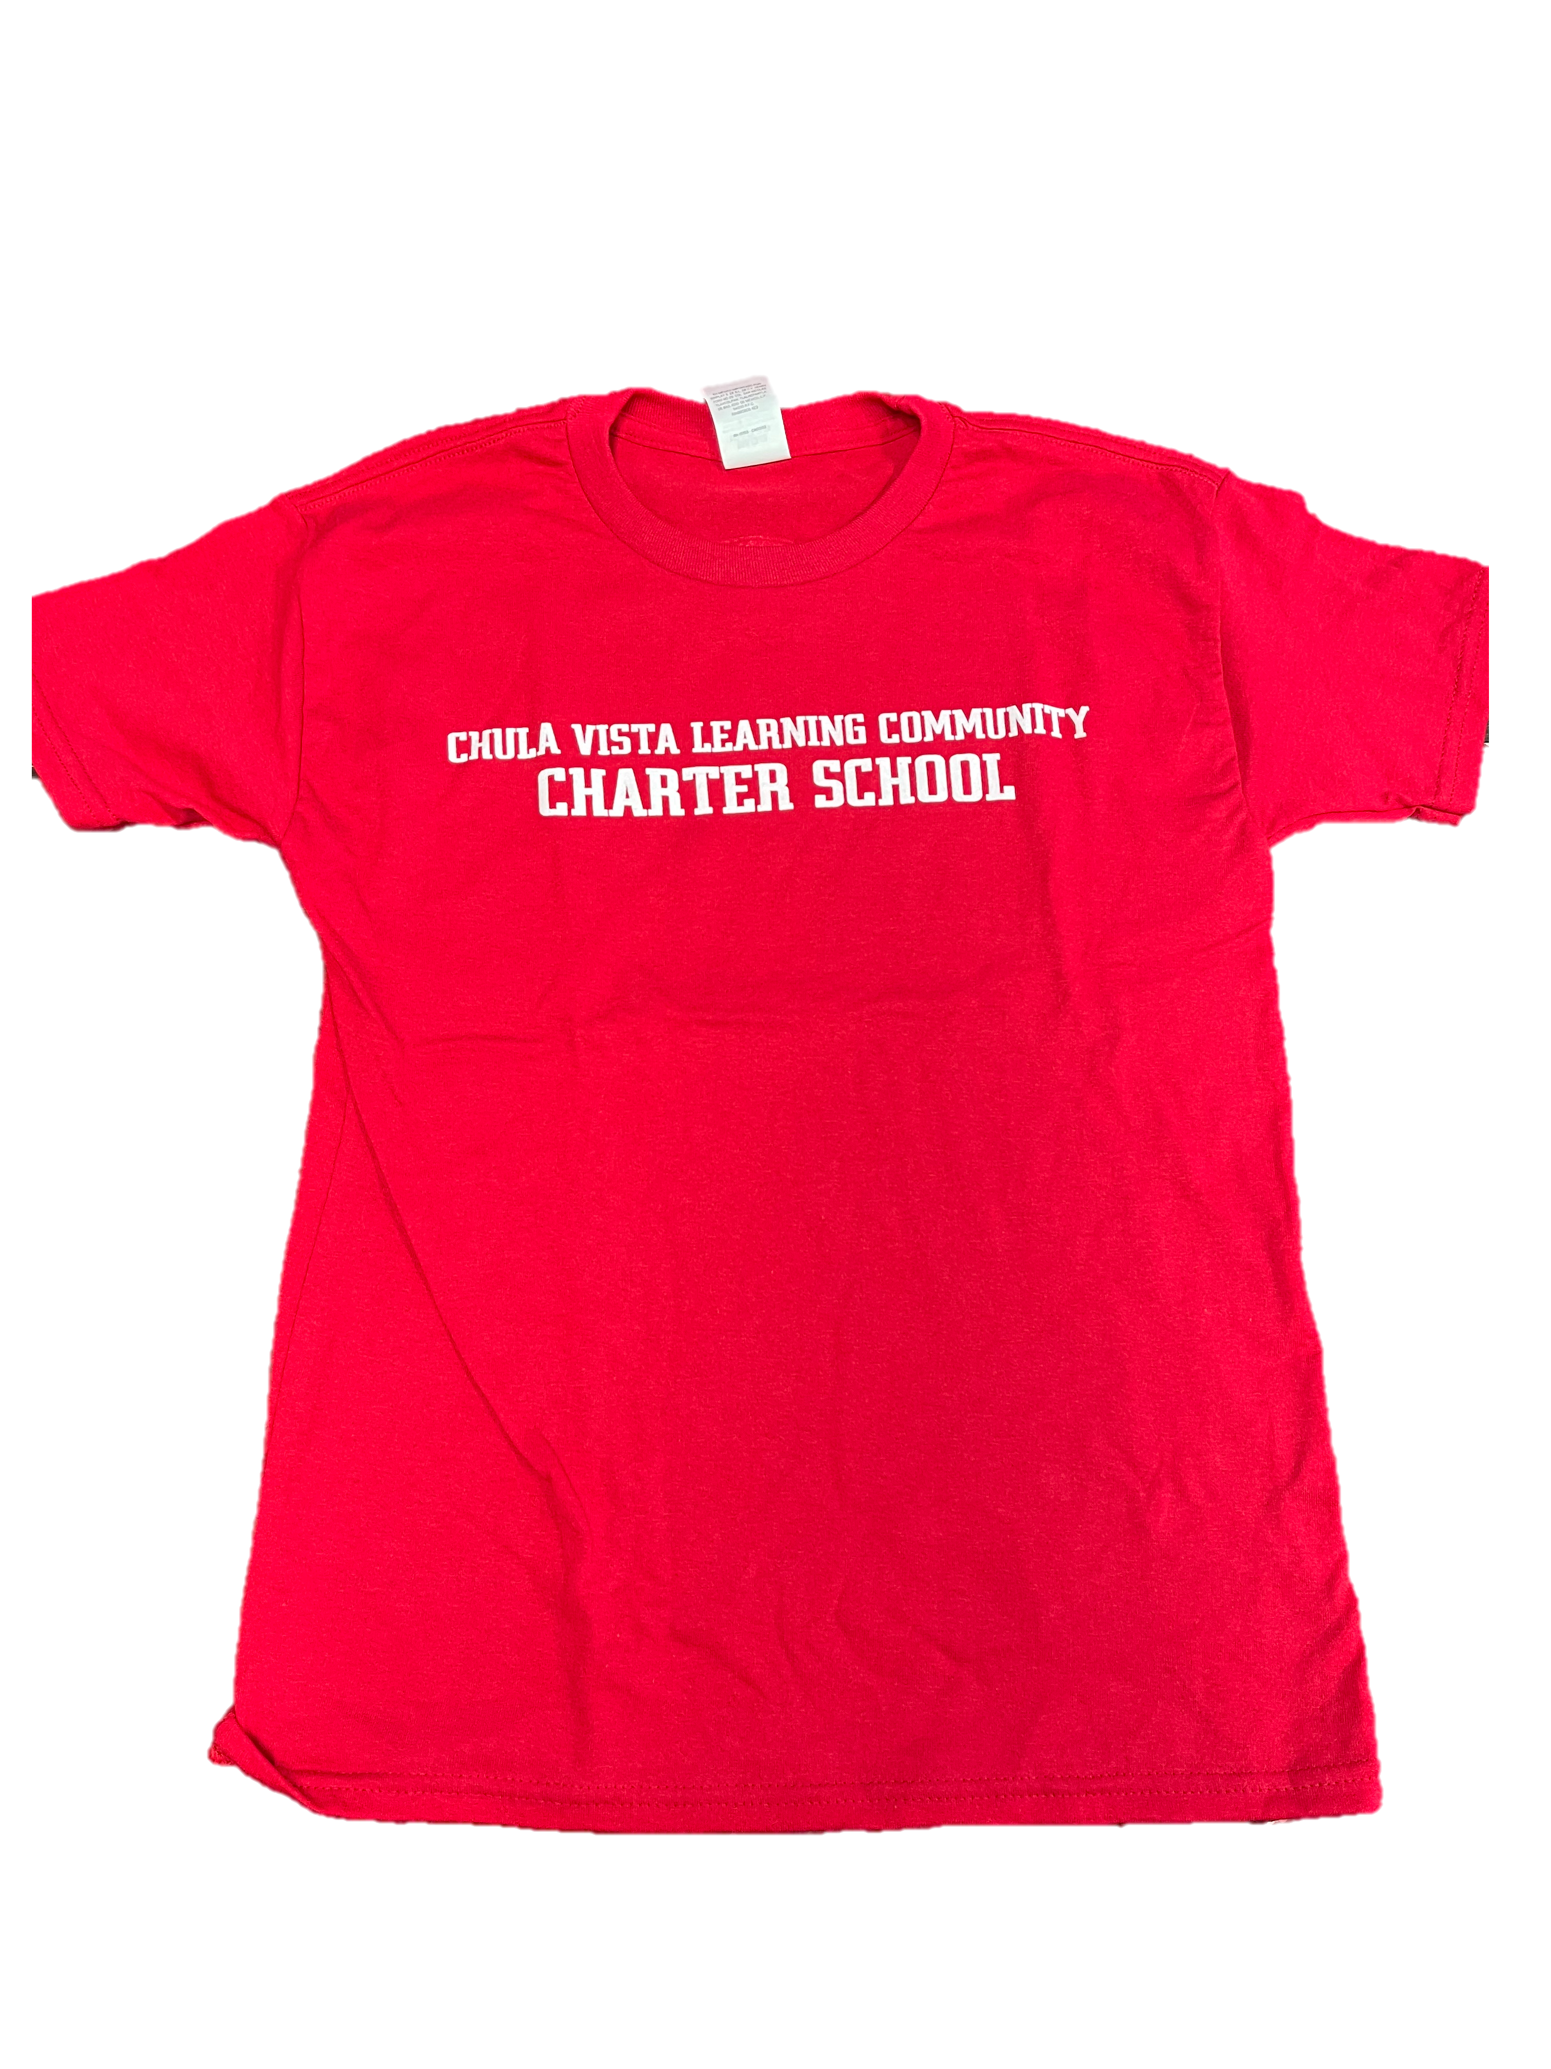
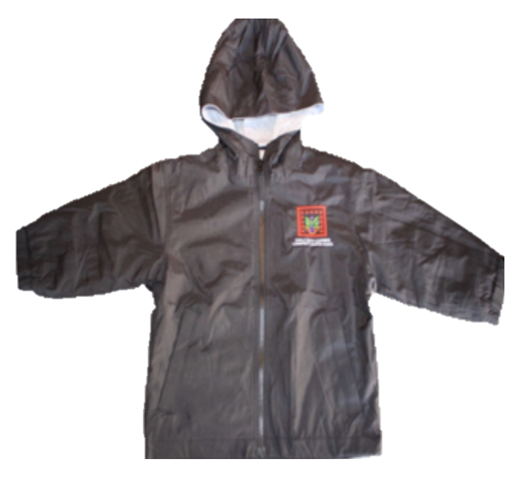
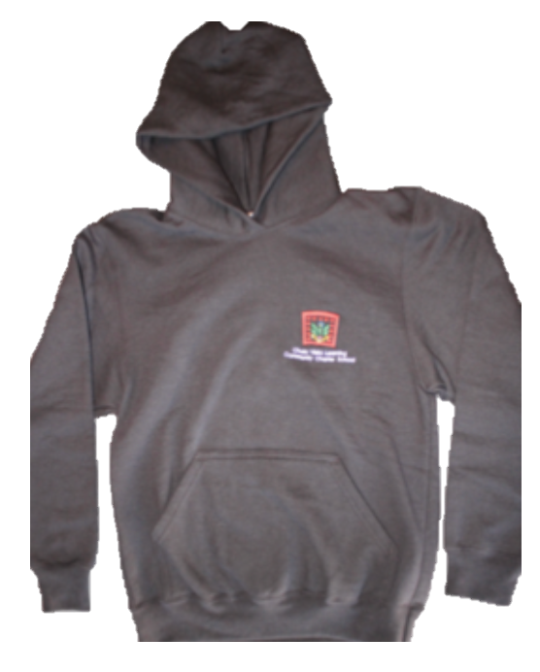
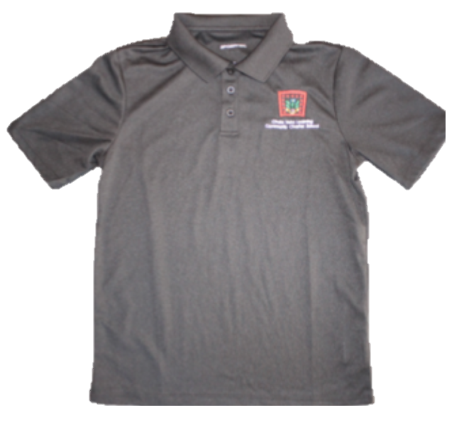
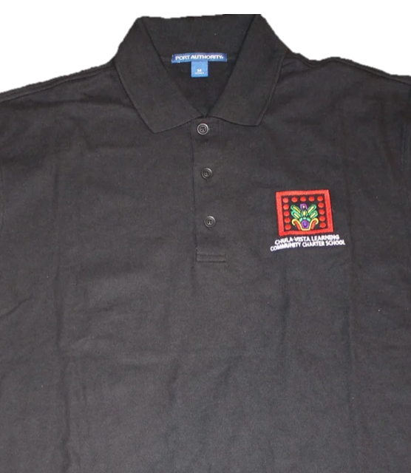

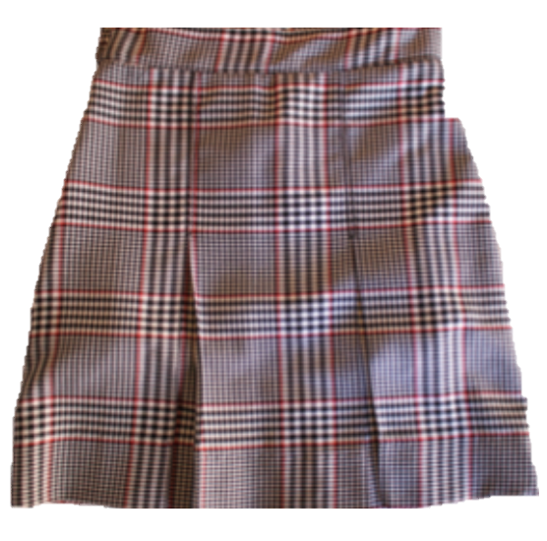
Student Uniforms
CVLCC Logo Optional
Girls
Boys
Charcoal Grey or Black Polo (short or long sleeve)
Black or red Sweater, Sweatshirt or Jacket
Black Pants or Shorts (appropriate length)
Black Belt
CVLCC Plaid Skirt
Black, white or red shoes (no open toe) & socks
Charcoal Grey or Black Polo (short or long sleeve)
Black or red Sweater, Sweatshirt or Jacket
Black Pants or Shorts (appropriate length)
Black Belt
Black or white shoes (no open toe) & socks
Notes:
Team Teaching
1 *English Teacher & 1 Spanish Teacher

Slide 13
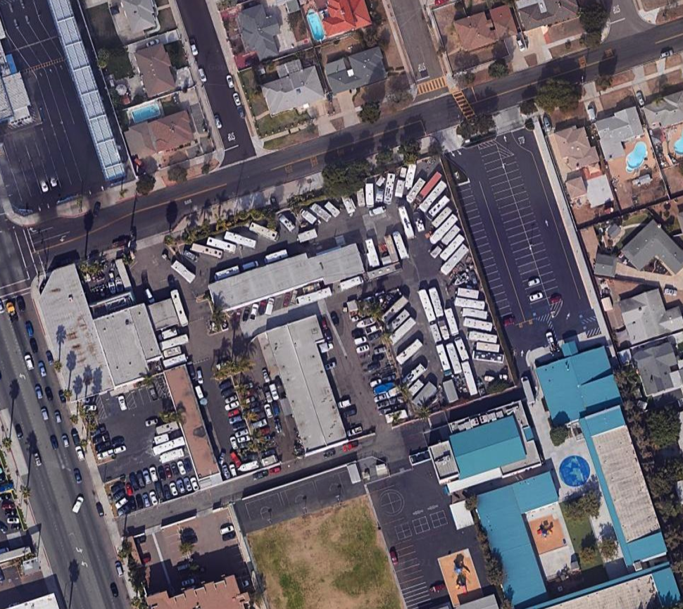
Ash Ave.
Beech Ave.
Cedar Ave.
K Street
Student Drop-off
TK – 1st Grades
2nd – 6th Grades
Pedestrian TK – 6th Grades
Tentative Schedule
Student Drop-off/ Breakfast Begins @ 7:30am

Slide 14

Ash Ave.
Beech Ave.
Cedar Ave.
K Street
Student Pick-up Routes
TK – Kinder
1st – 4th Grades
Pedestrian TK – 6th Grades
Tentative Schedule
Regular Day Pick-up Begins @ 3:00pm
Minimum Day
Pick-up Begins @ 1:00pm
Notes:
A new (click) white 1st grade placard will be sent home with students tomorrow
1st grade parents will come into the main parking lot, follow the white arrows by (click) enter the left lane, make a U-turn and pickup along the highlighted (click) student pickup zone.
Please remember that the new dismissal route will begin on Monday. We thank you for your continued patience and support as we update our process to ensure a safe and efficient dismissal of all 780 students.

Slide 15
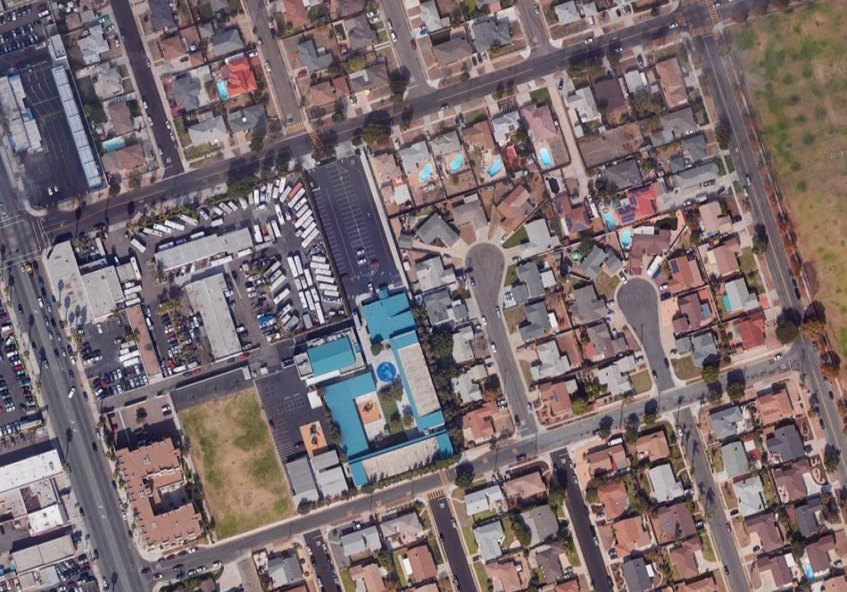
Students line up on sidewalk, wait for teacher to call them as their transportation arrives.
Enter only through 5th Avenue
  Take turns entering Sierra Way
  Display white student placard on dash
Avoid:
    Lining up prior to 2:30pm
    Parking, driving, blocking intersections or driveways on noted streets
    Using cell phone while driving
Remember to be Respectful
IMPORTANT: NO PEDESTRIAN PICK-UP
5th & 6th Grade
Pick-up Route
x
x
x
x
5th Avenue
x
x
Sierra Way
x
x
Broadway
x
x
x
Beech
Notes:
(Click twice) Students will line up on the highlighted section (click) of the sidewalk & wait for their teacher to call them as you drive up (Click)
Please enter only through 5th Ave (click twice) and take turns entering Sierra way
Display the white student placard on the dash & proceed to the pickup area (click)
After you pick up your child please exit via Beech (click) or Broadway (click)
(click) We ask that you please avoid lining up prior to 2:30pm (click), Do Not Park, Drive, Block intersections or driveways on noted streets, & please do not drive while using your cell phone (click)
Remember to be respectful of other drivers
Please note that Pedestrian pick-up and Students walking home will continue to exit from K street

Slide 16

CVLCC Extended Day Program
Monday through Thursday
6:30 AM – 8:00 AM
3:00 PM – 6:00 PM
Friday
6:30 AM – 8:00 AM
1:00 PM – 6:00 PM

Slide 17
Questions? www.cvlcc.org
First day of School
July 19, 2023

