Slide 1
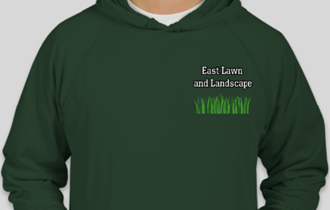
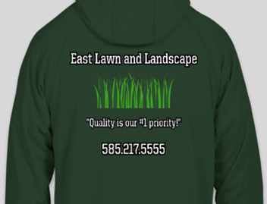
Learning Target: I can Design and develop a business shirt using Custom Ink software.
Do Now: What is the purpose of a business shirt?
Demonstration
Lab time
Save file as:
  Business Shirt_Your Name
Ticket out the door

Slide 2
Learning Target: I can Design and develop a business shirt using Custom Ink software.
Dimensions | Exceeds or Meets Expectations 10 pts | Approaching Expectations 9-5 pts | Lacking or does not meet Expectations 4-0 pts
Front | Chose color, added business name, added art (image), text and art is within safety box, correct spelling/grammar, centered, balanced, neat, clean and professional. | Missing 1-3 items of requirements. | Missing 4+ items of requirements, or did not finish.
Back | Added business name, added art (image), added slogan, added contact information, text and art is within safety box, correct spelling/grammar, centered, balanced, neat, clean and professional. | Missing 1-3 items of requirements. | Missing 4+ items of requirements, or did not finish.
Save File | “Print Screen” is used to capture both front and back of shirt design, Microsoft Paint is used to Crop and Cut images, saved in Microsoft Word as Business Shirt_ Your Name | Missing 1-3 items of requirements. | File not saved, cannot be found in student H: drive

Slide 3
Learning Target: I can Design and develop a business shirt using Custom Ink software.
Save file as:
  Business Shirt_Your Name

Slide 4


Learning Target: I can Design and develop a business shirt using Custom Ink software.
Ticket out the door:
What should be included in the design of a business shirt?

