Slide 1

SECAC Meeting
March 20, 2025
Carroll community College
6:00-7:30

Slide 2
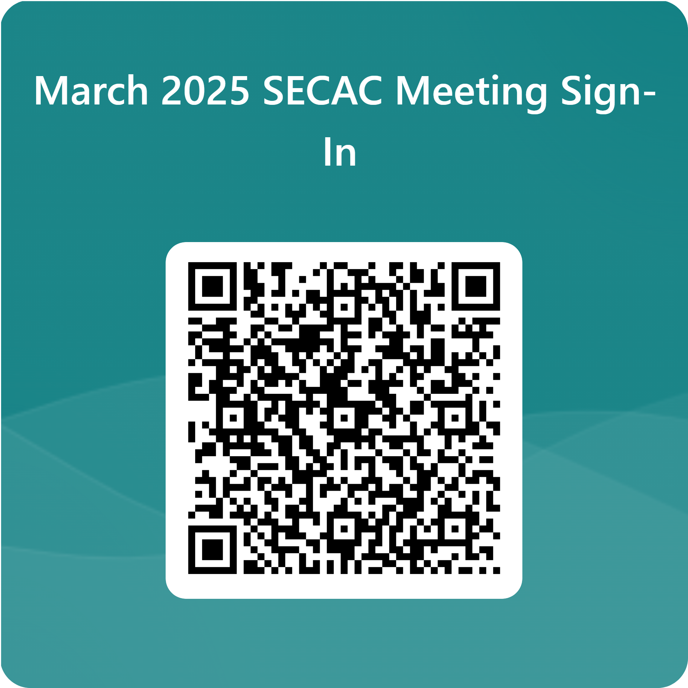
Welcome and Opening
Sign In
Introductions

Slide 3
Family Support Upcoming Events
Tammy Chisolm

Slide 4
February Meeting Updates
Diploma and Certificate Endorsement Update
Alternative Standards and Alternative Assessment Eligibility
Pathways to Graduation

Slide 5
Ground Rules
“Share the Air”
All participants have a voice
There is value of a diversity of perspectives as an essential part of the process
“Be the crew not the passenger”
Actively contributing to the meeting (crew)
Instead of falling back into the role of an observer (passenger)
“3 X 3 Rule”
Cleaver rule to create equal participation
Wait until 3 other people have spoken, or 3 minutes have passed before speaking again

Slide 6
Ground Rules
“Agree to Disagree”
Difference of opinion
May not leave with resolution
“A & A Rule”
Helpful for brainstorming without judgement
“Adding” and “Alternative”
“Good of the Group”
Share perspective without going into specifics
Seeking system changes and patterns
“Parking lot”
Park off-topic ideas, questions, or comments for a later time.

Slide 7
SECAC 2025-2026 Executive Committee
Chair
Co-Chair
Secretary
Assistant Secretary

Slide 8
Resource and Transition Fair
SECAC Table
  Sign Up for Event
  Sign Up for Emailing a new member
  Let voice be Heard
  Year at Glance
  Application for Awards
  Clipboard for Recruitment
  **Starbucks $5.00 gift card**
Resource & Transition Fair

Slide 9
Award and Recognition Ceremony
Need to Create Subcommittee
Increase Awareness of Event
  Website Ribbon
  Local School Campaign
Keep Appreciation
Keep Recognition
Discussion Regarding
  Student
  Administrator
  School-Wide Spotlight
Award & Recognition Ceremony

Slide 10
CCPS SECAC Board Report
Discussion Regarding Meetings for Next Year
2 proposals
Topics for Meetings
Review Recommendations to the Board of Education
Last year overall priorities and recommendations-
Other thoughts that help communicate the message of SECAC
Action of Committee
Indicate which we completed this year/ which we did not complete
Thoughts for actions for next school year
Open to other suggestions
Do they still align?
Any updates or changes to wording?

Slide 11
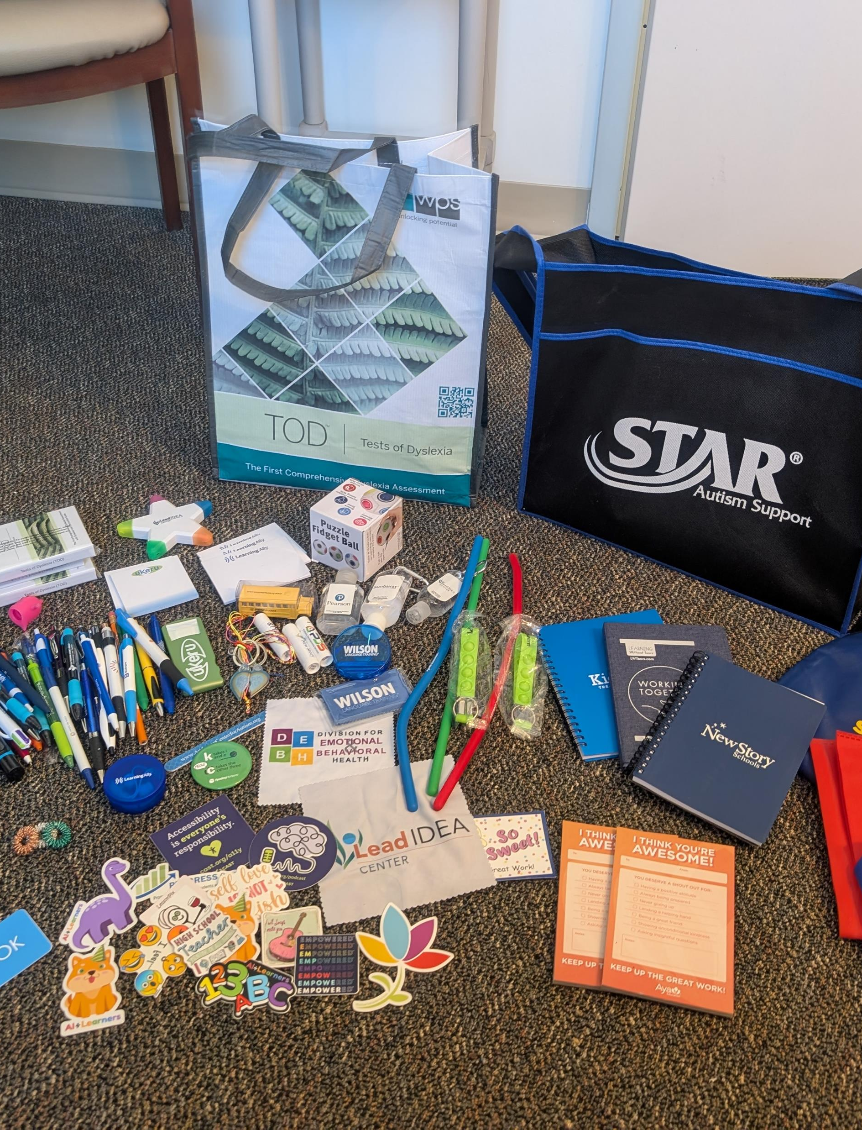
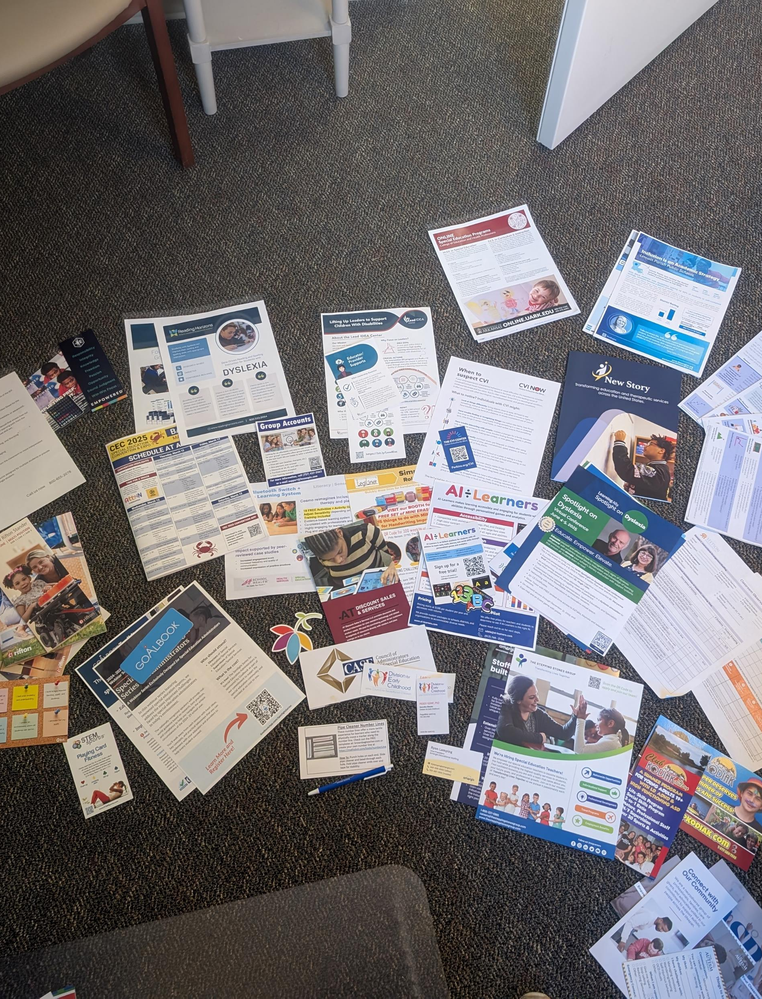
CEC Conference Recap and Resources

Slide 12

Action Plan

Slide 13

A Look Ahead…..
Resource and Transition Fair
  March 27, 2025, Winters Mill High School, 4:30-8:00pm
Award Ceremony
  May 1, 2025, Winters Mill High School, 6:00-7:30pm

Slide 14
A Look Ahead…..
Resource and Transition Fair
  March 27, 2025, Winters Mill High School, 4:30-8:00pm
Award Ceremony
  May 1, 2025, Winters Mill High School, 6:00-7:30pm

