Slide 1
EXPLORATORY DATA ANALYSIS and
DESCRIPTIVE STATISTICS

Slide 2
means to
DESCRIBE & UNDERSTAND THIS DATA’S CHARACTERISTICS
before you analyze this data

Slide 3
this is part of
EXPLAINING INFERENTIAL STATISTICS

Slide 4
Exploratory Data Analysis
NOMINAL / ORDINAL (qualitative / categorical) DATA
bar graphs, pie charts
INTERVAL / RATIO (quantitative) DATA
histograms, time plots, scatterplots
CENTER of the data → calculate and compare mean and median
SPREAD of the data → calculate range and standard deviation
DISTRIBUTION (or shape) of the data →
symmetric / bell shaped? skewed to the right/left? etc.
OUTLIERS →
[extreme] 3×Interquartile Range above 3rd or below 1st quartile
[moderate] 1.5×(IQR) above 3rd or below 1st quartile

Slide 5
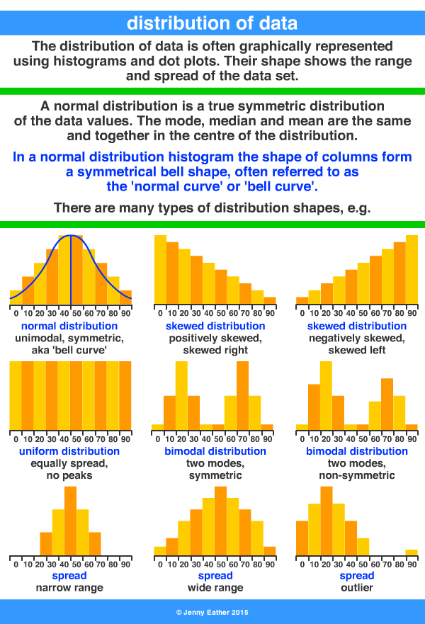

Slide 6
Interpreting Graphs
direction (+ slope = direct relationship & – slope = inverse relationship)
form (linear or curved)
the spread or variability of the measurements represents the strength of correlation (R²) between X and Y
the slope (b) of a regression line represents the rate of change in y as x changes

Slide 7
