Slide 1
GRAPHS

Slide 2
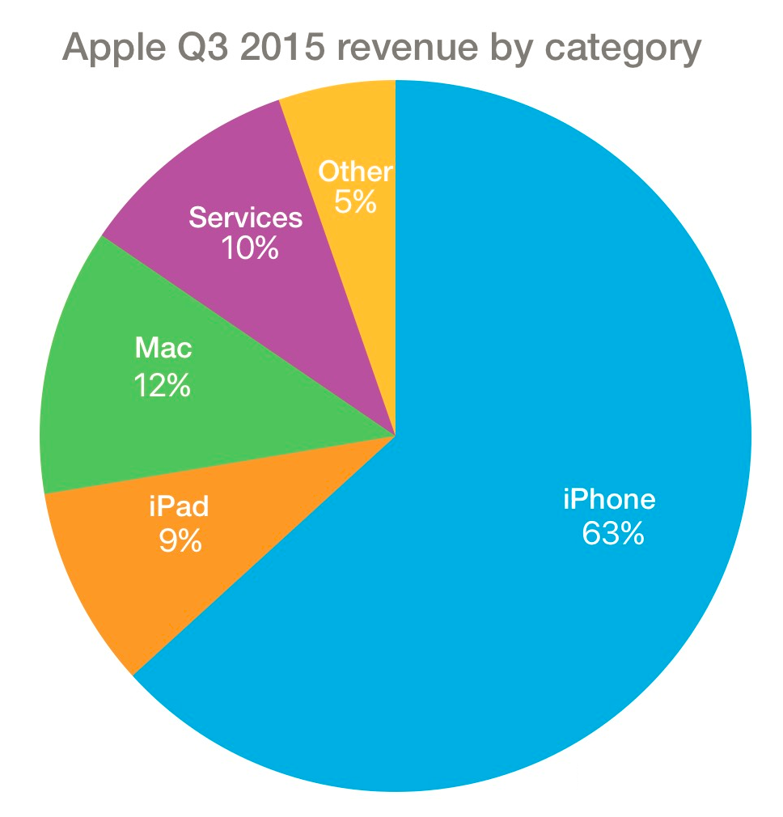
Types of Graphs
PIE CHART
compare parts to the whole (proportions or percentages)
use for nominal (categorical /qualitative) variable data
What is the conclusion of this experiment?
What is the dependent variable of this experiment?
What is the independent variable of this experiment?
What is the control of this experiment?
What are three controlled variables (constants) of this experiment?
selling computer and smart phone products, sold in the United States, during quarter 3
Did Apple’s quarter 3 sales in 2015 increase or decrease compared to last year?
Year being sold? Country or Location being sold? Type of Apple computer and smart phone products being sold?
Apple’s average sales in US for quarter 3 from 2014 (or average Apple sales from a Europe Q3 2015 or a competitor Q3 2015
This type of graph is used for what levels of data?
ordinal
categorical
nominal

Slide 3
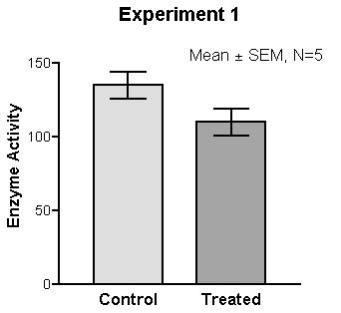
Types of Graphs
BAR GRAPH
compare groups
nominal on X (IV) & numbers (quantitative) on Y (DV)
What is the independent variable of this experiment?
What is the control of this experiment?
What is the conclusion of this experiment?
What is the dependent variable of this experiment?
What are three controlled variables (constants) of this experiment?
no treatment or the normal treatment
testing potato enzymes, 5 minutes of reaction time, room temperature (22°C)
may have gaps
the treatment decreased the enzyme activity
This type of graph is used for what levels of data?
ordinal
categorical
nominal

Slide 4
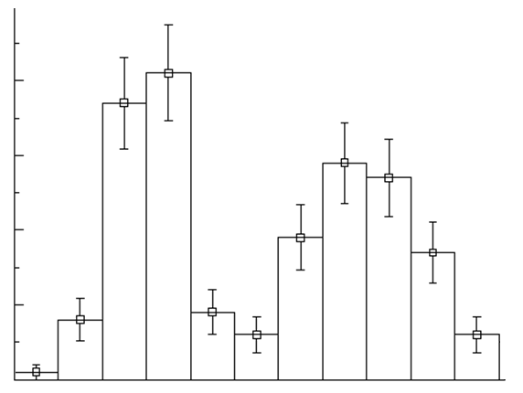
Types of Graphs
HISTOGRAM
distribution of a continuous data set that has been divided into equal class intervals (ranges of values)
numbers (quantitative) on both X (IV) & Y (frequency)
Petal Length vs. Frequency
What is the independent variable of this experiment?
What are three controlled variables (constants) of this experiment?
What is the dependent variable of this experiment?
What is the control of this experiment?
What is the conclusion of this experiment?
40
cannot have gaps
no petal or the normal petal length
sunflowers, grown for 3 weeks, grown in full sunlight
the most common petal length is ≥ 10 and < 11
30
Frequency
20
This type of graph is used for what levels of data?
10
ratio
quantitative
0
interval
7
8
9
10
11
12
13
14
15
16
17
18
Petal Length (cm)

Slide 5
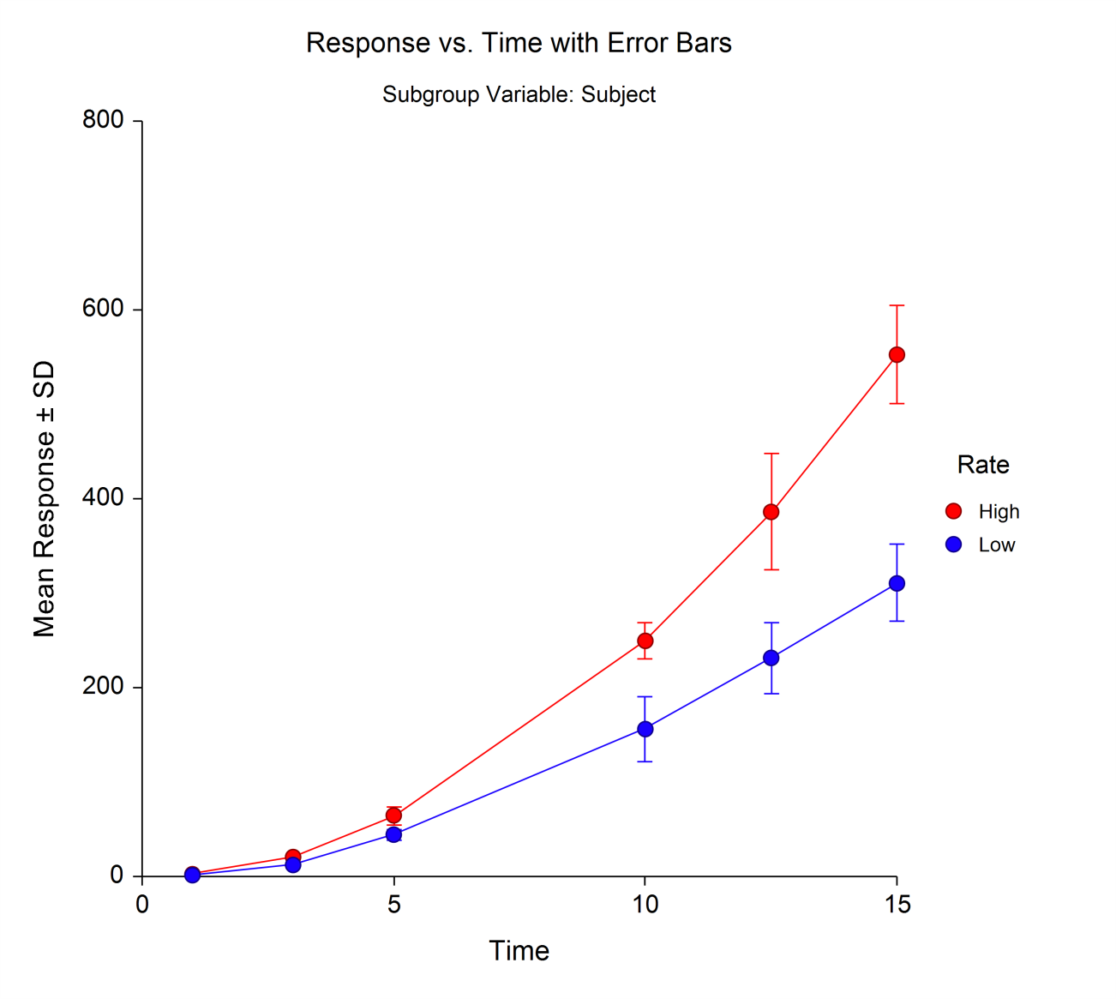
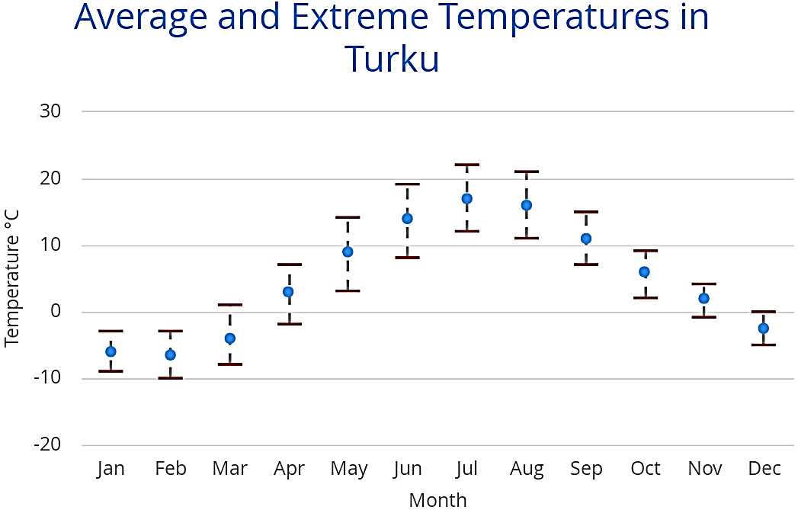
Types of Graphs
LINE GRAPH
compare change over time
numbers (quantitative) on both X (time) & Y (DV)
What is the independent variable of this experiment?
What is the dependent variable of this experiment?
What is the control of this experiment?
What are three controlled variables (constants) of this experiment?
line may connect data points
What is the conclusion of this experiment?
Has the current year’s monthly average temperatures increased compared to a baseline of the last 10 or 100 years?
Monthly averages for the last 10 or 100 years
Location is Turku, temperature measured at noon, measured in full direct sunlight
This type of graph is used for what levels of data?
ratio
quantitative
interval

Slide 6
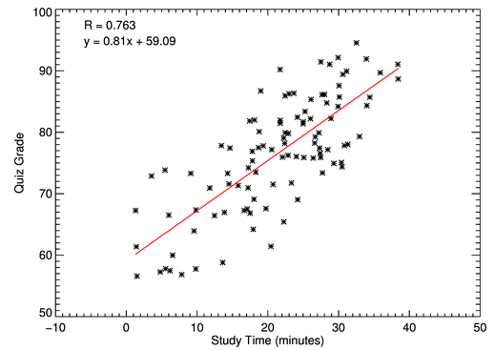
Types of Graphs
SCATTER PLOT
correlation of variables
numbers (quantitative) on both X (IV) & Y (DV)
best fit line or trend line (does not connect data points)
What is the dependent variable of this experiment?
What is the independent variable of this experiment?
What are three controlled variables (constants) of this experiment?
What is the control of this experiment?
What is the conclusion of this experiment?
Quiz grades increase at a constant rate 0.81 for every additional minute of study time.
no study time or the normal (recommended) study time
8th grade students, students were tested in a quiet & well lighted class room, same 10 question quiz
This type of graph is used for what levels of data?
ratio
quantitative
interval

Slide 7
BOX AND WHISKER GRAPHS

Slide 8
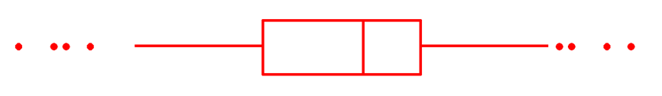
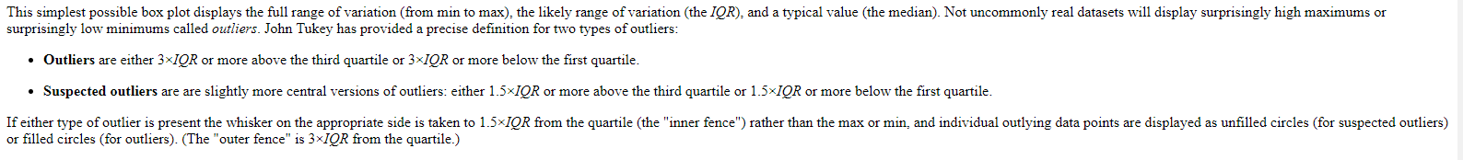
BOX & WHISKER GRAPH
MEDIAN
(entire data set)
MINIMUM value of data
50th percentile (Q2)
MAXIMUM value of data
25th percentile (Q1)
75th percentile (Q3)
(median of lower half)
(median of upper half)
SMALLEST non-outlier
LARGEST non-outlier
OUTLIERS
1.5 × IQR
1.5 × IQR
OUTLIERS
¼ of the data is below the box
INTERQUARTILE RANGE (IQR)
¼ of the data is above the box
½ of the data is in the box
¼ on each side of the line

