Slide 1
LEVELS of DATA

Slide 2
RELATIONSHIP OF DATA TO GRAPHS AND STATISTICS
Level of Data
Statistics
Characteristics of Data
Graphs
*continuous = measure, decimals (weight = 9.3 Kg)
Descriptive
Inferential
*discrete = count, whole numbers (students = 24)
quantitative* (numerical)
intrinsic order
(1, 2, 3 etc.)
equal interval values
absolute or true 0
Ratio
(ºKelvin temperature)
Timeplot Line Graph
Scatter Plot
Histogram
Paired 2-Samples T-TEST
2-Sample Regression
1-Sample T-TEST
Independent 2-Samples T-TEST
3+ Samples ANOVA
Interval
(ºCelsius temperature)
mean, median, mode, standard deviation
statistical analysis possibilities increase
qualitative (categorical)
(cold, room temperature, hot)
(≈numerical scale)
Ordinal
1 Sample Proportion
2 Sample Proportions
Bar Graph
Chi Square
Proportions
Nominal
Pie Graph
Frequency
(Yes, No)

Slide 3
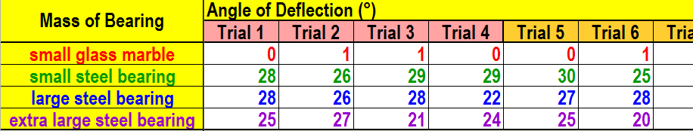
Levels of Data
qualitative
quantitative
ordinal
ratio
What is the dependent variable of this experiment?
What is the independent variable of this experiment?
What are three controlled variables (constants) of this experiment?
What levels of data were observed?
What is the control of this experiment?
What is the conclusion of this experiment?
What types of graphs are used for these levels of data?
20° angle ramp, 4 magnets, level table top
pie graph
bar graph
histogram
Angle of deflection increases as the mass increases
no mass or normal mass
(≈ no magnetism / glass marble)
line graph
scatter plot
What types of inferential statistics are used for this level of data?
chi square
t-test
regression

Slide 4
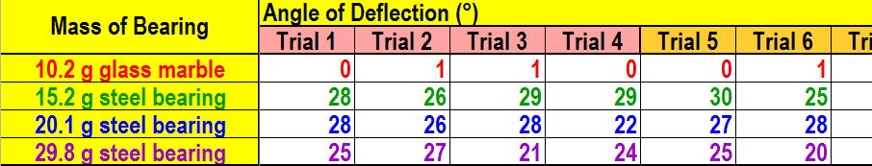
Levels of Data
quantitative
quantitative
ratio
ratio
What is the dependent variable of this experiment?
What is the independent variable of this experiment?
What are three controlled variables (constants) of this experiment?
What levels of data were observed?
What is the control of this experiment?
What is the conclusion of this experiment?
What types of graphs are used for these levels of data?
20° angle ramp, 4 magnets, level table top
pie graph
bar graph
histogram
Angle of deflection increases as the mass increases
no mass or normal mass
(≈ no magnetism / glass marble)
line graph
scatter plot
What types of inferential statistics are used for this level of data?
chi square
t-test
regression

