Slide 1
Types of T TESTS
and
1 & 2 Tailed Tests

Slide 2
Are INFERENTIAL STATISTIC TEST(S) applicable to this data?
*REQUIREMENTS for ALL inferential statistic tests
TWO or MORE EXPERIMENTAL GROUPS (control and one treatment, or two or more treatments)
OUTPUT is CONTINUOUS DATA (INPUT may be categorical or continuous)
COMPARE MEANS
minimum of 15 TRIALS
Which INFERENTIAL STATISTIC TEST(S) are applicable to this level of data?
REGRESSION: BOTH INPUT and OUTPUT must be CONTINUOUS INTERVAL or RATIO DATA
T-TEST: OUTPUT must be CONTINUOUS and INPUT may be CATEGORICAL or CONTINUOUS DATA
CHI-SQUARE: BOTH INPUT and OUTPUT are CATEGORICAL DATA

Slide 3
Which type of T-TEST is applicable to this experiment’s design?
INDEPENDENT TWO-SAMPLES T-TEST
two independent experimental groups
each experimental group is measured once
group 1’s observations are compared group 2’s observations
example: measure growth rates of different fertilizer amounts
PAIRED TWO-SAMPLES T-TEST (or dependent sample t-test)
one experimental group
each subject or entity is measured twice (often over time)
each pair of observations are compared
Example 1: measure employee performance before & after training
Example 2: zinc concentrations in surface & bottom water of a lake
Example 3: tread wear of two types of tires put on the same bicycles
ONE-SAMPLE T-TEST
one experimental group
each subject is measured once
observed measurements are compared to a null hypothesis value
example: compare an observed measurement to a known standard

Slide 4
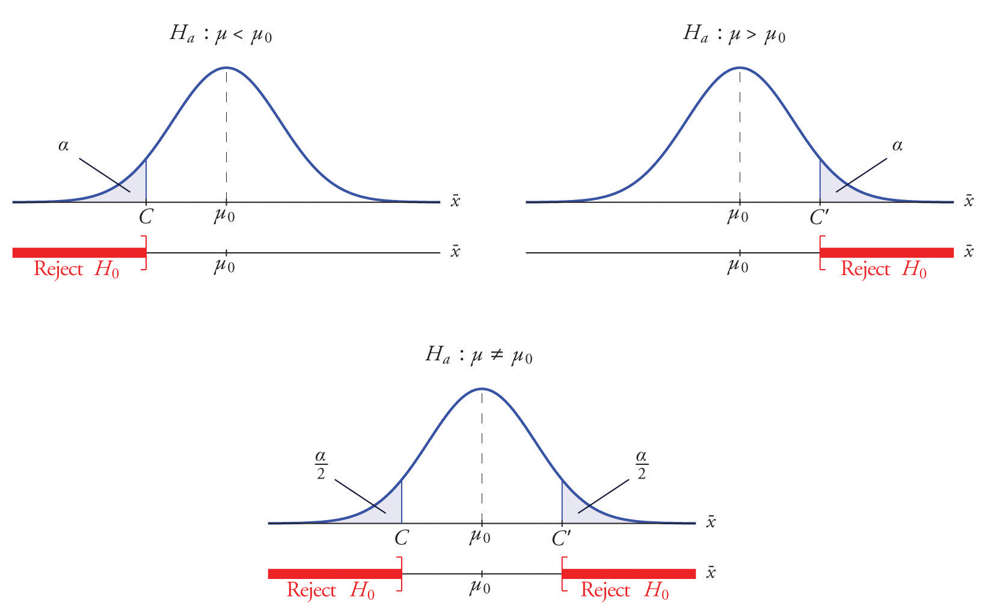
Which type of TAILED test (t-test or chi-square) is applicable to this experiment’s design?
TWO-TAILED T-TEST
H_{A} ≠ H₀
(consider H₁ being both greater than or less than H₀)
ONE-TAILED T-TEST
H_{A} > H₀ or H_{A} < H₀
(consider H_{A} being only greater than or only less than H₀)
Negative one-tailed test
Positive one-tailed test

