Slide 1
REGRESSION
(R²)

Slide 2
Are INFERENTIAL STATISTIC TEST(S) applicable to this data?
*REQUIREMENTS for ALL inferential statistic tests
TWO or MORE EXPERIMENTAL GROUPS (control and one treatment, or two or more treatments)
OUTPUT is CONTINUOUS DATA (INPUT may be categorical or continuous)
COMPARE MEANS
minimum of 15 TRIALS
Which INFERENTIAL STATISTIC TEST(S) are applicable to this level of data?
REGRESSION: BOTH INPUT and OUTPUT must be CONTINUOUS INTERVAL or RATIO DATA
T-TEST: OUTPUT must be CONTINUOUS and INPUT may be CATEGORICAL or CONTINUOUS DATA
CHI-SQUARE: BOTH INPUT and OUTPUT are CATEGORICAL DATA

Slide 3
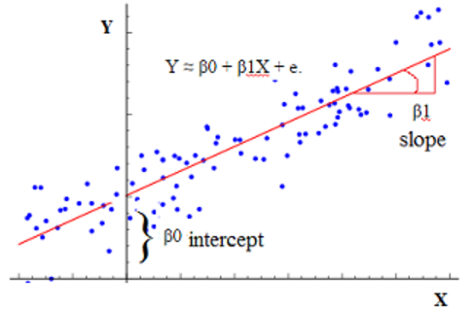
REGRESSION
REGRESSION (R²)
looking for the relationship between two variables
tested multiple levels of those variables
interval/ratio level data for both variables (independent & dependent)
compares variables to check for a linear relationship between means
estimates the strength of a relationship between independent and dependent variables
calculates line of best fit between data points
correlation coefficient (R²) measures how close line fits the data – closest to +1 (direct relationship) or -1 (inverse relationship)
measures the % of the variation in the dependent variable Y that is explained by the independent variable X

Slide 4
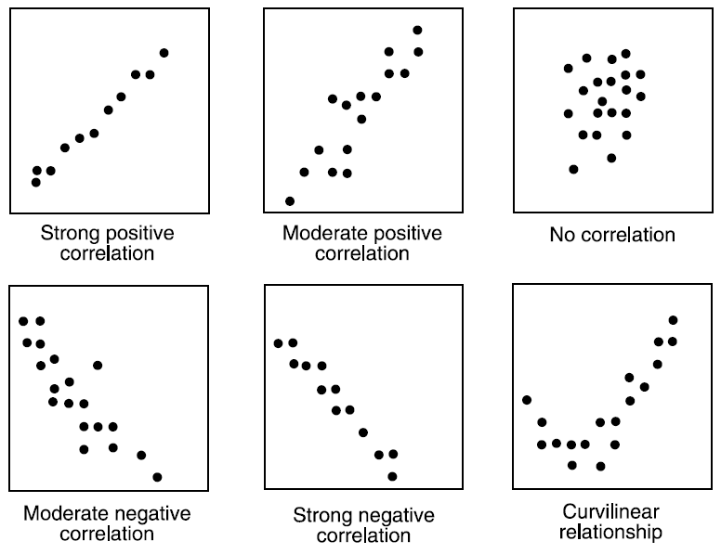

Slide 5
Statistically significant does NOT mean LARGE.
Statistically significant ≠ practical significance or usefulness
Statistically significant does mean there is evidence of a result in the population.
Statistically significant does not mean there is a strong relationship between the (X) independent variable and the (Y) dependent variable.
To examine the strength of a relationship between the (X) independent variable and the (Y) dependent variable we look at the slope, the correlation coefficient (how close the data points are to the fitted line) and the R² value (how much of the change in (Y) dependent variable is explained by (X) independent variable.
when two variables are correlated it does not mean that one causes the other. It means there is a linear relationship between the two variables. One might cause the other. (association ≠ causation)

