Slide 1
P-VALUE

Slide 2
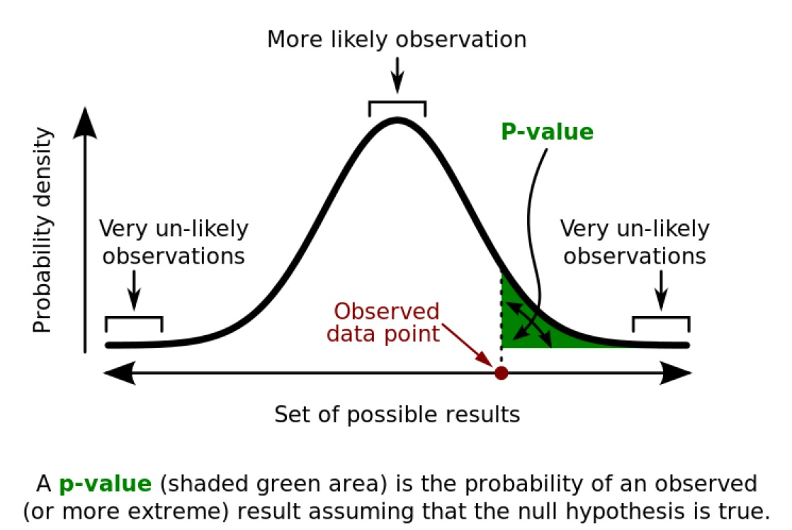
P-VALUE (t-test or chi-square)
*less than 5% chance
null hypothesis is true
no significant difference
< 0.05

Slide 3
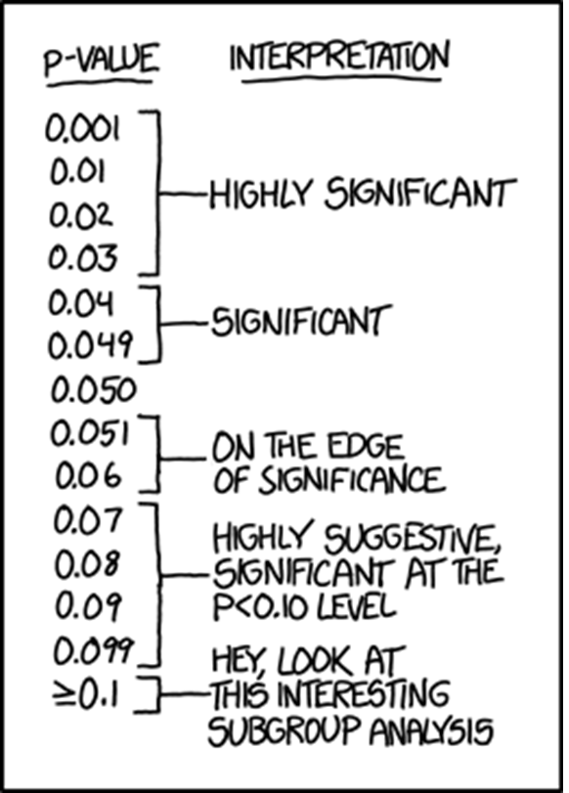

P-VALUE (t-test or chi-square)
probability that the observed result is due to chance
probability that, from a randomized, controlled experiment, the Null hypothesis is correct.
probability that there is no difference or significant effect between the means from two experimental groups
strength or amount of evidence effect occurs in population
level of significance (standard level of significance is α = 0.050)
Only 1% chance there is no real difference
Only 5% chance there is no real difference
p < 0.05
Reject H_{O}
because the difference is significant because observed results are unlikely to occur by chance

