Slide 1
STANDARD DEVIATION

Slide 2
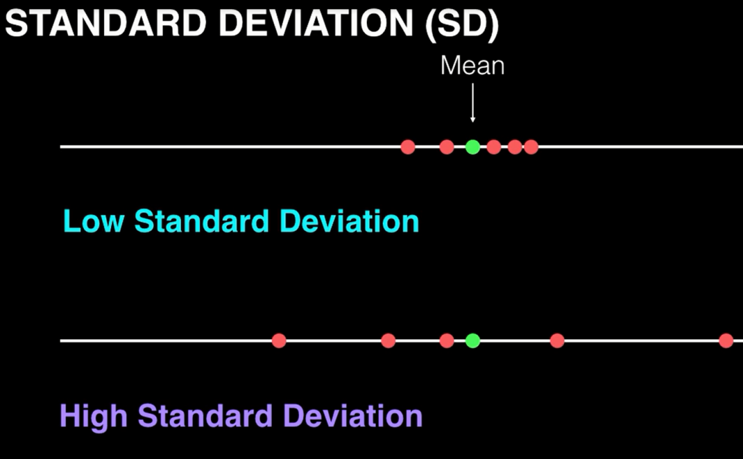
STANDARD DEVIATION (symbol is σ sigma)
measures VARIABILITY or SPREAD of MEASUREMENTS in a data set from repetition of trials within one experiment
What is the standard deviation of each data set below? High or Low?
Mean
LOW standard deviation
NARROW range of measured data
Mean
HIGH standard deviation
WIDE range of measured data

Slide 3
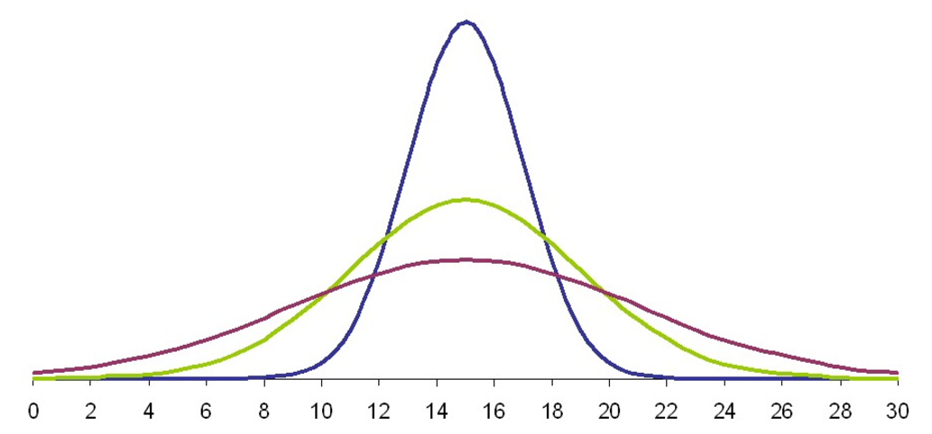
3. SMALLEST standard deviation
2. INTERMEDIATE standard deviation
1. LARGEST standard deviation
Put these in order from the highest standard deviation to lowest standard deviation.
LARGEST standard deviation (most variability of measurements in a data set)
1. red
INTERMEDIATE standard deviation (moderate variability of measurements in a data set)
2. green
SMALLEST standard deviation (least variability of measurements in a data set)
3. blue

Slide 4
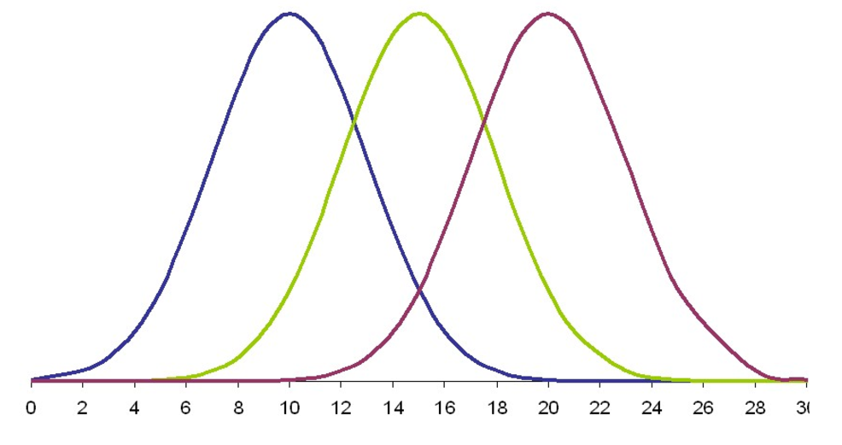
All three have the SAME standard deviation
because they all have the same data variability (spread).
10
15
20
Each data set has a different mean.
Put these in order from the lowest standard deviation to highest standard deviation.
SAME standard deviation (least variability of measurements in a data set)
blue
green
red

Slide 5
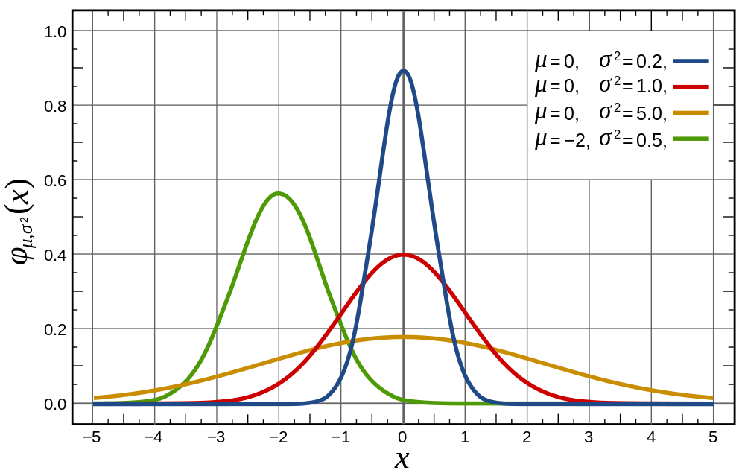
1. lowest standard deviation
4. highest standard deviation
Put these in order from the lowest standard deviation to highest standard deviation.
LOWEST standard deviation (least variability of measurements in a data set)
1. blue
Low standard deviation (less variability of measurements in a data set)
2. green
High standard deviation (more variability of measurements in a data set)
3. red
HIGHEST standard deviation (most variability of measurements in a data set)
4. yellow

Slide 6
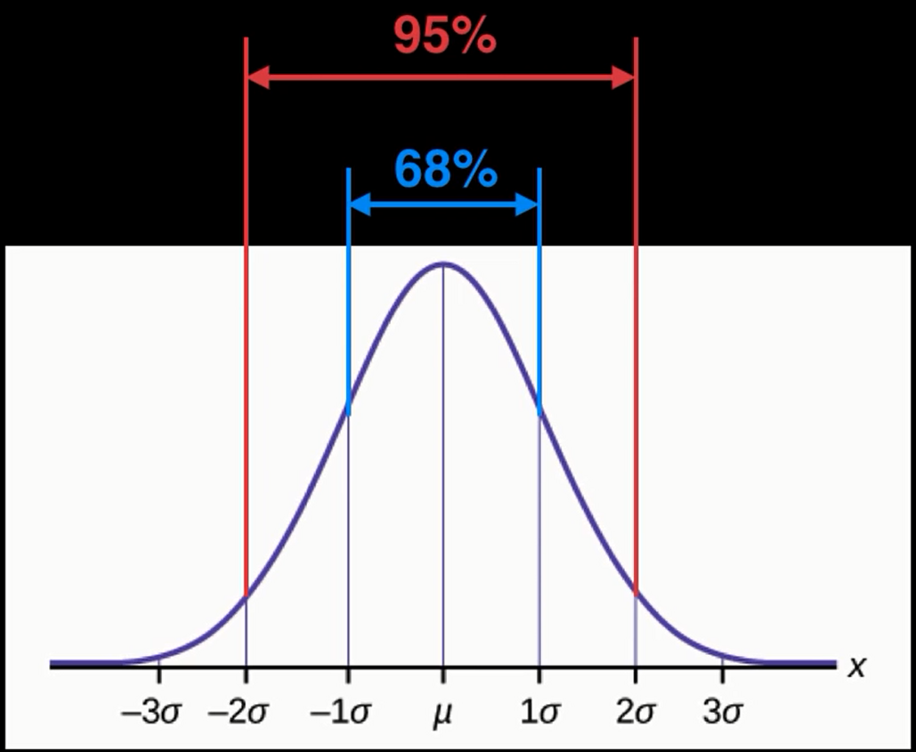
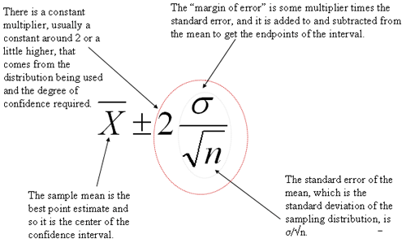
STANDARD ERROR of the MEANS (symbol SEM)
measures PRECISION OF THE MEAN of a data set of means from multiple replications of an experiment
(standard deviation of the means of replicated experiments)
how much sampling variation there is if resample & re-estimate
±2 SEM means 95% of replications will contain the true mean
smaller standard deviation (σ) decreases standard error
larger sample size (n) decreases standard error

Slide 7

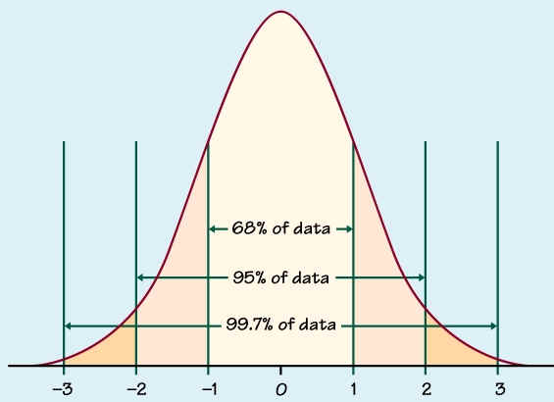
CONFIDENCE INTERVALS
a 95% confidence interval reflects a significance level of 0.05 (p-value < α-value of 0.05)
confidence interval of 95% means that the means of multiple replications would be within this confidence interval 95% of the time
Data found
out here is like way weird!!
AND YOU MUST REJECT THE NULL HYPOTHESIS

