Slide 1



2024 Tentative Tax Levy
October 7, 2024

Slide 2
Tax Levy:
Purpose
District requests funding from local taxpayers that is collected through property taxes
Property Classification:
Residential (87%)
Commercial (7.8%)
Rural (3.4%)
Industrial (1.3%)

Slide 3
Factors for Tax Capped Districts:
Consumer Price Index (CPI)
Equalized Assessed Valuation (EAV) - 2023
Estimated EAV (2024)
New Property Values

Slide 4
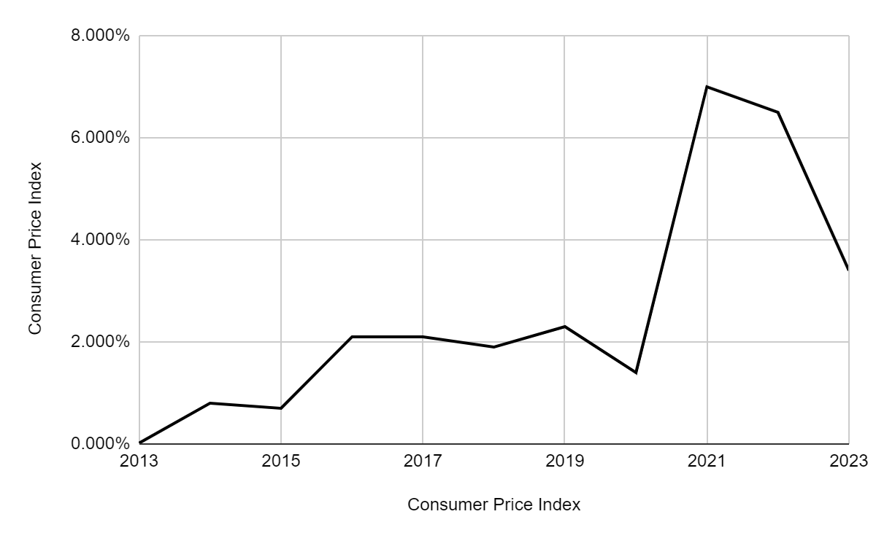
Consumer Price Index
#WeAreYorkville

Slide 5
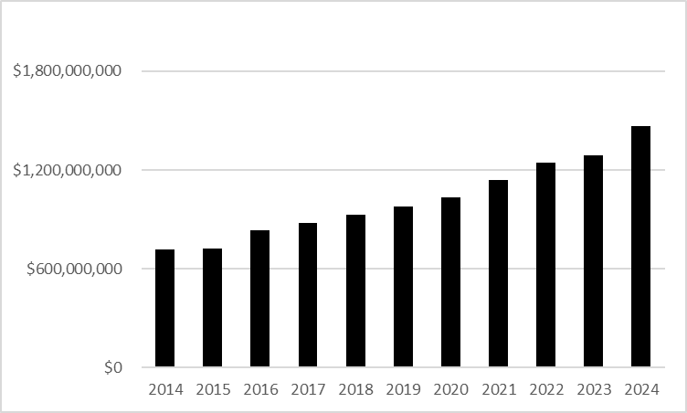
Historical EAV
2024 - 1.28B
2025 - 1.42B
#WeAreYorkville

Slide 6
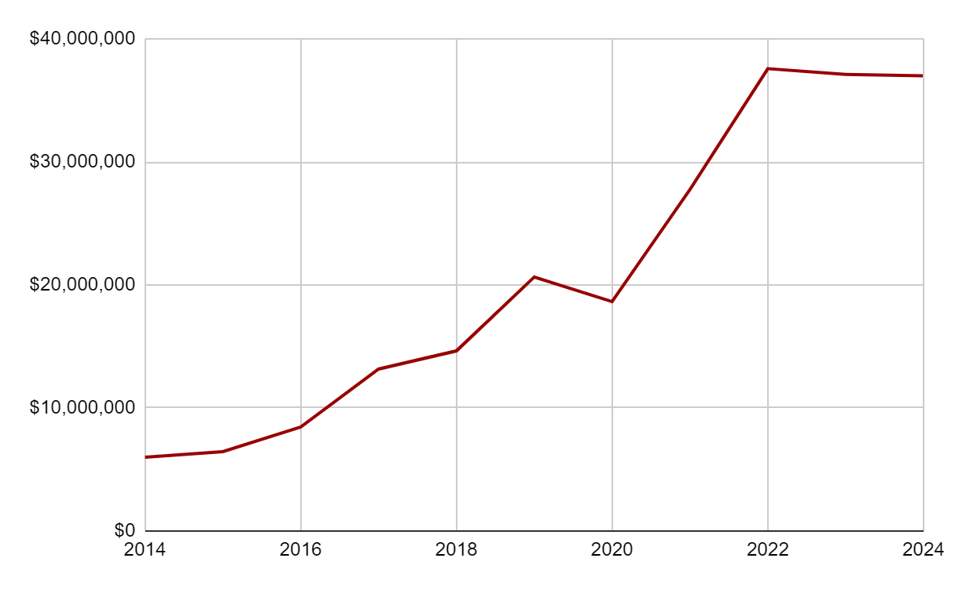
New Property Values
Estimate - $37,000,000
2025 - $1,465,628,768
13.87% Increase
#WeAreYorkville

Slide 7
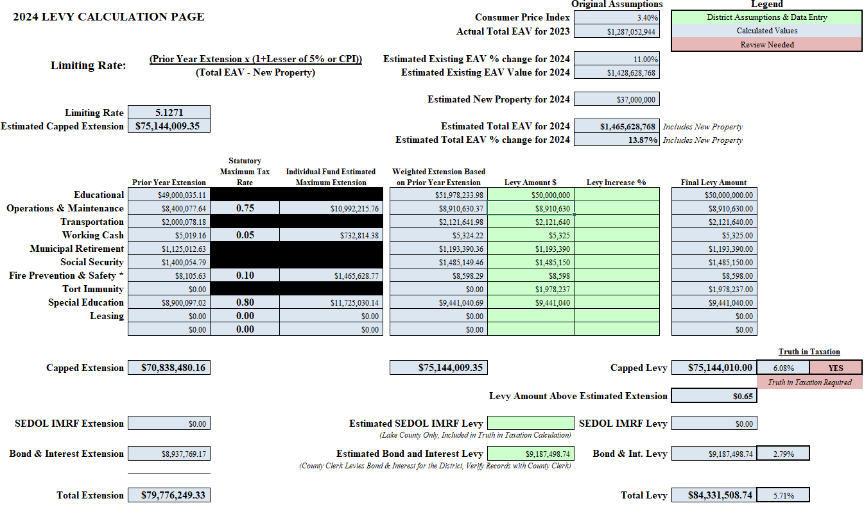

Slide 8
Tax Levy Timeline
Truth in Taxation Hearing Notice
Published in Kendall County Record
Tentative Levy Presented to BOE
Discussion and questions
10/28/2024
11/25/2024
10/7/2024
11/14/2024
Tax Levy Update to BOE
Tentative Levy updates based on new construction or assessments
Truth in Taxation Hearing and Board Votes on Proposed Levy

Slide 9

Questions?
#WeAreYorkville

