Slide 1


Long Island Student Forum
Student Participant Recap
February 28, 2025
Notes:
https://www.youtube.com/watch?v=QAEPWRfGjFQ

Slide 2

Event Overview
In January 2025, over 850 Long Island high school students participated in a ThoughtExchange to answer the following questions: What are some important topics about the high school experience that you feel students across Long Island should share and discuss? What are some student perspectives that adults and school administrators need to hear?
The responses were used to create table topics for the February 28 Student Forum
  Mental Health
  Academic Pressure
  School Environment
  What And How We Learn
109 students from 39 districts and 5 CTE schools attended the Forum
Students exchanged ideas, shared experiences and identified some very important takeaways to share with school district administrators

Slide 3


Table Topics |Key Takeaways

Slide 4

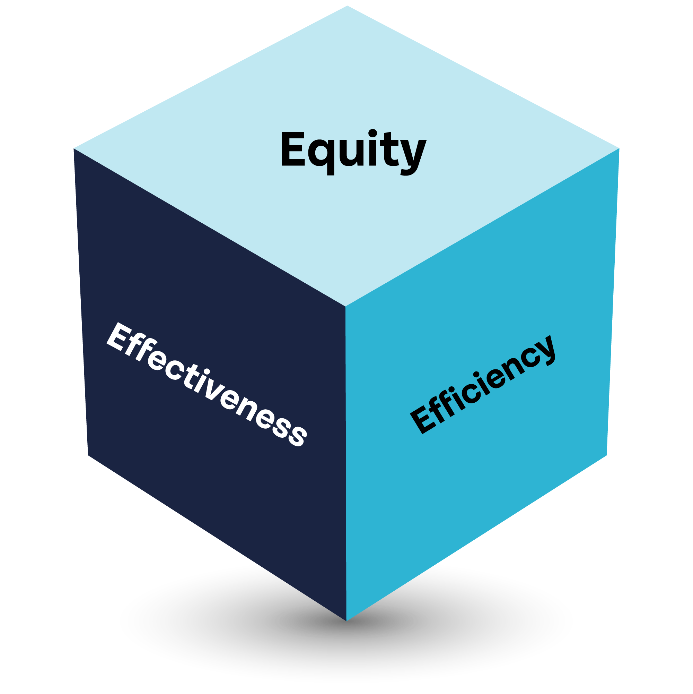

MENTAL HEALTH
Community and Support Systems: It is important to emphasize a supportive community within schools and include staff training to ensure students feel supported and understood.
Mental Health Resources: Offer more mental health resources such as wellness rooms, mental health days, and events that promote mental well-being.
Academic Pressure: Address the significant stress and pressure students face due to academic expectations, college applications, and standardized testing.
Extracurricular and Career Guidance: There is a need for better guidance in extracurricular activities and career planning, including more meaningful elective classes and career centers.
Open Discussions and Events: Encourage open discussions about mental health and organizing events that allow students to express their concerns and seek help.
"Mental health is just as important as physical health, yet it often gets overlooked in schools.”
"Mental health days off sound crucial and important.”
"It is important that schools emphasize the importance of mental health and encourage students to reach out if they are struggling."

Slide 5
ACADEMIC PRESSURE
Teacher and Parent Awareness: Teachers and parents need to be more empathetic and supportive of the personal and academic stresses faced by students. Proper training and education for guidance counselors are also essential.
Course Selection Pressure: There is significant pressure on students to take high-level courses (AP, IB, honors) that may not align with their interests but are perceived to look better for college admissions.
Impact on Mental Health: Academic pressure can lead to stress, anxiety, and burnout, often at the expense of personal growth, creativity, and emotional well-being.
Class Rank and Competition: The focus on class rank fosters unhealthy competition among students, damaging relationships and self-esteem. Reducing emphasis on ranking could promote a more collaborative environment.
Balancing Academics and Extracurriculars: Students, especially athletes and those involved in extracurricular activities, struggle to balance their schedules. A more supportive system and realistic expectations are needed to help manage this balance.
"Academic pressure can lead to stress, anxiety, and burnout as students feel intense pressure to perform well. This focus on grades often overlooks personal growth, creativity, and emotional well-being.”
"There is a lot of pressure placed on students to take high level honors, college, AP, and IB courses. These courses put unnecessary pressure on students to take the courses that 'look best' to colleges, peers, or parents, not to themselves.”
"Students don’t get the support system that will help relieve pressure. Especially with managing sports and academics at the same time."

Slide 6
SCHOOL ENVIRONMENT
Safety: There is a need for improved safety measures and solutions that effectively identify and address potential threats, including the impact of social media on school safety.
School Spirit: School spirit is highlighted through activities such as cultural fairs, club collaborations and in-school events. They are a way to boost school spirit, create a sense of community, and engage in diverse groups and activities.
Mental Health: Addressing mental health, having counseling available and creating Zen spaces in schools can lead to a safer and more supportive school environment.
Social Media: Promoting kindness campaigns and supportive interactions can mitigate some of the negative effects.
Inclusion: Inclusive practices are essential for a healthy school culture. More activities that allow students to interact with a variety of peers can lead to a more positive and engaging school environment.
“We need to put more emphasis on safety as well as encouraging club involvement.”
“Social media can be damaging to school safety.”
“Having supportive teachers and Zen spaces in school would help with safety and a positive school environment.”
“Cliques can cause toxic environments for those who want to be out there and engage in diverse groups of people.”
“Timings and schedules for clubs, sports and afterschool activities need to be organized so that students can participate in multiple programs.”

Slide 7
WHAT AND HOW WE LEARN
Curriculum: Students would like access to a variety of topics, more real-world learning experiences, internships and increased instruction on life skills. They feel that many of the subjects taught do not deal with real life experiences.
Testing: Participants believe standardized tests are stressful and often given priority over homework and projects. They feel they are not always accurate assessments of a student’s knowledge.
School/Life Balance: Students often have difficulty balancing school workload with extracurricular activities and work or personal obligations. A schedule that accommodates a lunch or recess period with space for students to interact would positively impact school effectiveness.
Student/Teacher Relationships: Participants believe the pace of teacher instruction is driven by exams. They feel they cannot connect with teachers which hampers their learning. They also feel they would benefit from access to additional resources.
“Students need to learn how to take tests. Oftentimes help is offered, but it is not widely known about or is viewed as embarrassing to participate in.”
“Introduce oral exams in addition to written exams, as a different way to evaluate student learning and understanding of content.”
“Offer virtual AP and IB classes to expand these courses to schools that are not typically able to offer them.”
“Classes such as personal finance and public speaking are essential to students because they highlight things that kids will use in college.”

Slide 8
MY NOTES

Slide 9
Student Feedback

Slide 10
Student Feedback
Student feedback was very positive, and participants would love to see this event continue. Some of the suggestions for future Forums include:
Add more discussion topics and make each session longer
Have a guest speaker
Give students the opportunity to network and share their contact information
Include an icebreaker or team-building activity
Provide sheets to take notes
Give students time to reflect on how they can help implement these ideas in their schools
Incorporate policy makers into the event and allow students to interact directly with them
What Are Your Suggestions For Future Events?

Slide 11
Student Quotes
"It’s great to see kids from different backgrounds talk to each other in such an open way.”
"My biggest takeaway from today is we as students need support systems that will help us get through hard times.”
"We need to have more student check ins from this Forum.”
"I loved it, my biggest takeaway is that when students get together and all collaborate, we can create amazing ideas.”
"My biggest takeaway was the need for community throughout school.”
"Students of this generation are more aware of global problems than ever before due to the social media and news we consume on a daily basis.”
"My biggest takeaway was that mental health really can be integrated and connected into everyone problem facing students today.”
"My biggest takeaway from the event is that nobody is alone."

