Slide 1

Federal Programs
John Spikes, Director
Richard Vail, Supervisor
Loree Smith, Family Engagement & Non-Public
Johnethia Bellard, McKinney Vento
Latarsha Theard, Funds Coordinator
Melonie Wallace, Computer Network Technician
Courtney Leonard, Funds Coordinator
Della Bell, Secretary
CrystalAnn Fleming , Secretary
Kendria Guice, Secretary
Lacitta Lavergne, NP/FE Clerk & Fixed Assets

Slide 2
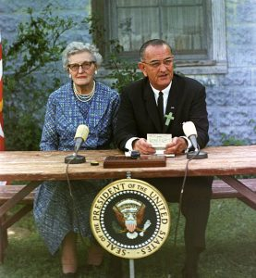
Elementary and Secondary Education Act of 1965
The Elementary and Secondary Education Act (ESEA) was a cornerstone of President Lyndon B. Johnson’s “War on Poverty”.

Slide 3
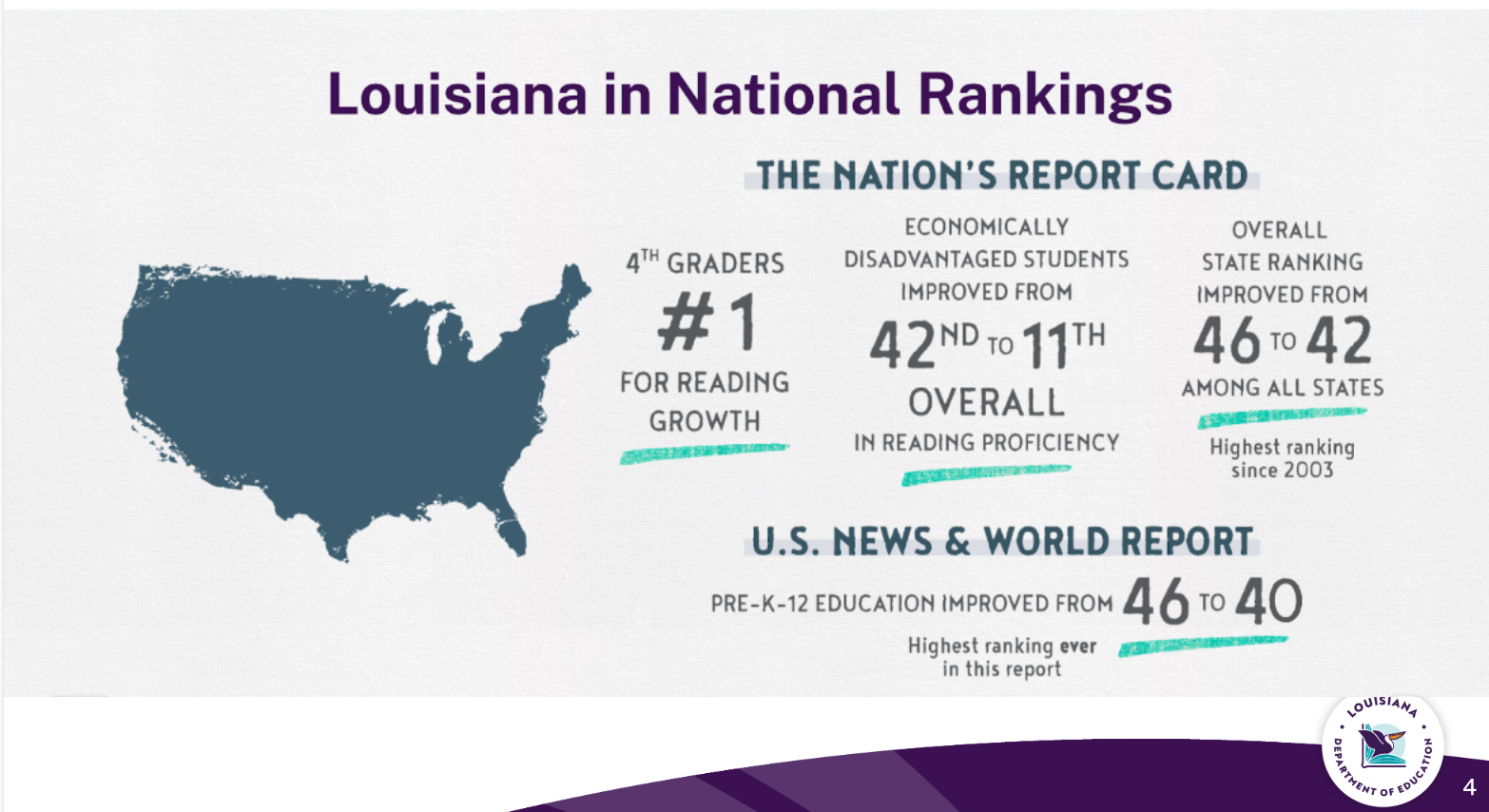
Louisiana in National Rankings

Slide 4
Federal Programs -- ESSA
Every Student Succeeds Act
  Title I, II, III, III Immigrant, Title IV, Non-public, Homeless, Foster Care, N & D

Slide 5
Title I Schoolwide Program Qualifications
Calcasieu Parish School System Federal Programs Department serves all schools having a poverty level of 60% and above for middle and high schools . Elementary and elementary grade span schools greater than 40% poverty level are also served. The date to determine Title I eligibility (F/R %/ED %) is set by the LDOE. If a school falls below the poverty level, the school will be given a one-year grace period to get back above the poverty level. If they still fall below the poverty level a second year, the school will no longer be a Title I school until they get back above the poverty level.

Slide 6
Title I Services
•38 Schools in Calcasieu Parish
•4 Neglected and Delinquent Facilities
  •Boys Village, Harbour House, Louisiana Methodist Children’s Home, and Juvenile Detention Center
•9 Non Public Schools
  •Episcopal Day School, First Baptist Christian Academy, Hamilton Christian Academy, Immaculate Conception Catholic School, Life Christian Academy, Our Lady Queen of Heaven Catholic School, Our Lady’s Catholic School, St. Louis Catholic High School, and St. Margaret Catholic School

Slide 7
Title II
Improving Teacher Quality Grant is a federally funded grant for the purpose of increasing the academic achievement of all students by helping schools and districts improve teacher and principal quality and ensure that all teachers are highly effective.
Below are some examples of funded activities across all schools in the district
  Teacher Leader Summit
  New Teacher Academy
  Gifted Training
  PD
  Teacher/Para Certification

Slide 8
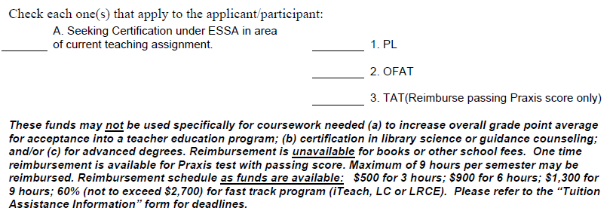
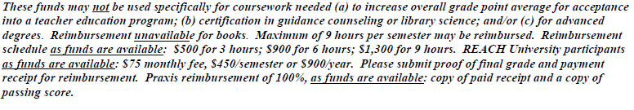
Teacher/Para Tuition Assistance
Located on the Personnel Website

Slide 9
Certification/Notification
Principals are required to work with CPSB Personnel Department to determine each teacher's and paraprofessional's Certification status.
ESSA Parental Notification Requirements; LEA must provide families with written notification.
Certification Documentation:
  Attestation
  Example Parent Letter
  Notification Documentation Letter
This can be found in the CPSB Student Code of Conduct.

Slide 10
Title III
The English Language Learner (ELL) program is to help ensure that children who are non-English speakers attain English proficiency, develop high levels of academic attainment in English and meet the same challenging LA academic standards as all children are expected to meet.
Below are some examples of funded activities across all schools in the district
  Schools with EL training
  Interpreter
  PD
  Site Licenses
  Supplies

Slide 11
Title III English Learners
Home Language Survey, English FP 800-1B-E
Home Language Survey, Spanish FP 800-1B-S
Form Letter of Attestation for HLS FP 800-1A
All forms can be found under FP Forms tab.

Slide 12
Title IV
Provides all students with access to a well-rounded education, improve school conditions for student learning, and improve the use of technology in order to improve the academic achievement and digital literacy of all students.
Below are some examples of funded activities across all schools in the district
  Dual Enrollment/CLEP/AP Testing
  Mental Health/Counseling Services
  World Languages
  Literacy Enhancement/Family Nights
  PBIS
  PD
  Tech Con
  Magic School
  Discovery Education

Slide 13
SAPE
The goal of the SDFS program is to provide all students with learning environments that are safe, drug-free, and conducive to learning.

Slide 14
SAPE
Substance Abuse Prevention Education
  SAPE Team FP 800-2A
  Mandated Compliance FP 800-2B
  Documentation of SAPE Hours FP 800-2C (kept on file at school)
This is a requirement as per Louisiana Act 861

Slide 15
McKinney-Vento Homeless
Under the education subtitle of the McKinney-Vento Homeless Assistance Act, the term “homeless children and youth” refers to individuals who lack a fixed, regular, and adequate nighttime residence.
The McKinney-Vento Homeless Educational Act for Children & Youth aims to provide educational stability, which is crucial for academic success, to children and youth whose lives have been disrupted by the loss of housing.
  Principal will:
    Designate two MV/Foster Care Point of Contacts (POCs) – form due before August 1st
      POCs required to view MV Training Webinar with updates (Webinar available July 28th)
      Principal verifies POCs completion of training by signing certificates & uploading to school’s folder in OneDrive – due by August 18th
    Ensure your staff receives MV Professional Development/Training before August 11th
      Enlist your designated POC to provide MV training to faculty/staff (back to school in-service)
      Document “Title VII Homeless Information” on your meeting agenda
        Upload copy of agenda and faculty sign-in sheet to your school’s folder in OneDrive
  Code of Conduct: MV Referral form
  Purple Folder for school’s POCs – late July 2025

Slide 16
Foster Care and Migrant
For Foster Care, the family will provide a DCFS Foster Care Form to the school's administrator during enrollment. This form, along with the FP Foster care confidential Referral form, should be emailed to federalprogramsrosteet@cpsb.org
Migrant: Someone who moves because the student or family are involved in seasonal agricultural or fishing work.
Migrant children and youth are eligible for all McKinney-Vento services, including free school meals, if they lack fixed, regular, and adequate nighttime residence.
Code of Conduct: Migrant QR codes (English, Spanish, Vietnamese)

Slide 17
Comprehensive Support and Improvement (CSI) & Targeted Support and Improvement (TSI) Plan
ESEA section 1111(d)(1)(B) requires LEAs, in partnership with stakeholders (including principals and other school leaders, teachers, parents, and, as applicable, Tribes), to develop and implement a plan for a school identified for CSI (CIR-A and UIR-A) to improve student outcomes.

Slide 18
Documentation
Electronic documentation via Federal Program Website
Documentation is required and will be verified throughout the school year by the District Federal Programs staff.

