Slide 1

2024 Summer Projects/ Work Facilities Department

Slide 2
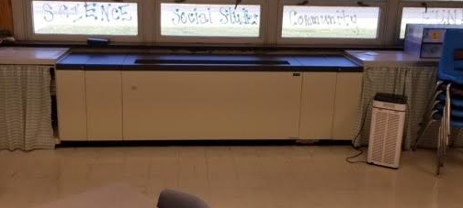
HVAC Installation at CRES and CDMS

Slide 3
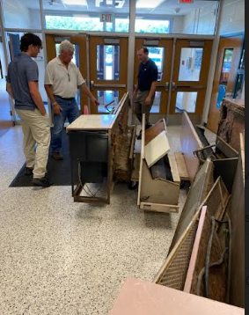
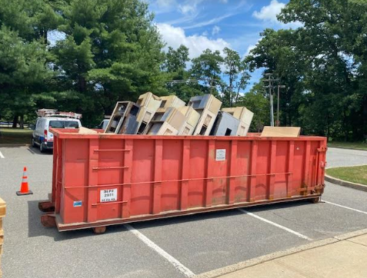
Old Uninvents Removed at CRES and CDMS
Removed 60 year Old units

Slide 4
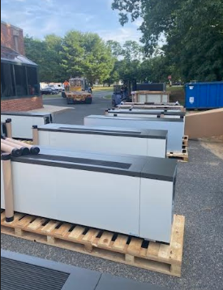
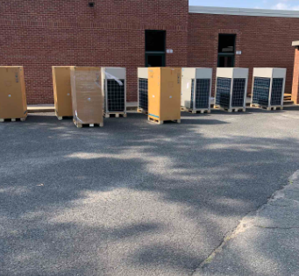
New Uninvents/ Condensers Being Delivered

Slide 5
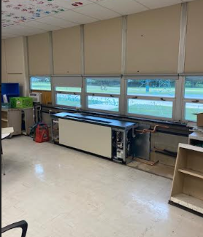
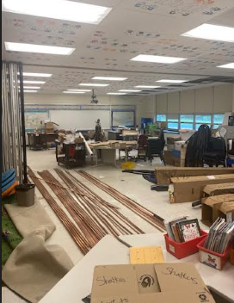
Uninvents Being Installed By D and B
New Refrigerate Piping Installed for both Schools

Slide 6
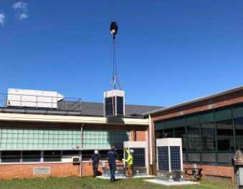
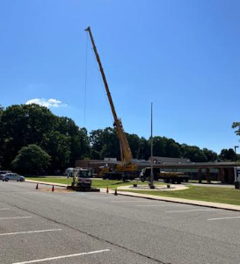
Condensers Craned into Courtyard for Installation

Slide 7
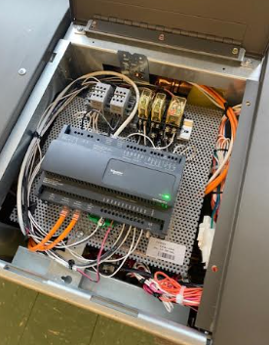
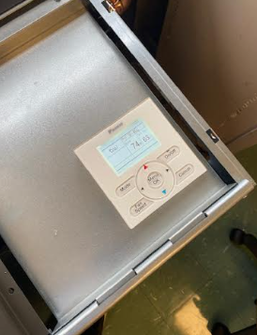
HVAC Controls Installed for New Units By JSC
Specific Individuals are now able to make changes remotely utilizing new controls program

Slide 8
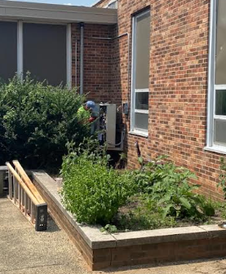
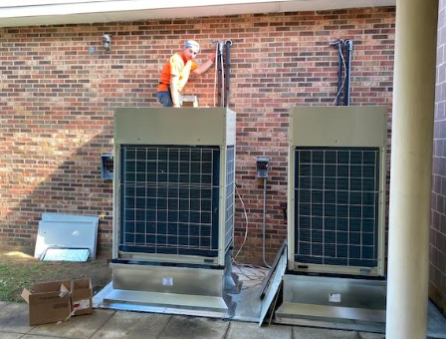
New Condensers Being Installed

Slide 9
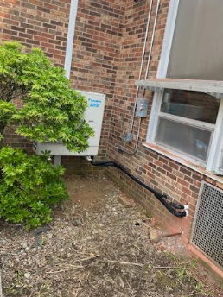
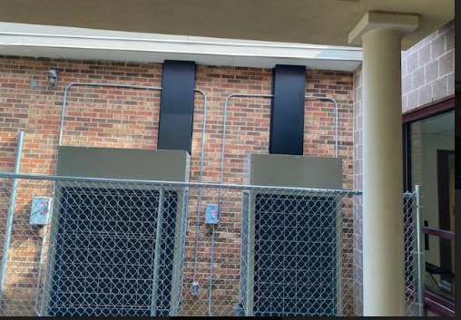
Condensers Installed And Running
Units are extremely quiet so will not affect teaching/ learning

Slide 10
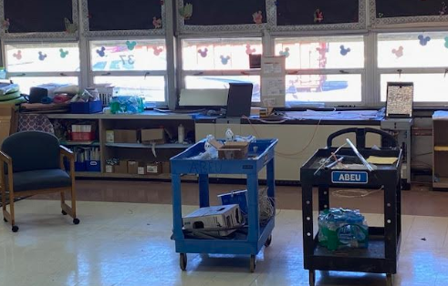
Uninvents Installed / HVAC Is Running
New Units come with GPS Bi Polar Ionization, that kills mold and break down particulants in the air.

Slide 11
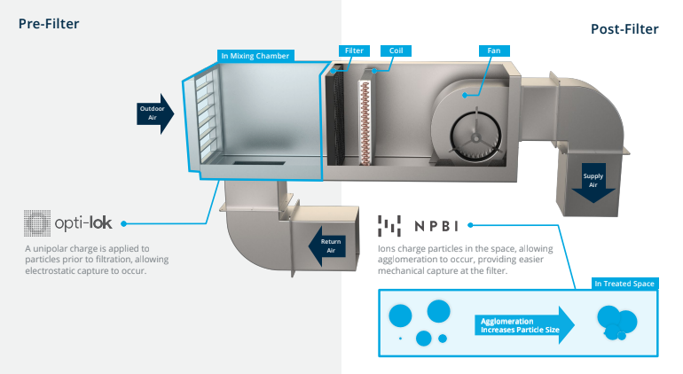
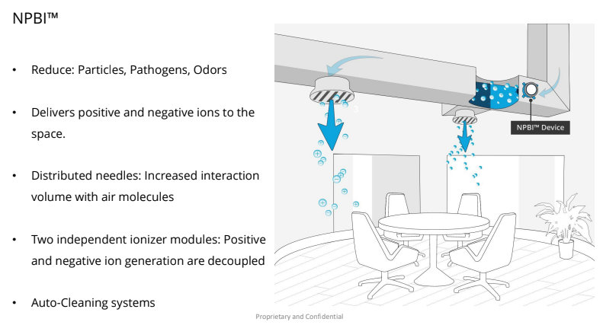
New Units come with GPS Bi Polar Ionization, that kills mold and break down particulates in the air.

Slide 12
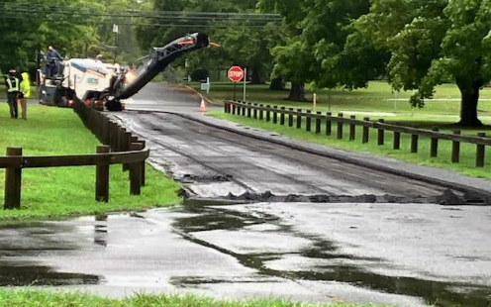
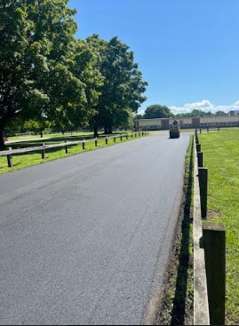
Driveway at CRES Milled and Repaved

Slide 13
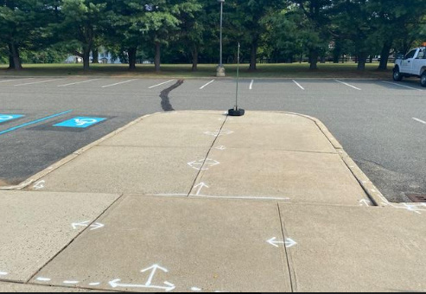
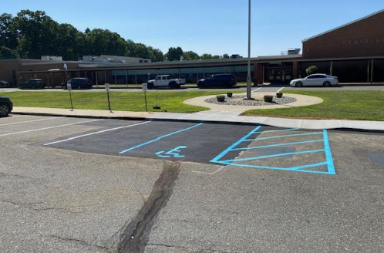
Sinking Sidewalk Removed/ Sidewalk Redone at CDMS
8 inch drop in sidewalk that could cause serious injury

Slide 14
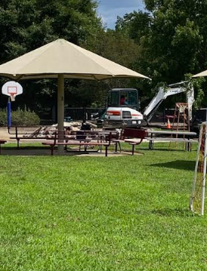
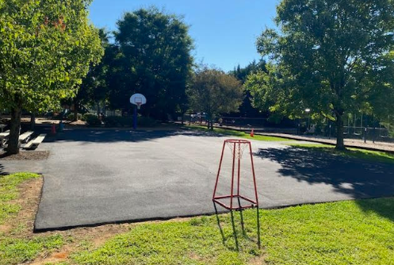
Basketball Court Milled and Repaved

Slide 15
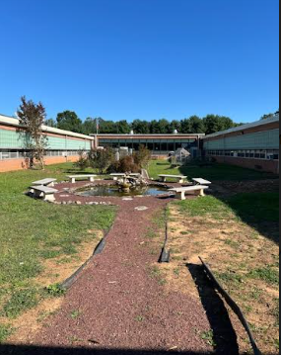
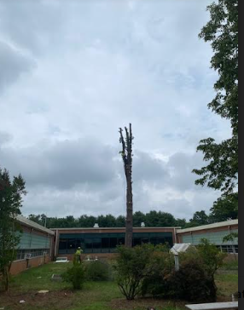
Trees Removed at CDMS Courtyard

Slide 16
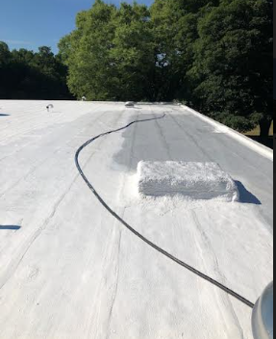
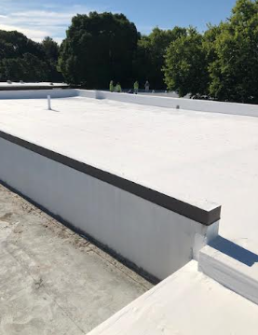
New Roofs Coats Installed In Specific Areas at CRPS, CRES, and CDMS

Slide 17
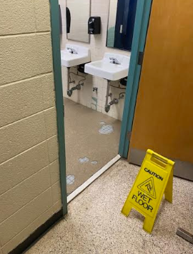
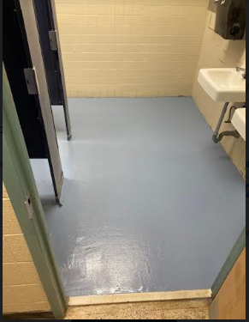
Bathroom Floors Replaced At CDMS Men's/ Women's Room
Old Floors (3) removed and replaced

Slide 18
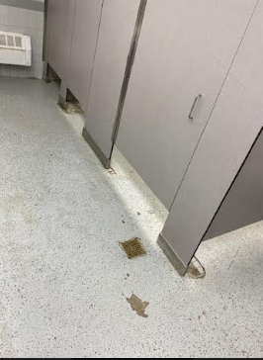
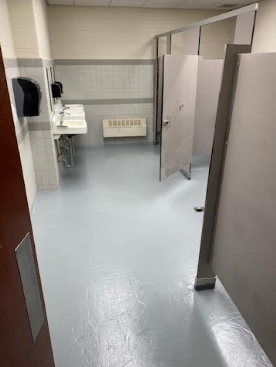
Replaced Bathroom Floor at CDMS 7th Boys Room
Old Floors (3) removed and replaced

Slide 19
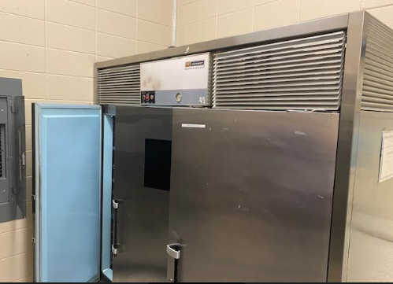
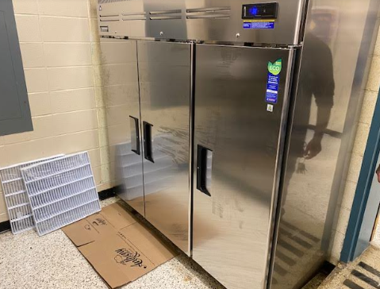
New Refrigerator at CRES Kitchen
Replaced 60 Year Old Fridge

Slide 20
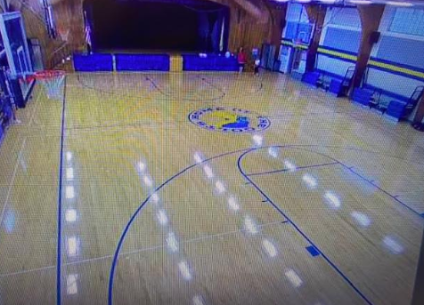
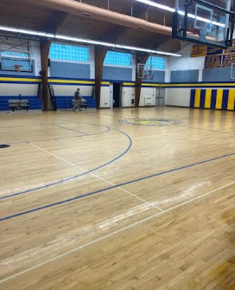
CDMS Gym Floor Recoated

