Slide 1
Federal Programs
John Spikes, Director
Richard Vail, Supervisor
Loree Smith, Family Engagement & Non-Public
Johnethia Bellard, McKinney Vento
Latarsha Theard, Funds Coordinator
Melonie Wallace, Computer Network Technician
Courtney Leonard, Funds Coordinator
Della Bell, Secretary
CrystalAnn Fleming , Secretary
Kendria Guice, Secretary
Lacitta Lavergne, NP/FE Clerk & Fixed Assets

Slide 2
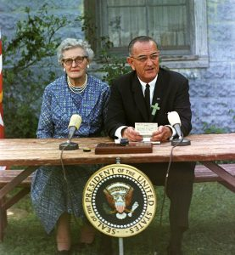
Elementary and Secondary Education Act of 1965
The Elementary and Secondary Education Act (ESEA) was a cornerstone of President Lyndon B. Johnson’s “War on Poverty”.

Slide 3
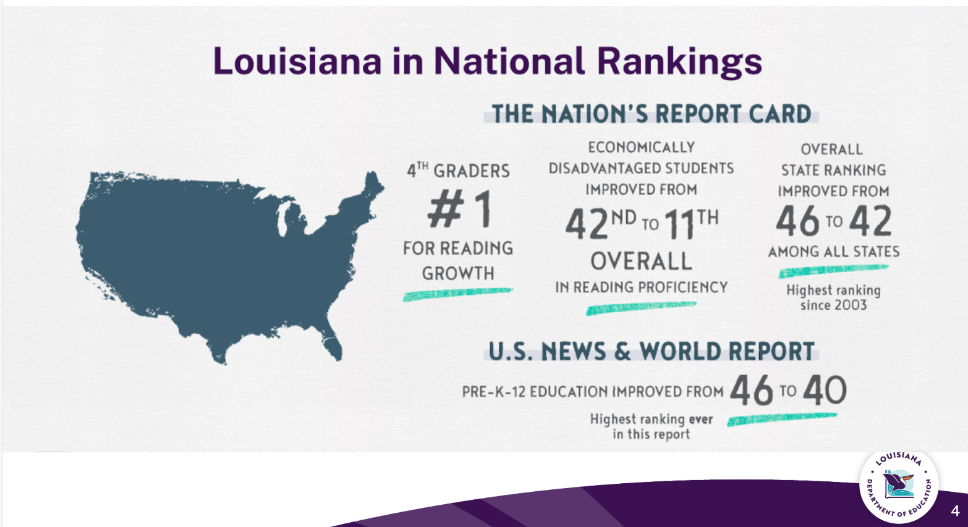
Louisiana in National Rankings

Slide 4
Federal Programs -- ESSA
Every Student Succeeds Act
  Funding is to enable children who are most at risk to meet the state’s challenging student academic achievement standards. The schoolwide program is to improve academic achievement throughout a school so that all students, particularly the lowest achieving students, demonstrate proficiency related to the state’s academic standards. Federal Programs is a support to instructional achievement and in no way will be used to circumvent CPSB Policies and/ or Procedures.
  Title I, II, III, III Immigrant, Title IV, Non-public, Homeless, Foster Care, N & D
  Federal programs are audited each year

Slide 5
Title I Schoolwide Program Qualifications
Calcasieu Parish School System Federal Programs Department serves all schools having a poverty level of 60% and above for middle and high schools . Elementary and elementary grade span schools greater than 40% poverty level are also served. The date to determine Title I eligibility (F/R %/ED %) is set by the LDOE. If a school falls below the poverty level, the school will be given a one-year grace period to get back above the poverty level. If they still fall below the poverty level a second year, the school will no longer be a Title I school until they get back above the poverty level.

Slide 6
Title I Services
•38 Schools in Calcasieu Parish
•4 Neglected and Delinquent Facilities
  •Boys Village, Harbour House, Louisiana Methodist Children’s Home, and Juvenile Detention Center
•9 Non Public Schools
  •Episcopal Day School, First Baptist Christian Academy, Hamilton Christian Academy, Immaculate Conception Catholic School, Life Christian Academy, Our Lady Queen of Heaven Catholic School, Our Lady’s Catholic School, St. Louis Catholic High School, and St. Margaret Catholic School

Slide 7
School Allocation
ED/Enrollment Count – 179/323 = 55.42
179 ED Students x $720 per student = $128,880

Slide 8
School Wide-Team
•Determines how their school’s allocation is spent based on their school-wide plan that was developed and approved by their committee, faculty, and staff.

Slide 9
School Wide Plan (SWP)
SWP must be available for Federal & State Auditors and the public.
Each SWP must include eight components. (Title I SWP checklist).
Title I Request for Expenditures must be supported by the schools SWP.
SWP committee members are parents, teachers, administrators, and meet a minimum for 4 times a year.
Log into Federal Programs Website: Click on the following: Federal Programs, and SWP Components.
Log into Federal Programs Website: Title I School wide Plan Checklist, Flipping Arrows, One Year Action Plan, Transition Plan (Elementary & K-12 Schools only), Plan for attracting Highly Qualified Teachers, Signature of Faculty review of SWP, and letter of Attestation.

Slide 10
Title I Documentation
Title I Documentation
  Electronic documentation via Federal Program Website
  Title I documentation must be kept for 5 years.
  Documentation is required and will be verified throughout the school year by the District Federal Programs staff.

Slide 11
Professional Development
Professional Development
  The school will devote sufficient resources to effectively carry out PD activities.
  Are an integral part of schoolwide and district wide educational improvement plans.
  Are high quality, sustained, intensive and classroom-focused in order to have a positive and lasting impact on classroom instruction and the teacher's performance in the classroom.
  Are developed with extensive participation of teachers, principals, families and administrators of schools served under ESSA;
  Include instruction in how school staff can work more effectively with families.

Slide 12
Family Engagement: FP Principal's Handbook
Loree Smith, Family Engagement and Non-Public Liaison
Examples of FE allowable expenditures
  Title I Guidelines for FE
  ATP- Action Team for Partnerships, FE Policy, Learning Compacts, One Year Action Plans, Documentation, Meeting Requirements, and NNPS (National Network of Partnership Schools) A one-day NNPS training will be provided in early fall.
    FP 600-4 can be found on the FP website, under Forms tab
    Tips and Tools

Slide 13
Title I Job Descriptions
Title I Instructional Tutors
CAI Lab Manager
Title I Instructional Teacher
Title I Curriculum Coordinator
Title I Lead Teacher
Title II Lead Teacher

Slide 14
Certification/Notification
Title I Principals are required to work with CPSB Personnel Department to determine each teacher's and paraprofessional's Certification status.
ESSA Parental Notification Requirements; LEA must provide families with written notification.
Certification Documentation:
  Attestation
  Example Parent Letter
  Notification Documentation Letter
This can be found in the CPSB Student Code of Conduct.

Slide 15
Title III English Learners
Home Language Survey, English FP 800-1B-E
Home Language Survey, Spanish FP 800-1B-S
Form Letter of Attestation for HLS FP 800-1A
All forms can be found under FP Forms tab.

Slide 16
SAPE
Substance Abuse Prevention Education
  SAPE Team FP 800-2A
  Mandated Compliance FP 800-2B
  Documentation of SAPE Hours FP 800-2C (kept on file at school)
This is a requirement as per Louisiana Act 861

Slide 17
FP Quick Reference Guide
Table of Contents
CPSB Federal Programs Checklist 2025/2026
Basic steps for Request for Expenditure
Procedures for Title I Admission Tickets
Request for Expenditure form

Slide 18
Budgets
Two Budgets -- Title I and Family Engagement
They are not final and can be changed
Can send request for expenditures after July 1, 2025
Categories
100 – Salaries
200 – Benefits
300 – Professional Services
400 – Property Services
500 – Other Purchase Services
600 – Supplies (anything below $5,000)
700 – Equipment (anything $5,000 and above – this must be approved by the LDOE)

Slide 19
Request for Expenditures
Submit electronic request, quote, and School Wide Plan (specific section/page of plan that justifies purchase being requested)
Contract Speaker - submit Electronic Request, Federal Programs Contract (FP 300-1/S-514) signed and SWP 6 weeks prior to the activity
Site License must have addendum attached
Stipend Request we recommend sending 1 PD and 1 Tutorial for the year
EX: 7/1/2025-5/24/2026

Slide 20
Supply Orders
We had a lot of problems with Staples last year, when ordering from staples try to keep orders to a maximum of 25-line items per quote
Tech orders – separate quote – maximum of 25-line items per quote
Please do not submit request for the same vendor close together it's hard to keep up with which PO the items were placed on
Family Engagement try to order the items you think you will need for your activities early in the year
If you have any questions, please do not hesitate to call us we are here to help

Slide 21
FIXED ASSETS
I Pad, laptops, desktops, copiers, must be assigned to a specific location the items must be for instructional use only
Items purchased with Title funds cannot be housed in administrative offices
Any item 5 years or older can be salvaged. You must fill out tech salvage form S-523 email to federal.programs@cpsb.org for approval

Slide 22
McKinney-Vento Homeless, Foster Care, Migrant
Johnethia Bellard, Homeless Liaison
  McKinney-Vento (MV) Homeless, Foster Care, Migrant
  Principal will:
    Designate two MV/Foster Care Point of Contacts (POCs) – form due before August 1st
      POCs required to view MV Training Webinar with updates
      Principal verifies POCs completion of training by signing certificates & uploading to school’s folder in OneDrive – due by August 18th
    Ensure your staff receives MV Professional Development/Training before August 11th
      Enlist your designated POC to provide MV training to faculty/staff
      Document “Title VII Homeless Information” on your meeting agenda
        Upload copy of agenda and faculty sign-in sheet to your school’s folder in OneDrive
  Code of Conduct: MV Referral form & Migrant QR codes (English, Spanish, Vietnamese)
  Foster Care forms sent to our office
  Purple Folder for school’s POCs – late July 2025

Slide 23
Federal Programs – Additional Information
Approval process – Please call before the fact
  Submitted to federal.programs@cpsb.org
  Secretaries will check to make sure everything is correct – if not, it will be sent back to the school
  The funds coordinator will approve/disapprove if funds are available
  Title I Supervisor will approve/disapprove if this is an allowable expense
  Request for expenditures will be sent back to the school approved/disapproved
  Secretaries will process the request for expenditures
  Never place an order or spend any Title funds without an approved request for expenditure – We can correct before the event, but not after – the school will be responsible for the expenditure

Slide 24
Federal Programs
Additional Information
  July 1 – PD for Title I expenditures/documentation/SWP for the 2025 – 2026 school year
  Request for Expenditure – Recommend that you number them consecutively and not start over each day
  Copier contracts/maintenance agreement and site licenses – from July to June
  Parenting Refreshments -- $299 or less per event
  Supplementals – submit each month
  Contract Speakers/Services
    If working with individual students, they must have a background check
    Services must end May 31
  Field Trips
    Trip Tracker
    Invoice – Follow procedures with Title
  Travel
    Conference Rates
    Agenda at a Glance

Slide 25
  Deadlines – On the Calendar
  2nd Grade Laptop – District Plan
  Email federal.programs @cpsb.org not an individual person
  Reimbursement – don’t email and interoffice – one or the other
  Recommendations late in the year – avoid this
  Budget tracker

