Slide 1
West Elementary
Grade 3 Promotion Policy
Family Meeting
September 19, 2023

Slide 2
Welcome!
Thank you for being here tonight!

Slide 3
Grade 2 Test Scores

Slide 4
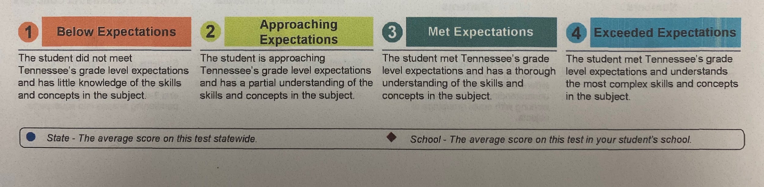

Slide 5

ELA
Math
Approaching
Expectations
(334-364)
Met
Expectations
(365-385)
Approaching
Expectations
(334-364)
Met
Expectations
(365-385)
Below
Expectations
(200-333)
Exceeded
Expectations
(384-450)
Below
Expectations
(200-333)
Exceeded
Expectations
(384-450)
2
4

Slide 6
ELA (did not pass the test)
ELA (passed the test)
Approaching
Expectations
(334-364)
Met
Expectations
(365-385)
Approaching
Expectations
(334-364)
Met
Expectations
(365-385)
Below
Expectations
(200-333)
Exceeded
Expectations
(384-450)
Below
Expectations
(200-333)
Exceeded
Expectations
(384-450)
2
3

Slide 7
Grade 3 Aimsweb Test

Slide 8
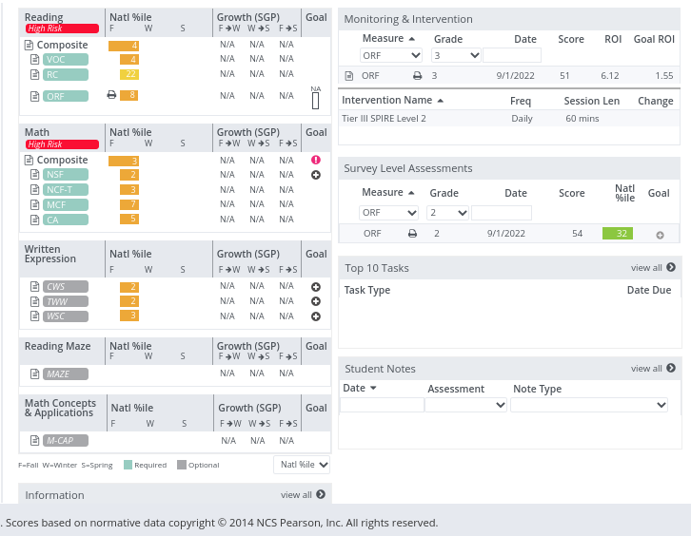
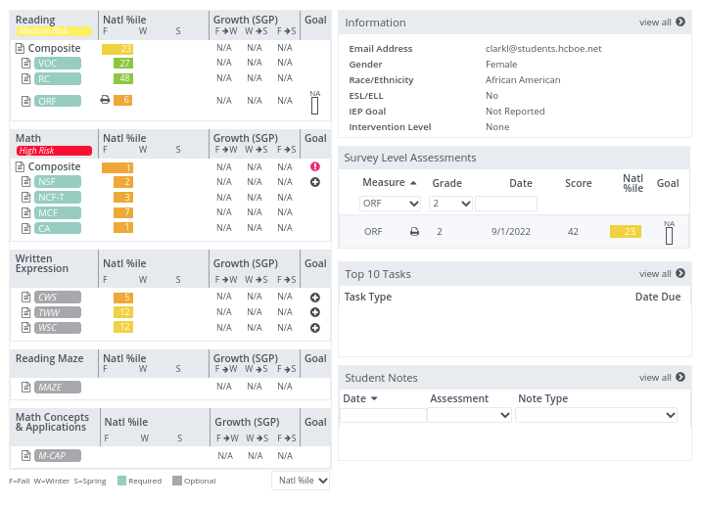
Well Below Average Student
Below Average Student

Slide 9
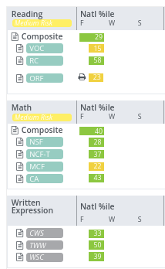
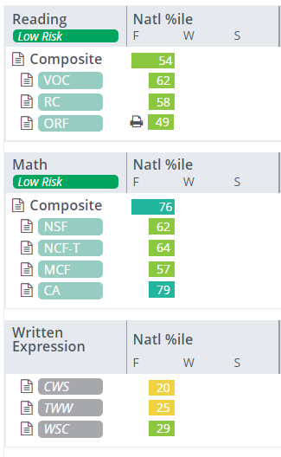
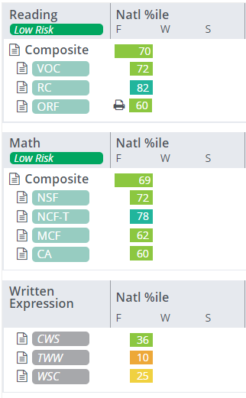
Average Student -
Just above 25%
Average Student -
Just above 50%
Average Student -
at 70%

Slide 10
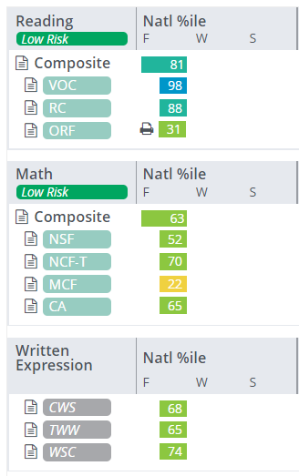
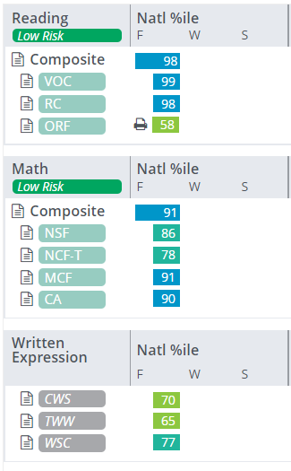
Above Average Student
Well Above Average Student

Slide 11
TN State Law for 3rd Graders

Slide 12
TN State Law for 3rd Graders
Tenn. Code Annotated 49-6-3115 requires that schools and districts retain any student in 3rd grade who does not Meet (3) or Exceed Expectation (4) on 3rd Grade ELA assessment.

Slide 13
This student would be impacted by the TN State Law for Third Graders
ELA
Math
Approaching
Expectations
(334-364)
Met
Expectations
(365-385)
Approaching
Expectations
(334-364)
Met
Expectations
(365-385)
Below
Expectations
(200-333)
Exceeded
Expectations
(384-450)
Below
Expectations
(200-333)
Exceeded
Expectations
(384-450)
2
4

Slide 14
This student could be retained for not passing the 3rd grade ELA Assessment.
This student would be promoted to 4th grade for passing the 3rd grade ELA Assessment.
ELA (did not pass the test)
ELA (passed the test)
Approaching
Expectations
(334-364)
Met
Expectations
(365-385)
Approaching
Expectations
(334-364)
Met
Expectations
(365-385)
Below
Expectations
(200-333)
Exceeded
Expectations
(384-450)
Below
Expectations
(200-333)
Exceeded
Expectations
(384-450)
2
3

Slide 15
TN State Law for 3rd Graders
Tenn. Code Annotated 49-6-3115 requires that schools and districts retain any student in 3rd grade who does not Meet or Exceed Expectation on 3rd Grade ELA assessment.
A student who does not meet these expectations may be promoted to 4th grade if they meet certain requirements:
Attend a summer program, maintaining a 90% attendance rate and demonstrate adequate growth.

Slide 16
TN State Law for 3rd Graders
Tenn. Code Annotated 49-6-3115 requires that schools and districts retain any student in 3rd grade who does not Meet or Exceed Expectation on 3rd Grade ELA assessment.
A student who does not meet these expectations may be promoted to 4th grade if they meet certain requirements:
The student is retested before the beginning of the next school year and scores proficient in ELA.

Slide 17
TN State Law for 3rd Graders
Tenn. Code Annotated 49-6-3115 requires that schools and districts retain any student in 3rd grade who does not Meet or Exceed Expectation on 3rd Grade ELA assessment.
A student who does not meet these expectations may be promoted to 4th grade if they meet certain requirements:
The student is assigned a tutor through the TN Accelerating Literacy and Learning Corps to provide tutoring services for the entirety of the upcoming school year attending 90% of sessions.

Slide 18
TN State Law for 3rd Graders
Tenn. Code Annotated 49-6-3115 requires that schools and districts retain any student in 3rd grade who does not Meet or Exceed Expectation on 3rd Grade ELA assessment.
What does this mean for my child as a West Elementary 3rd grader?

Slide 19
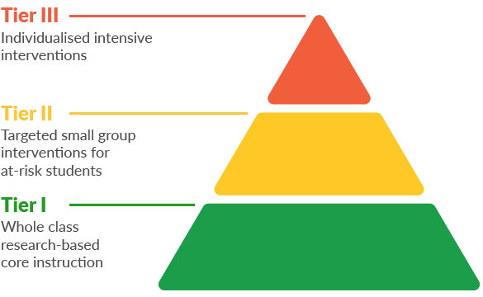
Individualized Intensive Intervention
Targeted Small Group Interventions for at-risk students
Whole Class Research-Based Core Instruction
Every Third Grader (110 minutes per day)

Slide 20
Individualized Intensive Intervention
Targeted Small Group Interventions for at-risk students
30 minutes per day
110 minutes per day
Whole Class Research-Based Core Instruction

Slide 21
Individualized Intensive Intervention
60 minutes per day
Targeted Small Group Interventions for at-risk students
110 minutes per day
Whole Class Research-Based Core Instruction

Slide 22
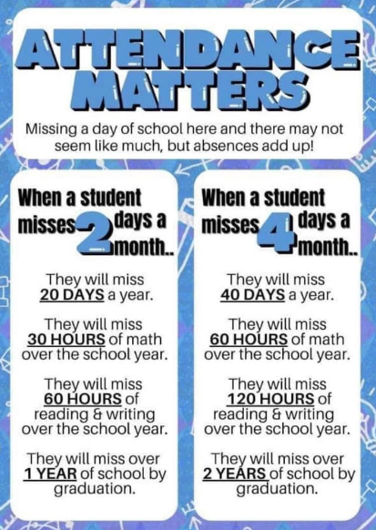

Slide 23

What can families do at home?
Please read with your child about 100 minutes per week or 20 minutes per day.

Slide 24
Have you signed up for conferences?

Slide 25
Questions?

